Slide 1
Radiation Tolerant Electronics for the Protection System for Superconducting Circuits in the LHC (QPS)
R. Denz TE-MPE-CP
Acknowledgements:
Present and former colleagues of TE-MPE-CP, AT-MEI-PE …
Members and chairmen of the RADWG
Safety commission for radiation protection and dosimetry
External irradiation facilities (FRM I Munich, PSI Villigen)
PH department (recent developments)

Slide 2
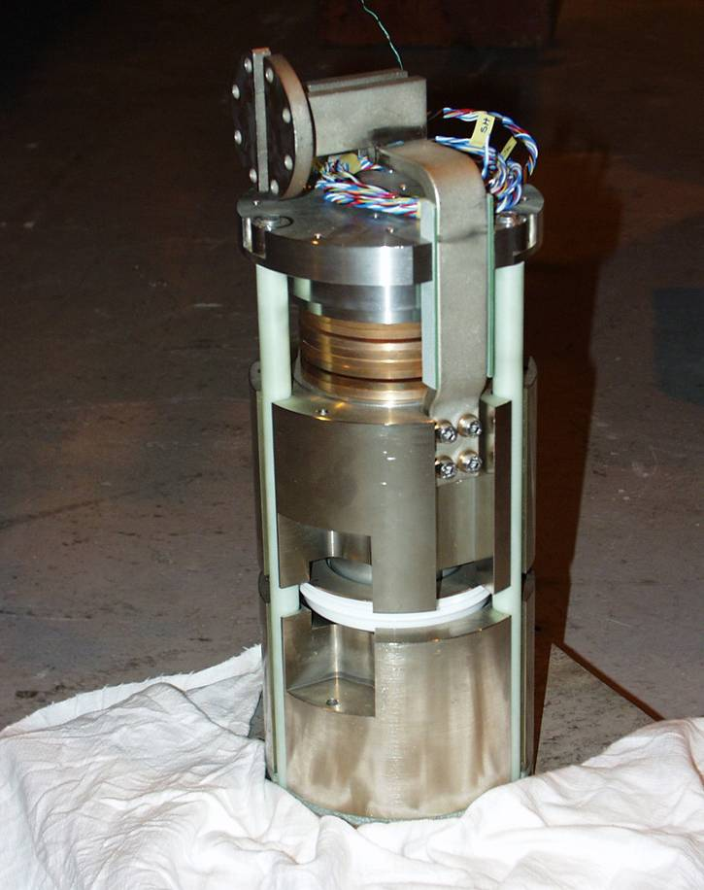
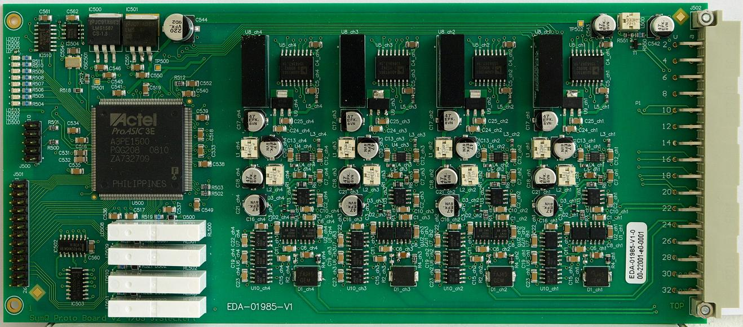
More than a decade of R&D
from …
to
Digital quench detection system type DQQDS
Cold high current by-pass diode for main magnets

Slide 3
Outline
QPS – a short introduction
An exotic example
Hardening strategies
Classical radiation tolerant designs
Micro-controllers and SEE
Powering of electronics
Radiation tests re-loaded
Recent developments
Future developments
Summary

Slide 4
QPS – a short introduction
Protection of LHC superconducting circuits (I > 120 A)
  Main dipoles and quads
  Main bus-bars and interconnections (splices)
  HTS current leads
  Insertion region magnets and bus-bars
  Corrector circuits and bus-bars
  Energy extraction systems for 13 kA and 600 A circuits
  Acquisition & monitoring controllers for supervision of all devices including energy extraction systems
Constraints
  High reliability and availability required for LHC operation
  Large quantities
  Restricted access
  Radiation levels in the LHC tunnel and underground areas

Slide 5
QPS - integration into LHC
90 standard racks in the LHC underground areas and alcoves
  Originally declared as radiation free ...
1670 special protection racks in the LHC tunnel
  Radiation tolerance as basic design parameter of all installed electronics
  436 racks installed under the mid dipole will house as well the new QPS protection layer introduced after the sector 3-4 incident
  New QPS protection electronics is significantly more sophisticated
202 energy extraction systems for 600 A circuits in the LHC underground areas
32 energy extraction systems for 13 kA circuits in the LHC underground areas and tunnel
2016 cold bypass diodes in LHC main magnets type MB and MQ
  Dedicated radiation tolerant component design
11000 quench detection systems, 6100 quench heater power supplies, 2500 DAQ systems (all must work to inject beam into LHC)

Slide 6
As a starter an exotic example of radiation tolerant design …
High current cold diodes act as by-pass elements in case of a main magnet quench.
  Installed inside the magnet cryostat relatively close to the beam tubes and exposed to radiation resulting from beam-gas interactions and proton losses.
Radiation induced damage affects several diode parameters
  Turn-on voltage → late turn-on may cause damage to protected magnet
  On-state resistance → burn-out of diode
    Mechanical support structure will prevent an opening of the diode circuit
  Reverse breakdown voltage (also external breakdown)

Slide 7
Device development and radiation tests
LHC cold by-pass diode is a specially developed high current diode of the diffusion type
  Final design is a compromise between the required radiation resistance, the highest possible reverse blocking voltage and a reasonable yield for mass production in industry.
Small sample tests at T = 4.6 K at the low temperature irradiation facility of the research reactor FRM I in Munich
  Irradiation position inside reactor core
  Turn-on voltage including annealing effects (warm-up to room temperature)
  1 kGy, 2 x 10¹² n cm⁻² , nuclear reactor radiation spectrum
Sample test at T = 77 K and T = 300 K in the CERN radiation test facility in the north target area TCC2
  On-state resistance, reverse blocking voltage, annealing effects
  2 kGy, 3 x 10¹³ n cm⁻² , mixed more LHC like radiation spectrum
Both test facilities are de-commissioned since several years
Development and qualification of radiation tolerant power devices is tedious and requires quite some knowledge of the physics of semiconductor devices.

Slide 8
QPS strategies for development of radiation tolerant electronics
Baseline
  Special development and test program for radiation tolerant cold by-pass diodes
  Development and test of radiation tolerant electronics based on COTS for protection systems installed in the LHC tunnel
    Target: 200 Gy (Si), 2 x 10¹² n cm-2
  Non-hardened but significantly more sophisticated electronics in the “safe” adjacent underground areas
  Custom made electronics, very limited use of “assemblies off the shelf”
Evolution of requirements over the last years
  From 2003 onwards: electronics installed in areas previously declared as radiation free may suffer from SEE → tests at PSI in 2003 & 2004
  2008: re-start of radiation testing in CNGS
  2008: new layer of QPS requires installation of sophisticated electronics in the LHC tunnel (very limited time for development)
Installation of electronics in areas exposed to radiation requires a continuous follow-up including new developments and test. Boundary conditions and functional requirements may change significantly over time.

Slide 9
Successfully tested COTS in TCC2 from 1999 to 2003
Amplifiers
  INA105, INA141, OPA27, AD210BN
Comparators
  LM311
Timer
  NE556
Voltage regulators
  MC7815, MC7915
Voltage references
  REF102, LT1236A-10
Digital isolators
  ISO150
Thyristors
  SKT80/18E
Isolated DC-DC converters
  THI0522, THI0511, TMA0505S, TMA0515D
Micro-converters
  ADuC812, ADuC831, ADuC834
Of course there has been also a number of not so successful tests, e.g. PLC’s (results published @ RADECS 2000 conference), some AC-DC and DC-DC converters, voltage references of the band-gap type …
Basic set of components for building up low bandwidth analog and digital electronics.

Slide 10
Example: local quench detector type DQQDL
Used for the protection of LHC main magnets (MB and MQ)
Analog bridge detector based on state of the art instrumentation amplifiers
(2 out of 2) || (2 out of 2) hardwired multi-channel evaluation scheme
Radiation tolerant
  Test of individual components and complete device including on-board data acquisition system
Adjustment free – fixed threshold detector
Digitally isolated interface – detector circuit on magnet potential
Cost efficient (2500 circuit boards in LHC)
One of the few electronic devices being already exposed to radiation in LHC.
This device type detected the first beam induced quenches of LHC main dipoles.

Slide 11
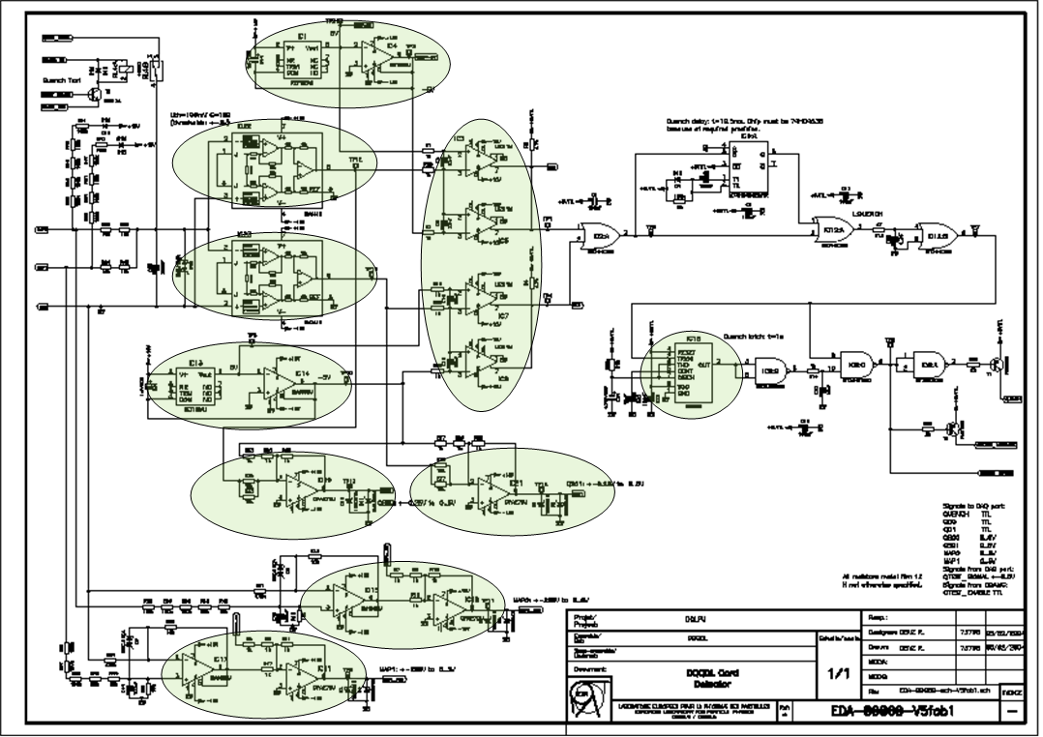
Example: local quench detector type DQQDL continued

Slide 12
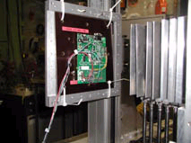
SEE in μcontrollers: ADuC8XX family
ADuC812 (4000 devices in QPS electronics)
  8 channel 12 Bit ADC + 8051 compatible core + 8k Flash EEPROM
  ADuC831 (2700 devices in QPS electronics)
  As ADuC831 but 62k Flash EEPROM
ADuC834 (7600 devices in QPS electronics)
  24 Bit ADC + 8051 compatible core + 62k Flash EEPROM
Functional test of the chip
  Communication during the test via serial port
Memory access tests
  ADuC812: external SRAM
  ADuC831 & ADuC834: internal & external SRAM, internal Flash EEPROM
Error correction algorithm
  Bitwise triple voting for data stored in external SRAM validated
data[i] = (d[0][i] & d[1][i])|(d[0][i] & d[2][i])|(d[1][i] & d[2][i])

Slide 13
SEE in μcontrollers: ADuC812 (PSI OPTIS 60 MeV 2003)
Fluence [10¹⁰ p cm⁻²]
Dose [Gy]
Remark
4.0
55
Properly working
11.0
151
Properly working but serial download is not possible any more (probably boot-loader firmware corrupted)
13.3
183
Serial communication stopped
External SRAM (SAMSUNG K6T0808C1D-TB70)
Fluence [10¹⁰ p cm⁻²]
Bits written
Errors
Single
Double
SEU cross section [10-¹³cm²]
1.0
262144
242
240
2
0.9
2.0
262144
487
477
10
1.0
5.0
262144
1230
1148
76
0.9
Fluence [10¹⁰ p cm⁻²]
Integer errors
Corrected errors
Efficiency
1.0
235
234
99.57%
2.0
413
413
100%

Slide 14
SEE in μcontrollers: ADuC831 (PSI OPTIS 60 MeV 2003)
Fluence [10¹⁰ p cm⁻²]
Dose [Gy]
Remark
2.0
28
Properly working
4.0
55
Properly working but hardware reset necessary
6.0
83
Properly working
10.7
147
Serial communication stopped
External SRAM (SAMSUNG K6T0808C1D-TB70)
Fluence [10¹⁰ p cm⁻²]
Bits written
Errors
Single
Double
SEU cross section [10-¹³cm²]
1.0
262144
258
258
0
1.0
1.0
262144
440
428
12
1.7
2.0
262144
1096
1010
80
2.1
Internal SRAM
Fluence [10¹⁰ p cm⁻²]
Bits written
Errors
Single
Double
SEU cross section [10-¹³cm²]
1.0
16384
19
19
0
1.2
1.0
16384
17
17
0
1.0
2.0
16384
47
39
8
1.4
Fluence [10¹⁰ p cm⁻²]
Integer errors
Corrected errors
Efficiency
1.0
218
218
100%
2.0
428
428
100%

Slide 15
SEE in μcontrollers: ADuC834 (PSI OPTIS 60 MeV 2003)
Fluence [10¹⁰ p cm⁻²]
Dose [Gy]
Remark
1.0
14
Properly working but 1 automatic reset
2.0
28
Properly working
3.5
49
Serial communication stopped
External SRAM (CYPRESS CY62256LC-70ZC)
Fluence [10¹⁰ p cm⁻²]
Successful qualification of COTS micro-controllers for usage up to some 10¹⁰ p cm⁻² including test of error correction code.
Radiation tolerance decreases with enhanced device functionality.
Latest generation of microcontrollers and future developments expected to be less radiation tolerant
Bits written
Errors
Single
Double
SEU cross section [10-¹³cm²]
0.2
262144
30
30
0
0.7
Internal SRAM
Fluence [10¹⁰ p cm⁻²]
Bits written
Errors
Single
Double
SEU cross section [10-¹³cm²]
0.2
16384
3
3
0
1.1
Fluence [10¹⁰ p cm⁻²]
Integer errors
Corrected errors
Efficiency
1.0
77
77
100%

Slide 16
Powering electronics: AC-DC and DC-DC converters
In general radiation damage will increase the power consumption of the exposed equipment; power supplies must be dimensioned accordingly
Typical failure modes of power supplies caused by radiation are:
  Destruction of power MOSFETs in switch mode power supplies
    Remedy: use overrated type
  Increase of output voltage due to damaged voltage references → breakdown of power supply or attached equipment
  Classical power supplies based on linear regulators are normally not affected by SEE but some of the more recent LDO regulators have features like enable circuits, which make these devices more vulnerable
Radiation tolerant power supplies have been successfully developed at CERN in collaboration with industry
DC-DC converters in general are less vulnerable
  Testing is nevertheless mandatory

Slide 17
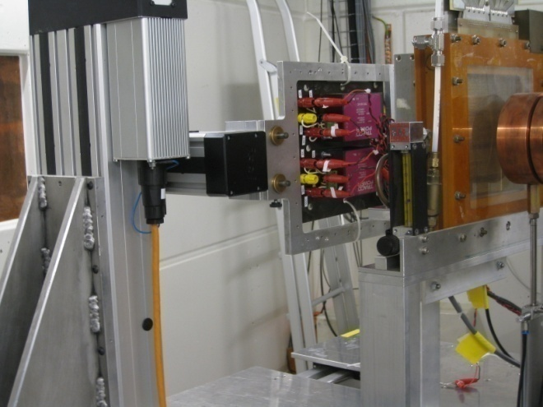
Powering electronics: examples
Failed test @ PSI with popular commercial AC-DC converters (photo G. Spiezia)
Hardened switch mode power supply successfully tested in TCC2
Isolated DC-DC converter in TCC2 (re-tested @ PSI in 2009 → still ok)
Non-isolated CERN designed DC-DC step-up converter successfully tested @ PSI

Slide 18
Radiation test re-loaded ...
Re-start of radiation testing of QPS electronics installed in the LHC underground areas in the newly created CNGS test facility
  Focusing on system level tests of devices installed in the LHC
Equipment of the LHC quench protection and energy extraction systems
  Quench detectors for current leads and corrector magnet circuits
  Data acquisition systems
    Supervision of quench detection systems
    Supervision of energy extraction systems
  Systems currently installed in RR, UJ and UA
  New requirements after September 19th – some of these equipment types will be installed in the LHC tunnel as well (mid dipole position)
  Systems are partly hardened and critical components have been previously tested at CERN and at PSI
    e.g. field-bus couplers, power supplies, DC-DC converters

Slide 19
Radiation test re-loaded ... results from CGNS tests 2008
Irradiation test position TSG46 (RadMon data → T. Wijnands)
  Total dose: 15.5 Gy
  Neutron fluence (equiv. 1 MeV): 1.0 x 10¹¹ cm⁻²
  Hadron fluence (E > 20 MeV): 1.3 x 10¹¹ cm⁻²
Hardware still alive → confirms previous radiation tests
  Hardened power supplies, qualified DC-DC converters …
  Power cycle sufficient to re-start stalled devices properly
Soft errors in local communication (I²CTM bus)
  Auto-recovery of stalled devices observed
  Possible firmware update to be studied
  Further testing will be required
Input stage offset voltage drift of DQQDC devices observed
  Drift to slow to be an issue for operation of the device
  Partial recovery after radiation stop observed

Slide 20
Recent QPS developments or what to do if requirements change suddenly ...
Mid 2008: with respect to potential radiation problems in some LHC underground areas decision to start development of a radiation tolerant digital quench detector
  Identification of potential technology → FLASH based FPGA
  Assignment of human resources (got a fellow …)
Autumn 2008: on top of a modified already tested device the upgrade of the QPS requires a newly designed radiation tolerant digital quench detector to be available in 2009!
Crash program to test a number of critical components for SEE problems
  ADC, FPGA, DC-DC convertors, PhotoMos relays, digital isolators, LDO regulators, LDO power regulators
  Two test campaigns at PSI in spring 2009
    ETH Zurich / PH-CMS team using 60 MeV OPTIS facility
    QPS team using 250 MeV GANTRY facility
  Successful identification of suitable components – design finished
    Final prototype testing in CNGS

Slide 21
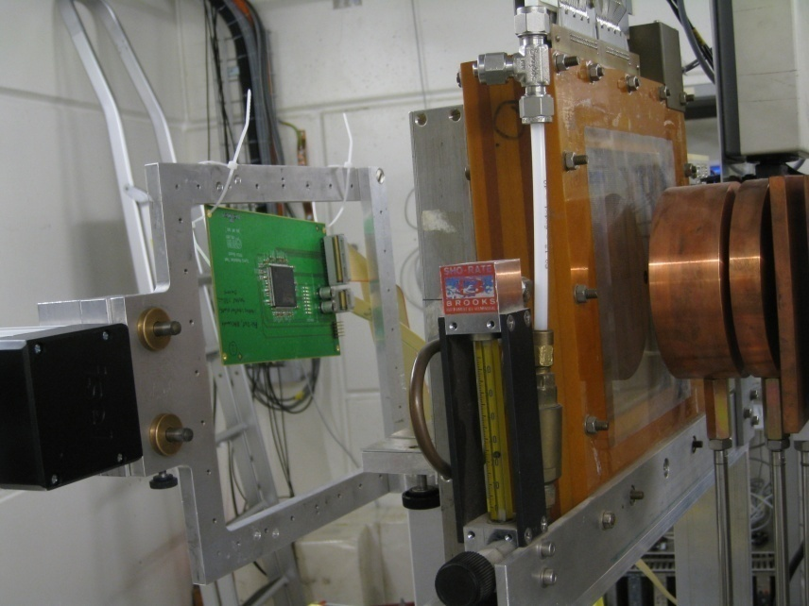
Recent QPS developments – radiation test results
The two radiation test campaigns gave a variety of results and confirmed in most cases expectations or results from previous tests
  DC-DC convertors, digital isolators, LDO regulators, LDO power regulators : as expected no SEE problems observed (10¹¹ to 10¹² p cm⁻² )
  PhotoMos relays: burn-out observed @ 10¹¹ p cm⁻² (→ regular checks in LHC feasible and mandatory)
  16 Bit SAR ADC: several brands under test, the BICMOS based winner showed a reasonable (no drifts, limited number of errors) up to 1.3 x10¹¹ p cm⁻²
FPGA grilling @ PSI GANTRY (photo G. Spiezia)

Slide 22
Recent QPS developments – radiation test results continued
Radiation test results FPGA:
  Bit-stream through chain of shift registers using most of FPGA
  No firm errors, only bit flips in registers
ACTEL A3PE1500-PQG208
Fluence [10¹⁰ p cm⁻²] | Number of cells | Errors | SEU cross section [10⁻¹³cm²]
3.5 | 38000 | 180 | 1.35
8.8 | 38000 | 500 | 1.50
10.0 | 38000 | 584 | 1.54
13.8 | 38000 | 788 | 1.60
15.0 | 38000 | 869 | 1.52
17.0 | 38000 | 988 | 1.53
20.0 | 38000 | 1144 | 1.51
25.0 | 38000 | 1414 | 1.49
ACTEL A3P1000-PQG208
Fluence [10¹⁰ p cm⁻²] | Number of cells | Errors | SEU cross section [10⁻¹³cm²]
4.0 | 24000 | 159 | 1.66
5.0 | 24000 | 200 | 1.67
7.5 | 24000 | 273 | 1.55
9.0 | 24000 | 340 | 1.57
10.0 | 24000 | 372 | 1.55

Slide 23
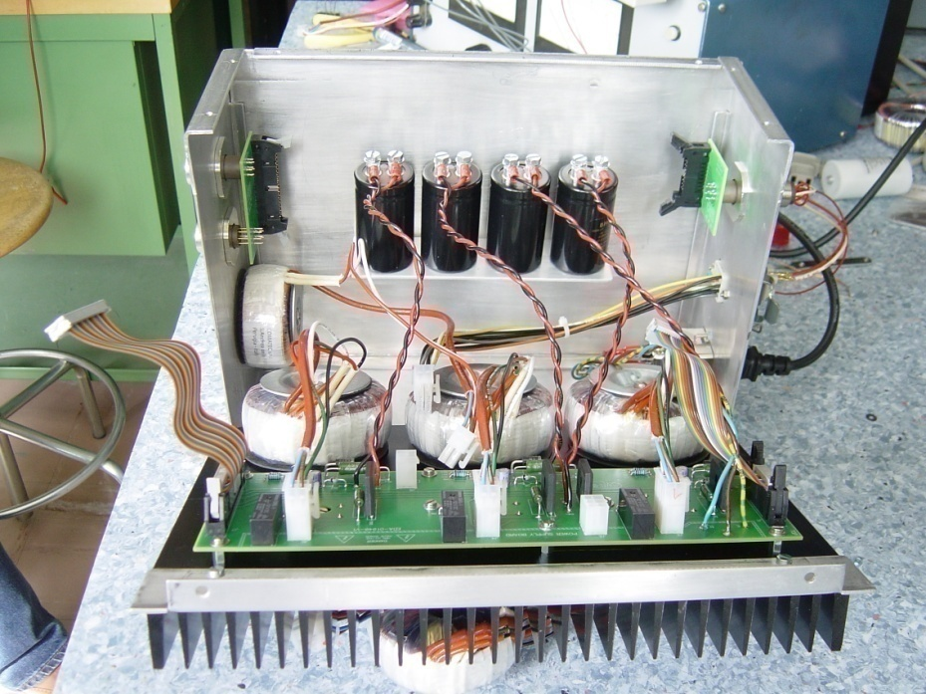
Recent developments continued ...
Radiation tolerant digital quench detector type DQQDS. The FLASH based FPGA analyzes the signals from 4 isolated input channels. Functional testing in CNGS will start soon.
Radiation tolerant power supply for the new QPS electronics. Critical components have been successfully tested @ PSI. A prototype is currently under test in CNGS.

Slide 24
Future developments and outlook
The radiation tolerance of the QPS electronics currently installed is regarded as sufficient for the first years of LHC operation
  Based on simulations, real world might be different (hot spots …)
With increasing luminosity some of the equipment will need to be displaced or replaced by more radiation tolerant versions
  New developments will be based on FLASH FPGA
    Functional replacements for some protection systems using obsolete components to be prepared
  The question of high precision radiation tolerant ADC is not fully solved yet (radiation tolerant 16 Bit ADC identified, but higher resolution is wishful)
  Problem of radiation tolerant field-bus coupler treated by dedicated CERN task force (→ talk by J. Palluel)
The LHC upgrade phase 1 will require a new protection layer
  Present integration studies indicate that there will be radiation issues

Slide 25
Summary
Installation of electronics in radiation areas is by default not a good idea but there are no feasible alternatives for LHC so far
Design and qualification of radiation tolerant electronics is cumbersome and has to cope with many constraints
  The boundary conditions (expected dose, functional requirements) are not always clearly specified and may change significantly with time
  Expert knowledge (at least of the electronics) is required
  “Assemblies off the shelf” by default won’t work, bad designs neither
  Usage of COTS remains always a kind of gamble as industry normally only specifies (and guarantees) the device functionality
  Real proof of radiation tolerance can only be made in LHC
Continuous effort necessary to maintain radiation tolerant electronics operational
  Replacement of obsolete components, broken devices (repair???)
  R&D including tests for functional replacements or upgrades

Slide 26
Further reading …
Publications:
  R. Denz and D. Hagedorn, Expected Lifetime of By-Pass Diodes for the LHC Magnet Protection Subjected to Liquid Helium Temperatures and Irradiation, Advances in Cryogenic Engineering (Materials), Vol. 46 (Parts A & B), p. 375-382, 2000
  R. Denz, F. Rodriguez-Mateos and A. Vergara, “Irradiation Tests on COTS used in the Protection System of LHC Superconducting Elements”, RADECS 2000, Louvain-la-Neuve (Belgium), 2000
  R. Denz and F. Rodriguez-Mateos, “Radiation Tolerance of Components Used in the Protection System of LHC Superconducting Elements”, LHC Project Report 606, RADECS 2002, Padua, Italy, 2002
LHC Radiation Workshops
  http://indico.cern.ch/getFile.py/access?contribId=s9t3&sessionId=5&resId=0&materialId=0&confId=a056232
  http://indico.cern.ch/getFile.py/access?sessionId=1&resId=0&materialId=0&confId=a056633
  http://indico.cern.ch/getFile.py/access?sessionId=14&resId=0&materialId=0&confId=a056695
RADWG
  http://indico.cern.ch/getFile.py/access?sessionId=5&resId=0&materialId=0&confId=43064
Information on more recent not yet published data available on request

