Slide 1
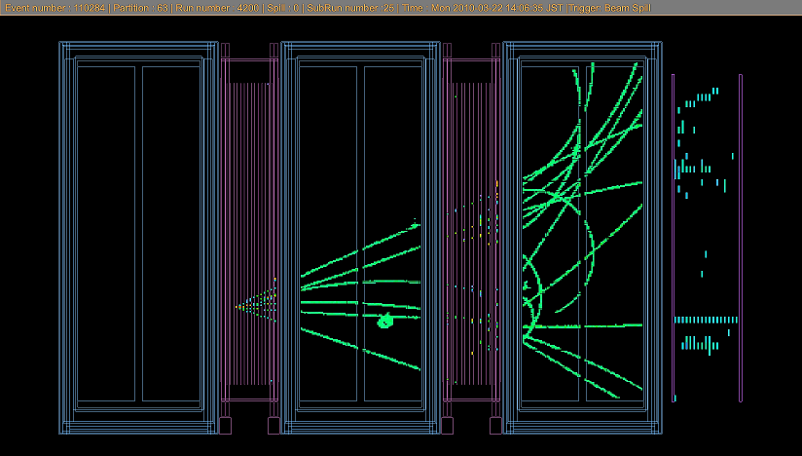
Workshop on neutrino near detectors based on gas TPCs
Goals of the workshop

Slide 2
We are happy to welcome >70 participants from
Armenia,
CERN,
France,
Germany,
Greece,
Italy,
Japan,
Netherlands,
Poland,
Spain,
Sweden,
Switzerland,
Russia,
UK,
USA
PLEASE REGISTER IF YOU ARE ATTENDING
AND ESPECIALLY IF YOU ARE GIVING A TALK!

Slide 3
Near detector challenges
Measure event rates at the near detector for the various channels of relevance
for the oscillation analyses -- as normalization or as background
-- Charged Current interactions of ν_{μ}‾ν_{μ} ν_{e}‾ν_{e}
-- neutral current interactions
Within the same phase space, same target & same flux (+ small corrections )
than in the far detector
-- Differences lead to systematic errors
-- Differences in neutrino spectrum due to oscillations are unavoidable
Provide enough information to understand the effects resulting from the flux
shape difference
-- in particular the energy response function P (E_{v}^{rec} – E_{v}^{true} )
-- or more information to help build a reliable model of neutrino interactions
Provide enough information to measure or constrain the double ratio
(ν_{e} /ν_{μ}) /(‾ν_{μ} /‾ν_{e}) cross-section ratio which directly enters the CP asymmetry.
MUCH OF OSCILLATION ‘ART’ IS IN THE NEAR DETECTOR!

Slide 4
Several near detector projects involve Gas TPCs
1. Presently the T2K ND280 TPC, working beautifully (with a few shortcomings)
2. T2K upgrade of the magnetic ND280
aim is to provide by 2020
full angular coverage for neutrino events using new side TPCs
water targets
significantly smaller systematic errors in view of T2K/T2K-II/HyperK
electron neutrino (gamma background) /muon neutrino cross-sections
Also : a state-of-the-art project and opportunity to gain experience and collaborate
3. High pressure TPC project(s)
earlier work on LBNO near detector
rate and target nucleus are well adapted for LArg far detector
at T2K/HyperK : a way to investigate the nuclear interaction model by exceptional
visibility of vertex activity
at DUNE : a near detector with high sensitivity to nuclear activity
a sufficient event rate as near detector (no pile-up)

Slide 5
T2K ND280 today
0.18 T UA1/NOMAD magnet + ECAL and SMRD Side Muon Range Detector

Slide 6
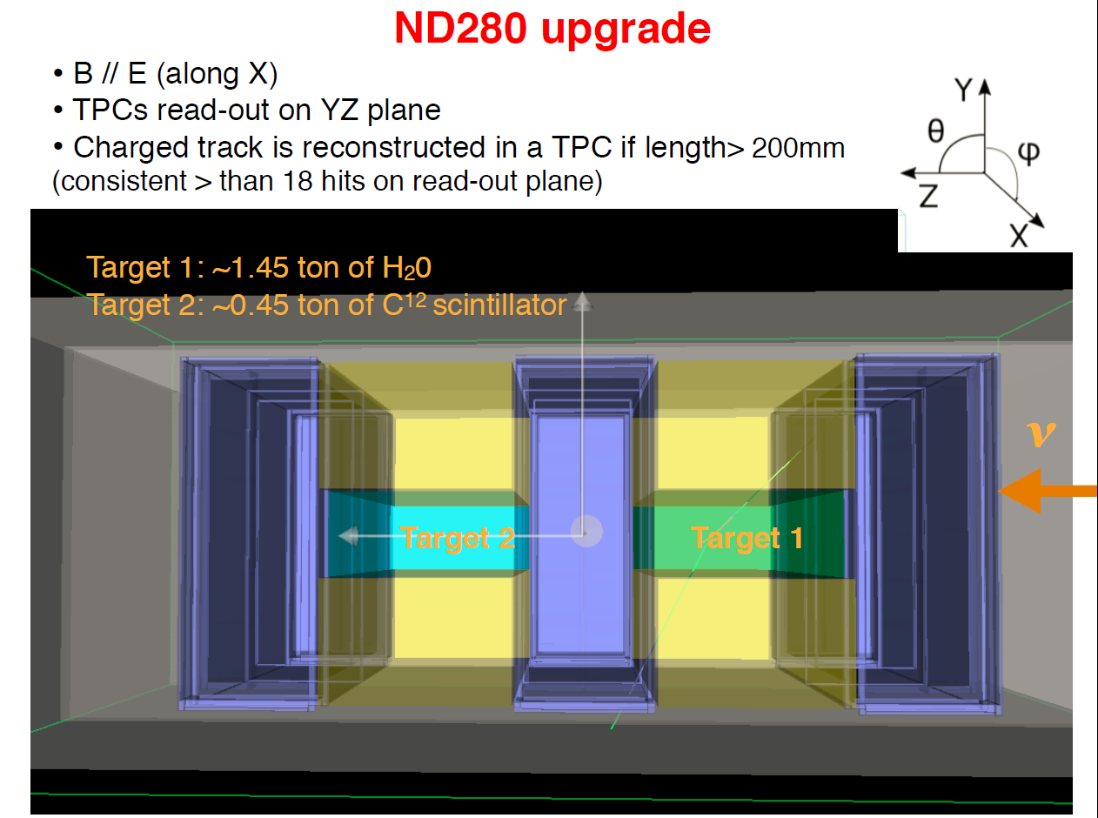

Slide 7
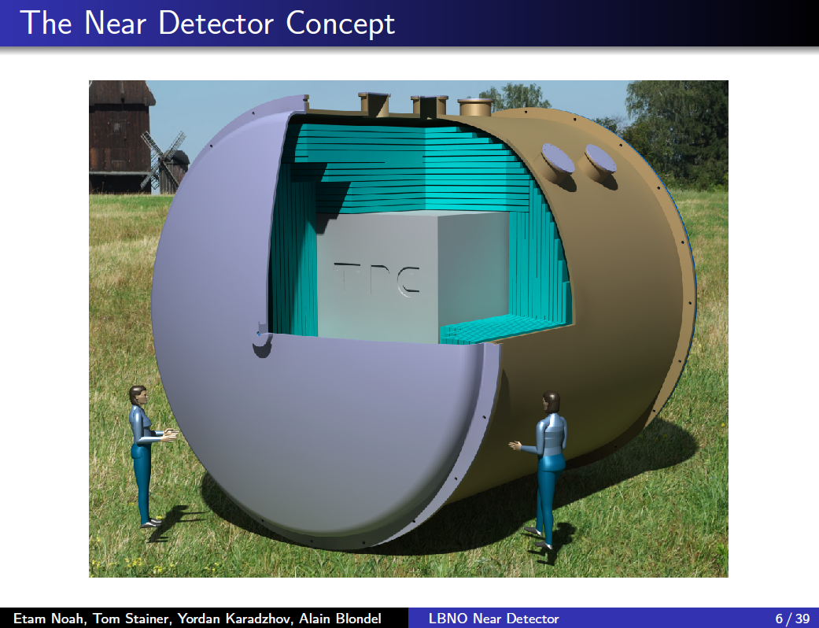
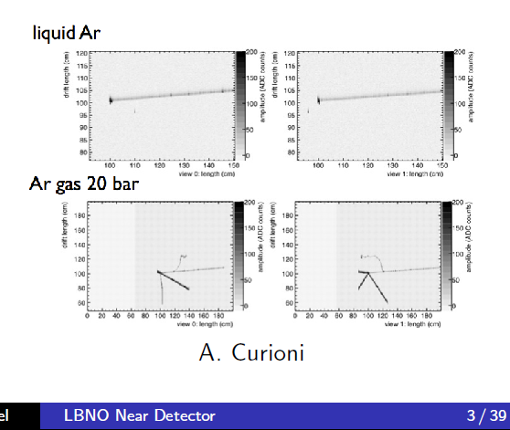

Slide 8
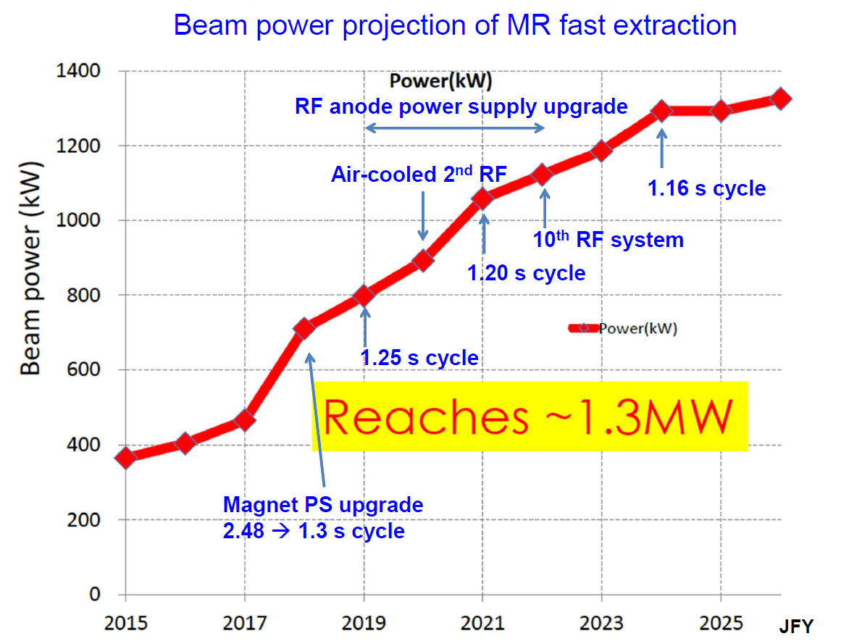
Koseki
NUFACT16
funded
2035
T2K-II
T2HK (prop.)
30GeV p.o.t*kton
7.10²¹ * 22.5
(T2K approved)
0.2
1
3
30
event numbers = 15 / 150 times today’s.
Systematics need reduction accordingly!

Slide 9
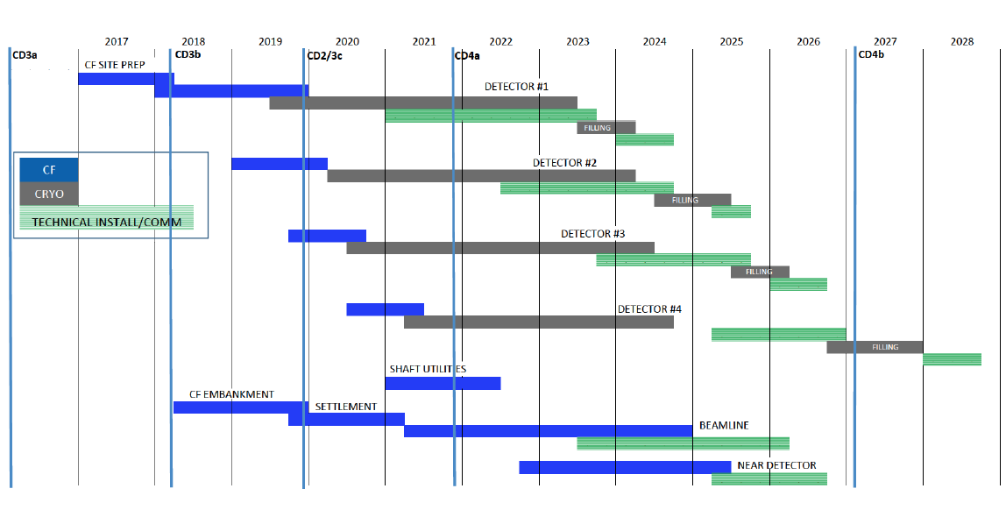
DUNE Schedule as of CDR http://arxiv.org/abs/1601.05471
Beam starts (with 1.2 MW capability) 2026 with 2 far detectors, upgrade to 2.4Mw ~6 yrs later.

Slide 10
Goal of this workshop:
-- Collaboration/synergy to develop state-of-the-art techniques
-- Acquire experience by building the required TPCs
-- Start with ND280 upgrade (normal pressure)
-- R&D for longer time scale HP TPCs
-- CERN natural base and support for EU groups
-- International collaboration (Europe, Japan, Russia, US +...)
-- More practically, review projects and ideas
-- identify areas of expertise (or lack thereof)
-- who does what etc…
-- agree on terms for SPSC proposal to be discussed tomorrow
-- agree on terms for e.g. EU funding proposal

