Slide 1
The CERN Neutrino Platform
08-11-2016
M.Nessi, CERN

Slide 2
ν _{e, μ, τ, …}

Slide 3
European strategy
“Rapid progress in neutrino oscillation physics, with significant European involvement, has established a strong scientific case for a long-baseline neutrino programme exploring CP violation and the mass hierarchy in the neutrino sector. CERN should develop a neutrino program to pave the way for a substantial European role in future long-baseline experiments. Europe should explore the possibility of major participation in leading long-baseline neutrino projects in the US and Japan.”

Slide 4
Our interpretation
no ν beams at CERN !
ν beams in the US and in Japan
A structure at CERN to foster an active involvement of Europe and CERN in the US and Japanese new facilities
→ Neutrino Platform as a project at CERN

Slide 5
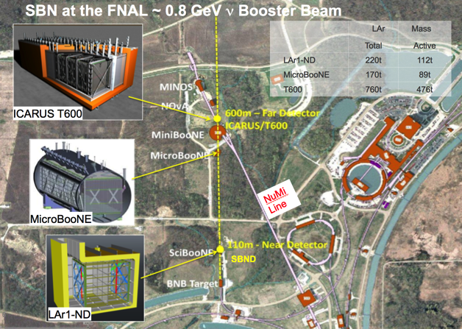
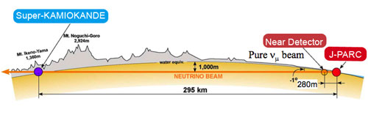
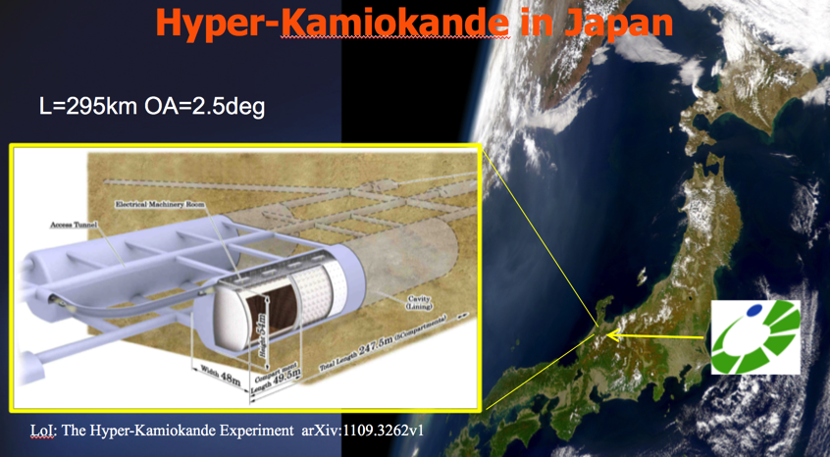
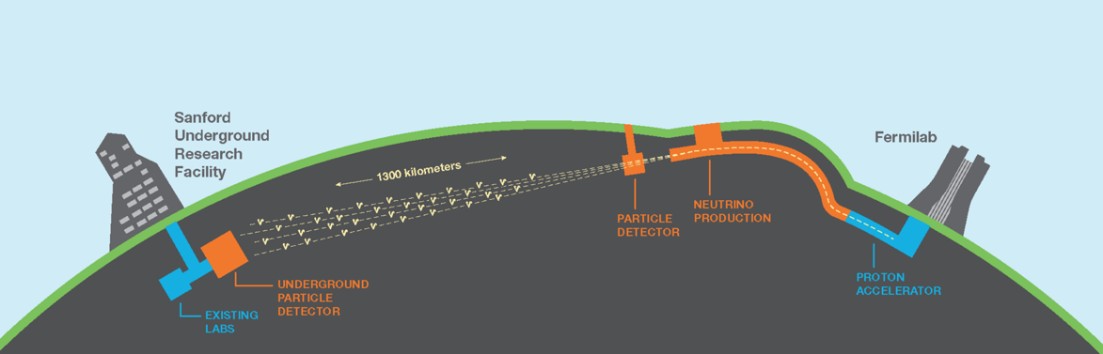
ν future landscape (oscillation physics)
Neutrino Platform at CERN
SBN (short baseline)
T2K
LBNF/DUNE

Slide 6
How does the CERN NP fit in all this?
With a long history and experience in Neutrino Physics in Europe
As a support structure for all activities, where CERN expertise can be a VALUE
As the support Laboratory for all European Groups interested in a collaborative effort
As a unique R&D and tests facility of detectors and components (hardware and software)
As a research group active at these facilities

Slide 7
How to get a new project in ?
Get in contact with us (Eckhard and myself) to prepare the ground for a possible R&D activity
Submit a LOI to the CERN SPCS committee for approval
If YES : receive approval from CERN research board and become a real experiment/collaboration
Finalize with us a MOU addendum (to the main MOU Frame) defining the project in term of WPs and resources. Define the support needed from CERN
Get FAs and CERN management signature (MOU)

Slide 8
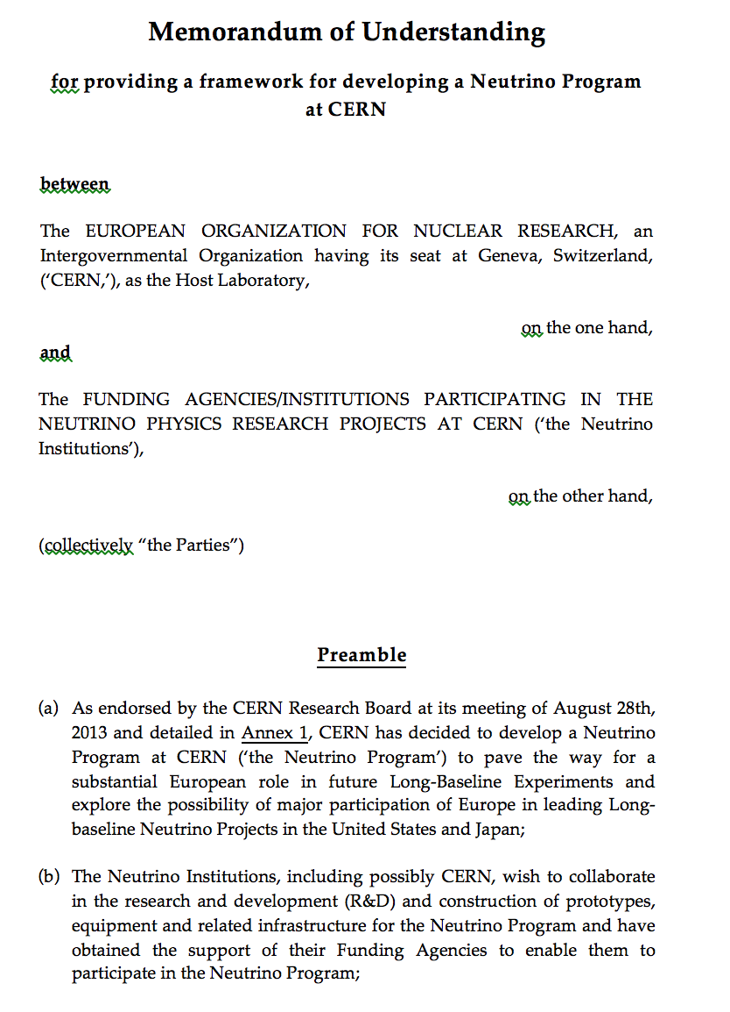
MOU frame
https://edms.cern.ch/document/1353815
As of Today we have 6 MOU addenda active !!

Slide 9
ν Platform Projects (oscillation physics)
Neutrino Platform at CERN
6 Projects presented to the SPSC and approved:
NP01: WA104, ICARUS as far detector for SBN
NP02: WA105, demonstrator + engineering prototype for a double ph. TPC
NP03: PLAFOND, an generic R&D framework
NP04: ProtoDUNE, engineering prototype for a single phase TPC
NP05: Baby Mind, a muon spectrometer for the WAGASCI experiment at T2K
ArgonCube : a modular TPC R&D
2-3 in the pipeline
SBN (short baseline)
T2K
LBNF/DUNE

Slide 10
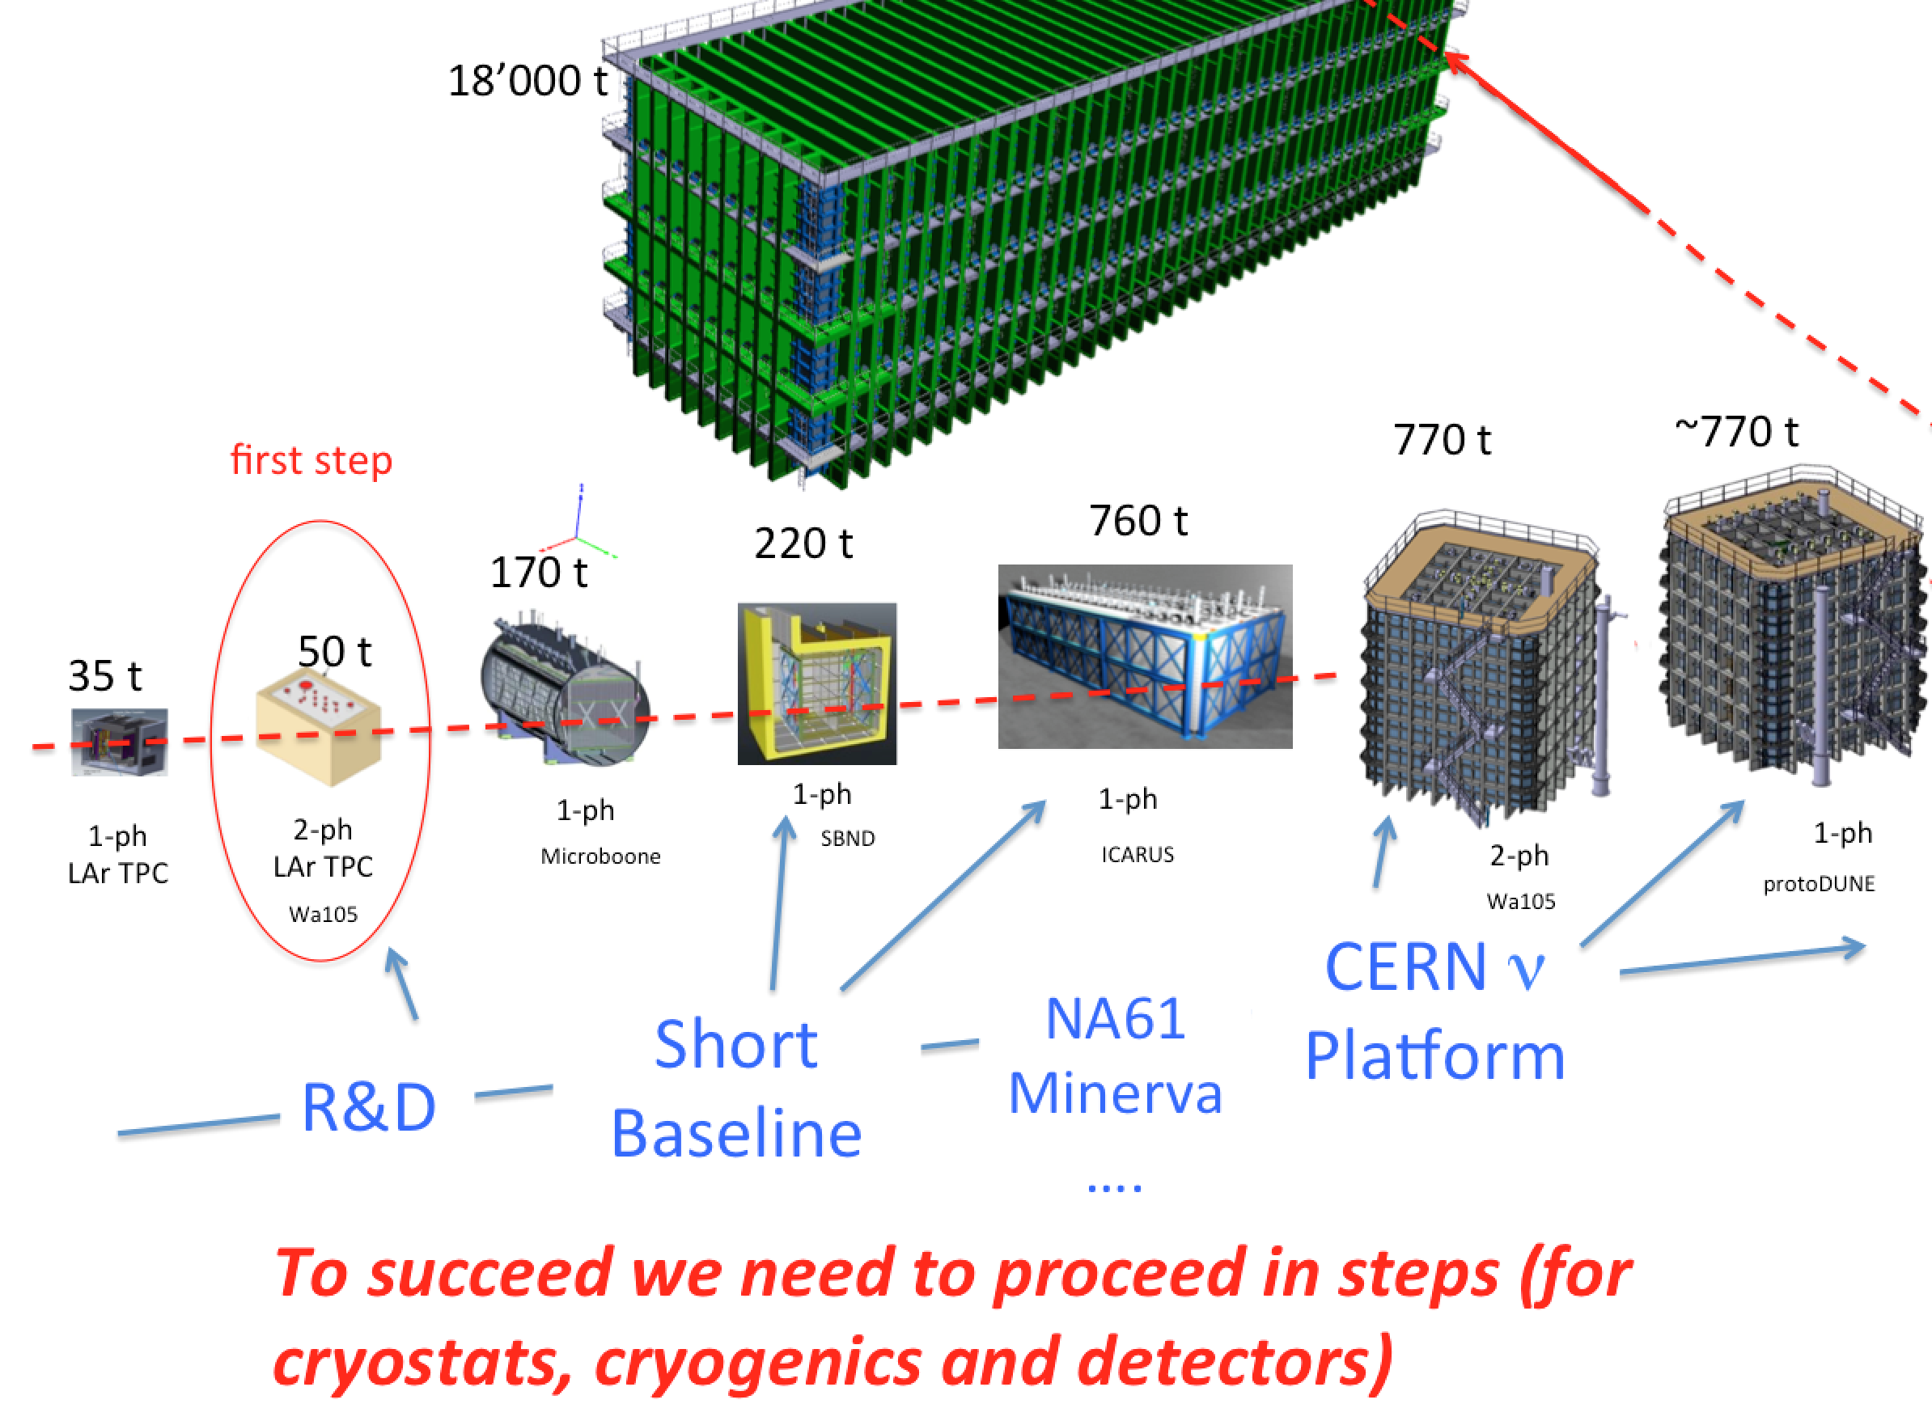
Step by step (LAr TPCs)
…. the large scale is a big and new challenge
4 x

Slide 11
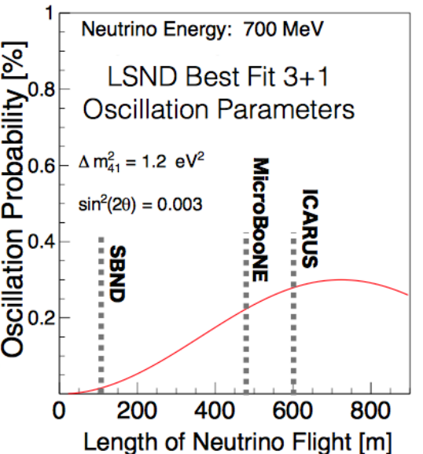
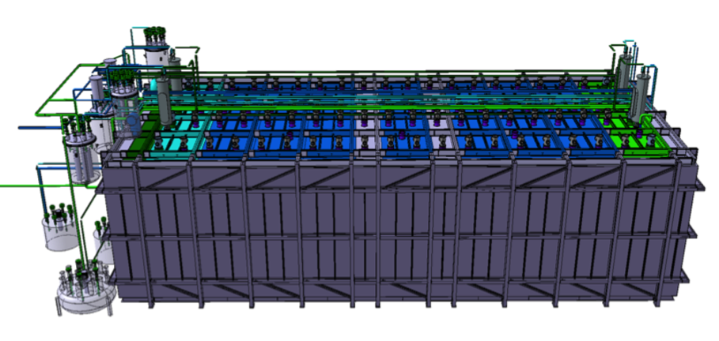
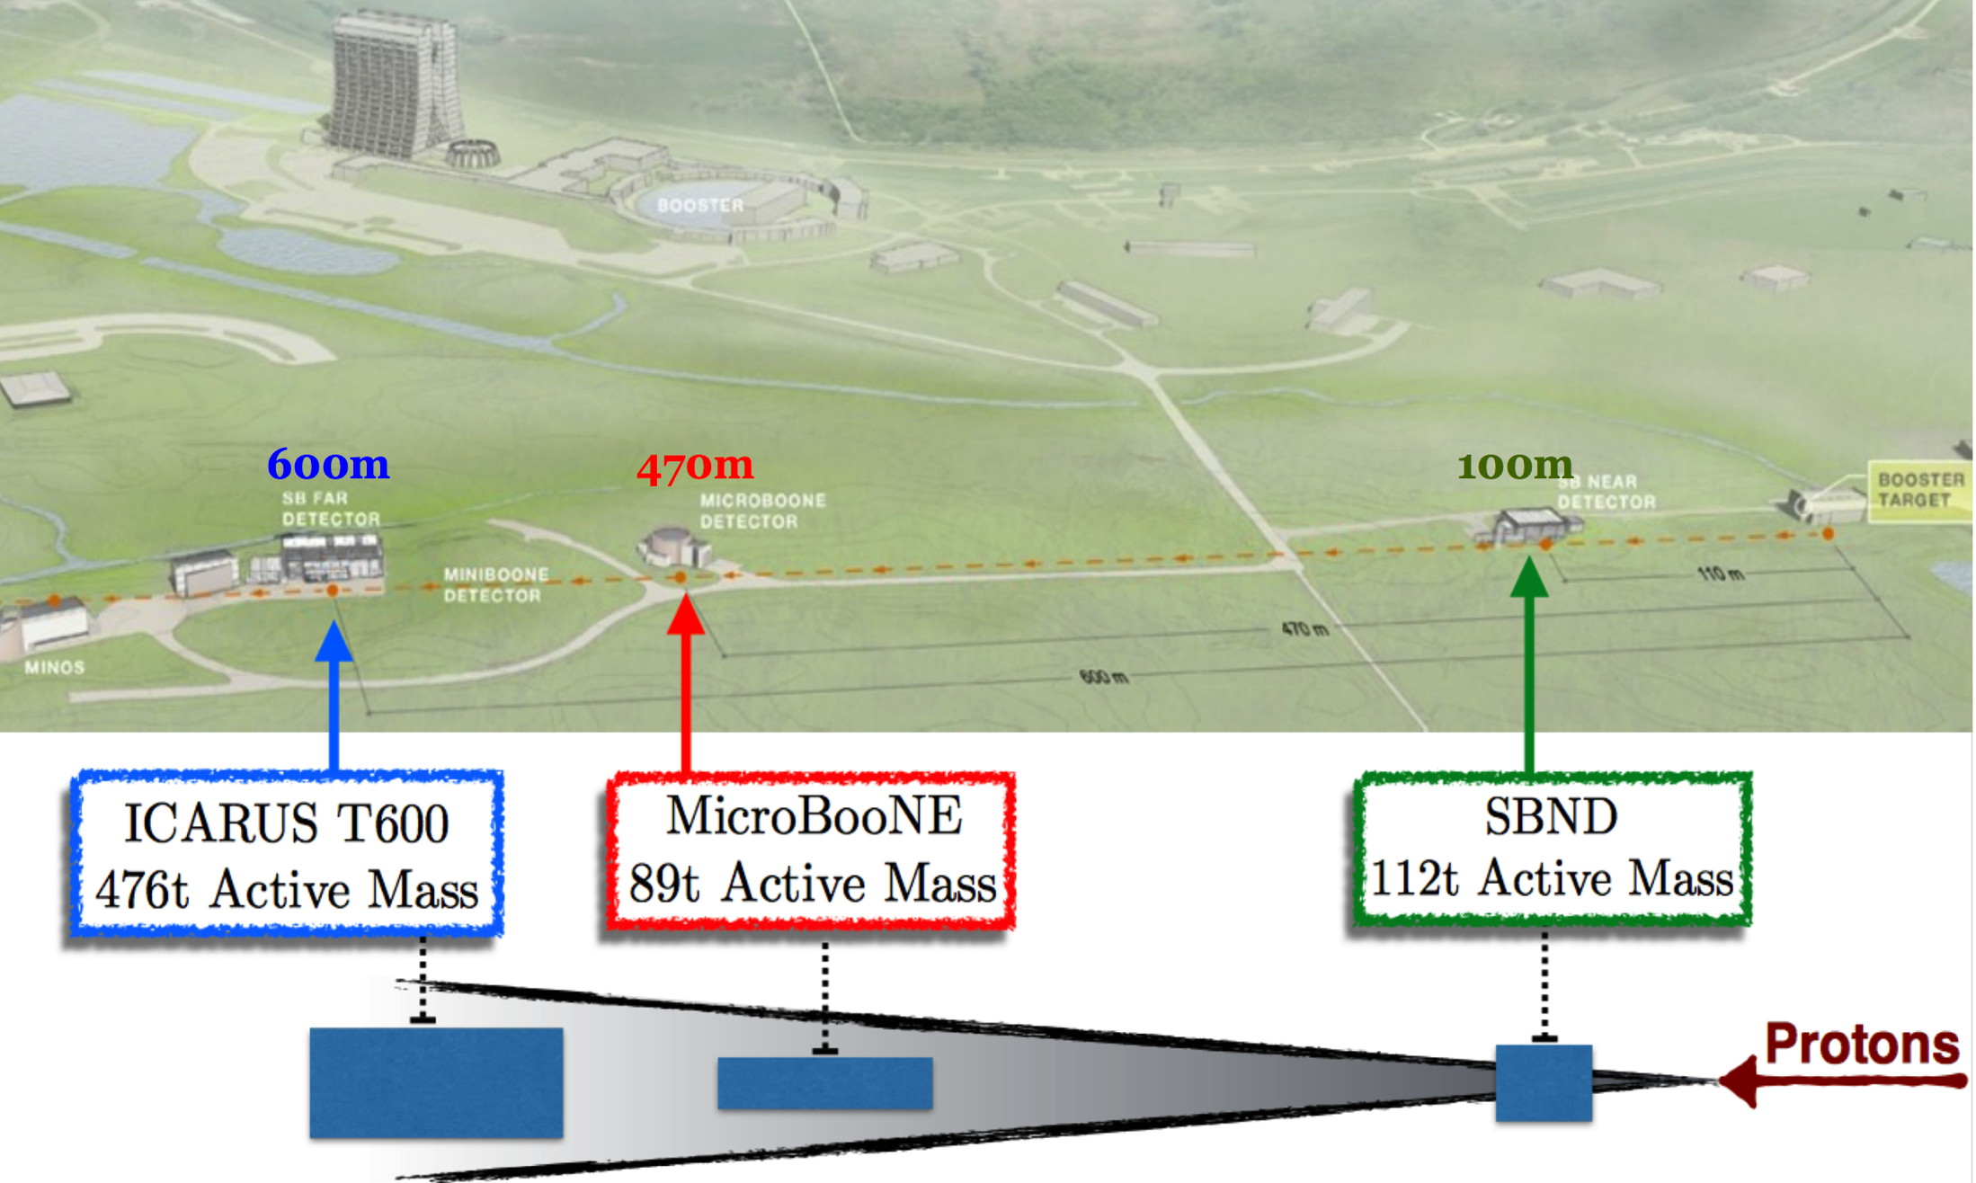
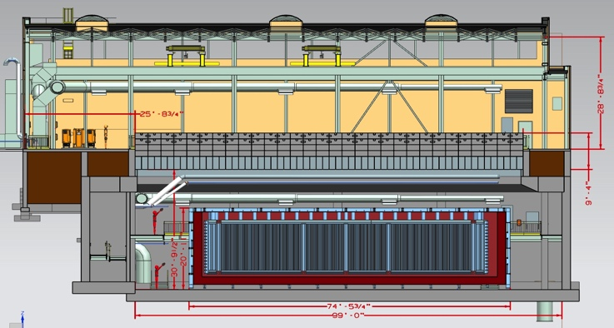
NP01: WA104→ICARUS, delivery to FNAL early 2017, installation and commissioning during 2017
ICARUS T600
476t Active Mass
MicroBooNE
89t Active Mass
SBND
112t Active Mass

Slide 12
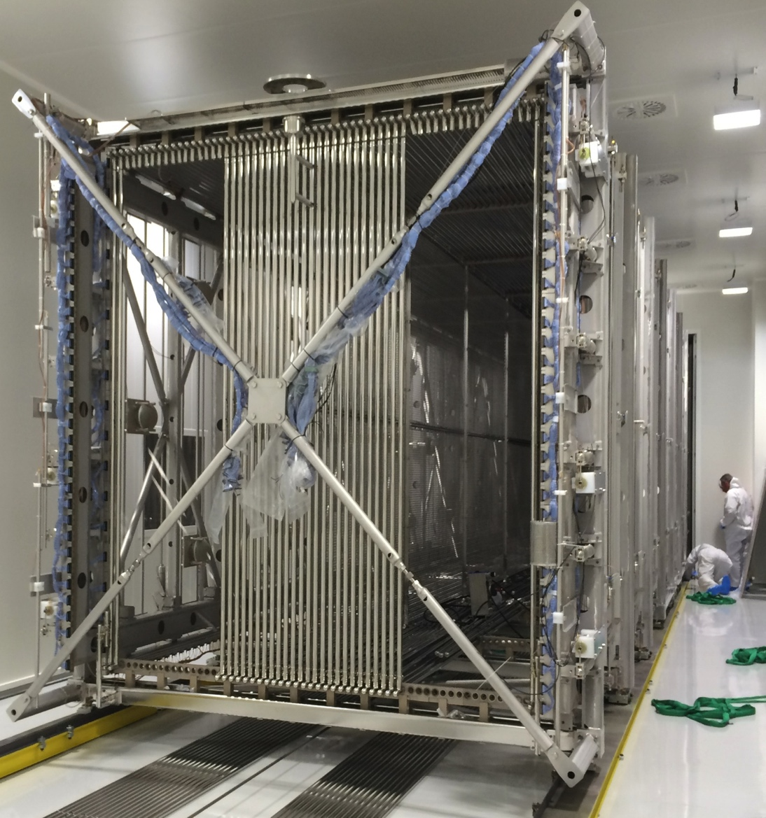
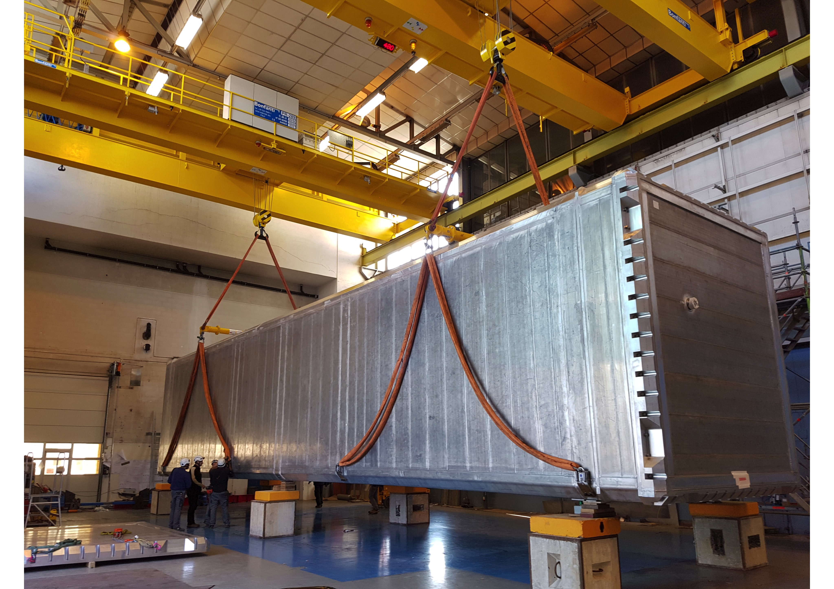
The ICARUS Detector arrived at CERN and is now being reshaped (CERN-INFN coll.)
It will be moved to the FNAL SBN in April 2017 and then installed and commissioned (two vessels) !!

Slide 13
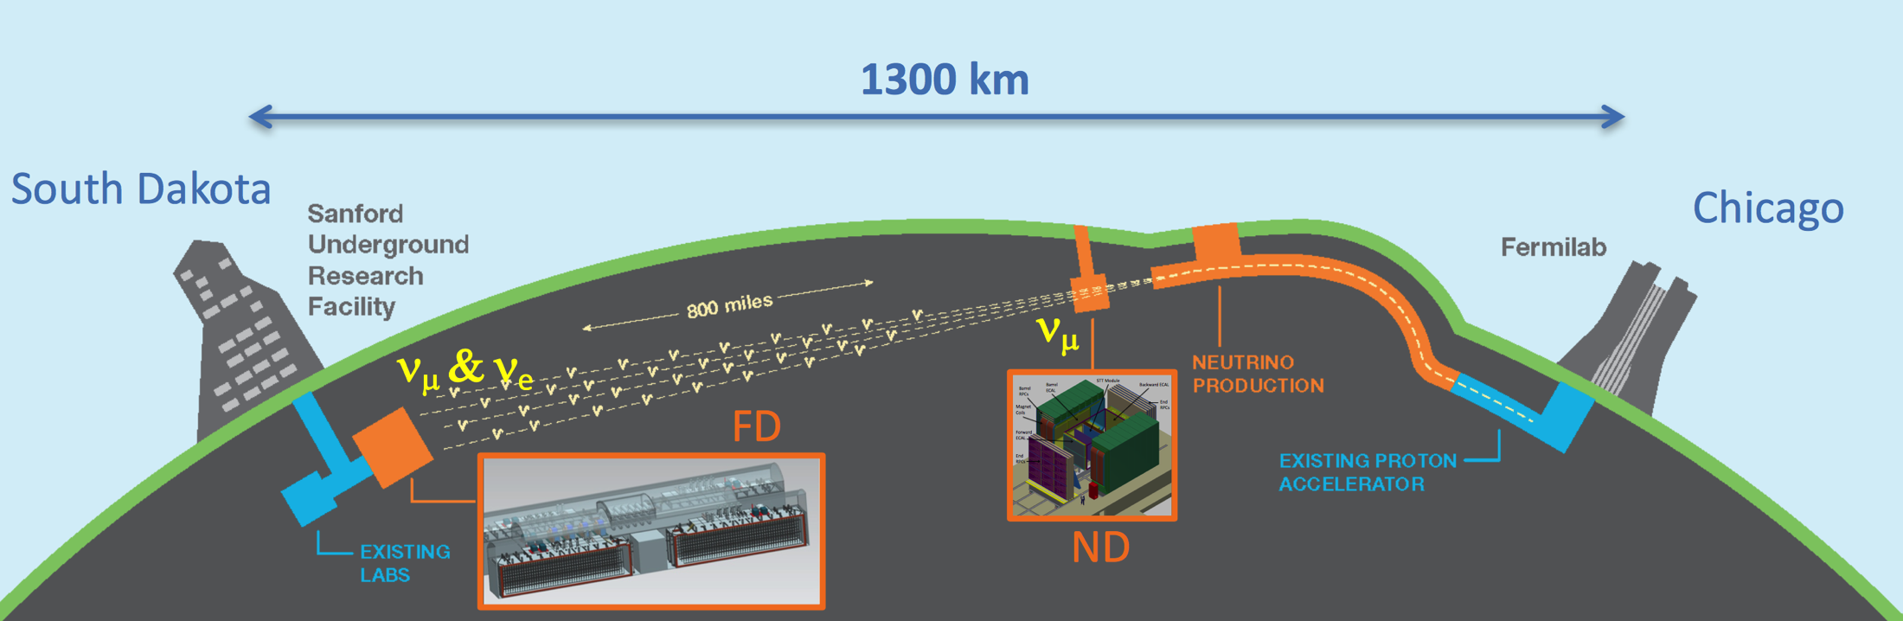
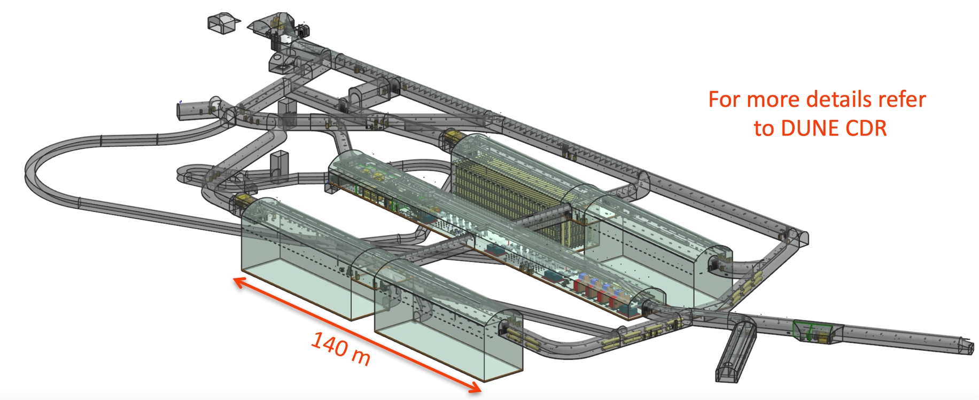
LBNF/DUNE long baseline
Detector R&D
Large Prototypes
Membrane cryostats and cryogenics
Detector construction

Slide 14
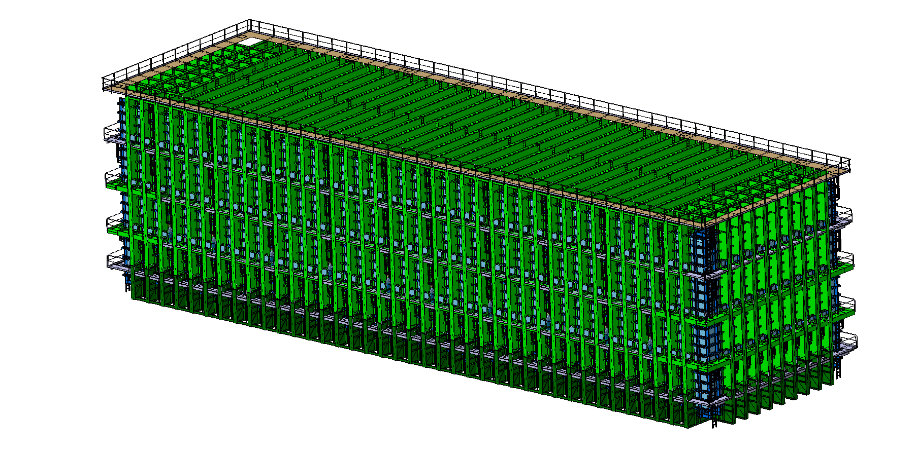
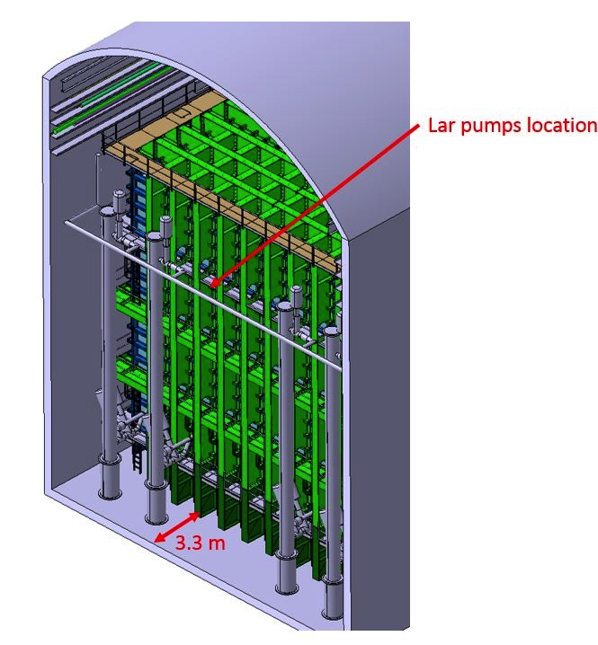
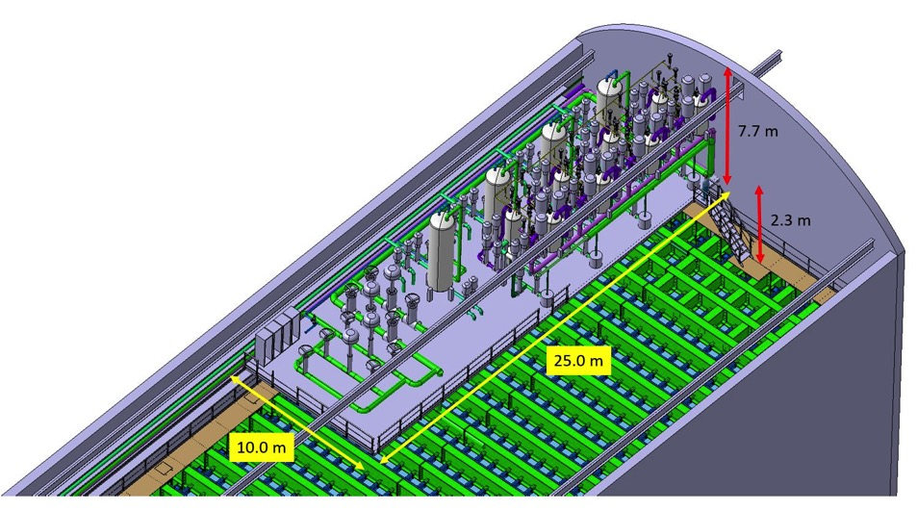
LBNF : cryostats (~18KT LAr)
Inner dimension (liquid+gas):
  L = 62.00 m
  W = 15.10 m
  H = 14.00 m
Proximity cryogenics mezzanine
Notes:
This is the list of the requirements that have an impact of the CF work.
READ.
Full list is available here.

Slide 15
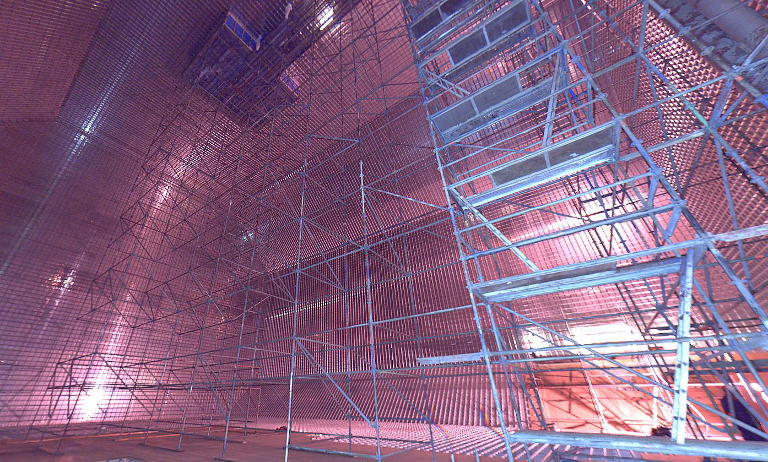
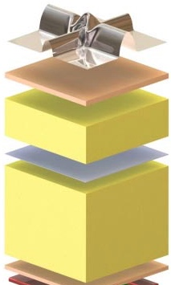
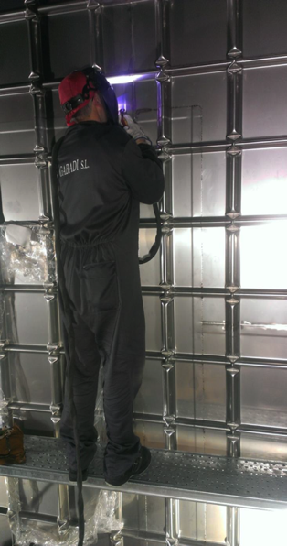
Then Cold Membrane Vessel (LNG industry technology)
secondary membrane : composite laminated material (secondary containment)
Insulation : reinforced polyurethane foam (5-6 W/m²)
SS 1.2 mm primary membrane in contact with the liquid (primary containment)

Slide 16
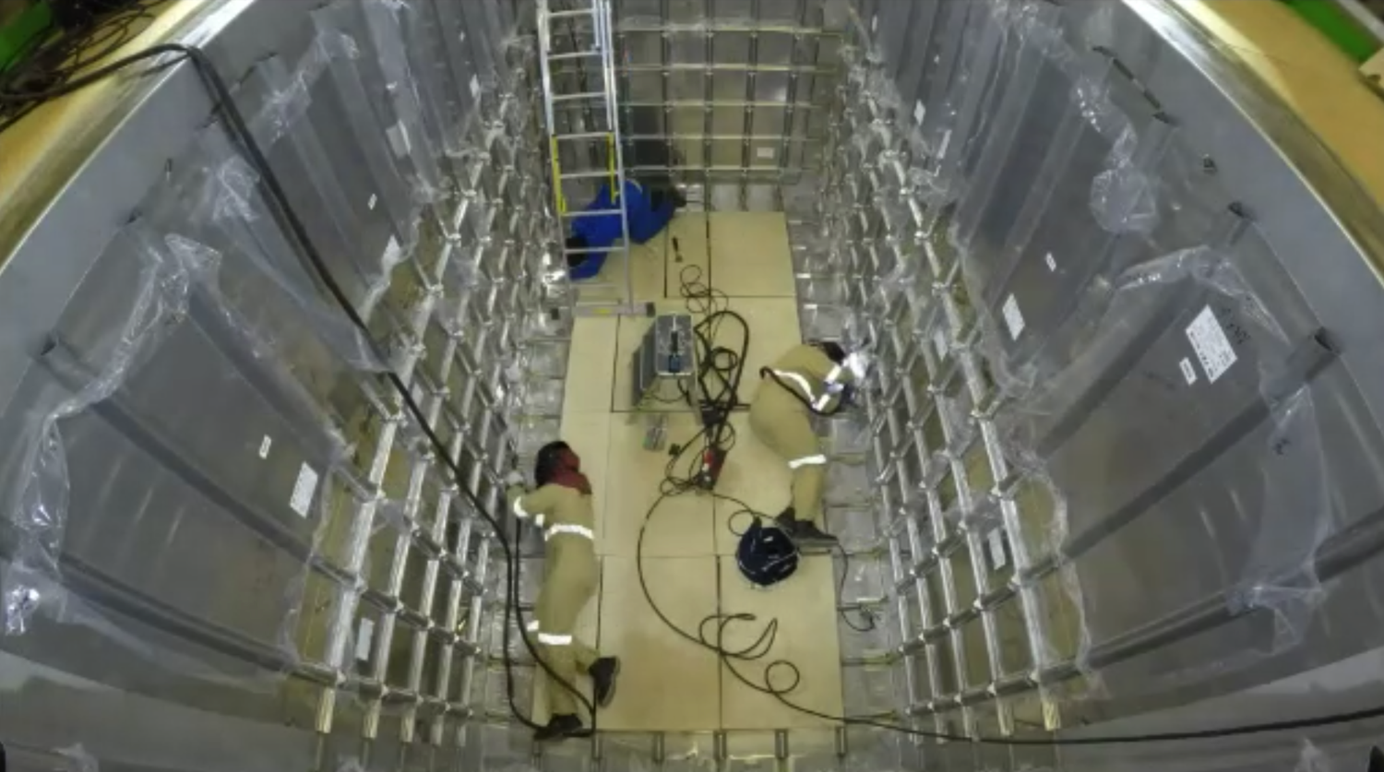
NP02 3x1x1 demonstrator experience

Slide 17
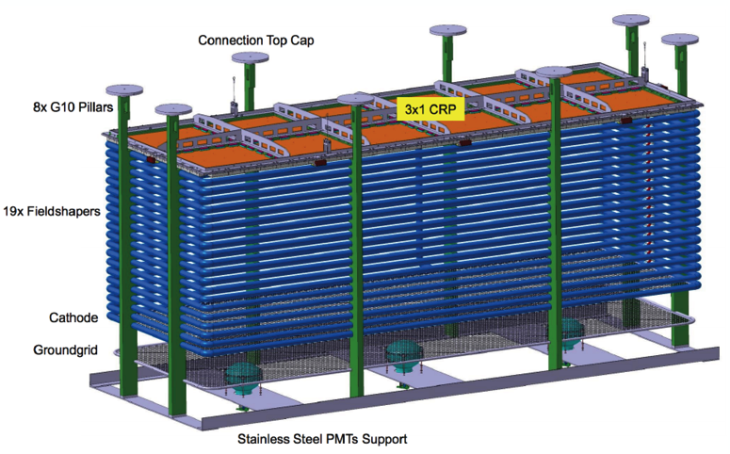

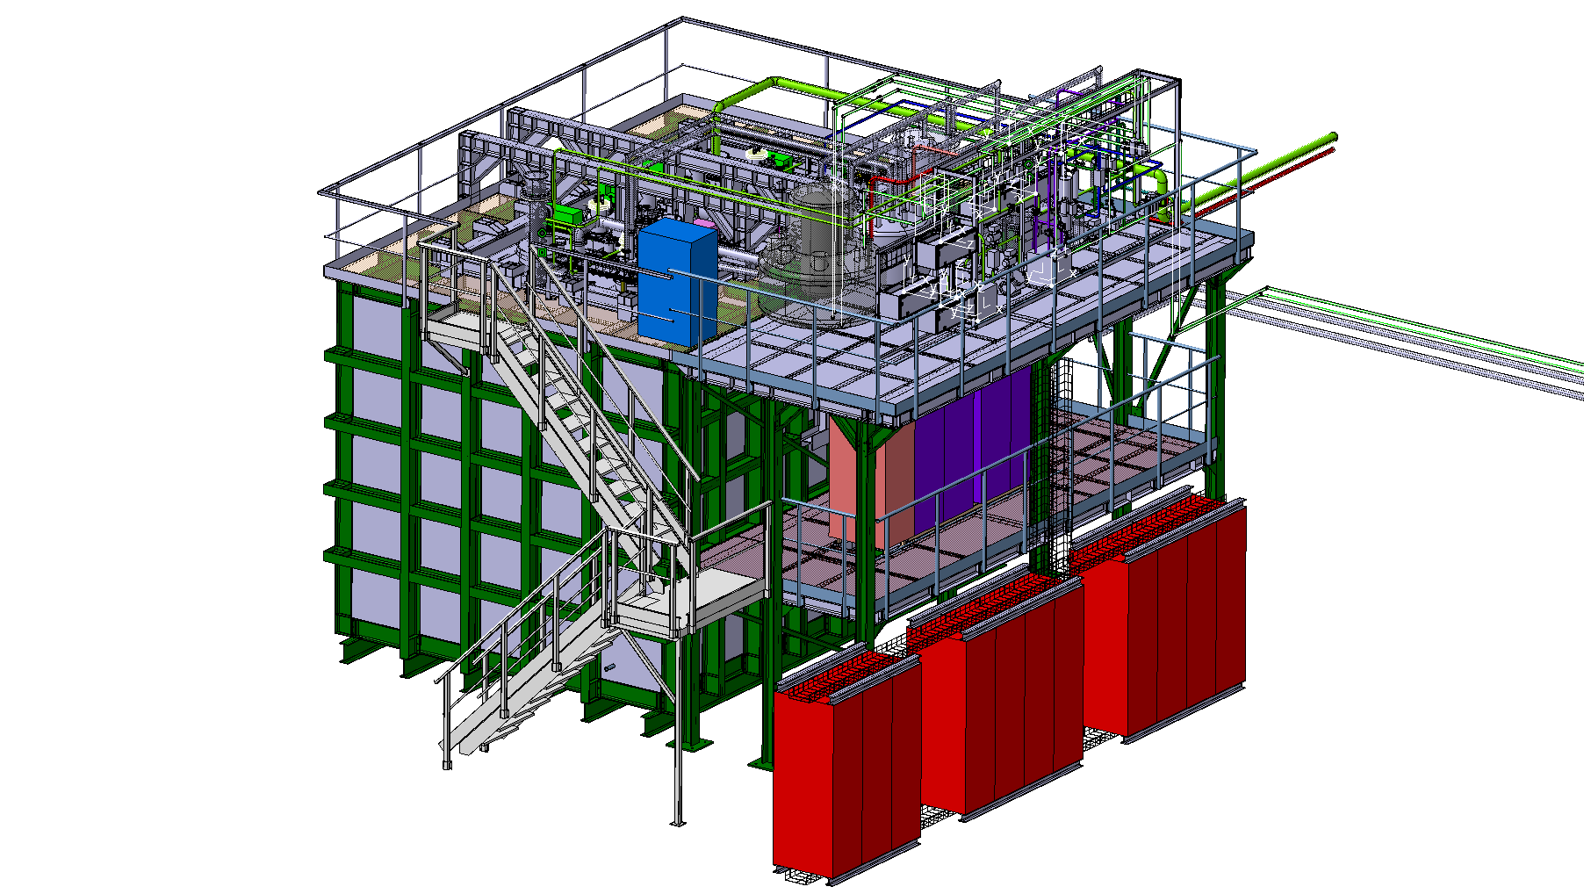
NP02 : WA105 LAr double Phase demonstrator
3x1x1 WA105 demonstrator module
Ready to start cool down in the next few weeks!!
Experimental setup (cryostat, cryogenics, control system, DAQ)

Slide 18
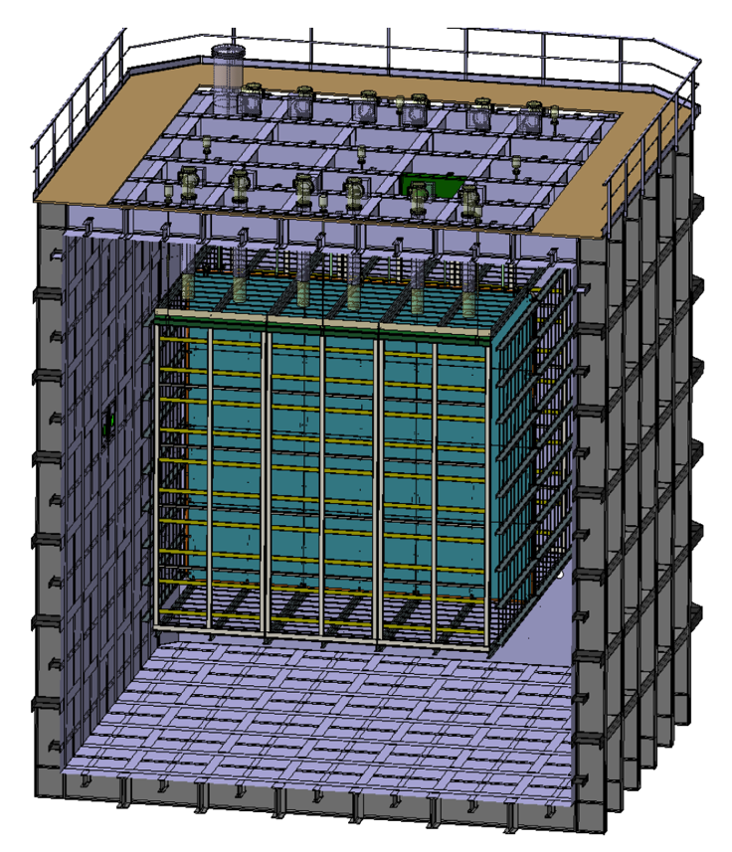
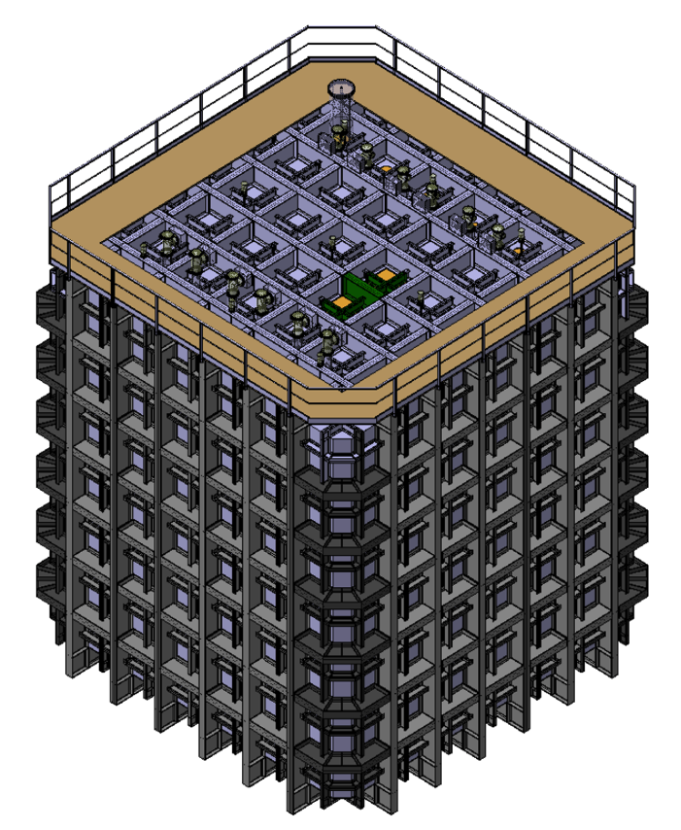
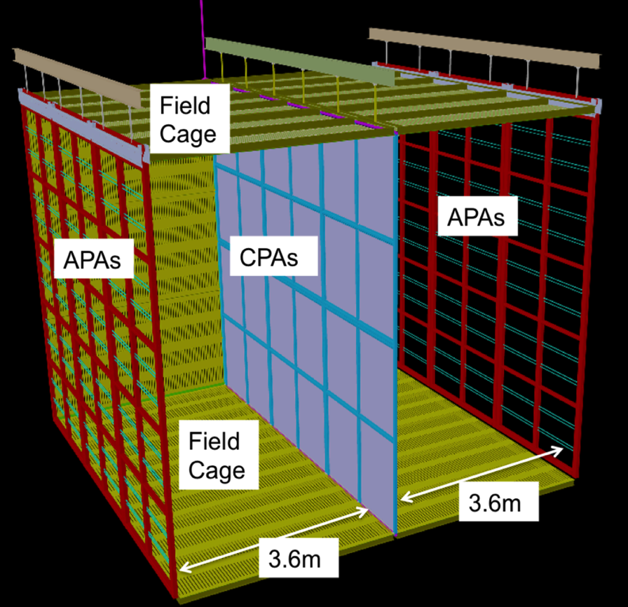
Single phase protoDUNE
Single phase LAr TPC
Operational in early 2018, SPS calibration beams in 2018
Active volume ~ 7x7x6 m³

Slide 19
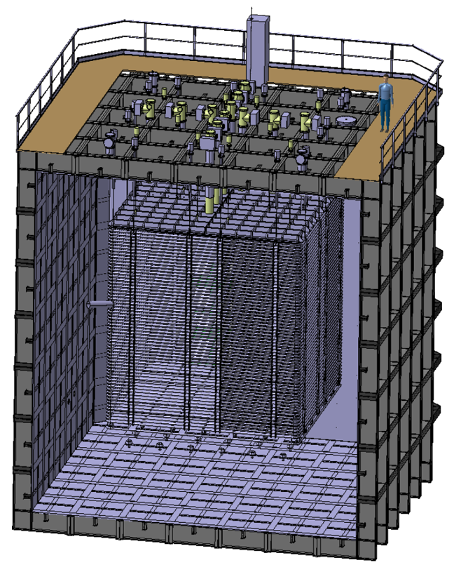
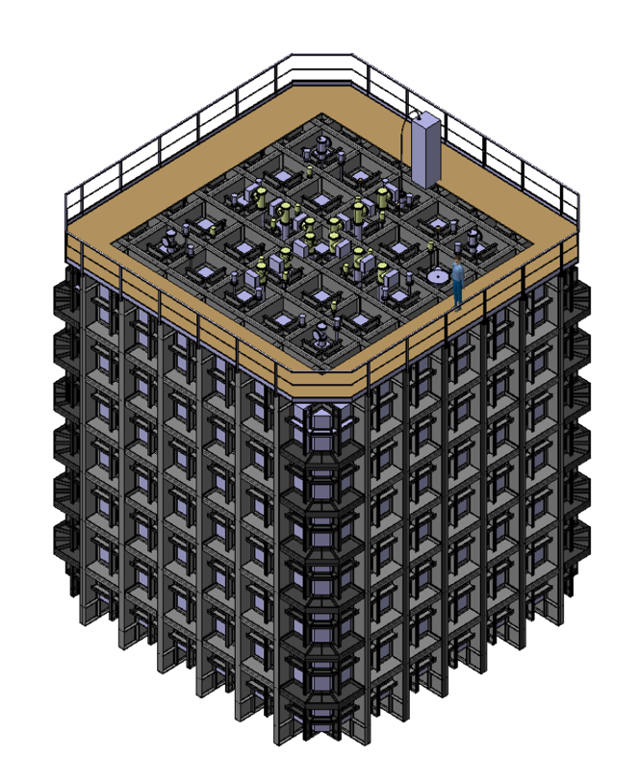
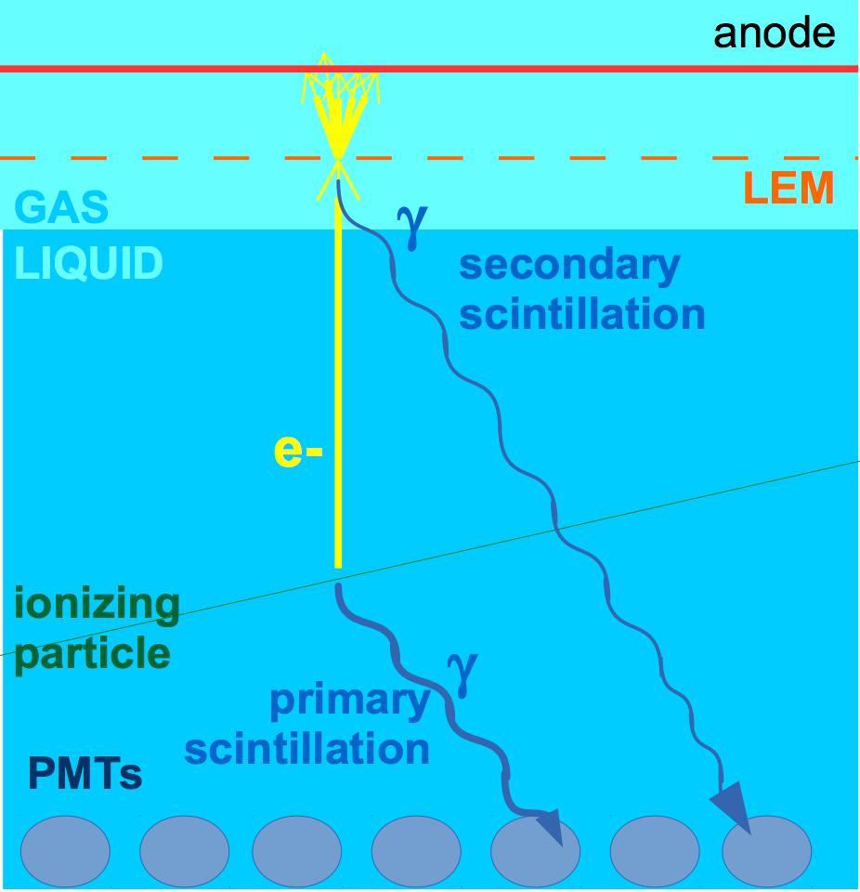
Double phase protoDUNE
Double phase LAr TPC
Operational in early 2018, SPS calibration beams in 2018
Active volume 6x6x6 m³

Slide 20
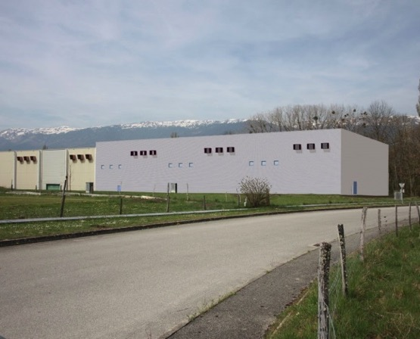
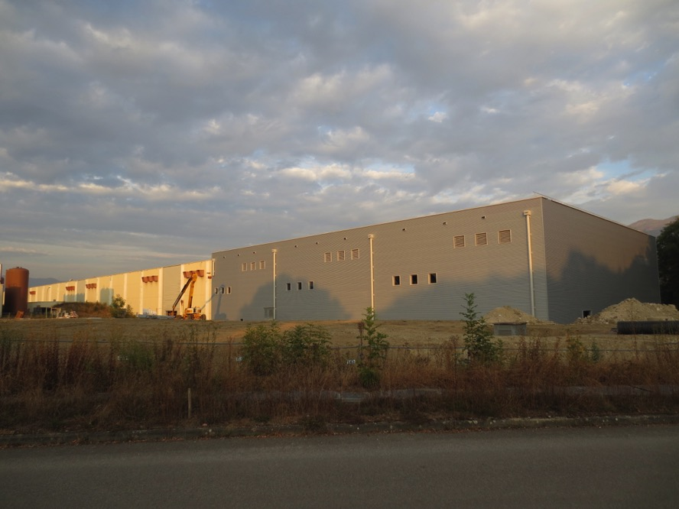
Building EHN1-extension, received the 6th of September from Civil Engineering
Simulation
Real !!!!

Slide 21
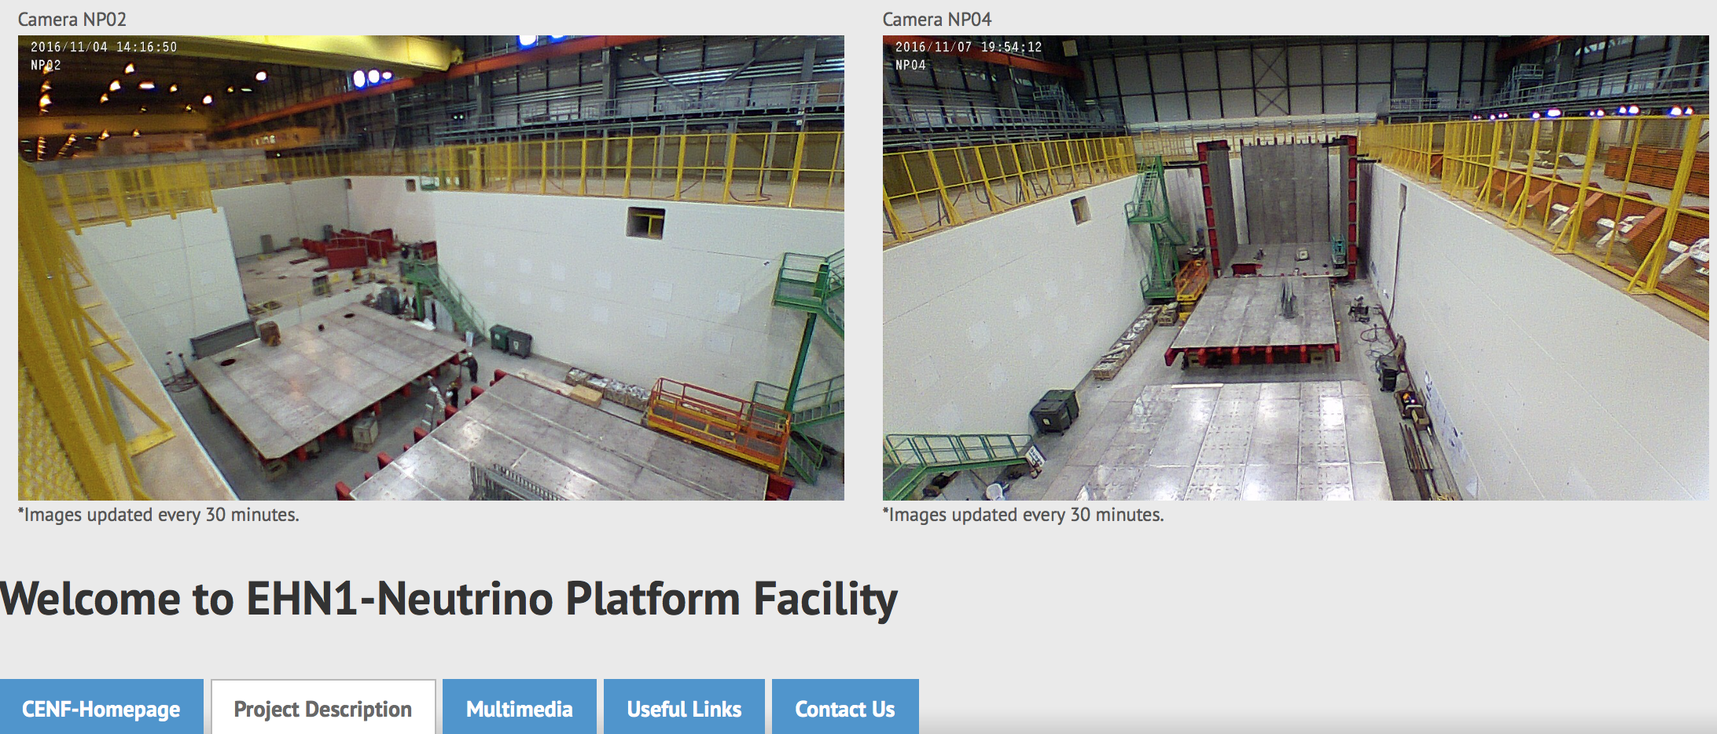
http://cenf-ehn1-np.web.cern.ch

Slide 22
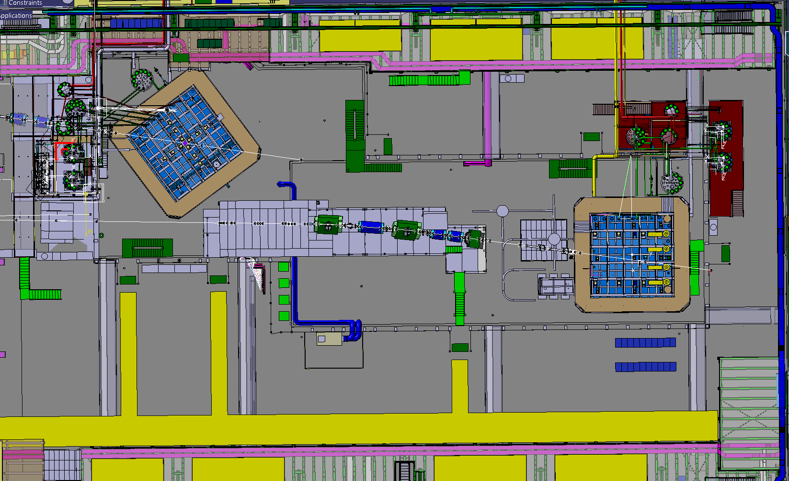

Slide 23
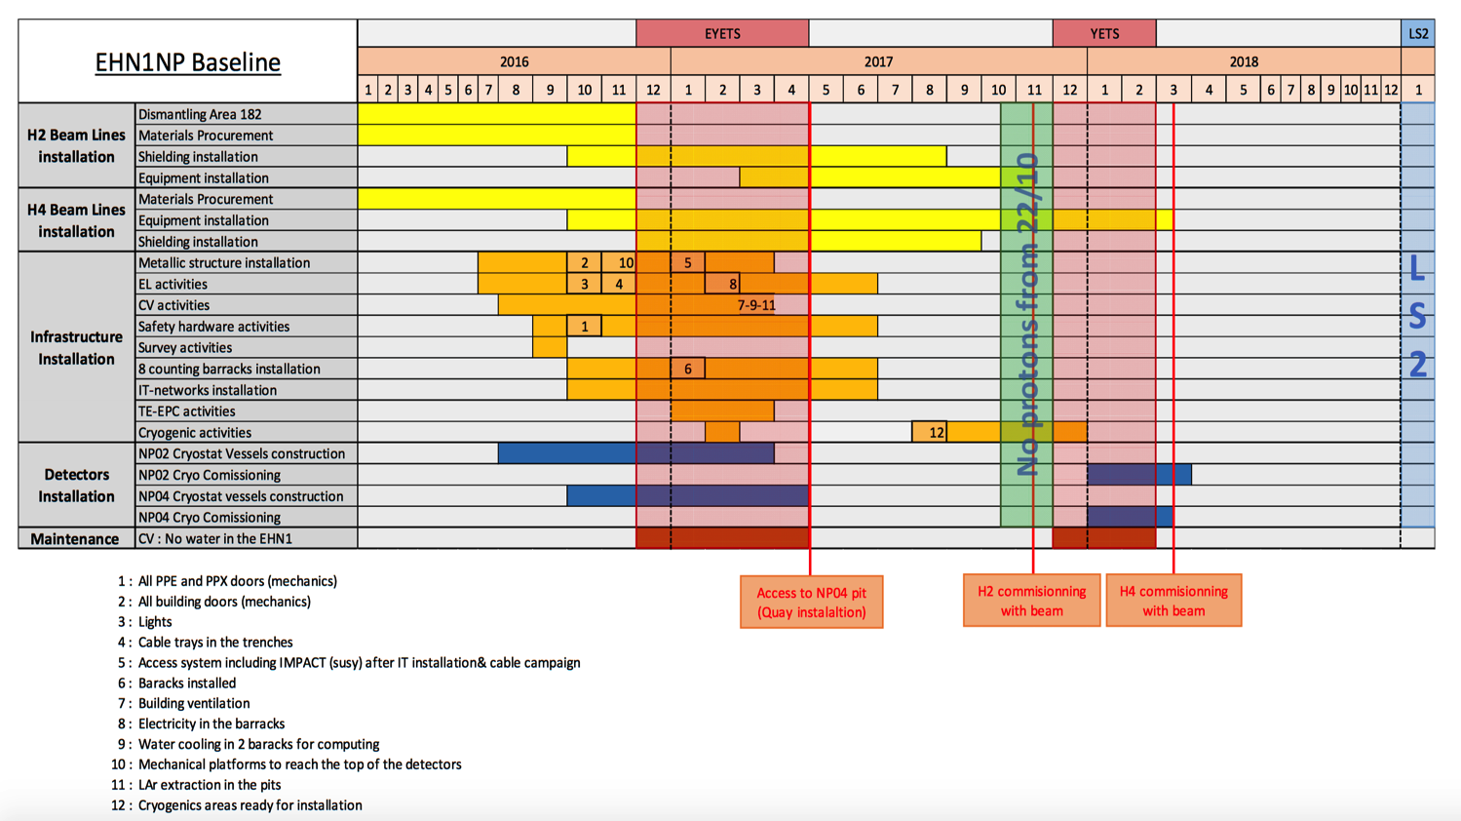
https://edms.cern.ch/document/1725184

Slide 24
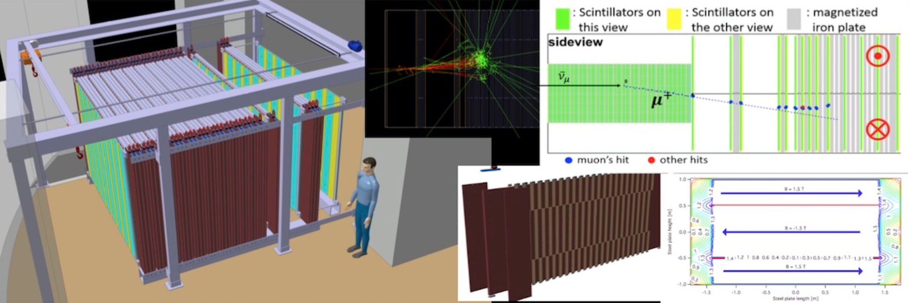
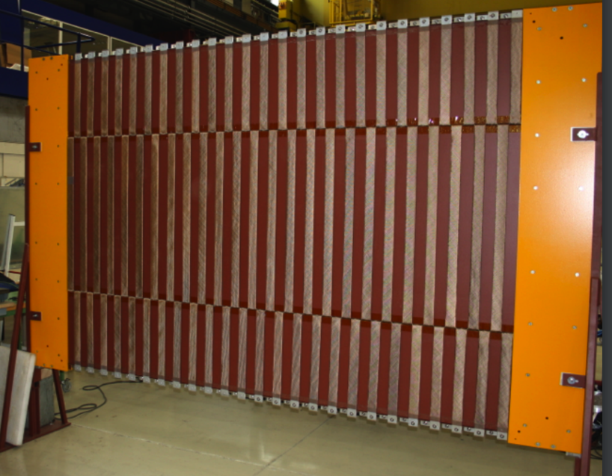
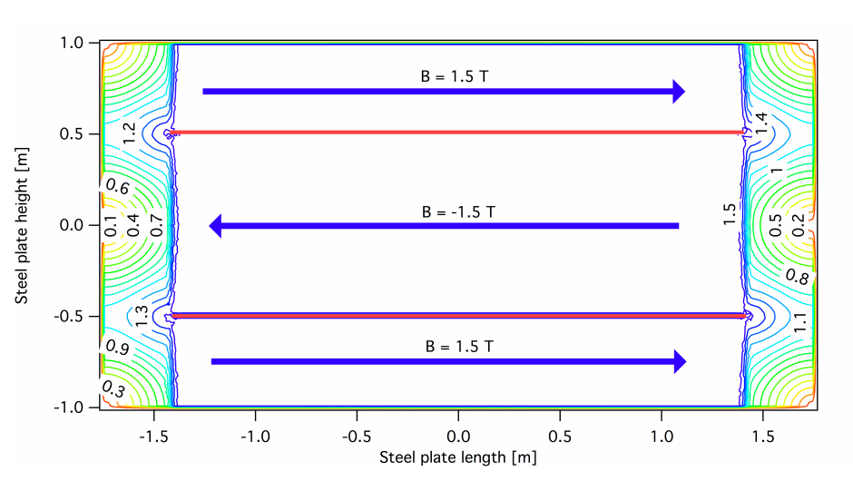
NP05: Baby Mind, a muon spectrometer for the WAGASCI experiment at T2K

Slide 25
CERN Neutrino Platform effort summary
Unique opportunity to rebuild a strong European Neutrino community
Immediate physics potential with the exploitation of the short baseline at FNAL and the T2K new near detector
Major contribution to the infrastructure of LBNF
Design and construction of new large detector prototypes
Generic R&D on new detectors and data handling
Participation in the construction, commissioning and physics exploitation of the new high intensity facilities

