Slide 1
Example field-cage structures
E. Radicioni - INFN

Slide 2
Aleph field-cage
Double layer of electrodes (35 μm Cu) separated by a Kapton foil (75 μm)
4 mm thick insulator, composed of 120 layers of mylar wound helically and glued together
Aluminum honeycomb 16 mm thick and sandwiched between two 1 mm aluminum foils provides the self-supporting structure.
The total thickness is ~2.2 cm, 4.8 % of a radiation length.
Drift lenght: 2.2m
110V/cm

Slide 3
NA 49 field-cage principles
no insulator surfaces exposed to the drift volume
single-layer electrostatic field structure made by mylar strips
functional separation of field cage and gas envelope
outside protective gas volume for gas purity and HV safety
one-piece field structure hanging from the top

Slide 4
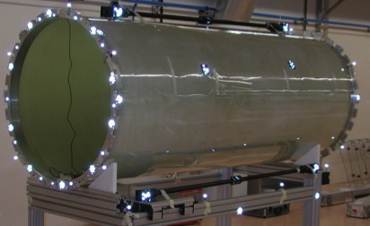
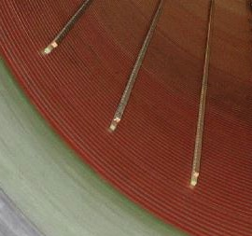
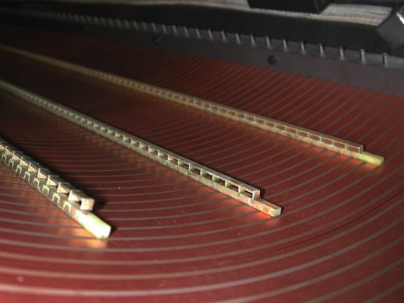
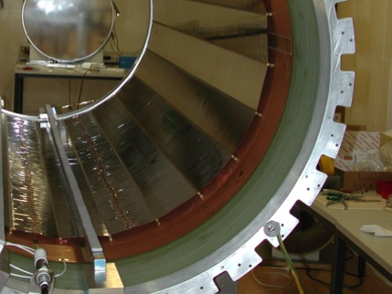
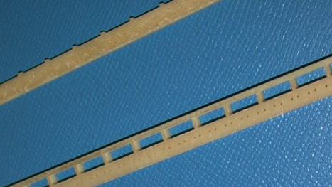
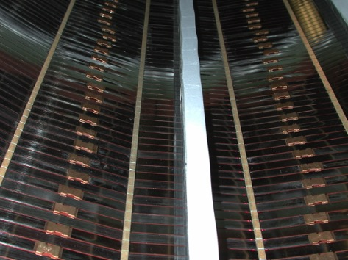
merging the 2 concepts: HARP field cage
Ar/CH4 90/10
operated at 110V/cm but capable of up to 35kV
1.5m drift
8mm Stesalit cylinder (65% glass fiber / epoxy)
Cu strips glued to Stesalit
voltage divider with holes for Mylar strips
staggered strips
extremely compact: < 2cm total thickness dead space
uniform material layer → better for simulation/reconstruction

