Slide 1

Scalable Readout System
SRS was developed by RD51 collaboration for R&D on MPGD gas detectors
Collaborating SRS teams and users in 2016
MPGDs @ GDD-lab CERN, Photon detectors @ NEXT coll., Muon Tomografy @FIT, MICROMegas @ ATLAS MAMMA, DTC links and SRU@ ALICE DCAL, GEMs @ FTBF Coll., Timepix-SRS for ILC-TPC test@Bonn Univ,, GEM stack readout @BNL, GEMs@ CMS GEM collab, optical Readout@ TOTEM, GEM detectors @ PRad Coll., Neutron detectors@ ESS Brightness, Large surface MUST detector @ LSBB, VMM frontend for FOCAL E-PAD@ Univ. Tsukuba, GEMs for CP-Violation @CAPP, … and many more

Slide 2
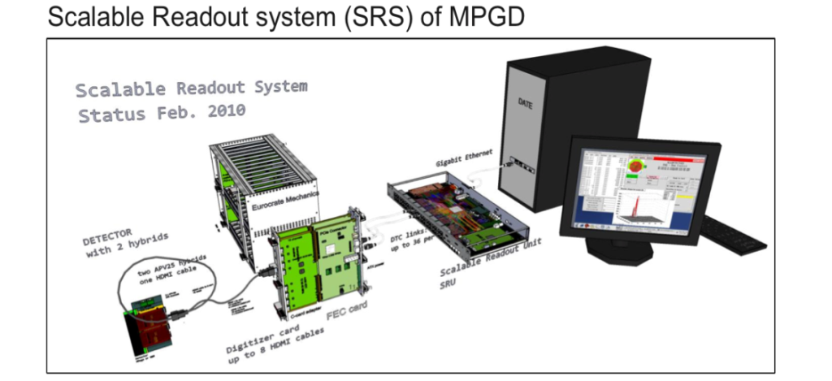
SRS concept (since 2009)
choose the best frontend for your detector
low noise, spark protection, dyn. range..
connect X frontends to SRS backend
scalable DTCC links instead of bus
start with few channels (1 hybrid=128 ch.)
get used with DAQ and Analysis software
scale up to X channels with same software
get support by large SRS user base RD51
many SRS systems, much experience
SRS services: detector-HV, amplifiers etc.
SRS Classic: purchase via @CERN store
Commercial SRS starting 2017 *
New SRS frontends: request-driven R&D collaboration based
Frontend carrier (hybrids)
ASICs, preamplifiers
on detector
FE Adapter (cards, mezzanines)
( ADC, DVM, Timepix, SiPM, PM)
+ Frontend concentrator (FEC)
Opt. Scalable Readout Unit (SRU)
data MUX/Buffer, TTCrx, clock and trigger source, Busy, Slow Controls
PC / Laptop with
DAQ and Analysis SW
Slow controls
DTCCP links
default HDMI
DTCC links
Default CAT7
UPD/ 10GBE
*exception: APV hybrid, only available through CERN

Slide 3

Scalable readout Architecture
Full SRS: stacks of vertical-slices
Minimal SRS: 1 or 2 vertical slices
PCs with Online SW
Laptop
with Test/Online SW
controls over
ethernet
high BW data
over UDP
UDP Ethernet
Data and Controls
trigger
SRU
CTF
Trigger
USB Device
Controls
& readout
Backend DTCC links
TC link
1 Vertical Slice
FEC
FECs
Crate(s)
(Mini)Crate
Adapters.)
Adapter (ADC, DVMcard, etc)
SRS
service
electronics
Frontend DTCC links
…..
Frontend link
SRS frontend
SRS Frontend (APV,VMM etc)
Detector
HV
Test Detector
Trigger Pickup

Slide 4
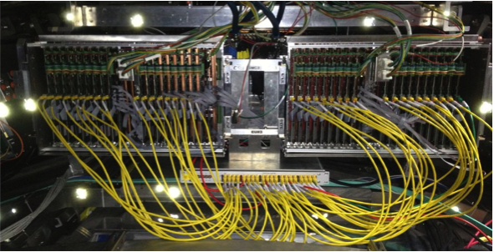
xTCX links ( SRS-specific links )
xTCx link flavors in use so far
DTC Data+Trigger+Clock (over CAT7, SRU-FEE ) 2009
DTCCP Data+ Trigger+ Clock +Control + Power ( over HMDI*, FEC-Frontend) 2010
TC Trigger + Clock ( over CAT7, CTF - FEC) 2010
DTCC Data +Trigger+ Clock +Control ( over CAT7, SRU - FEC) 2011
DTCCO Data+ Trigger+ Clock+ Control over Optical fibre ( planned , 2017 )
PC
ALICE DCal: DTC links over CAT7 from 40 FEE to 1 SRU
xTCx links make SRS scalable
10 Gigabit Ethernet / UDP
LINK scalability features vs. parallel Bus
Data in parallel over p-p links
=>Higher BW & Trigger rates
point-point controlled impedance
=> very high bitrates & lower error rates
overcome bus length limit
=> single point failures = non fatal
less wear-out of contacts
=> more reliable, less cost
D T C C
SRU
DTCC backend links
BUS
FEC
FEC
FEC
DTCCP frontend links
. . . . .
..
..
hybrids
..
* copper or fibre

Slide 5

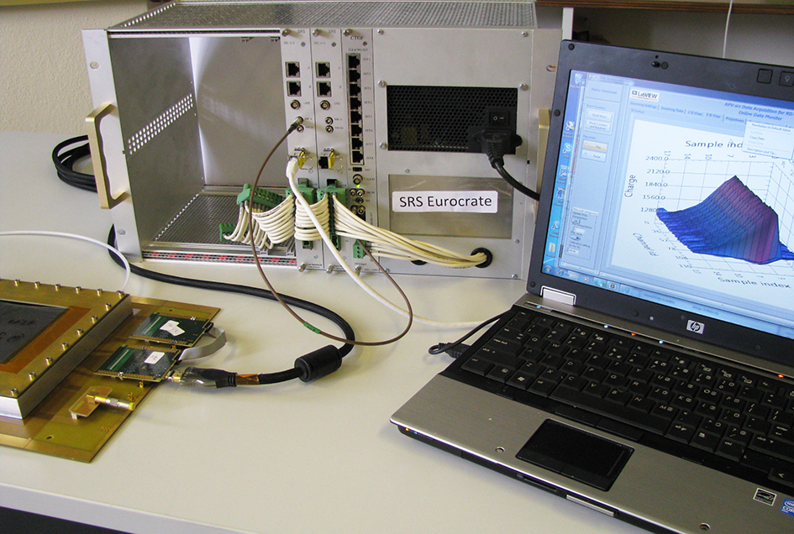
Table-Top SRS
Powered SRS crate with FEC / Adapter combo
Detector
with APV hybrids
Readout & power
via HDMI link
Laptop connected via
Ethernet cable to FEC
Online Readout systems
DATE, and/or Labview SRS

Slide 6
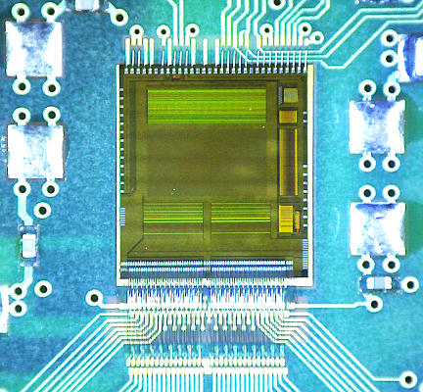
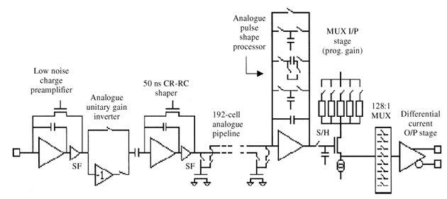
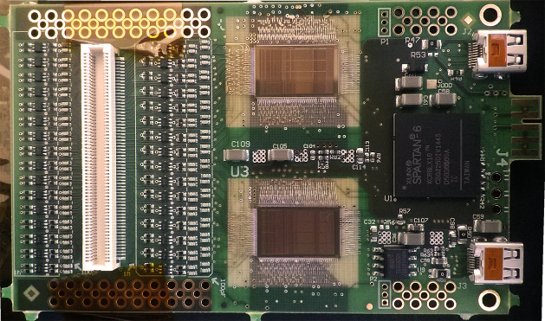
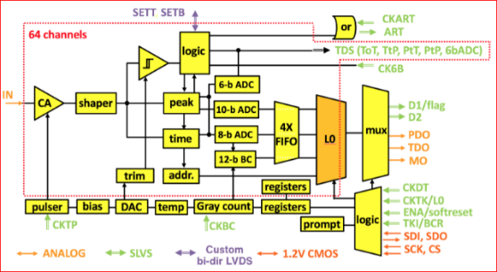
SCALABILITY ( a. over types of frontend )
APV wire-bonded, on SRS hybrid
1 ASIC: 128 analogue ch.
-general-purpose SRS:
APV frontend = 128 analogue ch. on hybrid
VMM frontend= 128 digital ch. on hybrid
-experiment –specific SRS:
SiPM and PM adapter (NEXT)
Octal Timepix-2 adapter (Univ. Bonn)
1 APV channel
2 x VMM wire bonded on SRS hybrid
1 ASIC: 64 digital ch.
Example of different frontends combined in a single RO system
1 VMM channel

Slide 7
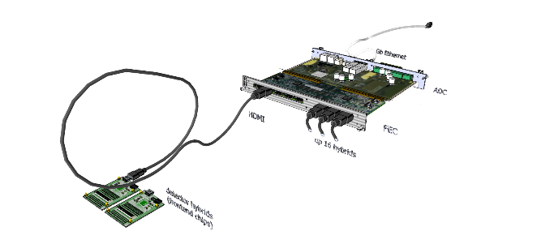
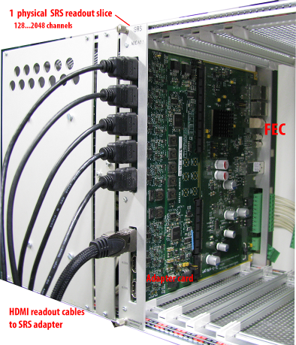
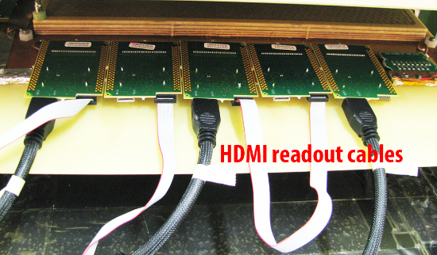
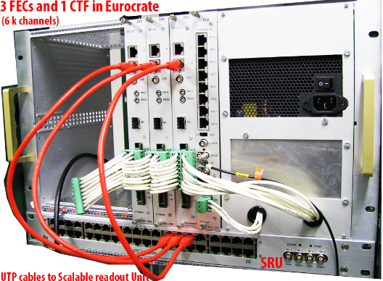
Scalability ( B. # channels )
Table-top minimal SRS system
1 ADC adapter card + 1 FEC
8 HDMI ports
SRS channel unit = 1 hybrid 128 channels
DTCCP readout cable unit = 256 channels
FEC Frontend concentrator unit = 2k ch.
Multi-FEC system with SRU = 4k…16 k ch.
Multi-Crate with SRU(s) > 16k ch
Frontend Hybrids
along Detctor frame
SRS slices (FEC+Adapter)
in Euocrate with SRU below

Slide 8
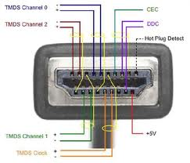
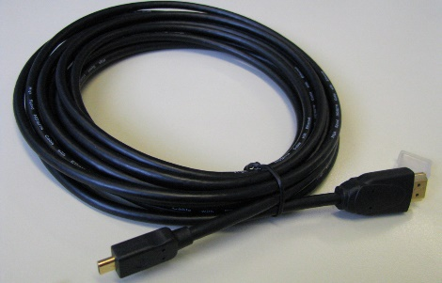
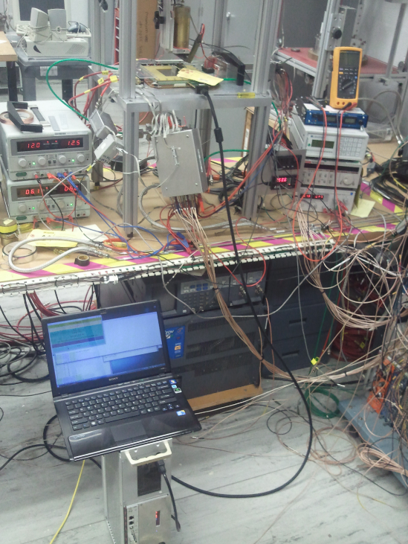
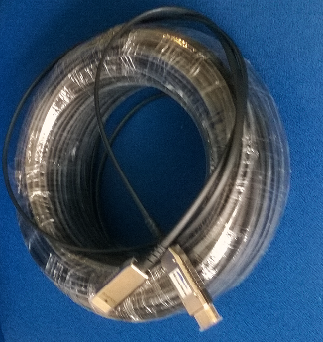
Frontend links (DTCCP)
5m HDMI standard A to micro (D)
HDMI* cables A-D (micro) up 5m
HDMI cables A-A coupled to A-D up 25m
Photo: SRS test with RCDAQ at BNL
GEM detector with
SRS APV hybrid,
powered over HDMI
NEW ( tests in preparation )
- active HDMI copper A-A + A-D max 50 m
- active HMDI fibre A-A + A-D max 150 m
Laptop with RCDAQ
Commercial
100m active, optical
HDMI cable
DTCC link HDMI A-A
SRS Minicrate
* we do NOT use HDMI protocols

Slide 9
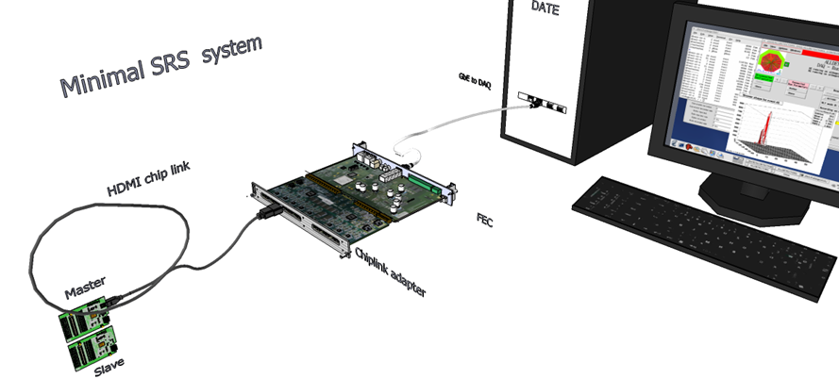
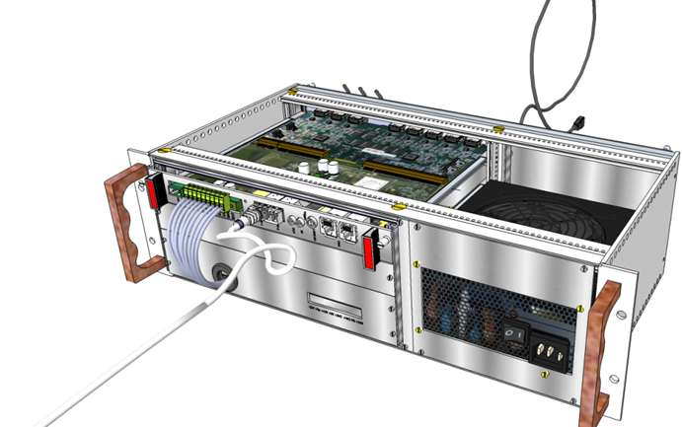
Small systems
“SRS Classic”
Complete
readout system from detector
up to offline Analysis
Table-top SRS
= 1 vertical slice
HDMI cables max 25 m
(active HDMI up 150m)
Crate –based SRS
Hardware available via CERN store
Firmware included
Software via RD51 database
2017+ commercial SRS sales licences
Mini-crate SRS system
> 100 crate systems in use worldwide
mainly by members of the RD51 collaboration

Slide 10
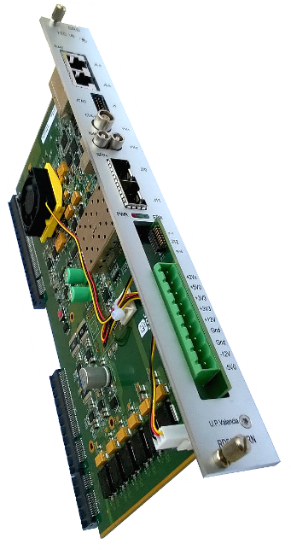
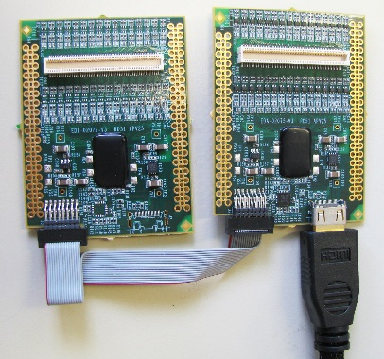
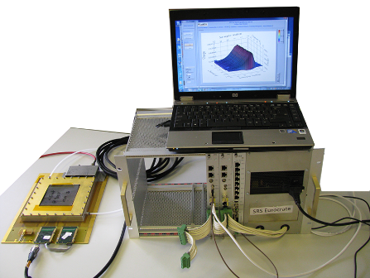
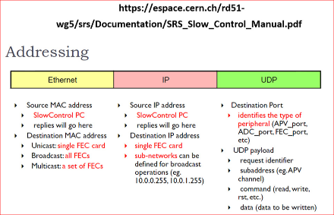
SRS frontends
SRS system Hardware
APV25 (128 ch, analog) @ CERN store, standard FE for RD51
VFAT (64 ch, digital) CMS/Totem -> prototype only
Beetle (128 ch, anal +digital) -> prototype only
SiPM and PM frontend @ UPV Valencia for NEXT
VMM (128 ch, digital+ ZS ) @CERN -> testing RD51/ESS
GEMROC (64 ch , digital) in prep @ AGH and EicSys
Timepix R&D for ILC TPC @ Bonn Univ. Proto system
FEC cards ( CERN store + commercial)
analogue adapter (16 x ADC 12 bit) ( CERN store + commercial)
digital adapter for VMM frontend (commercial)
Mini-crates up 4k channels (CERN store)
Eurocrates ( REV2 ) up 16 k channels (commercial)
ATCA crates, RTM cards 10 GBE, SFP (commercial)
ATCA blades ( 2x LX240) (commercial)
ATCA mezzanines (ADC, 6x12fibre ribbon) commercial, CDT (UPV)
CTF clock-trigger fanout (inhouse-> commercial)
Timepix adapter 6U card ( Bonn Univ, prototype )
Optocard VFAT 6U card (Totem)
High Voltage for MPGD’s AVD NIM ( in prep. -> commercial)
SRU LX240, 40xDTCC, NIM, 10GBE, 4x SFP (inhouse-> commercial )
APIC preamp-shaper , battery box ( finalized -> commercial)
Femto online current measurement over 10 decades (in prepar.)
SRS Online SW ( via UDP )
Slow controls (via IP )
DATE (= default RD51)
MMDAQ (ATLAS MM)
CODA ( PRad)
RCDAQ ( BNL/RHIC)
Labview SRS ( test systems)
SDC (Scalable Detector Controls )
scripts via Linux/DATE
Labview (for testing)

Slide 11
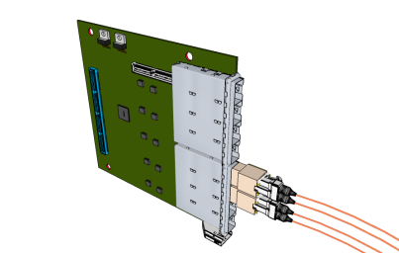
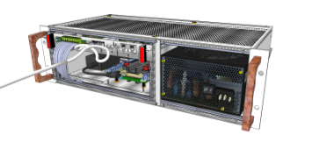

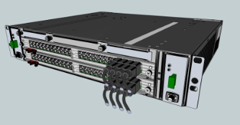
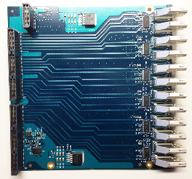
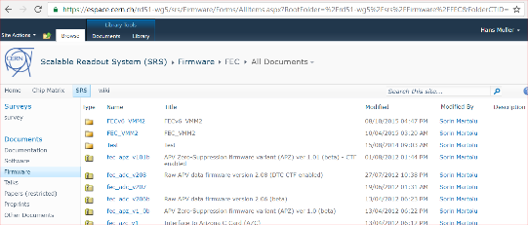
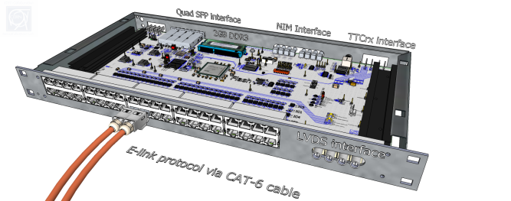
frontend link Adapters
Crate environment
ADC and DVM cards with HDMI ports
HDMI and SFP mezzanines (ATCA)
Optical ribbon mezzanines (ATCA)
Minicrate 19” 3U (CERN store)
Eurocrate 19” 6U (CERN store)
ATCA Minicrate (EicSys )
ATCA 14 slot full crate (EicSys)
Readout Units
SRS firmware
Network switch ( small systems)
SRU ( default, large systems)
SRU-ATCA (planned)
FEC -APV frontend
FEC -VMM frontend
analogue module APV readout
common mode/pedestal correction
Zero Suppression APV
10 Gbit core Virtex6 XAUI ( SRU)
DDL core ALICE
Slink core ATLAS
TTC rx module Virtex-6 (SRU)

Slide 12
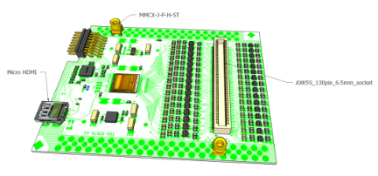
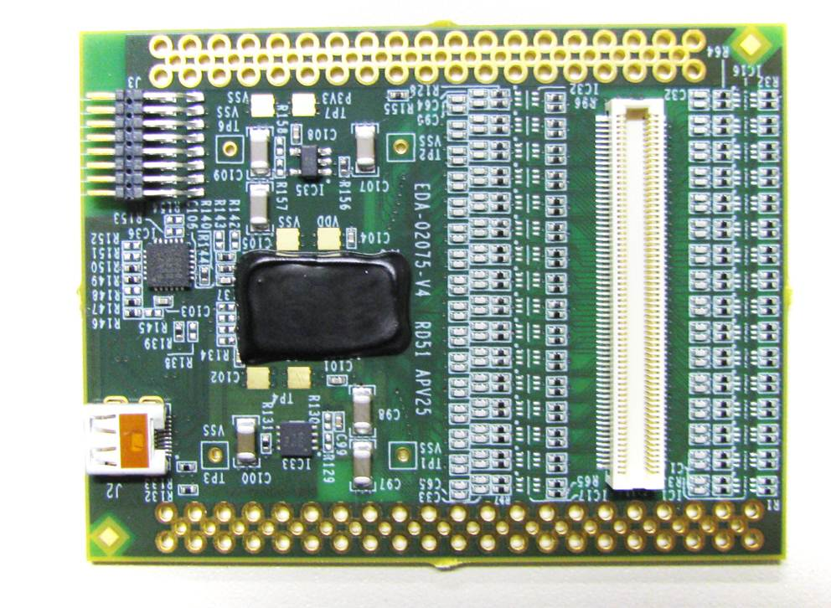
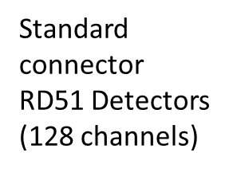
APV 128 hybrid SRS (CERN store SCEM 07.89.00.005.9 )
Master-Slave
cable
connector
Low noise LDO’s
Wire –bonded,
APV 25 chip,
analogue
128 channels
(below globtop)
IEC-61000
Level-4
spark
protection
PLL for clock/trigger
separation
Micro HDMI-D
readout plug
= SRS chiplink
Discrete AC coupling and grounding
MMCX connector
array for GND/click-in

Slide 13

VMM hybrid SRS ( new digital SRS frontend under test )
Photo: 2 x wire-bonded VMM2 chips, VMM3 under work)
HDMI link 1 DTCCP
AC coupling
&
spark protection
JTAG
Companion FPGA
Panasonic 130 pin
connector for MPGDs
to be replaced by new
140 pin HRS connector
HDMI link 2 DTCCP
Detector GND MMCx
Neighbor-channel via MMCX

Slide 14
APV(analogue) VMM(digital)
APV (250 nm CMOS)
Pipeline depth: max. 192 clocks
Trigger latency: max. 3 us
Noise: < 500 e- intrinsic >750..1400 e- on detector
dynamic range: 25 fC
Detector capacity: 18… < 60pf
ADC ext. 4096/1000 [counts/baseline]
Gain: fixed CSA gain 100uA/mip, 5 output signal gains (in step of 20%)
Timing jitter : ½(1/fc) [+- 12ns]
Shaping times: 50 ns adjustable to 80 ns
max readout rate: 7 kHz
VMM (130nm CMOS)
Pipeline depth: 64 digital frames (peak)
Trigger latency: (self triggered) or L0 (12.8us)
noise : < 400 e- on 10x10 detector reported
dynamic range: expect >> 25 fC
Detector capacity: 30pF .. .. < 1nF
ADC: embedded, 10 bit
Gains: 8 CSA gains [0.5..16mV/fC]
Timing jitter: 20 bit t-stamp, 1ns resolution
Shaping times: 4 [ 25… 200ns]
max readout rates: estimated 4 MHz/ch

Slide 15
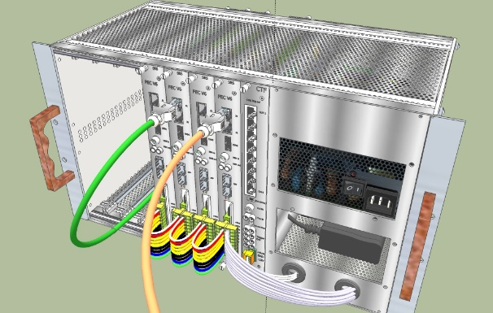
Eurocrates fOR larger systems
Stacking “of vertical slices”
up to 8K channels
per crate
CTF card for common clock and Trigger (TC link)
HDMI frontend links connected on rear side
Power for APV or VMM via HDMI

Slide 16
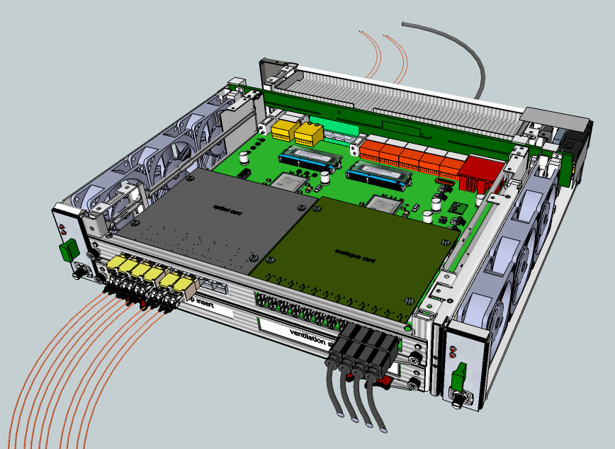
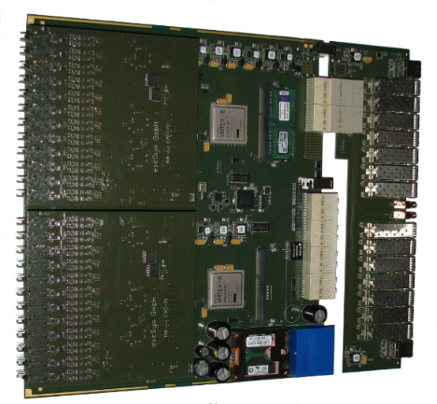
SRS ATCA
Meshed backplane
(6 Gbps, 100Ω links)
ATCA Minicrate
2 slots for SRS blades
shelf manager
RTM (rear Transition Module)
10 GB Ethernet, 3 GB SFP
SRS ATCA blade
2x FPGA LX240, 2 mezzanine slots
2x
SRS mezzanines
Left: optical
Right: ADC/HDMI

Slide 17
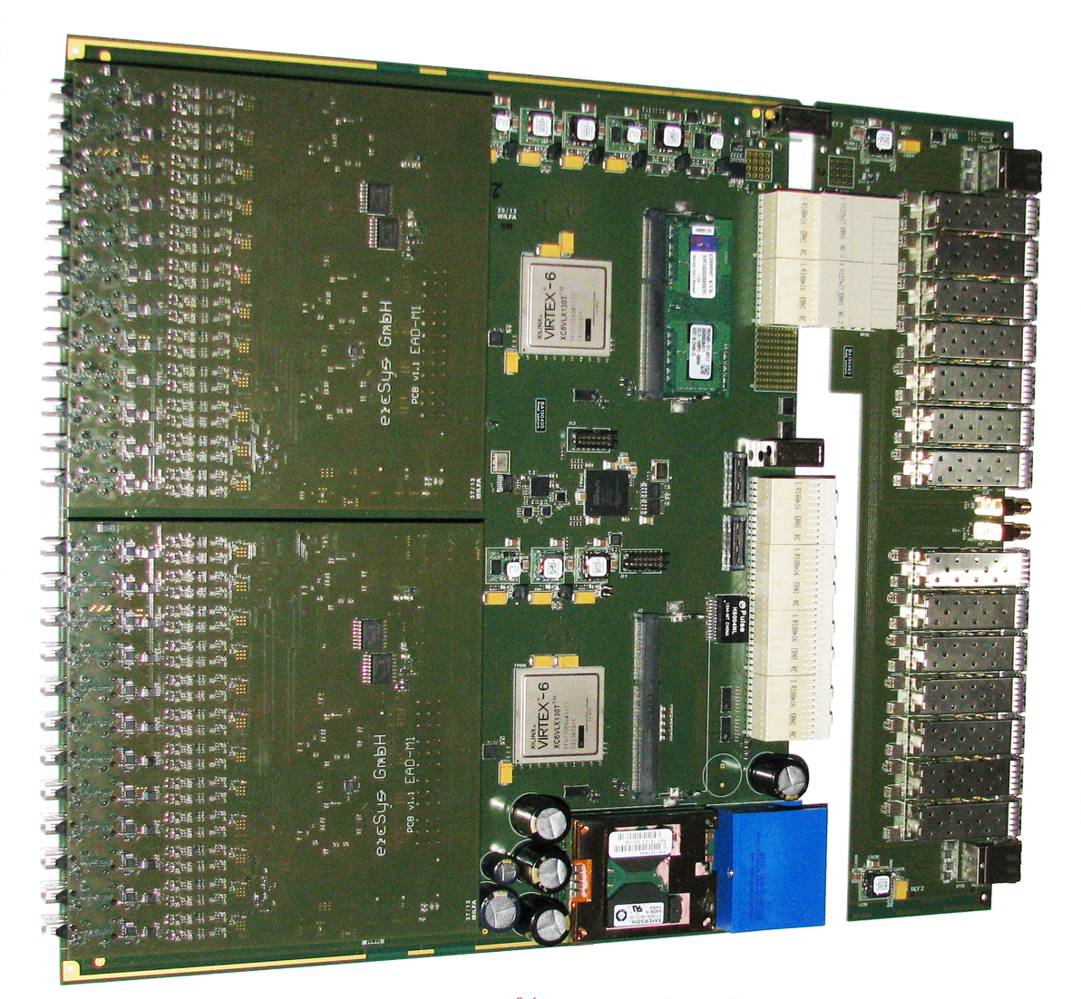
SRS ATCA overview
Blade main board:
2 x Virtex 6 LX240 FPGA
2 x DDR3 plugin
2 x mezzaine ports
RTM I/O card:
2 x 8 SFP+ ports
( 2x 10 GBE FPGA, 2 x 7 4Gbps to mezzanines)
2 x Rj45 (1 DTCC to each mezzanine)
2 x NIM (SMA)
ATCA Zone 3
RTM comemctor
2 x Mezzanines (ADC):
2 ADC mezzanines:
up to APV 6144 channels
ATCA Zone 2
backplane connectors
ATCA zone 1 power connector

Slide 18
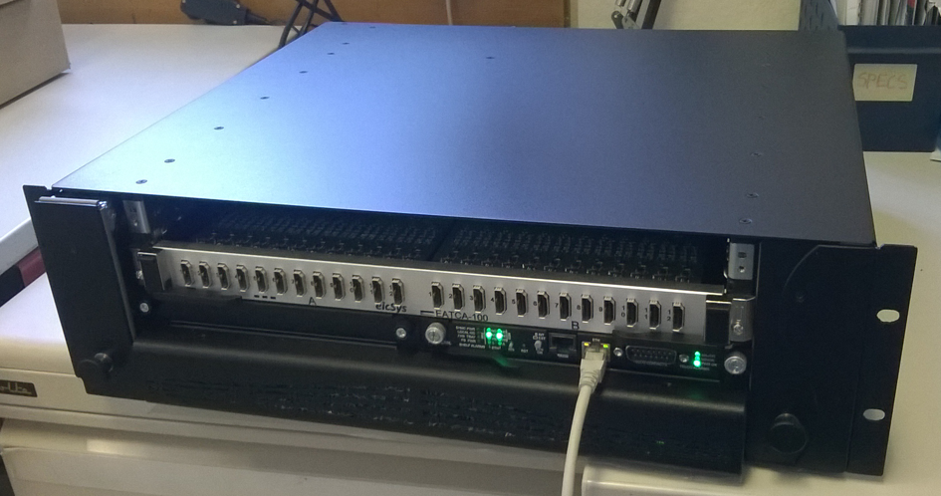
ATCA - based SRS
ATCA industry standard crates of different size
Very high-speed linked backplanes between blade-slots
3 x channel density compared to FEC
FEC => Blade with 2 x Adapter plugins
Adapter card=> mezzanine card
Photo SRS Minicrate with 1 blade, 24 HDMI ports for 6 kchannels

Slide 19
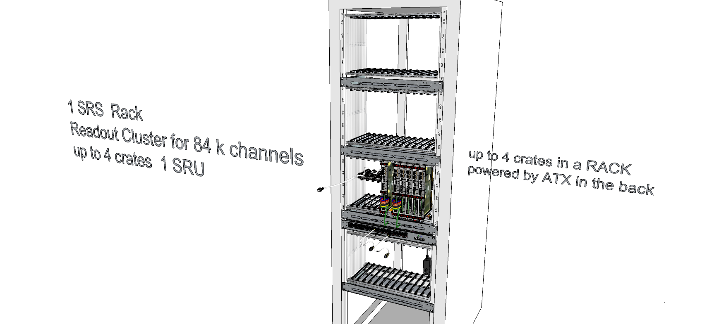
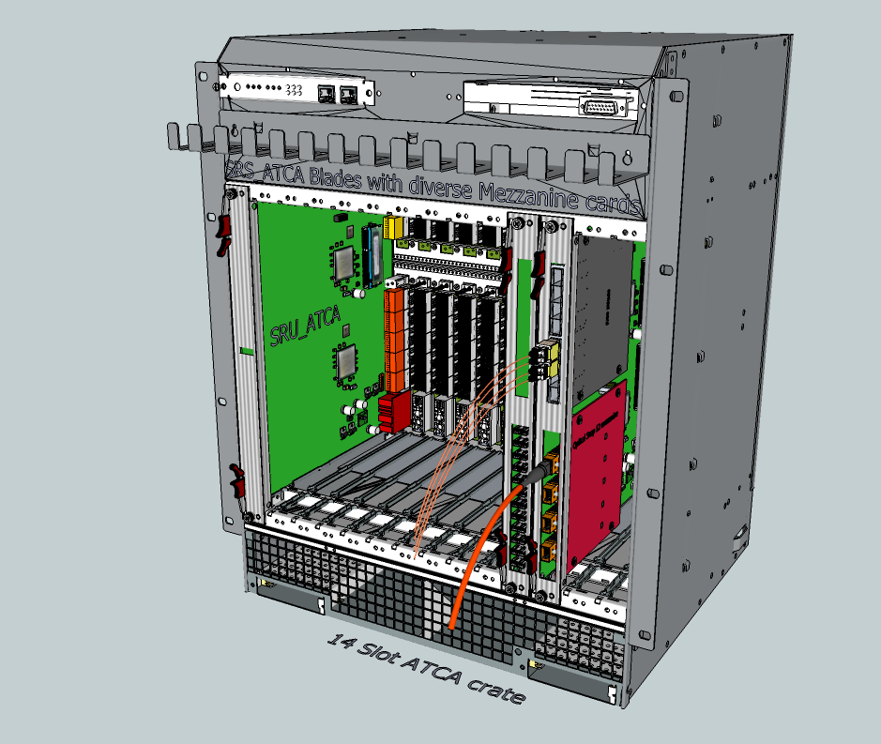
SRS Classic versus SRS ATCA
80 k APV channels 4 Eurocrates crates
in a Rack with SRS Classic
80k APV channels in one single 14 slot ATCA crate
with ATCA SRU in slot 1
ATCA:
3 x channel density
FECs, ADC, SRU available
Eurocrates for 8 FEC/ADC require ATX
power upgrade
ATCA blades, RTMs and ADC mezzanines are available
ATCA SRU is a planned design

Slide 20
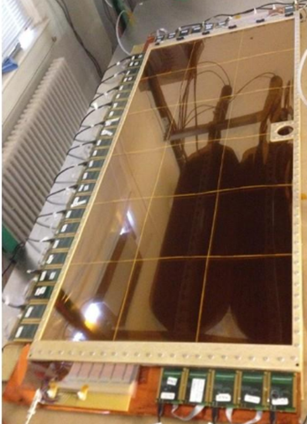
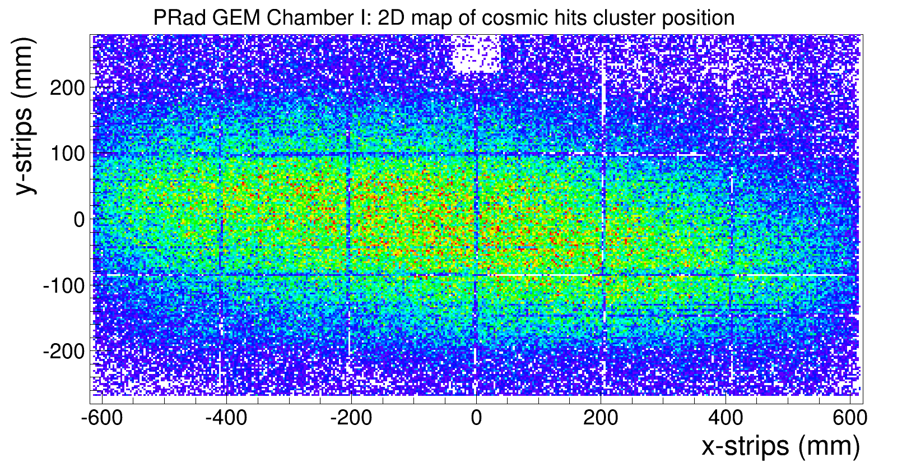
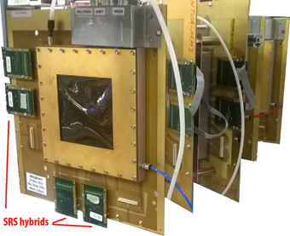

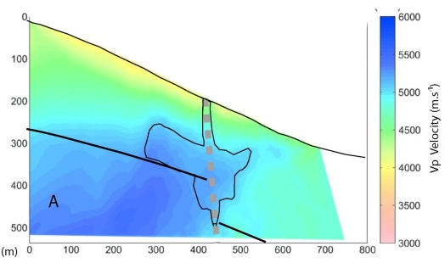
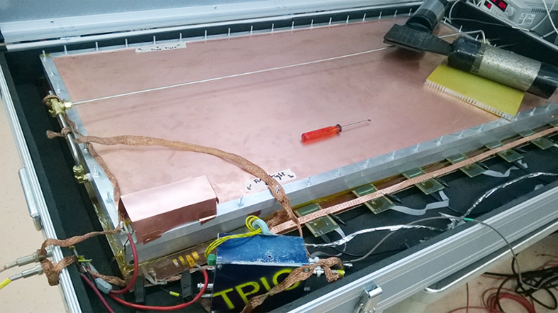
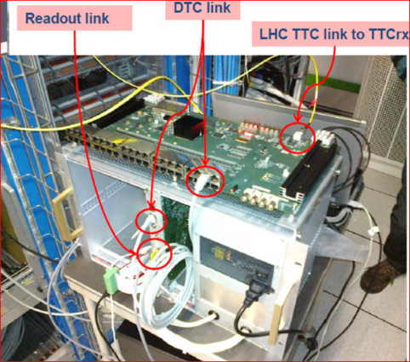

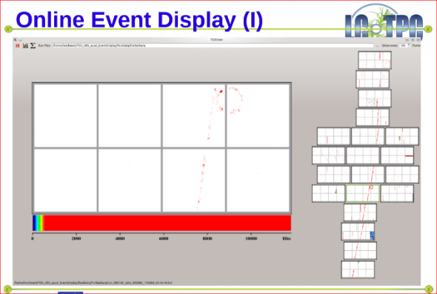
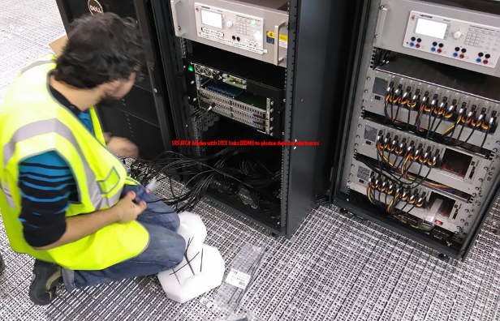
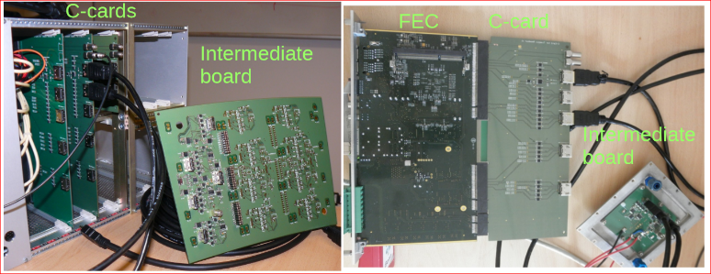
SRS in Experiments
Detector telescope with SRS readout
@testbeam 2016
PRad GEM with SRS- APV frontend @ UVa
Large surface MUST detector
with SRS Classic and APIC trigger
NEXT Collab. SRS-ATCA with photon
Detector frontend
SRS Totem: optical readout DTC
SRS with Timepix frontend

Slide 21
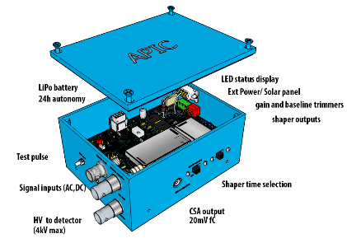
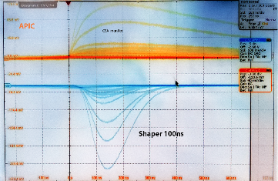
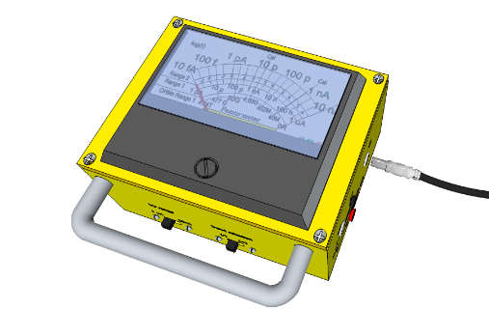
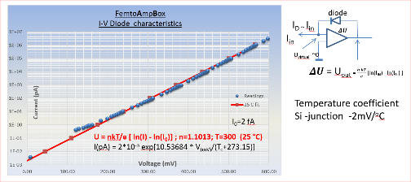



SRS service electronics
APIC: preamplifier -shaper box, solar chargeable
Femto: Femto-ampere meter with realtime signal output
AVD: Active Voltage Divider / generator for MPGD’s
..and more

Slide 22
Where to GET SRS
believe it or not, this was and still is, the most difficult about SRS
SRS procurement until 2016
INHOUSE production RD51 ( basically all early systems )
CERN Store ( from produces like Prisma, NEOHM etc ) https://edh.cern.ch/Document/SupplyChain/MAG
  AVP hybrids, FEC + ADC cards, Minicrates, HDMI cables, SRS accessories
  However !!! Only via team account, delivery only to CERN, APV purchase restrictions
EicSys http://www.eicsys.eu/
  ATCA crates, blades, RTM cards; ADC mezzanines
  However !!! No hybrids, waiting for news and testbeam qualification
  NEXT and ATLAS NSW users have their your own experts for SRS ATCA
SRS procurement from 2017+
INHOUSE production RD51: stopped
CERN Store: continued
EicSys: no change reported
NEW SRS production licencies* 2017
SAMWAY Electronics: http://www.samwayelectronic.com
FEC and ADC cards, Eurocrates, SRS-ATCA
mezzanines
SRS Technology: http://www.srstechnology.ch
VMM hybrids, DVMcards, SRU, APIC, AVD, Femto

Slide 23
more possibilities
… possible with active support and collaboration from your team
For example:
optical 3D frontend with CMOS cameras or Timepix-3 chips ( >> 10 kHz frame-rate )
multichannel, low noise photodetector frontend ( APD's, SiPMs, MPCCs etc )
calorimeter frontend with up to 16 bit dyn. range ( high/low gain channel hybrids )
SRS sensor frontends via I2C with new HRS connector ( pressure, temperature, position, currents, gas purity, UV ps pulser, etc )

Slide 24
SRS Resources and references
SRS documents and binaries database https://espace.cern.ch/rd51-wg5/srs
RD51 electronics school 2014 https://indico.cern.ch/event/283113/
MPGD Applications beyond Fundamental Science, 18 RD51 Collaboration meeting Aveiro 2016
https://indico.cern.ch/event/525268/timetable/#20160912
S. Martoiu, H.Muller, J.Toledo, Front-end electronics for the Scalable Readout System of RD51
IEEE Nucl. Sci. Symp. Med. Imag. Conf. (2011) pp.2036-2038.
K. Gnanvo et al.,
Detection and Imaging of High-Z Materials with a Muon Tomography Station Using GEM Detectors
Nuclear Science Symposium Conference Record (NSS/MIC), Nov. 2010 IEEE
J. Toledo et al., The Front-End Concentrator card for the RD51 Scalable Readout System,
2011 JINST C11028.
S.Martoiu, H.Muller, A.Tarazona, J.Toledo,
Development of the Scalable Readout System for Micro-pattern gas detector and other applications,
2013 JINST 8 C03015
Ignacio Lázaro et al.
Muon telescope based on Micromegas detectors: from design to data acquisition,
IDUST 2014
R. Esteve et al., Readout and data acquisition in the NEX-NEW detector based on SRS-ATCA
2015 JINST C01008
Gianluigi De Geronimo et al, VMM2 - An ASIC for the New Small Wheels,
TWEPP 2014 – Aix en Provence, France, September 2014

Slide 25
Backup slides

Slide 26





MPGD-detector-specific hybrids and accessoirs
128 channels for 0.4 mm
continuous pitch
Typical desktop
MPGD detector*
Panasonic 130-pin socket
on detector
header on hybrid
Gas connector
Master
(has HDMI)
Slave
no HDMI
9 mm above detector
detector plane
M-S flat cable
10 cm:
SAMTEC FFSD-08-D0401N
20 cm:
SAMTEC FFSD-08-D0801N
Master-Slave = 256 channels
per HDMI A-D readout cable
(Farnell 1786338 )
power via HDMI
MMCX click-in Ground system
on detector and hybrid, stackheight 6.5 mm

Slide 27
DTCC link protocol
DTCC Tx
DTCC Rx
Ch. request
Framing Control
Framing Detection
Flow control
ctrl
commas
High Priority ch.
Trigger/Busy/..
Latency correction
8b/10b
8b/10b
Low Priority ch.
Data / Contrl
Time multiplexed DTCC link
Trigger, Busy, Clock = high priority and low latency
Data = low priority
Controls = Ethernet frames @low priority

Slide 28


Frontend link (DTCCP)
HDMI-D (micro)
SRS uses HDMI cables A-D
for connection of frontends to
SRS
DTCCP =
Data uplinks
Trigger downlink
Clock downlink
Controls bidir I2C
Power 5V max. 1A
For distances 25m< L <150m
➔ active HDMI links
copper/ fibre under tests
HDMI-A

Slide 29



Scalable Readout Unit (SRU)
designed for use in magnetic field:
Alu chassis, no transformers, no DC-DC
4 x SFP+ ports
3 x 3 Gbit
1 x 10 Gbit Ethernet XAUI
2 GB DDR3
4 x NIM in
4 x NIM out
Virtex 6
FPGA
TTCrx optical
PHOTO SRU
Jitter cleaner
TTC clock
40 x DTCC links
2 LVDS in, 2 LVDS out
4 x LVDS
horizontal synchronization and Trigger
Hans.Muller@cern.ch

Slide 30


VMM issues
3x power of APV frontend: direct powering via HDMI is limited in length
VMM Power and HDMI repeater box for long HDMI links is under works
VMM requires cooling on the detector:
cooling strategies under discussion
Standard MPGD connector ( Panasonic 130 pin obsolete)
=> new connector for both MPGD detector frames and VMM3 hybrid in 2017
New 140 pin connector for VMM

Slide 31
SRS history RD51
SRS, 2009+ standard readout system for MPGD detectors ( GEM, MM, etc)
CERN made MPGD detectors come with SRS connectors for SRS hybrids
2010+ SRS crates, electronics, accessories available trough CERN store
Firmware, Software and Manual download from RD51 server
DAQ systems : DATE (default), Labview
O(100) deployed small and medium-sized SRS systems

