Slide 1
RD51 test facilities
E. Oliveri (CERN) on behalf of RD51

Slide 2
RD51 Common Facilities @ CERN - Outlines
Common Laboratory
Common Test Beam – Semi-Permanent Installation
Access to CERN Facilities

Slide 3
Common Laboratory
A common place where projects based on different MPGD technologies can perform their activities in close contact.
Fully devoted to detector R&D and measurements, no production activities involved.
Main subject: Detector Physics

Slide 4
How it is practically used…
Two main types of installation:
    Permanent (Long Term Projects)
    Temporary (on different time scale)
Rough averaged occupancy: about 5-10 persons everyday in the lab, one external group every one/two months.. Very rough, just to give some feeling

Slide 5
Permanent Installations
Long Term Projects
    ALICE TPC (GEM)
    ATLAS NSW (mm)
    CMS high eta CMS (GEM) … moved to their own lab few years ago
    ESS NMX Instrument (GEM)
Workspace, infrastructures and support if needed
Directly involved in the daily management of the laboratory.
Completely independent.

Slide 6
Temporary Installations… different types
Experienced groups that have to perform specific measurements.
Support during the installation.
Normally one week, almost independent once familiar with the lab.
Groups (with different level of MPGD expertize) with a well defined ongoing project coming to the laboratory for detector optimization or troubleshooting.
Support on defining and performing measurements. Support on detector optimization.
It can go up to few months, with a support tat is normally fading out with time.
Groups that are approaching for the first time MPGD based detectors
Introduction and training, det.assembly/operation/characterization, support on det. design, on setting up measurements and laboratory.
Normally few weeks, with the obvious need of constant support, that normally evolves into remote support.
Important requirement for the lab: flexible and dynamic…

Slide 7
Common Developments
(where the laboratory framework is directly involved)
Internal development - Coming from members of the collaboration
  Electronics: See H. Muller talk and Working Group 5 related activities
  Software: DAQ, DCS, Instrumentation control and readout,…
External Development - Interaction with Companies:
  MPGD producer
  Electronics (CAEN, eicSys,..)
Knowledge Dissemination
Laboratory equipment copy/paste
School & Visits

Slide 8
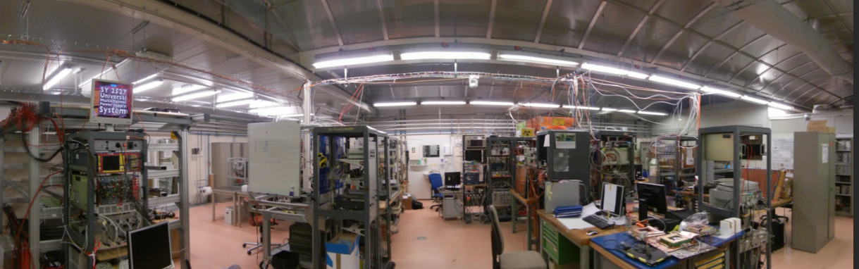
Hosted in the CERN EP-DT-DD Gas Detector Development (GDD) laboratory.
[Charpak→Sauli → Ropelewski Group]
EP-DT-DD GDD Laboratory (Detector R&D) – Bdg. 154/R-007

Slide 9
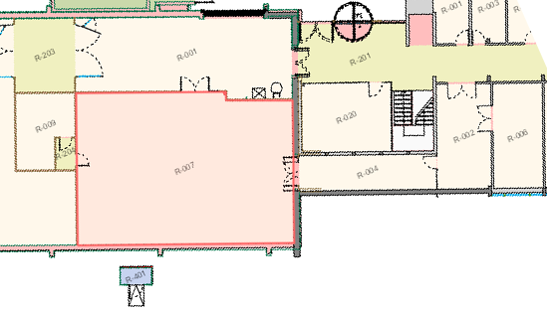
Strategically located (i.e. @ CERN) from MPGD point of view
2nd Clean Room
(20m)
NA test beam facility
(~5km)
Thin Film and Glass Laboratory (100m)
Micro Pattern Technology Workshop (20m)
1st Clean Room
(17m2)
Meeting & Visitors Room
GDD/RD51
Laboratory (140m²)
Small Workshop (Electronics/Mechanical)
Std. and Flammable Gas Point

Slide 10
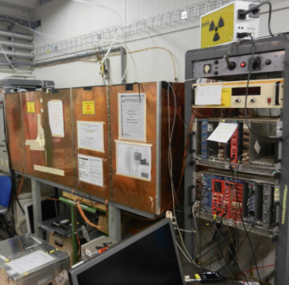
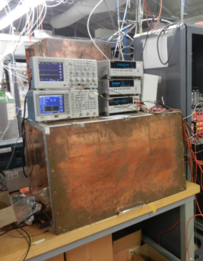
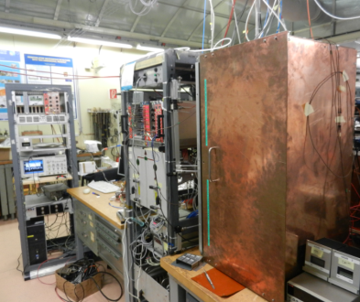
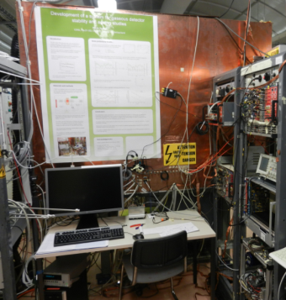
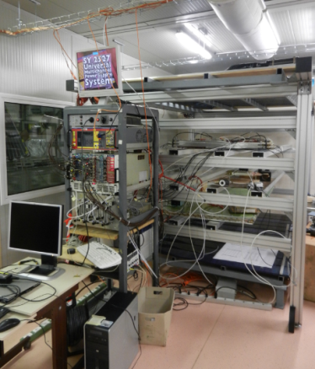
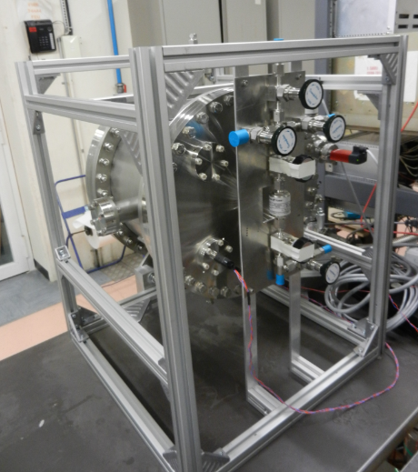
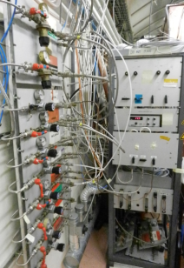
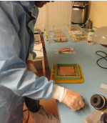
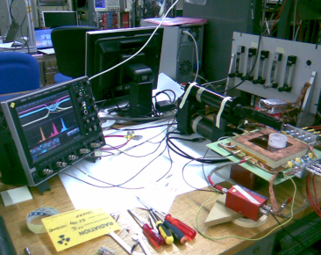
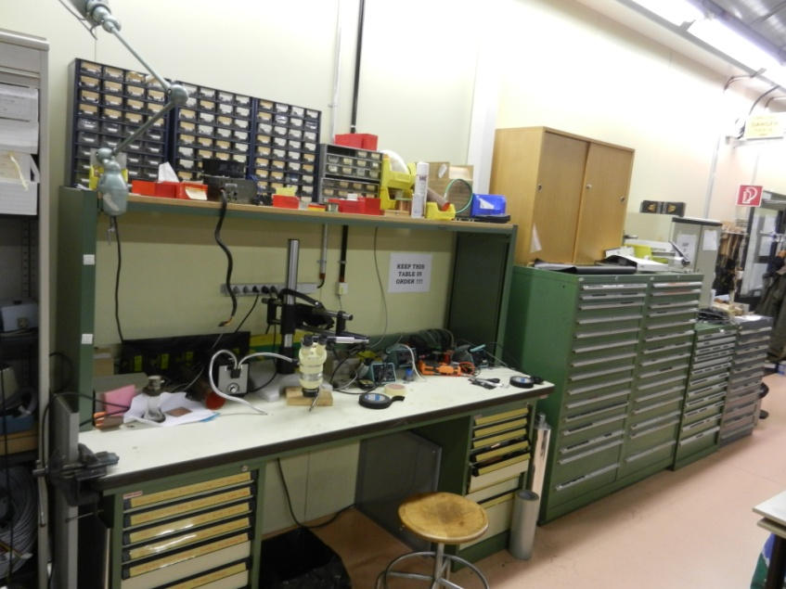
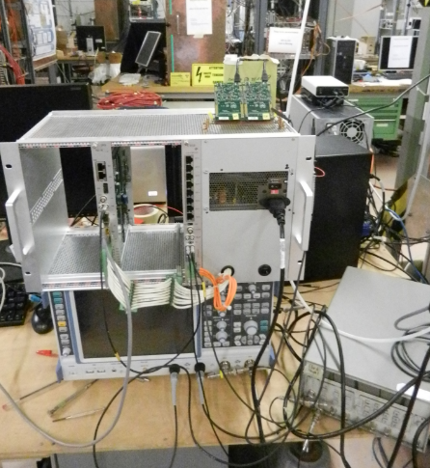
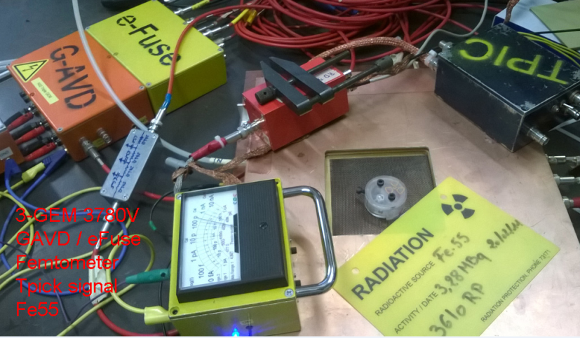
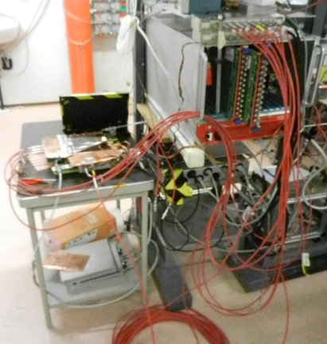
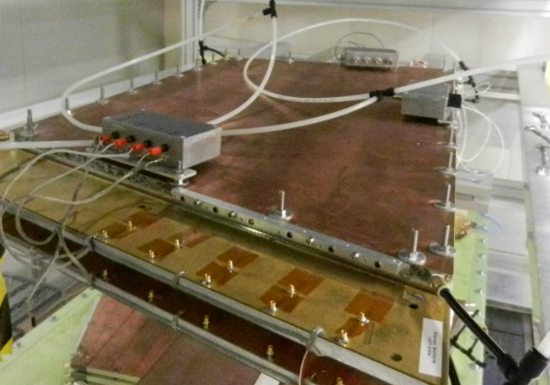
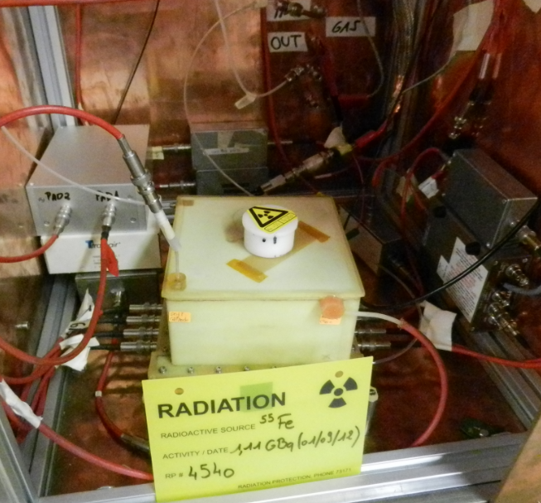
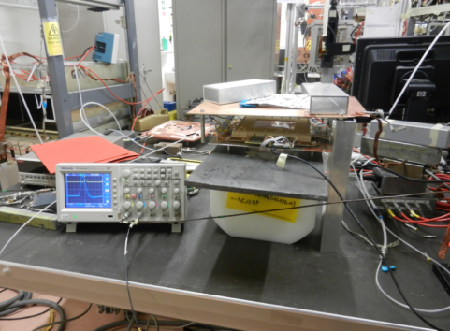
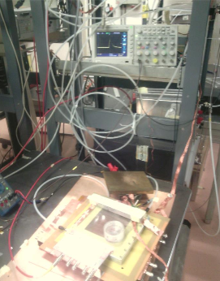
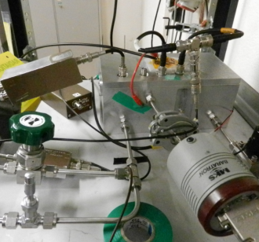
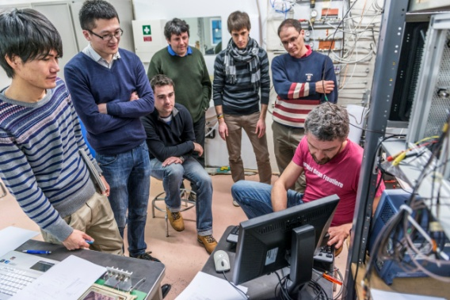
Cosmic Stands
Vacuum System
Gas System
(flammable)
Active (X-Ray) and Passive Radioactive Sources
Clean Room
Working Station
Workshop (M&E)
Electronics Development (Instrumentation and Readout Front End)
Permanent Users (ALICE, ATLAS, ESS) working station
Temporary Users Working station
Schools

Slide 11
Test Beam
North Area (H4) - Semi permanent Installation

Slide 12
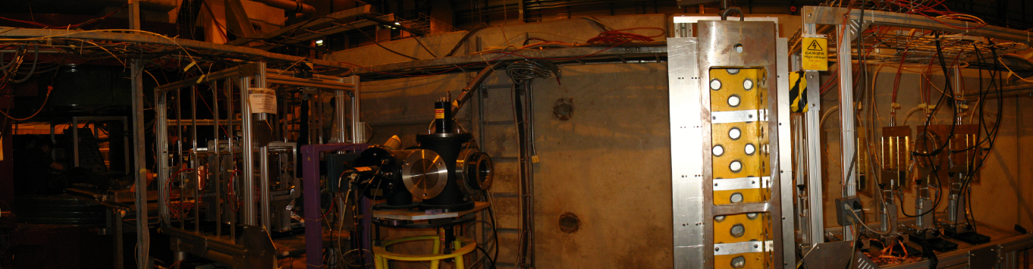
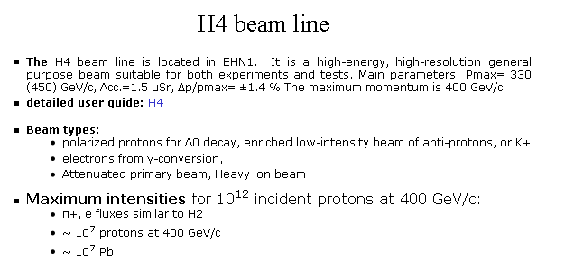
http://sba.web.cern.ch/sba/BeamsAndAreas/resultbeam.asp?beamline=H4

Slide 13
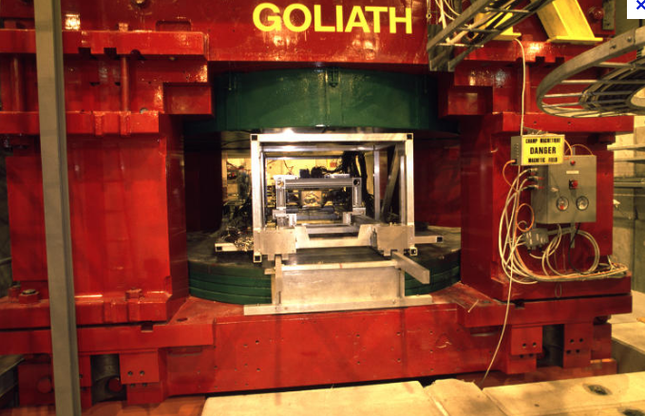
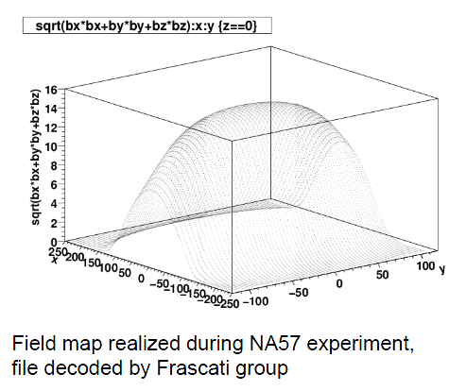

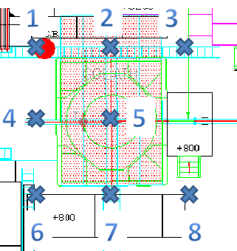
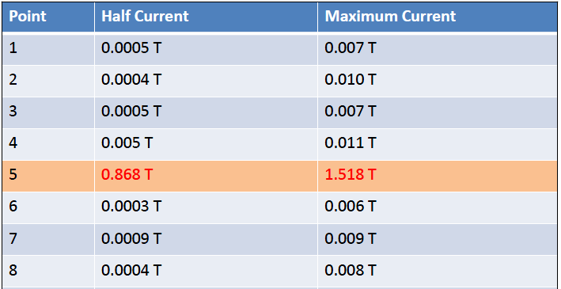
http://ab-div-po-mpc.web.cern.ch/ab-div-po-mpc/Pages/SPS_EA/Spectro/Goliath/Goliath.htm

Slide 14
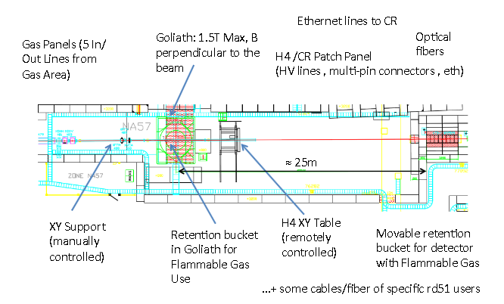
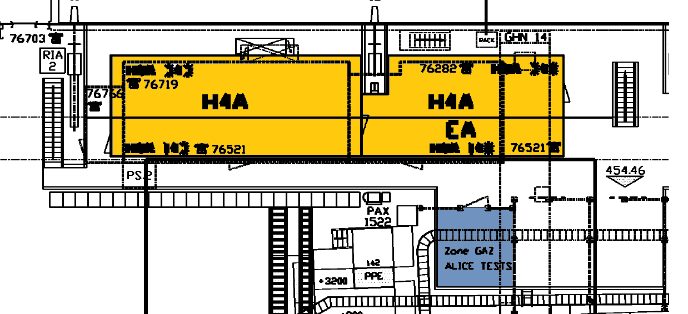
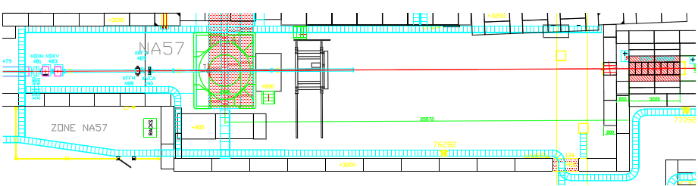
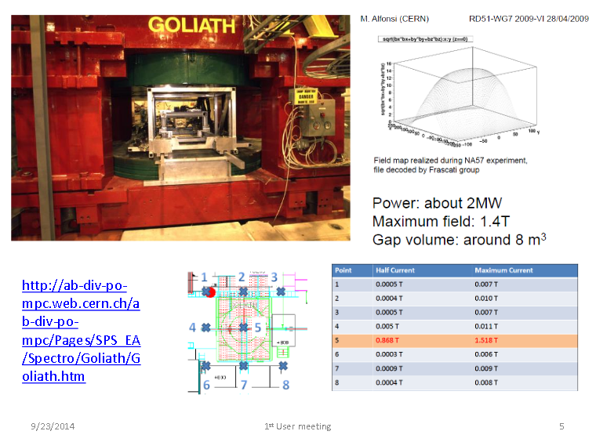
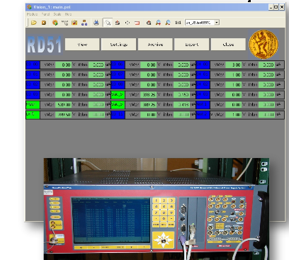
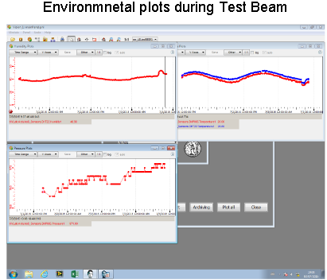
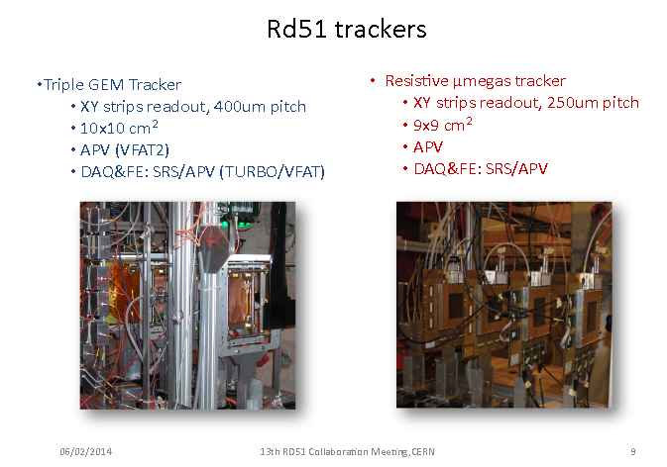
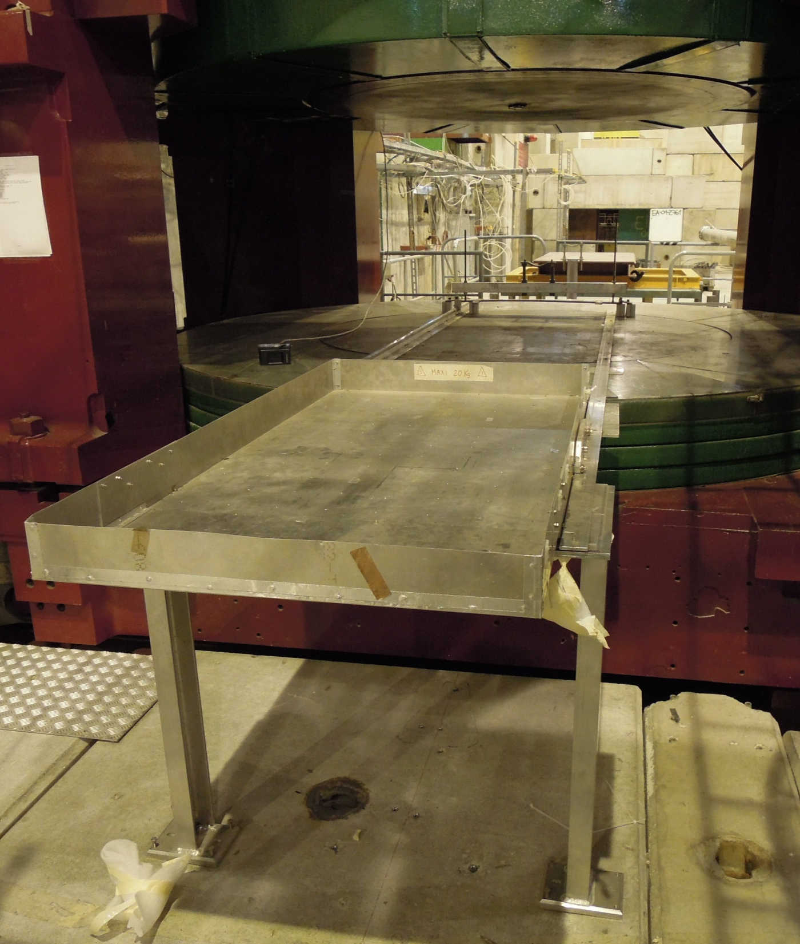
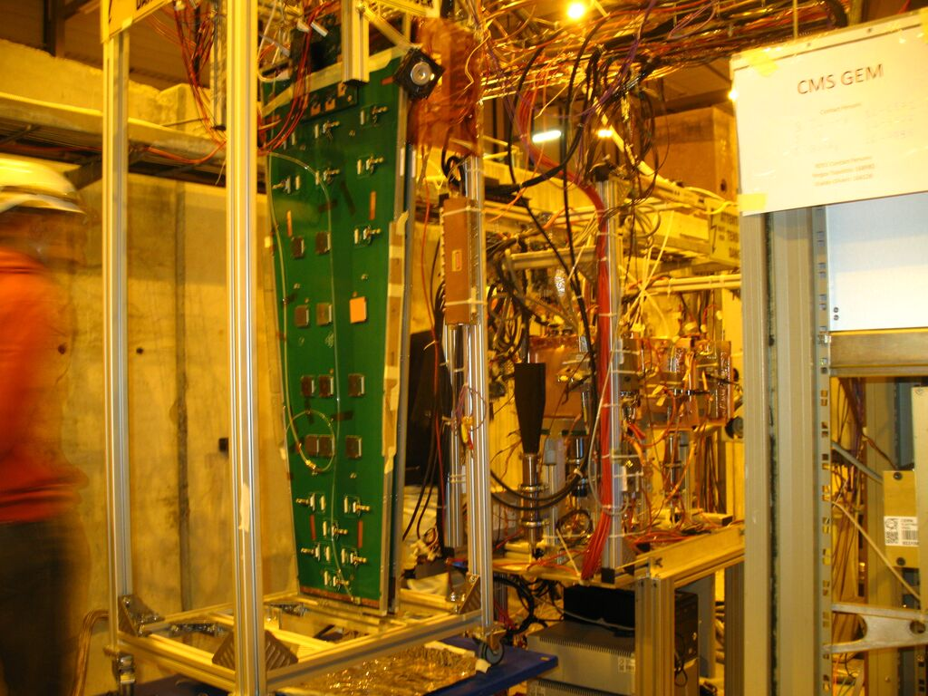
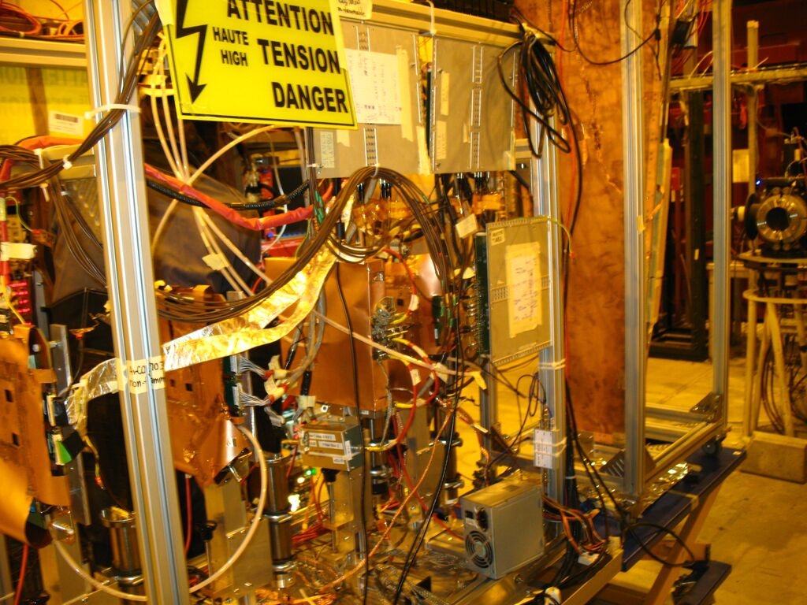
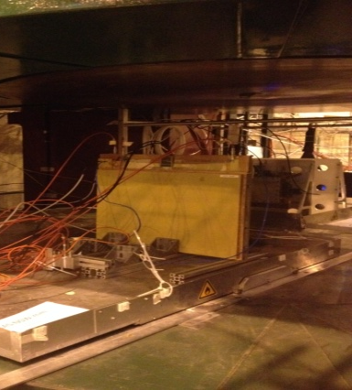
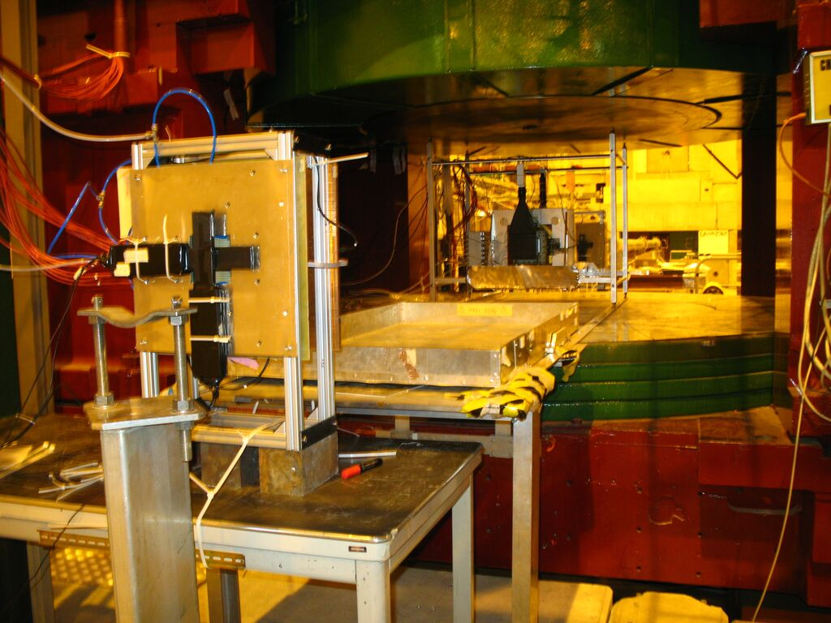
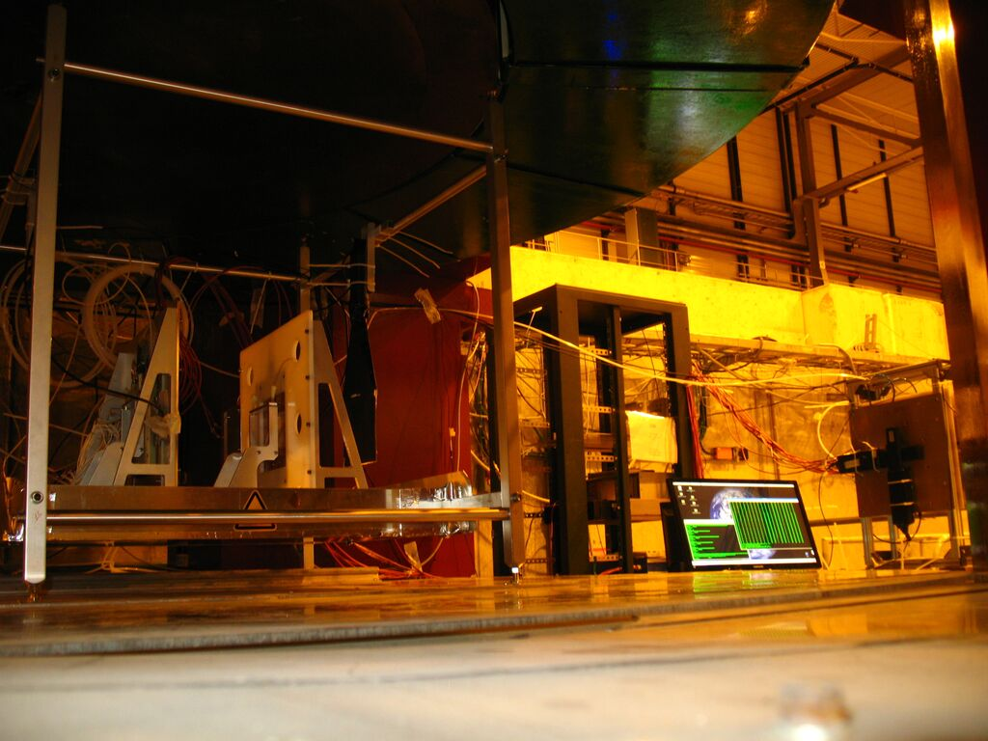
Semi permanent installation EHN1-H4 (SPS North Area)
Three periods of two weeks each per year, about fifteen-twenty users per year
Control Room
Gas Zone
Storage Area
Infrastructures (gas, HV, LV, sensors,…)
Experimental Area
(H4)
Mechanical support (Miranda)
Goliath Magnet
(1.5T max)
RD51 DCS (Control and monitoring)
RD51 Trackers and SRS/APV25 DAQ
RD51 test beam, November 2015
,
CMS (GEM, FTM), ATLAS (NSW resistive mm), LNF(μResWELL), BES3(GEM), SHIP(emulsions & GEM)

Slide 15
How it practically works…
A common request is sent every year to the SPS coordination based on “expression of interest” from the member of the collaboration.
Normally: three periods of two weeks each – spring, summer, fall. Always accepted by the SPS, always used with an average presence of 4 groups per period.
Main user periods are given to each group according to a rotating shift schedule (about 8h shift). The beam condition normally allows each user to run during the main user period of the other groups. Users has to carefully evaluate this point to be sure that they will be ale to complete their measurements in these conditions.
The collaboration is ready to provide support for the measurements (gases, triggering and tracking system, detector slow control, powering system (HV/LV), readout electronics, mechanical support,…) if needed.
Safety, infrastructures, services, handling in the area… everything is managed by the collaboration in a common way, simplifying the efforts for each group and for the facility itself.

Slide 16
What is priceless…
Daily meeting and continuous discussion during the beam between the groups on…
    Detector physics..
    How to perform specific measurement or implement new ones..
    Interpretation of preliminary results..
    Trouble shooting..
    A common laboratory @ few km
A large community and expertize available “on-fly”

Slide 17
Access to CERN Facilities

Slide 18
CERN Facilities
Contacts and facilitating access
CERN Irradiation Facilities & alternative beam lines…
CERN gas group…
Materials and Metrology Services (SEM, EDS,..)…
Bonding lab…
Access to specific instrumentation or measurement tools (X-Ray radiography, thermo-camera, chemical analysis,… ) available at CERN
…..
Very important for groups not familiar with CERN

Slide 19
And finally….Common “coffee break”
Most efficient way of knowledge/technical transfer, sharing, troubleshooting, new ideas, start-up of collaborations…
Very important for groups not familiar with CERN everybody

Slide 20
Thanks

