Slide 1

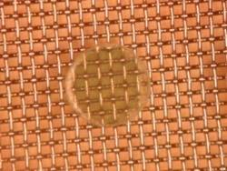
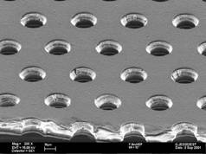
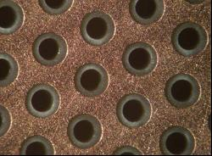
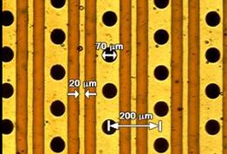
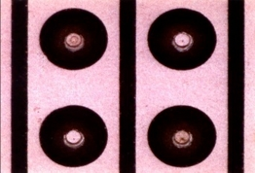
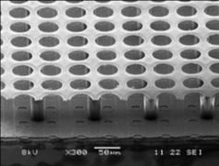
Introduction to the RD51 Collaboration
Theodoros Geralis,
NCSR Demokritos, Greece
On behalf of the
RD51 collaboration
OUTLINE
RD51/MPGD history
Organization/Infrastructures
Technological achievements
Applications
Workshop on Neutrino Near Detectors based on gas TPCs
CERN, 8-9 Nov. 2016

Slide 2
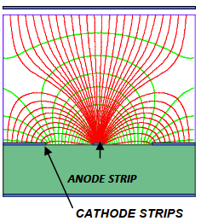
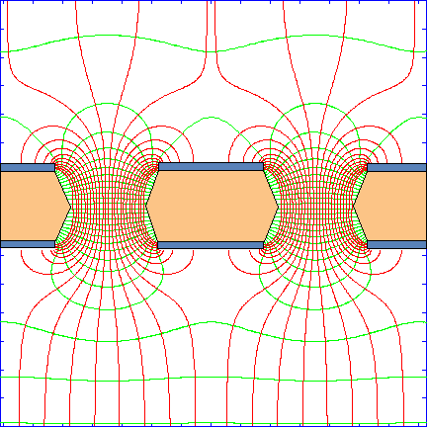
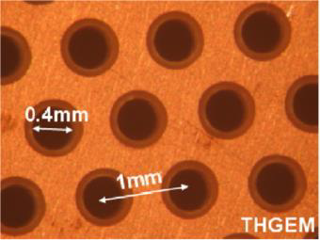
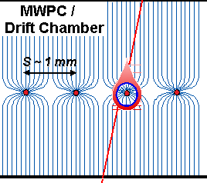
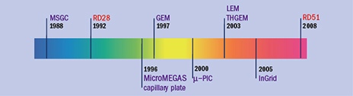
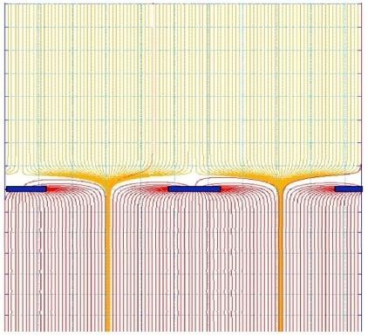
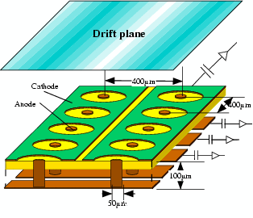
From Multi-Wire Proportional Chambers to Micro Pattern Gaseous Detectors
MSGC: Oed 1988
GEM:Sauli 1997
Rates: ~10⁶Hz/mm²
But: Sparks,
irreversible damages
~50 μm
~50 μm
Rates: >10⁶Hz/mm²
σ_{Spatial} ~30μm
MWPC: Charpak
1968
RD51 Collaboration:
86 Institutions
500 Scientists
~50 μm
Rates: >10⁶Hz/mm²
σ_{Spatial} ~30μm
~100 μm
Micromegas:
Giomataris 1996
μ-PIC
Ingrid

Slide 3
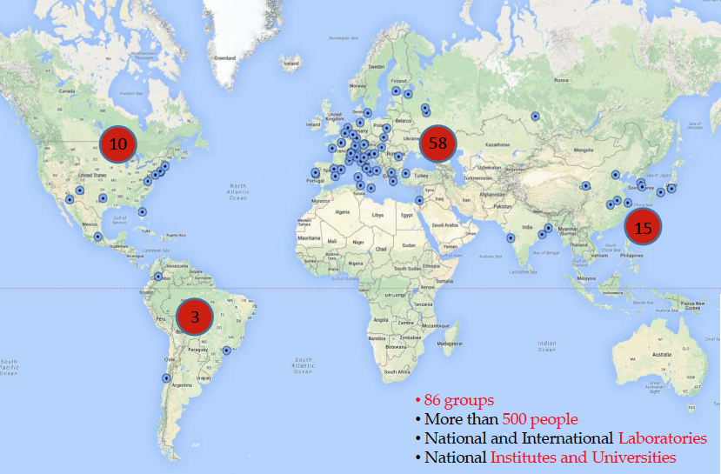
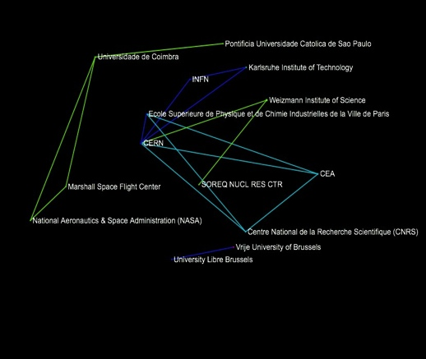
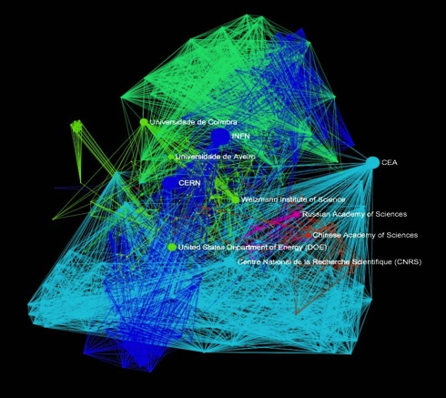
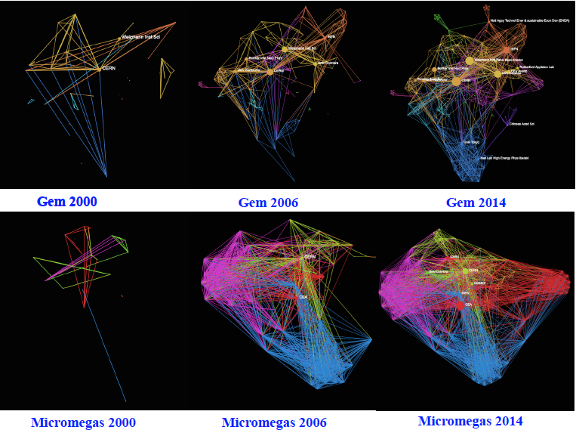
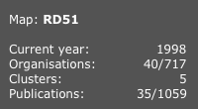
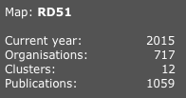
The RD51 Collaboration
Main objectives:
MPGD technological development
  Provide the collaboration framework
  Develop common simulation
  packages
  Develop common read out electronics
Access to “MPGD know-how”
Foster Industrial production
→ huge growth in interest in the MPGD
technologies
Collaboration Spotting Software: http://collspotting.web.cern.ch/)

Slide 4
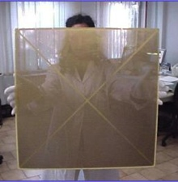
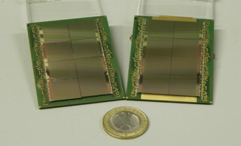
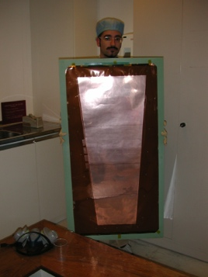
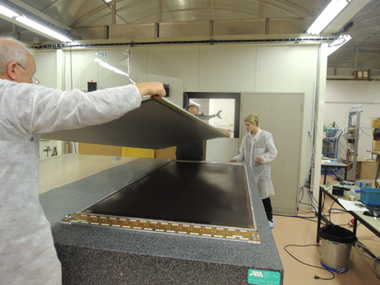
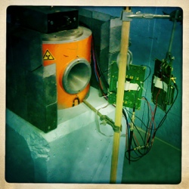
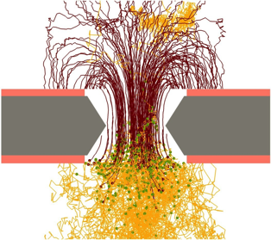
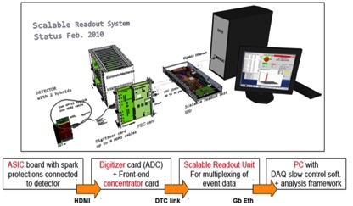
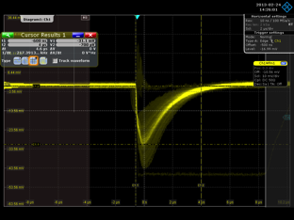
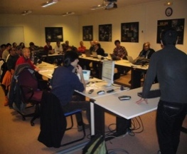
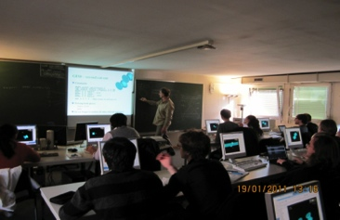
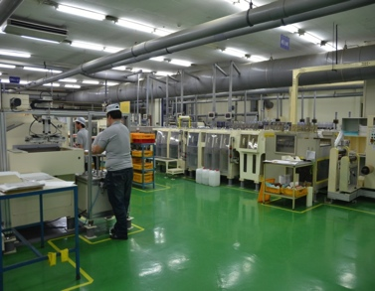
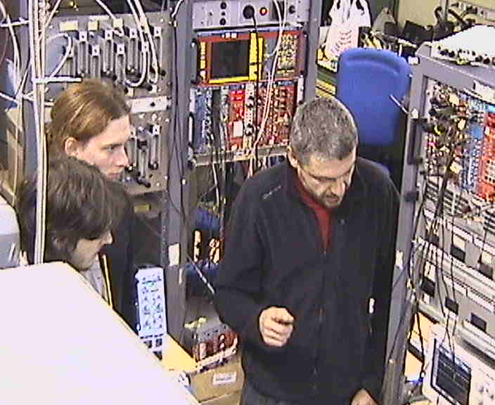
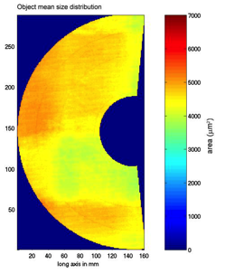
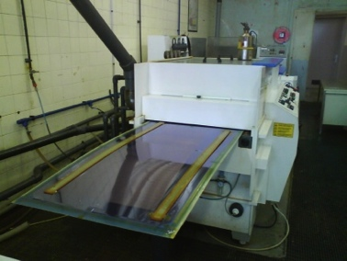
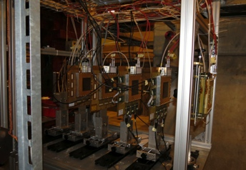
The RD51 Collaboration: Working Groups
Technological Aspects
New Detector Structures
Detector Physics and
Performance
RD51 Common Projects
WG2:
WG1:
WG5:
RD51
MPGD Electronics
Modeling of Physics Processes
Software Tools
WG4:
WG7:
WG6:
Applications, Training
and Dissemination
WG3:
Common Test Facilities
Production and Industrialization

Slide 5
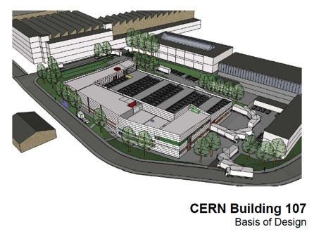
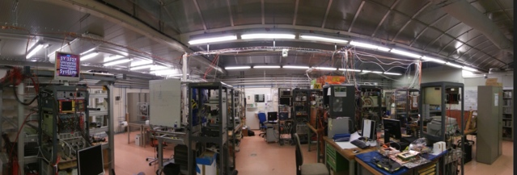
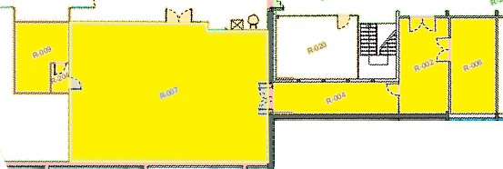
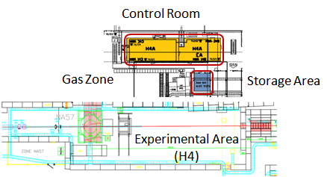
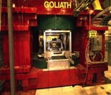
RD51 related infrastructures:
EP DT MPT Workshop (Head: Rui De Oliveira)
The heart of the MPGD Globe: Design, prototyping, production
New infrastructure (building, MPGD production machines, clean room etc) will be soon ready
2) GDD Laboratory (RD51)
The Detector R&D laboratory:
- Permanent users (ALICE, ATLAS, ESS)
- Temporary Users stations
- Cosmic stands, X-ray and radioactive sources
- Clean room, Workshop
- Vacuum and Gas System
- MPGD Electronics support
- 15 visiting groups, synergies with companies
3) Test Beam Area (SPS/H4 semi permanent RD51 area)
Laboratory (140m²)
Clean
Room
(17m²)
Workshops
Meeting/
Visitors
Room
GOLIATH
(1.5T Max, 1mt gap)
R&D for Experiment
HEP Experiments:
LHC upgrades
CERN & Others
Applications
Electronics
Organize test beam
3 times (2 weeks)/year
5

Slide 6
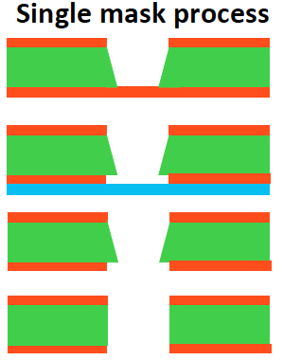
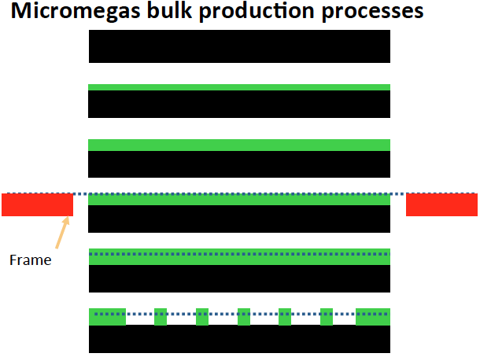
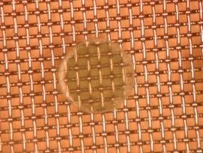
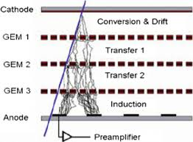
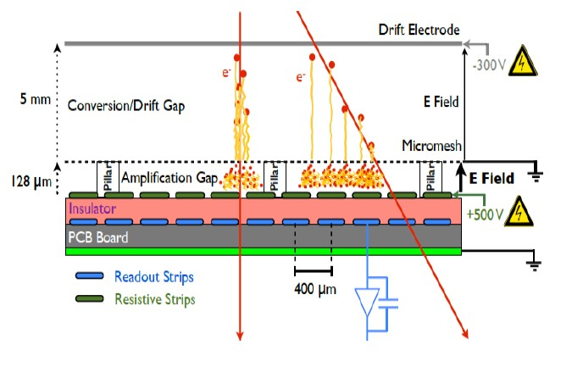
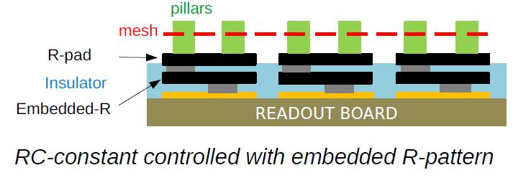
RD51 Technological achievements (I)
Large MPGDs production/industrialization of GEM, THGEM, Micromegas:
single mask GEM Bulk Micromegas
High rates and spark mitigation:
Staged Gain: multiple layers Resistive coating, buried resistors
GEM, THGEM, MHSP Micromegas, RETGEM, RPWELL

Slide 7
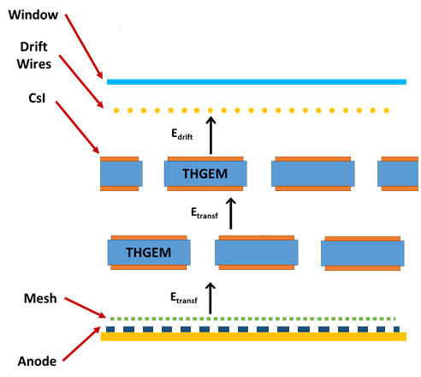
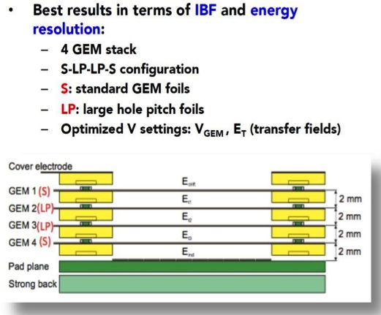
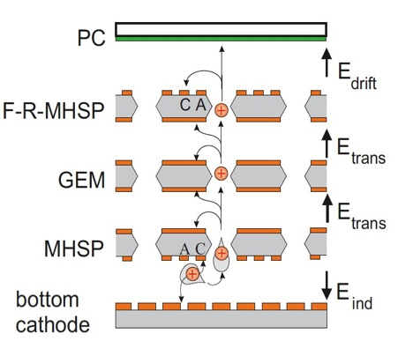
RD51 Technological achievements (II)
Ion Back Flow (IBF), Application in TPCs (field distortion) and
  photon detection (photocathode protection): Multiple Layers
  Hybrid: THGEM+ CsI and MM Multi layer GEM stack MHSP/GEM/F-R-MSHP
Radiation hardness
LHC MPGD Upgrades (ATLAS NSW project - Resistive Micromegas and CMS GEM
muon chambers) proven to withstand the equivalent of 10 years of operation at the
HL-LHC. Irradiation with: neutrons, X-rays, α and β.
Staggered THGEMs
COMPASS RICH
ALICE TPC
IBF ~ 5. 10⁻²
IBF ~ (5 – 25) . 10⁻³
IBF ~ (1-3) . 10⁻⁴

Slide 8
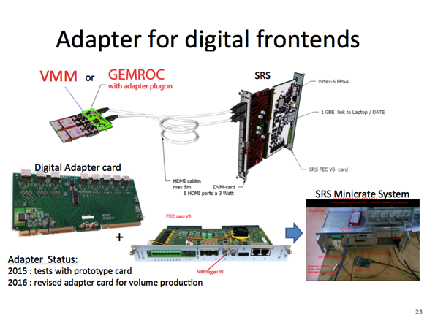
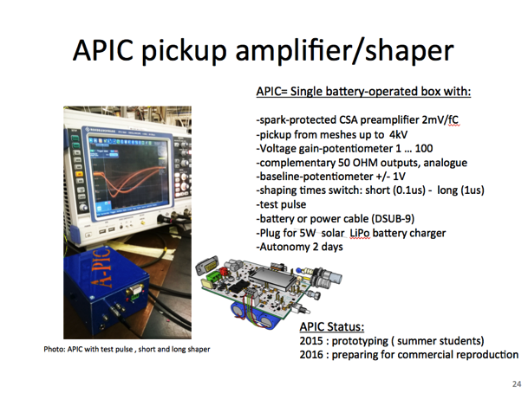


RD51 Technological achievements (III)
Sealed detectors (purity) for space and non-laboratory applications
Physics simulations and tools
  Software tools: Magboltz (transport equations), Degrad (cluster size), Garfield++
  (speeding up), optimization of charging up simulation
  Modeling of Physics processes: Penning in Ne mixtures, CO2 impact, GEM gas gain
  dependence on hole diameter, impact of mesh geometry to micromegas
Read-out electronics
  Scalable Readout System: Development of the readout system for MPGDs adaptable
  to various FE ASIC chips (APV25, VMM2, GEMRoc)
Development of generic electronic devices for MPGDs:

Slide 9




Generic Detector R&D

Slide 10
MPGD Technologies for Present and Future:
Hadron / Nuclear Physics Experiments-Heavy Ion Facilities
High Energy Physics
Hadron / Lepton Colliders
Photon / Neutron Detection
Neutrino Physics / Dark Matters Detection
X-Ray Detection and γ-Ray Polarimetry

Slide 11



















MPGD Technologies: LHC experiments Upgrades
Challenges: Ultra high rates, radiation harsh environment, longevity, large area detectors
Present:
TOTEM (GEM), LHCb (GEM)
Future:
ATLAS Muon System NSW (μΜ), Muon tagger μ-PIC, CMS Muon System (GEM), ALICE (GEM TPC), FCC Collider (GEM, THGEN, Micromegas, μ-PIC, InGrid)
ATLAS NSW (mm)
CMS (GEM)
ALICE (GEM)

Slide 12




MPGD Technologies: Hadron and Nuclear and Heavy Ion Physics experiments
Challenges: Ultra High rates, IBF
Present:
COMPASS (GEM, μMegas, THGEM RICH), rates: 100kHz/mm²
First experiment to use MPGDs (GEM, Micromegas and recently THGEM)
KEDR (GEM), Rates: 1MHz/mm²
CLAS12: Cylindrical MM
Future: JLAB: SBS, pRad, SoLID (GEM, NP, tracking), JPARC: E42, E45 (Hadron Physics, ACTAR TPC
The ACTAR TPC Project
Cylindrical GEM for BESIII Experiment @ e+e- collider Beijing
(gas is used as a secondary target for nuclear reactions):
Goal: Nuclear structure with rare-isotope beams
¹²C breakup
J. Pancin
MM-based readout
⁴He(¹²C,3α)⁴He

Slide 13



MPGD Technologies: Photon detection
Challenges: IBF photocathode protection
Present:
COMPASS (THGEM RICH)
Future: JLAB: SBS, pRad, SoLID (GEM, NP, tracking), JPARC: E42, E45 (Hadron Physics, ACTAR TPC
MWPC’s + CsI
Hybrid: THGEM+ CsI and MM
Staggered THGEMs
F. Tessarotto
mass production ongoing
After a long-term fight for increasing electrical stability at high rates: MWPC robust operation is not possible at
gain~10⁵ because of photon feedback, space charge & sparks
PMTs not adequate → only small demagnification factor allowed; 5 m² of PMTs not affordable.

Slide 14







MPGD Technologies: Neutron detectors (ITER spallation sources,
Macromolecular Crystallography
Beam diagnostics)
Challenges: Low mass detectors
Present:
nTOF
Future:
ESS (macromolecular crystallography, neutron scattering)
nTOF at CERN
GEM detector
Pixel detector
Installation on NTOF
4 pad detector
μMegas detector:
2 D reconstructed image
T. Papaevangelou
μM Neutron Monitor applied to fission reactor
2D image of thermal neutron
F. Murtas
2D image of fast neutron

Slide 15




MPGD Technologies: Neutrino Physics
Challenges: Large area TPCs
Present:
T2K (Japan), first large scale neutrino experiment with MPGD (9 m² TPC with micromegas)
Future:
LBNO-DEMO (LAr TPC THGEM), DUNE 720 m² (LAr TPC THGEM), Ship (26 m² micromegas, GEM, mRWELL)
T2K experiment
72 Micromegas,120k channels (since 2009)
Charge, momentum and dE/dx PID)
Spatial resolution : 0.6 mm
Momentum res.: 9% at 1 GeV
dE/dx: 7.8 % (distinguish μ/e, identify ν_{e})

Slide 16



MPGD Technologies: Dark Matter detection
Challenges: Ultra low background detectors < 10⁻⁷cnts/keV/cm²
Present:
CAST (Micromegasμbulk and Ingrid), NEWAGE (Kamioka, TPC GEM, μPIC)
Future:
PANDA-X(TPC μbulk micromegas, DARWIN (THGEM GMPT), IAXO (μbulk micromegas)
IAXO: Axion searches
NEWAGE
µ-PIC based TPC with electronics Only DM experiment with 3-D tracks
NEWAGE-0.3b’
K. Miuchi, A. Ochi
μbulk background
GEM
-31×32 cm²
- 70μm/140μm
LCP 100μm
made by Scienergy, Japan
μ-PIC
- 31×31cm²
- made by DNP, Japan

Slide 17









MPGD Technologies: X and γ ray detection and polarimetry
Astrophysics and fusion plasma monitor
Challenges: Track photoelectrons and low energy e
Present:
KSTAR Korea (Plasma monitor), SMILE II (γ-ray imaging, GEM and μPIC) , ETCC camera (GEM and μPIC) environmental γray monitoring
Future:
PRAXyS (TPC GEM x-ray polarimetry), CALISTE (piggy back micromegas, X-ray polarimetry)
PRAXyS X-ray polarimetry
CALIST-MM:
X-ray polarimetry
GEM + Readout
Piggyback Micromegas
GEMs
Photoelectron
track
KSTAR Tokamak
GEMPIX (GEM + Timepix) for fusion
The first dedicated mission for X-ray polarimetry in astrophysics
US-Japan joint mission (NASA lead)
The space craft carries two identical
GEM-TPC
CALIST
10 x 10 x 20,7 mm³ (Compact)
16x16 pixels : 8 ASICs of 32 channels
Pixel Ø = 500 μm ; Pixel Pitch = 580 μm
Consumption = 850 μW/channel (218 mW in total)
Low Noise (ENC = 50 e⁻ rms)

Slide 18





Experiment / Timescale | Application Domain | MPGD Technology | Total detector size / Single module size | Operation Characteristics / Performance | Special Requirements/ Remarks
ILC Time Projection Chamber for ILD: Start: > 2030 | High Energy Physics (tracking) | Micromegas GEM (pads) InGrid (pixels) | Total area: ~ 20 m² Single unit detect: ~ 400 cm² (pads) ~ 130 cm² (pixels) | Max. rate: < 1 kHz Spatial res.: <150µm Time res.: ~ 15 ns dE/dx: 5 % (Fe55) Rad. Hard.: no | Si + TPC Momentum resolution : dp/p < 9*10-⁵ 1/GeV Power-pulsing
ILC Hadronic (DHCAL) Calorimetry for ILD/SiD Start > 2030 | High Energy Physics (calorimetry) | GEM, THGEM RPWELL, Micromegas | Total area: ~ 4000 m² Single unit detect: 0.5 - 1 m² | Max.rate:1 kHz/cm² Spatial res.: ~ 1cm Time res.: ~ 300 ns Rad. Hard.: no | Jet Energy resolution: 3-4 % Power-pulsing, self- triggering readout
ILD
Concept:
Particle Flow Calorimetry (ILD/SiD):
SiD Concept:

Slide 19

MPGD Conferences since 2009:
1st MPGD2009, Crete, Greece
2nd MPGD2011, Kobe, Japan
3rd MPGD2013, Zaragoza, Spain
4th MPGD2015, Trieste, Italy
NEXT: 5th MPGD2017, Temple University, USA
May 22 – 26, 2017
MPGD Conferences and Special focus events
4th MPGD2015, Trieste, Italy
140 participants, 120 abstracts
Special focus MPGD events. Most recent :
- Academia-Industry Matching event:
Second special workshop on neutron detection with MPGDs, CERN, March 2015
Rd51 Academia-Industry Matching event:
Special workshop on photon detection with MPGDs, CERN, June 2015
Topical workshop on resistive electrodes, CERN, Dec. 2015
Topical workshop on discharges in MPGDs, CERN, March 2016
MPGD Applications Beyond Fundamental Science Workshop, Aveiro, Portugal, Sept. 2016
- Schools, visits, events

Slide 20
                CONCUSIONS
RD51 collaboration contribution:
MPGD technologies have received enormous boost over the last decade
MPGDs are used in many scientific domains
MPGDs are used in many applications beyond Particle Physics
Exciting field for creative new ideas, attractive for young scientists !

