Slide 1
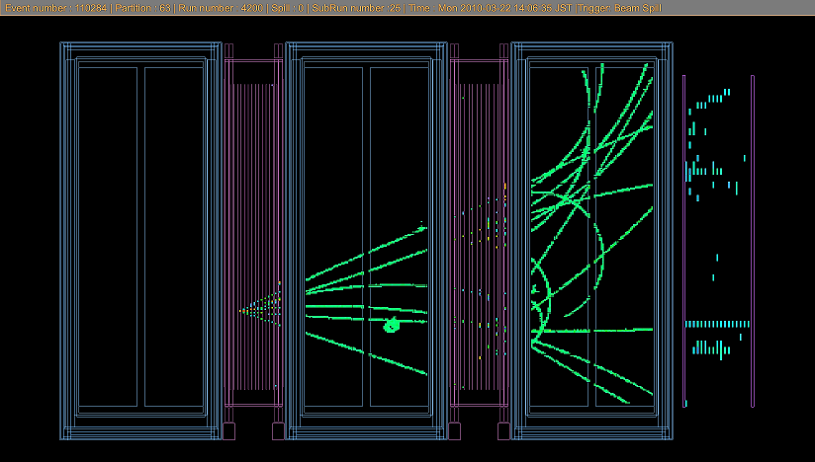
Workshop on neutrino near detectors based on gas TPCs
From workshop, next steps

Slide 2
Please interrupt/correct as it goes.

Slide 3
Project 1: T2K ND280 upgrade
Atmospheric pressure TPC resistive cathodes and thin field cage
large participation of European groups
notional time scale
-- this workshop
-- letter to SPSC for early January
2017: from powerpoint to project with cost and WBS
last bits of R&D if needed
2018-2019 construction
2020 final testing & calibrations, installation in ND280
NB not only TPC also targets, TOF, associated test beam measurements
Project(s) 2 R&D development towards High Pressure TPC
several independent efforts
welcome efforts to understand the exploitation of the vertex information
for constraining nuclear model of neutrino interactions
(most useful also for use of low density scintillator targets)
synergies to be exploited in readout method, electronics, gas system etc…
time scales :)
test beam for 2017 (UK group) other groups welcome
conceptual design

Slide 4
Status of ND280 upgrade project
-- baseline layout ‘exists’
-- evaluation of impact on physics not fully complete
-- no baseline exists for technical solutions once one looks into details,
but nothing ‘extravagant’
-- need about one year to evolve from «powerpoint» to «real plan»

Slide 5
Next steps towards T2K ND280 upgrade
Now: ND280 upgrade task force
➔ in 2018: ND280 upgrade construction project: international, significant resources, cost, size
organization needs to grow in structure and strength
this will come quite naturally if project becomes neutrino platform project
needed steps:
-- T2K approval (internal report has been written )
-- LOI to SPSC (to be completed by end of December)
organized in chapters also corresponding to «Work packages»
(only a few pages per chapter)
possible list below.
-- also need for an ‘IB’ made of contacts with ‘responsible person’ in each lab (country?)

Slide 6
This slide is very preliminary, for discussion only
Who does what?
-- WP0 management and cost estimates (need engineer and a project manager)
-- WP1 NDup Overall design optimization (Physics) Quillain, Sgalaberna, Bolognesi …
-- WP2 NDup Mechanical design and integration (Cadoux(UNIGE), CERN, UK Wark, KEK)
-- WP3 TPC readout with MPGDs (Saclay, DESY?, CERN)
-- WP4 TPC electronics (Saclay, Poland, Sweden)
-- WP5 TPC field cage and gas vessel (Radicioni/INFN, CERN)
-- WP6 WAGASCI Scintillator and readout (LLR, Kyoto, Tokyo, KEK)
-- WP7 TOF system (INR, …)
-- WP8 Gas system (CERN, UK, Aachen)
-- WP9 Calibration (Aachen, Barcelona)
-- WP10 Test beam measurements to improve systematics (Sanchez, UK)
-- WP11 DAQ (Sanchez, UK) (consulting: Giles Barr (Oxford), Tim Nichol (RAL))
-- WP12 TOF and Wagasci electronics (INR,LLR maybe UNIGE?)
Please let us know of interest in participation, leader/convenership etc..

Slide 7
Suggestions
0. write a note to ourselves and CERN management
summarizing the workshop to express
-- attendance and interest of community
-- identify a number of synergies
-- needs in terms of likely test beam, ancillary measurements, technical supports
1. LOI to SPSC for ND280 upgrade
2. LOI to SPSC for HPTPC test beam etc….
or should we have only one common LOI?
3. should we have a next workshop on this theme? where? and when?
4. EU funding request (ITN, Federico)
--- --- ---

