Slide 1
Q&A session
15/09/2016

Slide 2
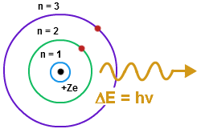
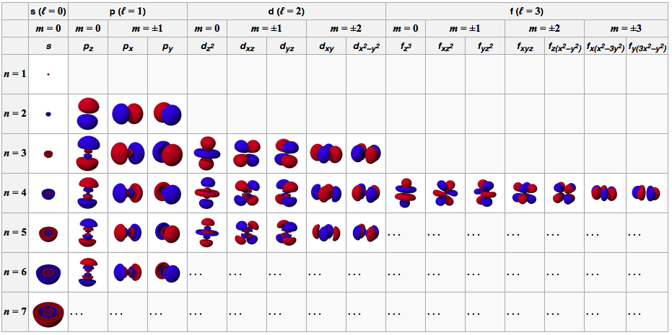
Is planetary model of atom correct?
Borh’s model correct in containing a nucleus, electron, energy levels, and electron cloud. Although it is wrong on the true positioning of the energy levels around the nucleus. Atoms are not flat as it shows, but are rather takes place in three-dimensional space

Slide 3
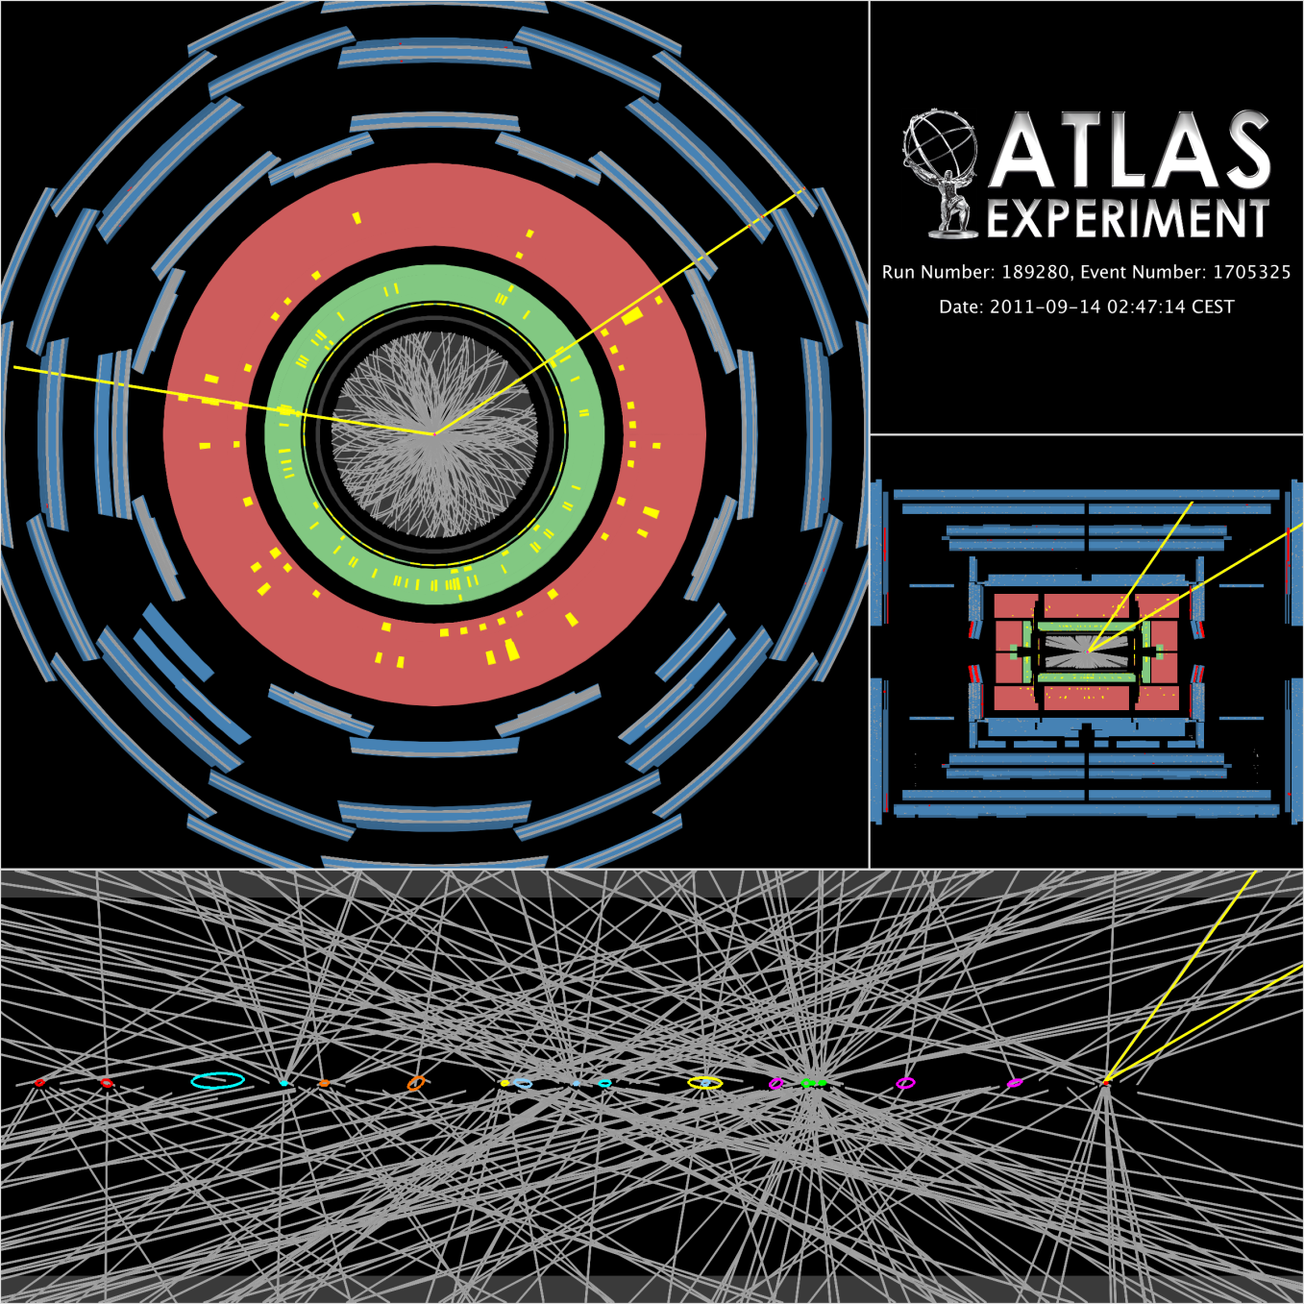
Non-valence quarks in the collision
Underlying event - Remnants of the two protons that did not participate in the hard scatter, including the products of any additional soft, multiple-parton interactions.
Minimum bias (low p_{T})
– inelastic interactions of protons –
and underlying event.
http://theory.physics.helsinki.fi/~heptop/stirling_all.pdf

Slide 4
Pentaquarks etc…

Slide 5
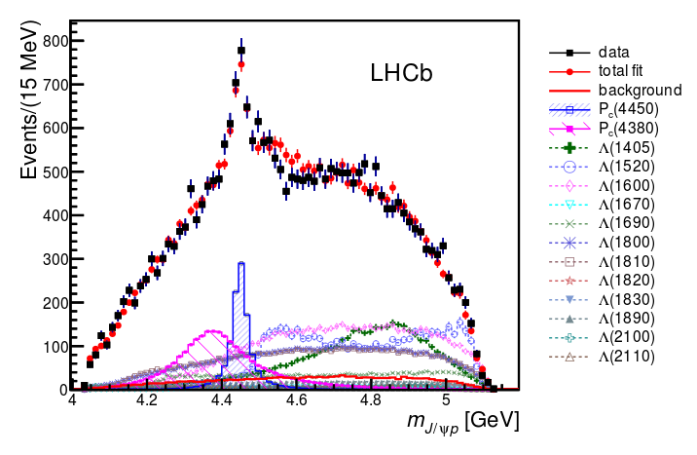
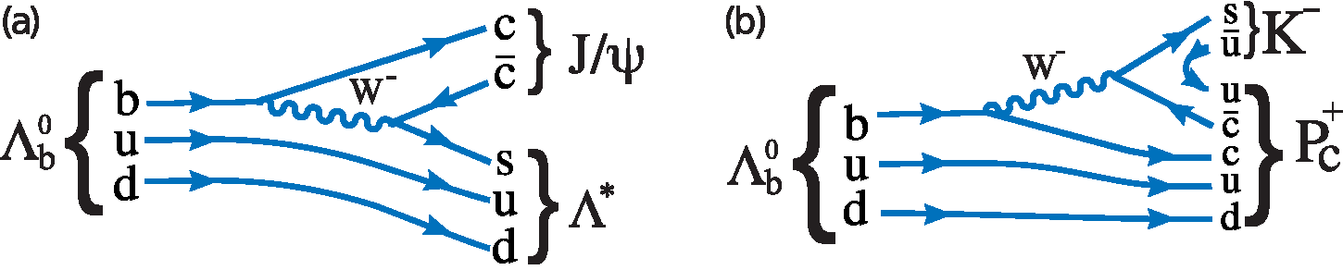
LHCb Pentaquark
http://arxiv.org/abs/1507.03414
« Heavy
Neturon »
P_{c}→J/ψp
Λ→pK

Slide 6
Gilardoni @ https://indico.cern.ch/event/471026/timetable/

Slide 7
Gilardoni @ https://indico.cern.ch/event/471026/timetable/

Slide 8
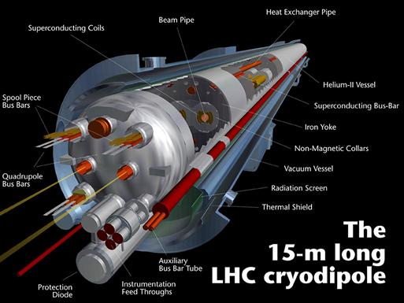
Inside magnets

Slide 12
Sextupoles – additional focusing of the beams

Slide 13
LHC Electron - Cloud effect
However, despite the ultra-high vacuum, residual gas molecules remain trapped on the surface of the walls of the beam pipes, which also contain electrons. When the beams circulate, these electrons are emitted from the walls and accelerated by the beam’s electrical field. The accelerated electrons then hit the walls with enough energy to release the trapped molecules, thereby compromising the vacuum.
Intense beams (containing many bunches) but at low energies are used in order to improve the beam pipe surface (scrubbing)
https://home.cern/about/updates/2015/06/chasing-clouds-lhc

Slide 14
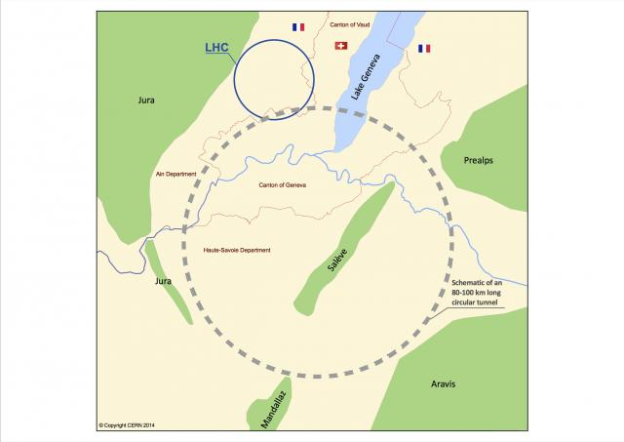
Energy needed for FCC
http://accelconf.web.cern.ch/AccelConf/ipac2016/papers/thpor024.pdf
http://accelconf.web.cern.ch/AccelConf/IPAC2014/papers/moxaa01.pdf

