Slide 1
Laser Update
SBLM
J. Moody, V. Fedosseev

Slide 2
Laser Objectives for AWAKE through end of year
Proton Beamline Commissioning
  Activities:
    Placement of MP5 (final turning mirror) on translation stage
    Spatial overlap and alignment with proton beam on BTVs up and downstream of vapor source
    Synchronization with proton beam
  Required Capabilities:
    Safety document complete for beam permit
    RF locked laser applied at safe level uJ level pulses for BTV screens
    Observation of virtual line for alignment correction due to thermal drifts in laser amplifier
    BTVs with unsaturated laser image
    Referencing of protons on final design trajectory with BTVs
    Streak camera to observe temporal overlap of laser and OTR from protons
Self Modulation Measurement
  Activities:
    Ionization of rubidium vapor to seed SMI
  Required Capabilities:
    Dynamic Delay to acquire high powered shots
    Cameras fully implemented
    Data acquisition fully implemented (Energy, 3 camera profiles, autocorrelator)
    Low power beam interlocks implemented and enabled
    Counter and shifter for LBDP 2 (laser beam dump immediately downstream of vapor source)

Slide 3
Laser Status for Proton Beamline Commissioning
Beam permit documents:
  Laser description document revised and sent for approval again.
  Laser safety inspection of TSG40 will happen on Thursday to check corrective actions
RF locked laser at appropriate levels:
  Locked on fundamental (88 MHz): sufficient for SMI measurement
  Will be improved by Menlo with BOMPD c. November, this is required for phase II
Virtual beamline:
  Setup but must be realigned once more (only virtual line) before beamline commissioning (after hours Thursday, for example)
BTVs with unsaturated laser image:
  Need neutral density OD 6 filter in BTVs (replacing OD1) to get unsaturated image, Stephane Burger ordered already
Protons referenced on design trajectory:
  A goal of first three days of proton beamline commissioning
Streak Cameras:
  BI / MPP discussion

Slide 4
Laser Status for SMI (after vapor source commissioning)
Dynamic Delay logic is implemented and tested, need extraction warning from Heiko
Low power mode interlocks installed minus screen status signals from BI and sending veto signals, PLCs need a bit of debugging/refinement
Data acquisition:
  Needs some work:
    Cameras: Pierre
    Pulse length Autocorrelator file reader (Veronika and I)
    Energy measurement (waiting on Gentec heads, but FESA implemented)
LBPD2:
  Needs some work counting

Slide 5
Cameras
6 Cameras in the line
  Beam profiler in laser room (compressor)
  5 Basler CCD cameras on the transport line
Camera Purpose:
  Profiler acts as closest observation to gratings
  CAM1: closest observation to optic of highest fluence.
    Needs objective.
  CAM2: Virtual delay line (wide aperture, can be used for coarse alignment if beam walks off CAM3-5)
    Needs objective.
  CAM3: Virtual Entrance of plasma cell.
    No objective needed but sensor nearly fully covered by beam.
  CAM4: Virtual center of plasma cell.
    No objective needed (beam is small)
  Cam 5: Virtual exit of plasma cell
    No objective needed, sensor nearly covered by beam.

Slide 6
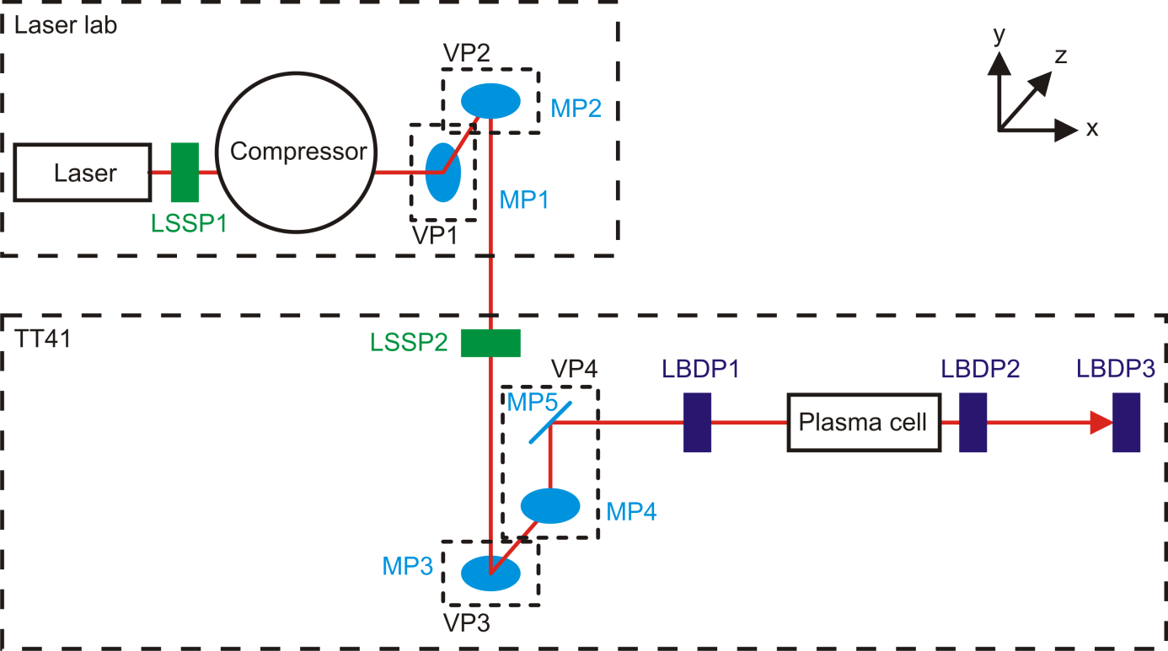
Functional scheme of main laser lines
ME1
LSSE2
VE1
ME2
Photoinjector
LSSE1
THG
ME4
1
a
ME3
Delay line
2
3
4
5
6

Slide 7
Diagnostic Line as Virtual Beamline
7800 mm till mirror MD2
2000
Leak Mirror 520mm above proton beam
Distance from the leak mirror to the 1st mirror on the table 520+7800+7800+400+920=17430
MD2
Cam 2
MD5
1300
MD6
MD3
MD4
400
MD1
FW5
1760
Cam 5
1645
MD13
FW2
e
MD12
1800
FW4
320
900
1555
680
Cam 4
1580
d
p+
MD10
1840
MD11
Cam 3
MD8
1570
MD9
Cam 1
FW1
c
1100
MD7
b
MD14
MD15
FW3
Cam a – to monitor the merging mirror
MD16
MD1, MD14, MD16 – 3” optics
Energy meter 4
21930 mm to plasma cell entrance
MD2 - MD13, MD15 – 2” optics
Filter wheels
TSG40 Beam Profiler: Closest virtual position to final grating in compressor
CAM1 / Additional Camera: virtual optic of highest fluence
CAM3 virtual beginning of vapor source
CAM4 virtual center of vapor source
CAM5 virtual exit of vapor source

Slide 8
Setup and Analysis Explanation
Setup:
  Laser run with LBDP1 in
  Laser run at 30mJ to attempt to see laser profile with gain
  No objectives on CAMs 3, 4, 5
Analysis:
  Camera array summed. Individual values normalized with Energy of 100 mJ to get fluence, then divided by 120 fs to get intensity at each pixel
  Checked peak intensity and intensities at r = 1mm

Slide 9
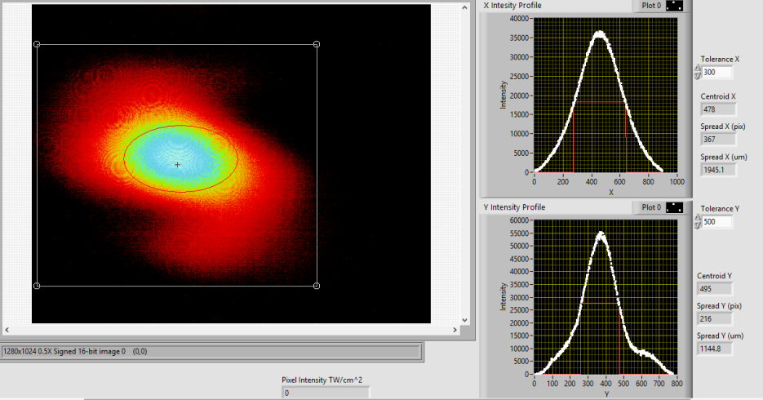
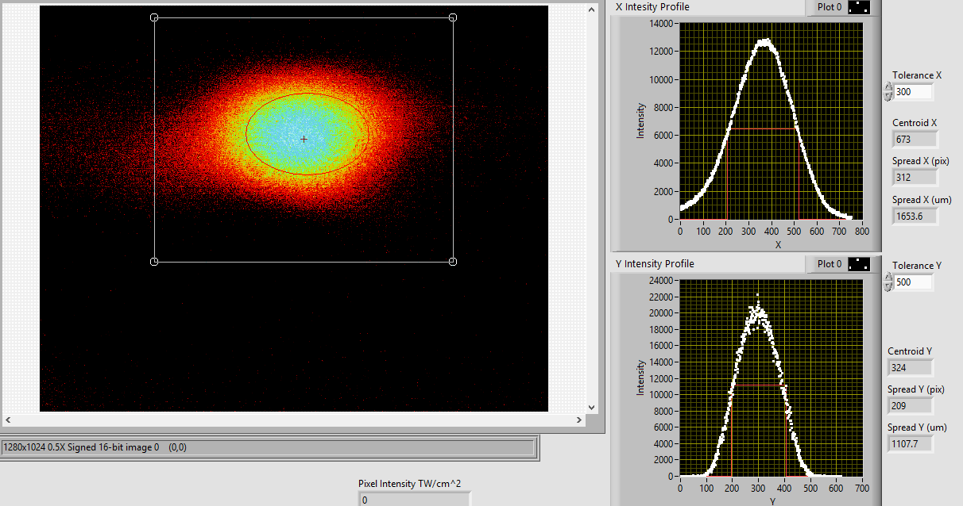
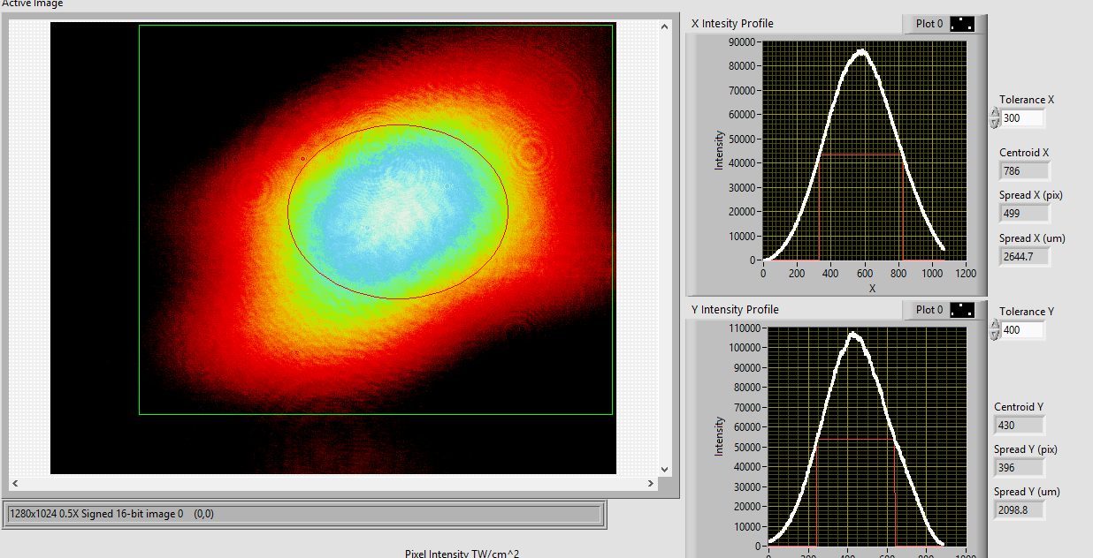
Virtual Line Cameras
CAM3: Virtual entrance of vapor source
FWHM: X: 2.1 mm Y: 1.2 mm
Peak Intensity: 20 TW/cm^2
1mm X: 3 TW/cm^2
1mm Y: 15 TW/cm^2
CAM4: Virtual center of vapor source
FWHM: X: 1.6mm Y: 1.1mm
Peak Intensity: 40 TW/cm^2
1mm X: 10 TW/cm^2
1mm Y: 4 TW/cm^2
CAM5: Virtual exit of vapor source
FWHM: X: 2.8 mm Y: 2.3 mm
Peak Intensity: 10 TW/cm^2
1mm X: 7 TW/cm^2
1mm Y: 6 TW/cm^2

Slide 10
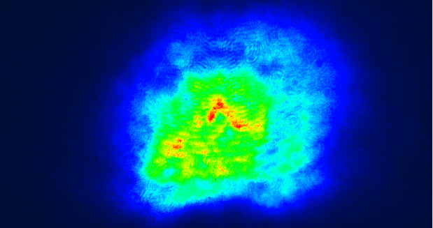
TSG40
Effective diameter of beam: 27mm
Average fluence at 450mJ:
60 mJ/cm^2
@ 100mJ: 13 mJ/cm^2
Damage thresh for gratings: 100 mJ /cm^2
This plane is downstream of the gratings so at this plane the beam is a bit smaller than at the actual gratings, 2m upstream of the imaging point

