Slide 1

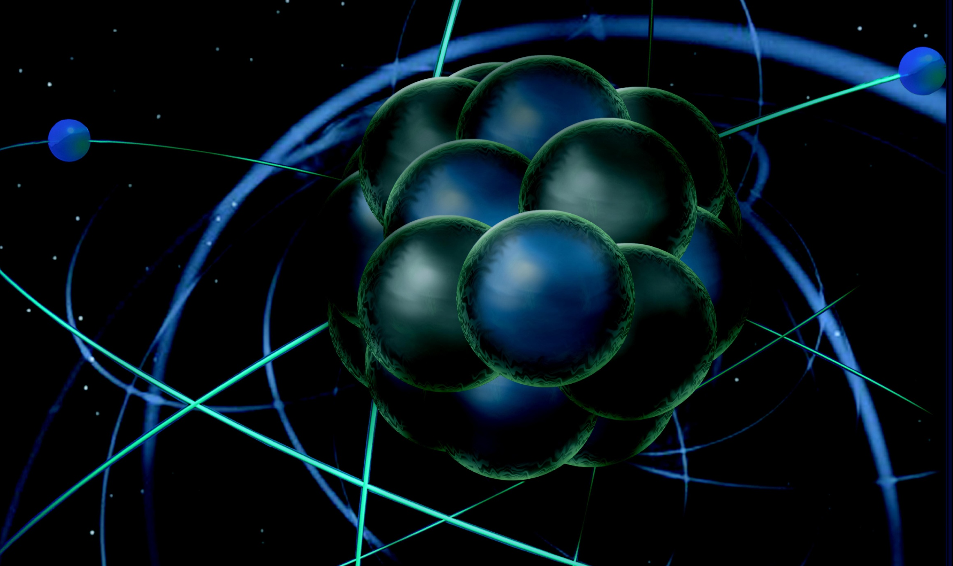
  JLEIC Detector
  Rolf Ent (Jefferson Lab)
  For the JLEIC Detector Study Group
  With acknowledgement to Markus Diefenthaler, Yulia Furletova, Tanja Horn, Charles Hyde, Vasiliy Morozov, Pawel Nadel-Turonski, and Rik Yoshida who all were instrumental folding in the ideas to fully integrate a detector into an e-p/A collider interaction region.
  Also with acknowledgement to Elke Aschenauer and Alexander Kiselev for healthy exchange of work & ideas.
DIS 2017 @ Birmingham
April 3-7, 2017

Slide 2
Outline
Electron-Ion Collider (EIC):
  Imaging the Gluons and Quark Sea of Nucleons and Nuclei
The requirements of the EIC – unique and perhaps counterintuitive
The integration of a detector in the JLEIC Interaction Region
The JLEIC extended detector and its ingredients
Notes:
2

Slide 3
Physics vs. EIC Design Requirements
What the nuclear physicists dream off and drives the EIC designs, with upgrade paths included either in luminosity or in CM energy
EIC range – with 100% acceptance
10³⁴
Flexibility in energies
Polarization – e⁻ and p/d/³He
Range of nuclei – H to Pb/U
Excellent acceptance
Good particle identification and resolution
100
Luminosity (cm⁻² sec⁻¹)
10³³
Integrated Luminosity (fb⁻¹/yr)
10
10³²
1
Polarized luminosity and the capability to measure physics of interest is what counts
40
80
120
√s (GeV)

Slide 4
EIC Requirements
Requirements from Physics:
High Luminosity: 10³³⁻³⁴ cm⁻²s⁻¹ and higher → nucleon/nuclei imaging
Flexible center of mass energy → wide kinematic reach
Electrons (0.8) and protons/light nuclei (0.7) highly polarized
→ study of spin structure
Wide range of nuclear beams (D to Pb/U) → high gluon densities
Room for a wide acceptance detector with good PID (e/h & π, K, p)
→ flavor dependence
Full (or large) acceptance for tagging, exclusivity, protons from elastic reactions, neutrons from nuclear breakup → target/nuclear fragments
The “sweet spot” for the EIC parameters is a balance of
  High enough energies to reach high Q² (up to ~1000 GeV²)
  Low enough proton energy to measure transverse scale of ~100 MeV well.
  High enough energy to explore collective effects towards saturation.
  High enough luminosity for the nucleon/nuclei imaging.
  IR and Detector with acceptance and performance to fully measure the relevance processes

Slide 5
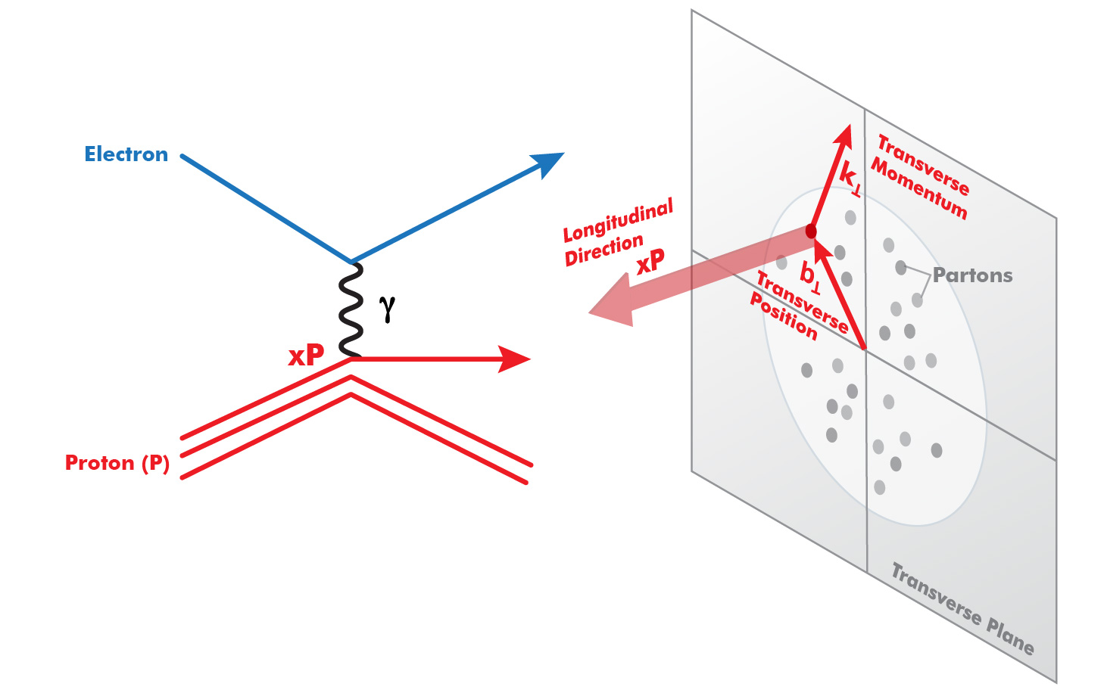
Experimental Challenge of the EIC
s=xyQ², s=4E_{e}E_{p}
(Q²)
On one hand: need high beam energies
to resolve partons in nucleons.
Q² needs to be up to ~1000 GeV²
On the other hand: need to resolve
quantities (k_{t}, b_{t}) of order a few
hundred MeV in the proton. Limits the
proton beam energy & High Lumi needed.
Electron-Ion Collider: Cannot be HERA or LHeC: proton energy too high
Notes:
5

Slide 6
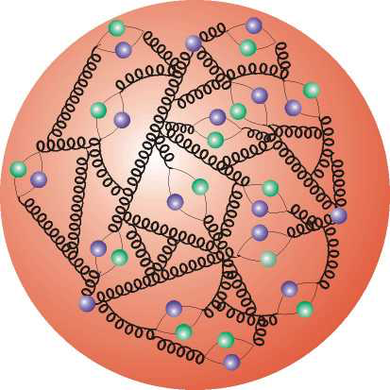
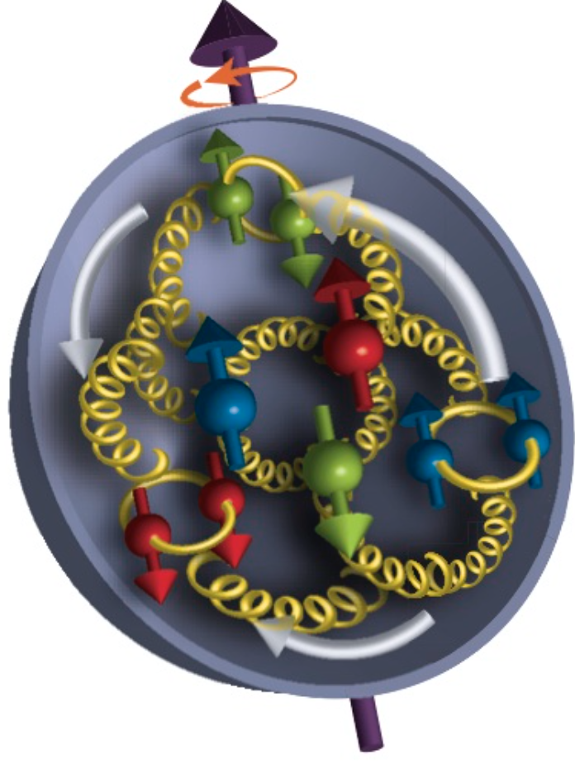
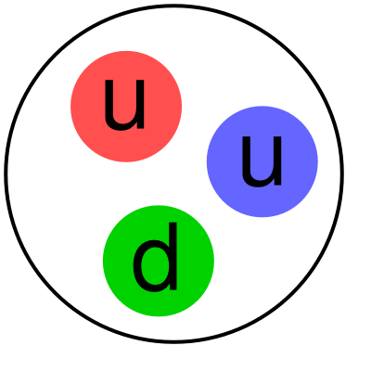
Where EIC Needs to be in x (nucleon)
Saturation
Regime:
Needs to be
accessed via Ions
Collective
Regime
Many-body
Regime
Few-body
Regime
(JLab 12)
10⁻⁴
10⁻³
10⁻²
10⁻¹
1
x (for proton)
QCD Radiation Dominated
(Studied at HERA)
Hadron Structure Dominated
Spin,TMD, GPD…
Main interest for EIC Nucleon/Nuclear Program
Notes:
6

Slide 7
Where EIC needs to be in Q²
x > 10⁻³,10⁻² to 1
Non-perturbative
Regime
Perturbative
Regime
Transition
Region
HERMES, COMPASS, JLAB 6 and 12
EIC
HERA high-x
Q²
10⁻¹
1
10
10²
10³
[GeV²]
Include non-perturbative, perturbative and transition regimes
Provide long evolution length and up to Q² of ~1000 GeV² (~.005 fm)
Overlap with existing measurements
Disentangle Perturbative/Non-perturbative, Leading Twist/Higher Twist
Notes:
7

Slide 8
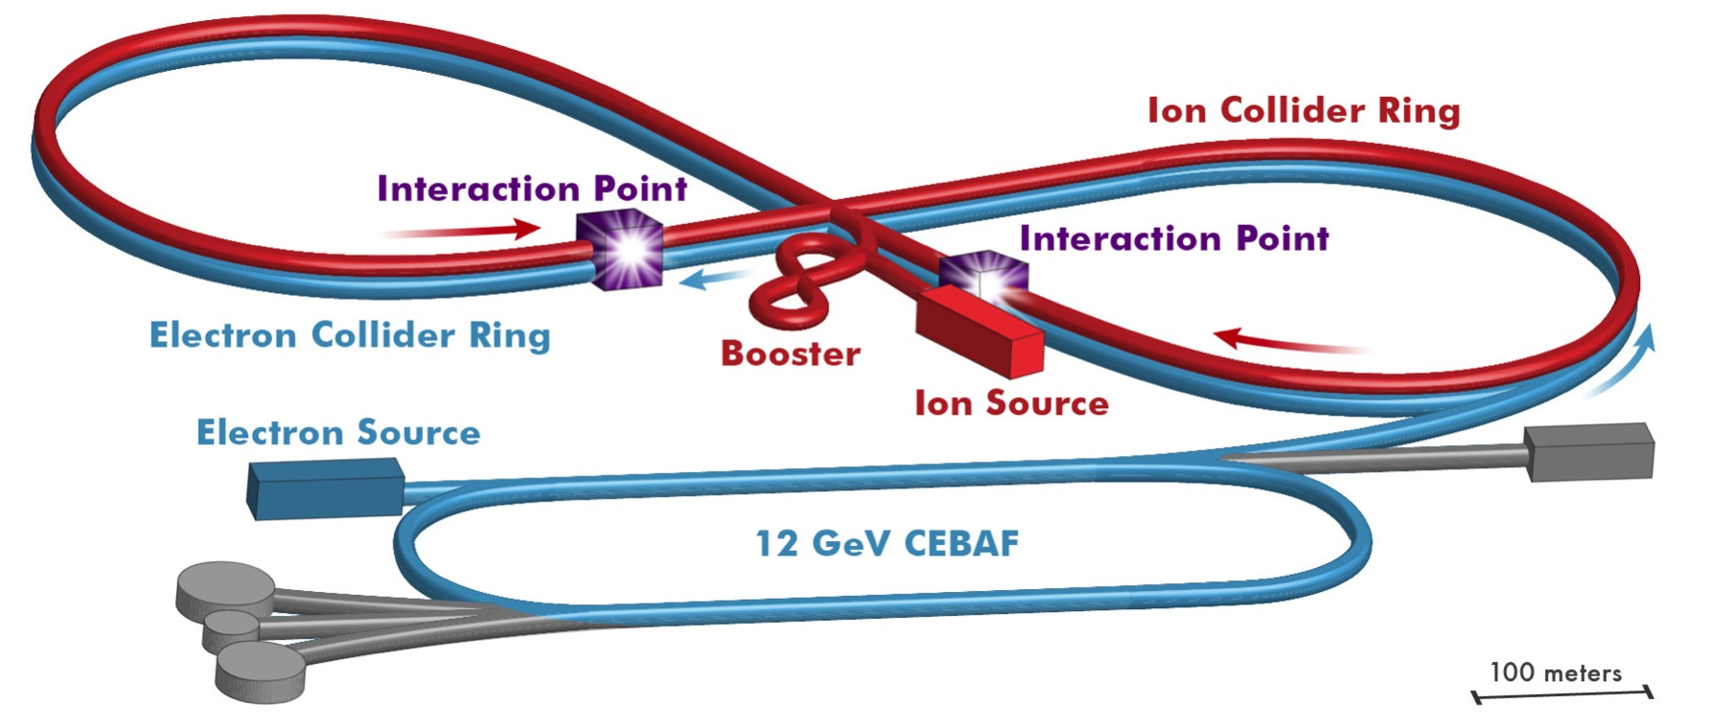
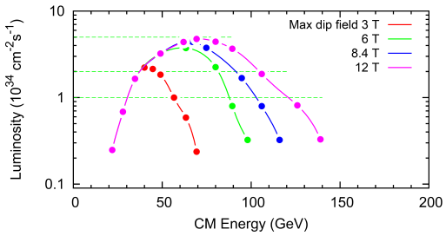
JLEIC Realization
Use existing CEBAF for polarized electron injector
Figure 8 Layout: Optimized for high ion beam polarization  polarized deuterons
Energy Range:
√s : 20 to 65 - 140 GeV
(magnet technology choice)
Fully integrated detector/IR
JLEIC achieves initial high luminosity, with technology choice determining initial and upgraded energy reach
10³⁵
LHC
(
10³⁴
400x12 GeV
100x10 GeV
10³³

Slide 9
The integration of a detector in the JLEIC interaction region
Notes:
9

Slide 10
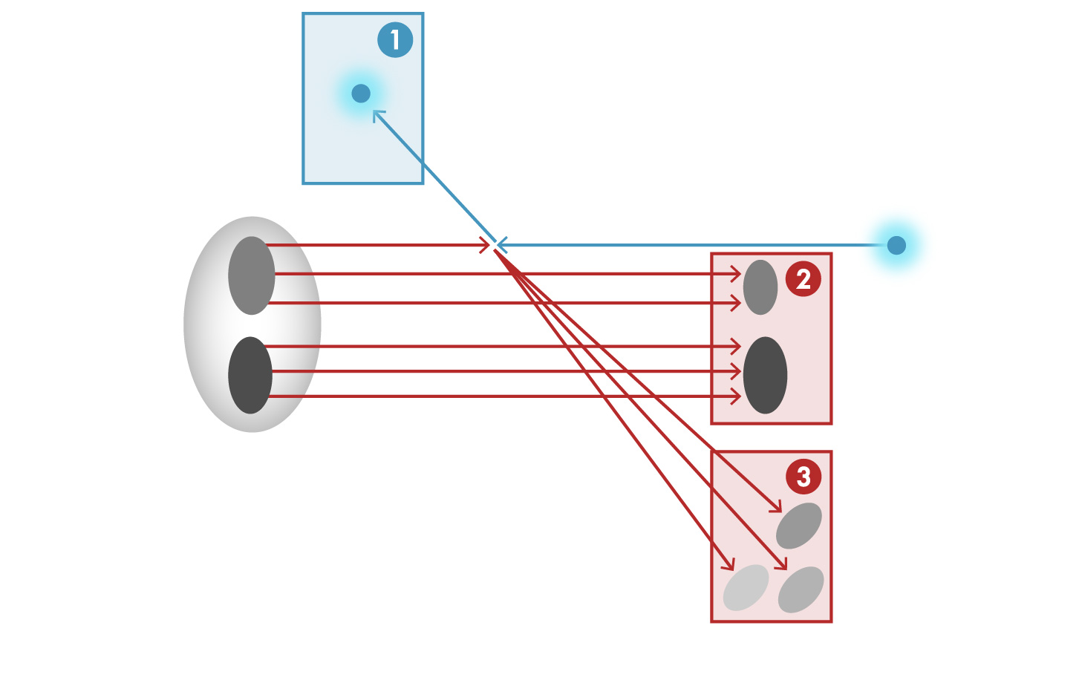


JLEIC – Total Acceptance Detector
e’, $ν$
Aim of EIC is nucleon and nuclear structure beyond the longitudinal description.
This makes the requirements for the machine and detector different from all previous colliders, including HERA.
e
$γ,$Z,W
p/A
q
p remnant
“Statistics”=Luminosity × Acceptance
e’
EIC Physics demands ~100% acceptance for all final state particles (including particles associated with initial ion - 2)
e
p/A
Ion remnant is particularly challenging
not a usual concern at colliders
the higher the Ion Beam energy, the more difficult to achieve.
Scattered electron
Particle associated with initial Ion
Particle associated with struck quark

Slide 11
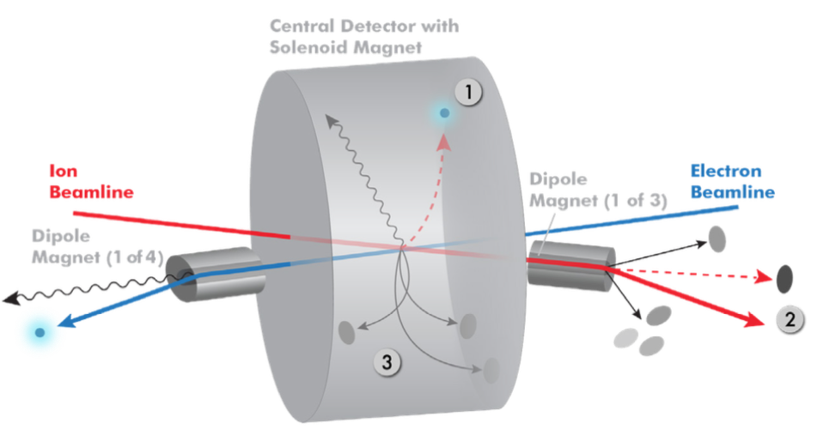
Integration IR: JLEIC total acceptance detector
Possible to get ~100% acceptance for the whole event
Scattered electron
Particles associated with struck parton
Particles Associated with Initial Ion
Relatively large crossing angle (50 mr) combined with large aperture final focus magnets,
and forward dipoles are keys to this design - this crossing angle creates room for forward dipoles and gives a space for detectors in the forward regions

Slide 12
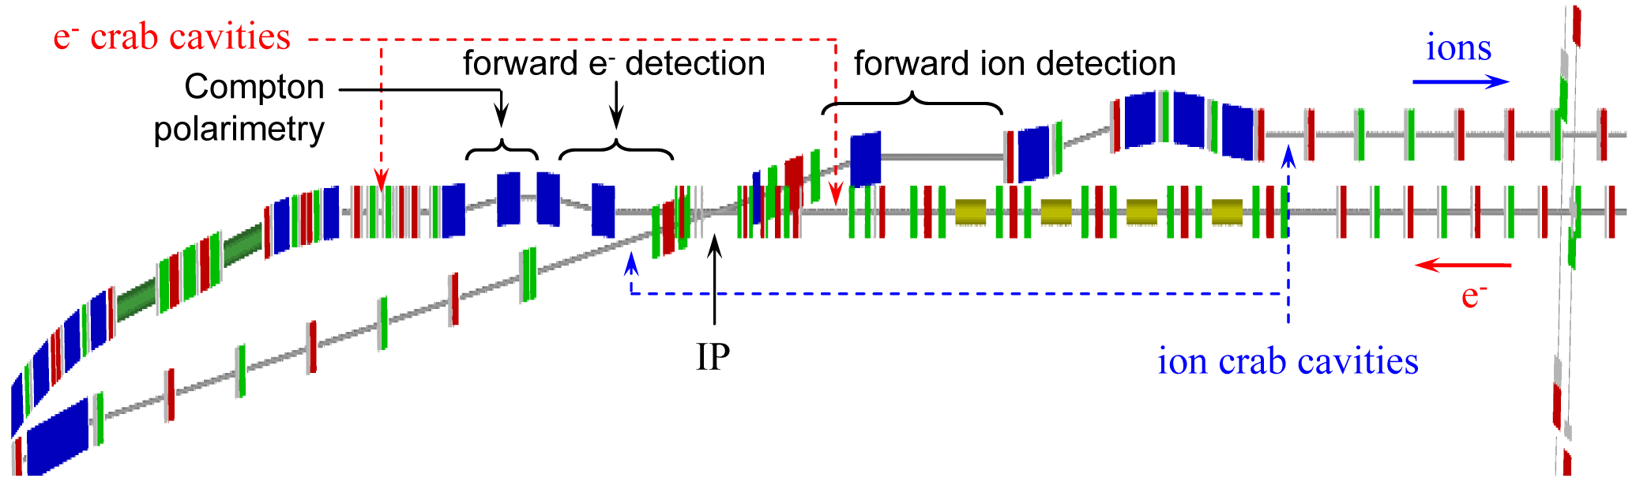
Integration with accelerator
Total size ~80m
1.Central detector ~10m
2.Far-forward electron detection ~30m
3.Forward hadron spectrometer ~40m
IP placement (to reduce background)
- Far from electron bending magnets (synchrotron)
- Close to proton/ion bending (hadron background)
Example from JLEIC design
Extended detector: 80+ m
2.
3.
1.
Yulia Furletova
Notes:
Interior Page Design 2
12

Slide 13
The JLEIC extended detector and its ingredients
Notes:
13

Slide 14
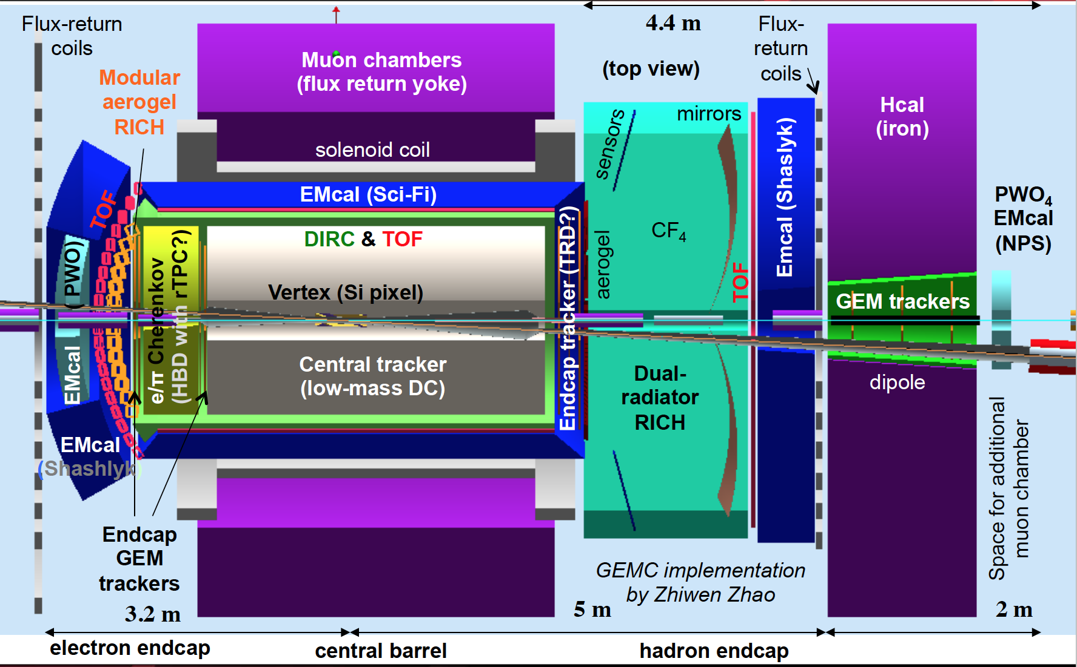
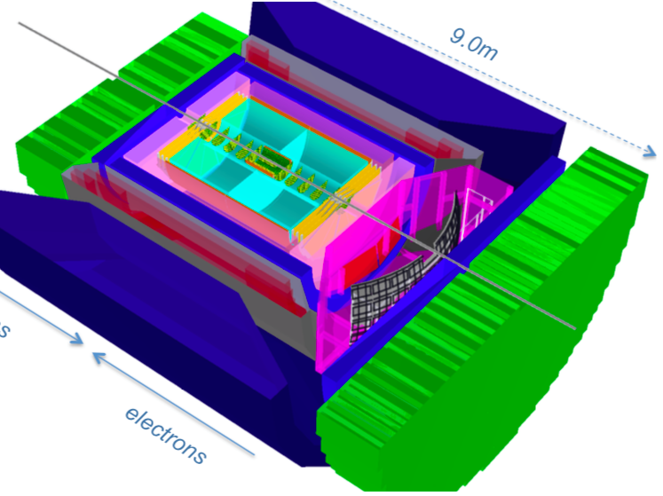
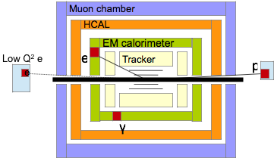
EIC Central detector overview
Jefferson Lab
(JLEIC Detector)
Brookhaven
BeAST
2nd IP for jets
Modular design of the central detector

Slide 15
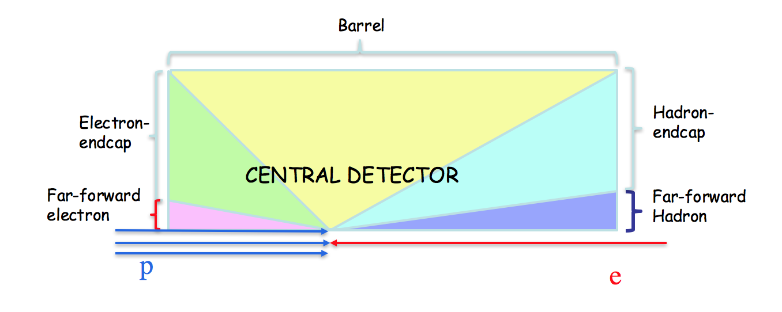


General structure of detectors
Stable particles ( e,μ,π,K,p, jets(q,g), gamma, ν - Pt^{miss}):
Momentum/Energy, Type(ID), Direction, vertex
e
e’, $ν$
vertex
tracking
PID
EMCAL
HCAL
muon
$γ,$Z,W
e
p/A
q
γ
K/π/p
p remnant
absorber
jets
μ
ν
P_{T}miss
bunch crossing is every ~2ns
Pythia Minbias EIC (Q2> 10⁻⁶ ) σ ~ 200 µb (HERA ~165 µb )
N events = σ•L ~ 2· 10⁶ ev. per sec (2MHz) ~ 2 events / μs
ZEUS/HERA(ep) ~3kHz
(100 GeV)
(10 GeV)
In order to reconstruct the kinematic x and Q² it is, in principle, sufficient to measure any two of these E’_{e’,}θ_{e’ ,}E_{q ,}θ_{q}

Slide 16
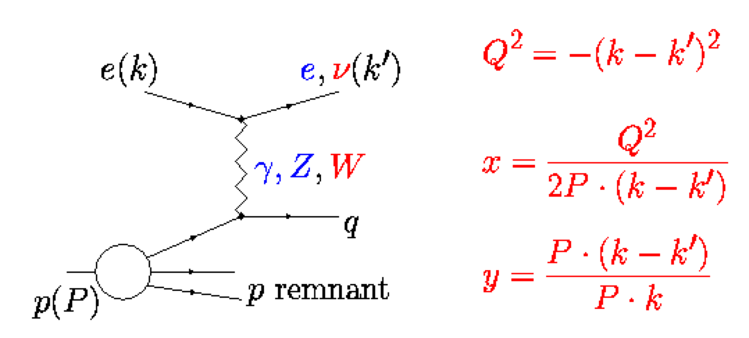
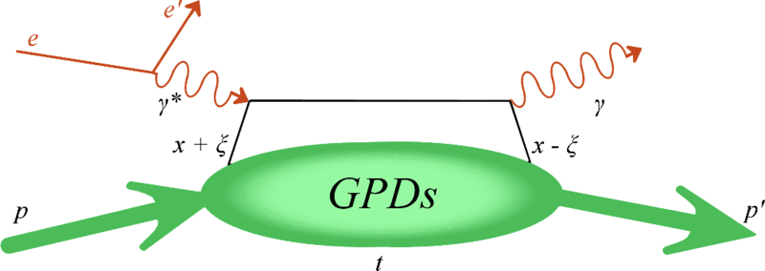
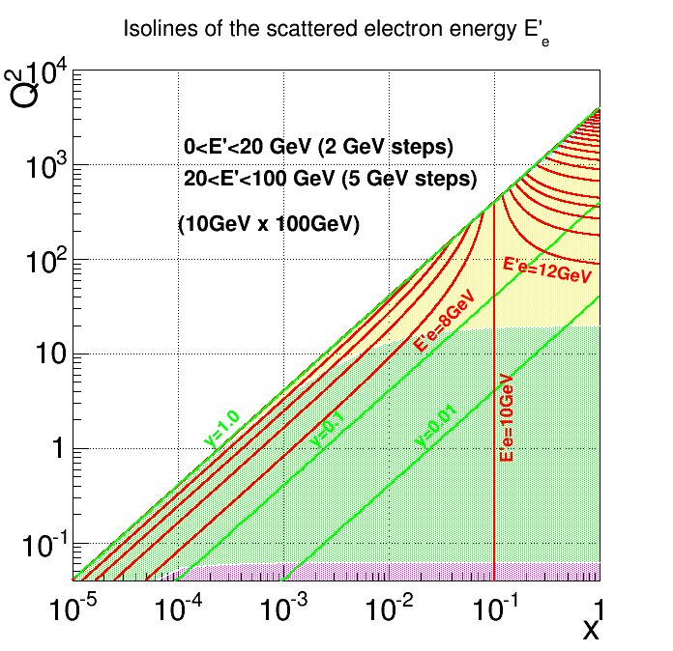
Electromagnetic Calorimetry
Electromagnetic Calorimeters
measure EM showers and
early hadron showers:
Energy, position, time
DIS
DVCS
PbWO₄ Crystal EM Calorimeter
-Tungsten glass, similar to CMS or PANDA
Time resolution: <2 ns
Energy resolution: <2%/√E(GeV) + 1%
Cluster threshold: 10 MeV
Produced at two places (China, Czech R.)
Ongoing EIC R&D (CUA, Orsay, …)
R&D ongoing also for JLab detectors
Barrel
Sampling EM Calorimeter
Electron end-cap
Shashlyk (scintillators +absorber)
- WLS fibers for readout
- Sci-fiber EM(SPACAL):
Compact W-scifi calorimeter, developed at UCLA
Spacing 1 mm center-to-center
Resolution ~12%/√E
On-going EIC R&D
Far-forward electron
PbWO₄ for e-endcap - close to the beam – need energy precision and radiation hardness (but not like CMS).
Shashlyk for barrel? – less expensive

Slide 17
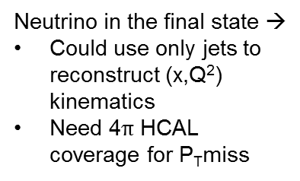

Jets at EIC and Hadronic Calorimetry
Jets evolution and dynamics ( jet == struck quark )
Jets as a probe of partonic initial state
Jets in medium
(cold nuclear matter)
    energy loss, quenching
    broadening
    multiple-scattering.
In a typical jet :
60 % of jet energy in charged hadrons
30 % in photons (mainly from $π0−>γγ$)
10 % in neutral hadrons (mainly n, K_{L} )
Traditional calorimetric approach:
-E_{JET}=EMCAL+HCAL
-70% of energy measured in HCAL with poor resolution : $σE /E$~60%/$√E$
Uranium Calorimeter at ZEUS: $σE /E$~35%/$√E$
Particle Flow Calorimetry:
E_{JET} =E_{track}+E$γ$+E_{n}
-charged particles measured in tracker (essentially perfectly)
- Photons in ECAL: : $σE /E$~2-10%/$√E$
- Neutral hadrons (ONLY) in HCAL →
Only 10 % of jet energy from HCAL
much improved jet resolution…
At EIC for the first time will be able to study in-medium propagation and hadronization of heavy quarks (charm & beauty)
Charged current DIS
Neutrino in the final state →
Could use only jets to reconstruct (x,Q²) kinematics
Need 4$π$ HCAL coverage for P_{T}miss

Slide 18
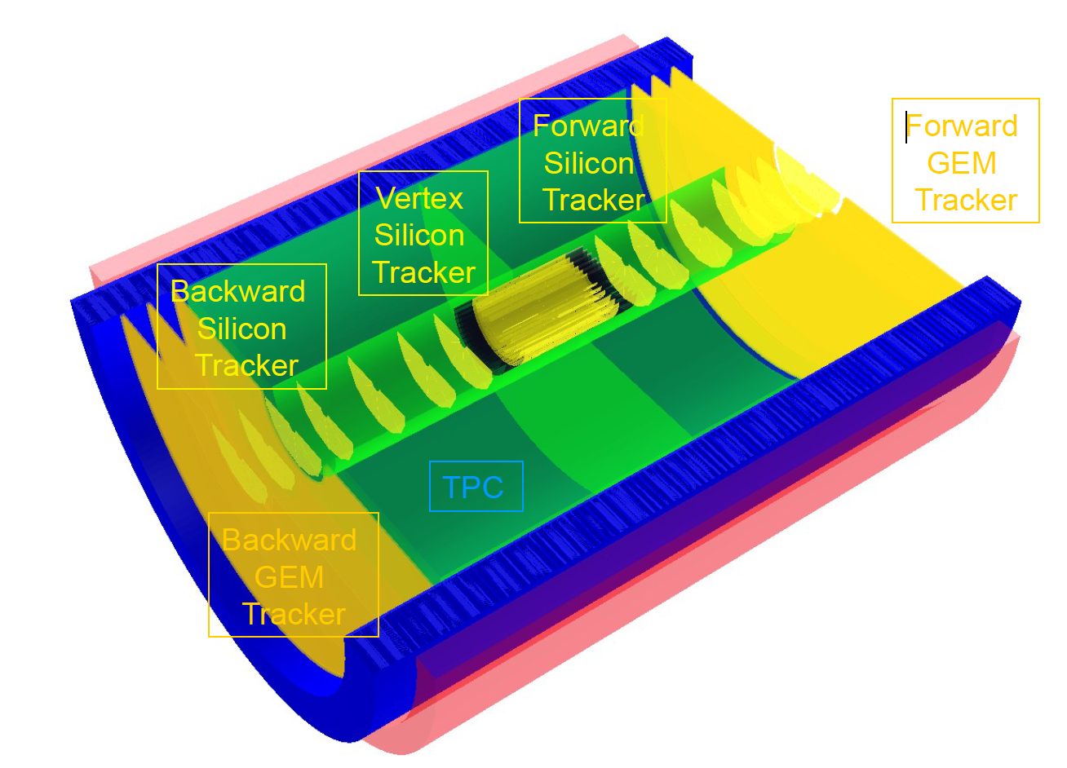
Tracking
Main purpose of tracking:
  - reconstruct charged tracks and measure their momenta precisely (~few %)
  - dE/dx (PID) for low momentum tracks.
Barrel: TPC or drift chambers
relatively fast detector,
minimal multiple scattering
limited PID
Endcaps: GEM
High multiplicity in forward region – we need a high granularity tracker
  resolution ~50 μm.
Radiation hardness
A. Kiselev, eRHIC detector

Slide 19
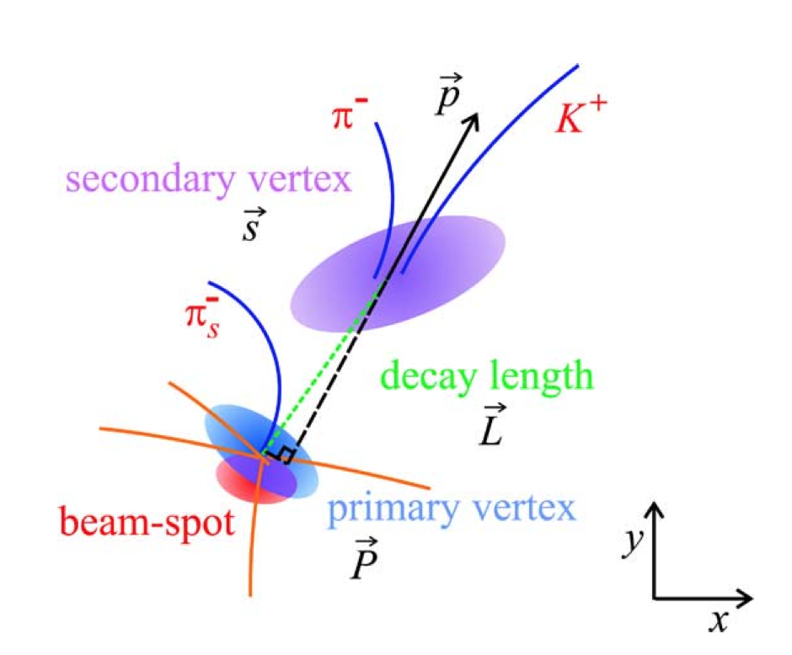
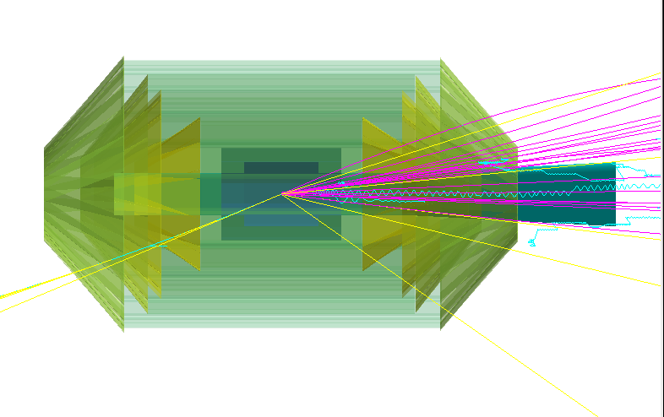
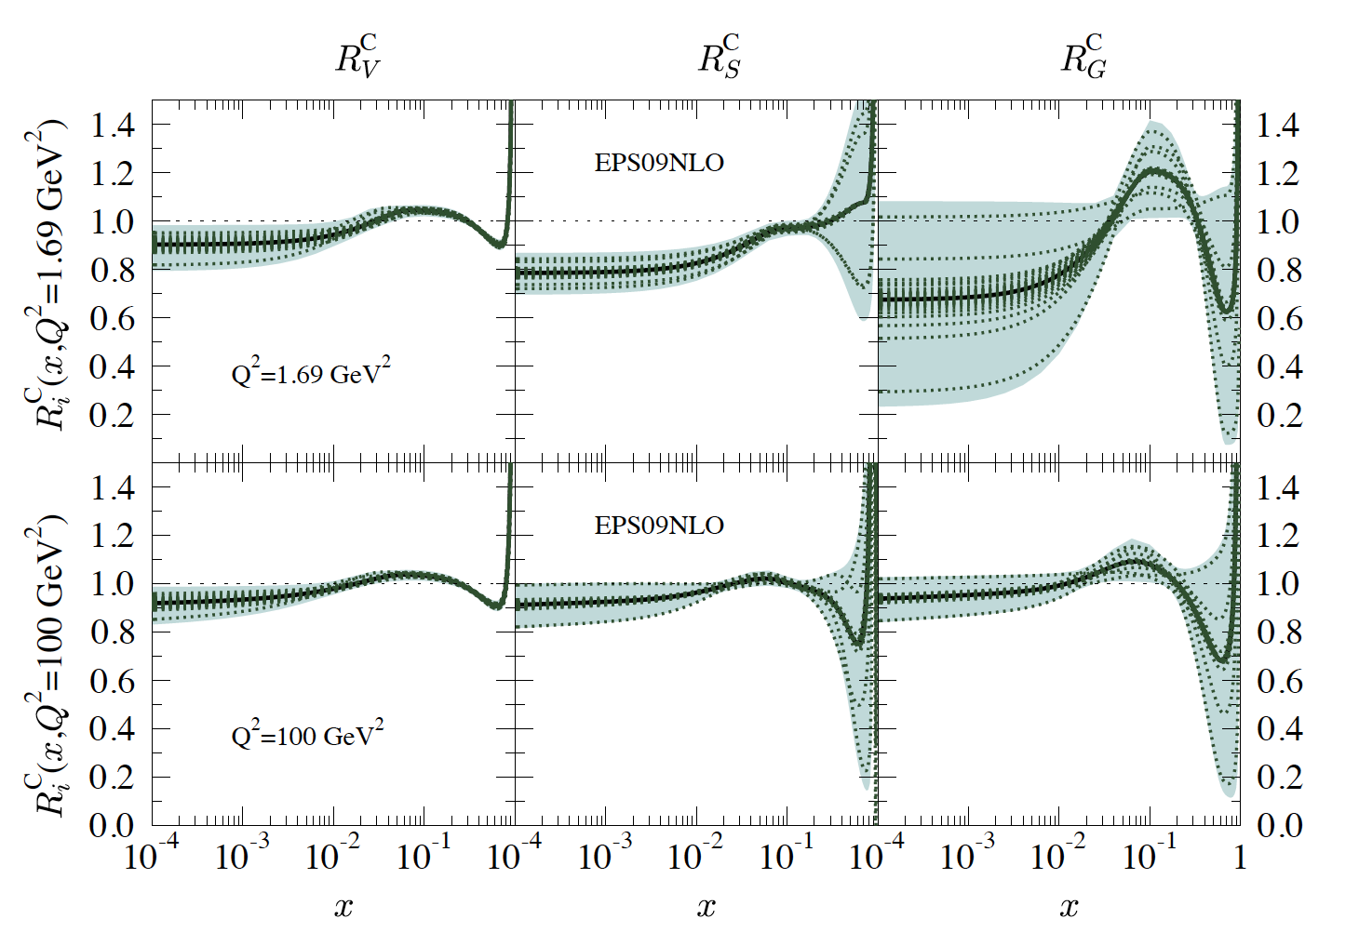
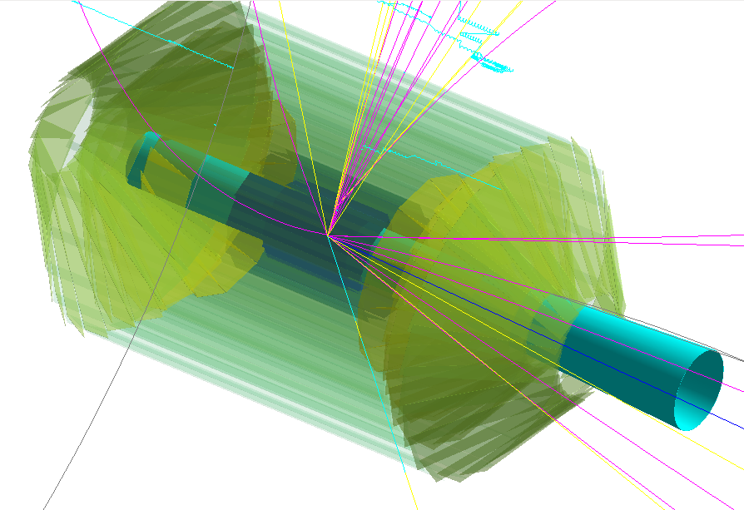
Vertex Detector
Heavy quarks
Main purpose of vertex detector:
- Reconstruction of a primary vertex
- Reconstruct secondary vertex:
Tagging of c and b quarks
(decay length ~100-500 µm)
- improve momentum resolution of outer tracker
- provide stand-alone measurements of low-Pt particles
- dE/dx measurements for Particle IDentification
Boson (photon)- Gluon Fusion (BGF)
Charm high-Q² event in the vertex detector
Nuclear PDF parametrization EPS09 Eskola et al. 2009
enhancement
shadowing
EMC?
Vertex detector is detector closest to IP, and background increases occupancy.
High granularity detector is needed (pixels)
Beam related background can also cause radiation damage.

Slide 20
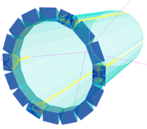
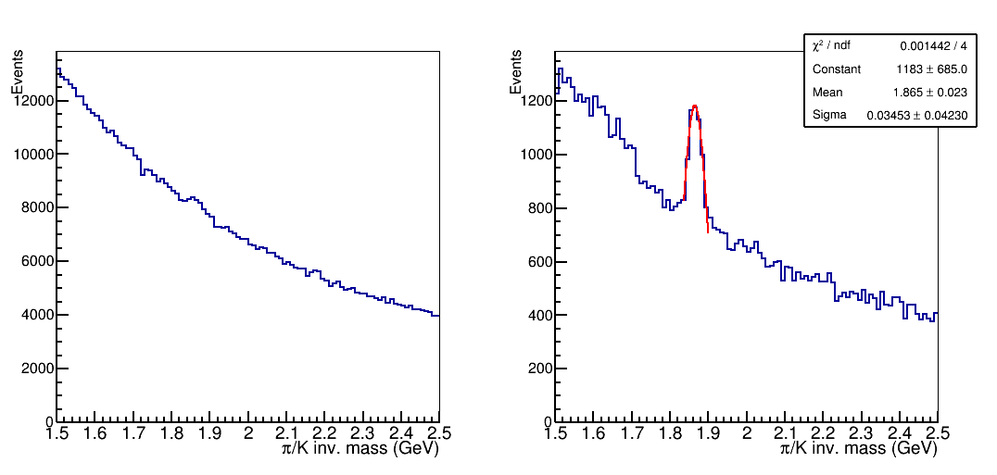

Hadron Identification
Semi-inclusive DIS: involves measurements of one or more final-state hadrons in addition to the detection of the scattered lepton.
Time of Flight: MRPC
Multi-gap Resistive Plate Chamber (MRPC) R&D: achieved ~18 ps resolution with 36-105 μm gap glass MRPC
π/K <3.5GeV
Electron end-cap: Modular RICH
Modular aerogel RICH (eRD14 detector R&D)
π/K separation up to ~10 GeV
Particle momentum range of interest to EIC science [GeV]
Crystal Calorimetry
Crystal Calorimetry
Barrel: DIRC
Aerogel RICH
DIRC
Dual-radiator RICH
radially compact (2 cm)
Particle identification (3σ) p/K < 10 GeV, π/K < 6 GeV, e/π < 1.8 GeV
Rapidity range of interest to EIC science
Exclusive processes:
D0 mass plots:
Hadron end-cap: dual-radiator RICH
JLEIC design geometry constraint: ~160 cm length
Aerogel in front, followed by CF4
covers energy for π/K up to 50GeV
Sensitive to magnetic field → Envisioned 3T solenoid with minimized field in RICH region
No PID
No vertex
With PID
No vertex
$$Λ$$
Pythia BGF

Slide 21
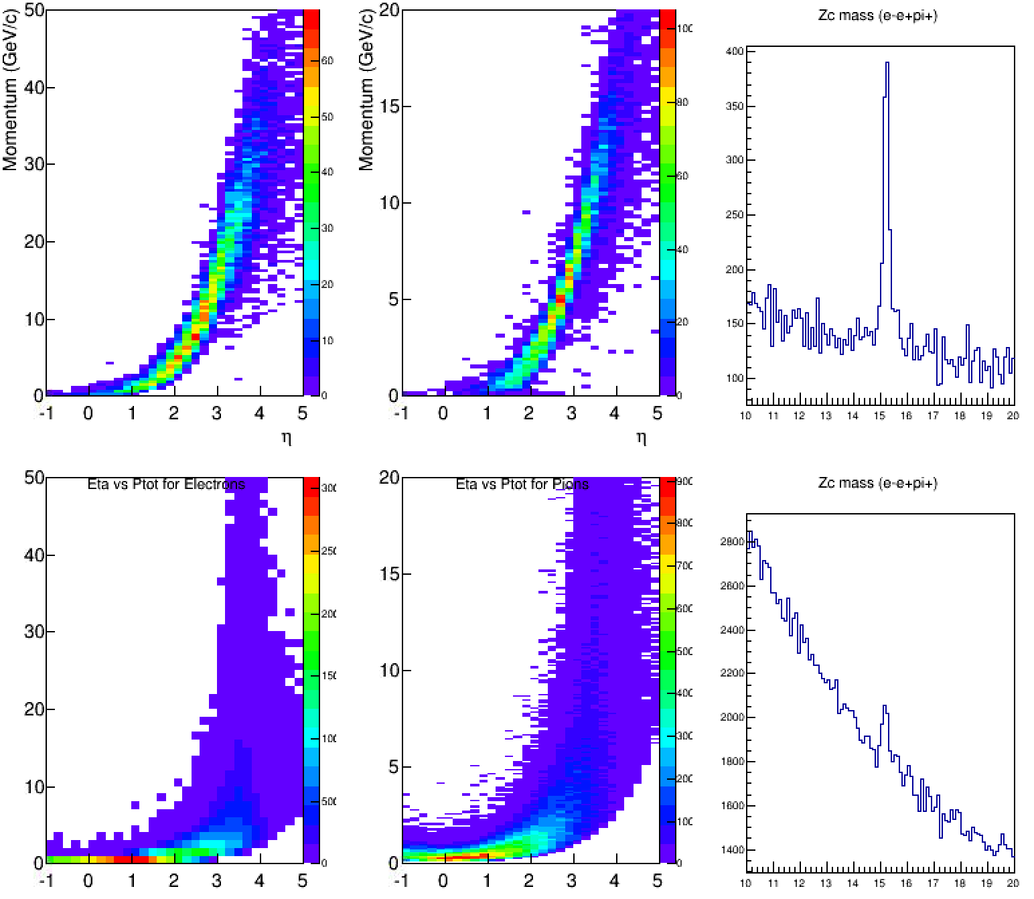
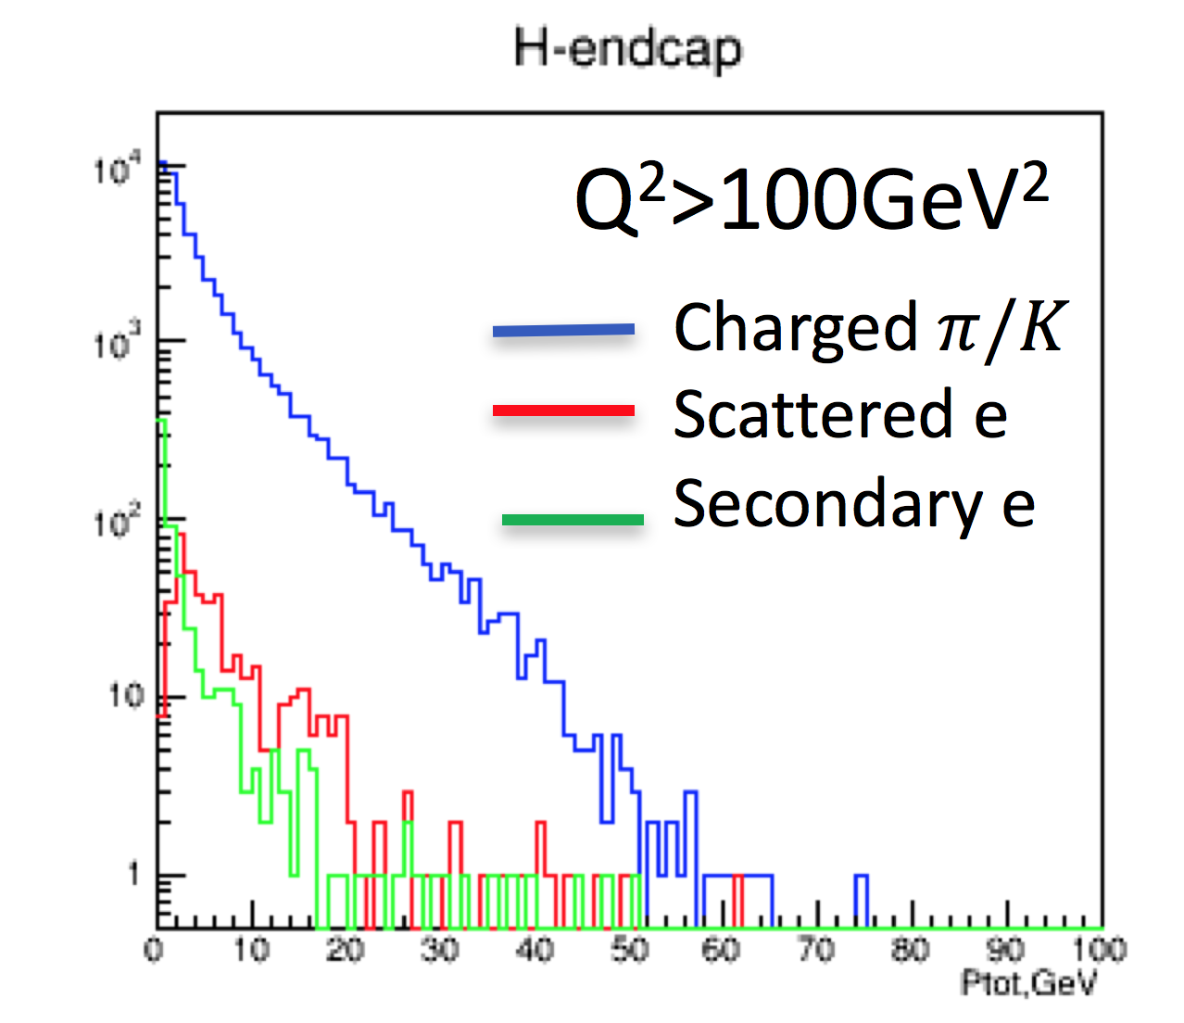



Electron Identification
σ(Zc[3900]) ~ 5 nb
σ(PhP, Q²<1GeV) ~ 10000 nb
Physics:
  For rare physics, based on electron identification
  Charmonium, light vector mesons (ρ,ω,φ)
  Tetraquarks and Pentaquarks (and other XYZ states)
  Open Charm and Beauty physics
  Di-lepton production
  Scattered electron identification at Large-x, large-Q2
New XYZ stage Zc[3900]
Zc[3900]
m² (e+e-π+)
$$e±$$
$$π±$$
ideal PID
Hadron end-cap
PhP background
$$π±$$
CAL PID
Transition radiation detector (TRD) under consideration for enhanced electron/hadron rejection: GEM/TRD
combined high granularity tracker and PID.
cover energy range 1-100 GeV.
provide additional e/hadron rejection factor 10-100.
Excellent e/π PID in the hadron endcap region is needed for electrons with energy 1-100GeV

Slide 22
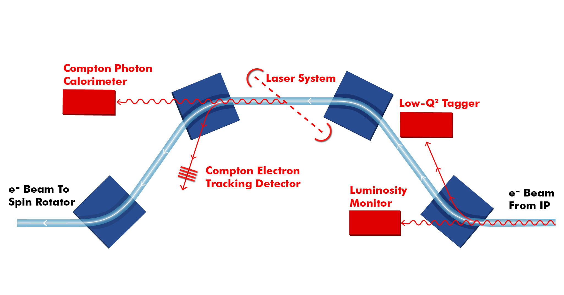
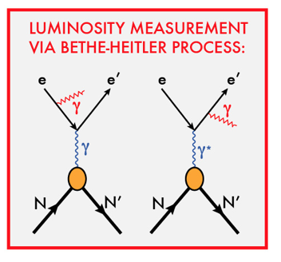
Chicane for Forward Electron Detection
Example from JLEIC design
Low Q² tagger
For low Q² electrons
Luminosity monitor:
Luminosity measurements via Bethe-Heitler process
First dipole bends electrons
Photons from IP collinear to e-beam
Polarization measurements
First two Dipoles compensate each other
The same polarization as at IP
Minimum background and a lot of space.
Measurements of both Compton photons and electrons

Slide 23
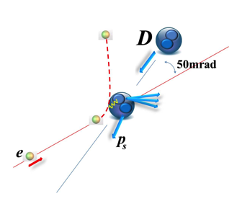
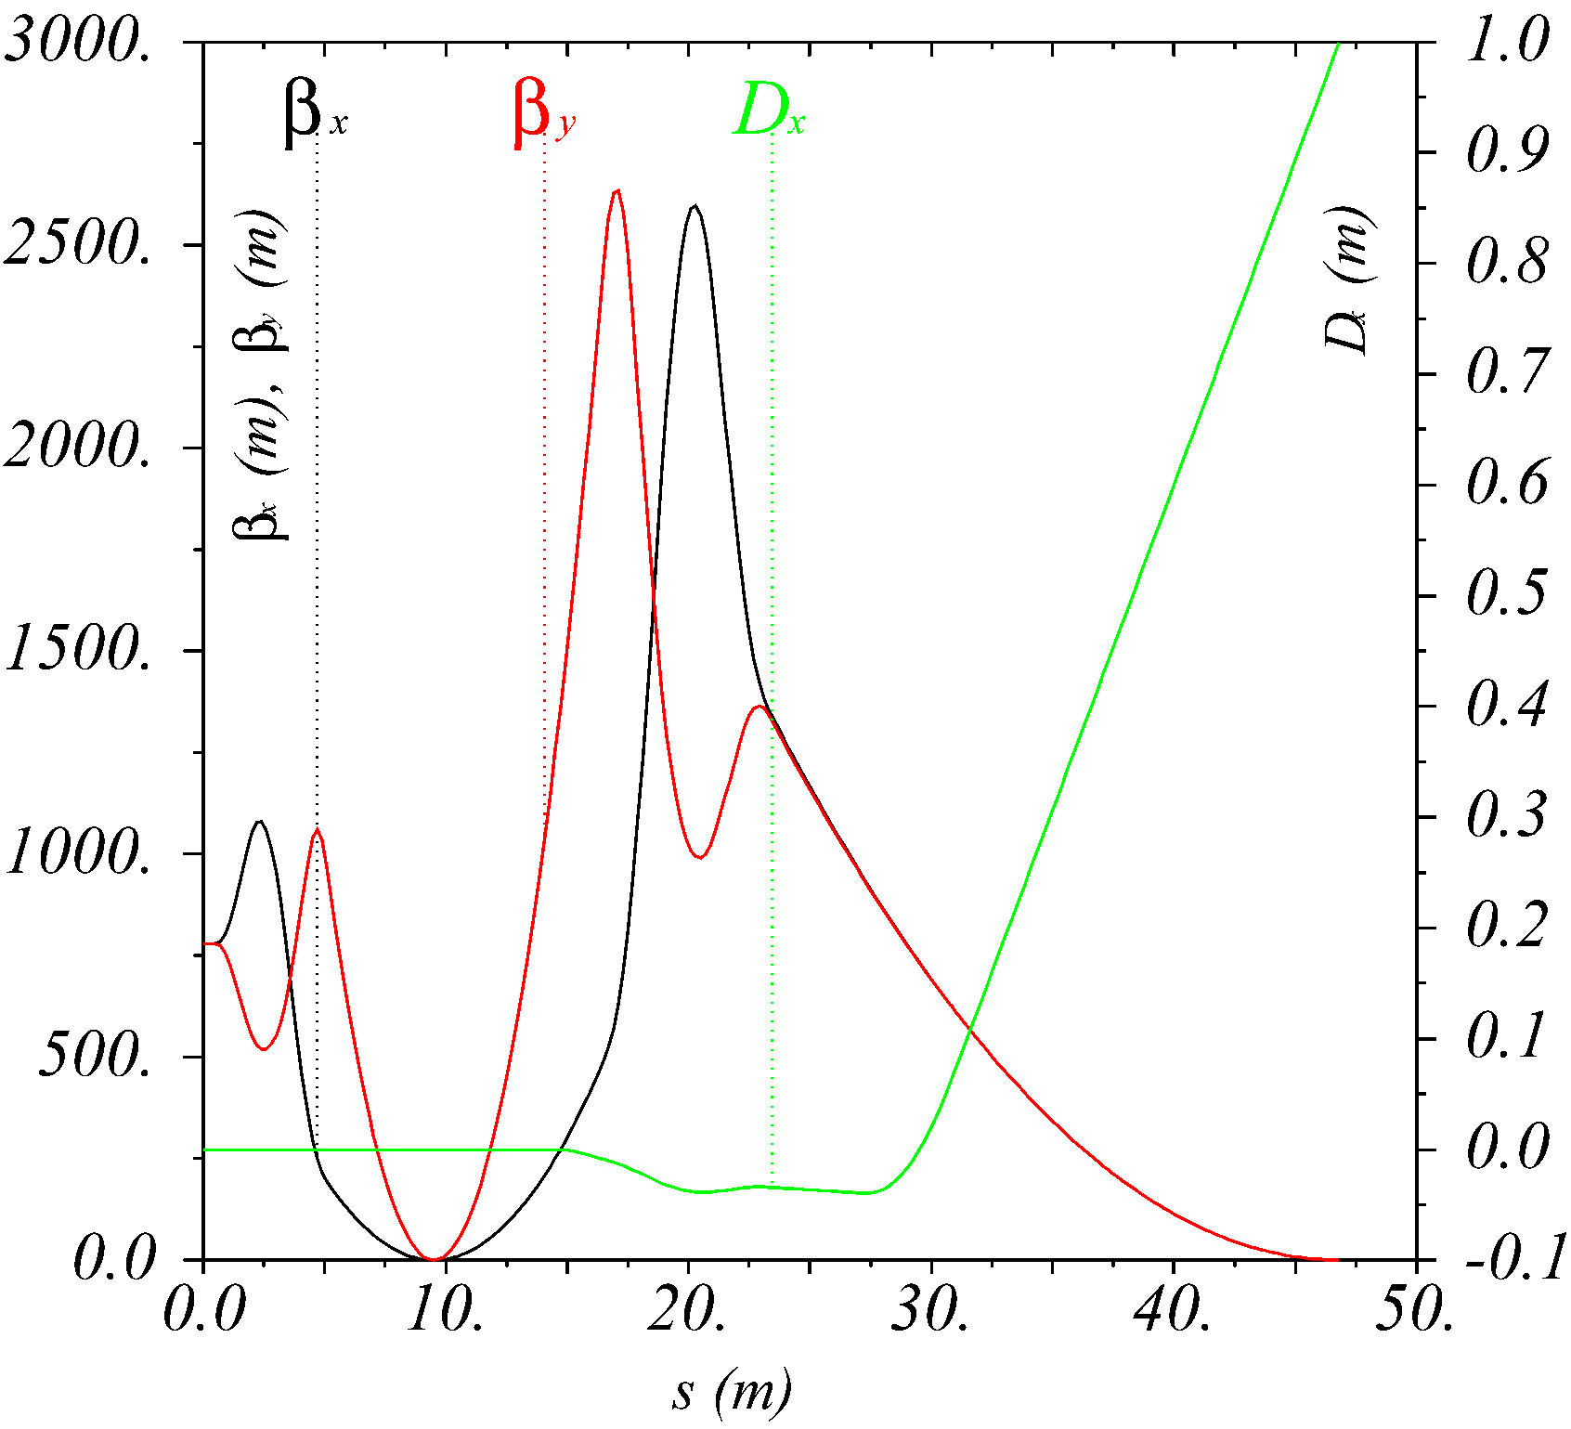
Far-Forward Ion Detection
Ion remnant/Tagging
E.g., tagging nucleon (p, n) structure function from e-d
Hadron detection in three stages
Endcap with 50 mrad crossing angle
Small dipole covering angles to a few degrees, detect down to 0.5 degree before ion final-ficus quads
IP
FP
Ultra-forward up to >0.5 degree, for
particles passing accelerator quads
Beamline functions as spectrometer: dp/p < 3x10⁻⁴ (i.e., at 50 GeV/u, Δp = 150 MeV/c ~ Fermi momentum)

Slide 24
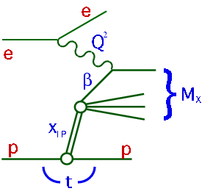
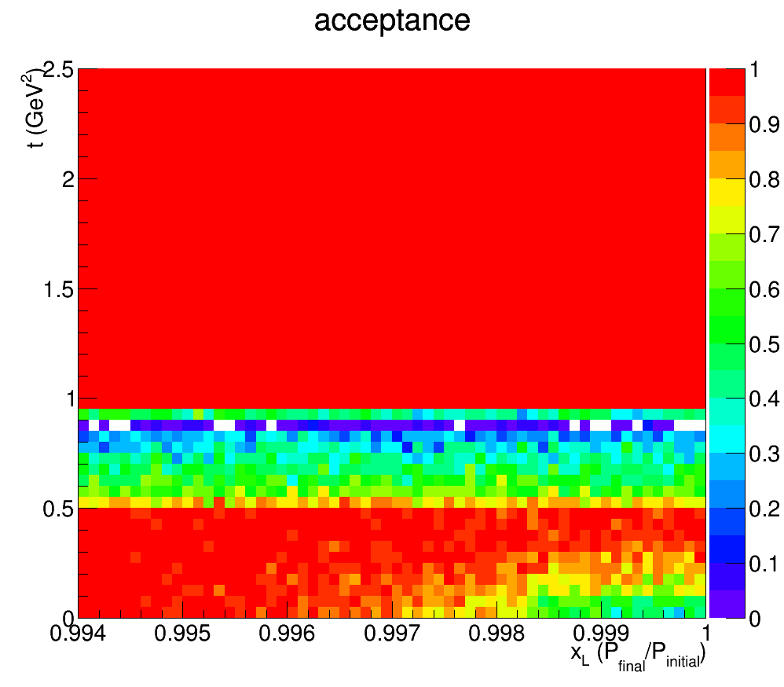
Full Acceptance for Forward Physics!
Example: acceptance for p’ in e + p → e’ + p’ + X
Diffraction
t, GeV²
0.994
1
Huge gain in acceptance for diffractive physics and forward tagging to measure F₂^{n}!!!

Slide 25
JLEIC Detector Documentation
Given that a JLEIC detector is still far away in years, we decided to take a different approach to documentation, and concentrate more on short high-level introductory documents such that new interested parties can get up to speed fast
What do we have, is ongoing, and have planned, each as 5-10 page documents?
  Overall strategy of integration of detector in JLEIC collider interaction region (Rik Yoshida, Markus Diefenthaler, Yulia Furletova)
      https://jleic-docdb.jlab.org/DocDB/0000/000001/001/JLEIC-InteractionRegionDetectorDesign.pdf
  Three documents on
    Forward Electron Detection Region (Dave Gaskell)
    Central Detector Region (Markus Diefenthaler, Yulia Furletova)
    Forward Ion Detection (Vasiliy Morozov et al.)
  Two further documents are next, on
    Hadron identification (Rachel Montgomery, Patrizia Rossi)
    Calorimetry (Tanja Horn)

Slide 26
Conclusion
Physics of nucleon and nuclear structure must drive the design.
High luminosity and polarization are essential for EIC physics program.
EIC physics program demands a total acceptance detector. This means excellent forward/rear coverage in addition to the central coverage.
Particle identification is crucial (e.g., for flavor decomposition)
    High performance DIRC with time-based reconstruction
    High-resolution crystal-based calorimetry
    Highly specialized aerogel RICH with TOF
    High-resolution TOF
R&D for accelerator, interaction region and detectors are progressing in a good collaboration among Accelerator Physicists, Experimentalists, and Theoreticians. Machine parameters, interaction region and detector design must go hand in hand, paying close attention to the emerging physics program of the EIC.
Anyone can get involved, see the backup slides if interested.
Notes:
26

Slide 28
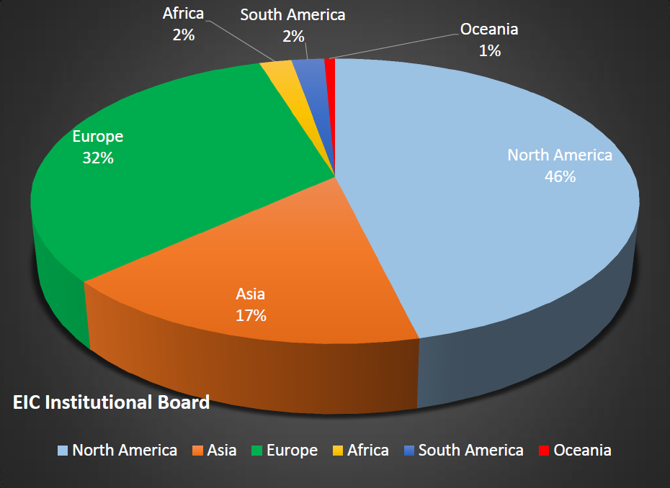
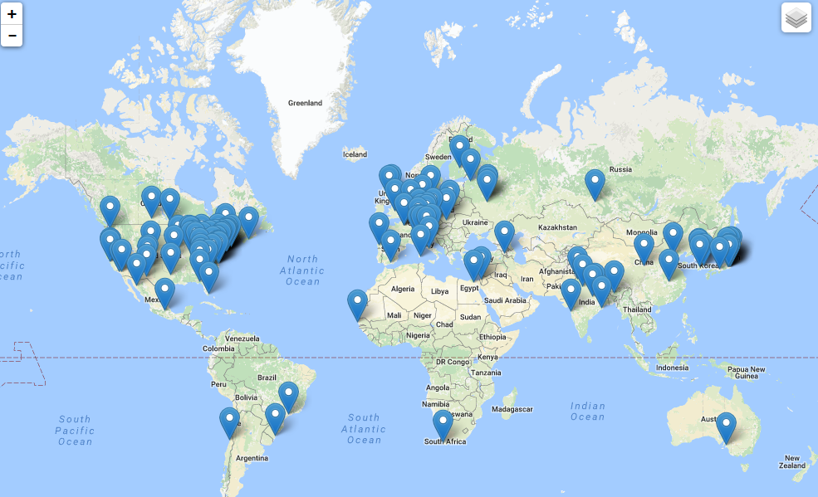
Worldwide Interest in EIC Physics
The EIC Users Group: EICUG.ORG
(no students included as of yet)
670 collaborators, 28 countries, 150 institutions... (December, 2016)
Map of institution’s locations

Slide 29
http://www.eicug.org/web/newmembers

Slide 30
EIC Final State Particles
Possible to get 100% acceptance for the whole event
Scattered electron
Ion beamline
Electron beamline
Particles Associated with Initial Ion
Particles associated with struck parton
Beam elements limit forward acceptance
Central Solenoid not effective for forward
Central
Detector
Beam Elements
Beam Elements
Notes:
30

Slide 31
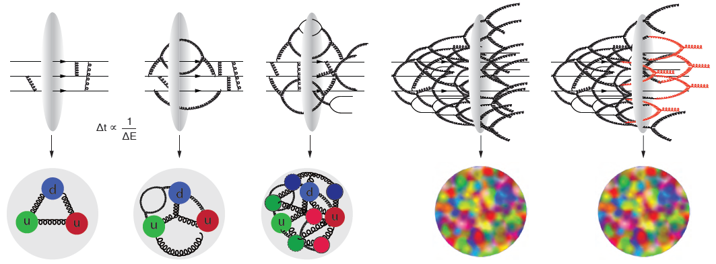
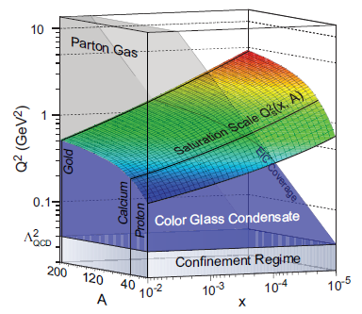
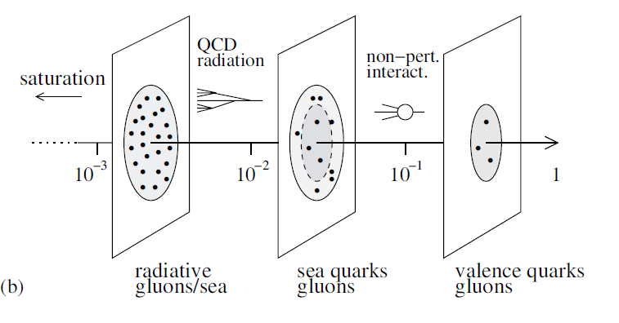
The Evolution of a Proton – Deep into the Sea
Resolution
=
>
Saturation

