Slide 1
AD status
Stable running from the start-up until early September with >3E7 pbars/cycle ejected and very little downtime.
Excellent beam quality (transverse and long. Emittances)
Increased downtime and reduced intensities (losses during the last ramp) during the last 2 weeks due to:
  C02 RF system: resettable trips, self-recovering trips, controls problems, intermittent longitudinal blow-up
  Orbit jumps
  Injection/ejection kickers: trips sometimes needing specialist resets
  Unstable horizontal position of ejected beam (ejection septum)
  Power converter controls problems
  Electron cooler trips needing long re-starts
3400 Physics hours realised so far
Beam availability since 25/4: 83%, AD machine uptime: 90%

Slide 2
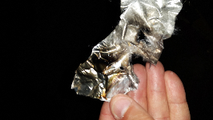
News from the weekend: short circuits at ring magnet connections, likely to be the cause of some of the beam losses
Most likely caused by bake-out jackets grounding some current from the main quadrupole circuit touching the coils at two different quads.
We fixed it at those places, but there are many other places looking dangerous. To be followed up.

