Slide 1
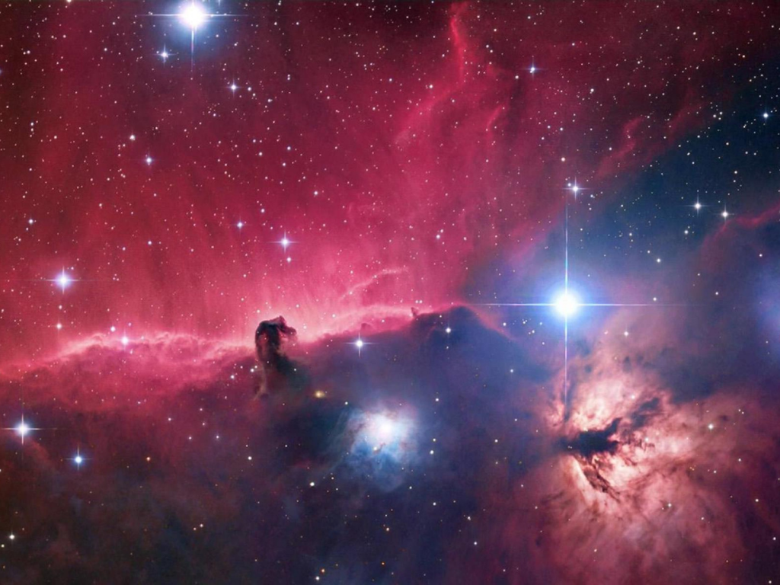





A journey into the fundamentals of matter
Dr Gianluca Valentino
Lecturer, University of Malta
Visiting Scientist, CERN

Slide 2
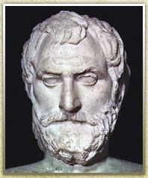

What is Matter made of?
According to the Ancient Greeks:
  All matter consists of tiny particles which are so small that they could not be broken down into anything smaller
  Atamos = invisible

Slide 3
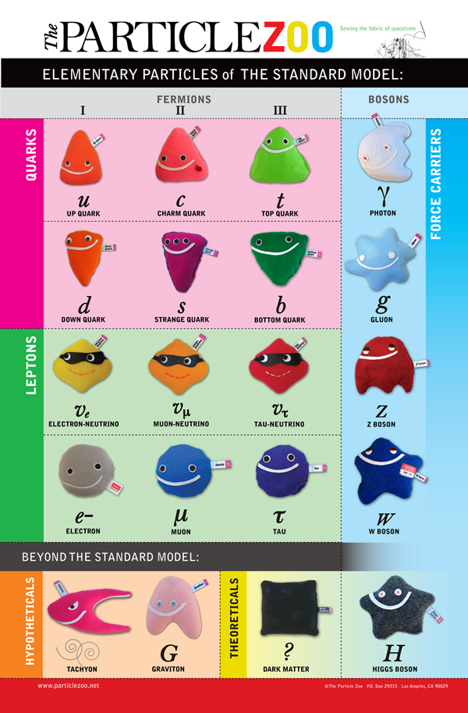
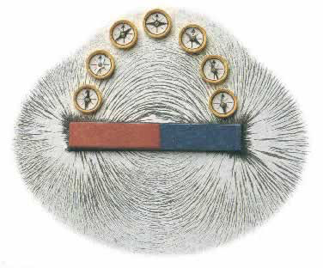
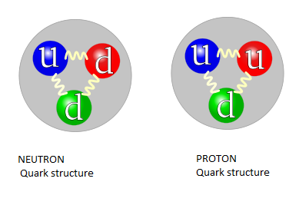


What scientists knew until 2012..
Nature’s 4 Fundamental Forces:
Electromagnetism:
Strong force
Weak force
Gravity:
Questions: why does matter have a mass? Why are protons heavier than electrons?
Possible answer: is there yet another particle which gives mass to other particles?
We test theories through experiment.
What experiments have you done so far?
?
?

Slide 4
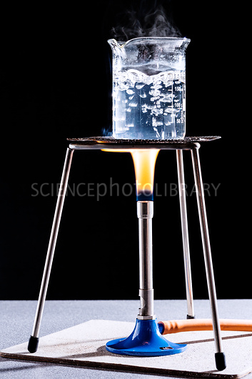
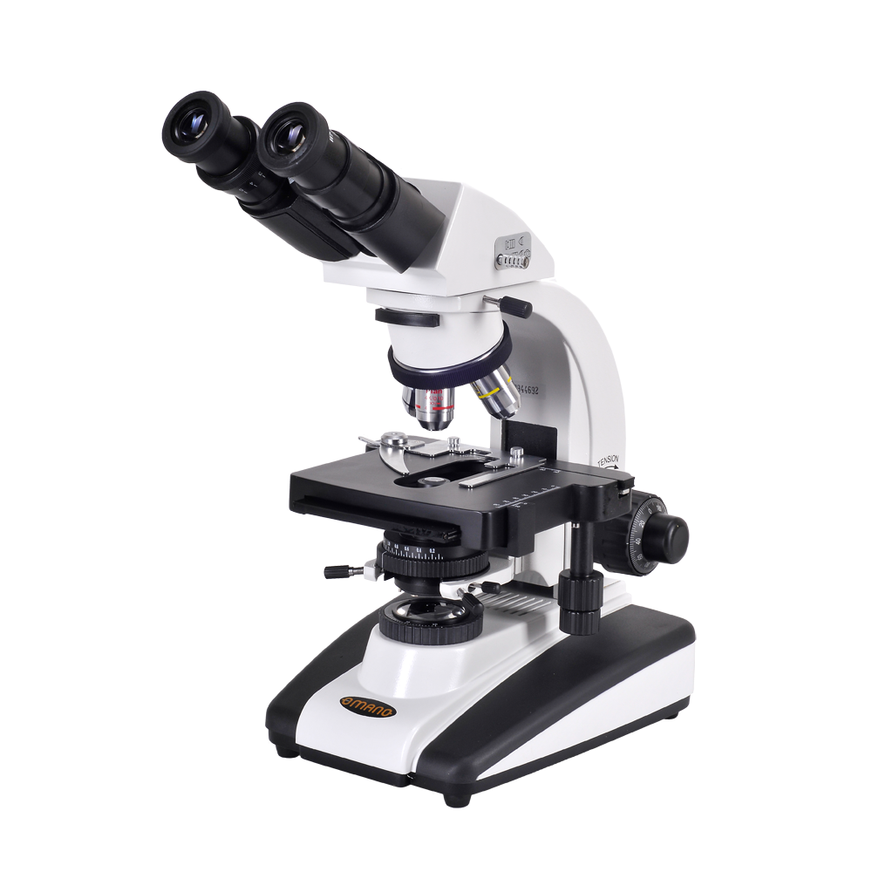
Measuring the properties of sub-atomic particles
If we want to perform an experiment, we need apparatus and a detector
Apparatus: e.g. Bunsen burner, a beaker, a magnet, iron filings etc
Detector: e.g. our own eyes, a microscope

Slide 5

Measuring the properties of sub-atomic particles
But sub-atomic particles such as the Higgs boson do not occur “naturally”!
So we need to:
  Produce a Higgs boson
  Measure that we produced a Higgs boson and not something else

Slide 6
Measuring the properties of sub-atomic particles
We create new particles by colliding high-energy protons together.
So we first need to accelerate protons and then collide them: we need a particle accelerator.
The new particles are too small to be seen using our eyes or a microscope: we need a new type of detector.
We know that when particles travel through certain gases, they produce electricity which can be measured.

Slide 7


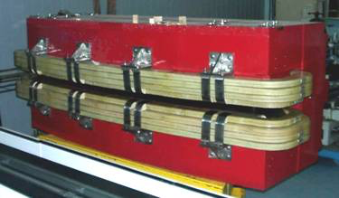
Basics of particle accelerators
To achieve a very high energy, we need to accelerate the protons over many, many turns of a circular accelerator
A charged particle is bent in a magnetic field
Proton
A dipole magnet from a particle accelerator

Slide 8
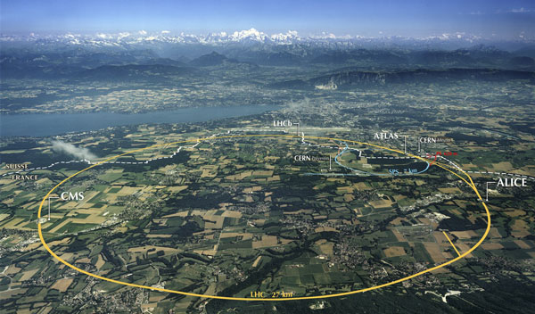
The CERN Large Hadron Collider

Slide 9
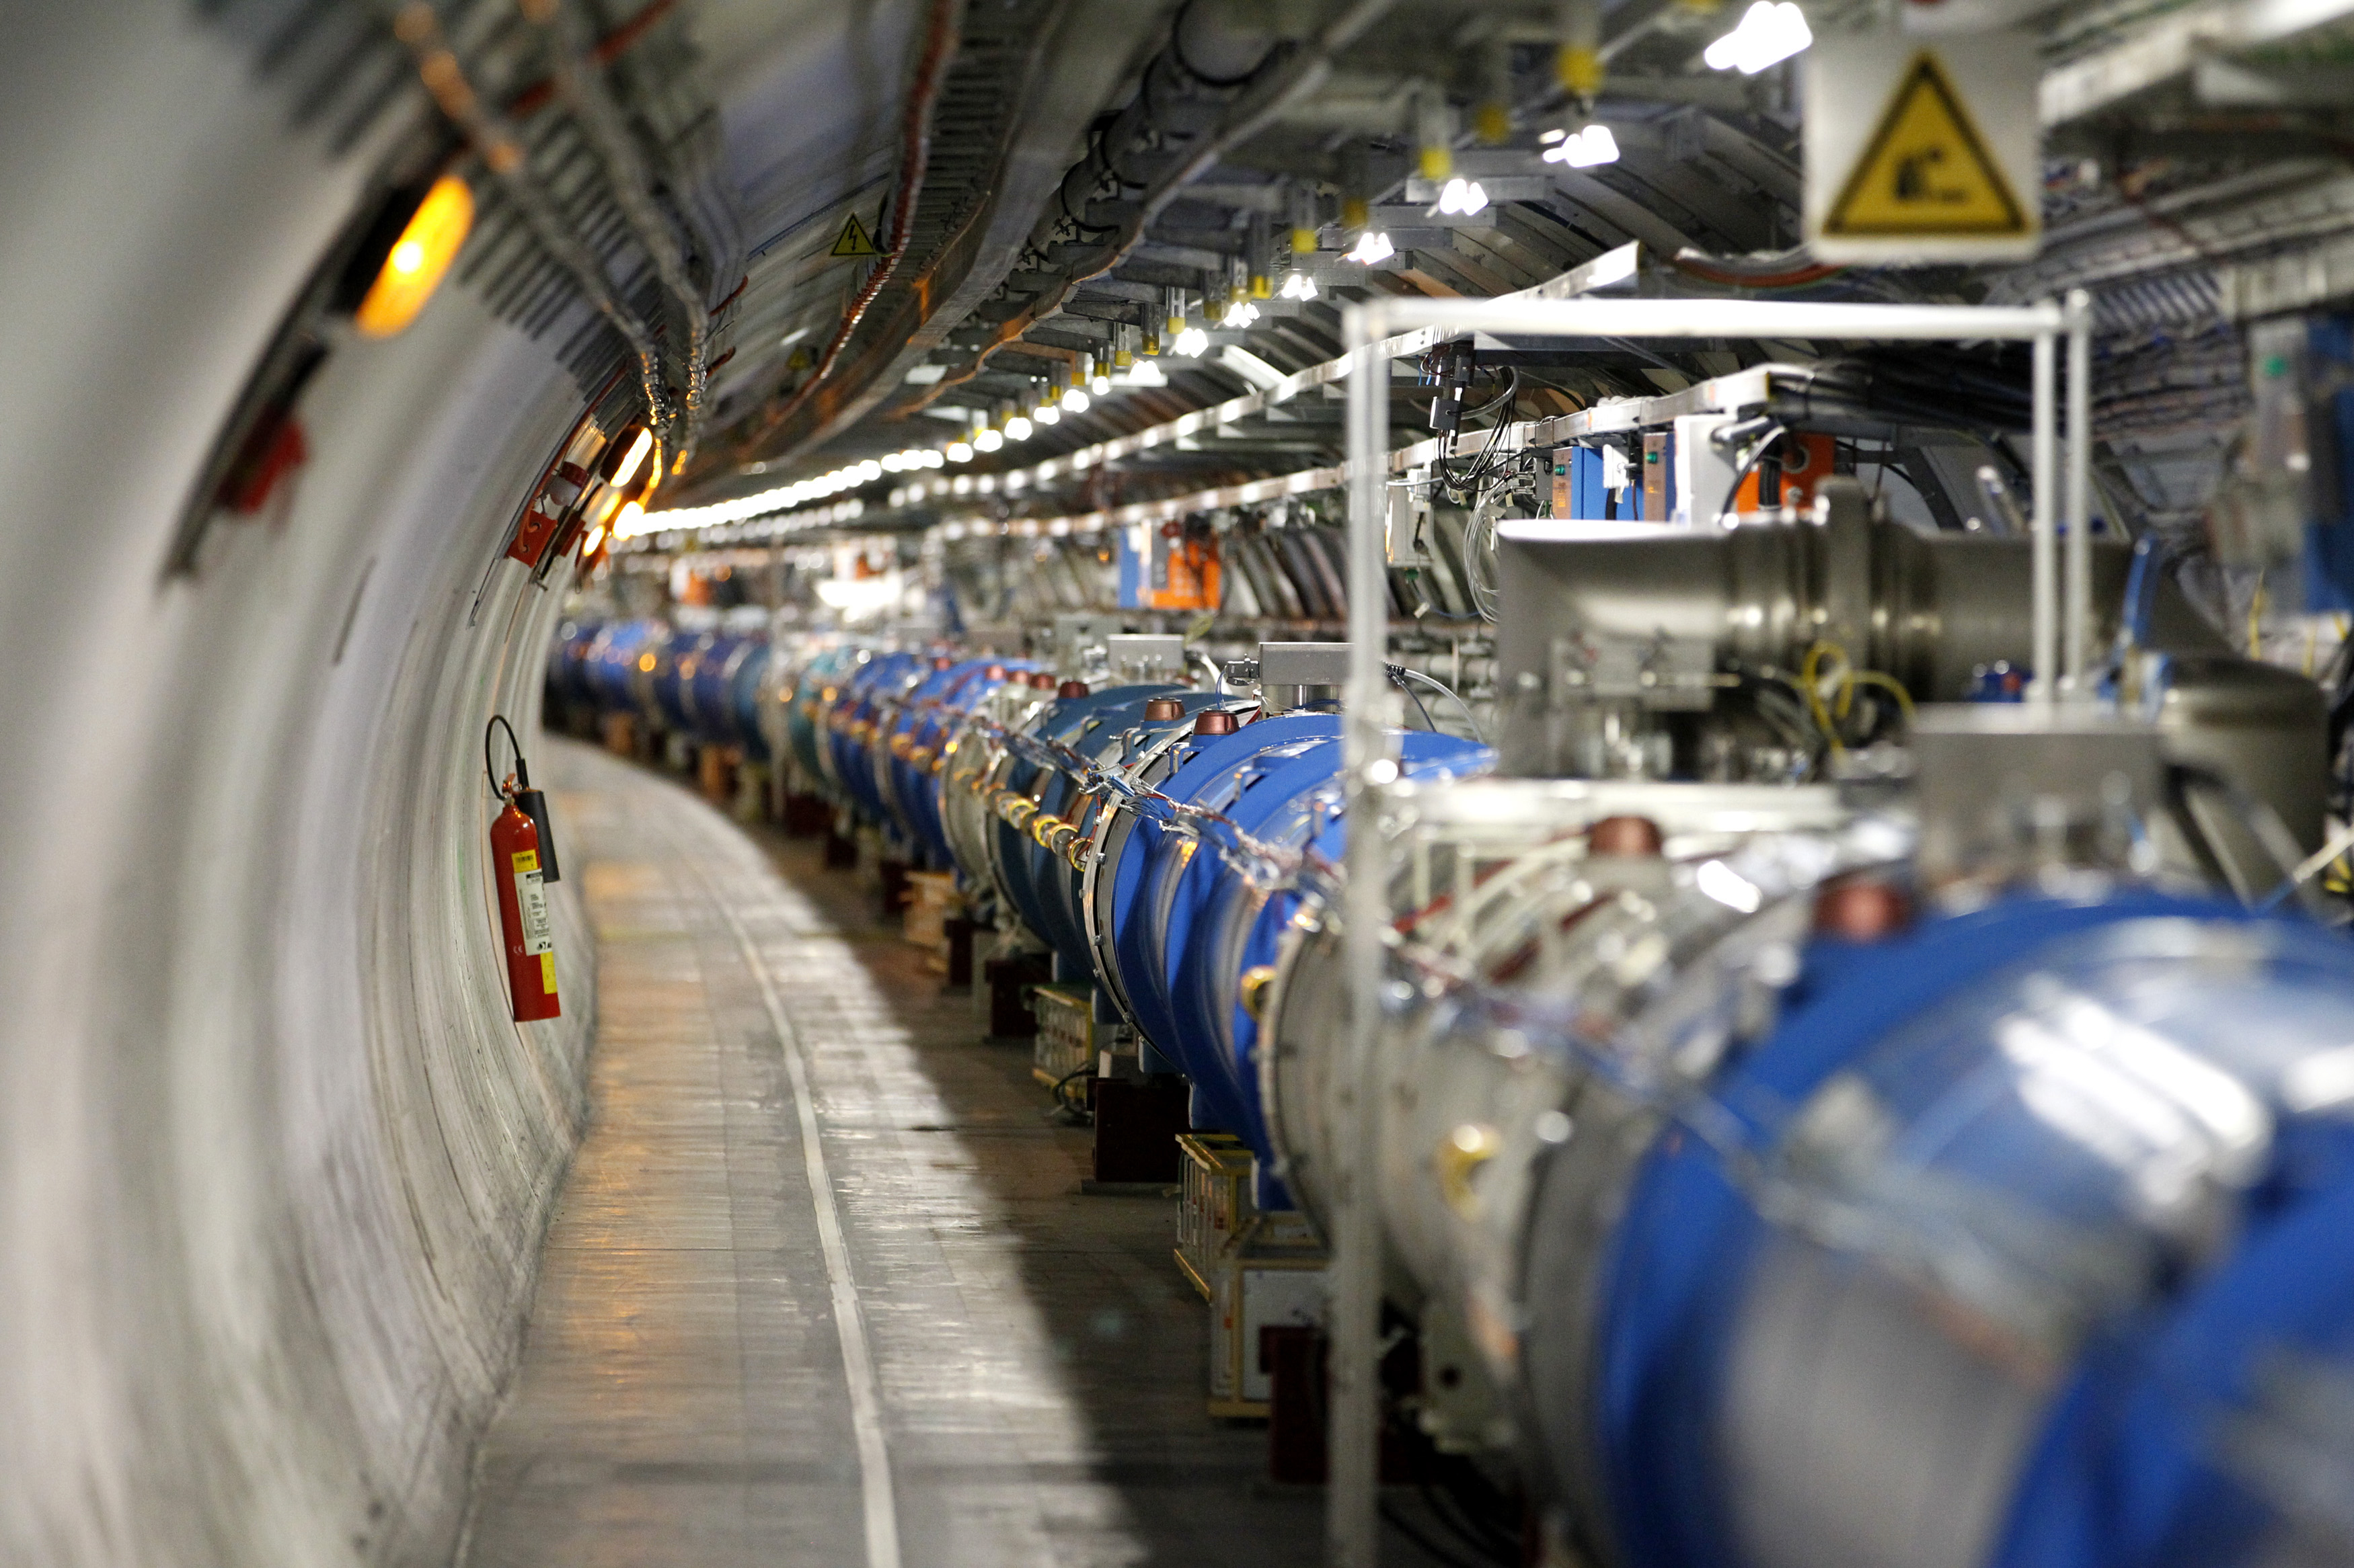


The CERN Large Hadron Collider
/
100 metres underground

Slide 10

Large Hadron Collider: Fun Facts
The LHC is the largest scientific experiment ever built
27 km circumference!

Slide 11
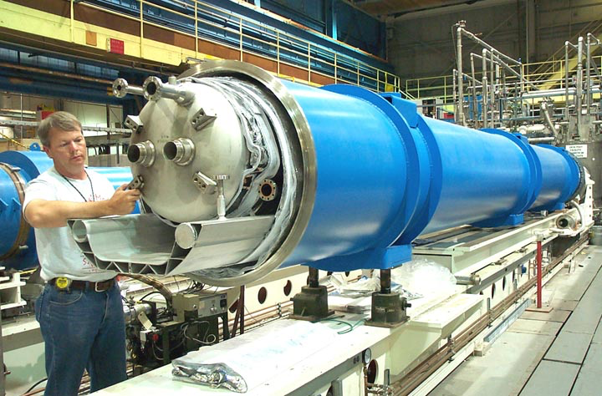
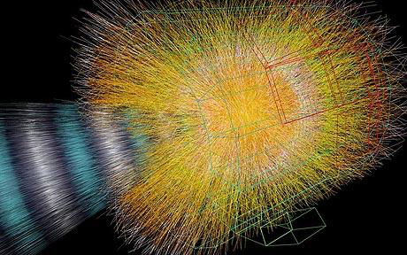
Large Hadron Collider: Fun Facts
It is the coldest place in the universe..
..but it can get very hot as well!
The LHC’s magnets need to be cooled to -273 degrees Celsius to become super-conducting
Help!!!
Collisions in the ALICE detector produce temperatures 100,000 times hotter than the centre of the Sun

Slide 12

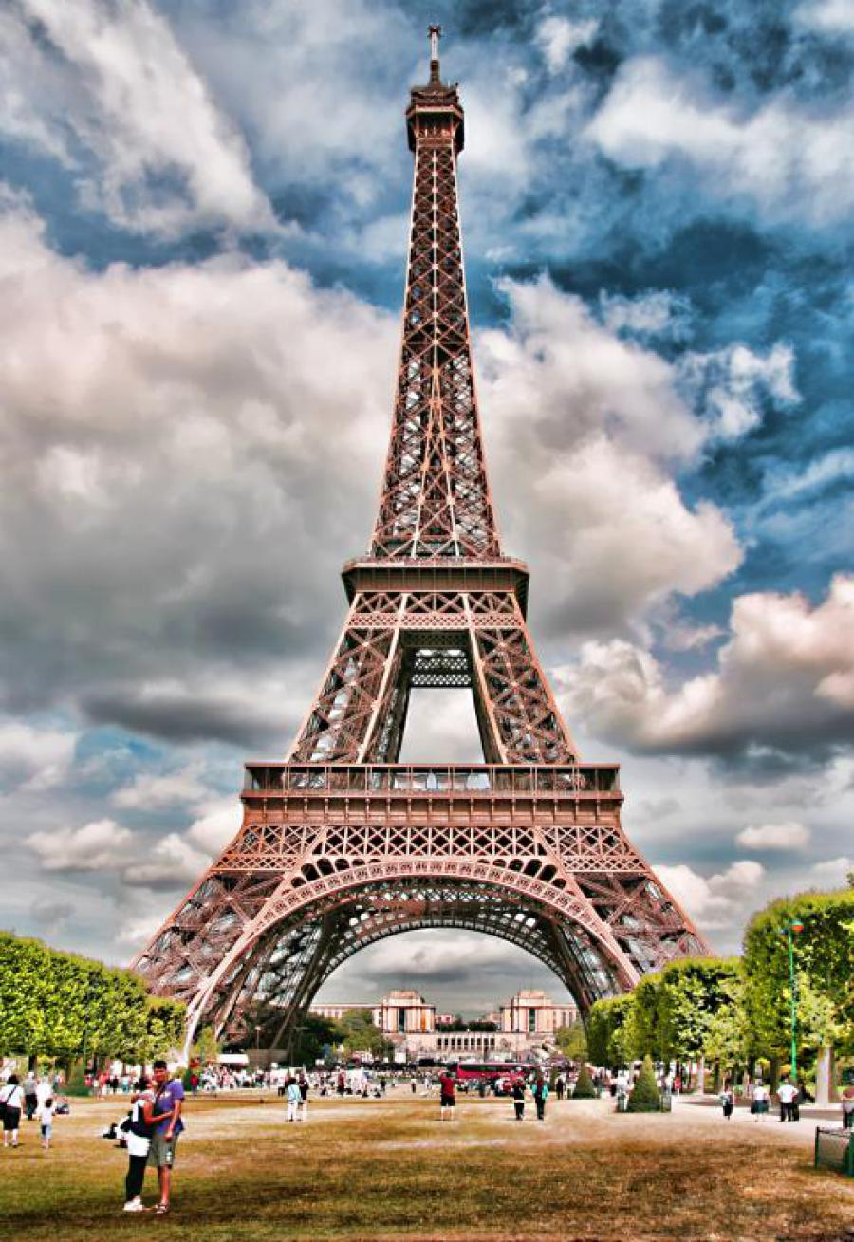
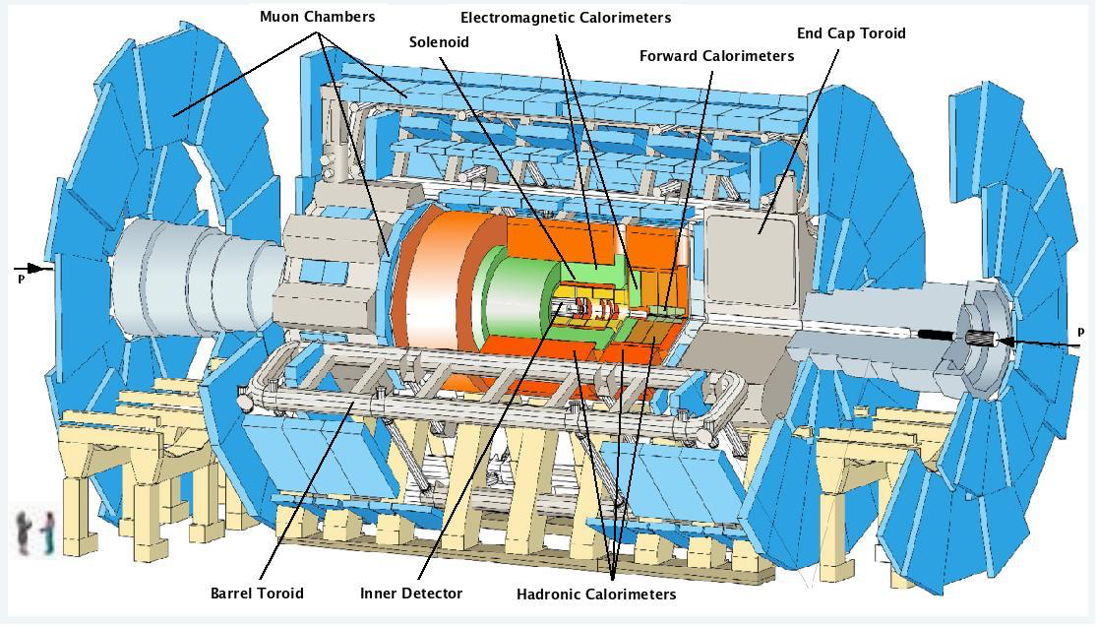

Large Hadron Collider: Fun Facts
The ATLAS experiment is the largest detector.
It is as tall as the Notre Dame cathedral and as heavy as the Eiffel tower in Paris!

Slide 13
How does the LHC work?
Video: the journey of a proton from start to finish

Slide 14
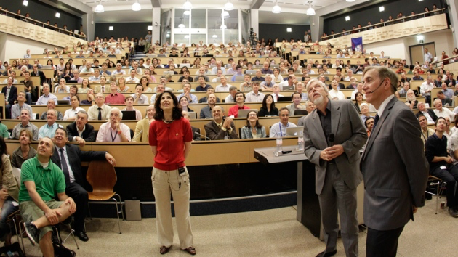
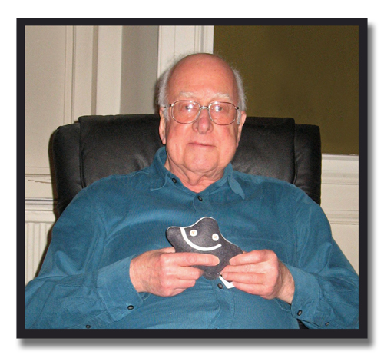

A new discovery!
On July 4th 2012, the ATLAS and CMS experiments announced the discovery of the Higgs boson
Peter Higgs (2013 Physics Nobel) holding a Higgs boson

