Slide 1
CPA/FC/HV Review
CERN – 9 November 2016
HVFT for ProtoDUNE SinglePhase TPC
Franco Sergiampietri
CERN - ETHZ

Slide 2
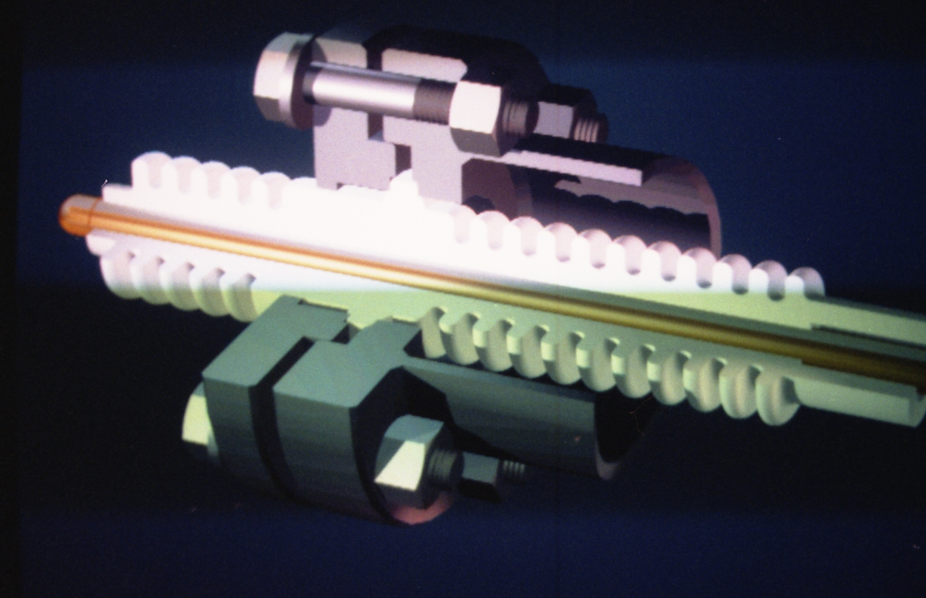
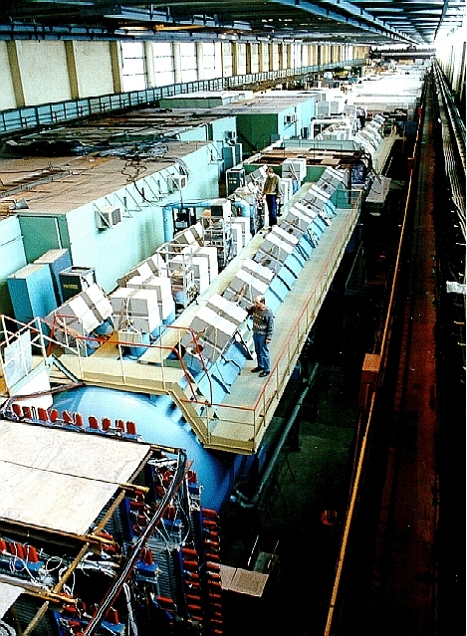
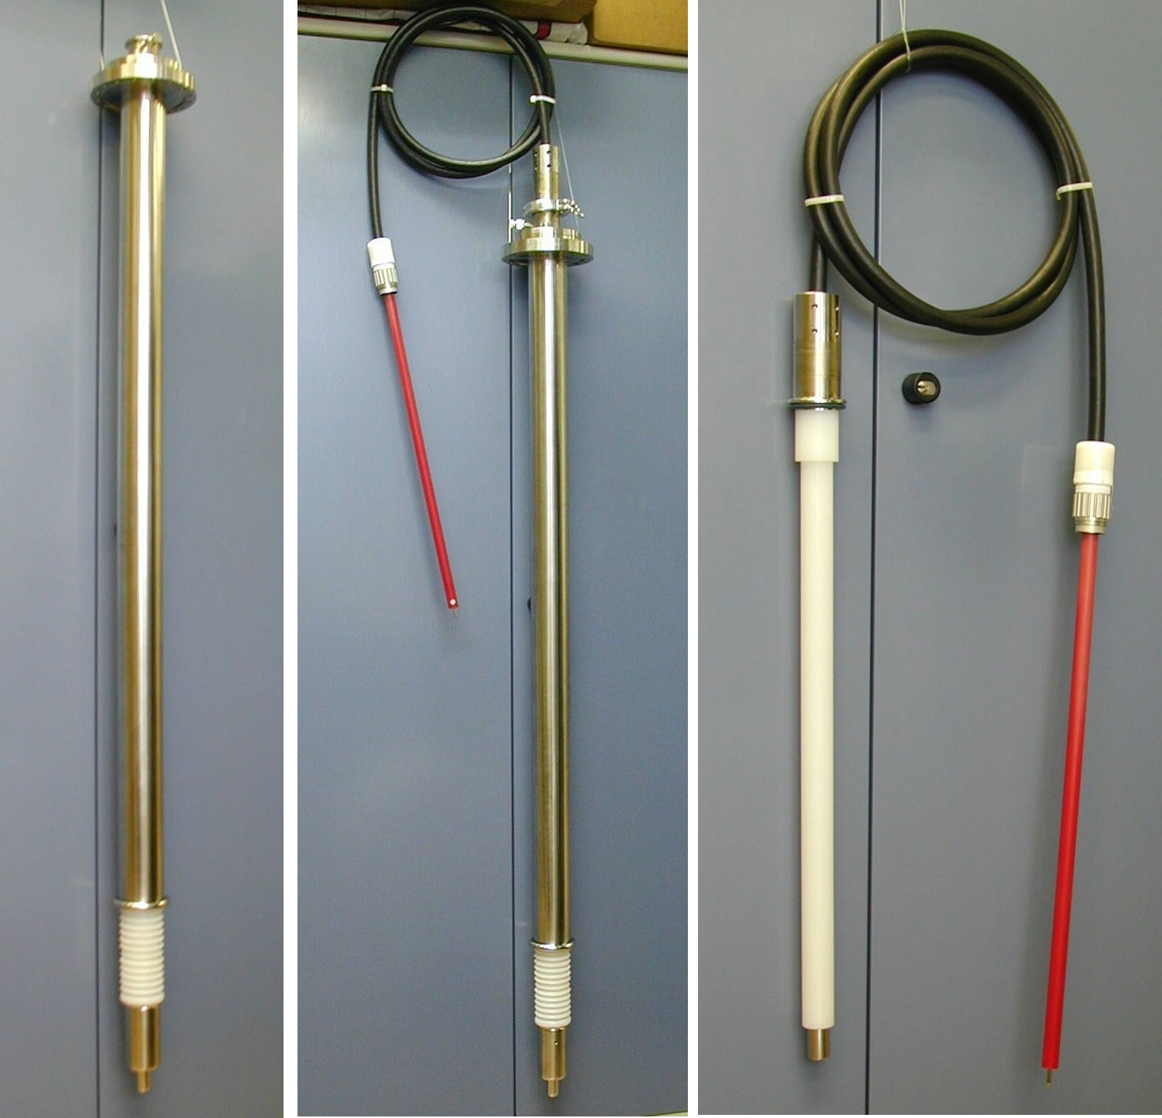
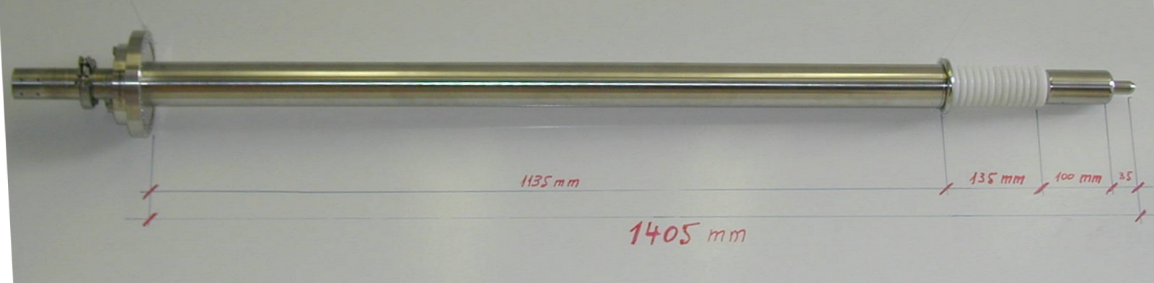
Past experience and references
Cryo/Thermo-fitting technology developed basing on many years experience
HVFT for ICARUS (1999)
Used at present also in the ArDM experiment at Canfranc
1st HVFT for BARS (Big Argon Spectrometer) IHEP – Protvino (RU) (1985)
N. 72 required
BARS, the liquid argon detector-target for tagged neutrino beams at the IHEP of Serpukhov
F. Sergiampietri
Fourth International Conference On Calorimetry In High Energy Physics, La Biodola, Italy
September 1993, Proceedings, P. 357
MARS-2: a “current sensitive” liquid argon calorimeter
C. Cerri, G. Gennaro, M. Ragadini, F. Sergiampietri, G. Spandre, S. P. Denisov, R. N. Krasnokutsky, A. A. Lebedev, S. A. Medved, V. S. Mikhailov, N. I. Naumov, E. A. Rasuvaev, R. S. Shuvalov, D. A. Stoyanova
Nucl. Instrum. Meth. A 227 (1984) 227
Design, construction and tests of the ICARUS T600 detector.
ICARUS Collaboration (S. Amerio et al.)
Nucl. Instrum. Meth. 221 A527:329-410, 2004

Slide 3
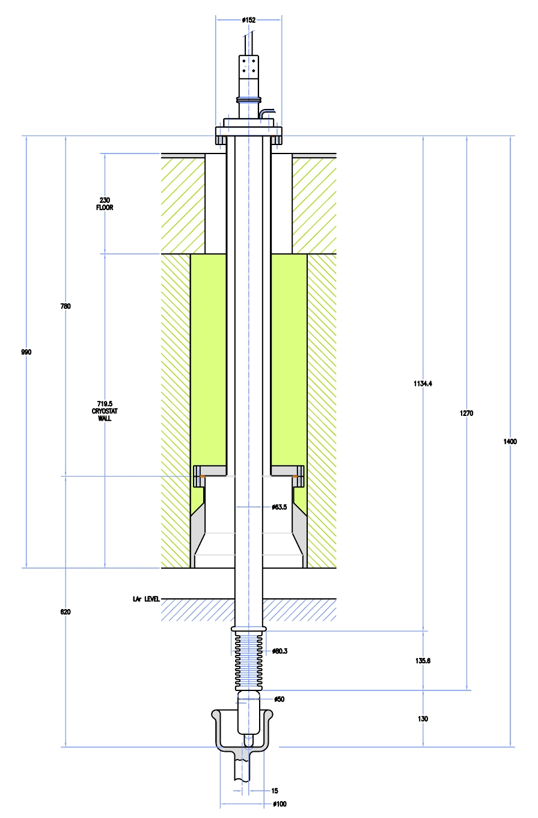
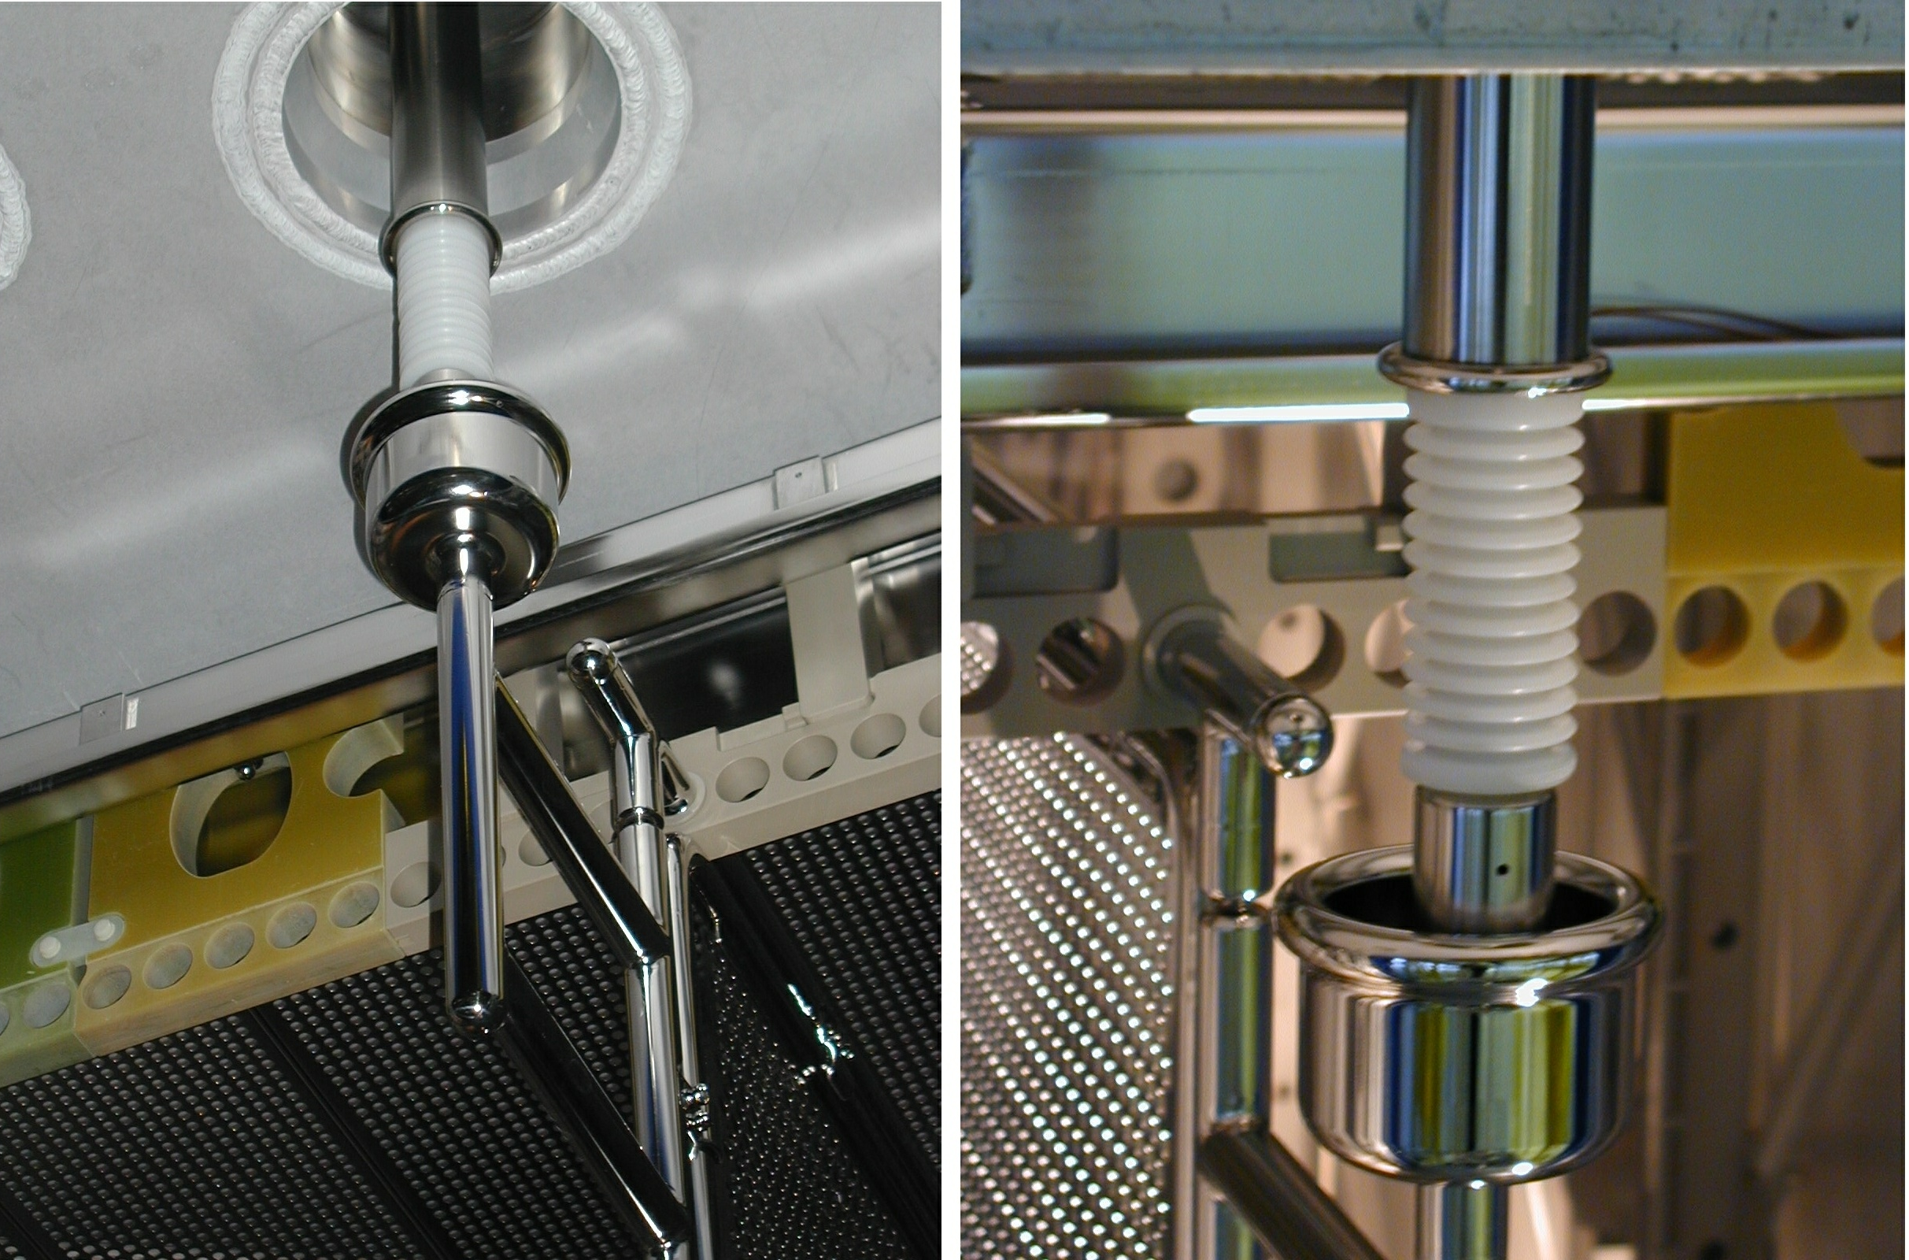
HVFT for ICARUS with elastic vertical/transverse sliding contact

Slide 4
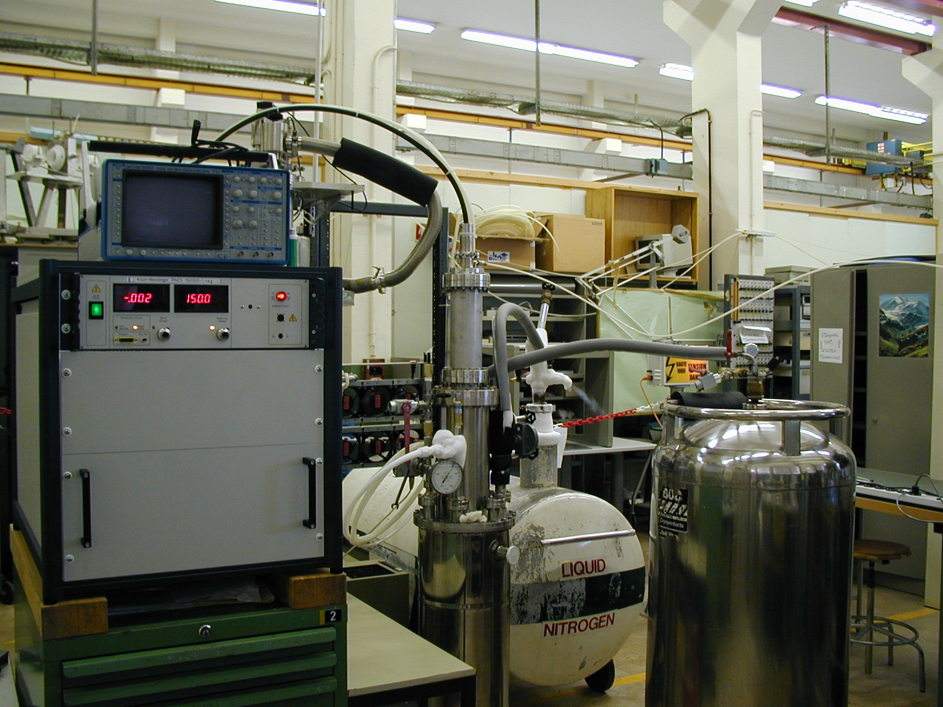
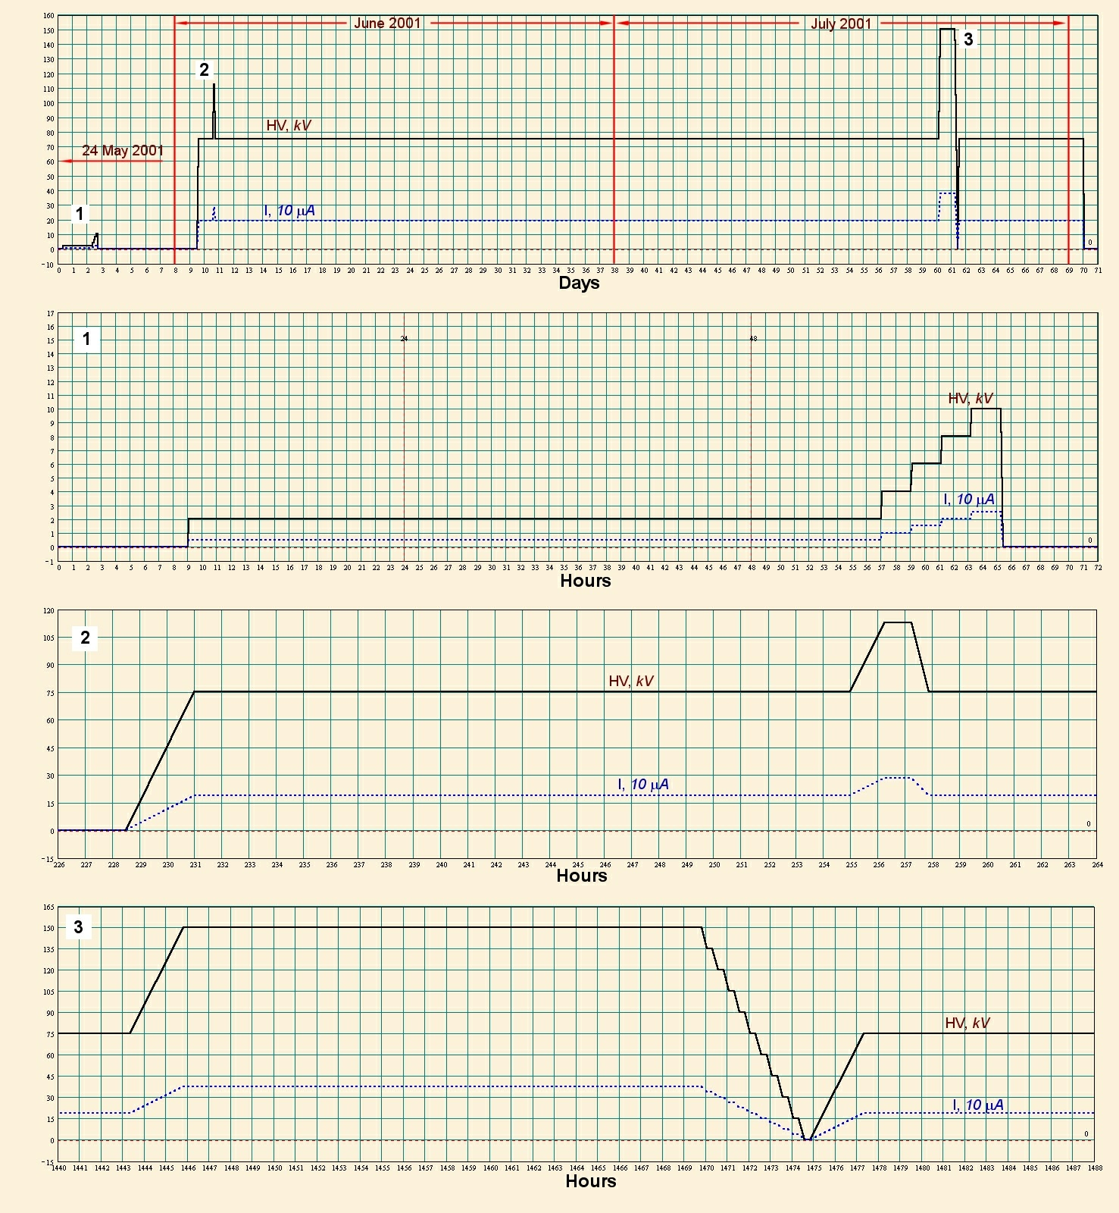
HV FT for ICARUS
HV FT for ICARUS (1999)
Positive laboratory test at CERN, 1999: HV = -150kV
Tested in ICARUS at -150kV, for 24h in Pavia (2001) and for several days at LNGS (2013)

Slide 5
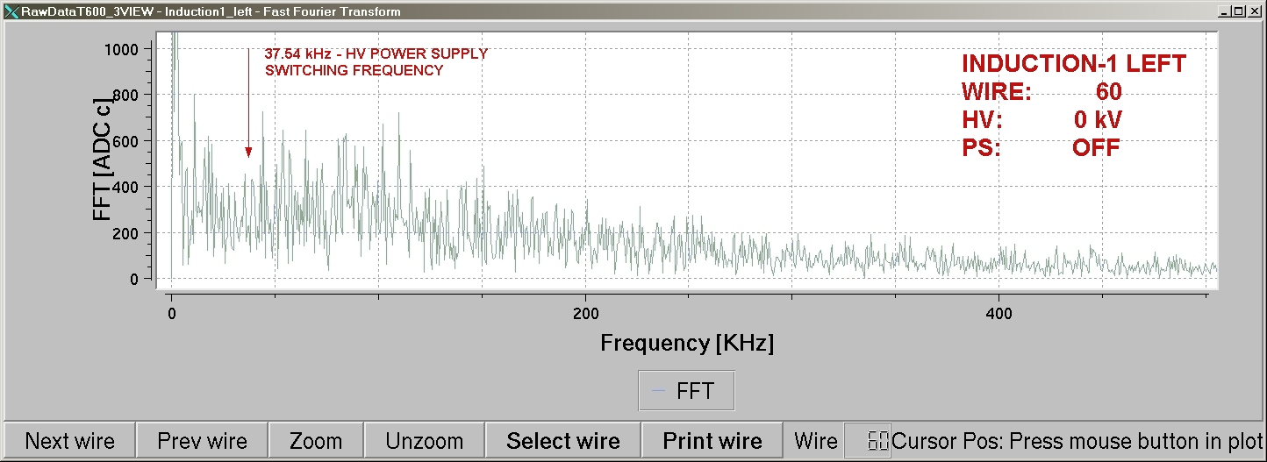
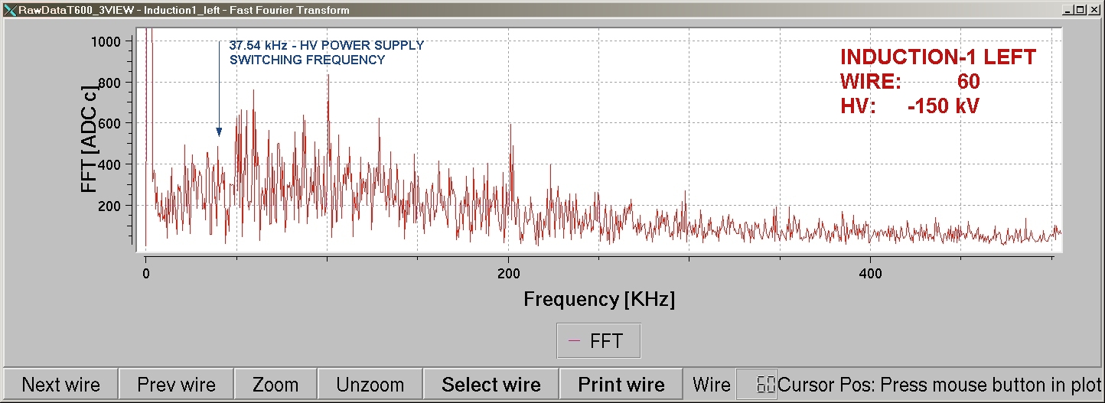
HV FT for ICARUS
HVPS residual ripple on the wire chamber with RC filter on the HV cable

Slide 6
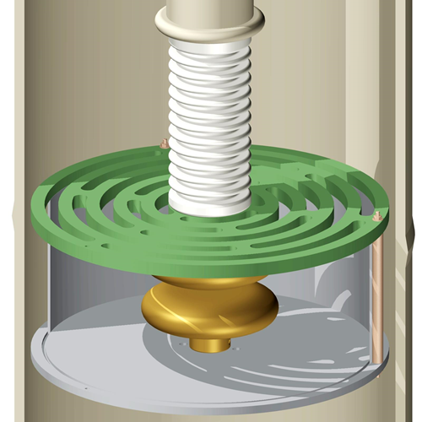
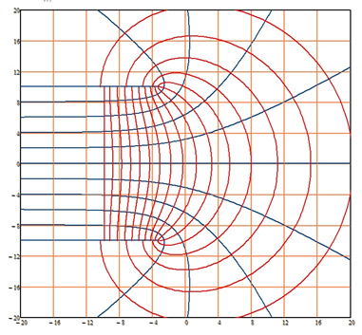
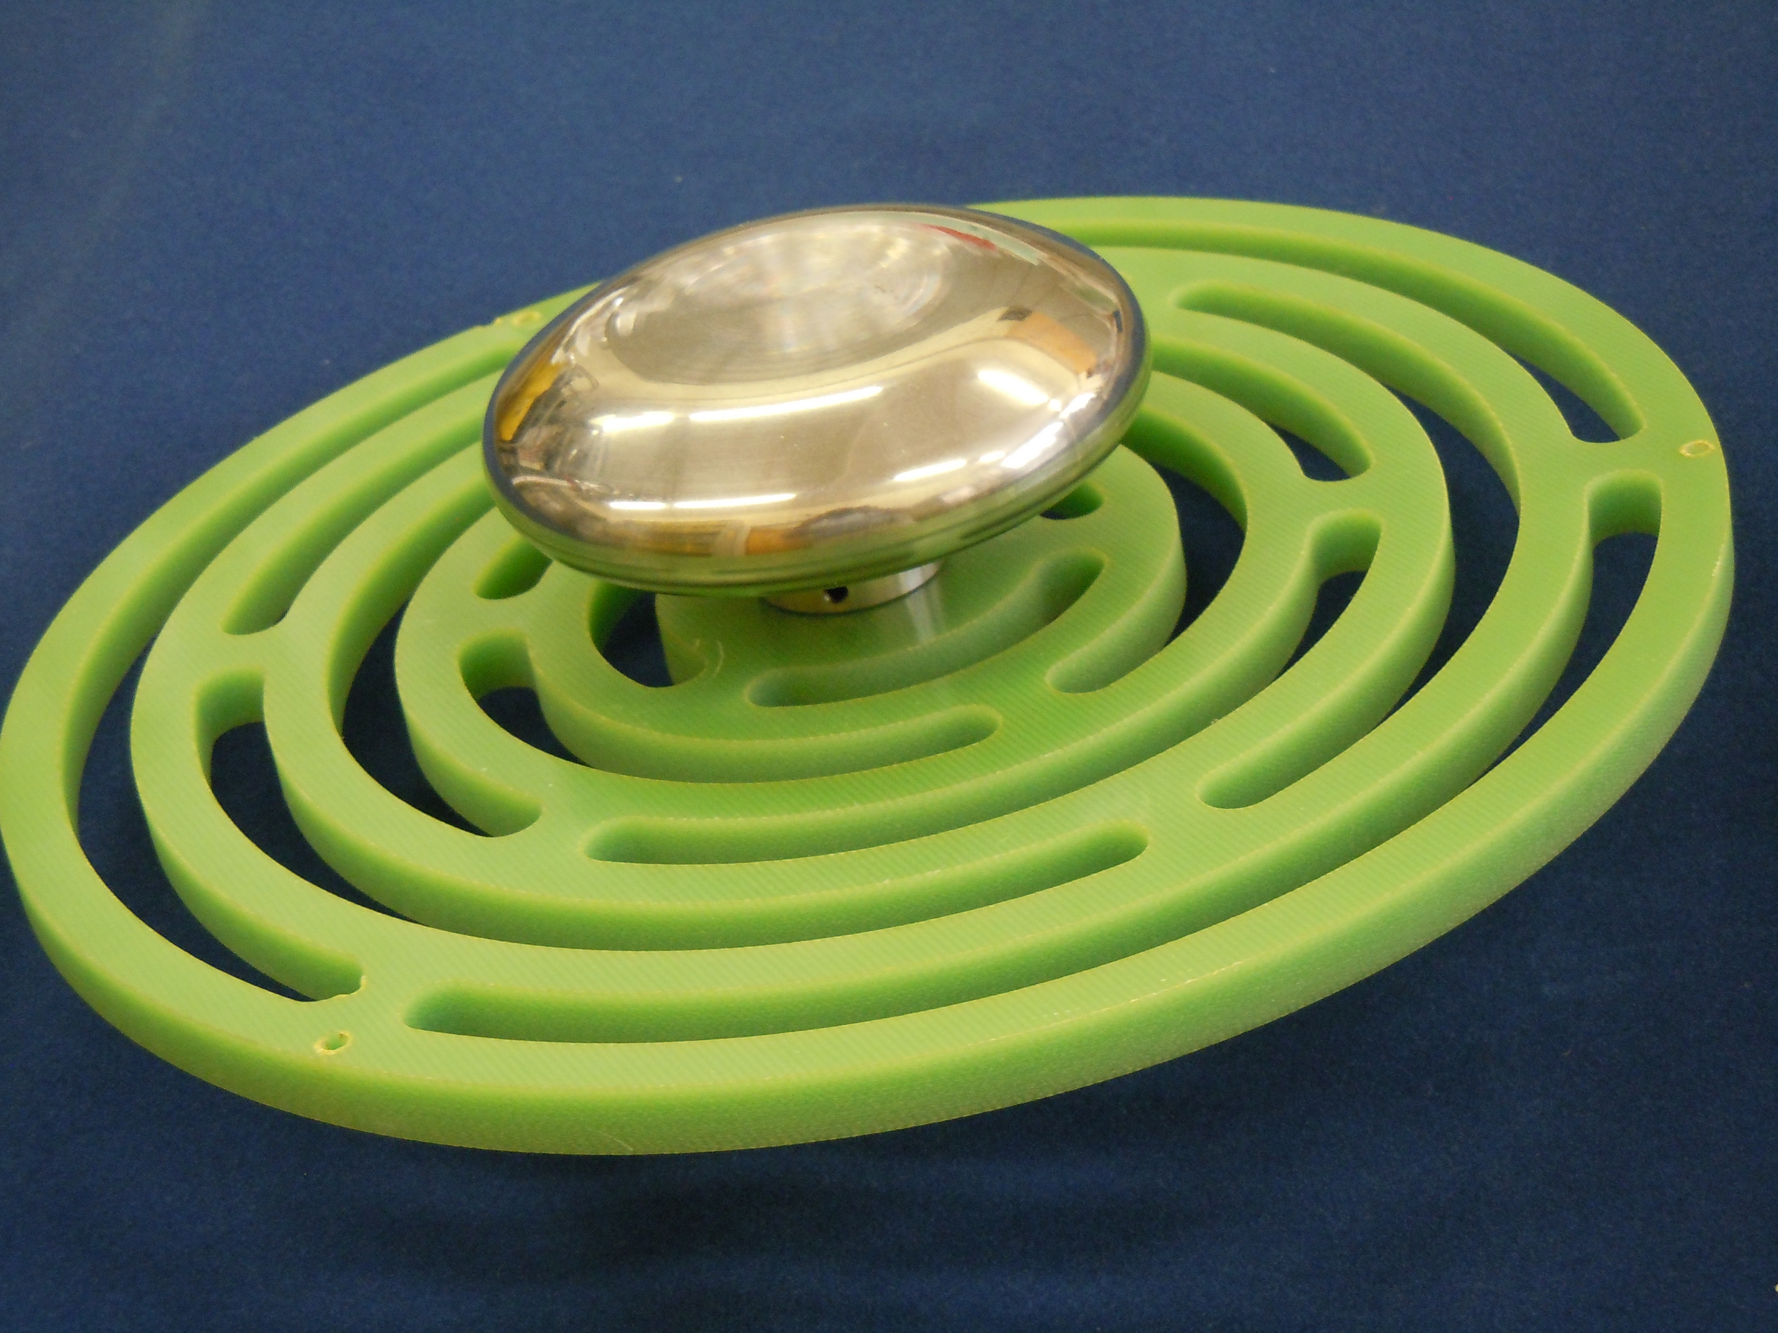
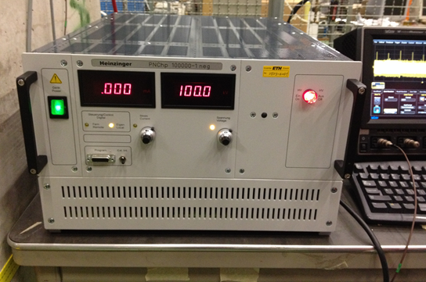
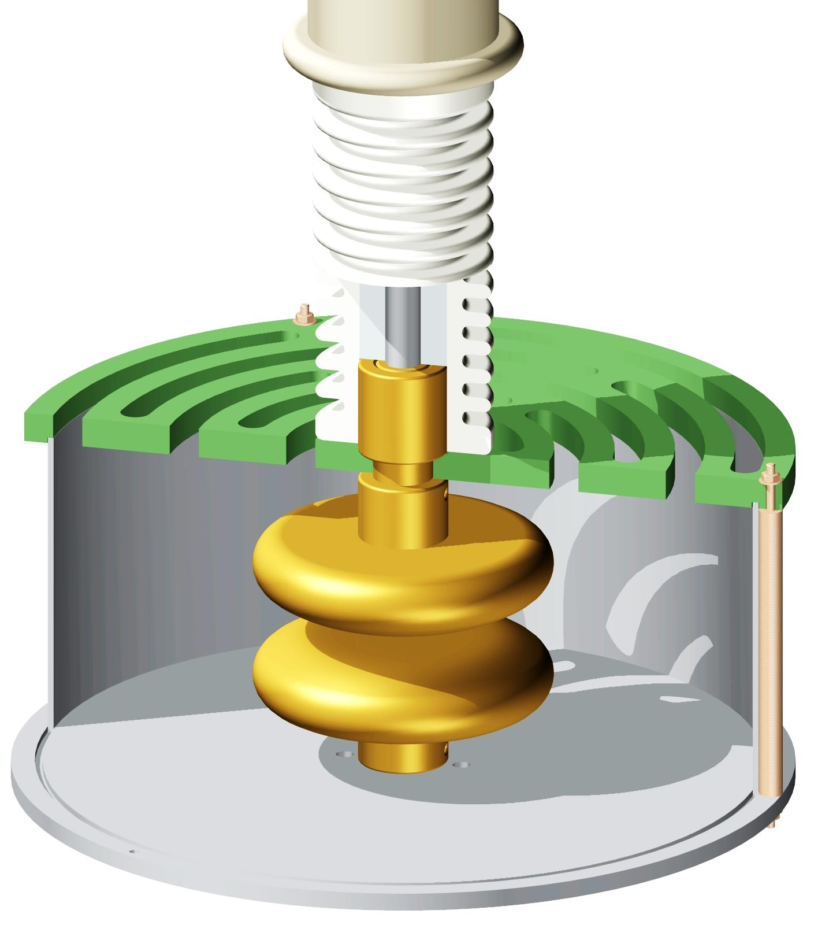
HV test of a Rogowsky profile pair in LAr (WA105)
Evidence of electric breakdown induced by bubbles in liquid argon
F. Bay, C. Cantini, S. Murphy, F. Resnati, A. Rubbia, F. Sergiampietri, S. Wu
http://arxiv.org/abs/1401.2777
W. Rogowski,
Arch. Electrotech., 12(1923), 1
Positive results (100.0kV - 0.000mA) with a HV-to-GND gap of 1cm when the LAr is quite
6

Slide 7
HVFT for Single-Phase ProtoDUNE
Recommended Liquid Level Position (~1cm over the terminal ground ring)
HMDPE RCH1000 with minimum thickness 36mm (breakdown voltage 90kV/mm)
Transversally and vertically sliding HV contact
7

Slide 8
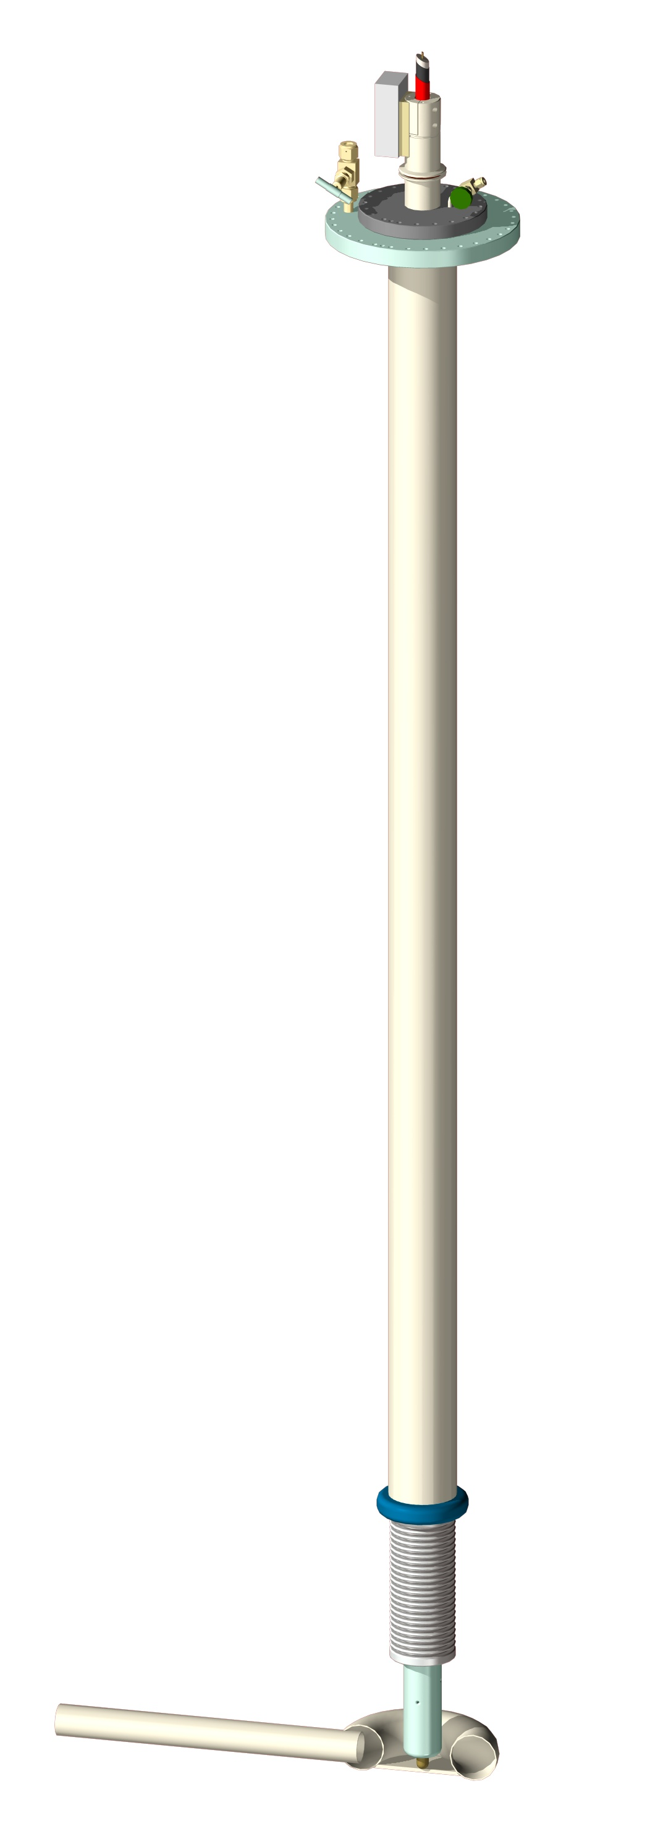
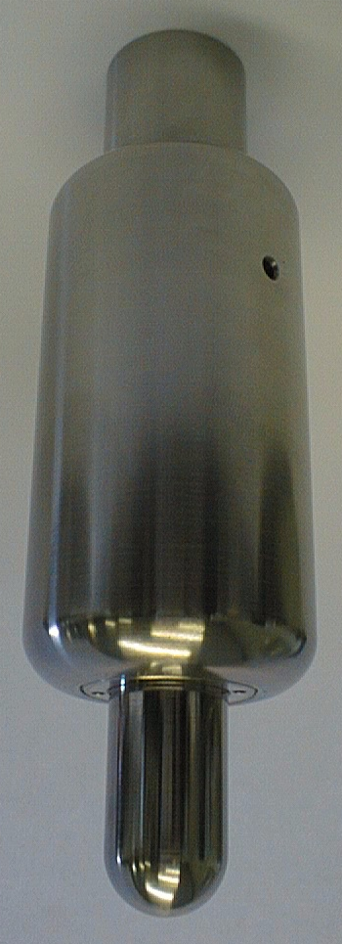
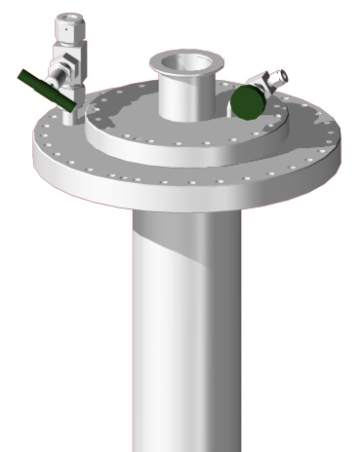
HVFT for Single-Phase ProtoDUNE
HV CHIMNEY PURGING VALVE
HV CABLE N₂ GAS PRESSURIZING/FLUSHING VALVE
CF250/306 FLANGE
ELASTIC SLIDING CONTACT
8

Slide 9
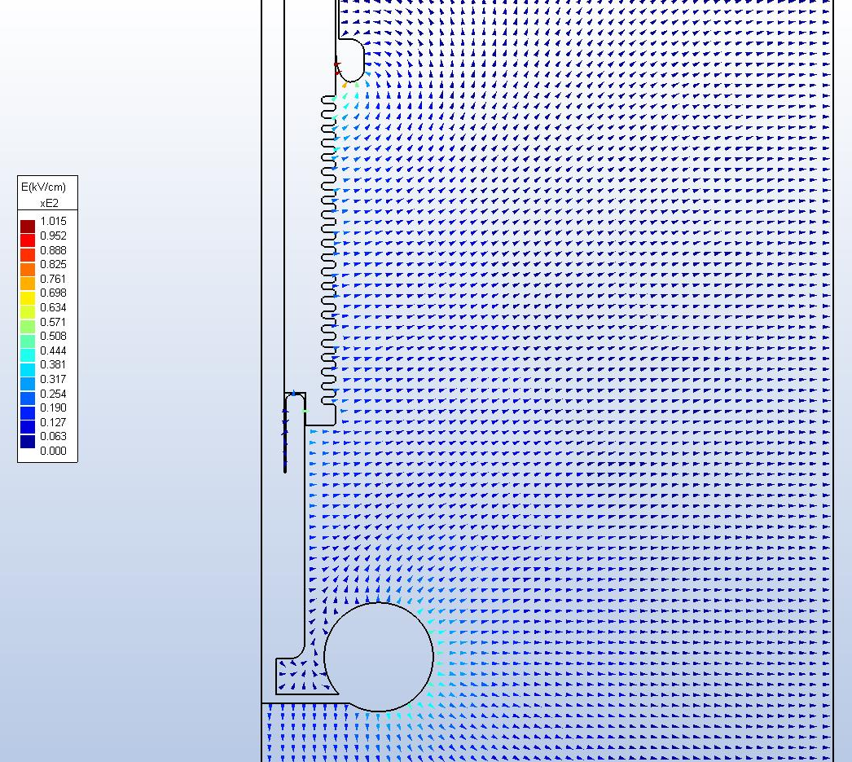
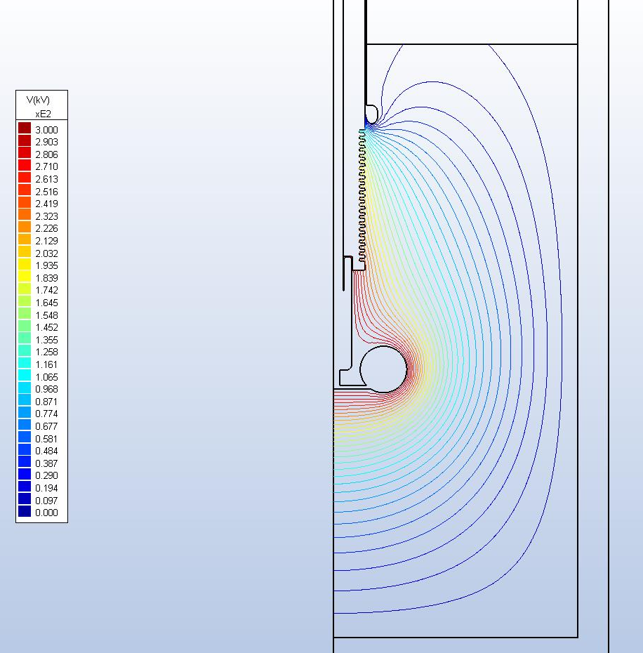
HVFT for Single-Phase ProtoDUNE
MAXIMUM FIELDS RESULTS ~⅓ HVPS VOLTAGE/cm (60.9kV/cm @180kV and 101.5kV/cm @300kV)
ELECTRIC FIELD INTENSITY at 300kV
EQUIPOTENTIAL LINES at 300kV
9

Slide 10
Insertion of the HVFT in the Single-Phase ProtoDUNE (to be finalized/adjusted)
Distance
Liquid level – Bottom of female contact 454 mm
10

Slide 11
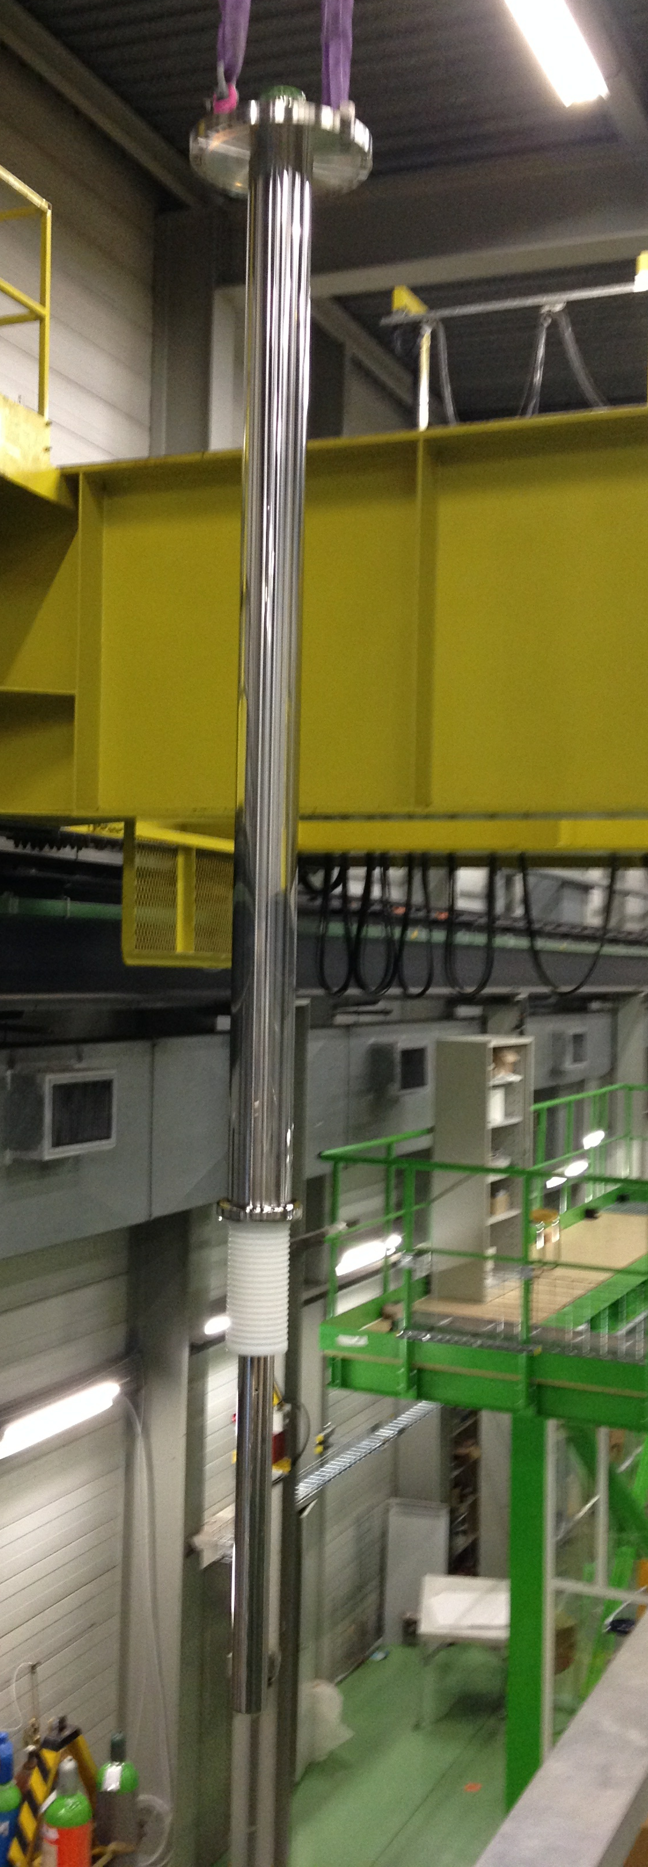
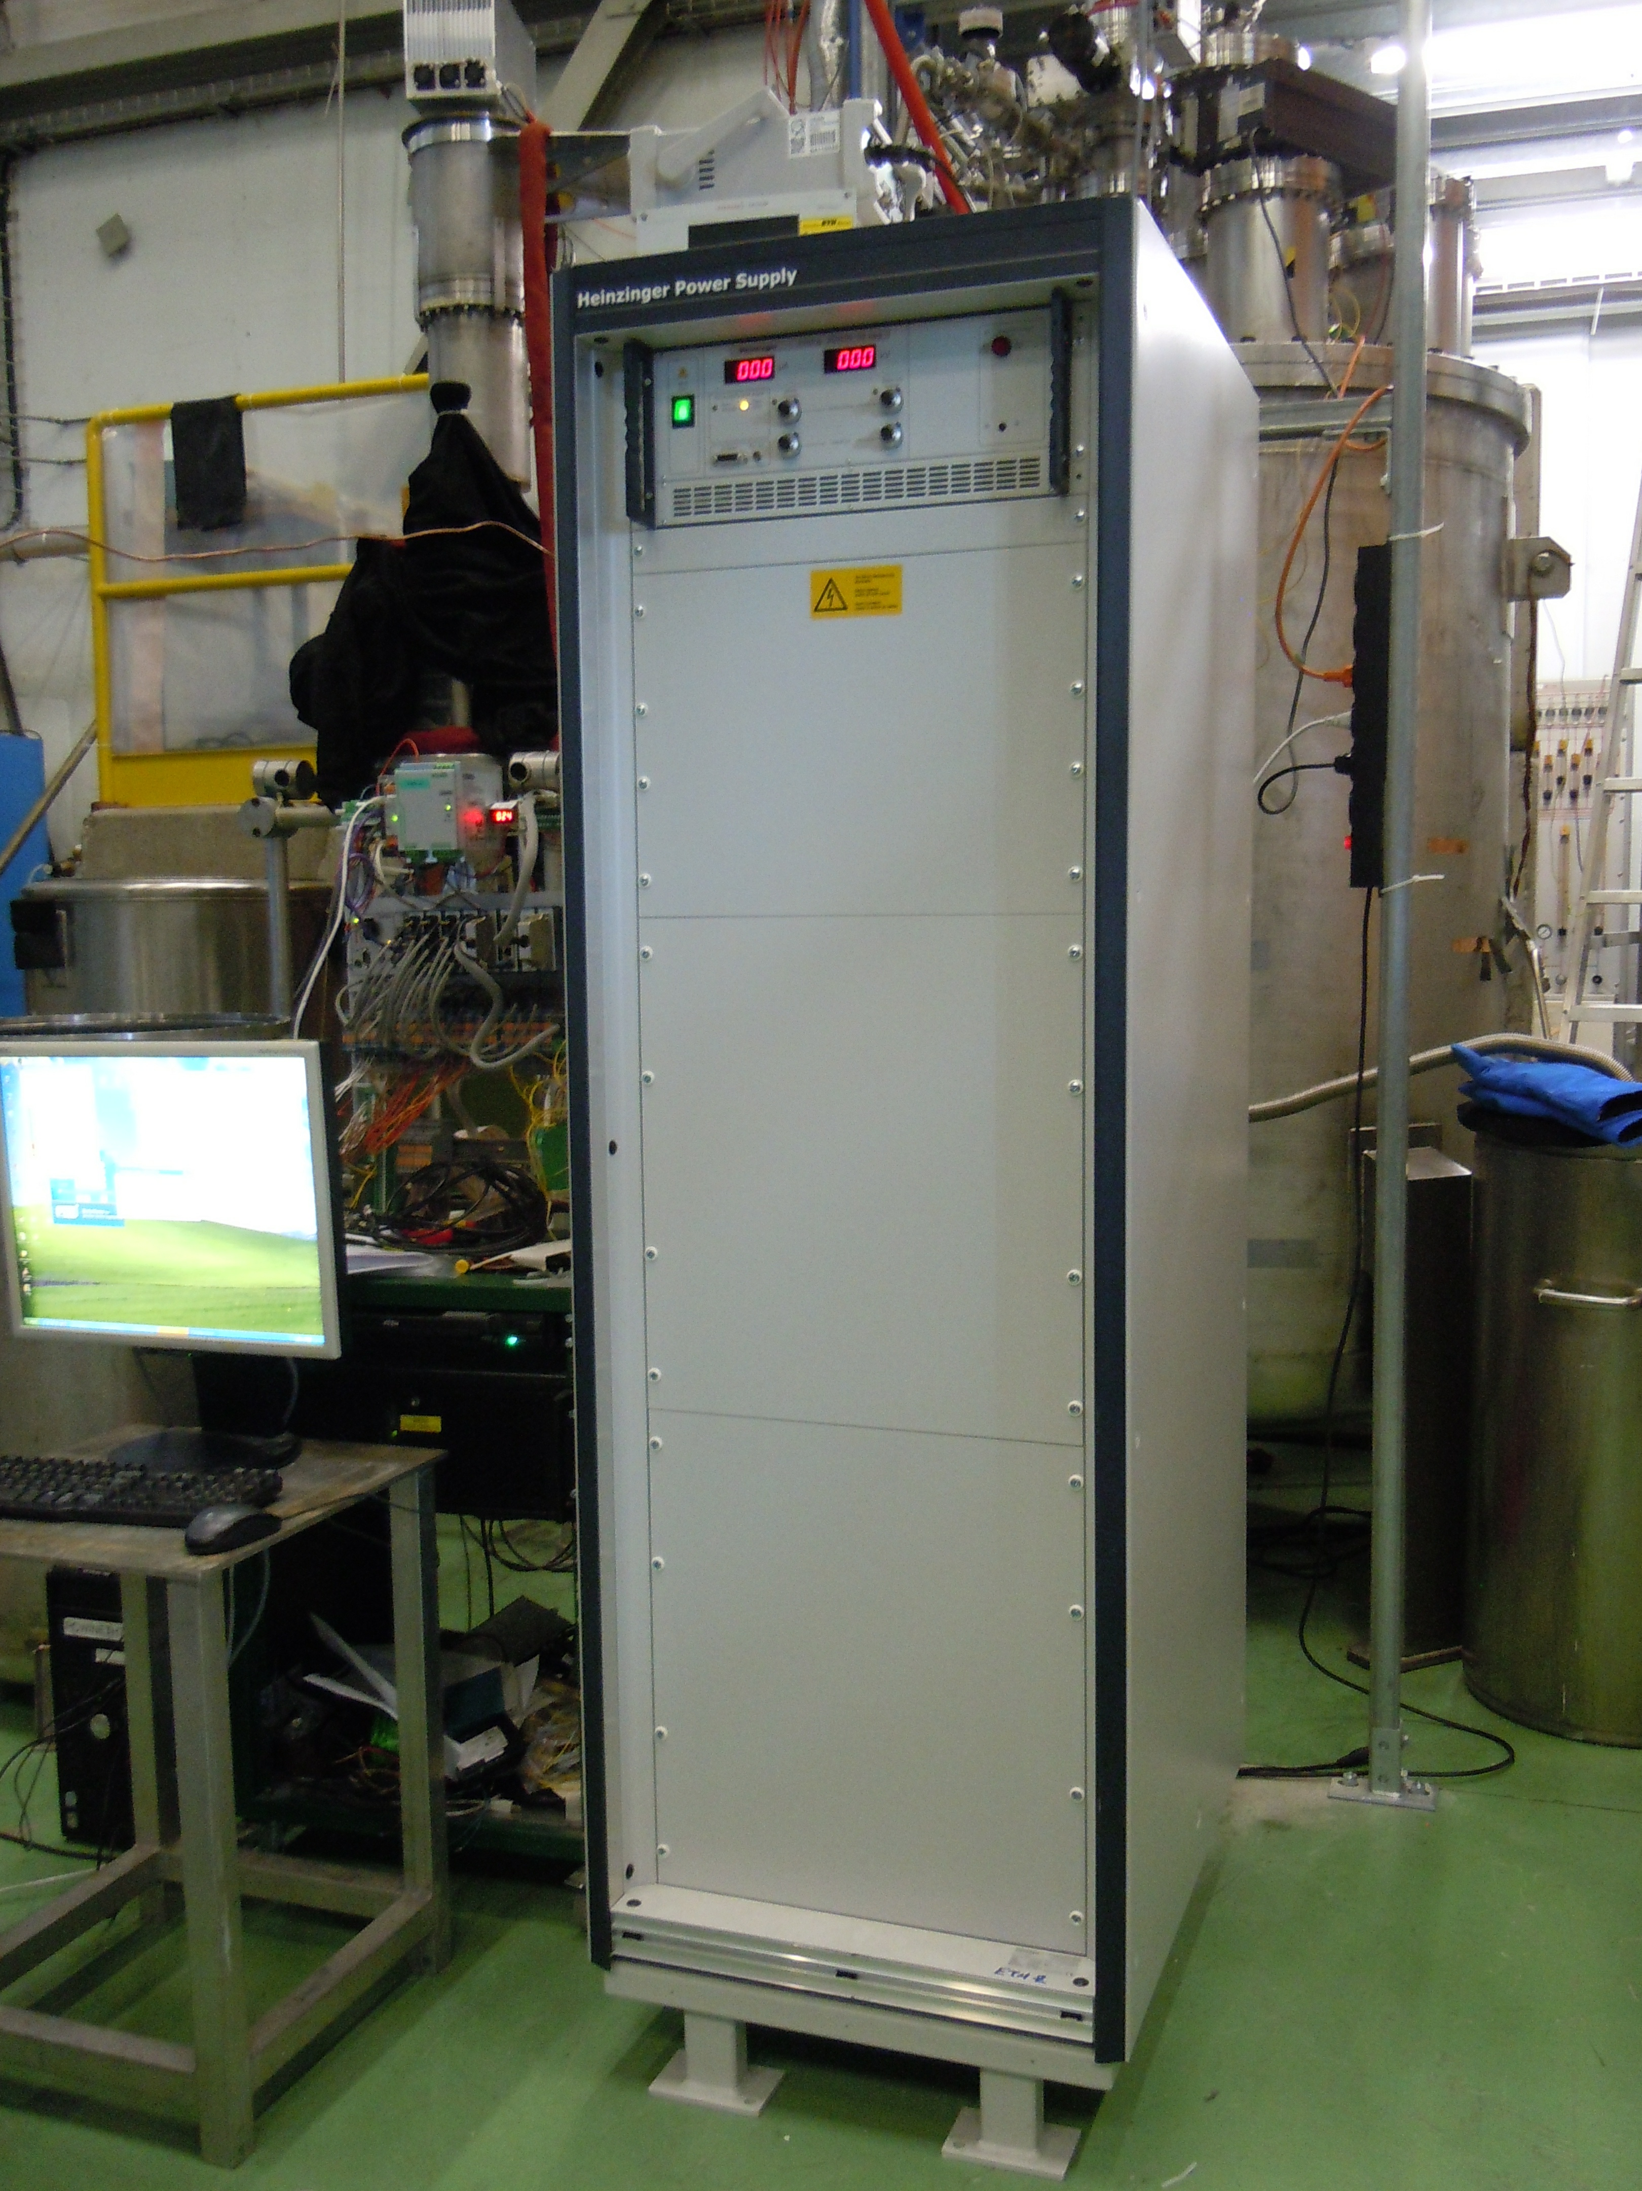
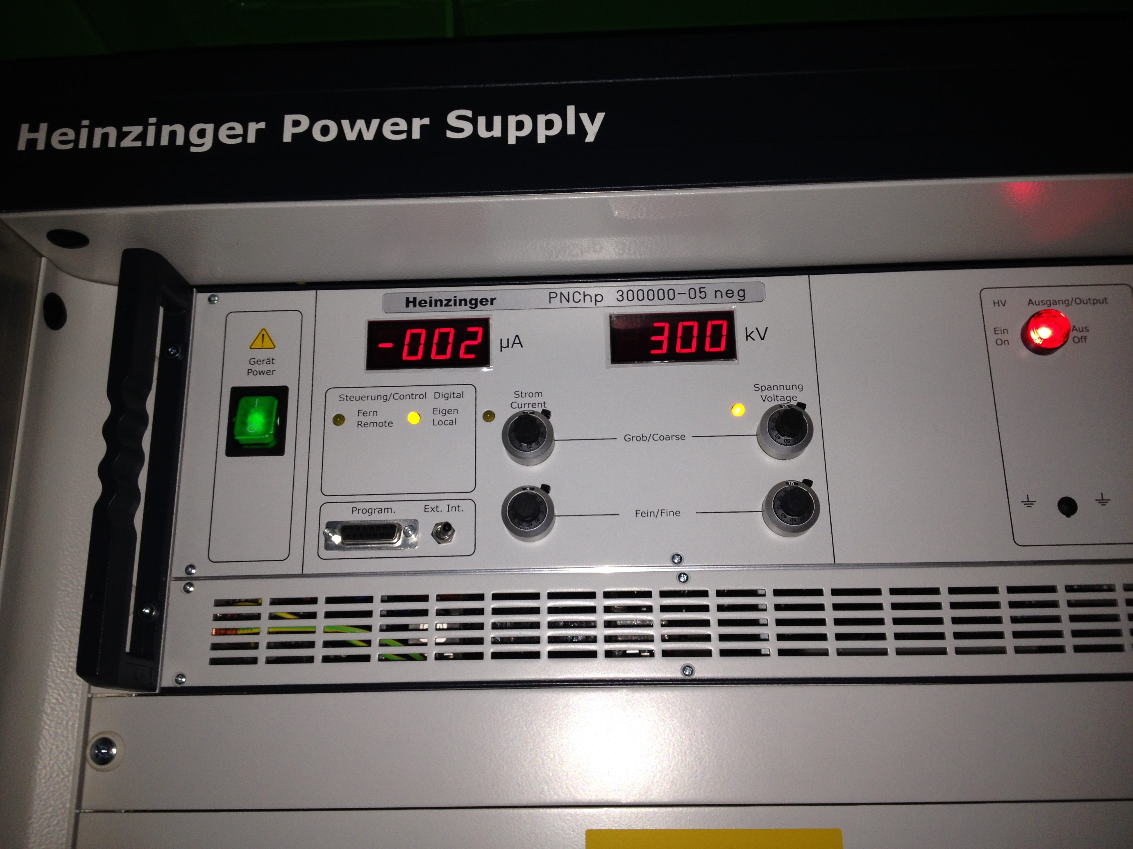
HV experience made for WA105 3x1x1
A similar design for the HVFT has been adopted for the WA105 DP 3x1x1 detector.
Differences essentially only on the HV terminal in LAr.
A ~300kV preliminary test of HVFT made on beginning of September 2016.
C. Cantini et al., “First test of a high voltage feedthrough for liquid Argon TPCs connected to a 300 kV power Supply”, https://arxiv.org/abs/1611.02085.
11

Slide 12
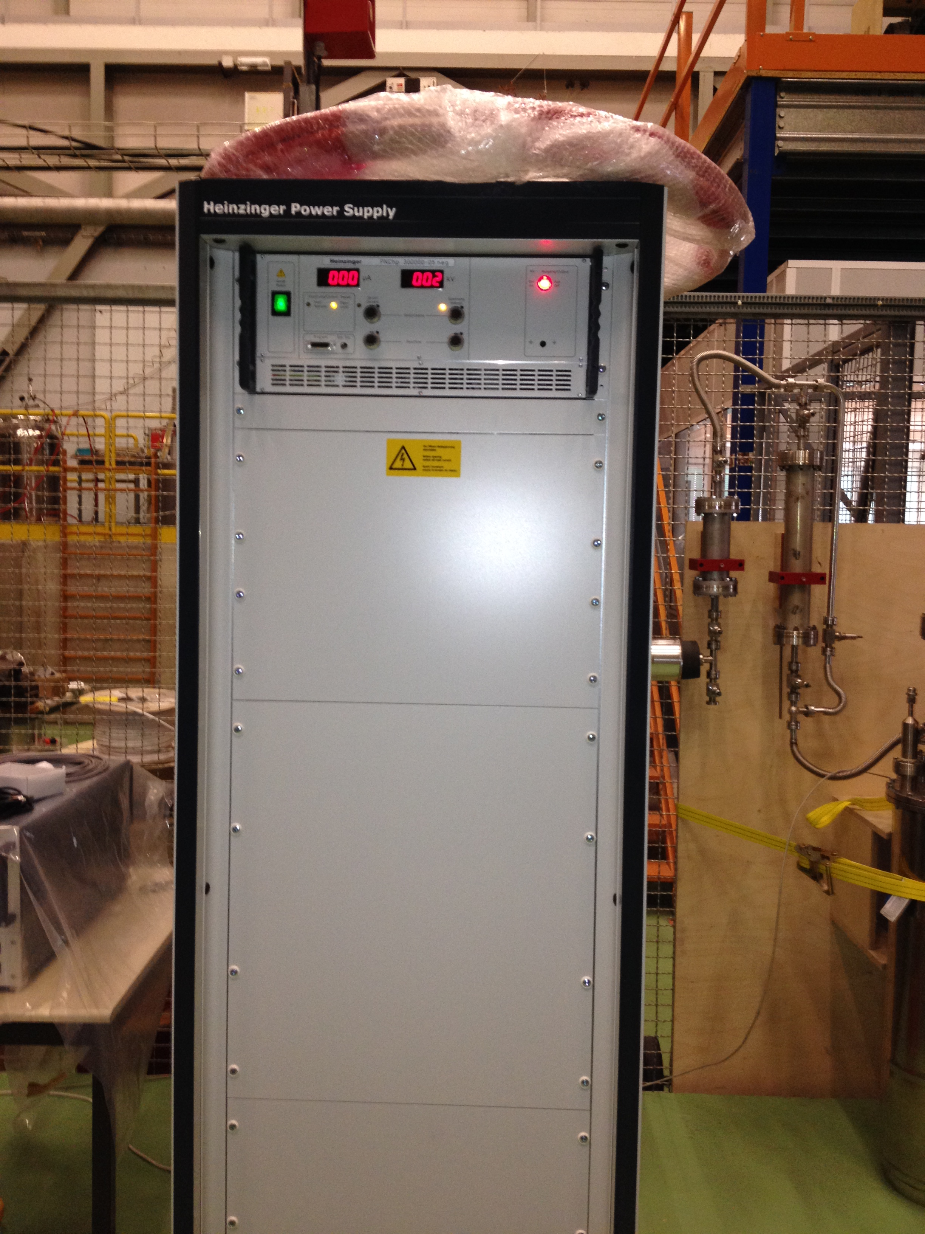
-300 kV Power Supply from Heinzinger
Residual ripple: ≤0.001% U_{NOM} ± 50mV
Residual Ripple at -300kV ≤3V ± 50mV
Can be reduced by the RC filter in the load:
Example: with a fieldcage-to-GND capacitance of 5.5nF and a switching frequency of 34kHz, a series resistor of ~850 Ω required.
300 kV HV cable parameters
Isolation voltage 300 kV DC
Capacity 101 pF/m
Inductance 0,3 μH/m
Impedance 67 Ω
Center wire Material Cu
Diameter 2.25 mm
Dielectric Material PE
Diameter 19.3 mm
Screening Material CuSn
Diameter 20.3 mm
Covering Material PVC
Diameter ca. 22 mm
Color red
Bending radius min. 440 mm
Temperature resistance up to ca 60°C
12

Slide 13
Further studies for the HVFT
Possible extension of the outer part of the HVFT (over the CF250 top flange) to guarantee a warm connection with the HVPS.
Possible Heinzinger-CERN joint study for ≥600kV PS directly integrated with HVFT.
Study and design ongoing...
13

