Slide 1
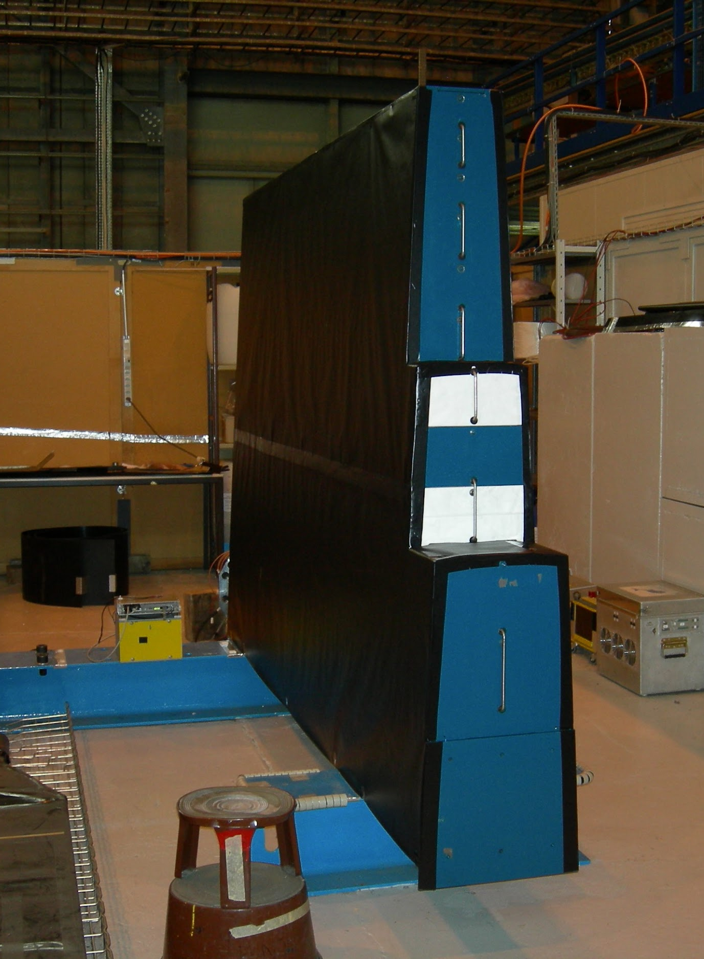
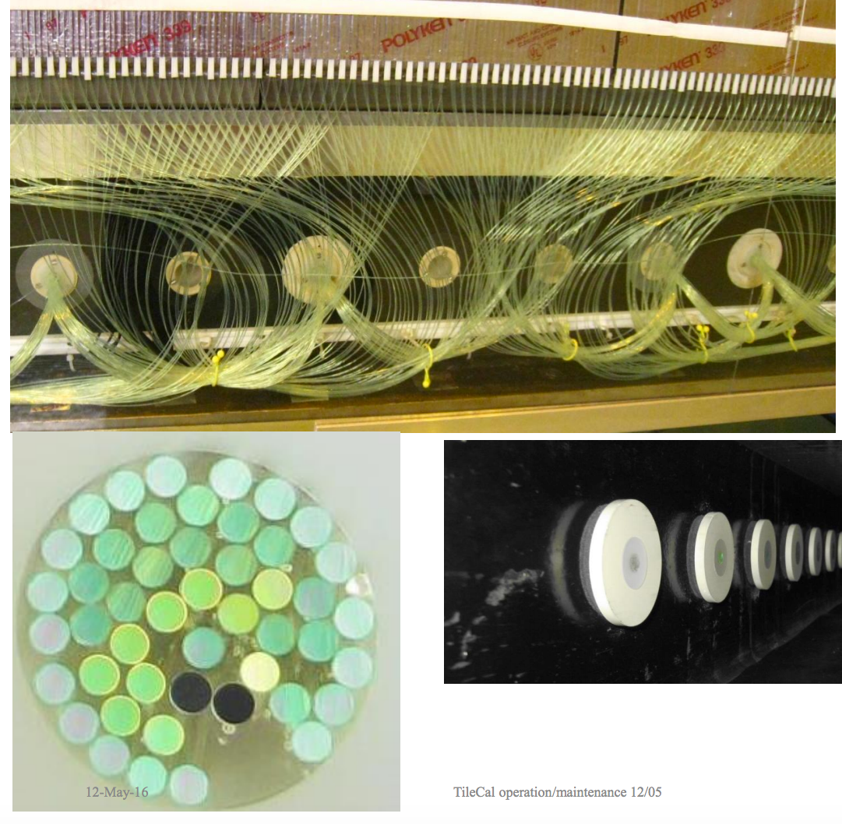


Increasing the Spatial Resolution
of the Tile Calorimeter
By Anthony Bisulco

Slide 2
Tile Calorimeter Overview
Tile calorimeter is a device used to measure the energy of particles
A particle deposits energy in the active material(Scintillator) and absorber(Steel) of the calorimeter
A scintillator is a material that exhibits the ability to luminesce when struck by a particle
The tile calorimeter reads this light off using a fiber optic system
Particle
Light
.
.
.
Active Material
Absorber
Readout
Tile Calorimeter, September 29, 2016

Slide 3
Read Out Electronics
Light signal from the scintillator is read out using a photomultiplier tube
Photomultiplier tube converts the light signal to a corresponding current, process:
  Photon from fiber hits another scintillator
  Via the photoelectric effect electrons are stripped from metal (Photocathode)
  These electrons are focused for the trajectory of a dynode(charged plate)
  Dynode then focus for another dynode until reach end of chain where current is produced
Photon
Photon
Scintillator
Photocathode
e-
Focusing Electrode
Dynode
xK
xK
Connector
Tile Calorimeter, September 29, 2016

Slide 4
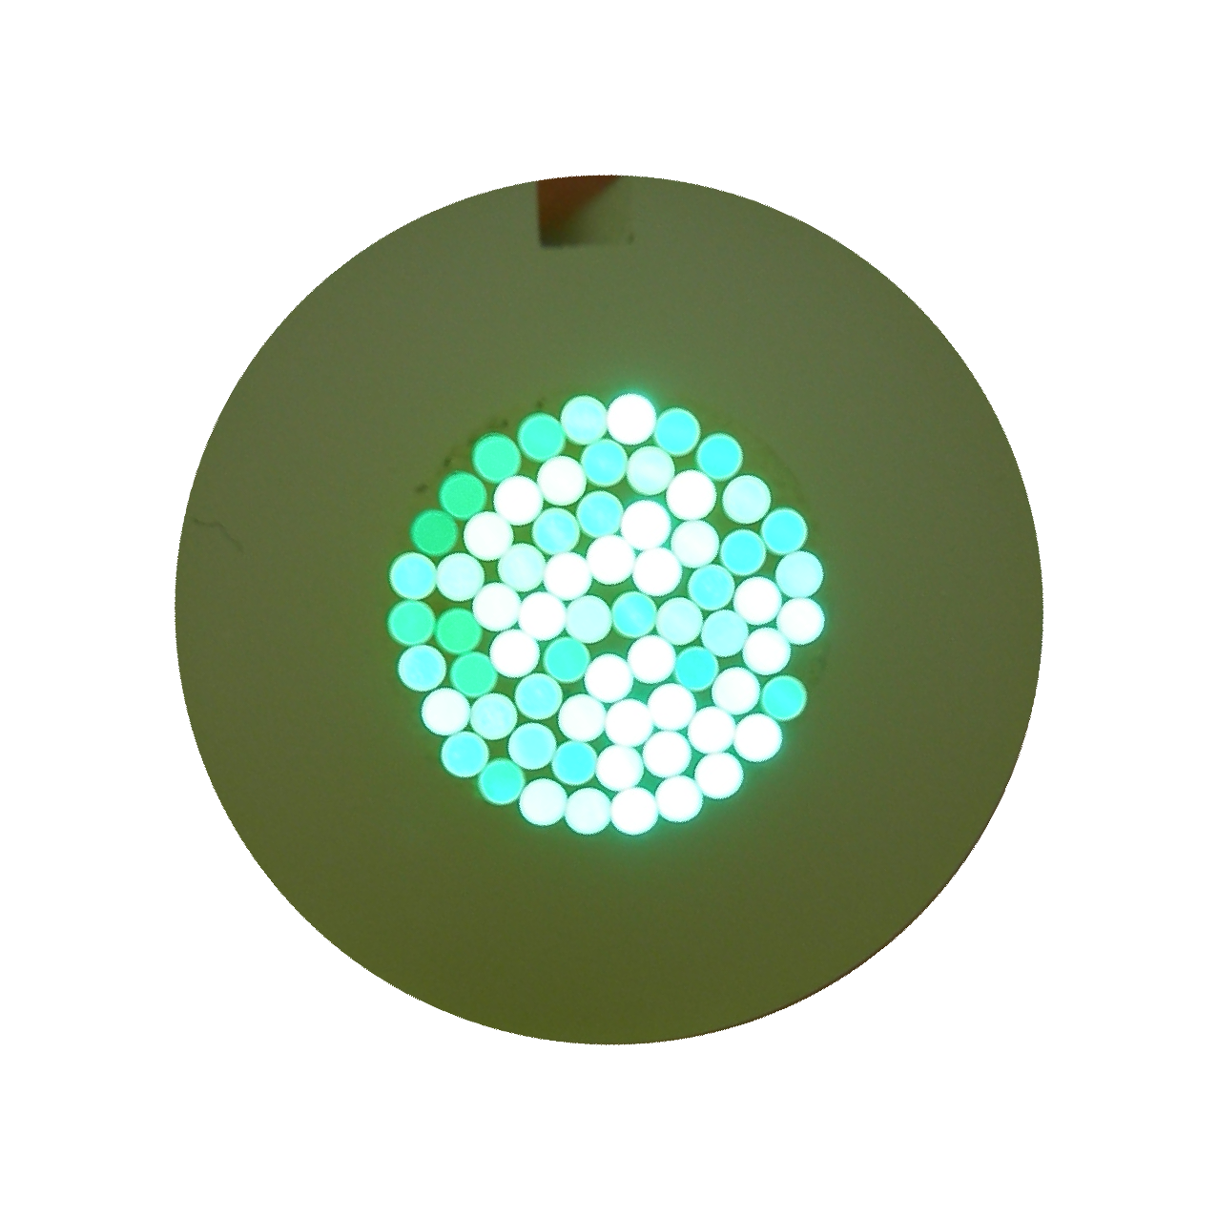
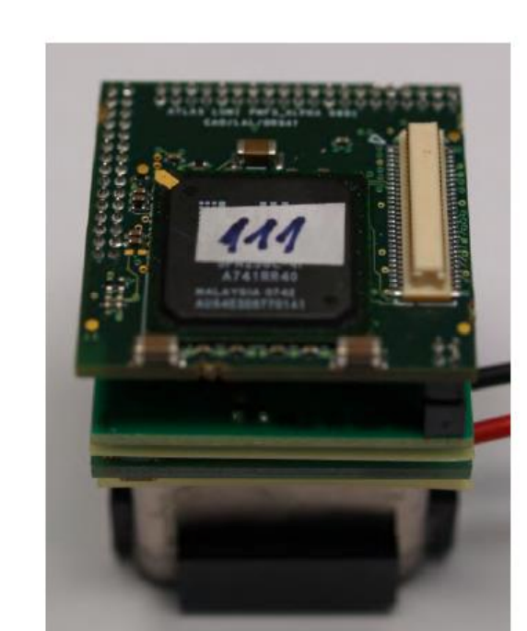
Past Setup
Scintillator
Photomultiplier tube would read out a bunch of fibers all at once
This grouping of fiber bundles reduces the calorimeters spatial resolution since not all are read individually
Also, current electronics are not optimized to store and sample individual fibers
Hence, the goal is to further implement hardware and software methods to increase system’s resolution
Photomultiplier
Analog to Digital converter
Signal Processing Algorithm
Tile Calorimeter, September 29, 2016

Slide 5
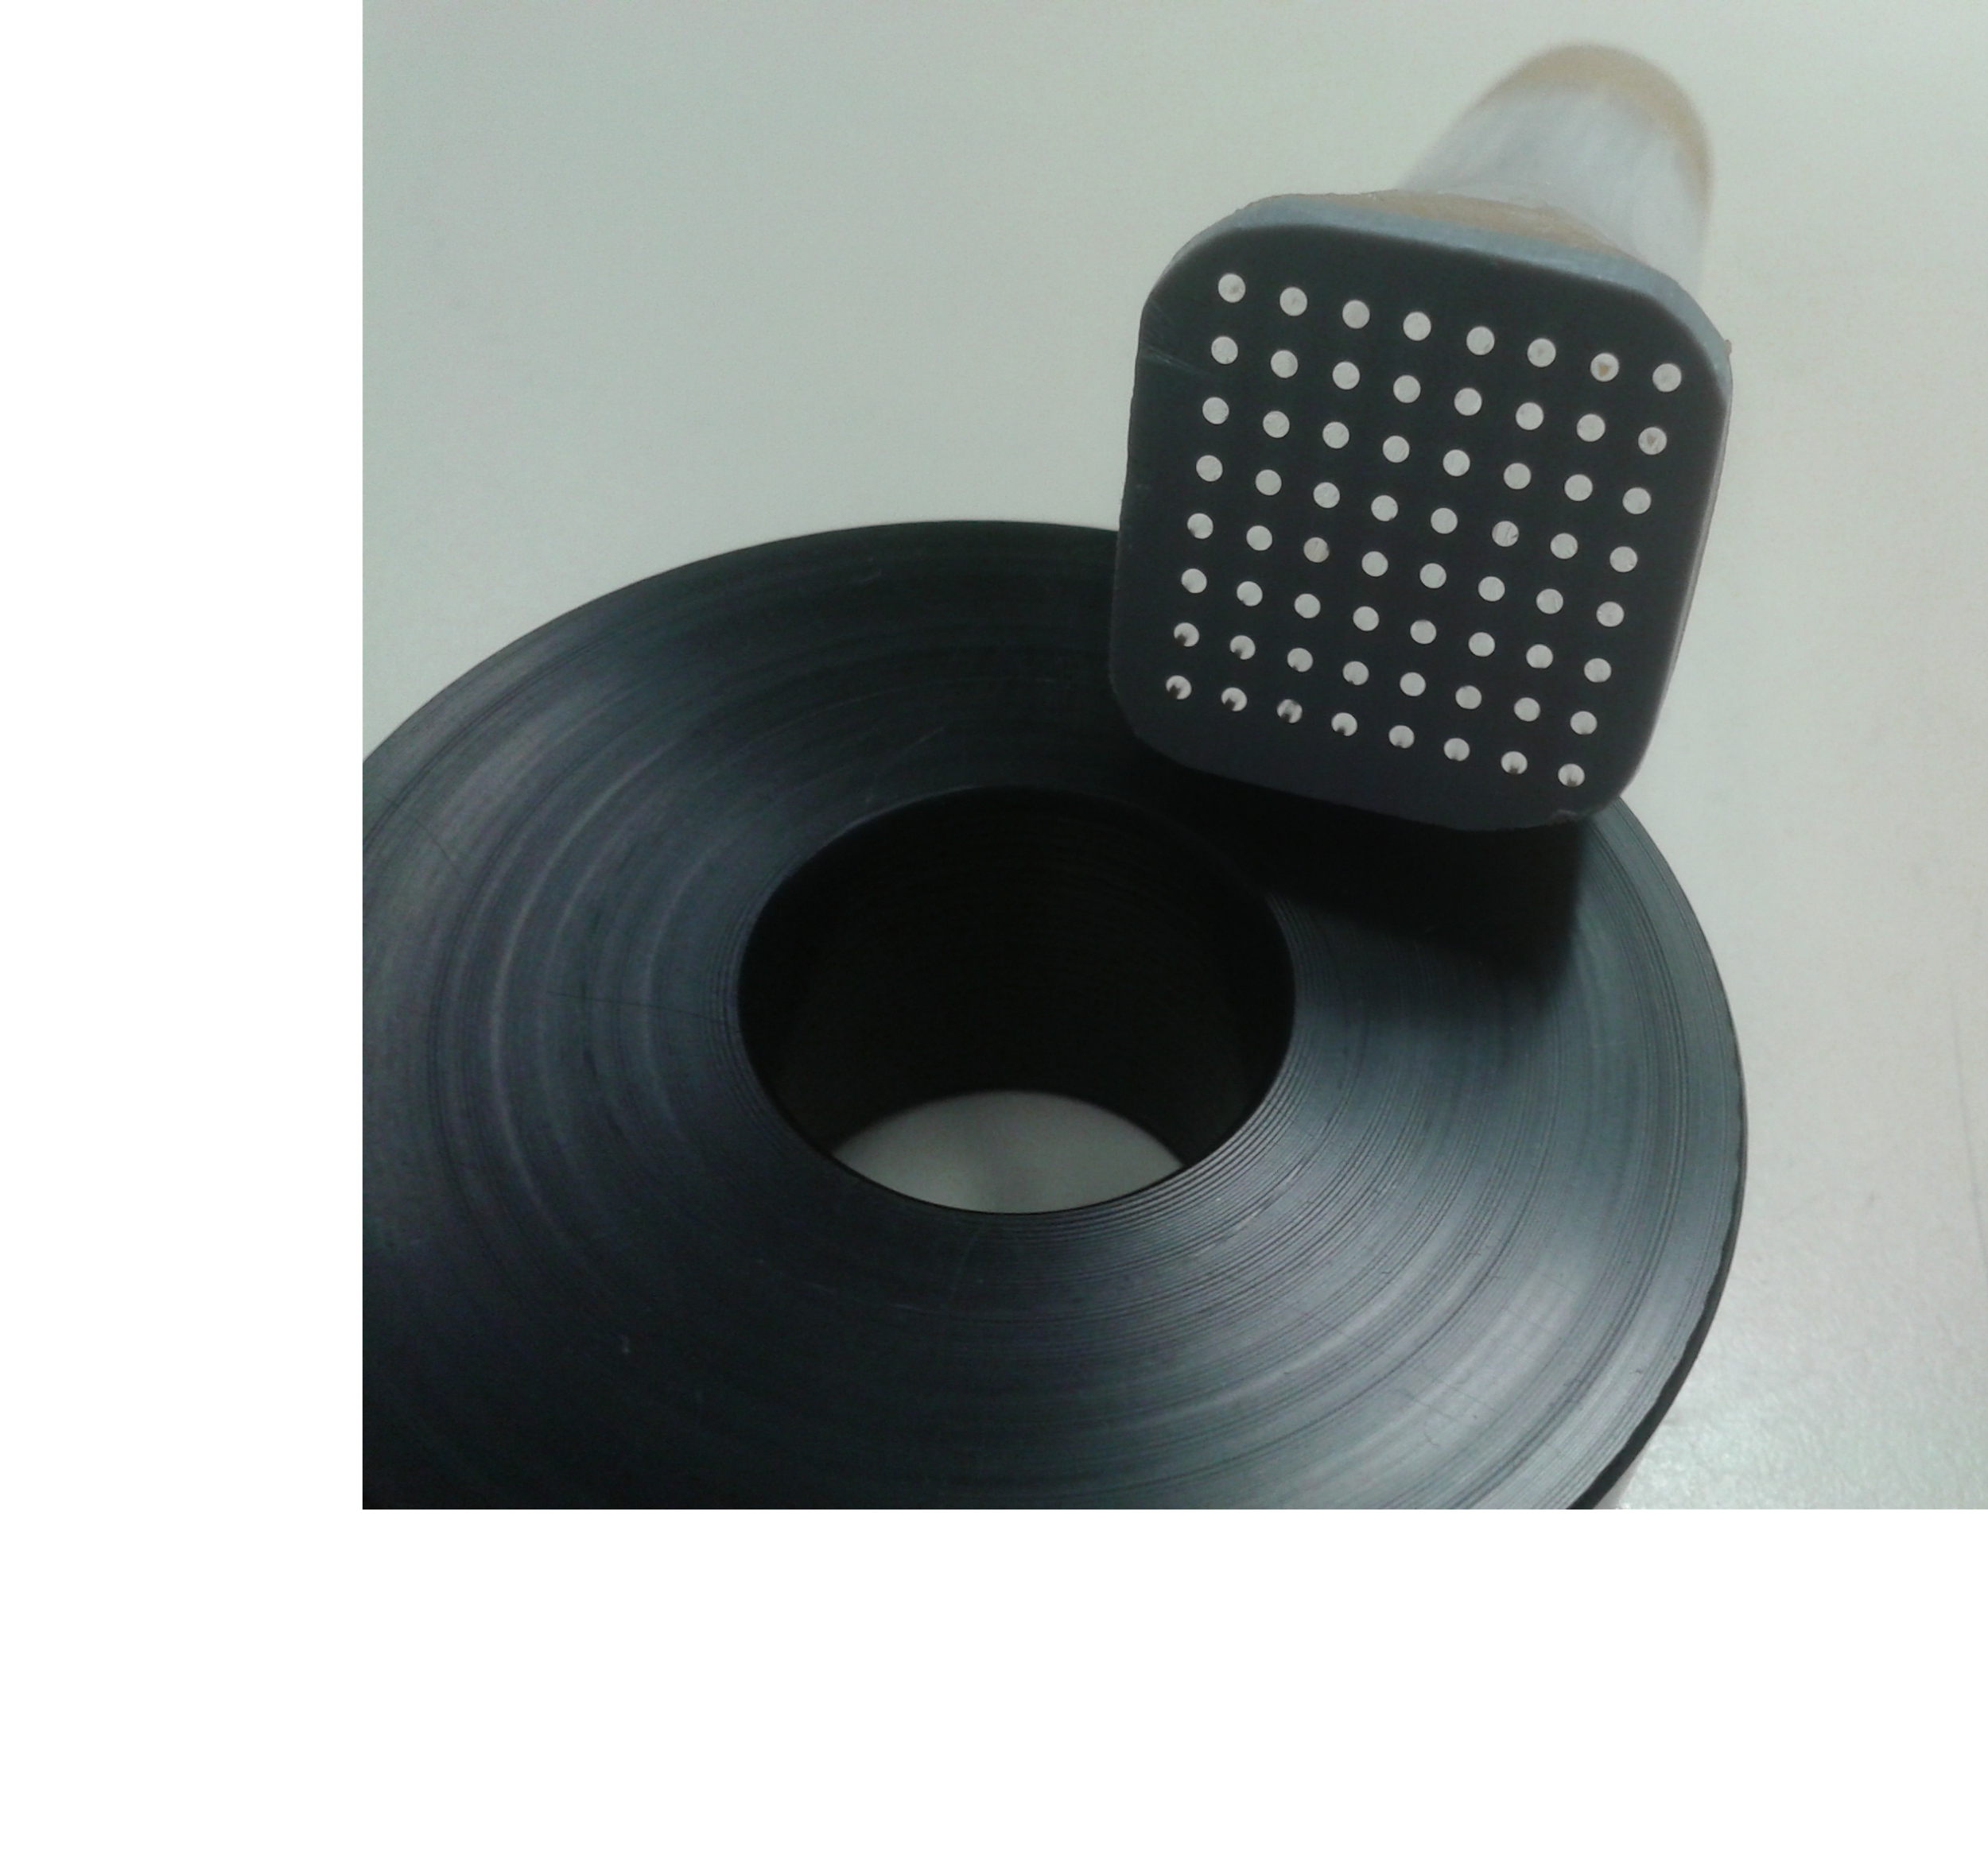
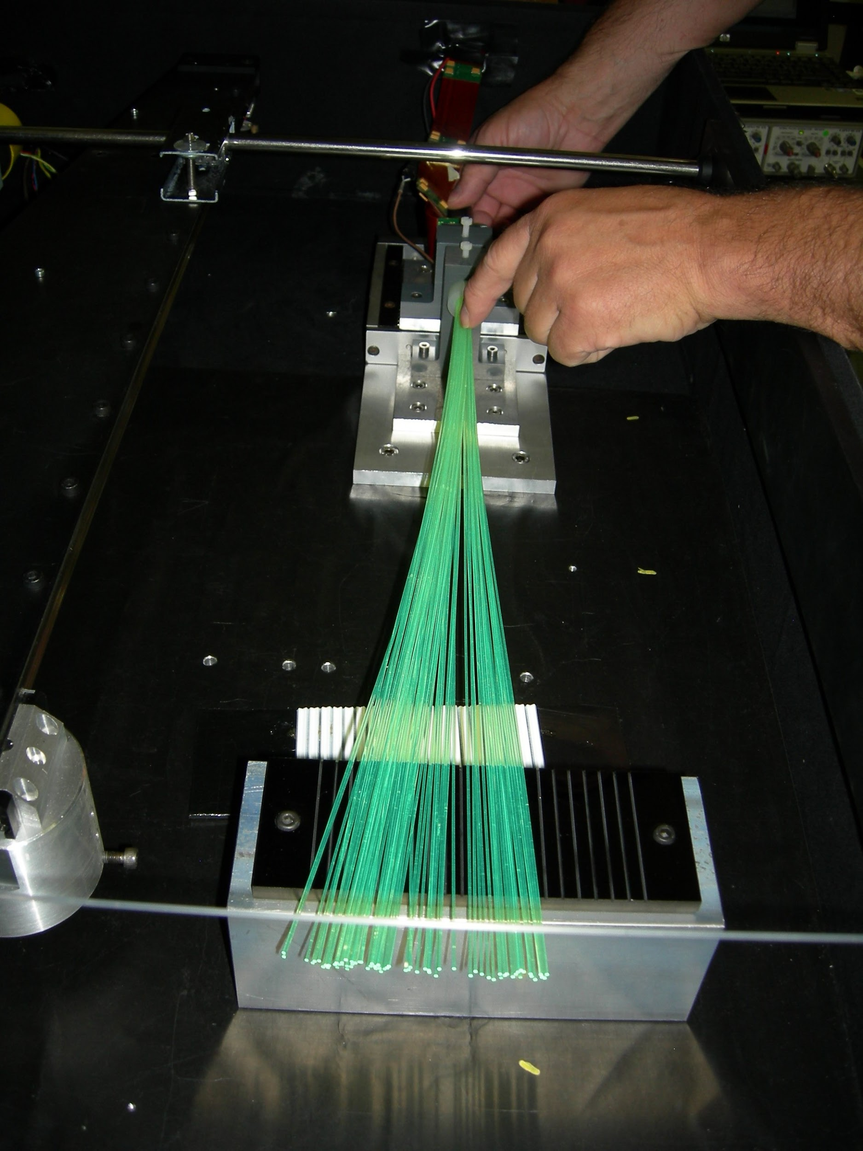
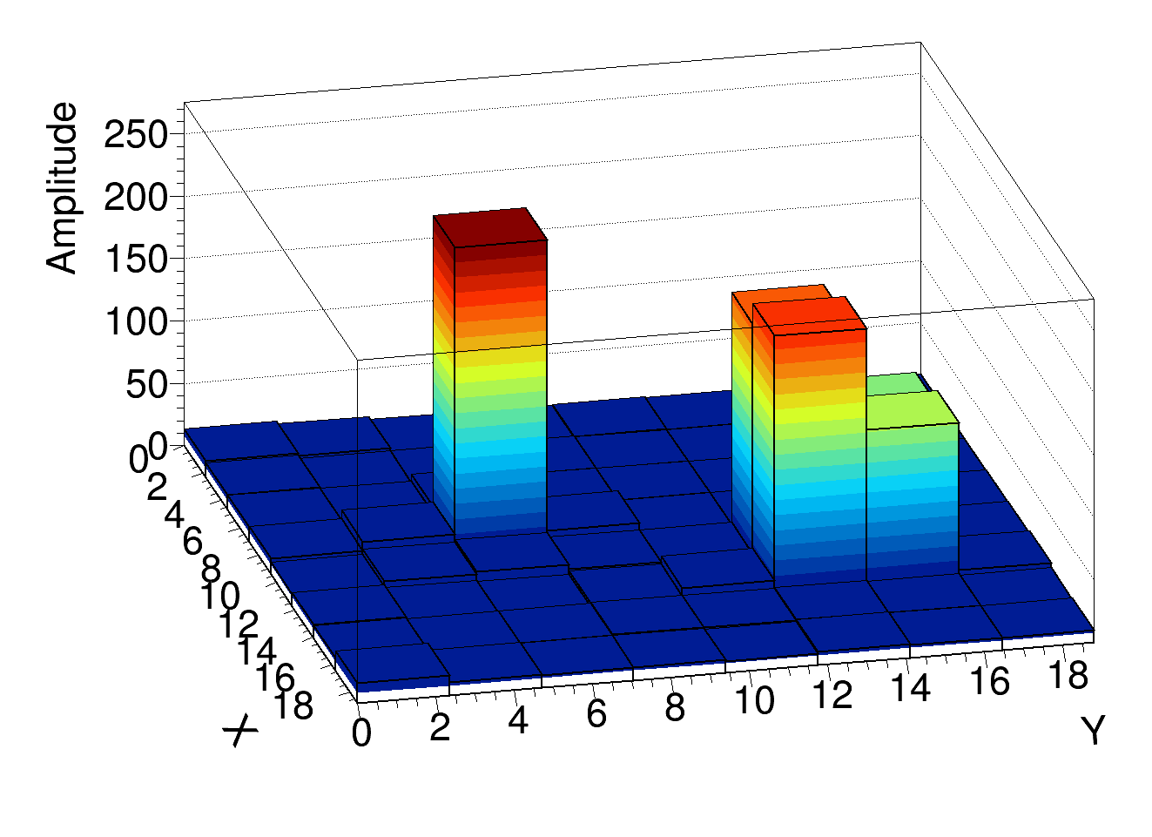
Current Prototype System
Photomultiplier prototype system has an 8x8 pixel array
Test setup: two fibers coupled to two different pixels are pulsed via an LED
Note:coupling between fiber and photomultiplier has 5x loss
Measurements highlight this reduces signal to noise ratio
Data has been processed with pedestal(noise) removal
Results highlight that crosstalk amongst pixels in the same region
This crosstalk needs to be eliminated to increase sensor's spatial resolution
Each pixel is about 2.35 mm x 2.35 mm
Images and Data Courtesy of Tigran Mkrtchyan
Tile Calorimeter, September 29, 2016
Notes:
Test bench in b175
“Black box”
65 Fibers (Bundle)
Blue LED
R7600-300-M64
Hamamatsu Multi-anode
PMT(EA0543)
Read-out electronics:
MAROC2 chip + Lumi PMF(Orsay)
board
LED Pulse Amplitude/Width: 5V/100ns
Trigger Pulse(NIM) Amplitude/Width:
-2V/30ns
Frequency: ~ 115 H

Slide 6
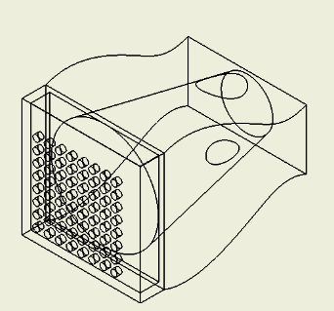
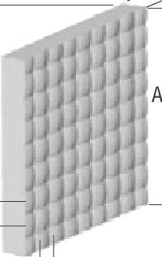
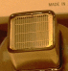
Future Prototype System
Fiber Coupler
Photomultiplier
Fiber Bundle
. . .
Developing 3D printed parts using Solidworks for fiber bundle to array coupler
Developing microlens array to evenly distribute sensor signal over localized region
Developing new analog to digital converter for signal readout
...
.
.
.
Microlens Array
Photo Courtesy: https://www.newport.com/mam/celum/celum_assets/square_microlens_600w.gif?1
Tile Calorimeter, September 29, 2016

Slide 7
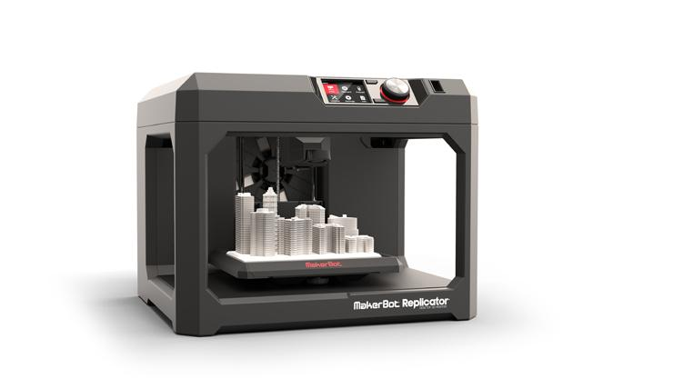
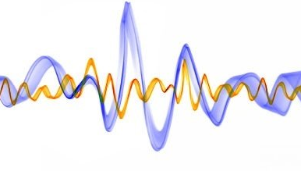

Conclusion and Future Tasks
Develop 3D printed parts for fiber and photomultiplier tube coupling
Test pixel sensitivity with new stable fixture for fiber to photomultiplier
Implement signal processing algorithms to optimize signal to noise ratio
Perform standard operating procedure for calibration using a radioactive source
Photo Courtesy: https://www.google.com/url?sa=i&rct=j&q=&esrc=s&source=images&cd=&cad=rja&uact=8&ved=0ahUKEwi_zfn9n7LPAhUFbxQKHXCFAN0QjRwIBw&url=http%3A%2F%2Fwww.pcmag.com%2Farticle2%2F0%2C2817%2C2470038%2C00.asp&psig=AFQjCNFXNIYSGEBoum4TzjhusvBdXkNQCw&ust=1475158552098010, https://media.licdn.com/mpr/mpr/AAEAAQAAAAAAAAQpAAAAJGNmNDlhNGUwLTk4YTgtNDQzMS1iMjY4LWQyNzgzZjdlNzdkOA.jpg
Tile Calorimeter, September 29, 2016

Slide 8

Travel

