Slide 1
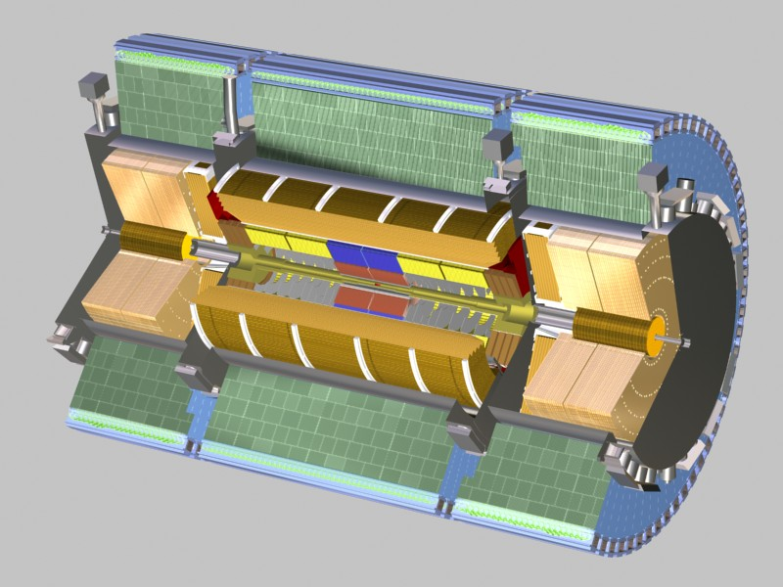



Improving the Spatial Resolution
of the Tile Calorimeter for Phase 2 Upgrades
12 m
Tilecal
8.5m
2900 tons
Tile calorimeter is a hadronic calorimeter in the barrel of the ATLAS detector
By Anthony Bisulco
Mentors: Tancredi Carli, Ana Maria Henriques Correia, Irakli Minashvili and Jenya Starchenko

Slide 2
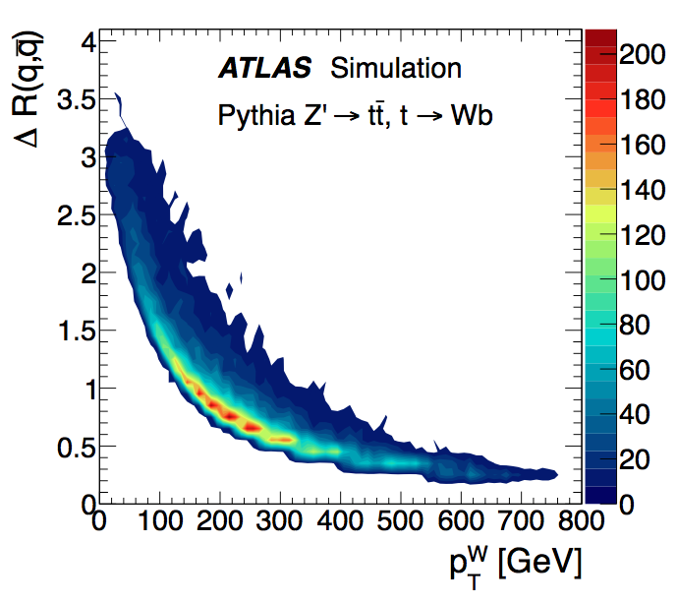
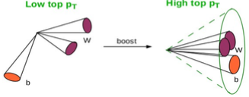
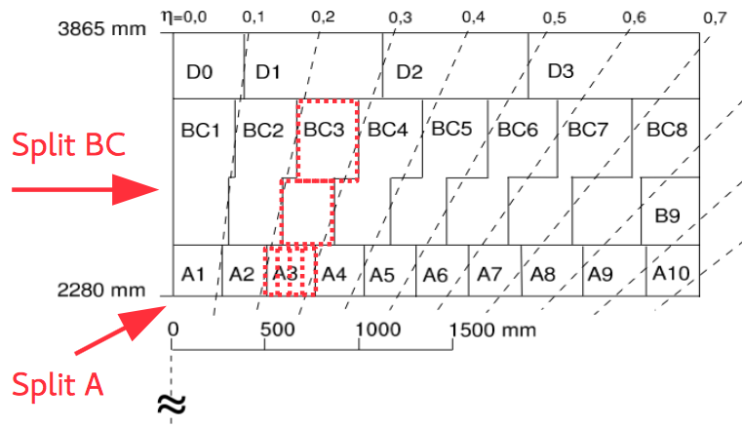
Tile Calorimeter Upgrade Challenge
Tile calorimeter is a detector made of three longitudinal layers(A, BC, D)
Measures the energy and position of particles through scintillator
Currently in tile calorimeter:
  620K Fibers
  400K Tiles
  10,000 channels
  Δη x Δφ =0.1 x 0.1
As momentum of the LHC increases, jets will become closer together
Goal:
  Split A Cells(x4)-> 0.1 -> 0.025 η
  Split BC Cells(x2) -> 3 -> 4 layers
  Not changing the detector(Only Electronics &Optics)
Current Resolution becomes comparable to typical separation between 2 quarks from W decay at high pt

Slide 3
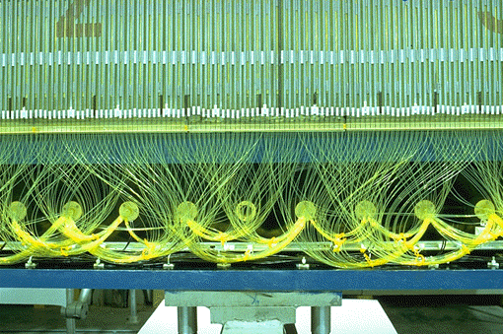
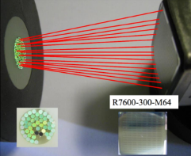
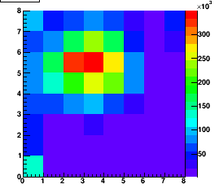
Current System
Particle
To DAQ
Light is read from scintillating material using optical fibers
Groups of fibers from longitudinal layers form bundles of 20-100+ fibers
Fiber bundles are read all at once by a single anode photomultiplier tube (PMT)
A PMT converts and amplifies the optical signal from the fibers to an electrical signal
Goal is to now read possibly individual fibers on PMT bundle using Multi Anode(MA) –PMT
Problem with an air gap system like currently used is the signal is concentrated in one region of MA-PMT
Iron
Fibers
Fiber Bundle
PMT
Scintillator
Iron
Light Transfer
MA-PMT Air Gap

Slide 4
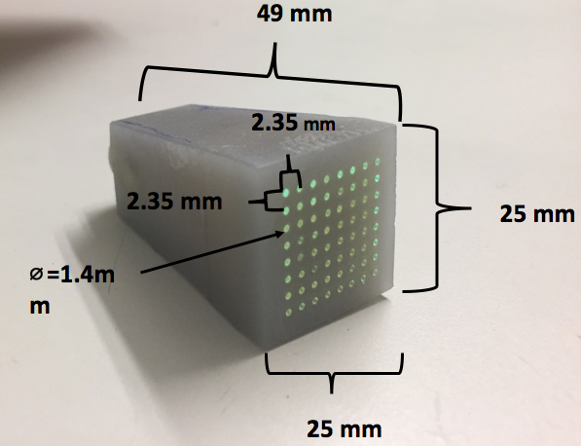
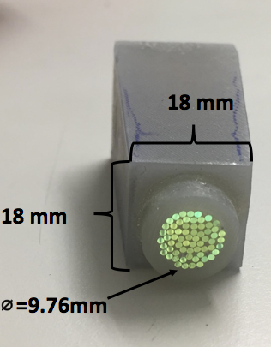
Fiber Light Guide
Fiber Light Guide
Solving the problem of the concentrated light in one region is the fiber light guide
Fiber light guide is inserted between fiber bundle and PMT to spread light
Casing was 3D printed using Form 1+ printer by hardening resin via laser irradiation
After printing process, fibers are assembled in casing and glued
Finally, fiber light guide is polished to maximize effective light transfer
Fiber Bundle
. . .
...
.
.
.
Design Concept Goal: to spread fiber signal over multi anode PMT
Implemented: Fiber Light Guide printed via Form 1+ 3D printer

Slide 5
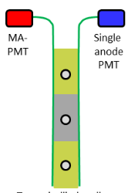
Data Collection Procedure
For testing the implementation of these ideas in a controlled setting a Cesium scan was performed
Cesium scans consist of a Cesium capsule passing through tubes in the tile calorimeter
As a result of energetic gamma radiation, scintillators in module luminesce
These scintillator are then read by a MA-PMT and a single anode PMT using the current electronics drawer
Results allow for prototype testing based on known response of Cesium in the Calorimeter
Cesium Scan Path
Electronics Drawer
Dual Tile Readout

Slide 6
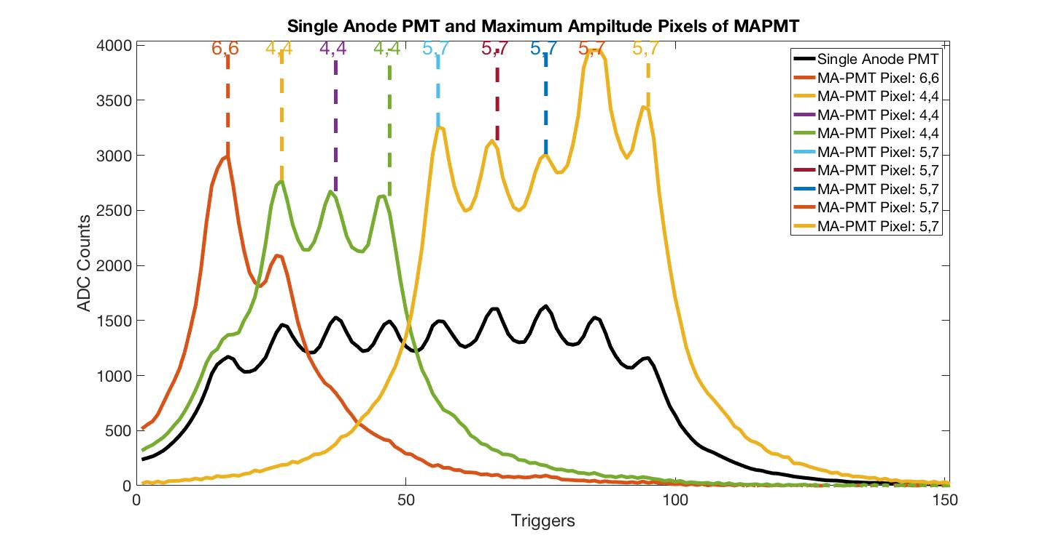
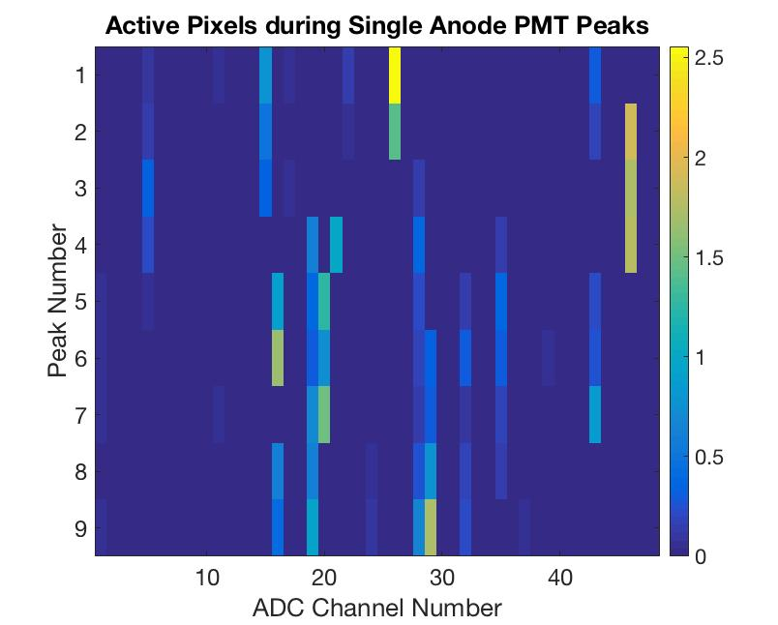
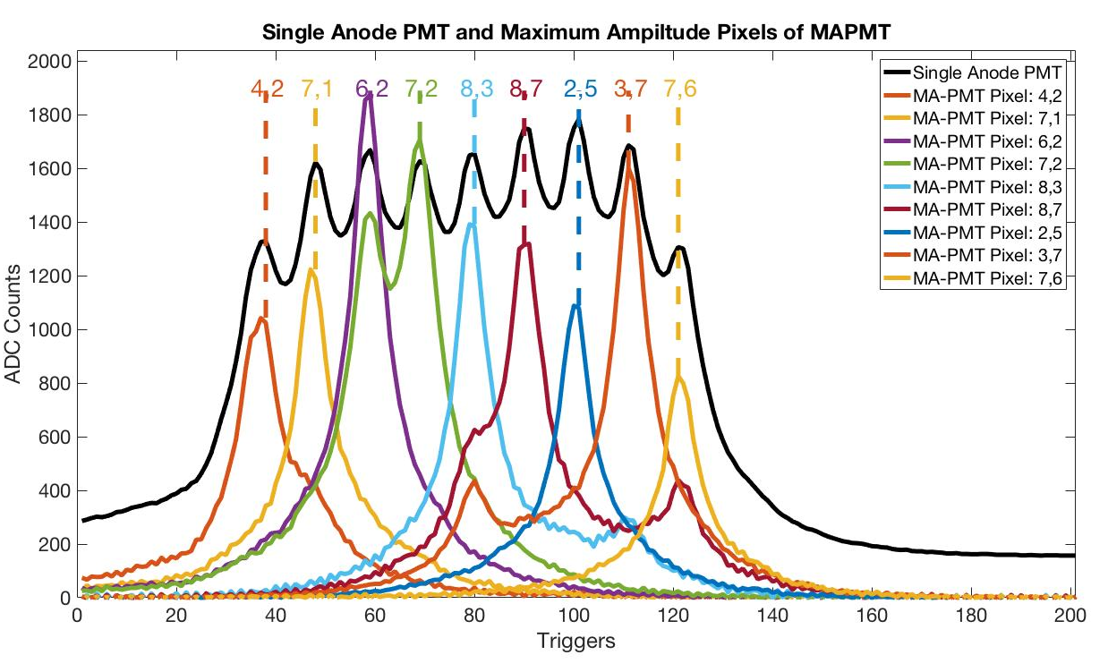
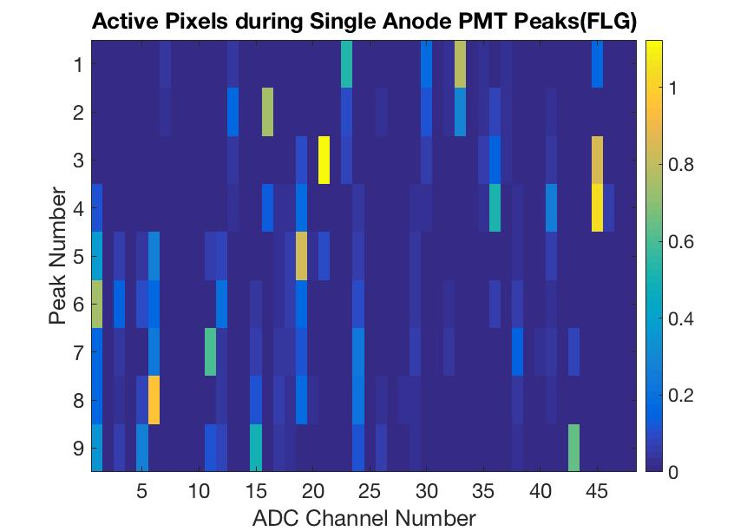
Results: A12 Cell
Two runs were performed one without a fiber light guide for control and one with a fiber light guide
Triggers are basically time axis positions as the Cesium moves through Tile Calorimeter
Air Gap run highlights 3 unique maximal amplitude pixels(Colored Pixels) for single anode PMT peaks
Fiber light guide run highlights distinct pixels for each single anode PMT peak
Effect can also be seen in color magnitude plots of each peak
Fig 1. Only Air Gap
Fig 2. With Fiber Light Guide

Slide 7
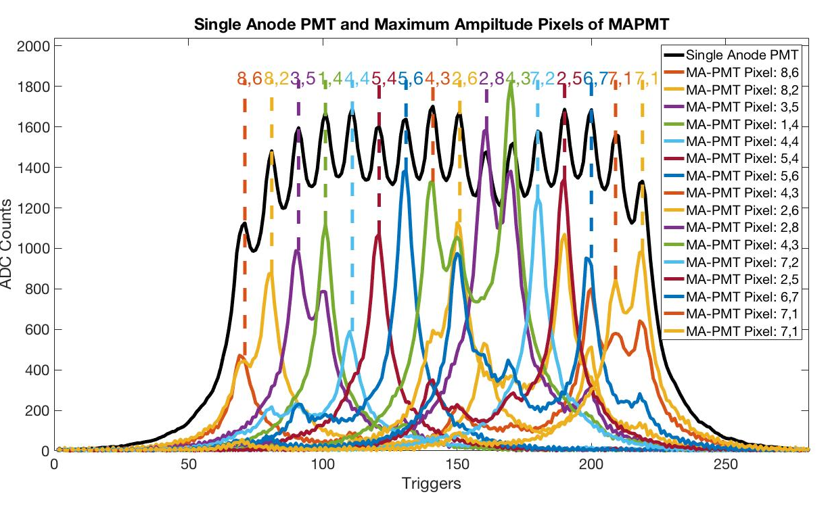
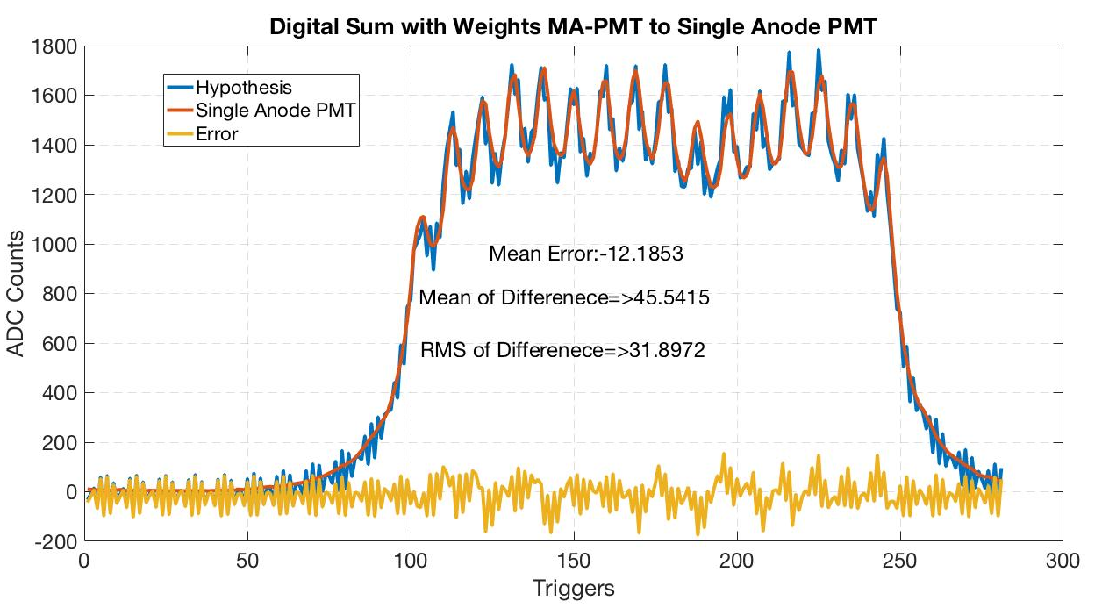

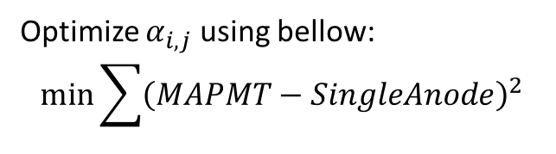
B11 Cell Results
Next step was testing the fiber light guide on B11 cell with 16 tiles
Data highlights fiber light guide distributes signal over different pixel
Although there are repeats in pixels active for each peak
One other thing to note based on a weighted summing scheme the Single Anode PMT can be recovered from the MA-PMT data sum
$$\sum_{i=1}^{8}{\sum_{j=1}^{8}{α_{i,j}Pixel(i,j)}}$$
MA-PMT Sum=
Optimize $α_{i,j}$ using bellow:
$$\min_{}{\sum{{\left(MAPMT−SingleAnode\right)}^{2}}}$$

Slide 8
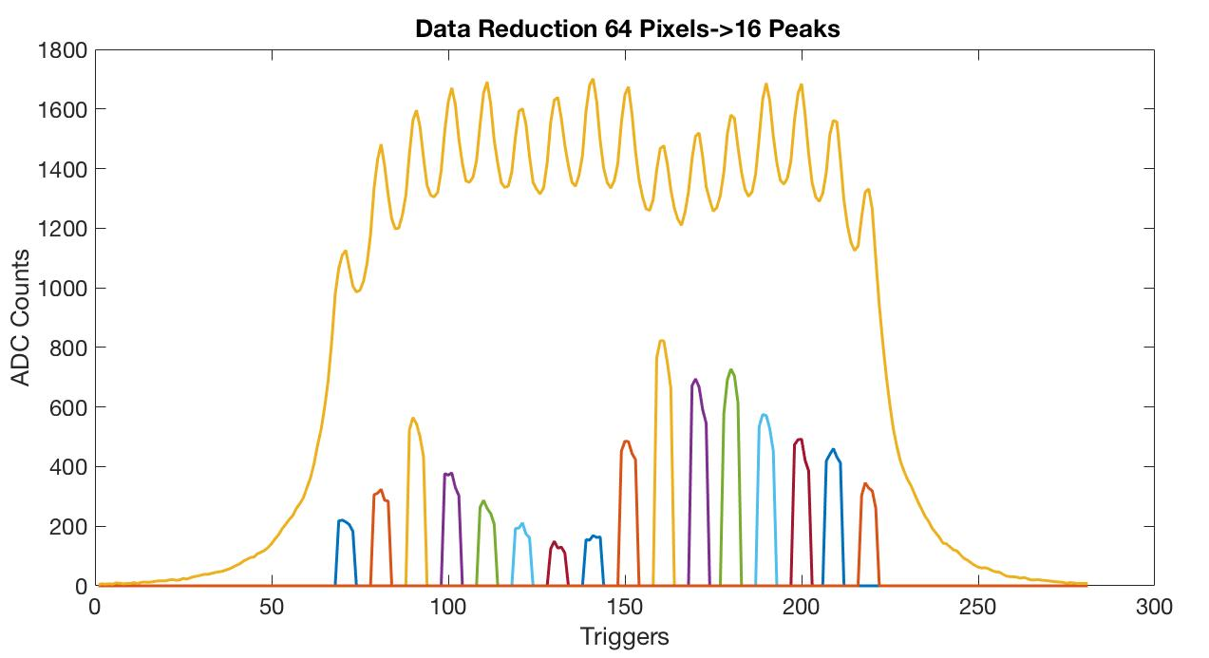
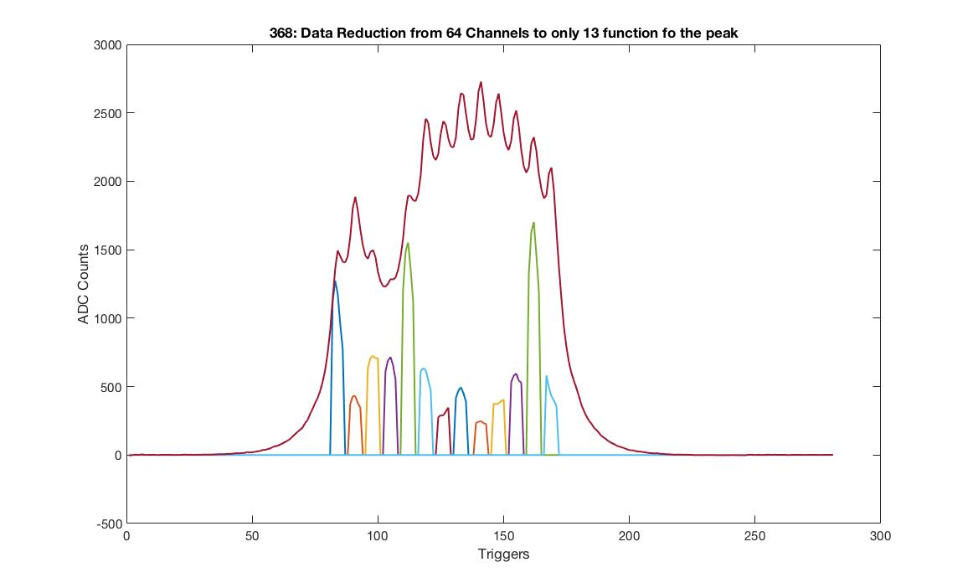


Data Reduction
Even though light sharing may occur among pixels, peaks can still be separated
Separation procedure is developed through:
  Attributing a light sharing ratio to each pixel for a peak
  Summing the pixel light ratio for each peak
Based on the above procedure data can be reproduced a better dealt with less pixel dimensions
$$\sum_{i=1}^{8}{\sum_{j=1}^{8}{α_{i,j,pk}Pixel(i,j)}}$$
Data(pk)=
$$α_{i,j,pk}=\frac{max⁡(Pixel\left(i,j,pk\right))}{Σmax⁡(Pixel\left(i,j,pk\right))}$$

Slide 9
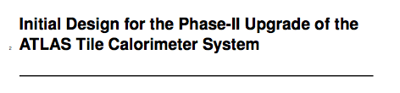
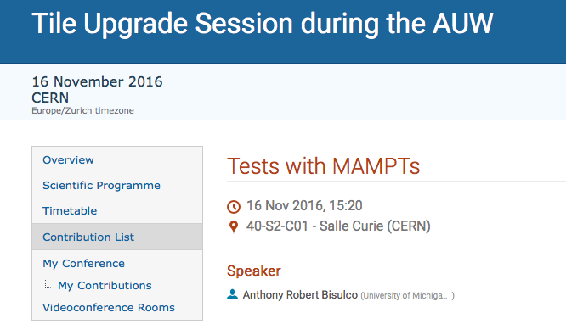
Conclusion
Our working group has successfully implement optical methods for tile calorimeter upgrades
My experience at CERN had been a great way to be exposed to working on a multi-disciplinary/cultural team
I have learned many new skills in data analysis procedures and manufacturing
I would like to thank all my mentors, Dr. Goldfarb, Dr. Krisch and University of Michigan for this experience
Contributed to developing material for upgrade proposal
ATLAS Upgrades Week Talk

Slide 10
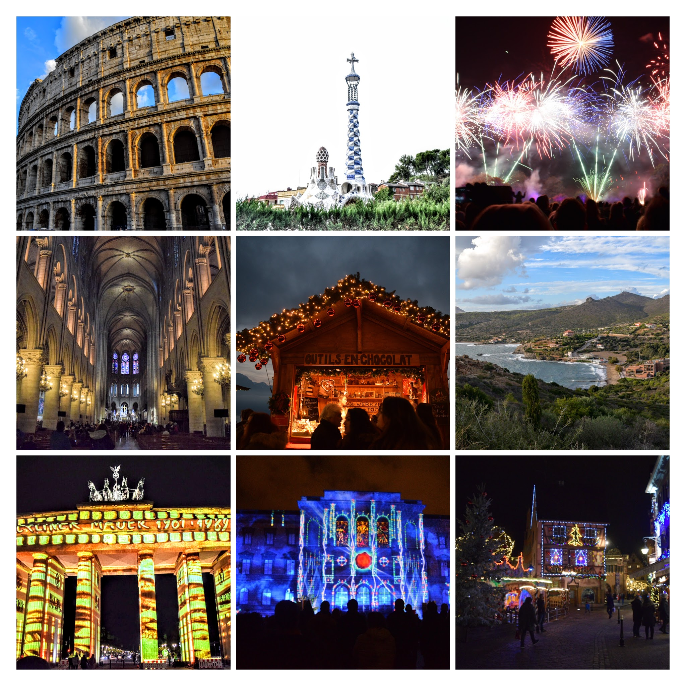
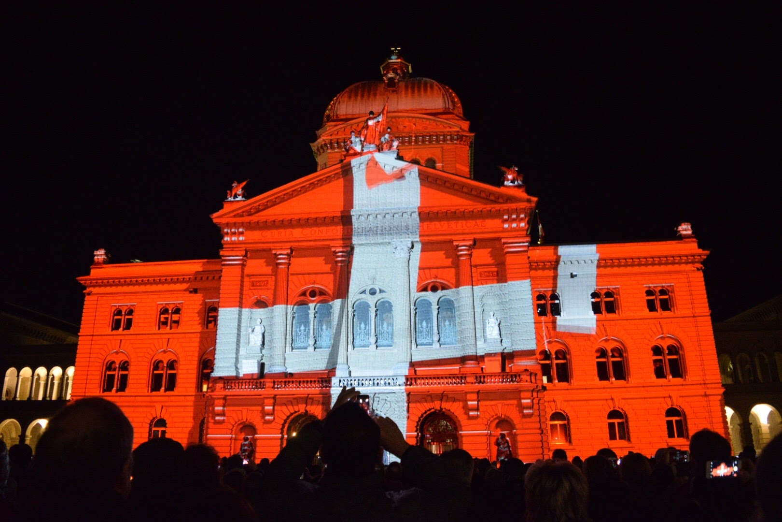

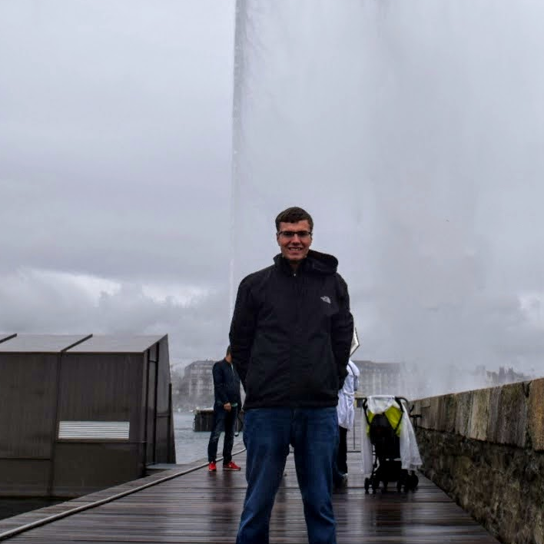
Travel
ED

Slide 11
Backup

Slide 12
Current Efforts
One problem with the fiber light guide is one fiber bundle fiber can share multiple fibers on the guide
A solution to this is subsampling the light transmitted by each aperture
As the limit of these subsamples increases a full image can be restored
Our implementation of this idea is through an Focon
Taper loss of only 10-20% of light compared to 50% using fiber light guide
Fiber Bundle/Light Guide Coupling
Possible Solution
Fiber Bundle Left, Focon magnification on right

