Slide 1


Radiation-Current Effect in ABC130 Chip
Georgia Murray
University of Michigan
Under the direction of
Dr. Richard Teuscher and Dr. Nicola Venturi
University of Toronto
ATLAS, CERN

Slide 2
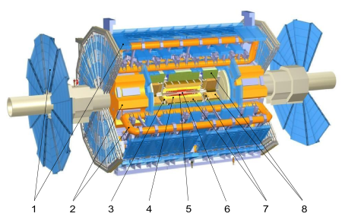
ATLAS
One of four major experiments utilizing CERN’s LHC
Largest particle collider detector constructed to date
Consists of four major components
  Muon Detectors (1)
  Magnet System
    Toroid Magnets (2)
    Solenoid Magnet (3)
  Inner Detector
    Transition Radiation Tracker (4)
    Semi-Conductor Tracker (5)
    Pixel Detector (6)
  Calorimetry
    Liquid Argon Calorimeter (7)
    Tile Calorimeter (8)
Notes:
Size: approximately the weight of the Eiffel Tower
Inner Detector: three layers of track detection; Pixel Detector, Semiconductor Tracker (SCT), and Transition Radiation Tracker (TRT).
Calorimeter: measure energy of particles through detector; Liquid Argon Calorimeter & Tile Hadronic Calorimeter
Muon Spectrometer: 4 technologies and 4k muon chambers to catch those darn things
Magnets: central solenoid; barrel toroid; end-cap toroid

Slide 3
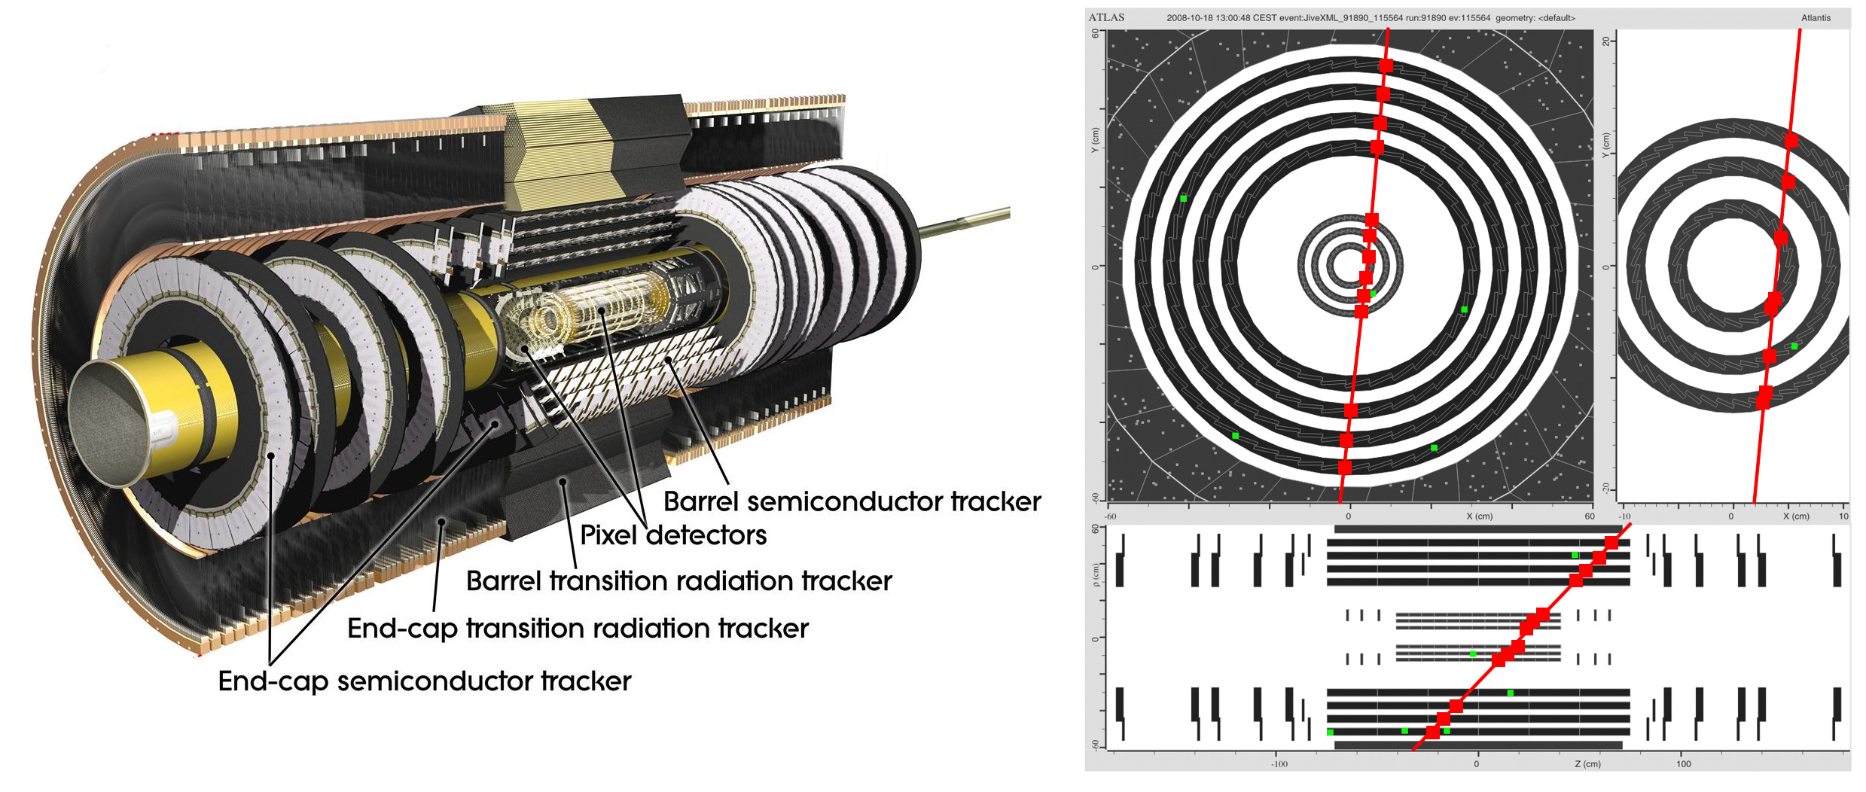
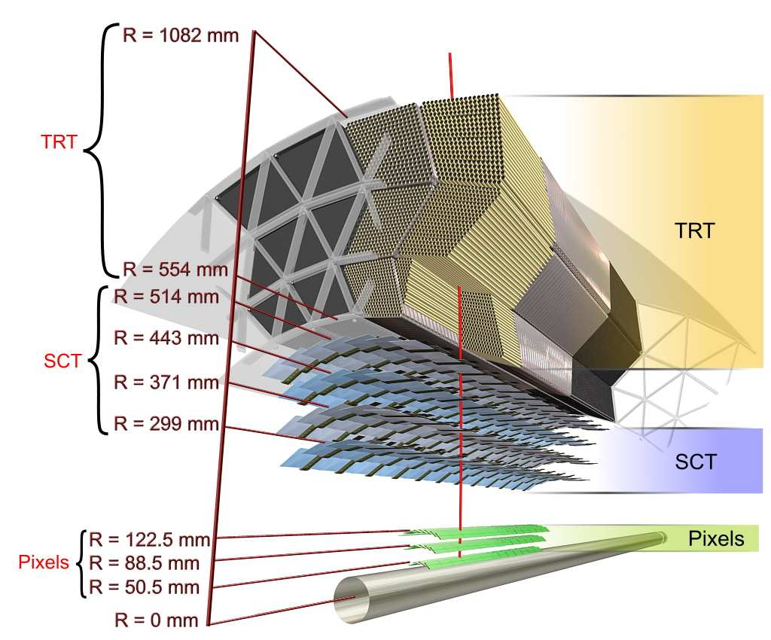
Inner Detector
Notes:
Discuss briefly what each of the three layers does (fill in later); specific project for SCT replacement chip during LH upgrade
After upgrade, TRT will be completely removed, resulting in an all-Si detector consisting of the Pixels and the Si Strips
These Si strips will feed their data into an specially designed ASIC called the ABC130

Slide 4
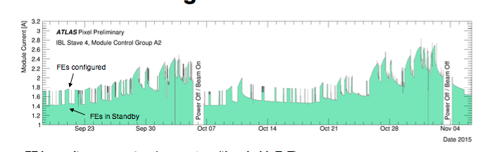
Early-life Radiation Effects
A year ago, single radiation-hardness test on proposed chip showed drastic jump in power consumption
Simultaneously, IBL power consumption jumped unexpectedly a year after installation, causing operational overhead and also temporary inactivation of IBL
Although this phenomenon was known as early as 2002, no predictive model currently exists, thus requiring experimental analysis of the individual system
TID effect on IBL in ATLAS

Slide 5
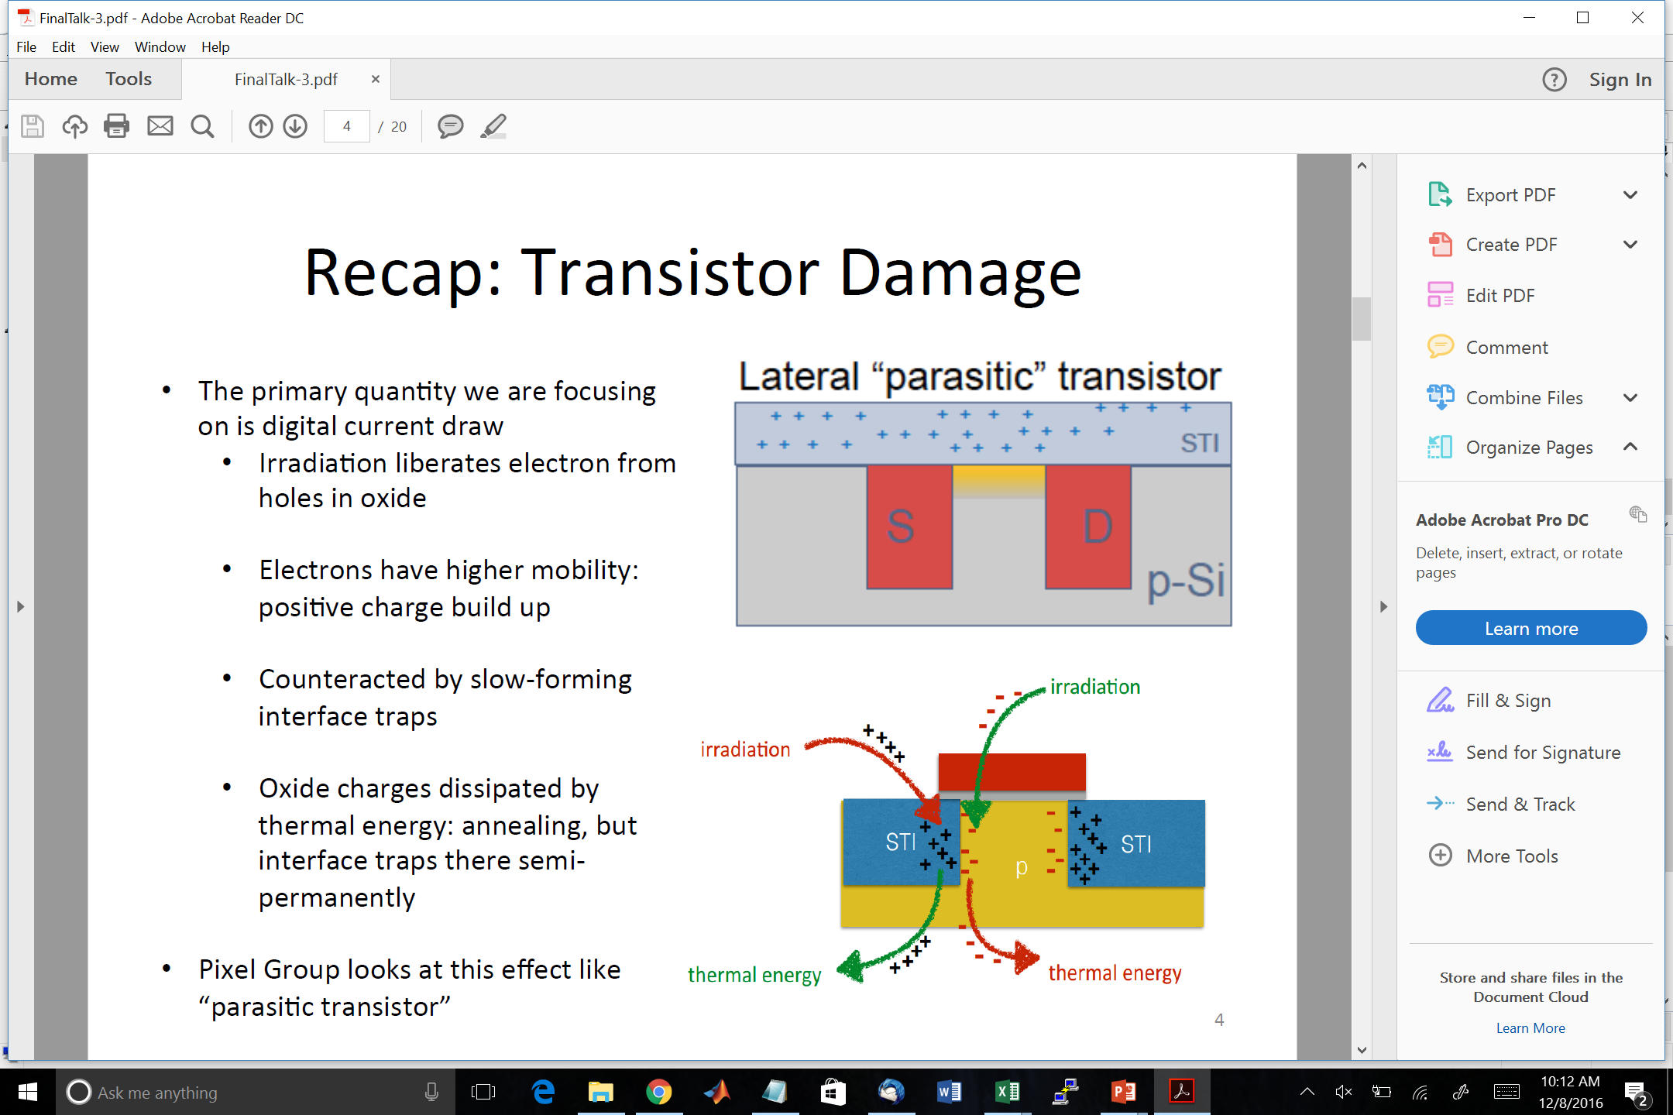
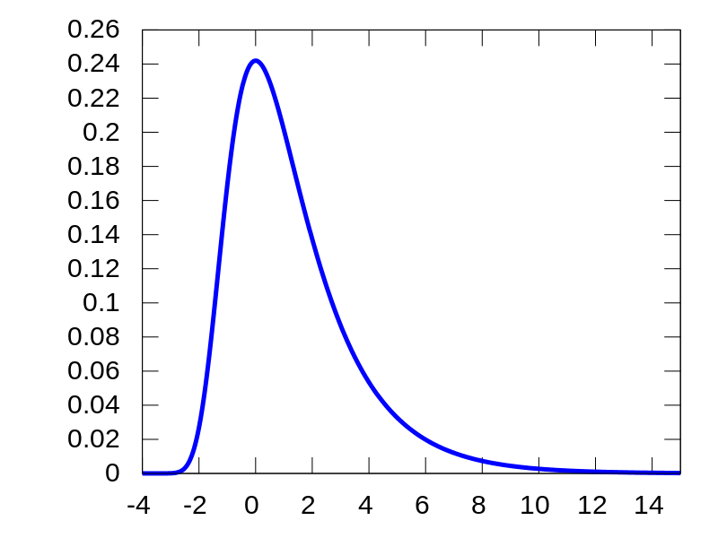
The Phenomenon – “TID Bump”
Irradiation creates in electron-hole pairs in SiO₂ in chip gate
  Electrons highly more mobile than holes, resulting in positive charge build-up
  Charge build-up increases linearly with TID but decreases exponentially with time due to diffusion
Charge build-up is counteracted by “interface traps”
  Positive charge in SiO₂ results in dangling bonds which trap electrons from p-type Si
  Since process activated by positive build-up, magnitude of effect varies linearly with SiO₂ charge
  Delay from SiO₂ charge accumulation to electron trapping results in current spike
Digital Current
TID

Slide 6
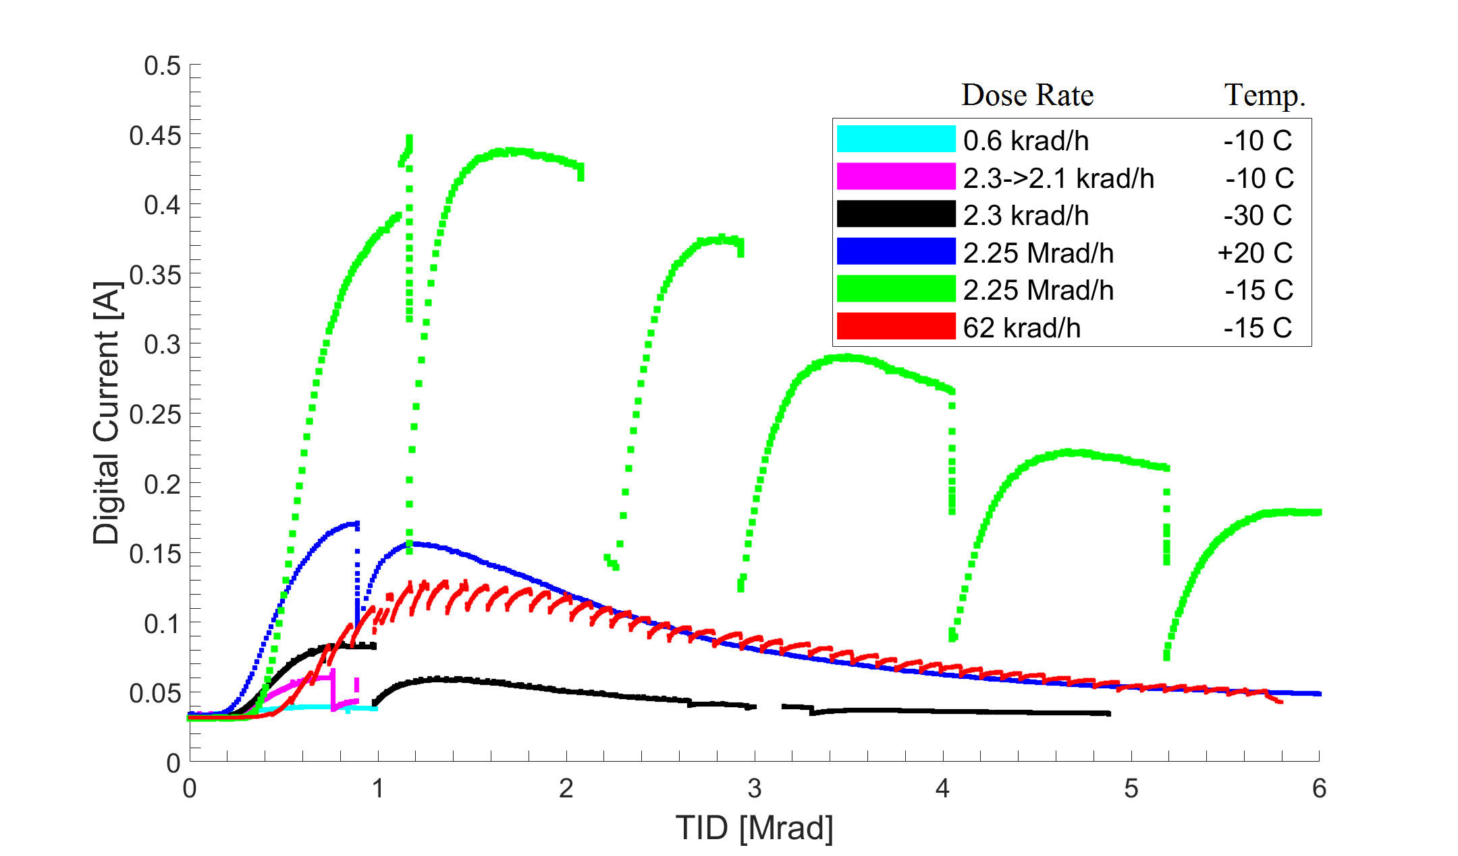
Experiments and Analysis
Test chips irradiated under controlled conditions:
  Temperature: low temperatures inhibit annealing and trapping, thus exacerbating mid-life current bump
  Dose rate (distance from source): actual chips will be placed at different distances from collisions, thus resulting in current fluctuations at different times throughout the system.
TID Bump in ADC130
Initial tests done locally using X-Rays
  Limited accessibility
  Excessively high dose-rate
Current tests off-site with natural cobalt source
  Occasionally power outages and computer restarts allow annealing in chip, thus interfering with representative data collection
Approaching critical point where data sufficient to attempt modeling

Slide 7
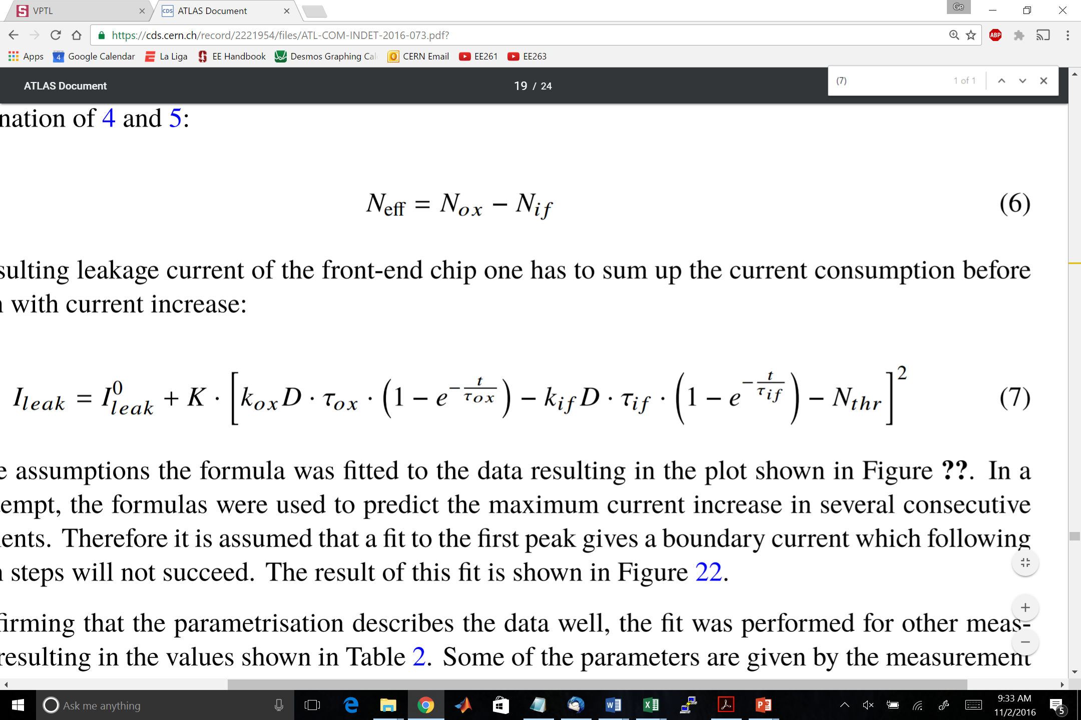
Developing a Predictive Model
Two potential models have been suggested based on current experimental results
A purely theoretical Landau fit
  Qualitatively similar to data obtained from radiation tests
  Well established fitting methods within particle physic
  Generates four fitting-parameters, which if linked to physical conditions, could provide valuable prediction method
  No such physical significance currently established
  Trends are difficult to identify due to low data density
A “physical” model, proposed and developed by Malte Backhaus
  Requires extensive parameter-fitting for each new condition-set, thus lessening use as predictive model

Slide 8
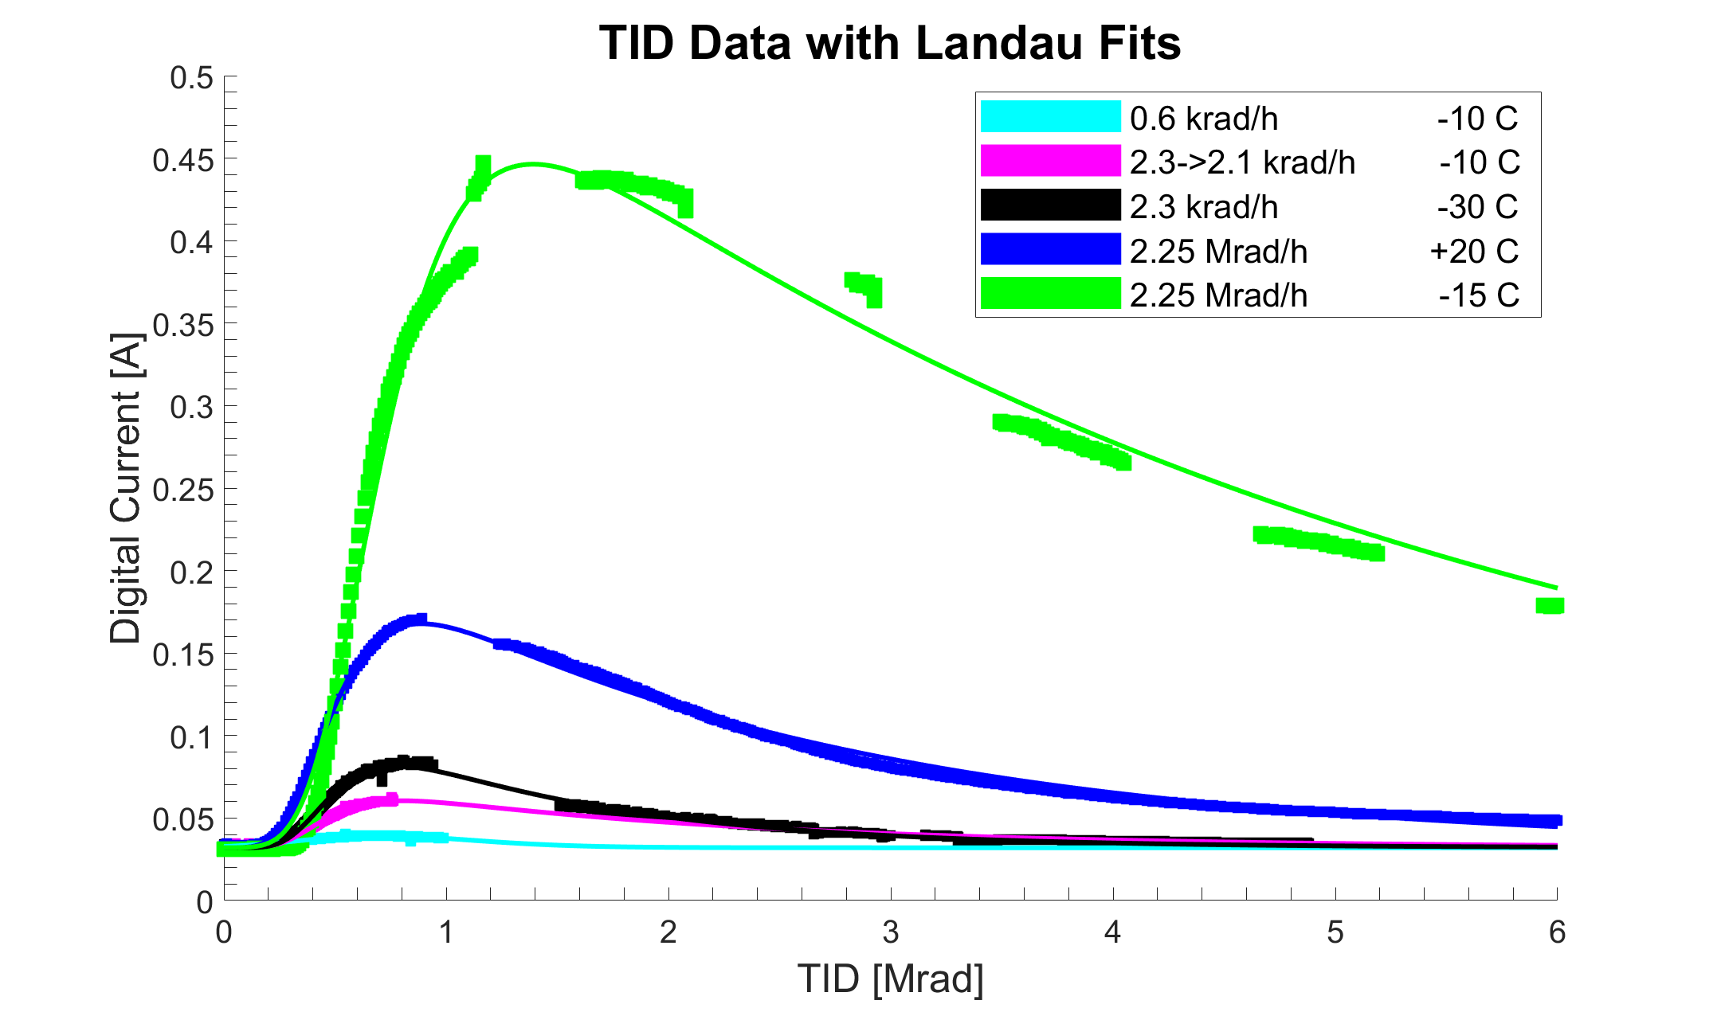
Theoretical Landau Fit
Excellent initial fitting results
Data too limited to achieve predictive model at present
Optimized parameters highly dependent on data selection and initial guess

Slide 9
“Physical Model” Fit
Substantially worse results than theoretical Landau
Accounts explicitly for dose rate but not for temperature
Some data achieves best fit with unphysical values for “physical” parameters
Conclusion: While a physical model is desirable, the current proposition is insufficient.
Improved insight into temperature dependence may help illuminate the problem.

Slide 10
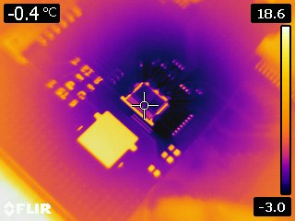
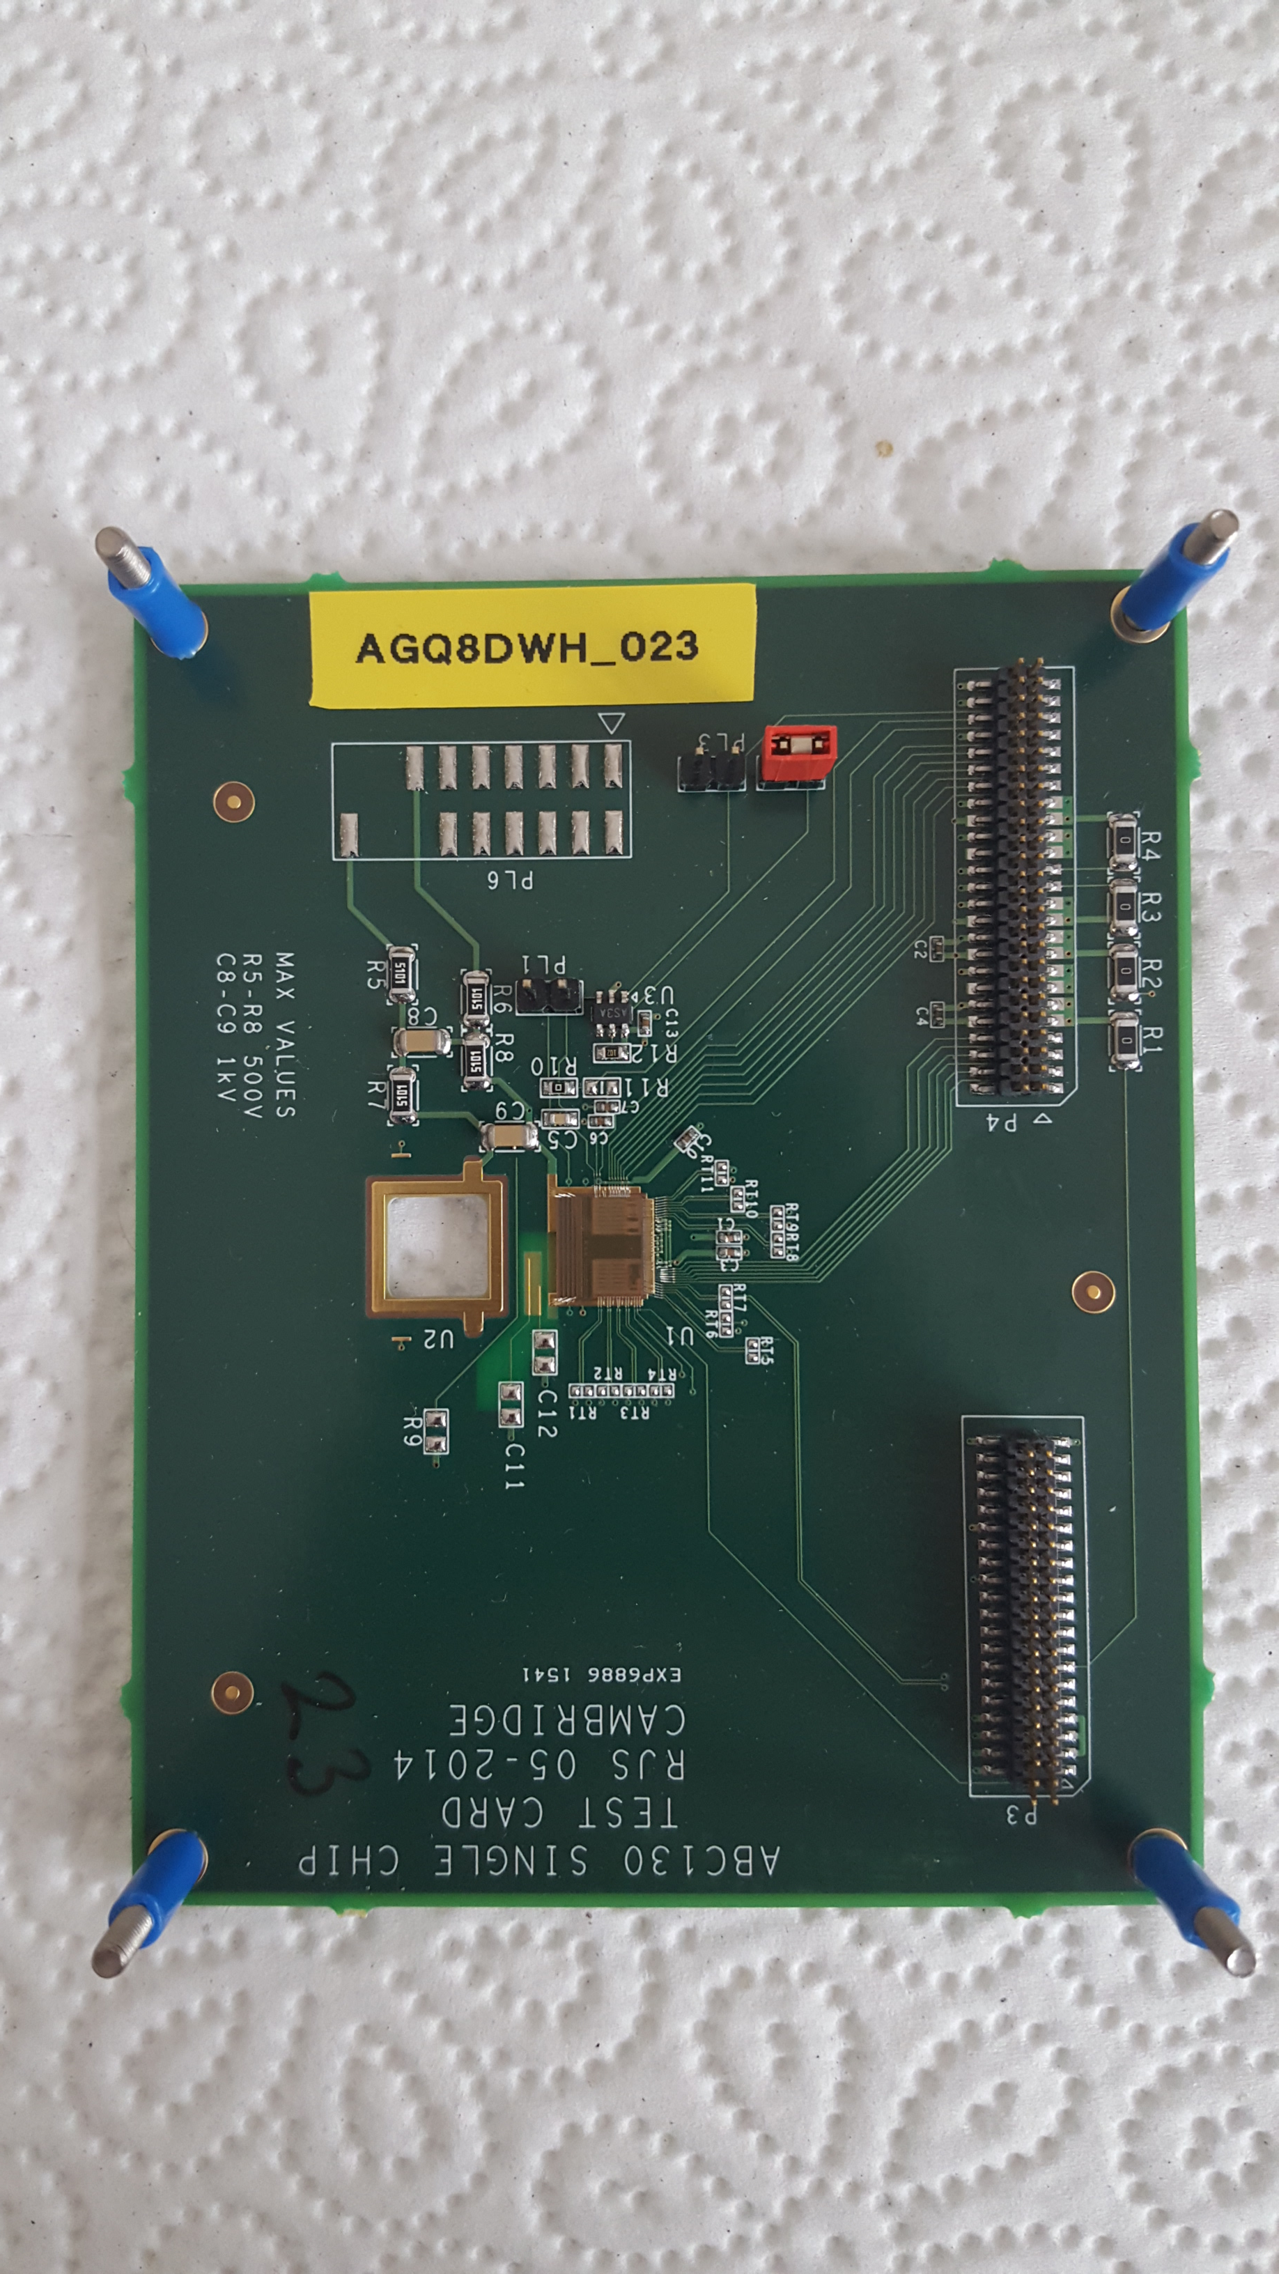
New Measurement – Temp Dependence
Backhaus’s proposed fitting equation takes explicit consideration of dose rate, not temperature
To analyze temperature dependence, new test at DR = 2.3 krad/h, T = 0°C
  Will have DR = 2.3 krad/h measurements at T = -30, -10, 0°C
New testing facility at Brookhaven National Laboratory, USA, will reproduce and extend measurements at same temperatures over a range of dose rates

Slide 11
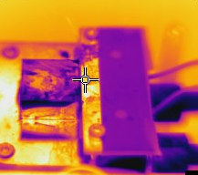
Temperature Validation
Temperature read-outs during irradiation are unreliable due to loosening of NTC connection
Previously, thermal camera used at termination of studies to confirm expected temperature, but accuracy questioned
  Dry-air flow shown to drastically alter measurements
  Possible error introduced from Kapton tape used to protect chip
Using X-Ray source, generated highly-controlled, easy-access environment in which temperature could be swept and NTC/camera measurements compared, with and without Kapton
Cooling
Peltier
Metal with
Kapton
Metal

Slide 12
Temperature Validation – Results
Expectations:
  Measurements may differ from setting due to physical setup, but NTC/camera measurements should agree
  Kapton should have little/no effect on NTC measurement
  NTC w/Keplar measurement may be slightly higher due to distance from cooling Peltier
Results:
  Measurements differ substantially from setting, indicate drastic effect of physical setup (likely dry air)
  NTC/camera measurements agree within +/- 2°C with Kapton; camera wildly inaccurate without
Peltier Setting | Camera Metal | NTC Metal | Camera Kapton | NTC Kapton
-02 | +17.1 | NA | -2.5 | NA
-12 | +17.5 | -1.0 | 0.5 | -0.3
-22 | +16.5 | -5.4 | -8.5 | -6.5

Slide 13
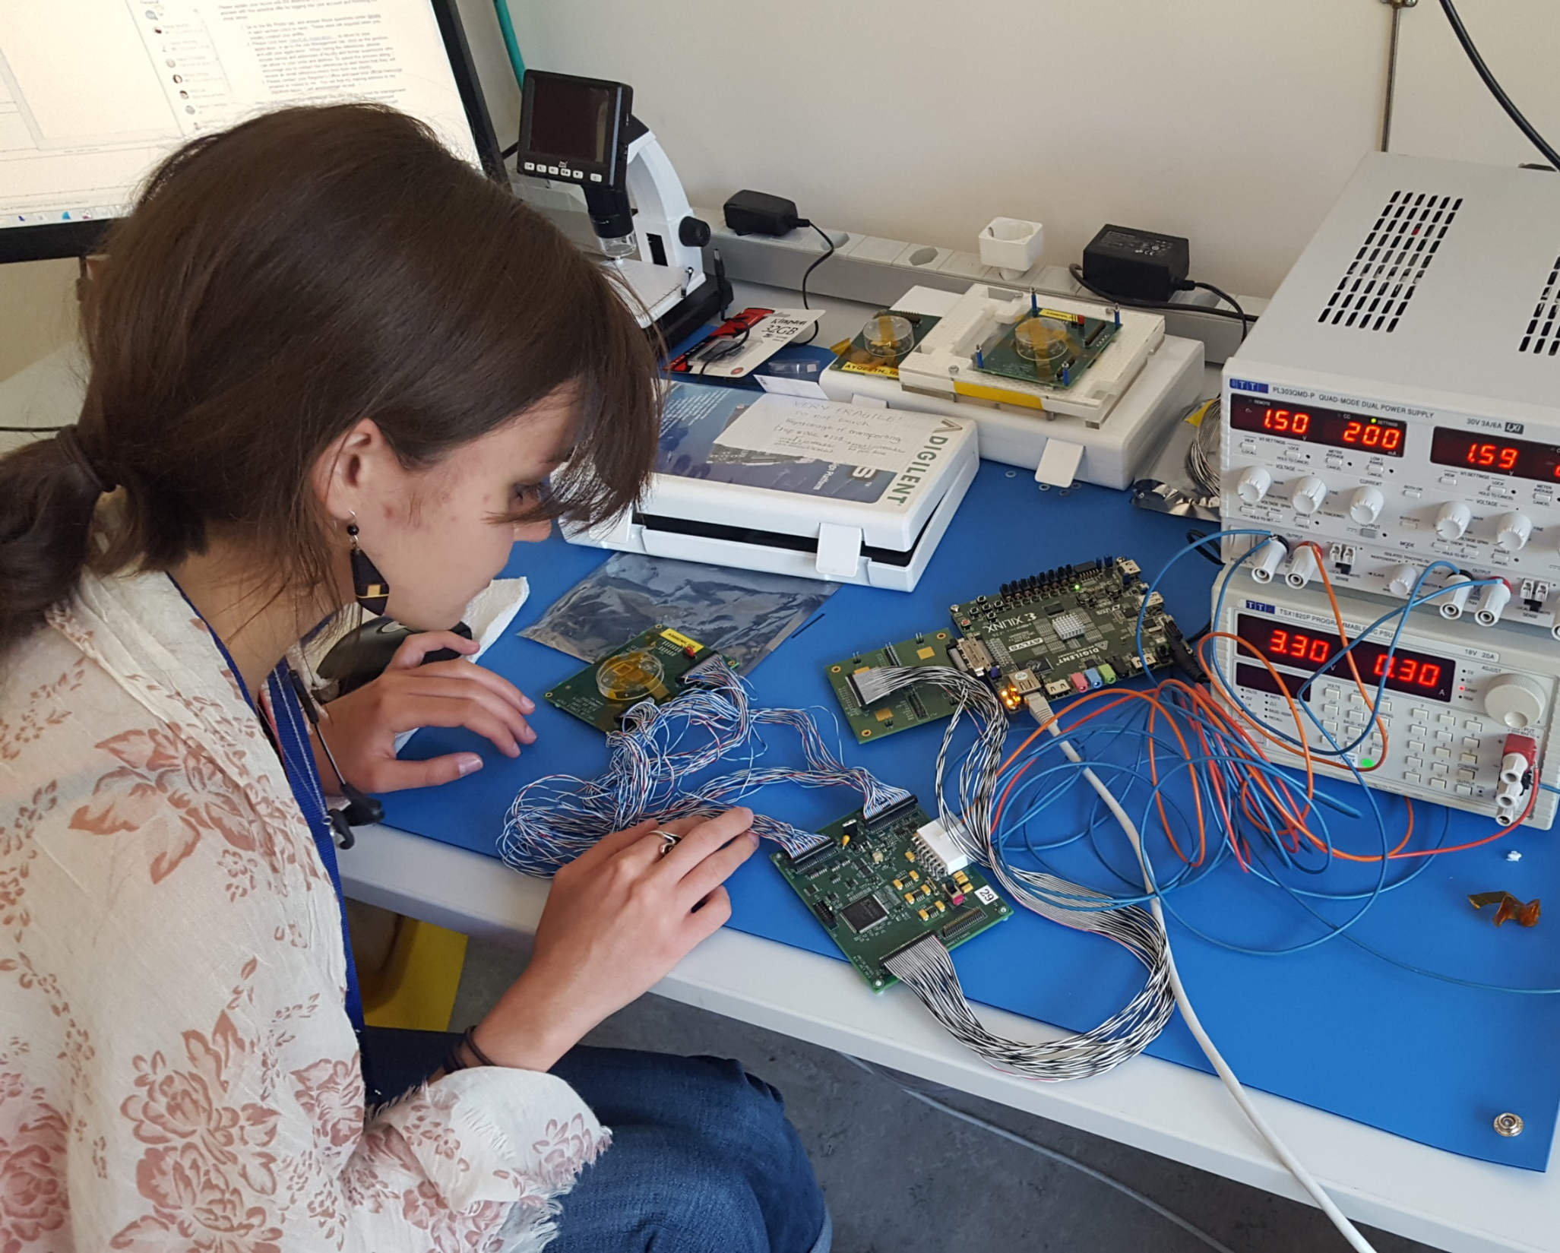
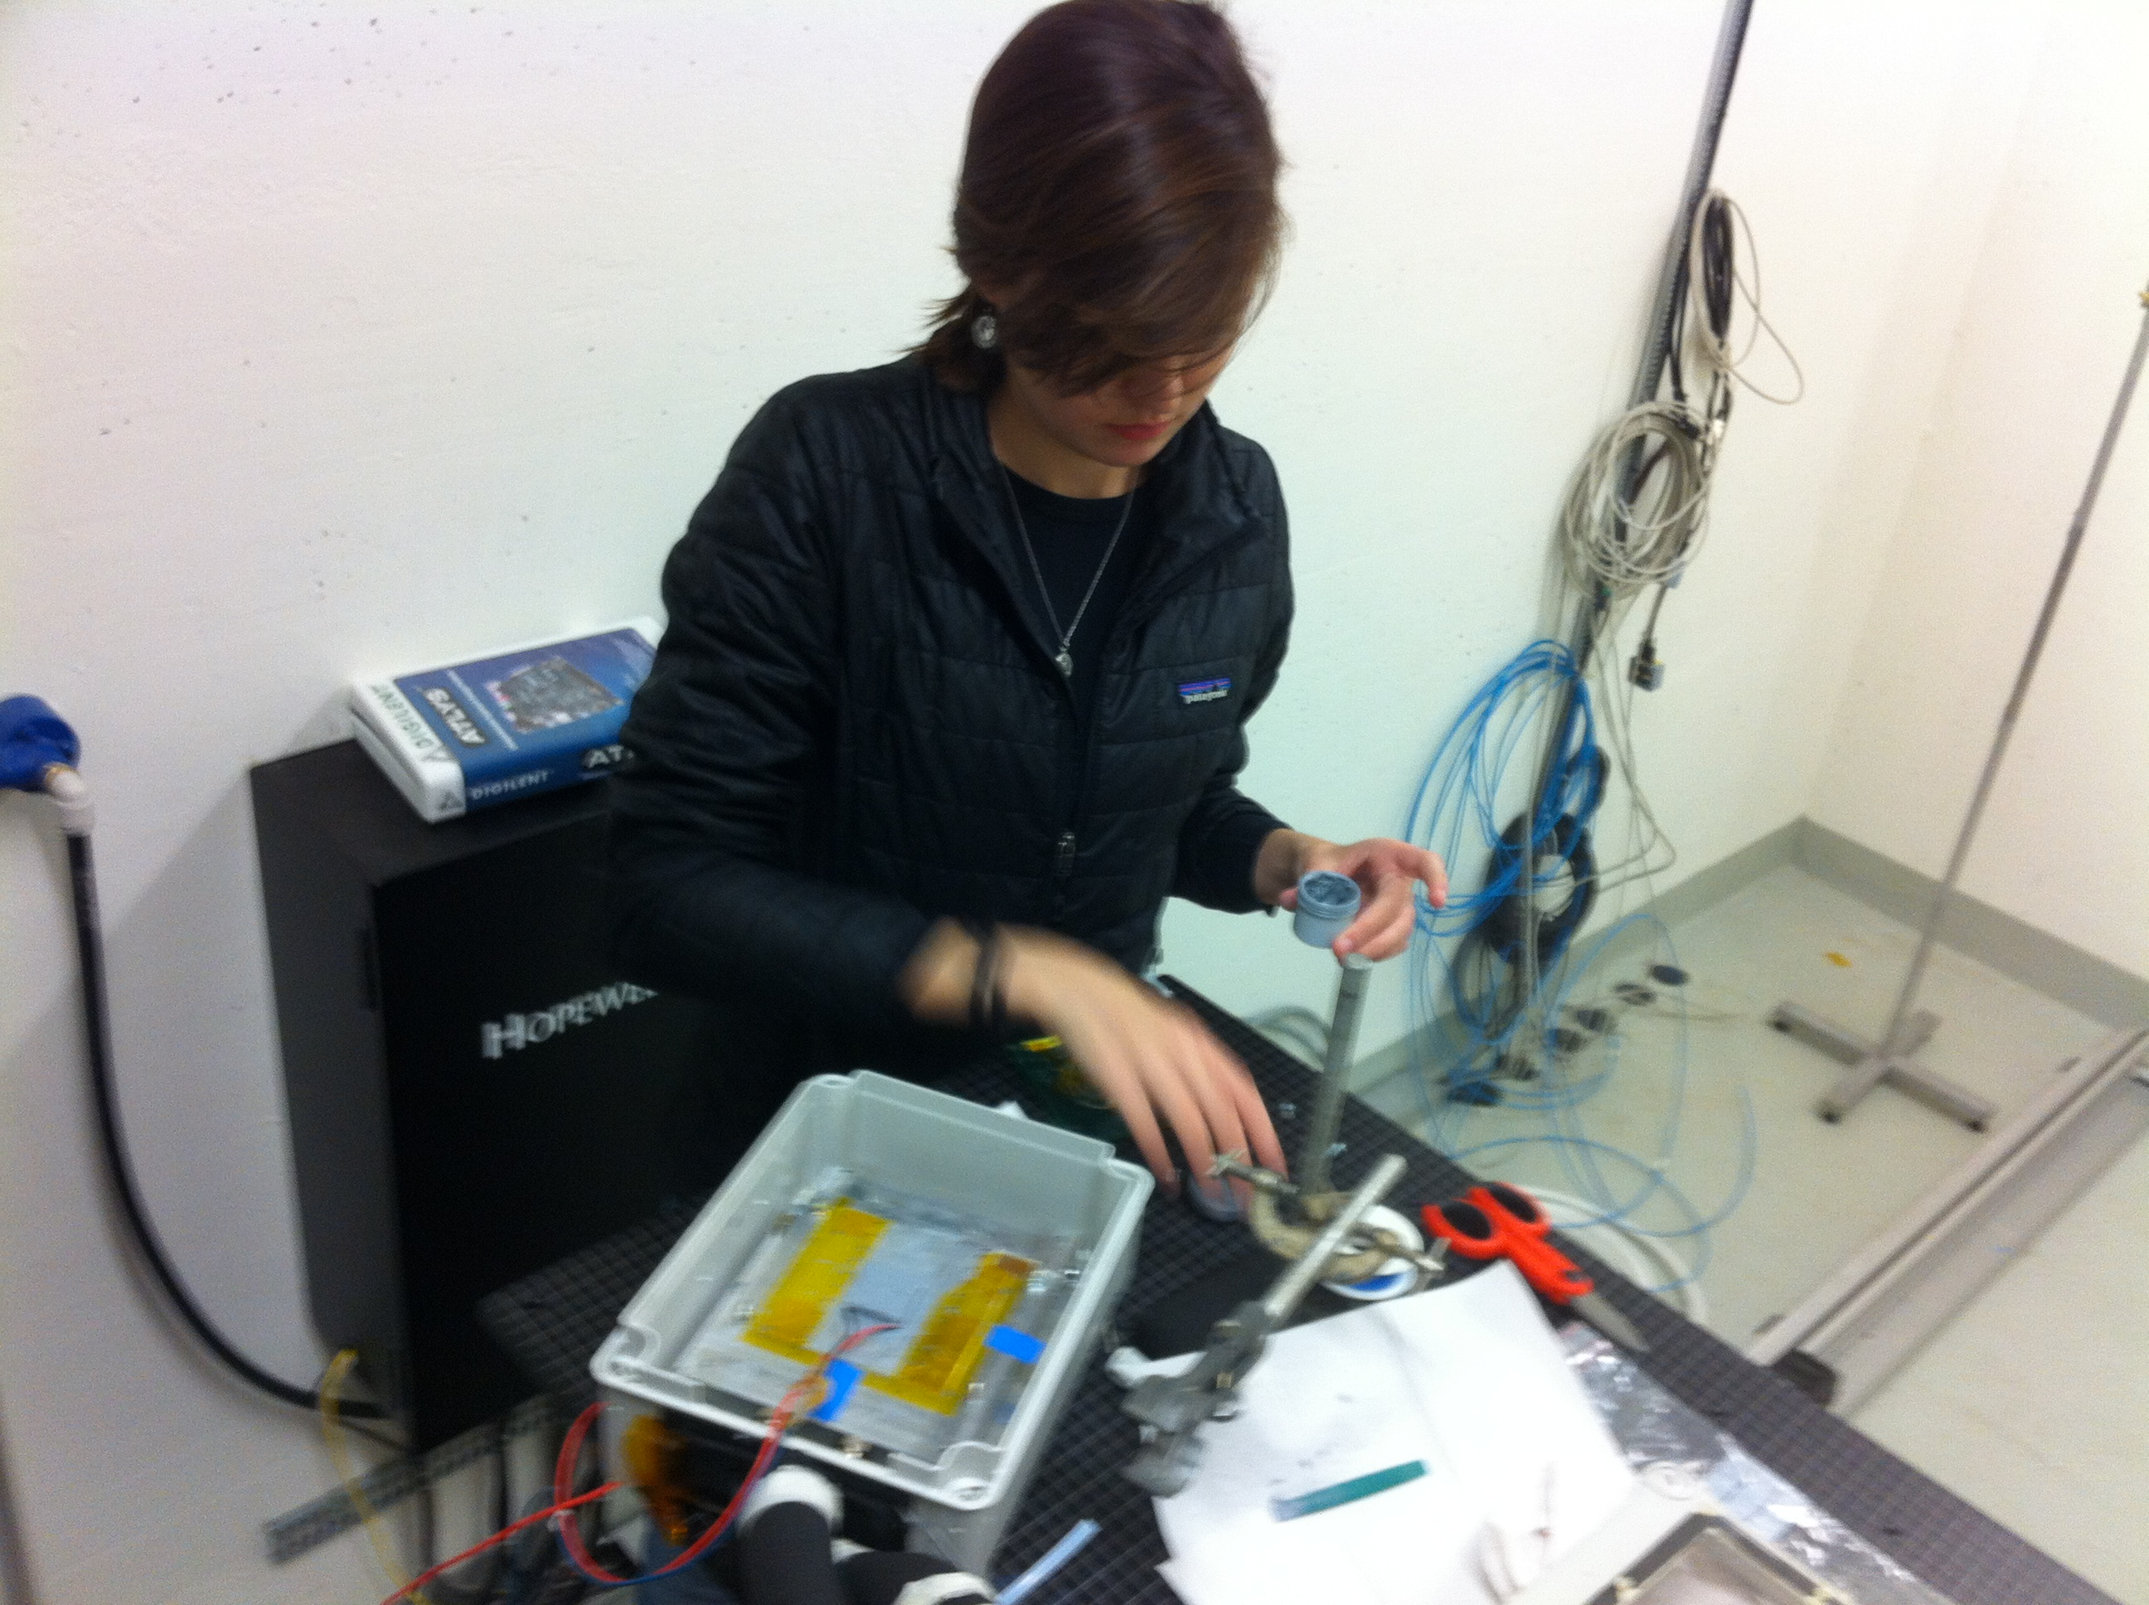
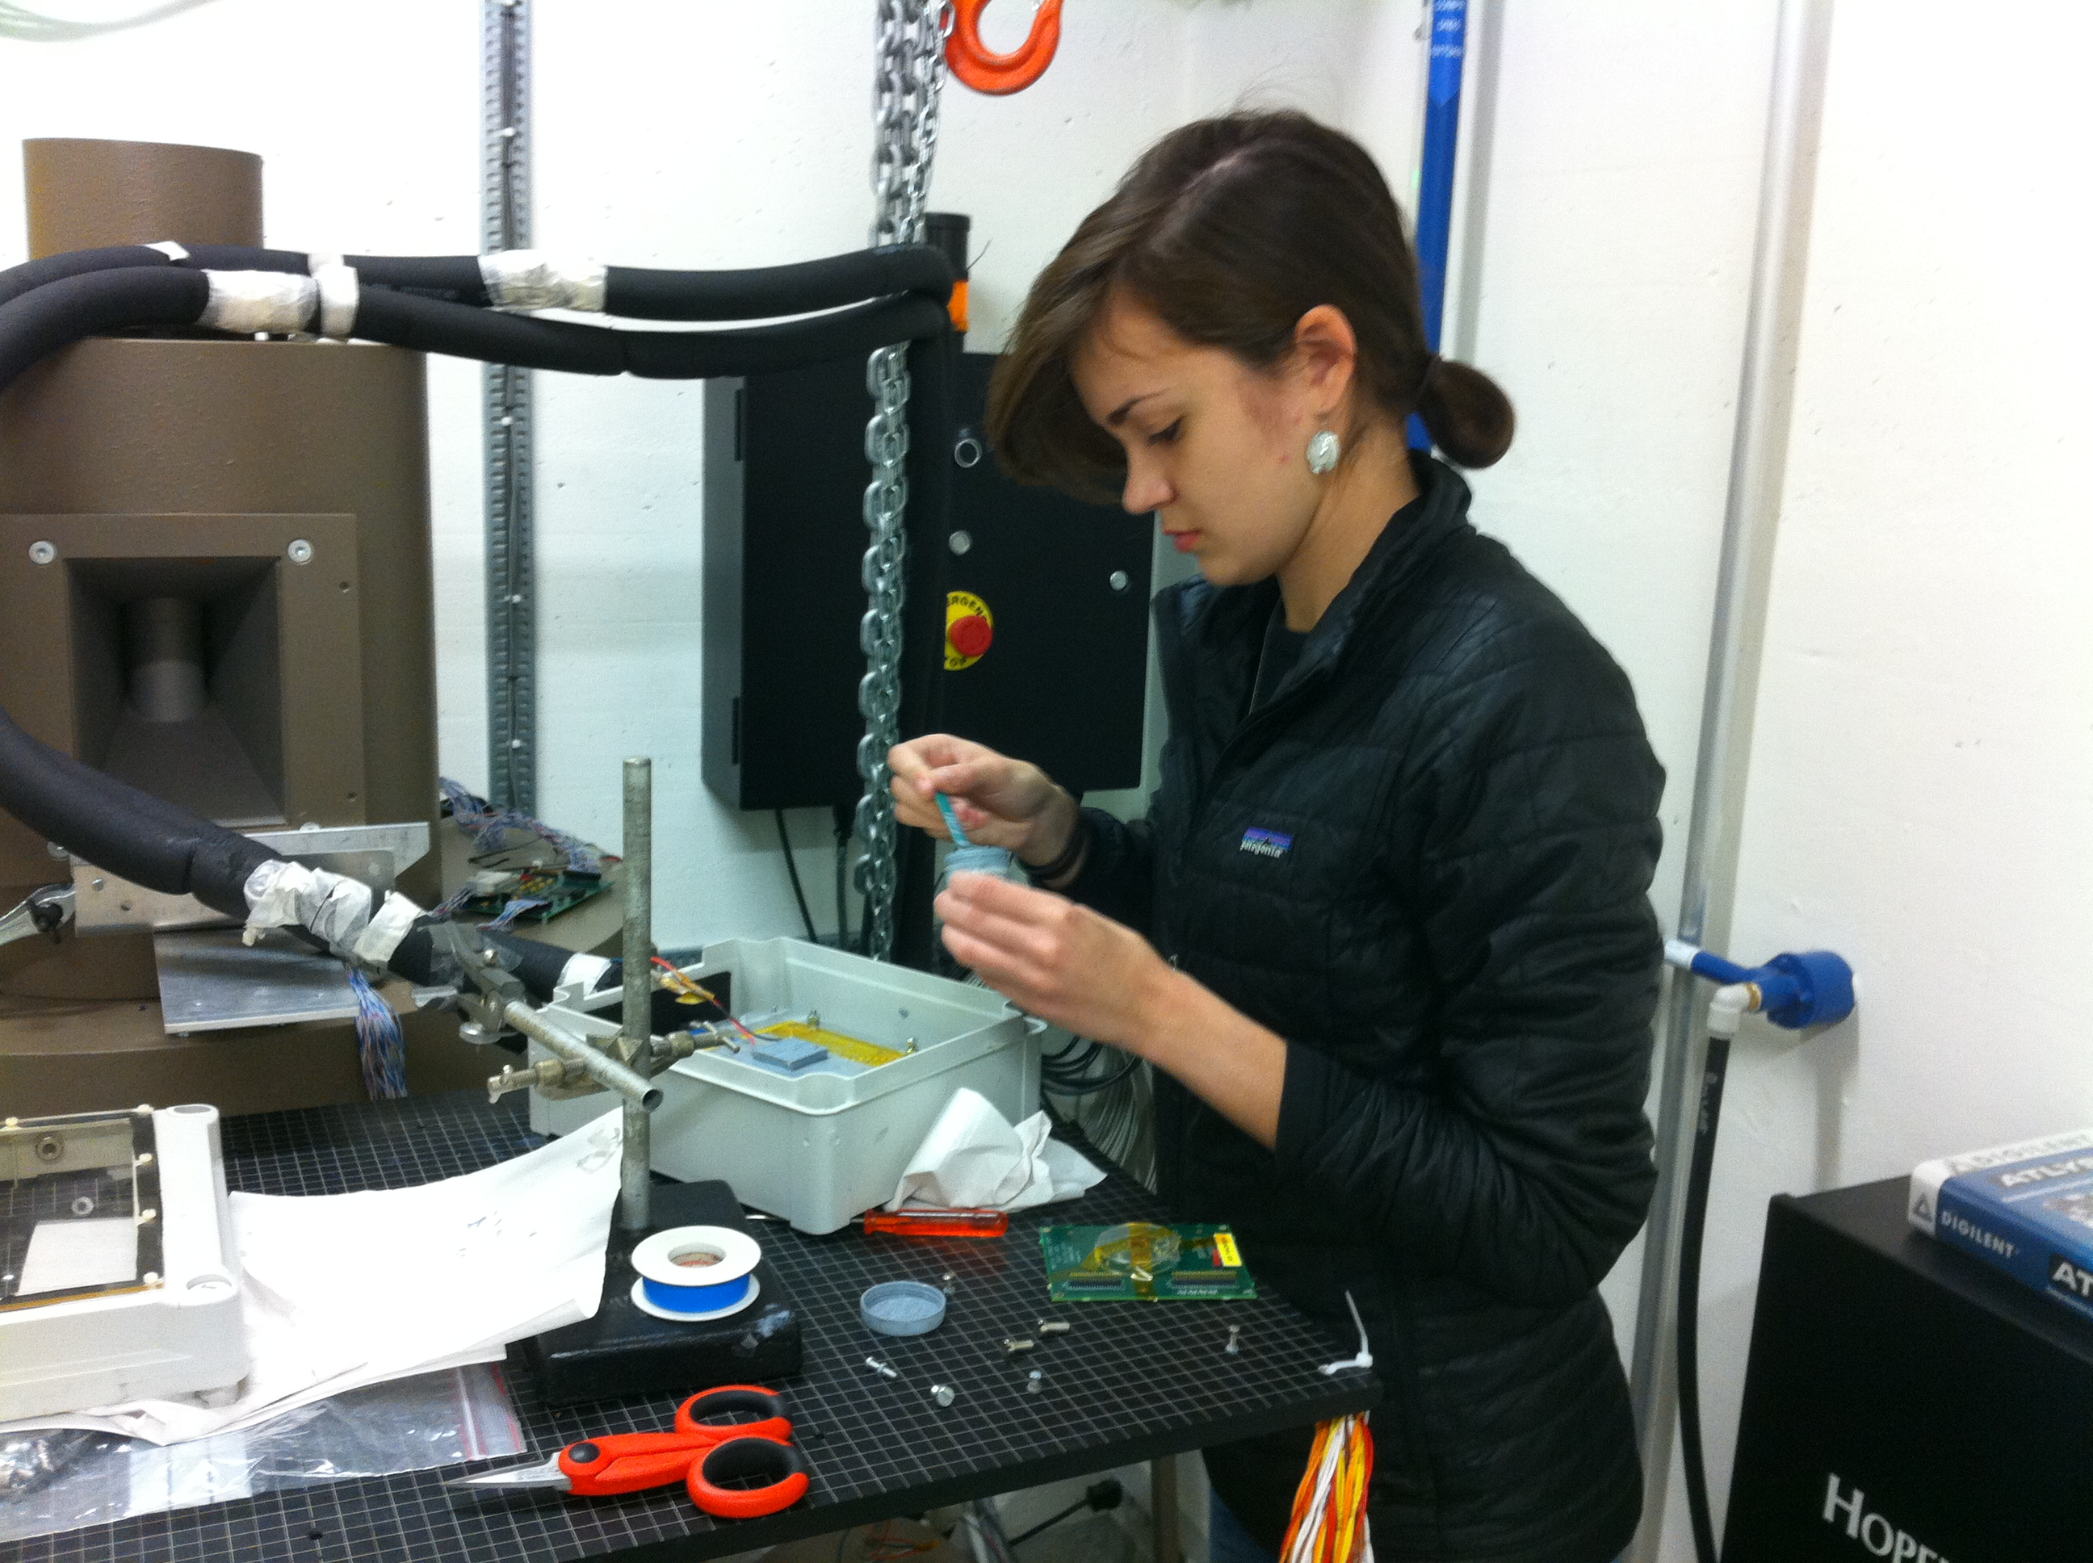
Next Steps
Upon completion of current radiation test, begin to explore possible models for temperature dependence
Use future BNL results to cross-check and extend temperature hypotheses
Continue investigating viability of proposed Landau model

Slide 14

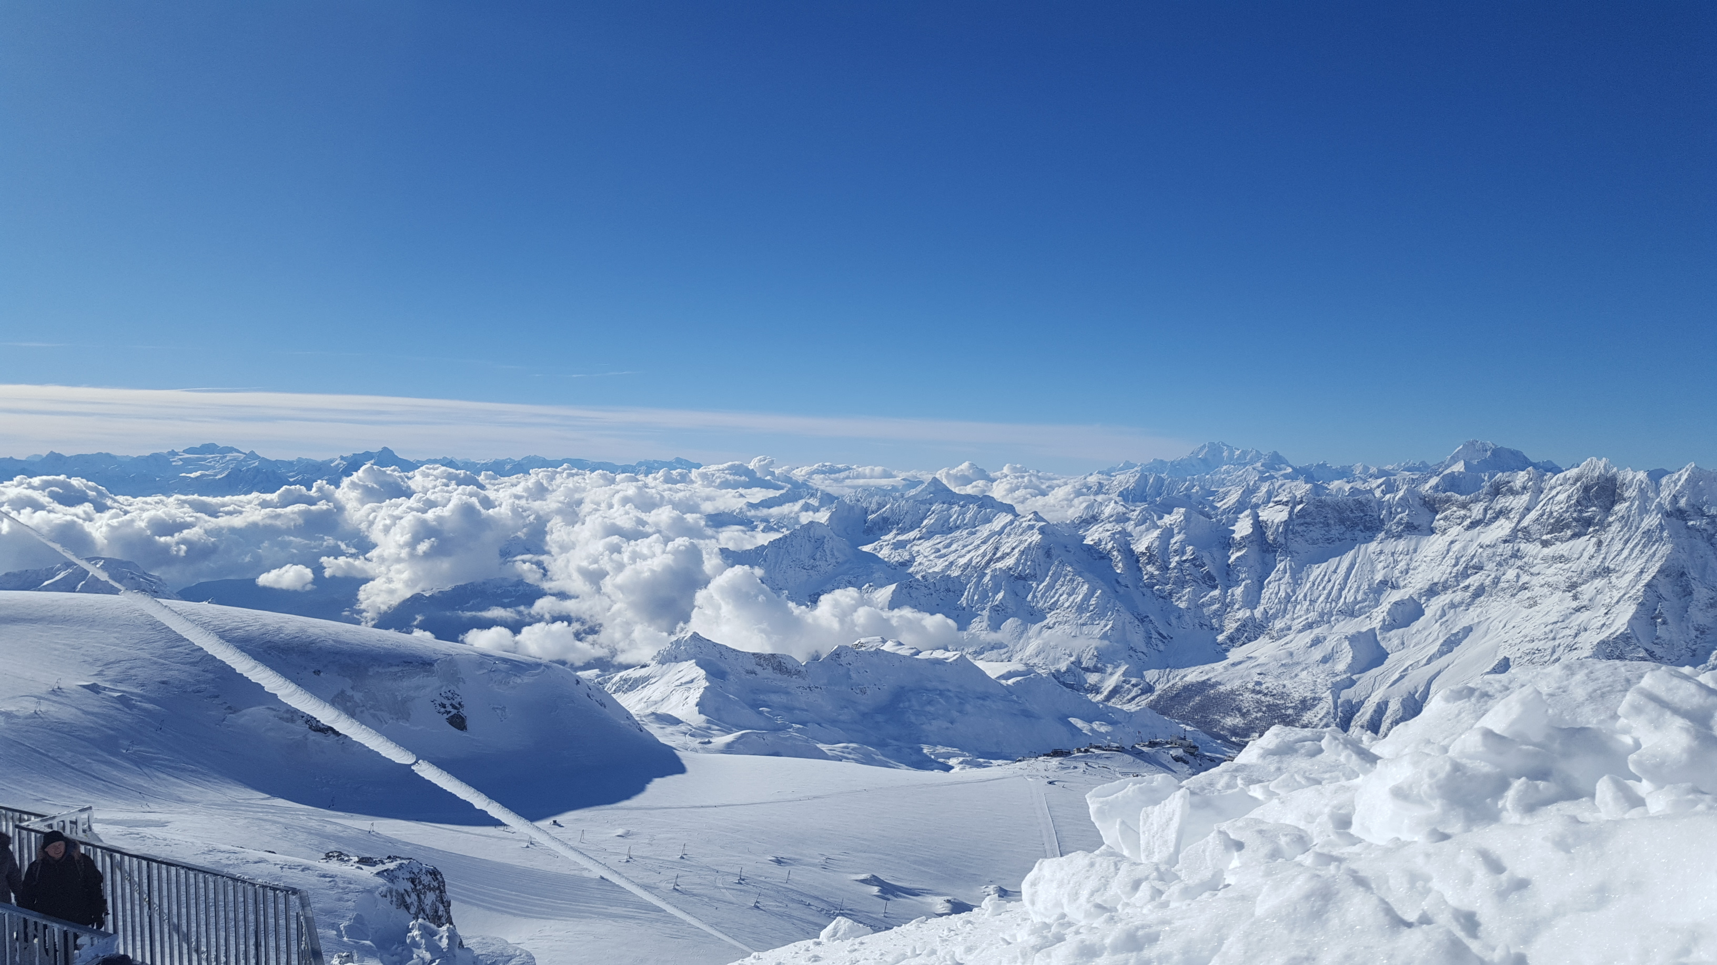

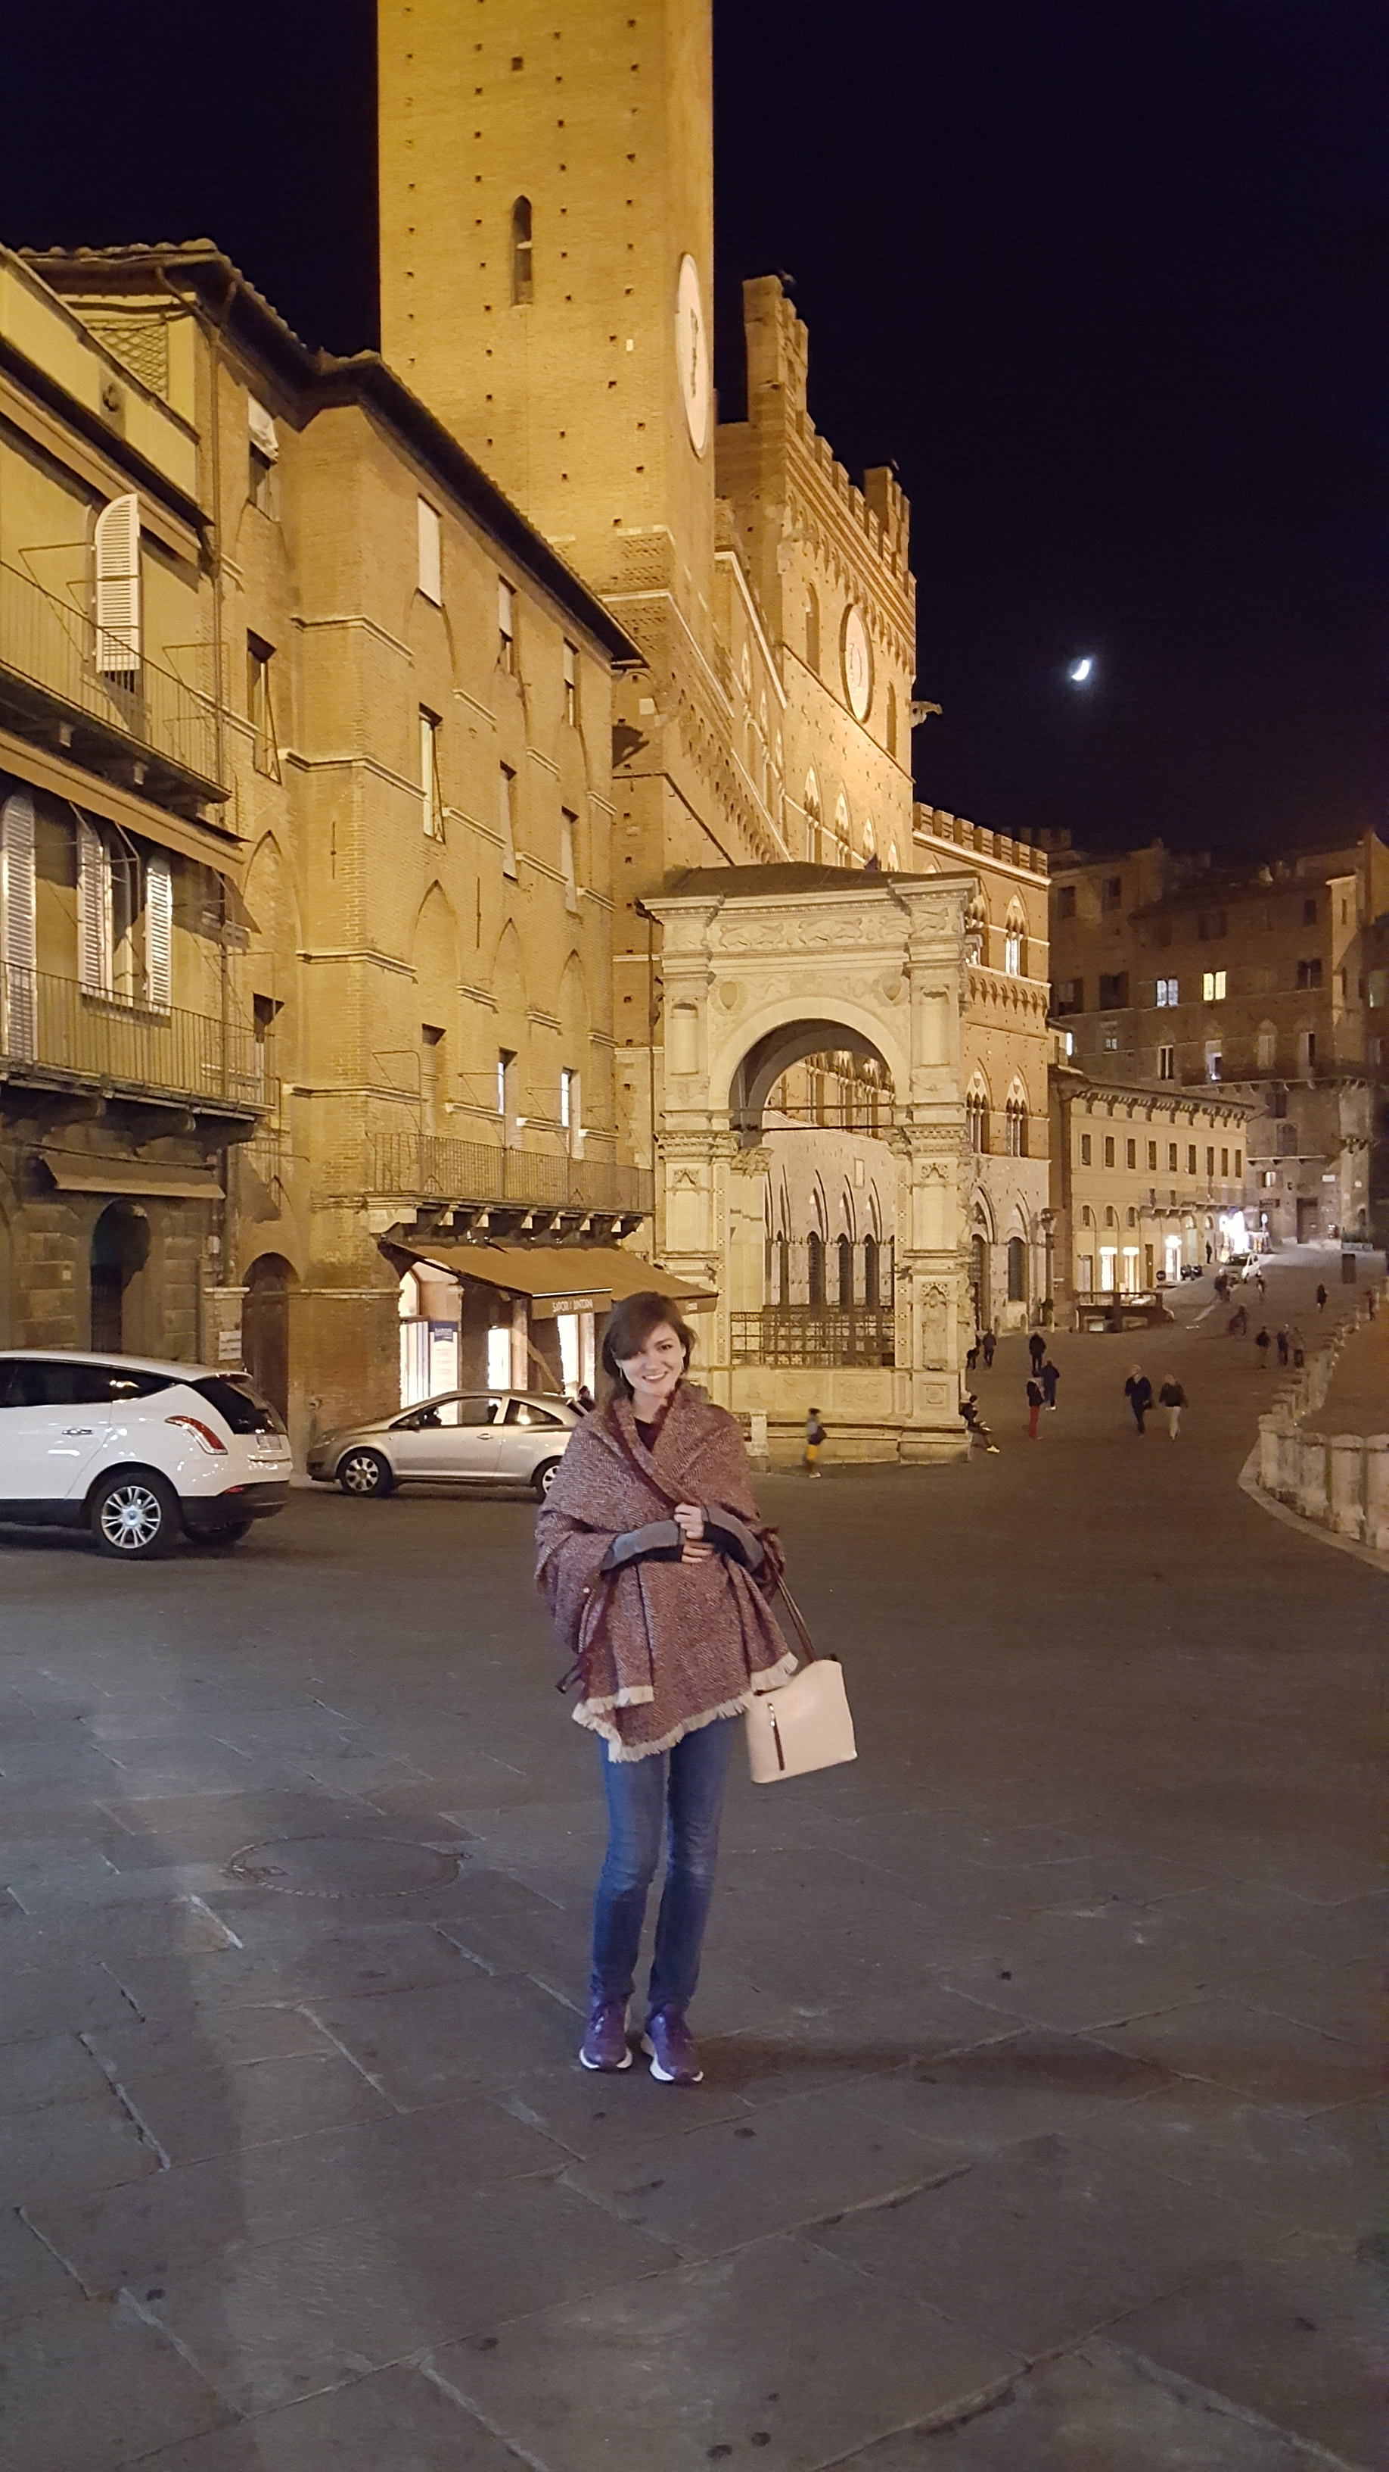
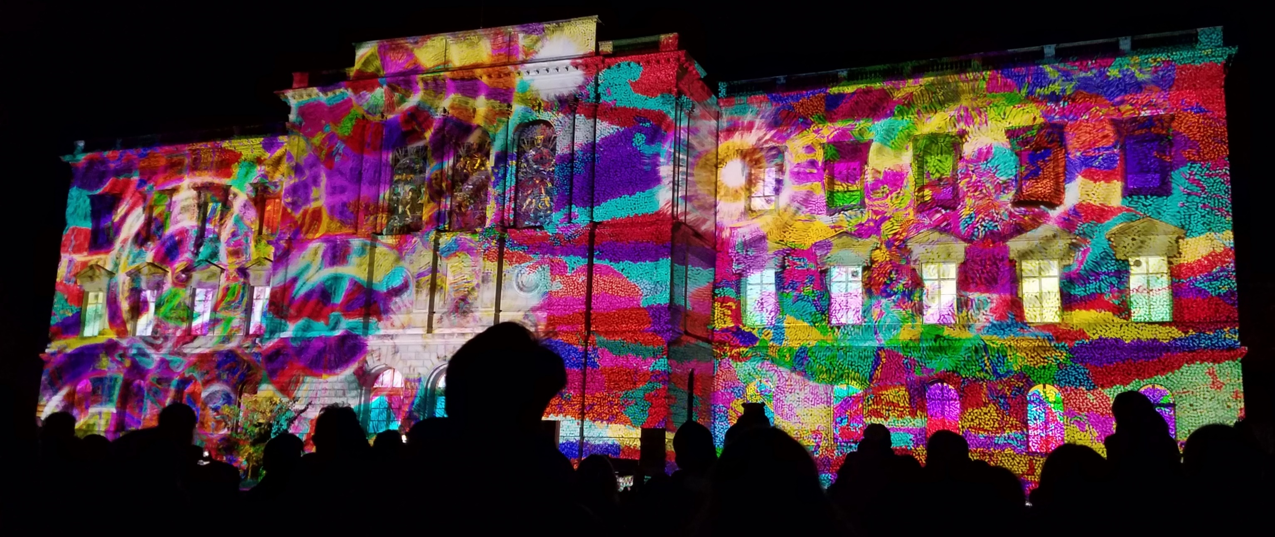
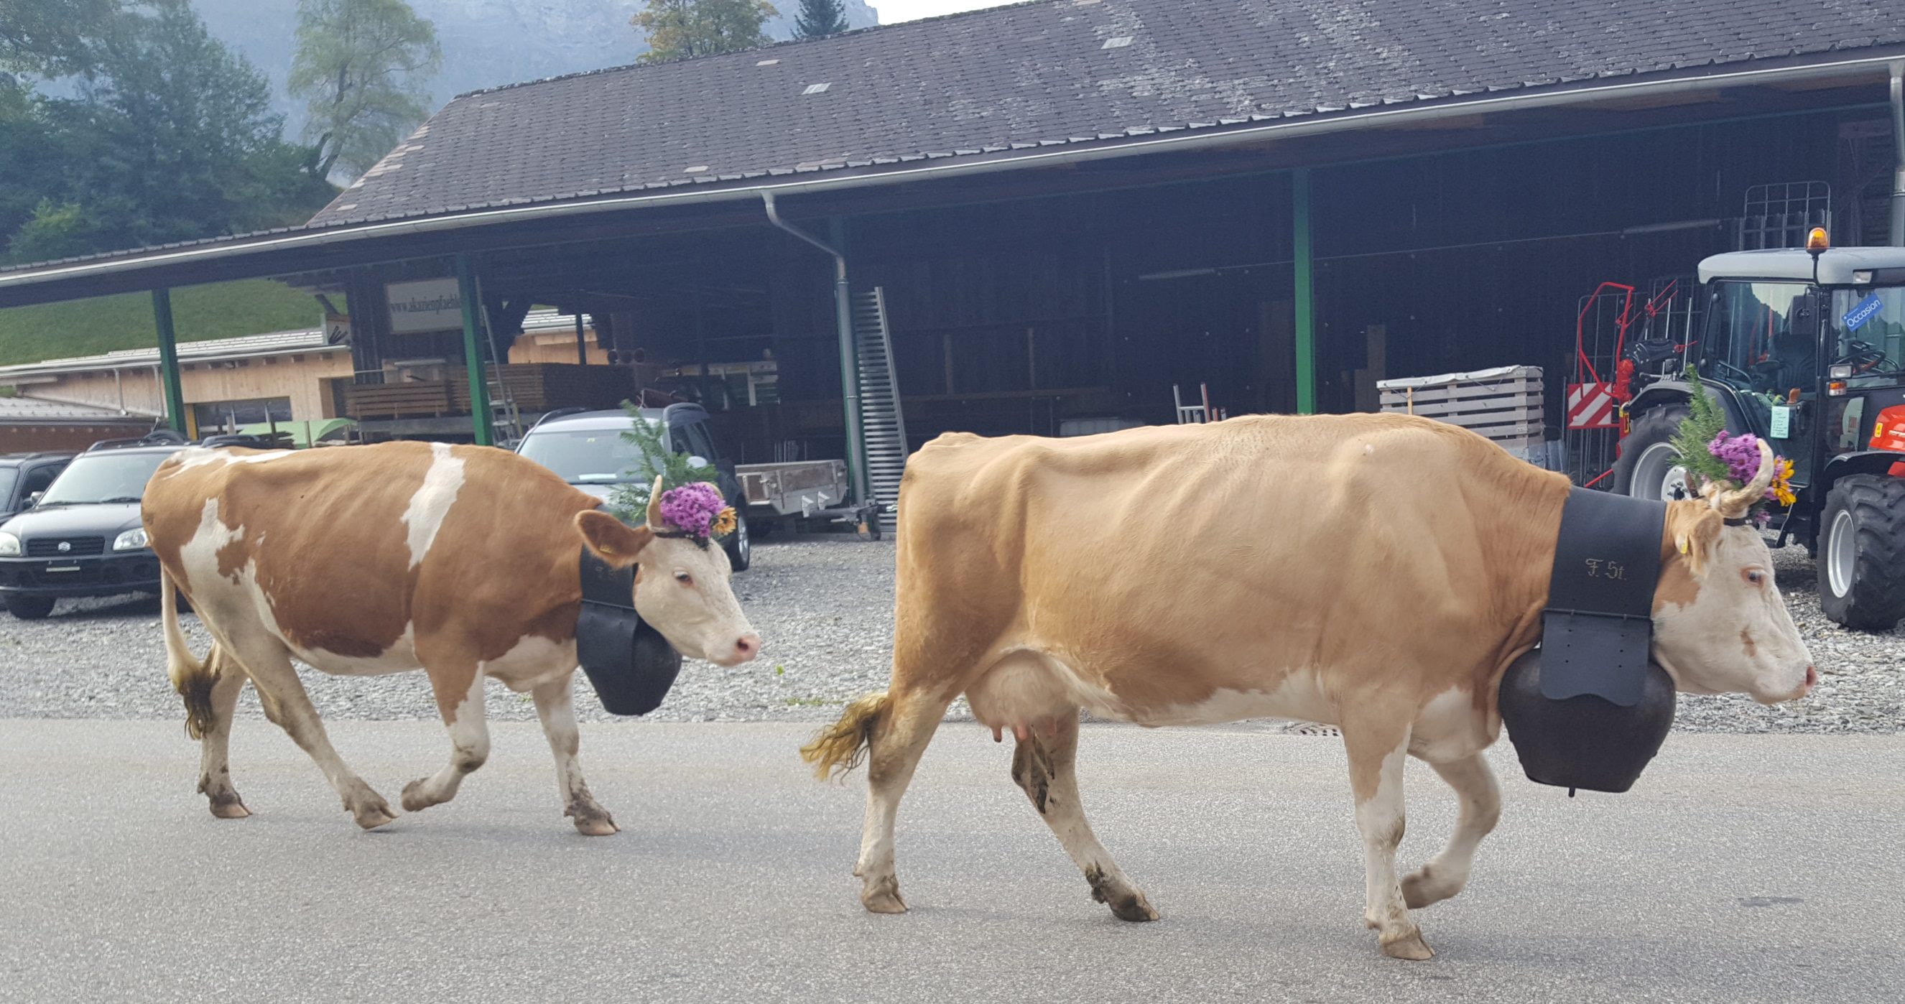
People don't take trips… trips take people.
John Steinbeck

Slide 15

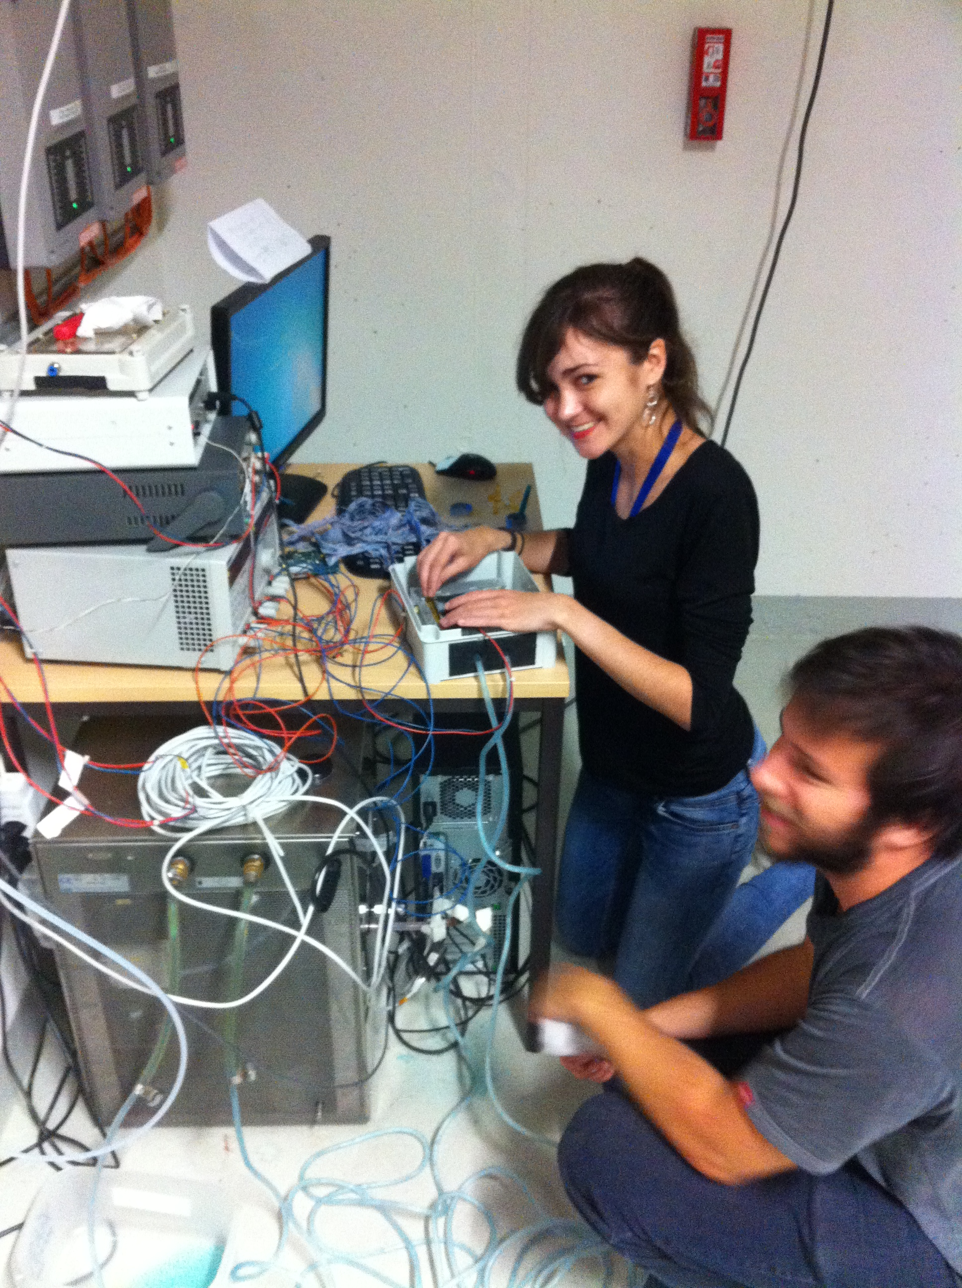

Acknowledgments
  Dr. Richard Teuscher
  Dr. Nicola Venturi
  Mr. Kyle Cormier
  Dr. Francis Anghinolfi
  Dr. Bruno Allongue
  Dr. Jean Krisch
  Dr. Steven Goldfarb
  University of Michigan

