Slide 1


Data Quality Monitoring with Machine Learning at CMS
12/8/2016
Mentor: Professor Nural Akchurin
Postdoc Mentor: Dr. Federico de Guio
Hector F. Lacera Otalora

Slide 2
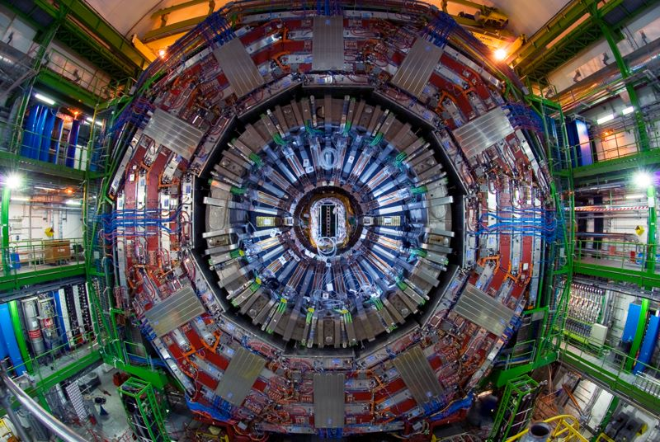
The Compact Muon Solenoid Detector

Slide 3
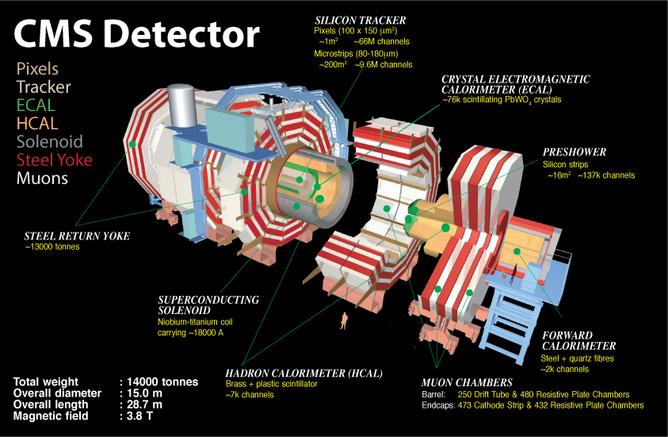

Slide 4
Data Quality Monitoring for CMS
The CMS detector is complex and produces large amounts of data.
A crucial part of CMS is to identify errors and problems in the detector.
Central component: DQM GUI
- High quality histogram viewing
- Web server accessible worldwide

Slide 5
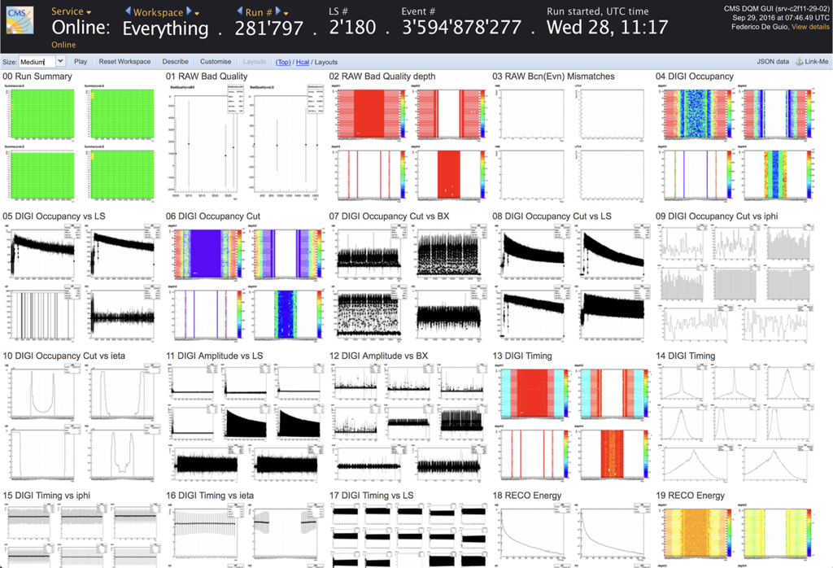
DQM GUI website

Slide 6
Machine Learning for better DQM
Current method: Physicists on shift check incoming data from the detector and test it against trusted references.
Better way: Implement Machine Learning techniques that recognize patterns and are able to accept or reject data in the trivial cases.
Leave only non-trivial cases to experts.

Slide 7
Objects of study: Jets
Variables used:
Pt = Momentum of the jet measured in transverse plane
(7 quantiles)
Eta= Jet pseudorapidity
(7 quantiles)
Phi = azimuthal angle
(7 quantiles)
Vtx = Number of primary vertices in the event
(7 quantiles)
Cross Section = Probability that two particles will collide and react in a certain way
Total = 29 Features

Slide 8
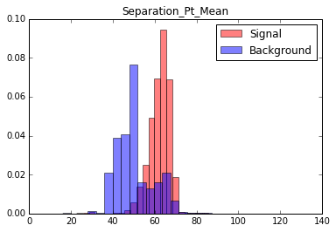
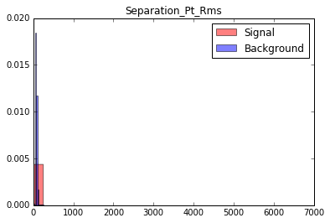
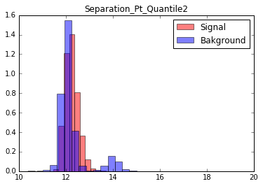
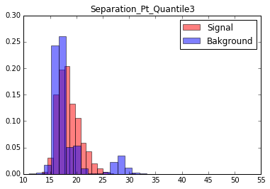
Discrimination Power by feature

Slide 9
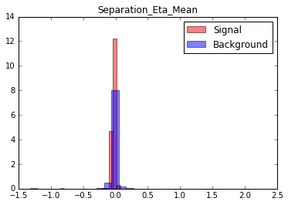
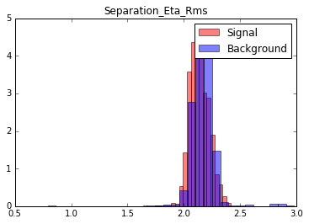
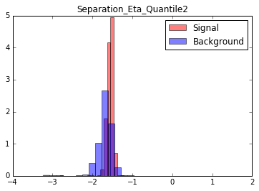
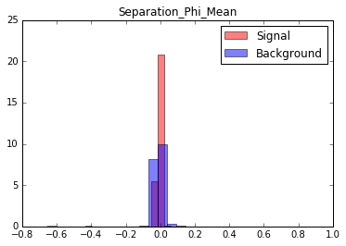
Discrimination Power continued

Slide 10
Summary of Data
Entire Database from 2016 runs .
~ 250,000 events (lumisections).
Data has “flags” telling us if it was signal or background.
Data has “flags” telling us which subsystem failed during that run.
Only 10% of bad data for 2016.
Used 50% of data for training and 50% of data for testing.

Slide 11
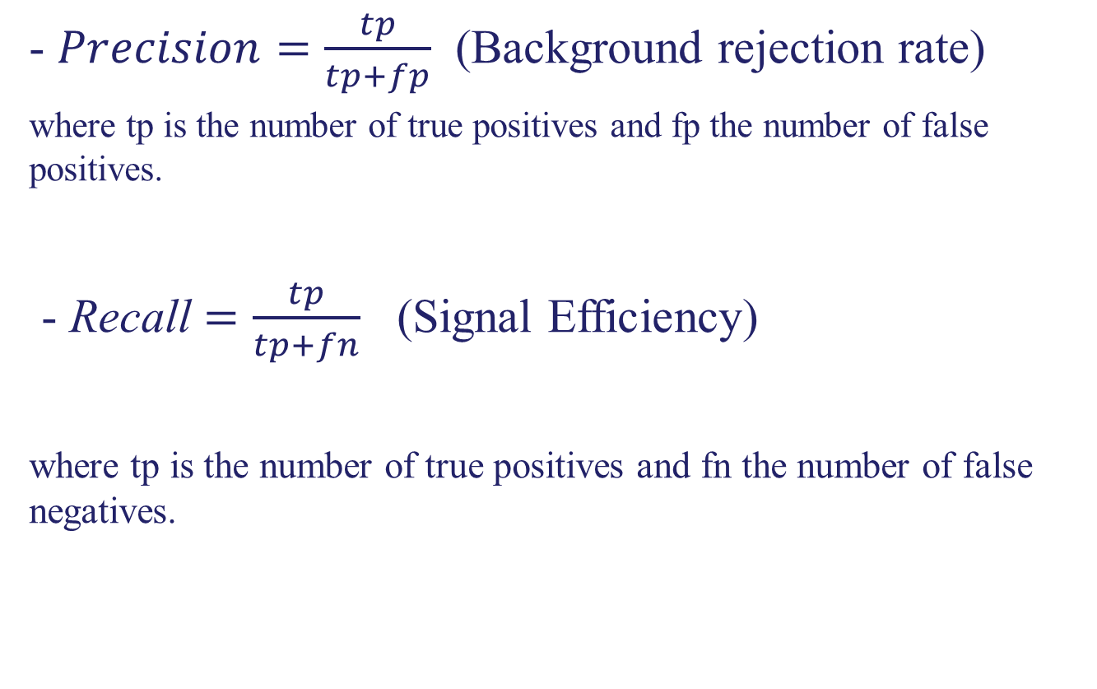
Definitions
- $Precision=\frac{tp}{tp+fp}$ (Background rejection rate)
where tp is the number of true positives and fp the number of false positives.
- Recall $=\frac{tp}{tp+fn}$ (Signal Efficiency)
where tp is the number of true positives and fn the number of false negatives.

Slide 12
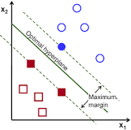
Support Vector Machines
A discriminating classifier that is described by a hyperplane.
Given some training data, the classifier generates a hyperplane to classify new examples.

Slide 13
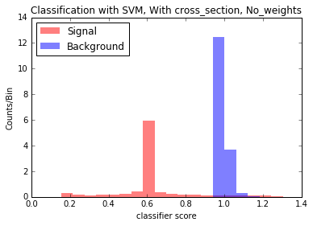
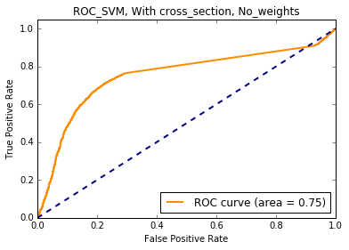
Training SVM with entire dataset
- Training completed in ~ 1 hour and 10 min.
- Precision = 0.97
- Recall = 0.97

Slide 14
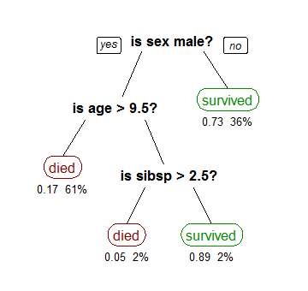
Boosted Decision Trees
Decision tree learning uses a decision tree as a predictive model.
This model maps observations about an item to conclusions about the item's target value.
Gradient boosting:
produces a prediction
model in the form of
an ensemble

Slide 15
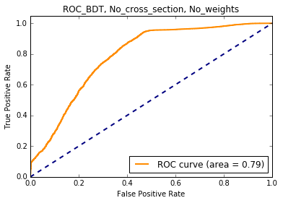
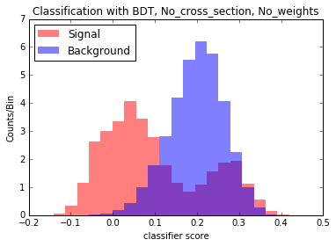
Training BDT with entire data
- Training completed in ~3 minutes.
- Precision = 0.92
- Recall = 0.93

Slide 16
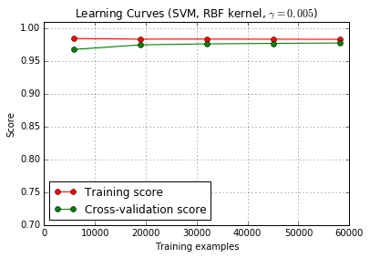
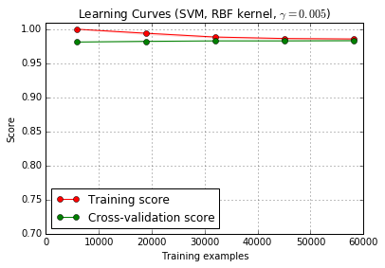
Did the classifiers learn?
BDT, Adaboost classifier

Slide 17
Post mortem Analysis
Top ten bad runs | Classified Correctly (Reason for bad Run) | Misclassified
Run (275831) | Hcal
Run (273017) | Hcal
Run (273318) | L1tmu
Run (274161) | ECal
Run (280099) |  | Misclassified
Run (277218) |  | Misclassified
Run (274157) | Pixels
Run (277220) | Hcal
Run (277202) |  | Misclassified
Run (273301) | Hcal

Slide 18
Conclusions and Work to be done
After using several algorithms to perform training, SVM proved to have the best performance.
The classifier was able to recognize more often failures in the Hcal.
Proceed to a more realistic workflow in 2017.

Slide 19
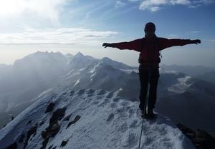
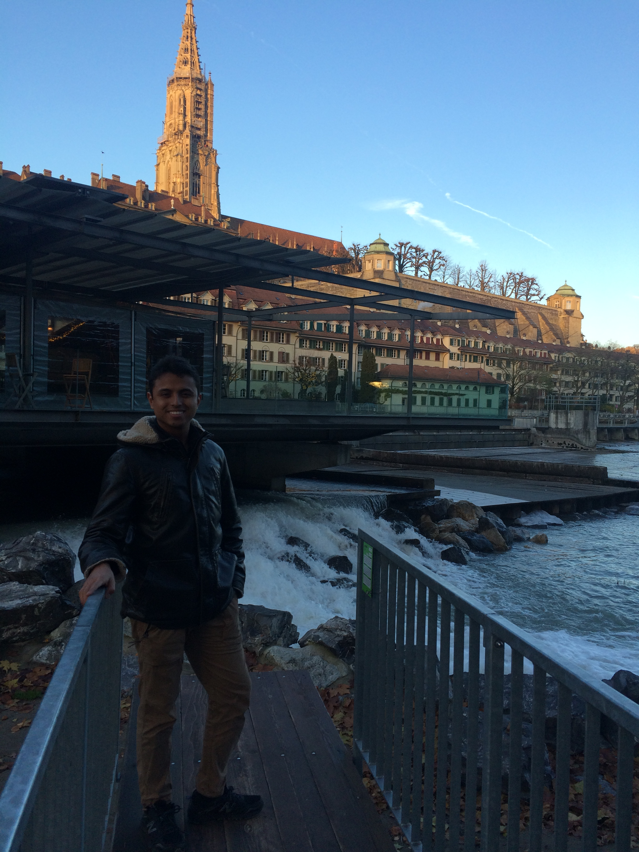
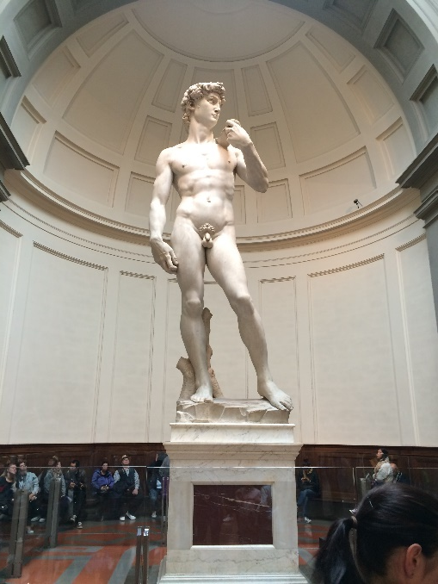
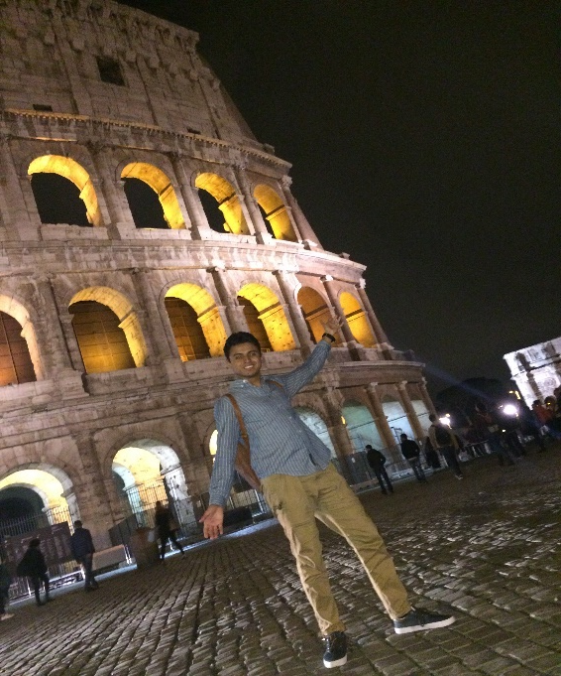
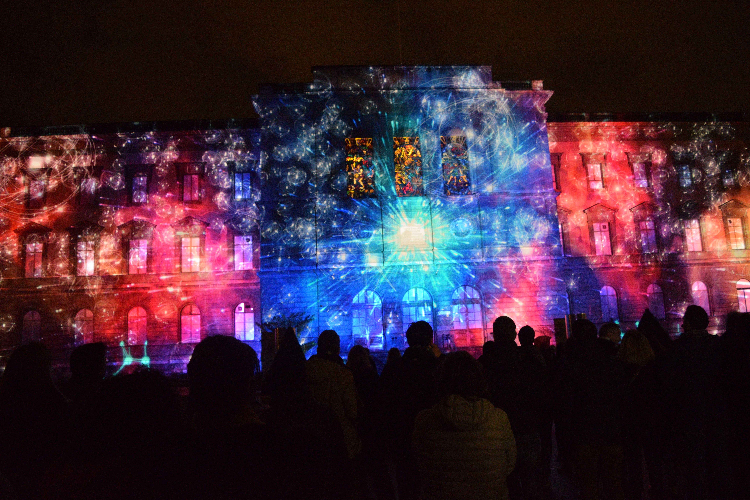

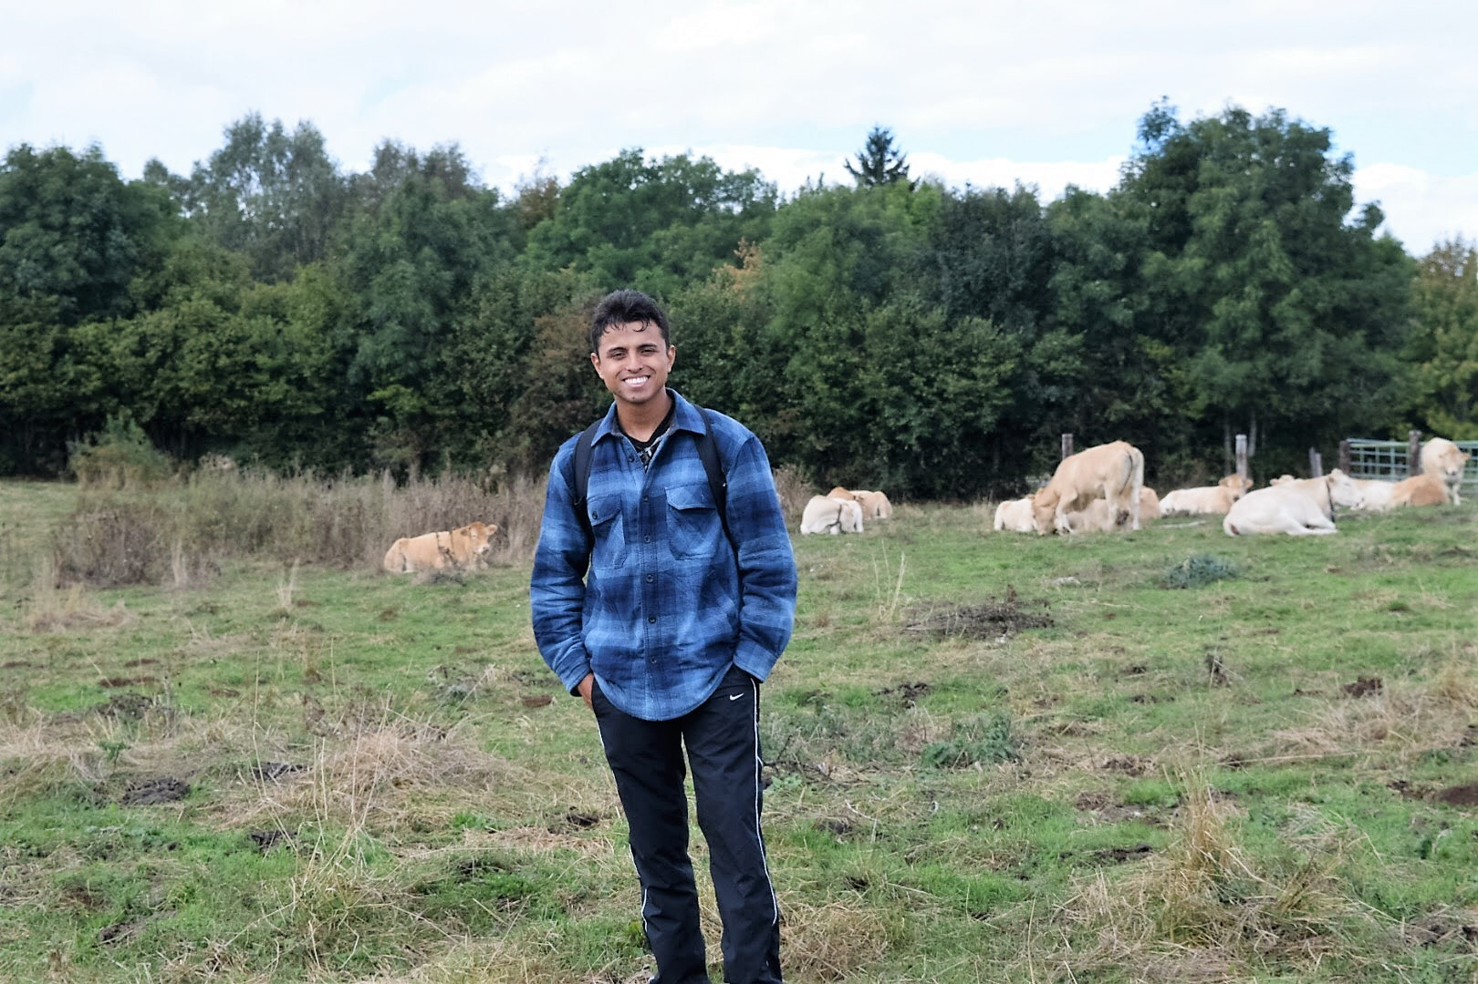
My experience at CERN!

Slide 20
Questions?
Thank you!

