Slide 1
Advanced initial energy densities in √s = 7 and 8 TeV p+p collisions
M. Csanád ¹ ,T. Csörgő ^{2,3}, Ze-Fang Jiang⁴ and C.-B. Yang4
¹Eötvös University, Budapest, Hungary
² Wigner RCP, Budapest, Hungary
³ EKU KRC, Gyöngyös, Hungary
⁴ CCNU, Wuhan, China
Intro to initial energy density estimate
Improving Bjorken’s estimate
First analysis of TOTEM/LHC p+p dn/dη data @ 7 TeV
arXiv:1307.2082, Proc. EDS Blois (Saariselka, Finnland, 2013) 53
Final analysis of CMS and TOTEM dn/dη data @ 7 and 8 TeV
arXiv:1609.07176, submitted for publication
Implications
Summary
Predictions

Slide 2
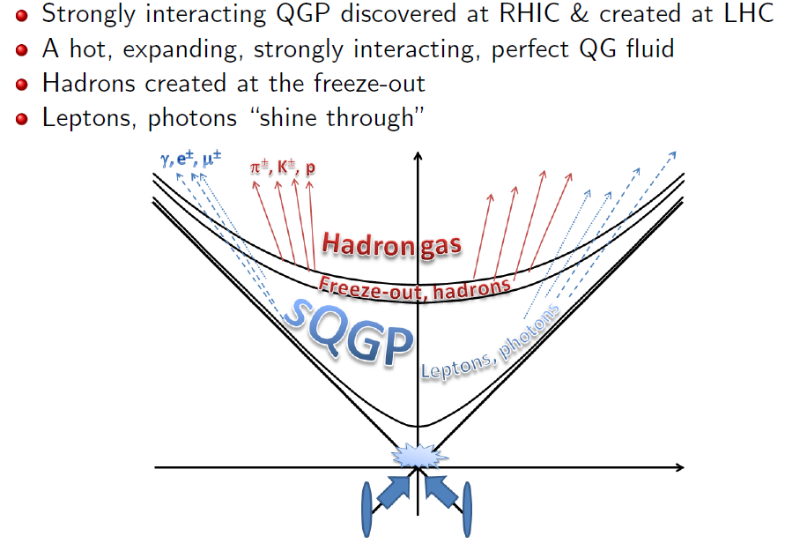
Standard Hydro Model for A+A

Slide 3
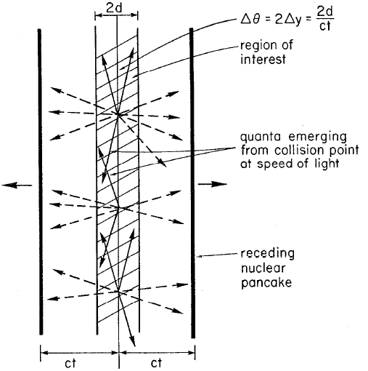
Björken-estimate – hydro for p+p
Idea: energy density measurable from dE/dy
QGP critical ε: ~1 GeV/fm³
dE/dy = ⟨m_{t}cosh(y)⟩ dn/dy
Area from nuclear geometry
(elastic e+A collisions)
Famous result
J.D. Bjorken,Phys.Rev. D27 (1983)
(2600+ citations)
Finite dn/dy even at LHC: Needs correction!

Slide 4
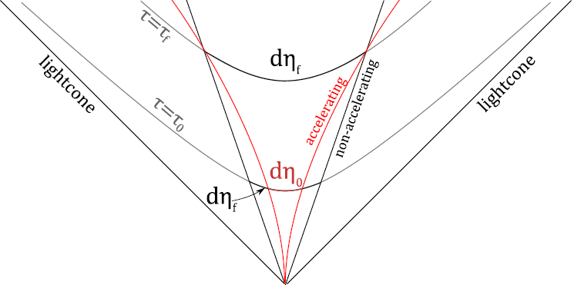
Advanced estimate of initial conditions
Need for correction:
dn/dy not flat, no rapidity plateaux even in pp @ LHC
Finite, accelerating!
Need:
accelerating solution
of relativistic hydro
Two modifications:
y ≠ η
η_{final} ≠ η_{initial}
Result:
Advanced estimate
of initial energy density:

Slide 5
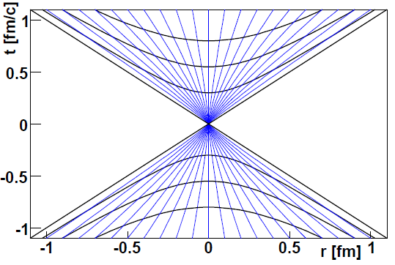
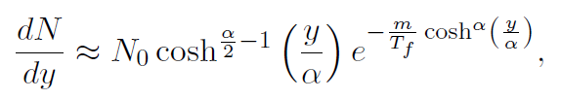

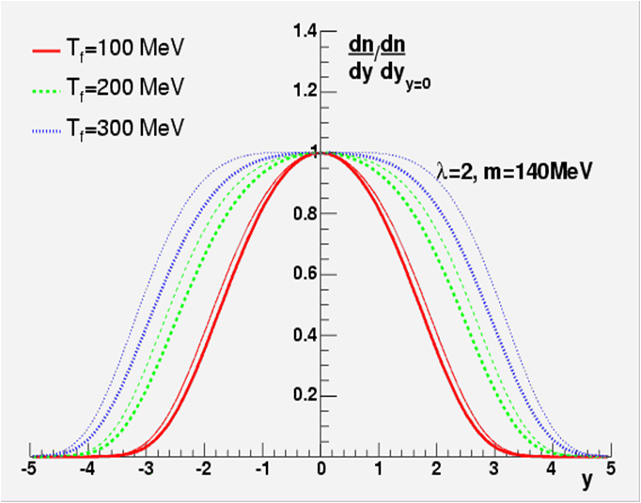
A new solution of relativistic hydro
Velocity: v = tanh(λη)
Acceleration if: λ≠1
Density: n = n₀ (τ/τ₀)^{λ}
M.I. Nagy et al, PRC 77:024908,2008
arXiv:0709.3677
(15 pages, 126 eqs)
Compare to RHIC data!
BRAHMS dn/dy measurement:
advanced initial ε estimate
Significant correction@RHIC!
Phys.Lett. B663 (2008) 306
nucl-th/0605070

Slide 6
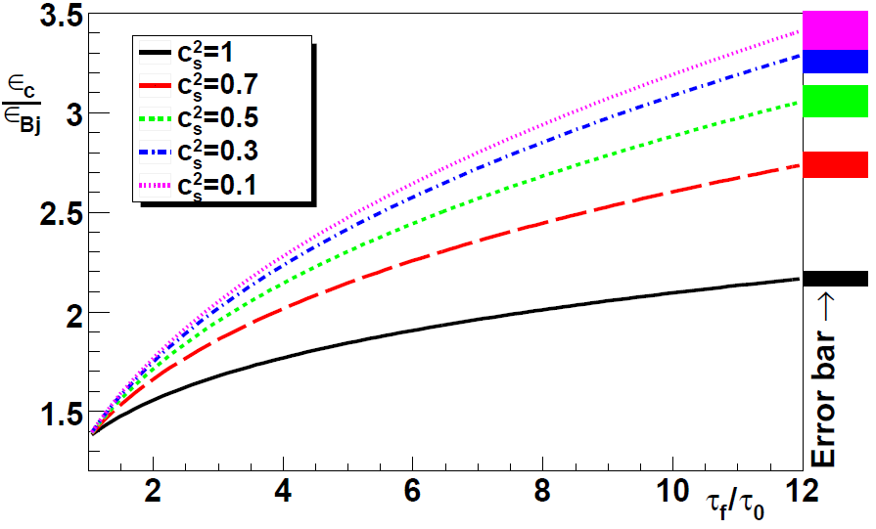
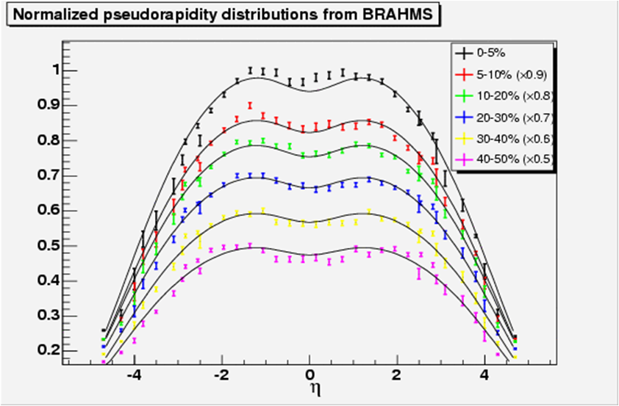
Initial energy density at RHIC
Bjorken estimate from BRAHMS: 5 GeV/fm³
Advanced estimate gives: 15 GeV/fm³
Correction: 2-3x, agreement with QCD EoS !
J.Phys.G35 (2008) 104128 (arXiv:0805.1562)
Corresponds to T_{ini} ≅ 2T_{c} ≅ 340 MeV
Consistent with PHENIX direct photon spectra
arXiv:0804.4168, PRL 104:132301, 2010

Slide 7
Initial energy density for pp@7 TeV
Bjorken estimate:
  Number of particles at midrapidity: ~7 (measured)
  Average energy: ⟨m_{t}⟩~0.5 GeV (measured)
  Initial radius of the system R: ~1 fm
  (from R²π=σ_{inel}/2, but similar final radii from HBT)
  Formation time τ₀: 1 fm/c
Energy density from this:
Just below critical?? Corrections may be important …
Missed opportunity?
arXiv:1307.2082, Proc. EDS Blois (Saariselka, Finnland, 2013) 53
New analysis:
improved estimate of R, corrections for π⁰ …

Slide 8
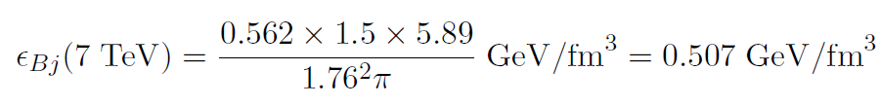

Improving Initial Energy Density Estimate
Initial radius:
  In A+A: eA and pA elastic collisions (Hofstadter, Glauber)
  Initial radius under-estimated by R: ~1 fm
  Gray disc (greyness g), or grey Gaussian proton:
  σ_{el} = g²R²π σ_{tot}=2 g R²π
  R²π = σ_{tot}²/(4 σ_{el}) R = 1.76 ± 0.02 fm
  Cross-check: B = 4 R² R = 1.76 ± 0.02 fm
  Decrease by a factor of ~ 3
  Energy also in neutrals, enhancement factor of 3/2
New analysis: arXiv:1609.07176
improved estimate of R, corrections for π⁰, cca ½ decrease

Slide 9
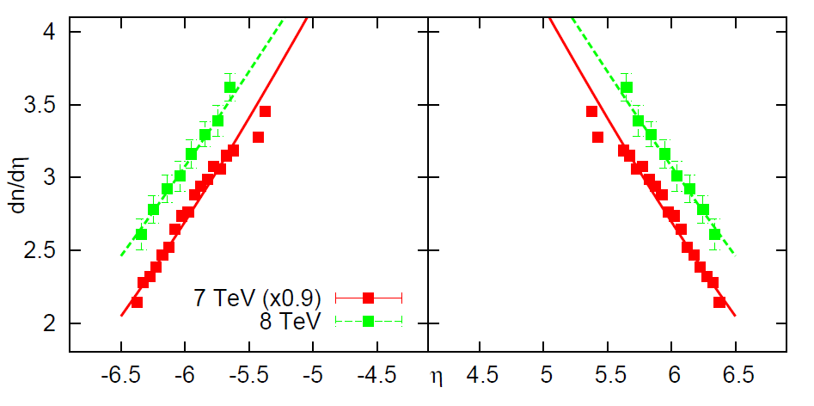
Advanced Initial Energy Density Estimate
New analysis: arXiv:1609.07176
cca ½ decrease but enhancement due to finite dn/dη fits

Slide 10
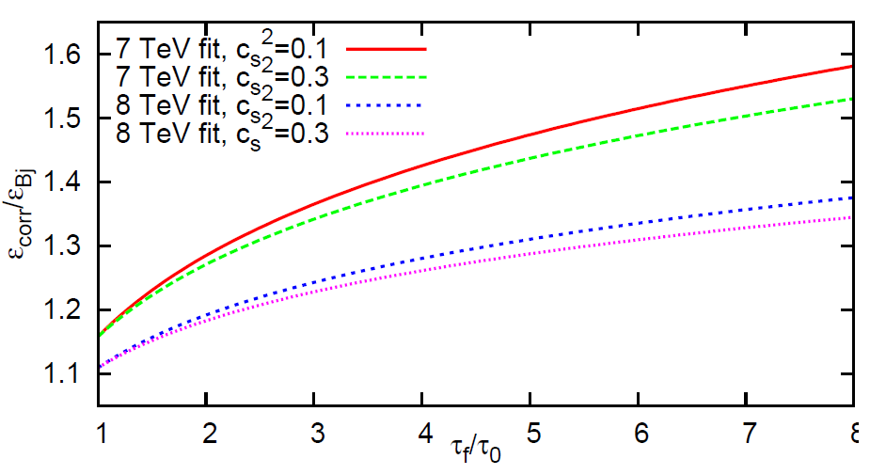
EoS, initial/final time dependence
New analysis: arXiv:1609.07176

Slide 11
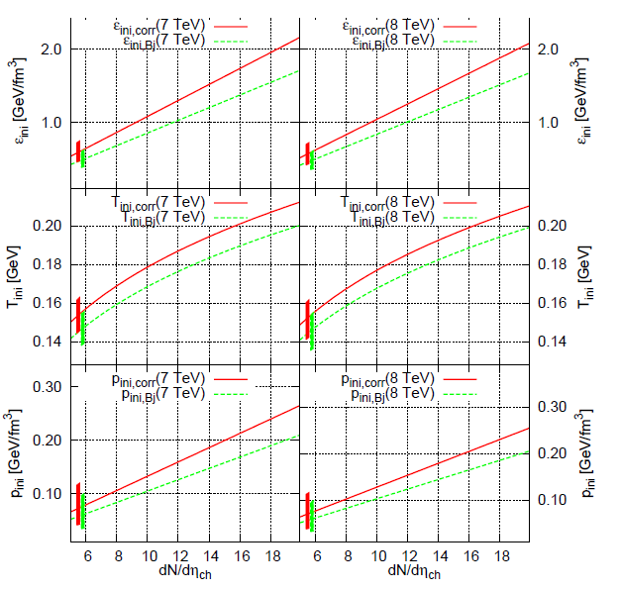
Multiplicity dependence
arXiv:1609.07176
‹n›_{crit} ~ 10 -12
at 7 and 8 TeV
Critical 1 GeV/fm3
Initial energy
Density
in high ‹n› > 10
pp collisions!

Slide 12
Systematic uncertainties
Bjorken-estimate:
  Main uncertainty source: multiplicity at midrapidity
  Area (from cross-section): very precise
  Formation time
Correction factors in ε/ε_{Bj} :
  Statistical error (from the data): 1%
  Fit parameter λ: 0.5% systematic error
  Speed of sound c_{s}²: 3%
  (if c_{s}²<0.5, it is 0.3 at RHIC)
  Duration τ_{f}/τ_{i}: 8% (if ratio maximally 6)
  Dissipative effects: further increase the initial ε …

Slide 13
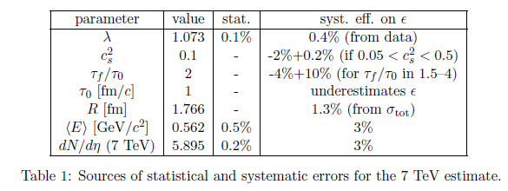
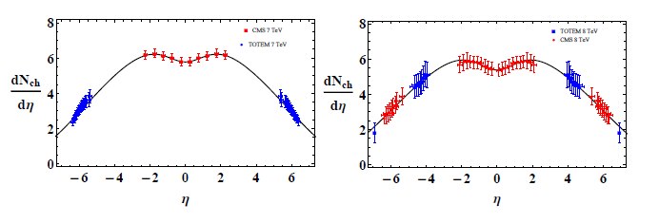
Systematics, cross-checks with CMS
Combined CMS+TOTEM dn/dη fits: within 0.5 % syst, the same results

Slide 14
Summary
Experimentally widely used Bjorken est. (2600+)
& QGP critical energy density: 1 GeV/fm³
Advanced estimate from forward dn/dη
Results on the initial ε for c_{s}²=0.1, at τ_{f}/τ_{ini}=2
Both at 7 and 8 TeV, ε > 1 GeV/fm³
^{but} only in high n> 10 multiplicity pp collisions!
arXiv:1609.07176
Small correction but important implications
- pp is not as good a reference for AA as eA
- R_{AA} not such a good concept, need:
R_{AA} per unit lenght ≡ optical opacity,
arXiv:0911.5015

Slide 15
Implications
pp, pA, dA, AA are similar
But differ in sizes (multiplicity)
Need for an electron-proton and eA collider
to determine a clear reference
Prediction:
Scaling laws for spectra,
elliptic flows
and HBT radii in pp@ LHC
Open question:
How important is the correction in pp@RHIC?

Slide 16
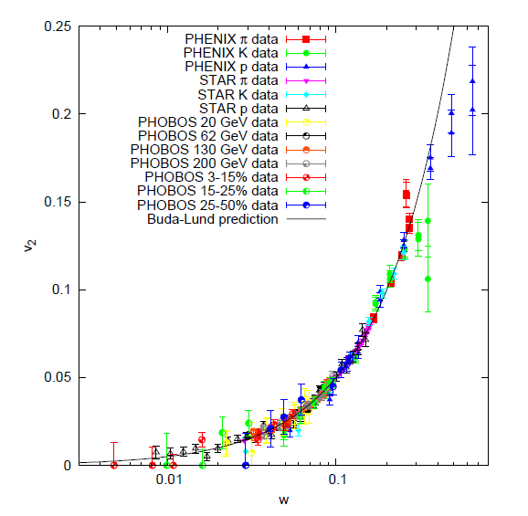
Prediction: UNIVERSAL
hydro scaling of v₂ will hold for pp@LHC
nucl-th/0512078 but new: v₂/n_{q} vs K_{ET}/n_{q} will be violated in p+p@LHC

