Slide 1
Beam Wire Scanner for PSB
Update
Dmitry Gudkov
BE-BI-ML
19-Sep-2016

Slide 2
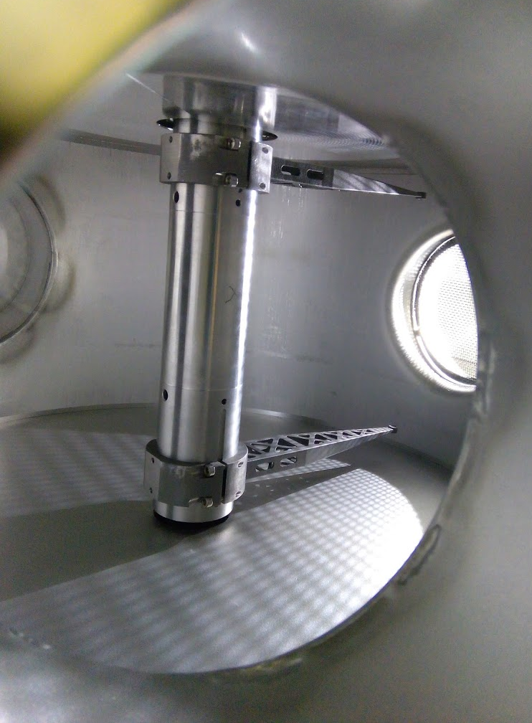
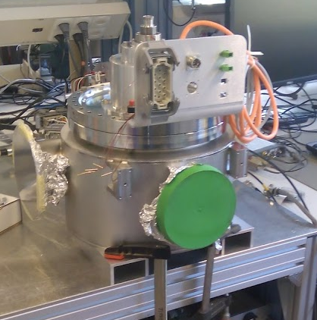
Contents
Status of prototypes
Optical disks
Scintillator/Filter box/Photomultiplier

Slide 3
BWS prototype for PSB. Test program
 | BWS in PSB | LAB prototype | Test bench (no tank)
Assembly | W37 | W37 | W37
Electromechanical test | W38 | W38 | W38
Impedance test |  | W39
Installation test |  | W41
Calibration test |  | W42
Control system test |  |  | W39
Mechanical reliability test |  |  | W40..42
Optical system |  |  | W40..42
Disassembly | W39
Cleaning | W40
Assembly | W42
Vacuum qualification | W43
Fiducialiasation | W44
Calibration | W45
Installation | W50

Slide 4
BWS prototype for PSB. Test program
 | BWS in PSB | LAB prototype | Test bench (no tank)
Assembly | W37 - done | W37 - done | W37 - done
Electromechanical test | W38 - done | W38 - done | W38 – under way
Impedance test |  | W39 – under way
Installation test |  | W41 - done
Calibration test |  | W42
Control system test |  |  | W39… – under way
Mechanical reliability test |  |  | W40….
Optical system |  |  | W40….
Disassembly | W39 - done
Cleaning | W40 - done
Assembly | W40 - done
Vacuum qualification | W41..43 - under way
Fiducialiasation | W44
Calibration | W45
Installation | W50

Slide 5
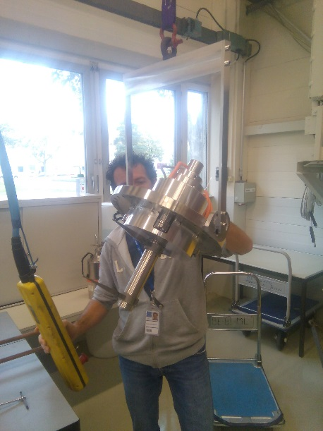
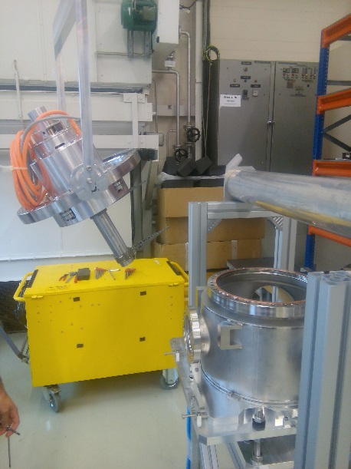
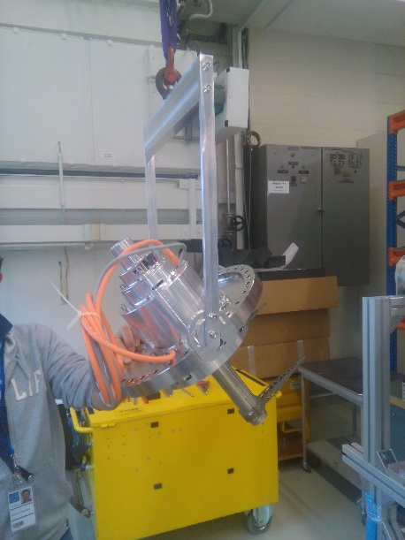
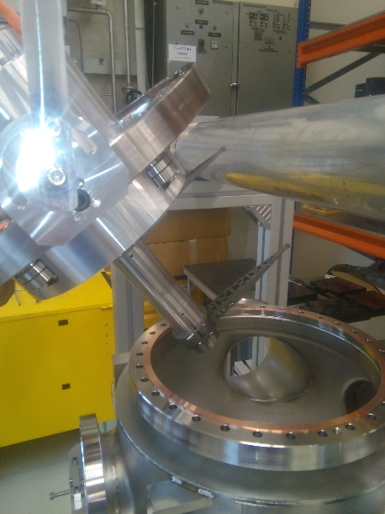
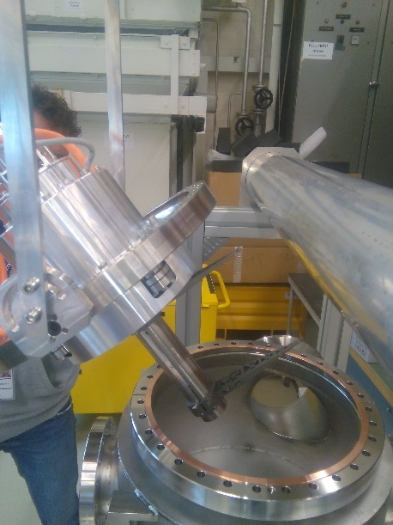
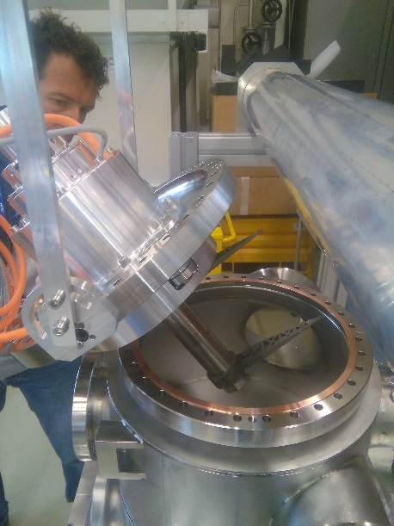
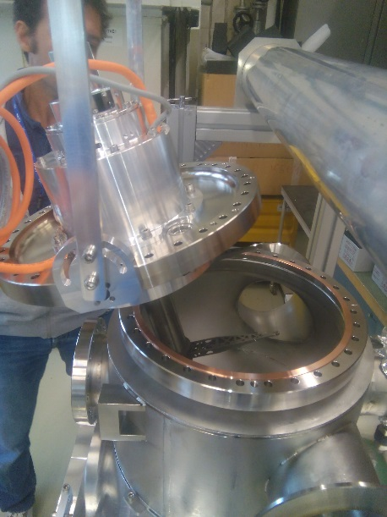
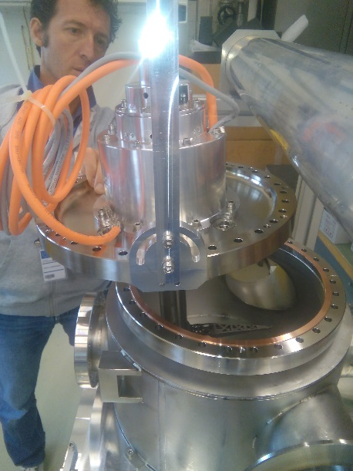
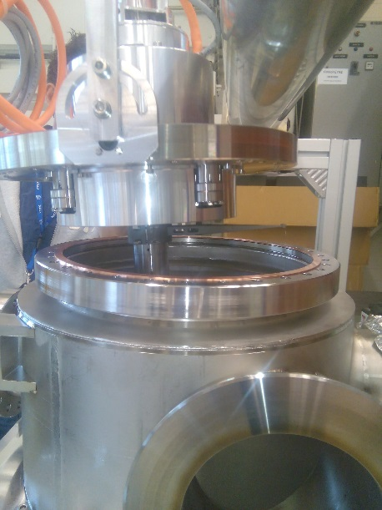
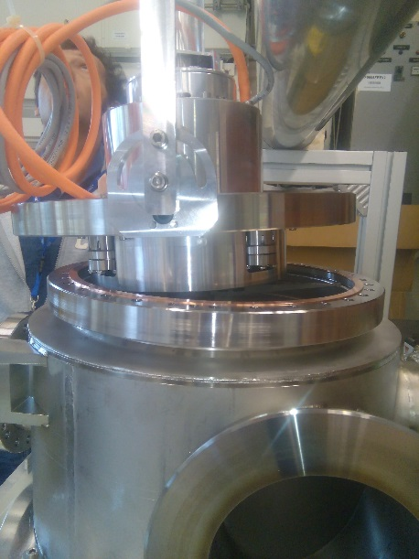
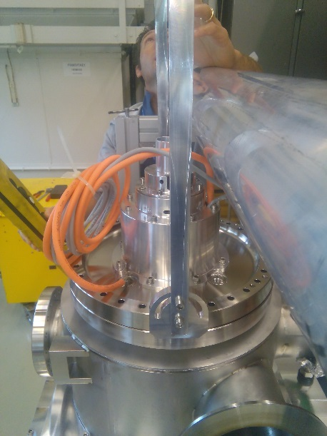
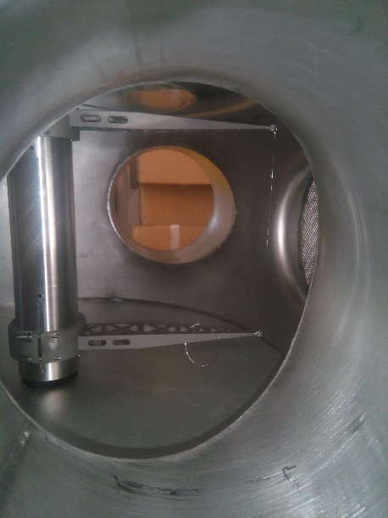
BWS prototype for PSB. Installation Test

Slide 6
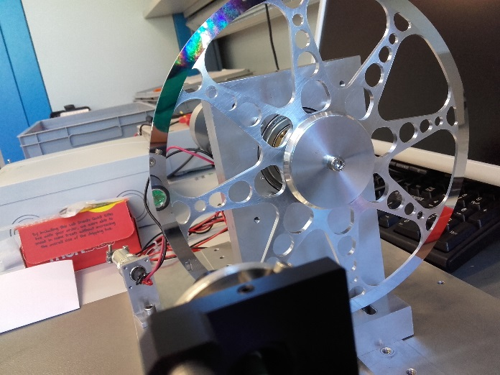
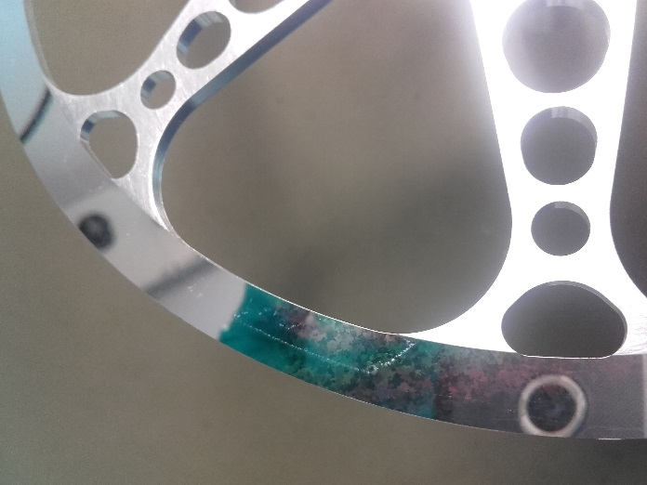
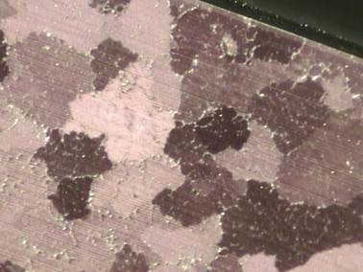
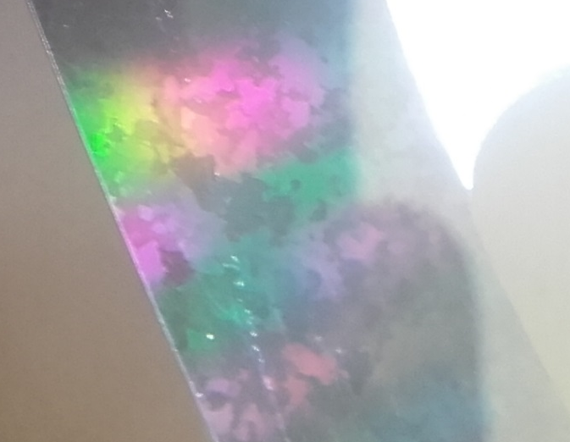
Optical Disks Status CW 41
Mechanical polishing of optical face | 1 extra disk, visit to the company for discussion (11.10)
Electrochemical polishing | 25 samples (AW-2219) + 25 samples (AW-6082), study is under way
Electrochemical polishing | SS sample for tests with optical system is under preparation (CW41..CW42)
4 disks order (AW-6082) | P.O. sent to VDL, they will give us special sample so we can choose the desired surface finish (CW41).
Glass disk | Holder design done, in production, integrated with current design. Test with smaller glass disk (no chrome coating) is foreseen

Slide 7
Scintillator/Filter box/Photomultiplier
Status CW38 | Status CW41
We have no spare components in stock. No 2D drawings or 3D models are available in CDD/Smarteam. 3D model has to be remade (readiness 80%), working on design optimisation considering new commercial components available on market (filters, holders etc.). Drawings will be completed after 3D model (~20 new drawings). Drawings approval process? How many complete units to be produced? | Detailed design is nearly completed (97.5%) Drawings are in CDD: PS_BWSA_0067…PS_BWSA_0092 Approval process: 1st control – William, 2nd control – Jose Filter wheel will be requested from Thorlabs (CERN – design) 10 units to be confirmed (2 with higher priority for EYETS ‘16-’17

