Slide 1


Introduction and Overview
Sergei Gleyzer, Lorenzo Moneta
TMVA Developers Meeting
September 15, 2016

Slide 2
Outline
Status and Overview
Release plans
Latest developments

Slide 3
Introduction
Today’s meeting aims to:
Bring together TMVA developers
  Past, present and future
  Hopefully make it a regular occurrence
  More open for anyone interested to attend or contribute

Slide 4
Overview
Today’s topic: latest developments in TMVA
  A lot of recent development (2015-2016)
  Design improvements, new features and functionality
  Significant involvement of S.G, L.M., Ph.D. students, GSoC, other contributors, IML

Slide 5
TMVA Future
One year ago: Future of TMVA document drafted
Future_of_TMVA_16_09_2015.pdf
In the beginning of IML
HEP Community inter-experimental review and consensus to what was missing and needed to improve
  Addresses important points about design, performance and desired features

Slide 6
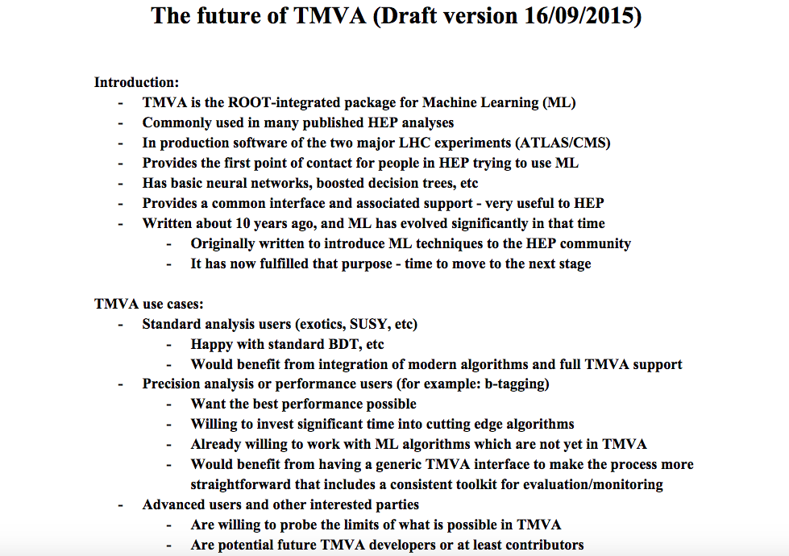
Excerpt 1

Slide 7
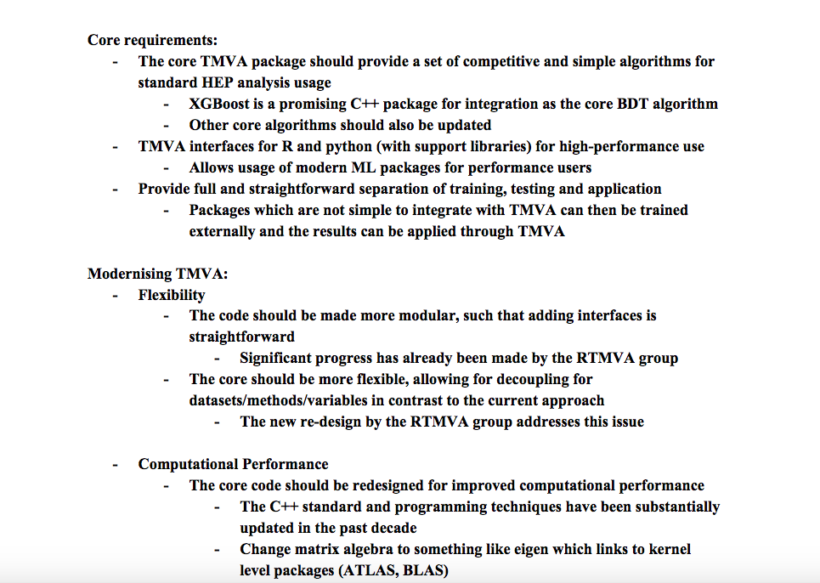
Excerpt 2

Slide 8
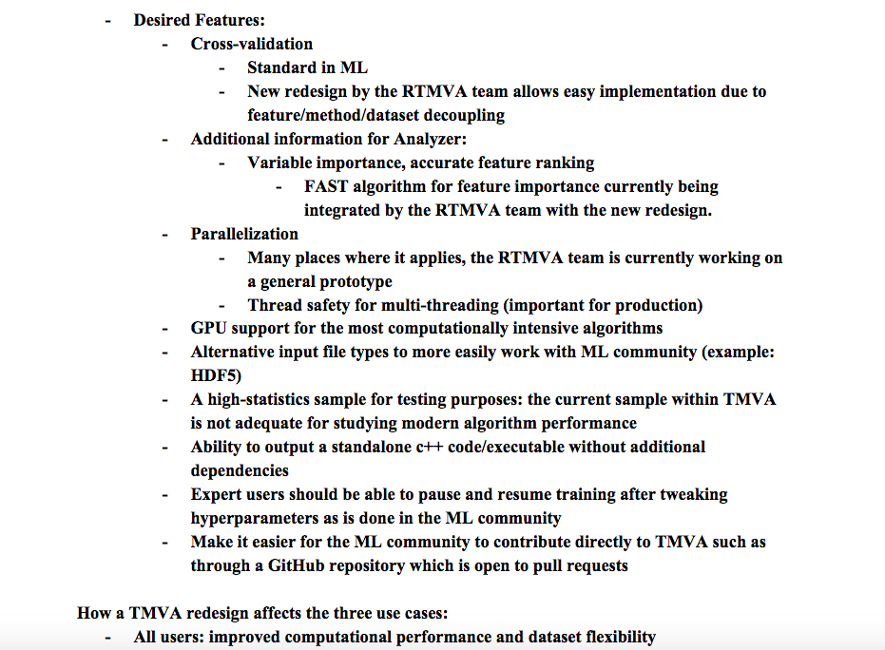
Excerpt 3
Most addressed this year

Slide 9
Development Goals
Stay true to what made TMVA successful
By HEP and for HEP
Method neutrality
Competitive performance
Ease of use
  Introduction of new users
Continuously improve
  Address modern challenges with latest ideas

Slide 10
New Features
Modular Design and Interfaces 2015
Deep Learning (CPU + GPU)
Parallelism
Multi-threading
Multi-processing
Spark
GPUs
Cross-Validation
HyperParameter Tuning
Interactive Training
Unsupervised Learning
Greater integration with Jupyter
2016

Slide 11
Release Plans
Next Release:
With next ROOT release at the end of September
  Will include some of the features you will see today
  Busy with integration
  Some of the features will follow shortly

Slide 12
Summary
Many recent developments in TMVA
  Addressing community-driven review and desired features
  People across experiments joining and contributing to this effort (IML)
    Especially students
      You will hear about some of their contributions today

Slide 13
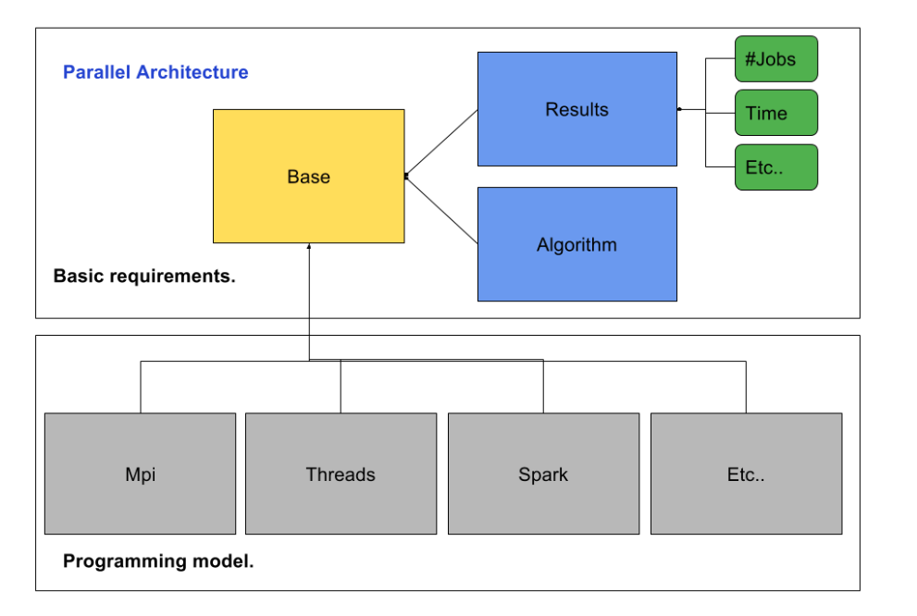
TMVA Parallelization
O. Zapata Mesa

Slide 14

JUPYTER Notebooks
Open source web-based application blends code with elements such as text, figures, links
  Excellent integration of instructions and executable code
  Perfect for interactive analysis and teaching demonstrations of anything that involves code
  Can be run locally, on a server, laptop or smartphone

