Slide 1
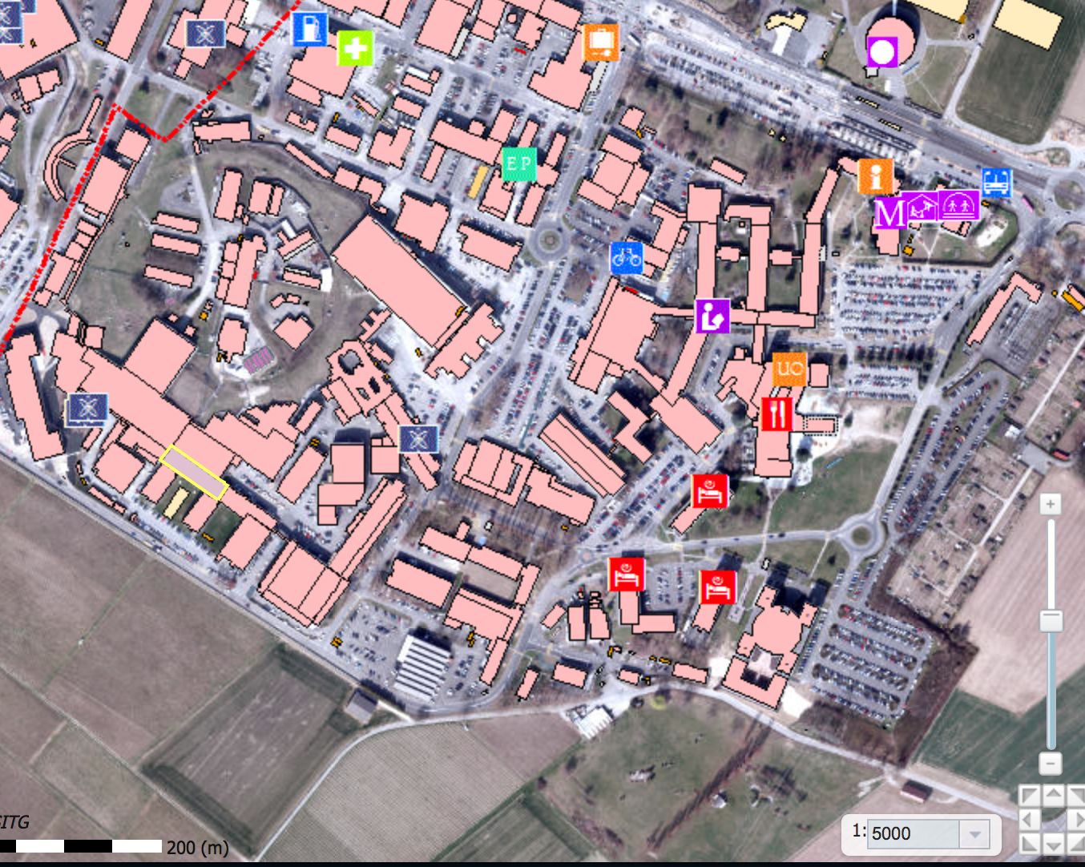
(ENTRANCE B)
ENTRANCE A
Meeting point
<- we are here today
X
X
Today: after lunch and visits, meet Bjarne at R1 Bus Stop at 1500.
Thursday morning: Meeting point is by the CERN reception at 0845 sharp. Bjarne will walk you to the meeting room (First lecture Thursday 0910 at building 6, R floor, room 6-R-016)
Friday morning: : Meeting point is by the CERN reception at 0845 sharp.

Slide 2
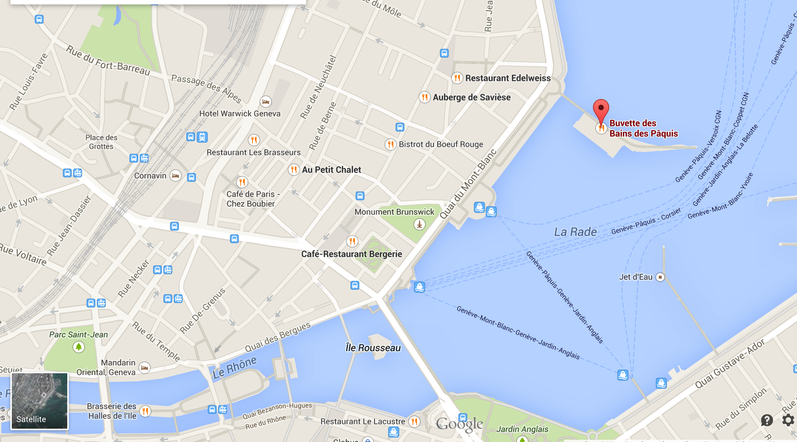
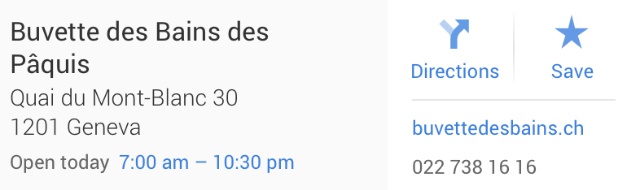
Meet at Restaurant Thursday 19:30
To CERN
Price for fondue : Max. 30 CHF per person, plus eventual drinks.

