Slide 1
CERN programs for students and young professionals and researchers

Slide 2

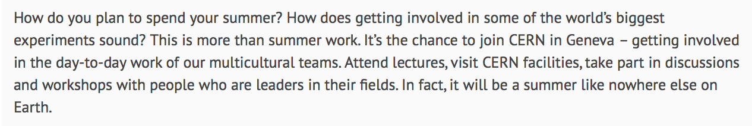
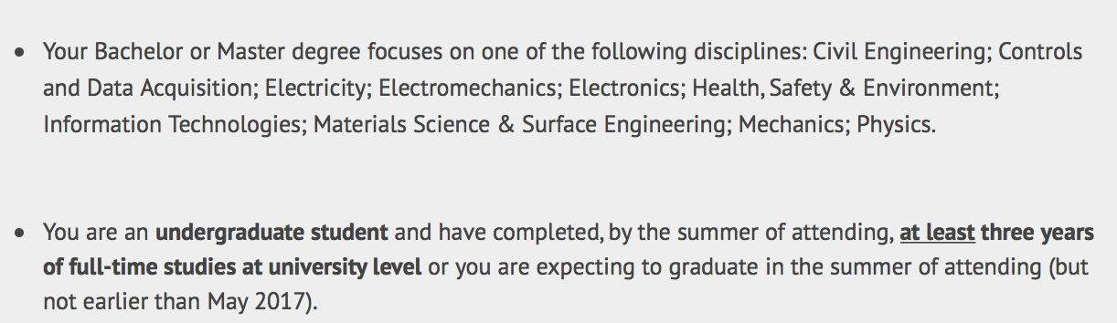
https://jobs.web.cern.ch/join-us/summer-student-programme-member-states

Slide 3
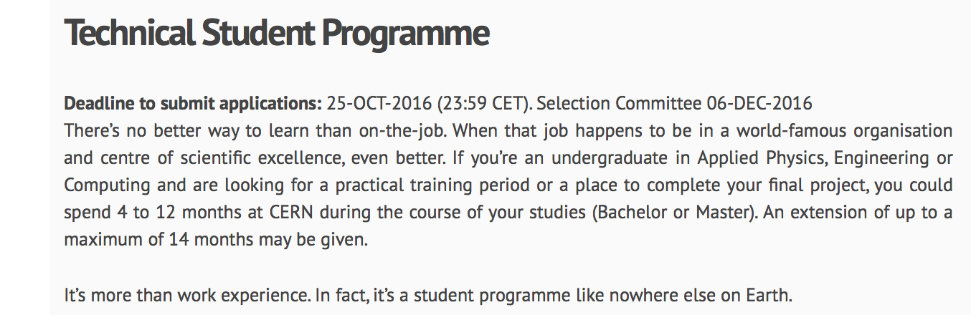
https://jobs.web.cern.ch/join-us/technical-student-programme

Slide 4
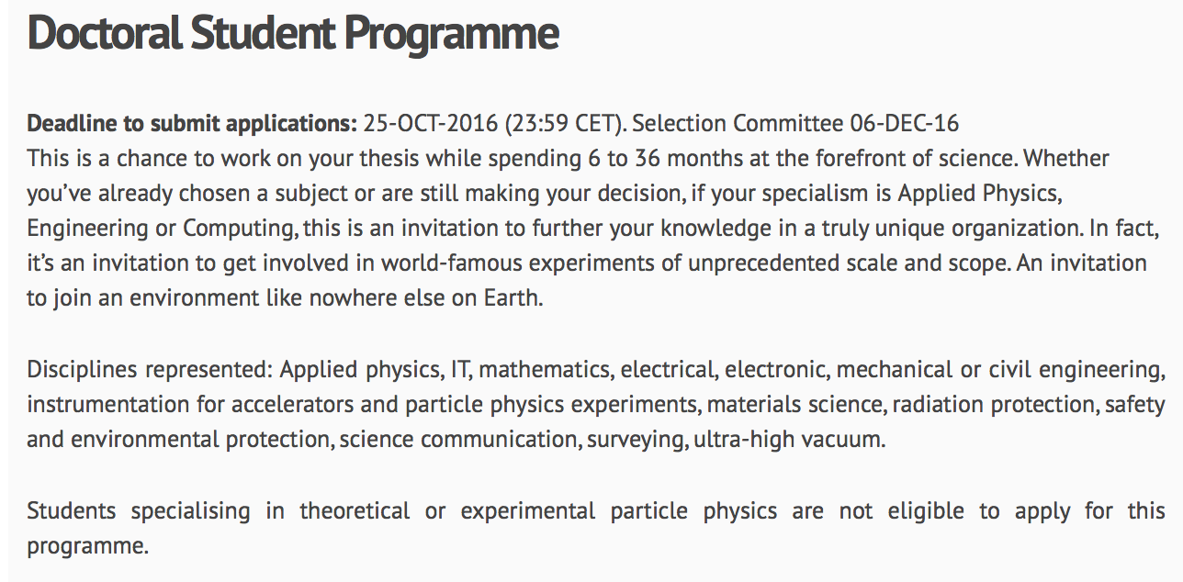
https://jobs.web.cern.ch/join-us/doctoral-student-programme

Slide 5
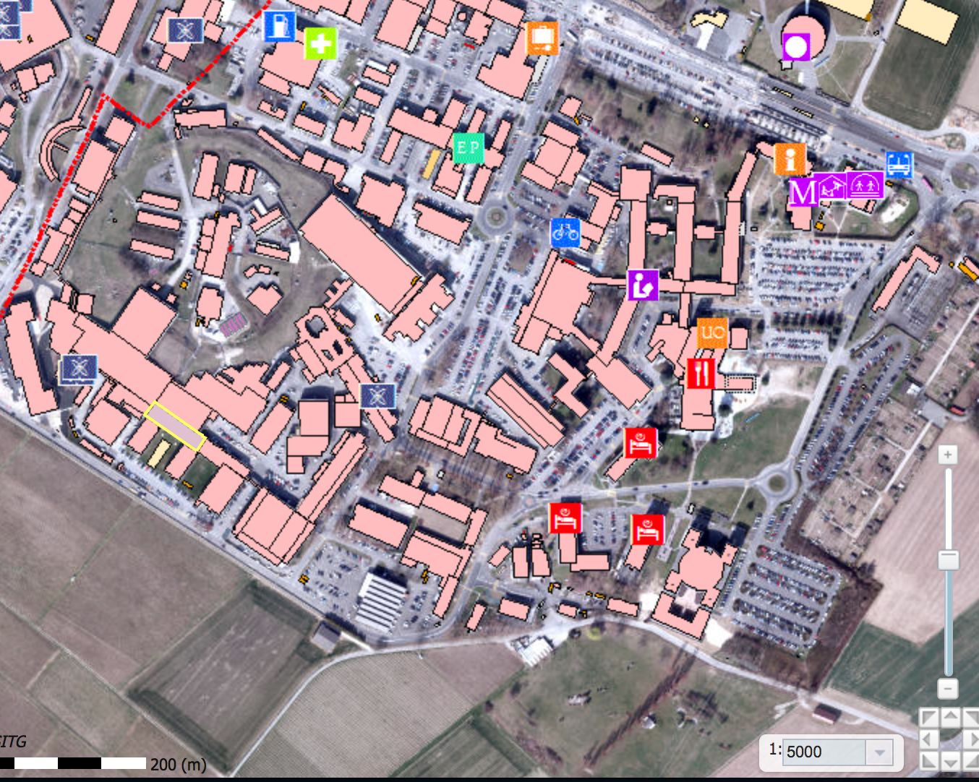
(ENTRANCE B)
ENTRANCE A
Meeting point
<- we are here today
X
X
Today: after lunch and visits, meet Bjarne at R1 Bus Stop at 1500.
Thursday morning: Meeting point is by the CERN reception at 0845 sharp. Bjarne will walk you to the meeting room (First lecture Thursday 0910 at building 6, R floor, room 6-R-016)
Friday morning: : Meeting point is by the CERN reception at 0845 sharp.

Slide 6
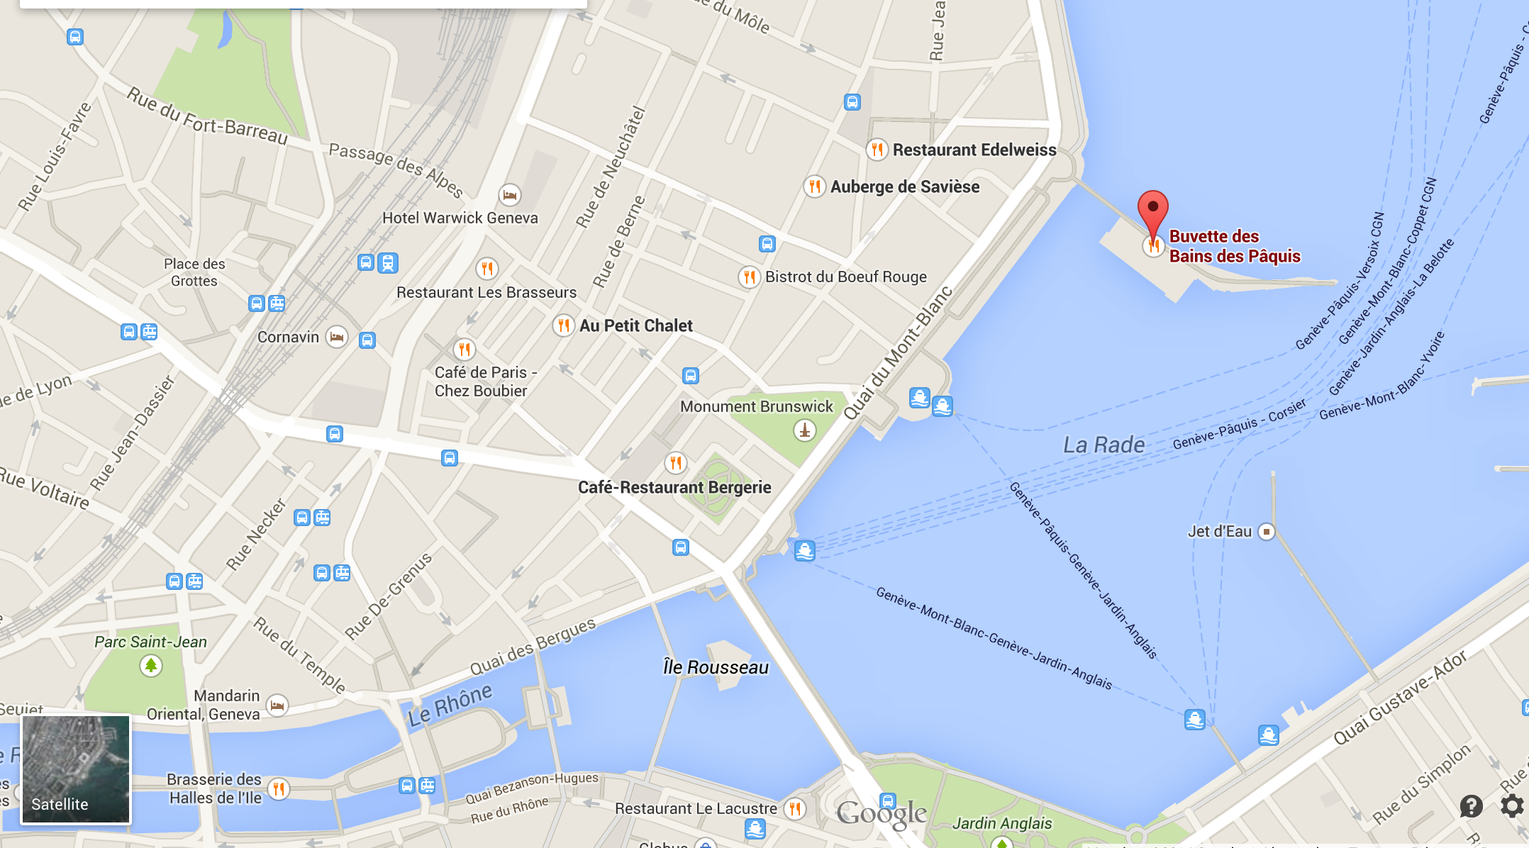
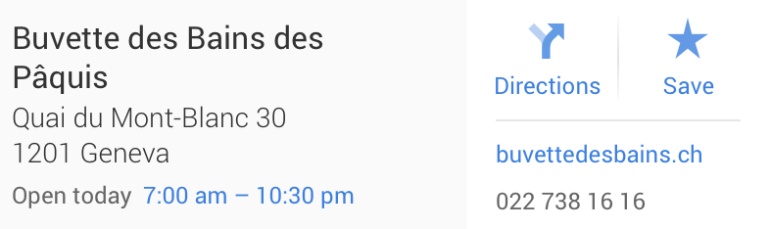
Meet at Restaurant Thursday 19:30
To CERN
Price for fondue : Max. 30 CHF per person, plus eventual drinks.

