Slide 1
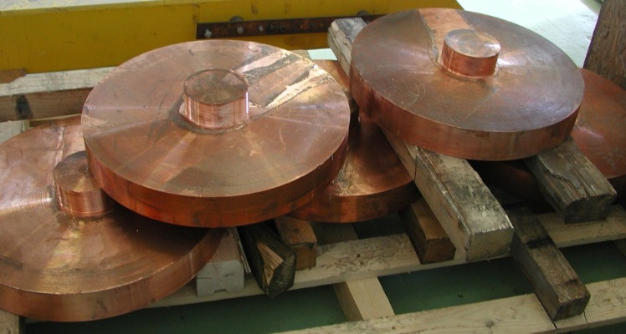
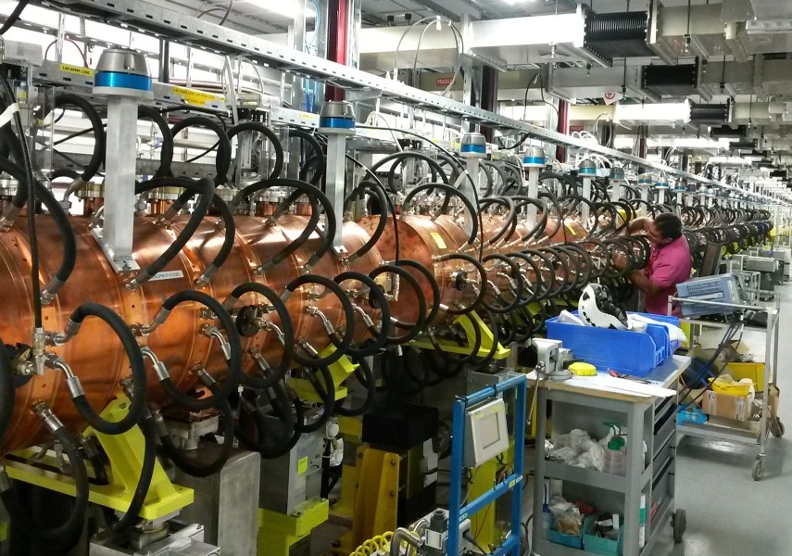
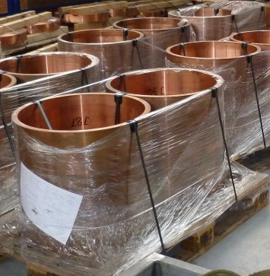
PIMS collaboration

Slide 2
Outline
PIMS cavities – Requirements and Results
PIMS – Memories

Slide 3
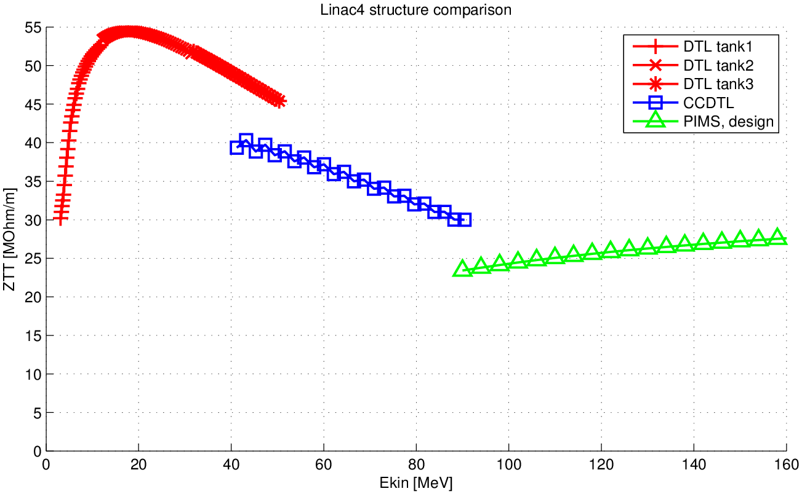
Acceleration Efficiency - ZTT

Slide 4
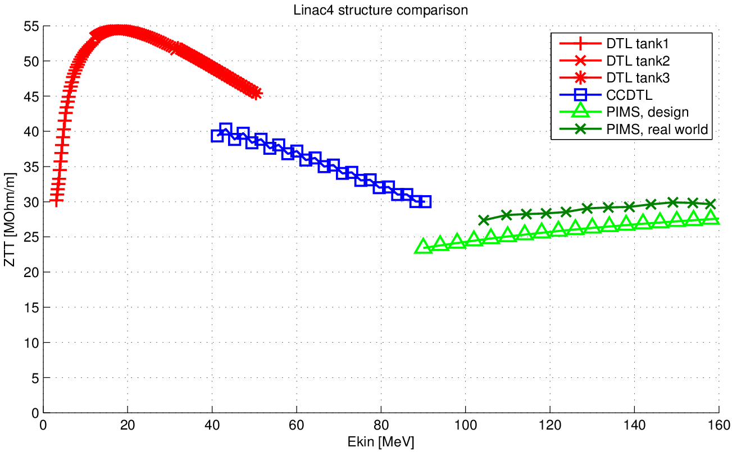
Acceleration Efficiency - ZTT
specified: R_{a} = 0.8 <=> 7% add. Losses
Measurement <=> R_{a} ~ 0.3
+ less penetration of tuners
=> ZTT 8% above design value

Slide 5
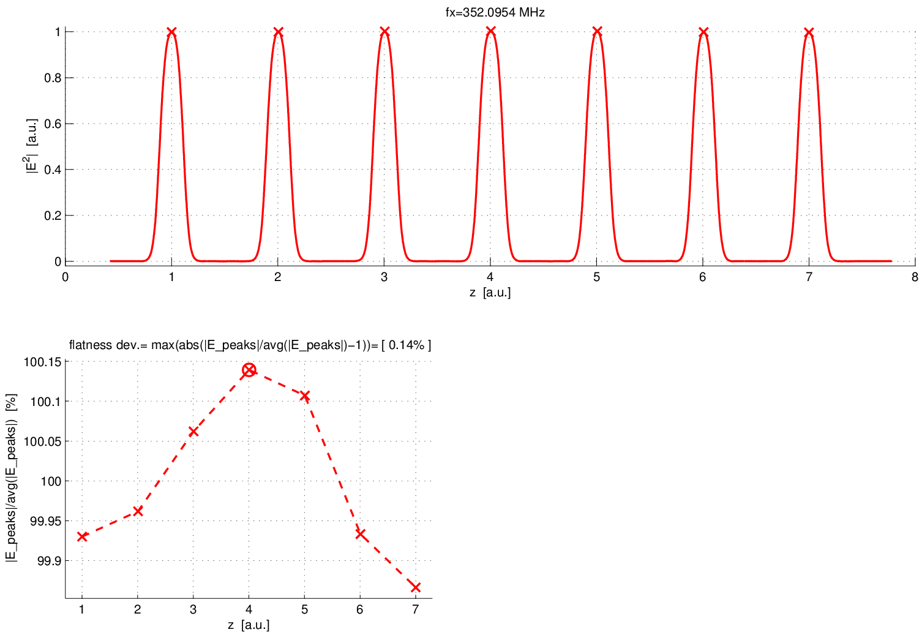
Resonant frequency
Flat field distribution, requirement ΔE/avg(E) ≤ ±5.0%
ΔE/avg(E) ≤ ±0.85% (PIMS L)
ΔE/avg(E) ≤ ±0.14% (PIMS E)
Tuning range > ±100 kHz (± 10 K)
=> Machining quality of all 180 PIMS elements
=> high-precision RF simulations (3 kHz / 350 MHz)
=> Re-machining of 144 tuning islands to ± 0.02 mm
=> not a single fault in calculations + re-machining !

Slide 6
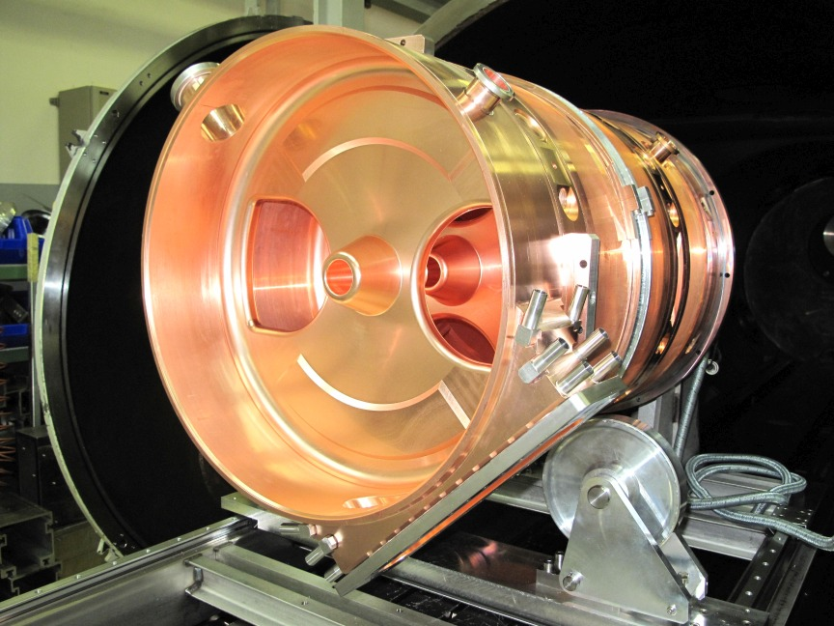
EB welding
12 * 14 = 168 EB welds
=> 569 m manual scabbing of copper, mm by mm
All welds vacuum leak tight
All cavities have excellent geometry after welding
(see next slide)

Slide 7
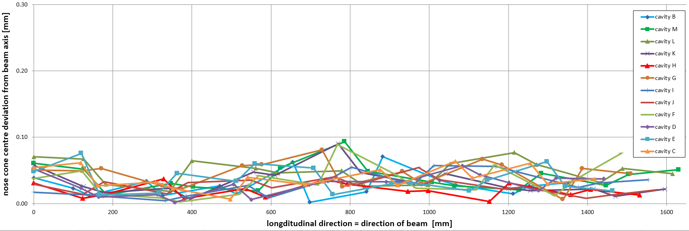
Geometry
Beam dynamic requirements: |beam axis – straight line| = Δ ≤ 0.30 mm
Amazing Achievement: all cavities Δ < 0.10 mm, best (PIMS H) Δ < 0.04 mm
Longitudinal length error (less important): ≤ ±0.15 mm over ~1’500 mm
4 cavities with length error ≤ ±0.02 mm
=> machining quality of crucial dimensions + metrology control
=> EB welding procedure + reproducibility

Slide 8
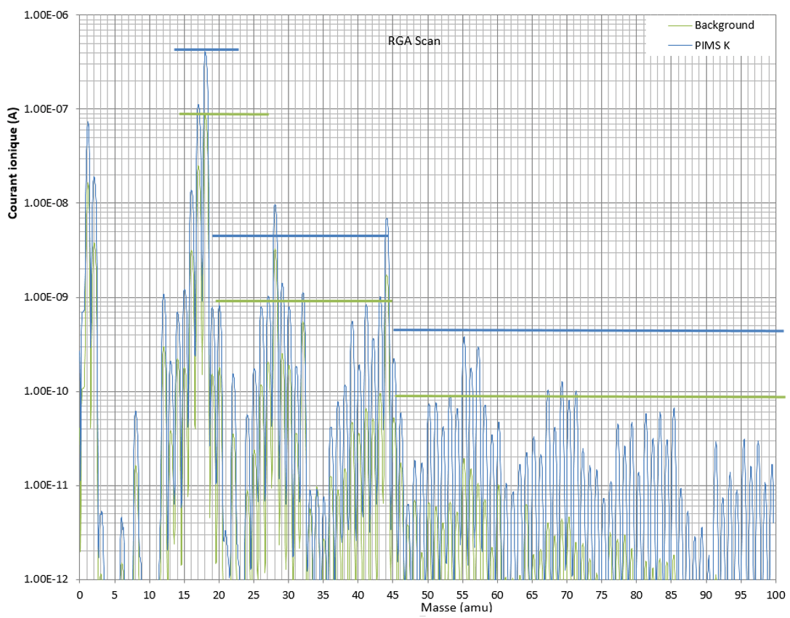
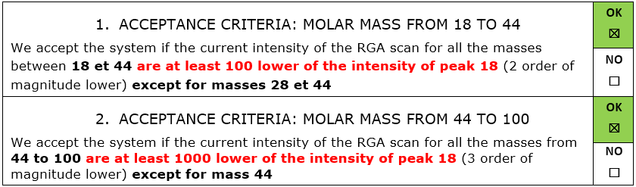
Vacuum Leak & RGA tests
All PIMS cavities are leak tight
RGA of PIMS cavities are conform to specifications
=> Surface treatment
=> Handling during EB welding
=> Handling during vacuum
installation (tuners)
=> PIMS sector (12 cavities)
could directly be
interconnected
=> Several weeks gained
RGA= Prisma
SEM Voltage= 1200 V

Slide 9
Summary and Acknowledgement
All requirements for the 12 PIMS cavities have been largely met due to the
high quality of the 180 PIMS elements produced by
the PIMS collaboration NCBJ + FZJ + CERN
sophisticated assembly at CERN (main workshop, surface treatment, EB welding, brazing support, ultrasound inspection, survey, vacuum testing, installation)
> 50 persons participated, thank you all very much for your excellent contributions !

Slide 10
PIMS - memories

Slide 11
PIMS cavities
2006 | Idea Frank Gerigk: use LEP copper cavities for low energy protons β ~ [0.3 .. 0.5]
2007 – 2008 | RF design
2009 | Mechanical design
2009 – 2010 | CERN Prototype
2010 | tuning + high power testing of CERN proto
2011 – 2016 | Collaboration for cavity element production NCBJ + FZJ + CERN, 12 cavities = 180 elements
2013 – 2016 | PIMS cavity assembly at CERN + installation

Slide 12
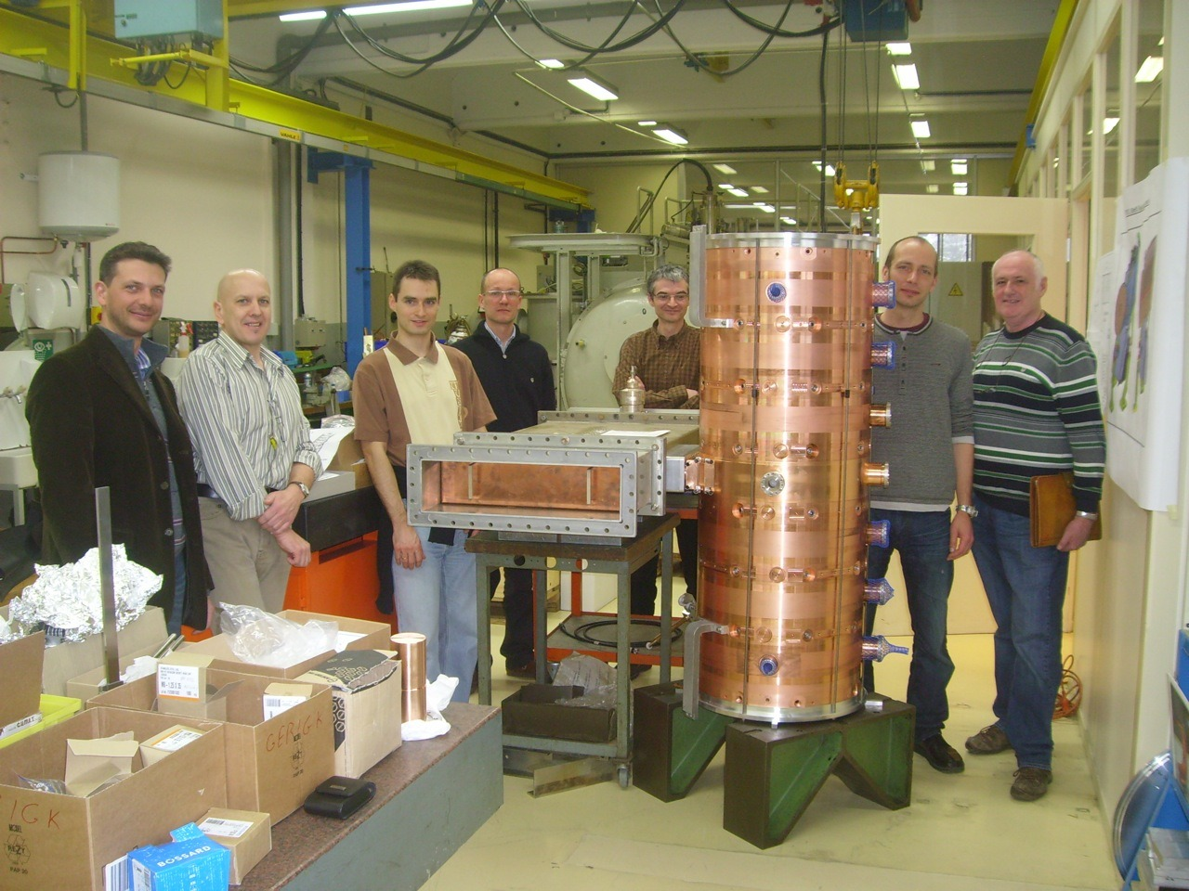
March 2010 – PIMS B

Slide 13
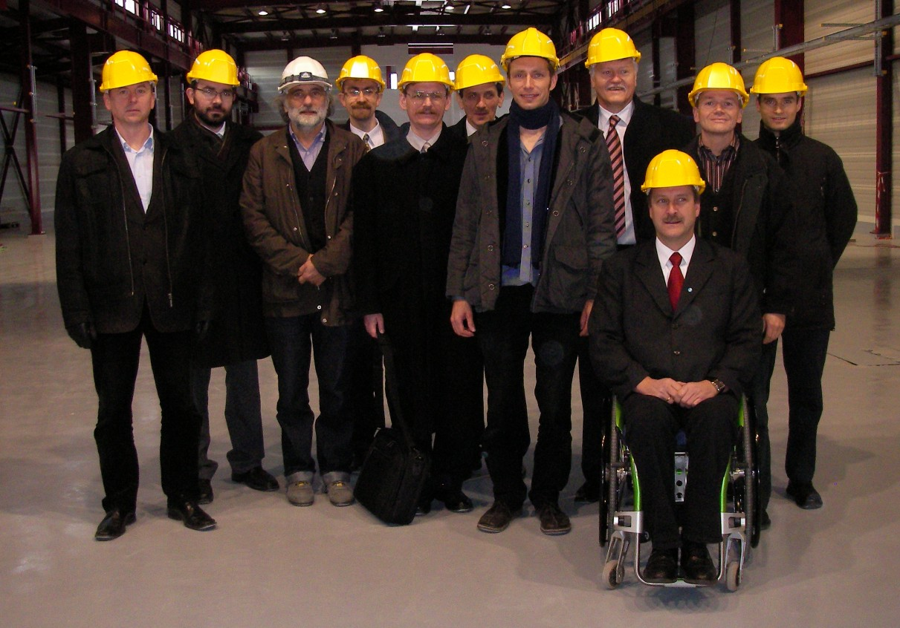
Nov 2010 - PIMS collaboration kick-off

Slide 14
PIMS element production
Mar 2013 | 5 elements for "Short Module" sent to CERN
Nov 2013 | PIMS M sent to CERN
2014 | 2 PIMS (L, K) sent to CERN
Oct 2014 | 50% of elements produced
2015 | 5 PIMS (H, G, I, F, D) sent to CERN
2016 | 4 PIMS (E, J, C, N) sent to CERN

Slide 15
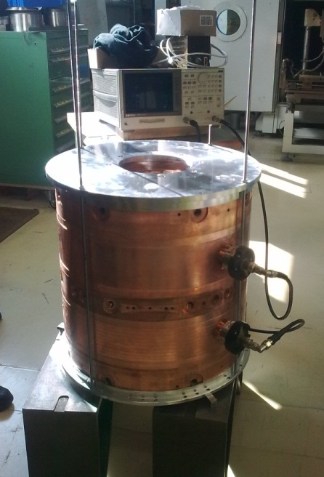
March 2013 – Short Module
end disc M_14
ring M_13-14
disc G_2-3
ring G_13-14
end disc M_1

Slide 16
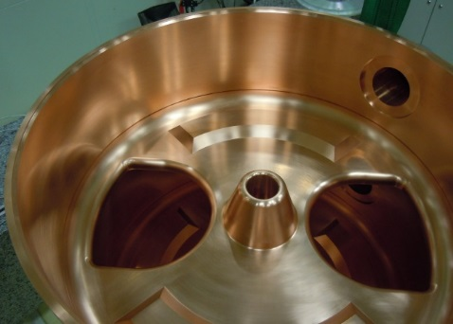
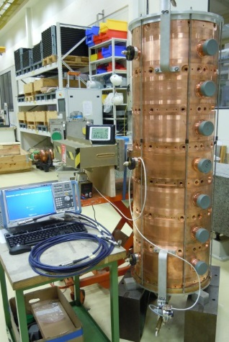
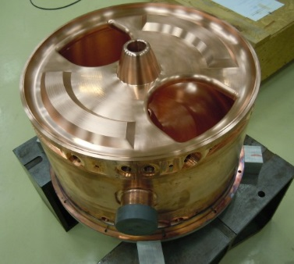
November 2013 – PIMS M

Slide 17
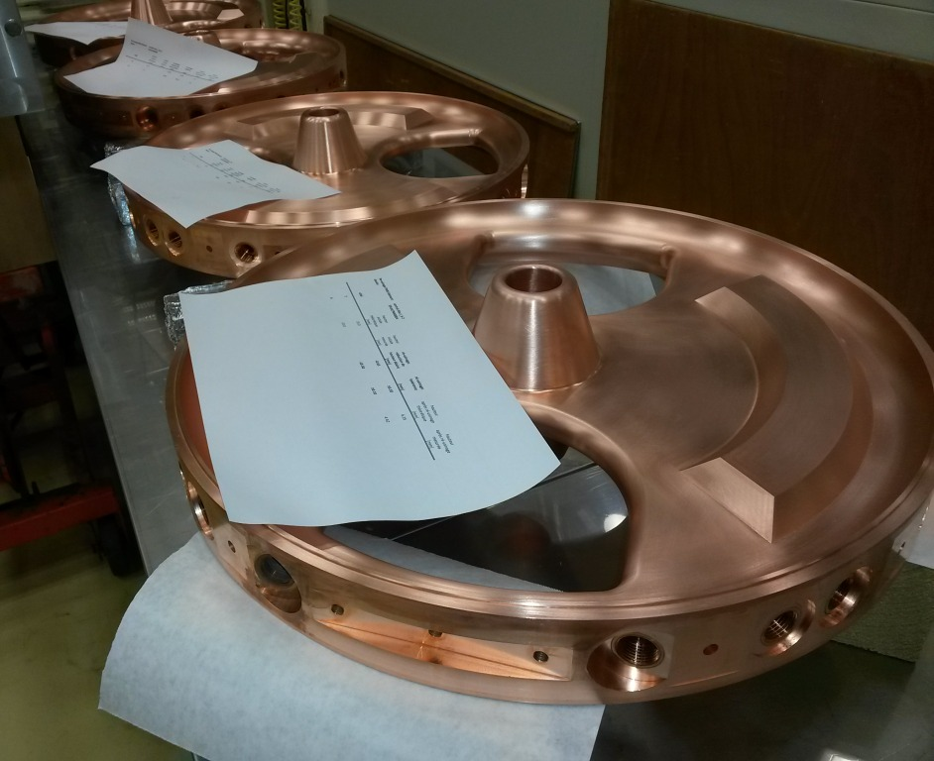
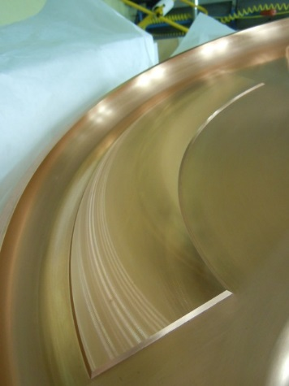
Re-machining of discs

Slide 18
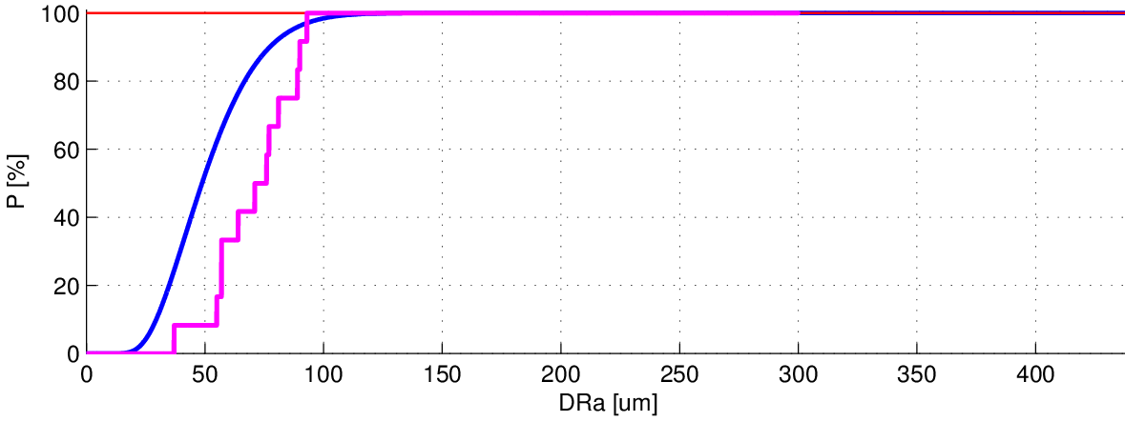
PIMS - tolerances
15 elements per cavity, 99 uncorrelated errors that can add up ==> aperture reduction
Probability of aperture reduction ≤ DRa (radius)
allowed limit (BD): 300 μm
worst case: 440 μm
With specified tolerances (very tight) => worst case aperture reduction <=> deviation from straight line Δ = ±0.44 mm (0% risk)
Accepting a 1% risk for all 12 cavities together: Δ = ±0.13 mm (1% risk)
=> some margin to accept deviations from specification [Δ ≤ ±0.30 mm]
Difficulties with coaxiality => beam dynamics simulations started to investigate effects of Δ ≤ ±0.60 mm
First geometry result Δ < ±0.1 mm was a big relief

Slide 19
PIMS - tolerances
"List of acceptable deviations from specifications"
no | influence | item | tolerance on drawing | acceptable tolerance
1 | RF | ø518.720 | ±0.02 | ±0.04
2 | RF | coaxiality @ ø518.720 to A | 0.02 | 0.05
3 | RF | profile from R3 to outside | 0.04 | 0.08
4 | RF | profile from inside to R3 | 0.04 | !!! must be kept 0.04 !!!
5 | RF | nose position ø0.02 to A | 0.02 | 0.04 (as defined by profile)
6 | assembly | ø538.720 | ±0.01 | ±0.02
7 | assembly | ø524.720 | -0.025, +0.000 | !!! must be kept !!!
8 | assembly | coaxialities @ ø524.720 to A | 0.02 | !!! must be kept !!!
9 | assembly | position to B | 0.01 | 0.02
10 | assembly | perpendicularity to A | 0.02 | replaced by 2 separated requirements flatness (needed to welding) 0.02 perpendicularity 0.04
11 | RF | position tolerance of nose tip | 0.01 | 0.02
=> very tight tolerances, example: ø524.7085 ±0.0125 <=> precision 2*10⁻⁵
28 times per cavity => 336 times in total
=> Outstanding work done by workshop + metrology !

Slide 20
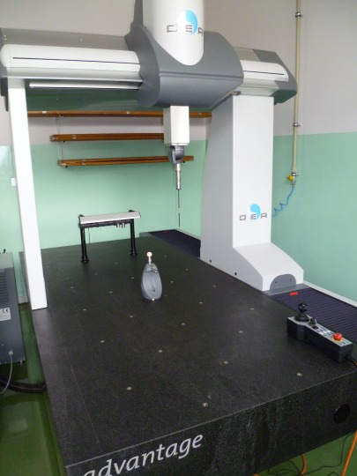
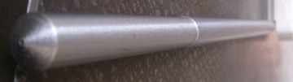
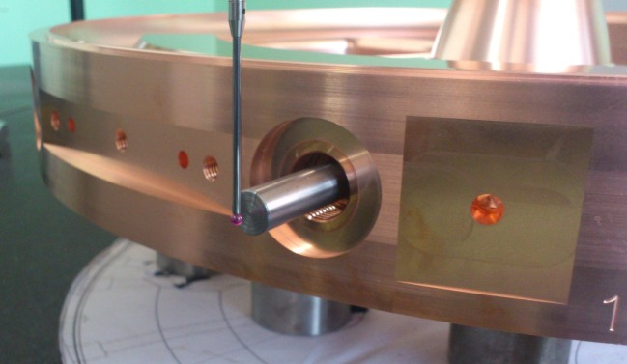
PIMS – metrology at NCBJ
every of the 180 PIMS elements measured
15’972 table entries in total (more measurements !)
7’440 cooling channels measurements
=> Tremendous work by metrology in excellent quality !

Slide 21
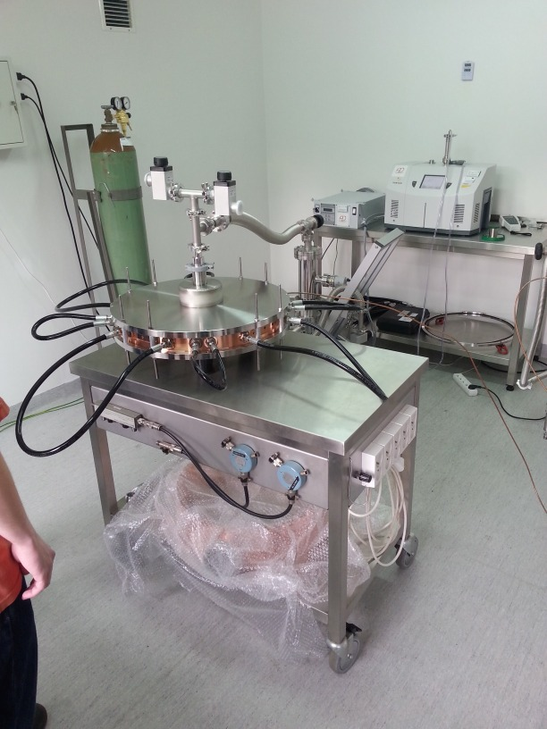
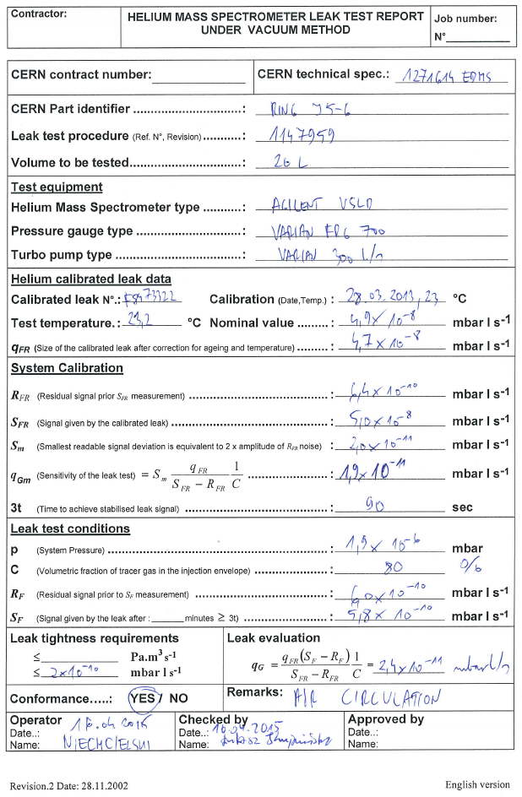
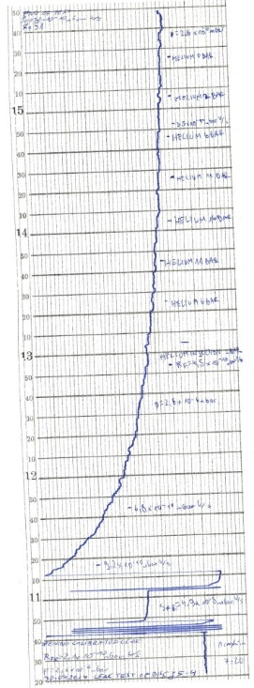
PIMS – vacuum testing at NCBJ
Vacuum tests crucial
=> only test before welding
every of the 180 PIMS elements tested
+ a few extra
1 report per element
difficult with He background
=> Tremendous work by vacuum testing team in excellent quality !

Slide 22
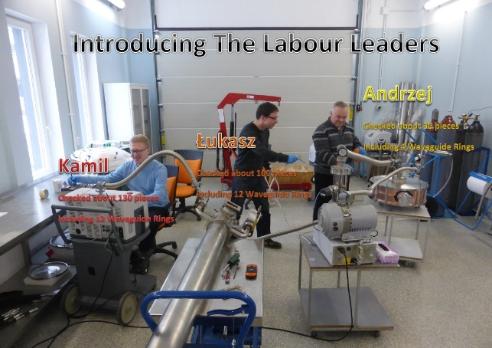
PIMS – vacuum testing at NCBJ

Slide 23
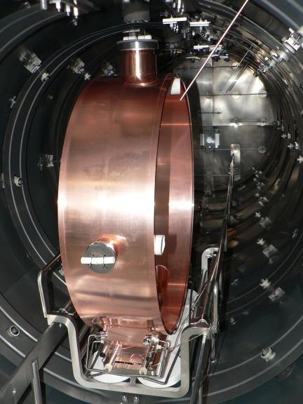
PIMS – WGR brazing at NCBJ
It was expected to be complicated
Furnace modified to braze vertically
brazing text Jul 2011 => very good
WGR M Sep 2013 => good
WGR L Mai 2014 => very good
calibration of thermocouples Mai 2014
(CERN recommendation)
6 brazing failed [gap, temperature]
5 repair brazings (cutting flanges, InCusil)
6 successful brazings
=> It went so well in the end that we brazed the 2 spare WGRs
=> Very difficult, high precision work done by brazing team with great success

Slide 24
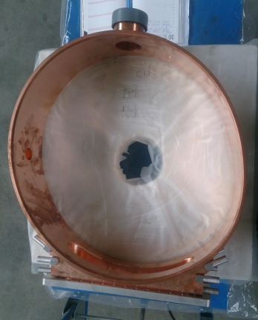
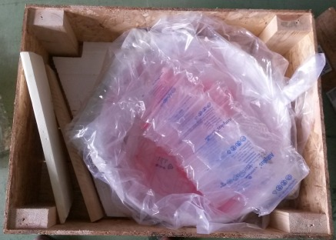
PIMS – transport accidents
June / July 2015:
1st accident during transport of WGR J from CERN to NCBJ for repair brazing
2nd accident during transport of WGR C from NCBJ to CERN

Slide 25

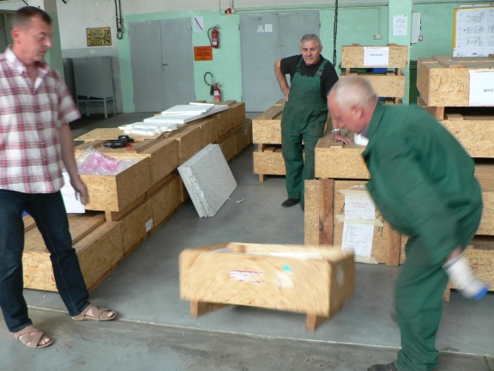
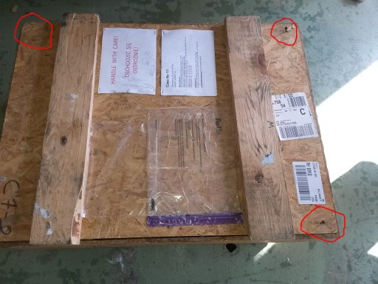
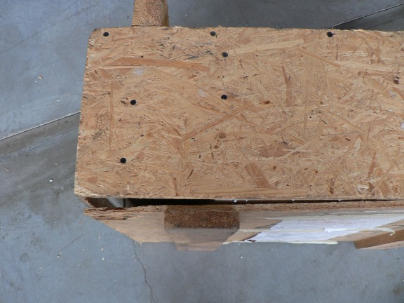
PIMS – transport accidents
WGR C transported from NCBJ to CERN by airplane
Reproducibility test
on 4 wheels

Slide 26
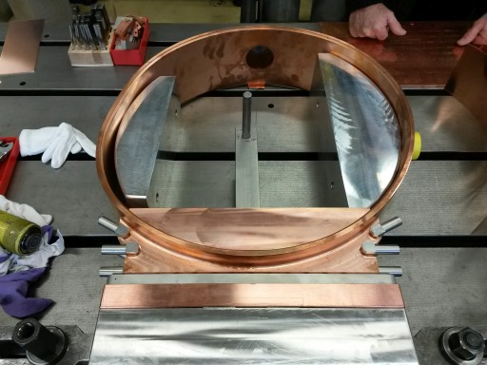
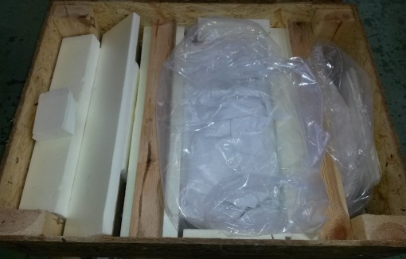
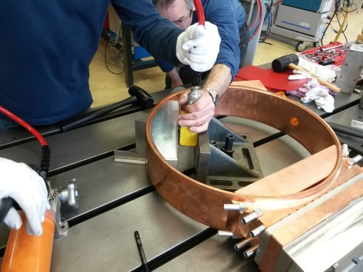
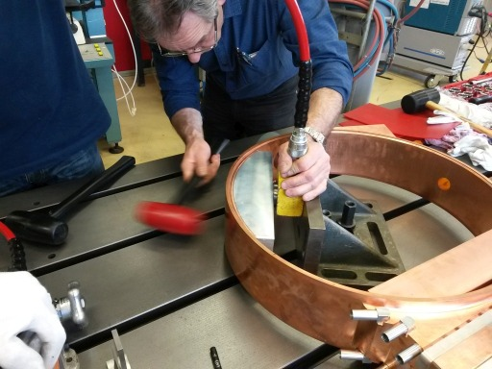
PIMS – transport accidents
Flying-truck-save(r) packaging
Re-forming at CERN
Results:
* circularity ok
* planarity not
reachable
=> risk for cavity
=> 2 replacement
WGRs needed

Slide 27
Acknowledgement for support from CERN services
Main workshop | machining procedure, advice on machining parameters & tools, visit to NCBJ, re-machining of tuning islands, re-forming of WGRs, steady support on many small issues
Metrology | advice, validation measurements, visit to NCBJ
EB welding | support + advice for port welding at FZJ, several repair welds of ports, advice for particular elements, quality + planning reliability during assembly phase
Brazing | support for preparation and in difficult phases, quick in analysing and advising on WGRs arriving at CERN
Ultrasound testing | quick inspection of brazing joints
Surface treatment | advice on cleaning procedure, Ni-plating of 15 WG flanges + 30 CF flanges, quality + planning reliability during assembly phase
Vacuum | support in designing tooling for vacuum tests of elements, visit to NCBJ, very quick checks of vacuum test reports, flexibility in leak & RGA testing of assembled cavities

Slide 28
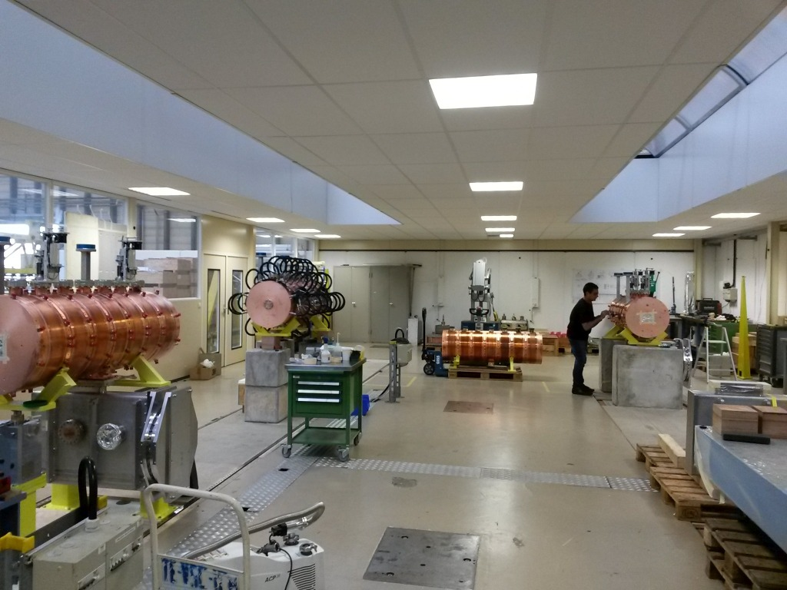
PIMS - assembly

Slide 29
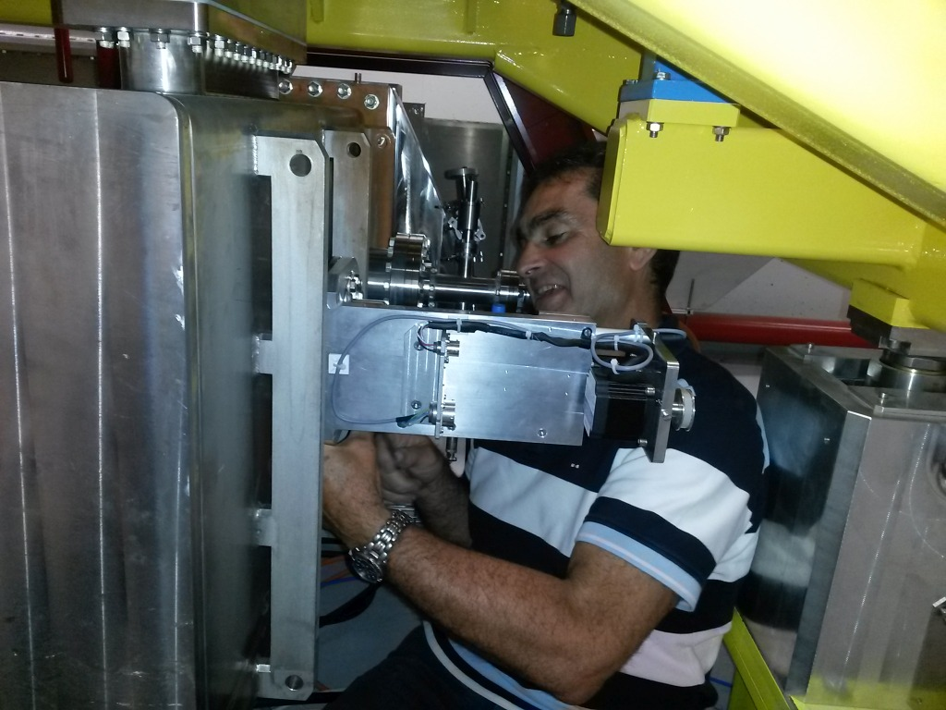
PIMS – installation

Slide 30
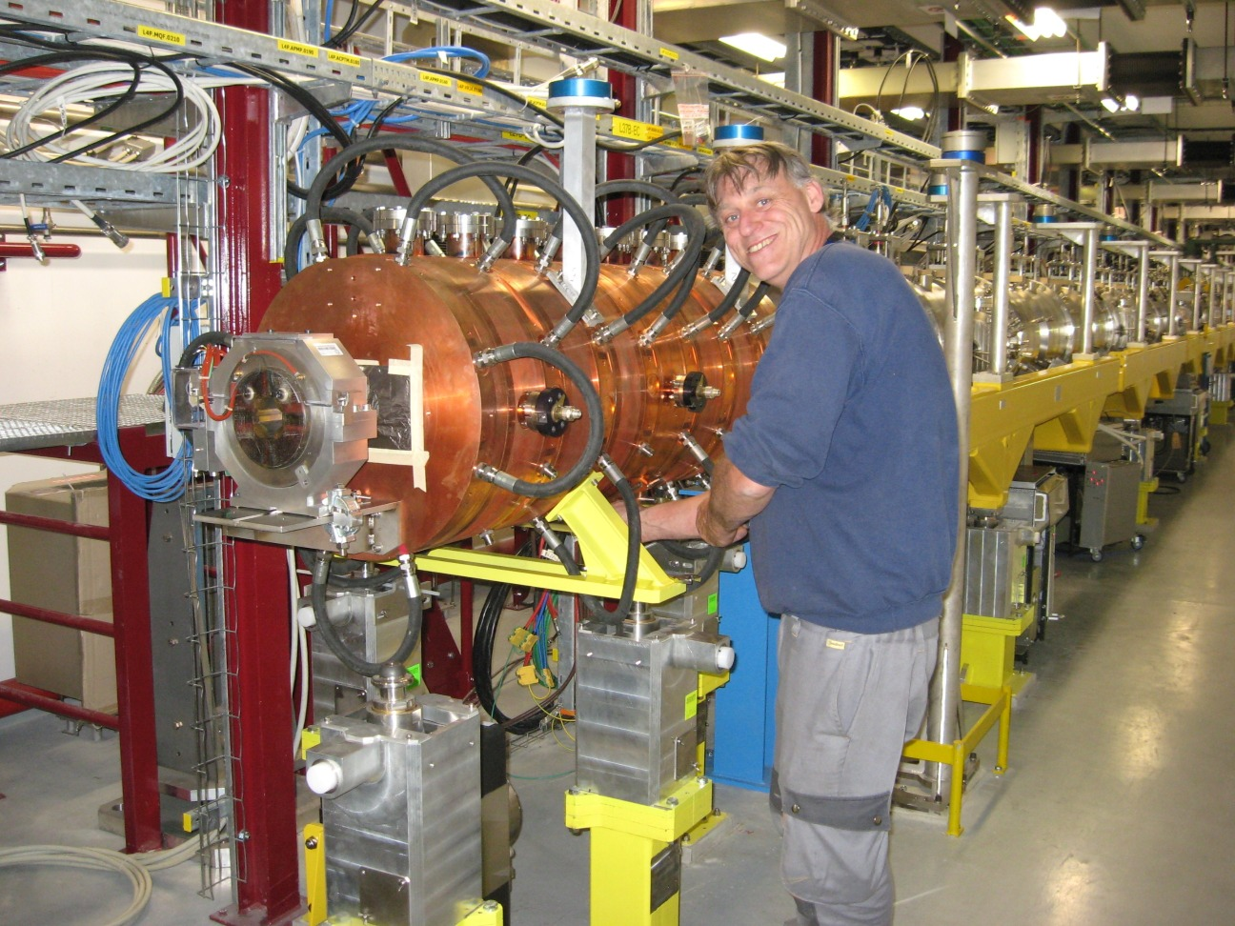
PIMS – installation

Slide 31
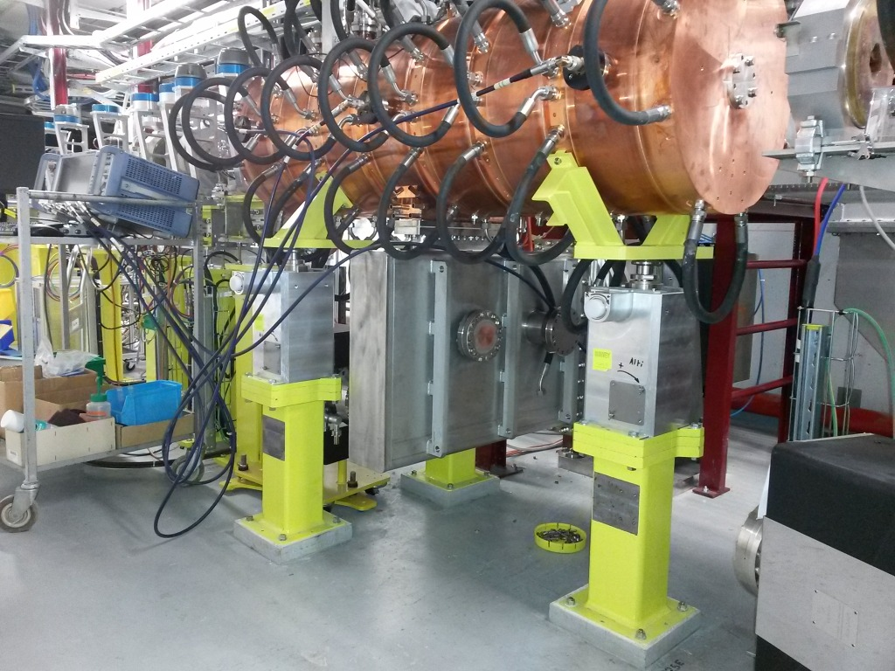
PIMS – installed in Linac4 tunnel

Slide 32
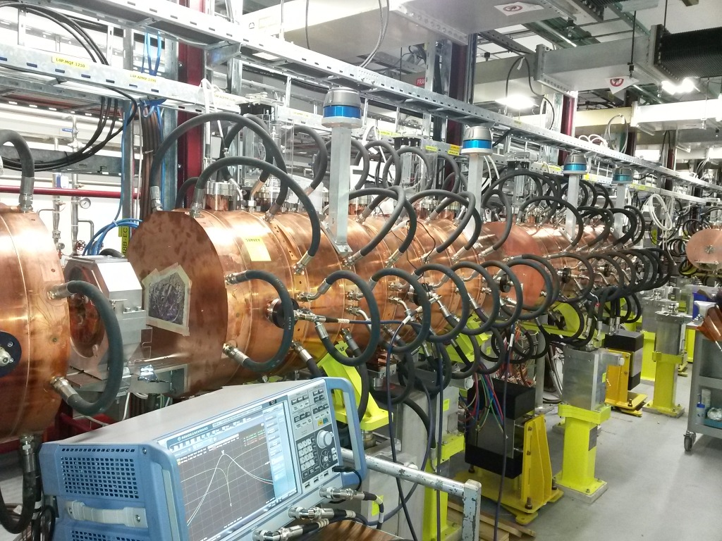
PIMS – installed in Linac4 tunnel

Slide 33
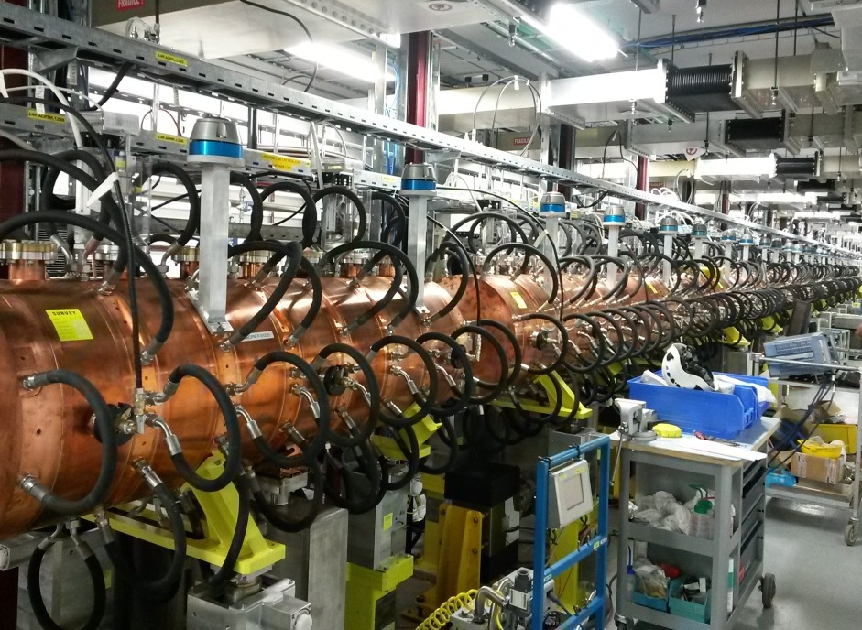
PIMS – installed in Linac4 tunnel

