Slide 1

Proposal to view FTS configuration
FTS Steering Meeting, 20th September 2016
Maria Alandes Pradillo
WLCG Operations

Slide 2
Motivation
In July we experienced issues affecting Network and FTS due to a big data backlog from CMS
  See GGUS:122415
  See ATLAS report in WLCG Operations Meeting:
      https://twiki.cern.ch/twiki/bin/view/LCG/WLCGDailyMeetingsWeek160718
ATLAS and CMS discussed together and identified some issues
  FTS configuration is managed independently by each experiment
    This is OK, BUT changes to the configuration are not communicated to the other experiments
  FTS is used by many experiments and its configuration can affect the others
    For this reason, we think WLCG Operations should understand also what’s going on

Slide 3
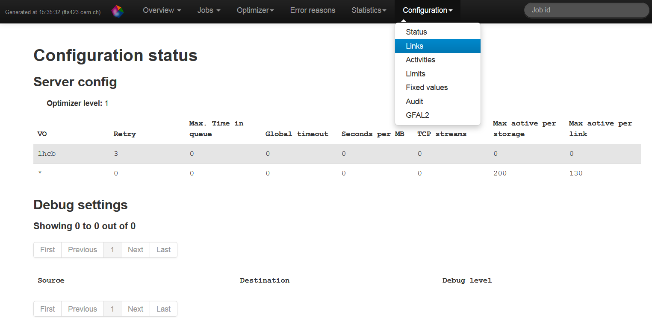
What is FTS configuration?
Configuration of the service
  Links, Activities, Limits and Fixed Values

Slide 4
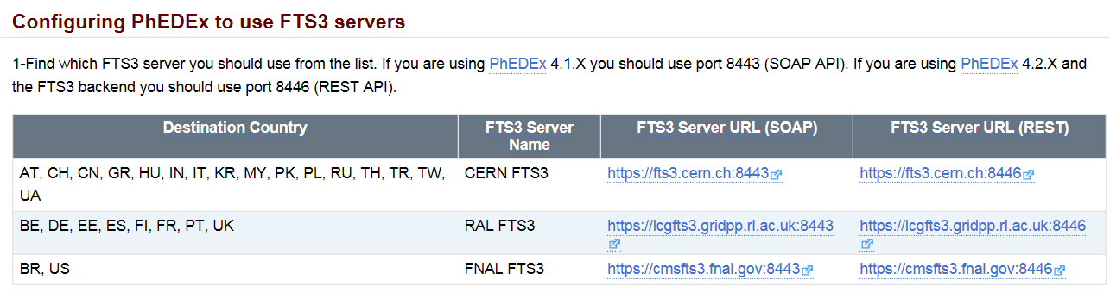
What is FTS configuration?
Experiment Policy on using FTS
  i.e. CMS PhEDEx configuration

Slide 5
Proposal
It would be very nice to have a central place where we could access FTS configuration
  Both Service configuration and VO specific
  With a log of changes: what, who, when, why
Useful for VO Operations team and also WLCG Operations
  FTS is critical for all VOs
  WLCG Operations should also understand what it is going on

Slide 6
What we have right now
FTS server configuration
  Check one by one (CERN, RAL, BNL/FNAL)
VO specific configuration
  Some VOs maintain twikis where there is documentation about VO specific configuration for FTS
    However, how much does this reflect reality?
    Maria Arsuaga worked on a prototype to get this information in real time:
      https://monit.cern.ch/goto/bd733f3d82c0ee432b712f949d02b4da

Slide 7
What we have right now
Log of changes
  The Configuration audit option is already available
    BUT it doesn’t include explanations of why a change has been made
    Is JIRA integration to open a ticket with the explanation a feasible option?

Slide 8
What’s next
Further improvements to Maria’s first prototype based on Kibana?
  This will also integrate service configuration but this requires more work
JIRA integration to get notifications about changes?

