Slide 1
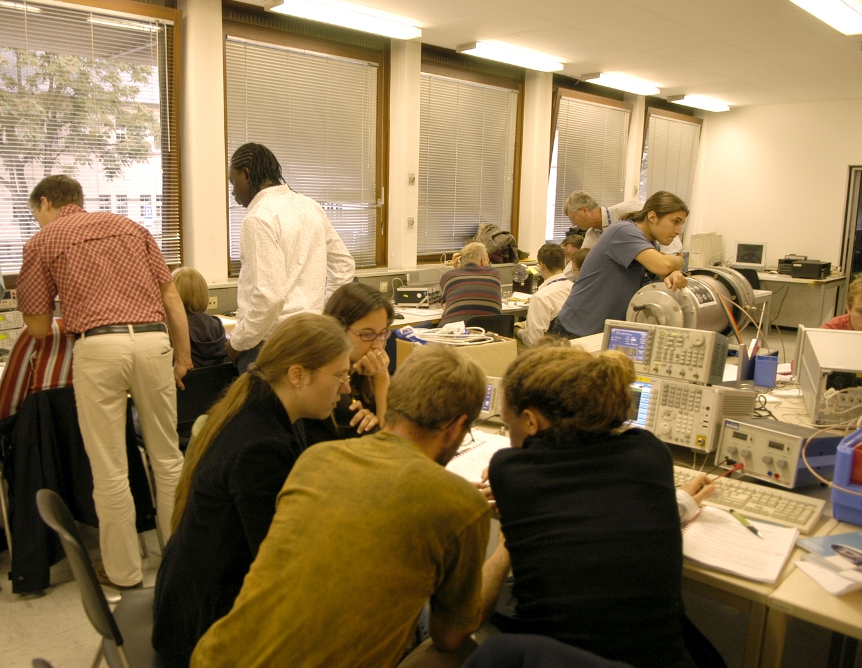
JUAS 2017 RF lab introduction
F. Caspers, M.Wendt

Slide 2
Contents
RF measurement methods – some history and overview
Superheterodyne Concept and its application
Voltage Standing Wave Ratio (VSWR)
Introduction to Scattering-parameters (S-parameters)
Properties of the S matrix of an N-port (N=1…4) and examples
Smith Chart and its applications

Slide 3
Measurement methods - overview (1)
There are many ways to observe RF signals. Here we give a brief overview of the five main tools we have at hand
Oscilloscope: to observe signals in time domain
  periodic signals
  burst signal
  application: direct observation of signal from a pick-up, shape of common 230 V mains supply voltage, etc.
Spectrum analyser: to observe signals in frequency domain
  sweeps through a given frequency range point by point
  application: observation of spectrum from the beam or of the spectrum emitted from an antenna, etc.
3

Slide 4
Measurement methods - overview (2)
Dynamic signal analyzer (FFT analyzer)
  Acquires signal in time domain by fast sampling
  Further numerical treatment in digital signal processors (DSPs)
  Spectrum calculated using Fast Fourier Transform (FFT)
  Combines features of a scope and a spectrum analyzer: signals can be looked at directly in time domain or in frequency domain
  Contrary to the SPA, also the spectrum of non-repetitive signals and transients can be observed
  Application: Observation of tune sidebands, transient behavior of a phase locked loop, etc.
Coaxial measurement line
  old fashion method – no more in use but good for understanding of concept
Network analyzer
  Excites a network (circuit, antenna, amplifier or similar) at a given CW frequency and measures response in magnitude and phase => determines S-parameters
  Covers a frequency range by measuring step-by-step at subsequent frequency points
  Application: characterization of passive and active components, time domain reflectometry by Fourier transforming reflection response, etc.
4

Slide 5
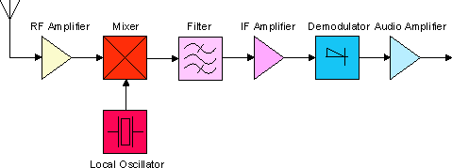
Superheterodyne Concept
Design and its evolution
The diagram below shows the basic elements of a single conversion superhet receiver. The essential elements of a local oscillator and a mixer followed by a fixed-tuned filter and IF amplifier are common to all superhet circuits. [super ετερω δυναμισ] a mixture of Latin and Greek … it means: another force becomes superimposed.
The advantage to this method is that most of the radio's signal path has to be sensitive to only a narrow range of frequencies. Only the front end (the part before the frequency converter stage) needs to be sensitive to a wide frequency range. For example, the front end might need to be sensitive to 1–30 MHz, while the rest of the radio might need to be sensitive only to 455 kHz, a typical IF. Only one or two tuned stages need to be adjusted to track over the tuning range of the receiver; all the intermediate-frequency stages operate at a fixed frequency which need not be adjusted.
This type of configuration we find in any conventional (= not digital) AM or FM radio receiver.
en.wikipedia.org
5

Slide 6
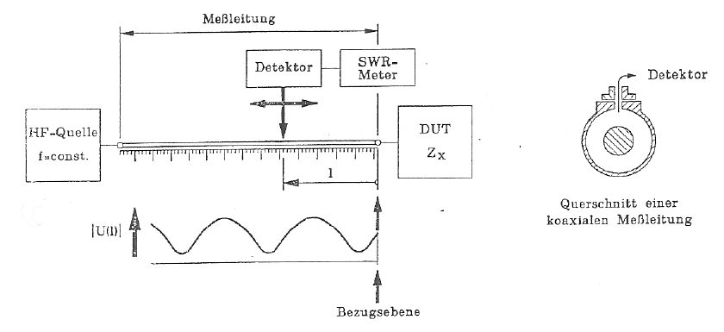
Voltage Standing Wave Ratio
Origin of the term “VOLTAGE Standing Wave Ratio – VSWR”:
In the old days when there were no Vector Network Analyzers available, the reflection coefficient of some DUT (device under test) was determined with the coaxial measurement line.
Coaxial measurement line: coaxial line with a narrow slot (slit) in length direction. In this slit a small voltage probe connected to a crystal detector (detector diode) is moved along the line. By measuring the ratio between the maximum and the minimum voltage seen by the probe and the recording the position of the maxima and minima the reflection coefficient of the DUT at the end of the line can be determined.
Voltage probe weakly coupled to the radial electric field.
RF source
f=const.
Cross-section of the coaxial measurement line
6

Slide 7
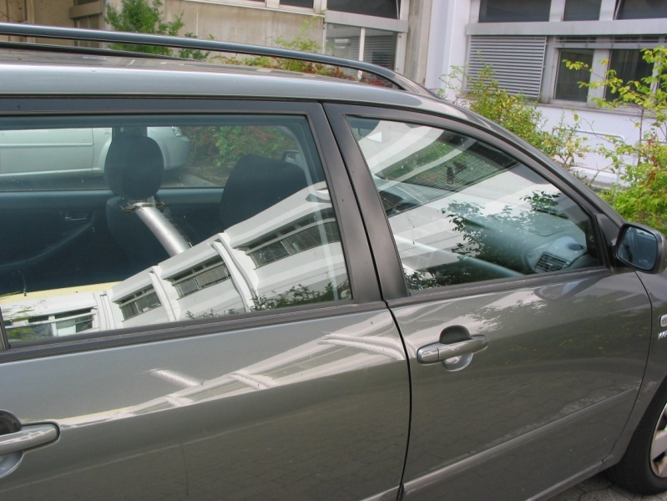
S-parameters- introduction
Look at the windows of this car:
  part of the light incident on the windows is reflected
  the rest is transmitted
The optical reflection and transmission coefficients characterize amounts of transmitted and reflected light.
Correspondingly: S-parameters characterize reflection and transmission of voltage waves through n-port electrical network
Caution: in the microwave world reflection coefficients are expressed in terms of voltage ratio whereas in optics in terms of power ratio.
7

Slide 8
Simple example: a generator with a load
a₁
Z_{G} = 50Ω
1
I₁
V(t) = V₀sin(ωt)
V₀ = 10 V
~
b₁
V₁
Z_{L} = 50Ω
(load
impedance)
1’ reference plane
Voltage divider:
This is the matched case i.e. Z_{G} = Z_{L}.
-> forward traveling wave only, no reflected wave.
Amplitude of the forward traveling wave in this case is V₁=5V;
forward power =
Matching means maximum power transfer from a generator with given source impedance to an external load
8

Slide 9
Evaluation of scattering parameters
Basic relation:
Finding S₁₁, S₂₁: (“forward” parameters, assuming port 1 = input,
port 2 = output e.g. in a transistor)
- connect a generator at port 1 and inject a wave a₁ into it
- connect reflection-free terminating lead at port 2 to assure a₂ = 0
- calculate/measure
- wave b₁ (reflection at port 1, no transmission from port2)
- wave b₂ (reflection at port 2, no transmission from port1)
- evaluate
DUT
2-port
DUT = Device Under Test
Z_{g}=50Ω
4-port
Matched receiver
or detector
prop. a₁
Directional Coupler
proportional b₂
9

Slide 10
The Smith Chart (1)
The Smith Chart (in impedance coordinates) represents the complex Γ-plane within the unit circle. It is a conformal mapping of the complex Z-plane on the Γ-plane using the transformation:
Imag(Γ)
Imag(Ζ)
Real(Ζ)
Real(Γ)
→The real positive half plane of Z is thus
transformed into the interior of the unit circle!
10

Slide 11
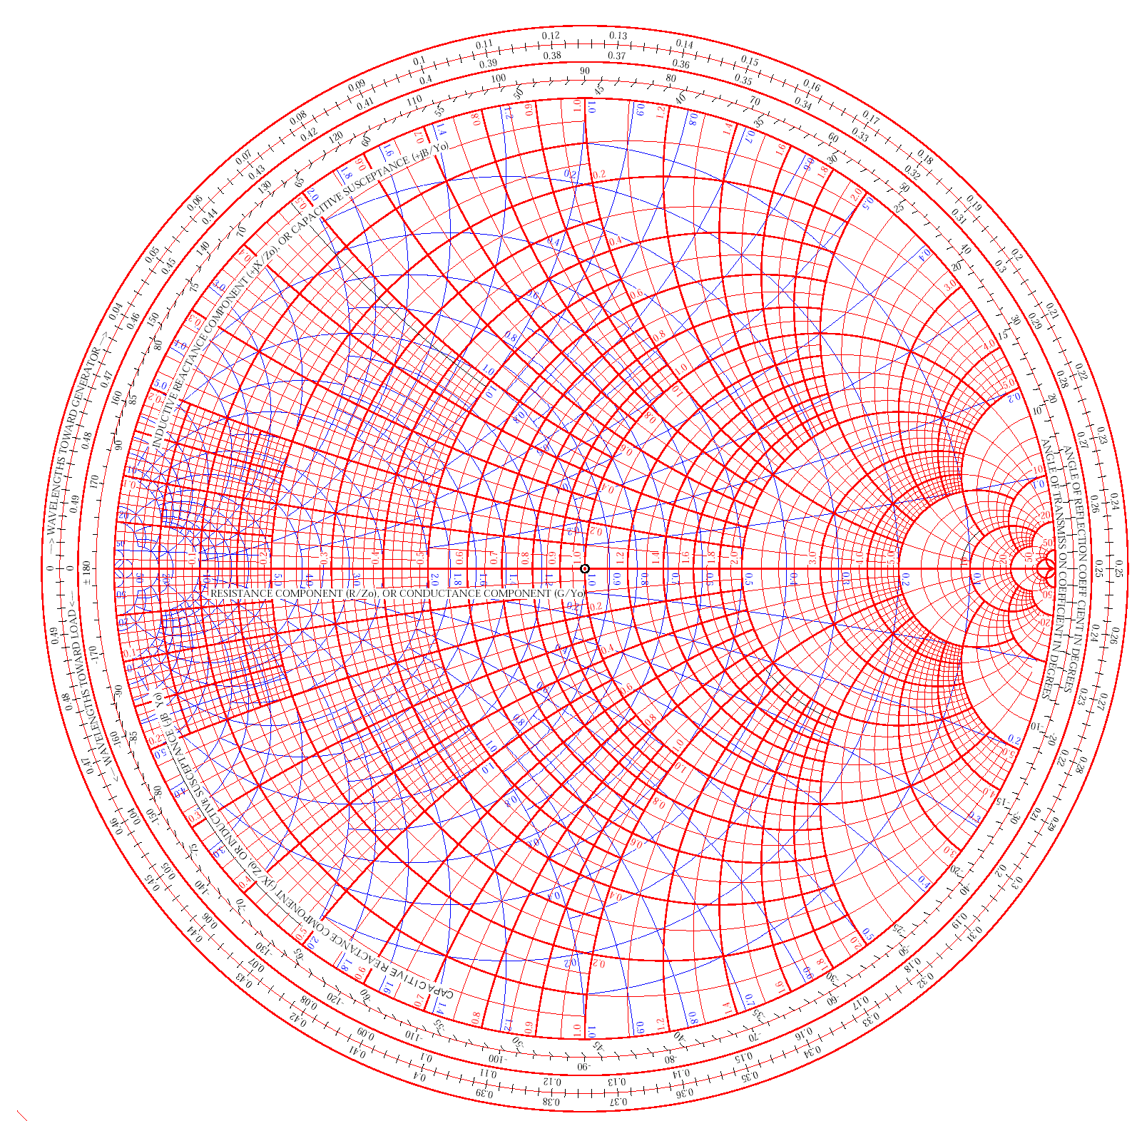
The Smith Chart (2)
The Smith Chart (Abaque Smith in French)
is the linear representation of the
complex reflection factor
This is the ratio between backward and forward wave
(implied forward wave a=1)
i.e. the ratio backward/forward wave.
The upper half of the Smith-Chart is “inductive”
= positive imaginary part of impedance, the lower
half is “capacitive” = negative imaginary part.
11

Slide 12
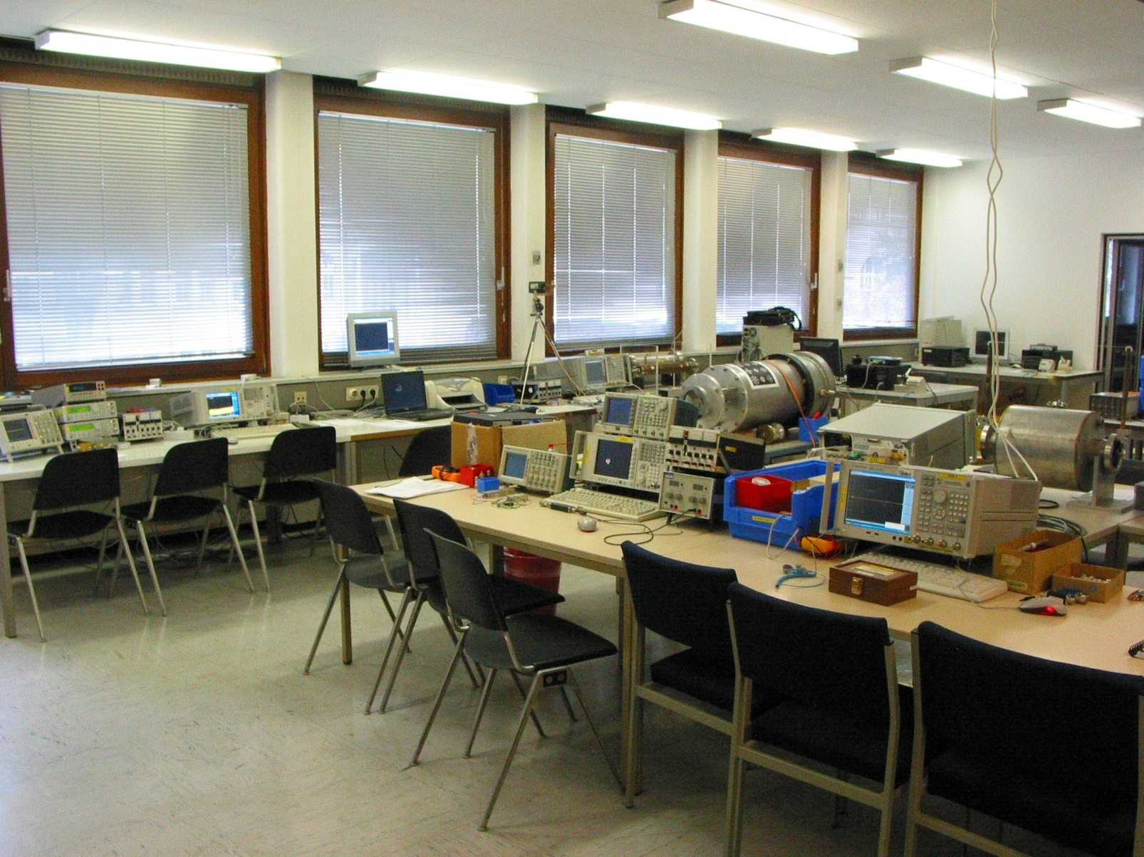
What awaits you?
Photos from RF-Lab CAS 2009, Darmstadt
12

Slide 13
Measurements using Spectrum Analyzer and oscilloscope (1)
Measurements of several types of modulation (AM, FM, PM) in the time-domain and frequency-domain.
Superposition of AM and FM spectrum (unequal height side bands).
Concept of a spectrum analyzer: the superheterodyne method. Practice all the different settings (video bandwidth, resolution bandwidth etc.). Advantage of FFT spectrum analyzers.
Measurement of the RF characteristic of a microwave detector diode (output voltage versus input power... transition between regime output voltage proportional input power and output voltage proportional input voltage); i.e. transition between square low and linear region.
Concept of noise figure and noise temperature measurements, testing a noise diode, the basics of thermal noise.
Noise figure measurements on amplifiers and also attenuators.
The concept and meaning of ENR (excess noise ratio) numbers.
13

Slide 14
Measurements using Spectrum Analyzer and oscilloscope (2)
EMC measurements (e.g.: analyze your cell phone spectrum).
Noise temperature of the fluorescent tubes in the RF-lab using a satellite receiver.
Measurement of the IP3 (intermodulation point of third order) on some amplifiers (intermodulation tests).
Nonlinear distortion in general; Concept and application of vector spectrum analyzers, spectrogram mode (if available).
Invent and design your own experiment !
14

Slide 15
Measurements using Vector Network Analyzer (1)
N-port (N=1…4) S-parameter measurements on different reciprocal and non-reciprocal RF-components.
Calibration of the Vector Network Analyzer.
Navigation in The Smith Chart.
Application of the triple stub tuner for matching.
Time Domain Reflectometry using synthetic pulse
→direct measurement of coaxial line characteristic impedance.
Measurements of the light velocity using a trombone (constant impedance adjustable coax line).
2-port measurements for active RF-components (amplifiers):
1 dB compression point (power sweep).
Concept of EMC measurements and some examples.
15

Slide 16
Measurements using Vector Network Analyzer (2)
Measurements of the characteristic cavity properties (Smith Chart analysis).
Cavity perturbation measurements (bead pull).
Beam coupling impedance measurements with the wire method (some examples).
Beam transfer impedance measurements with the wire (button PU, stripline PU.)
Self made RF-components: Calculate build and test your own attenuator in a SUCO box (and take it back home then).
Invent and design your own experiment!
16

Slide 17
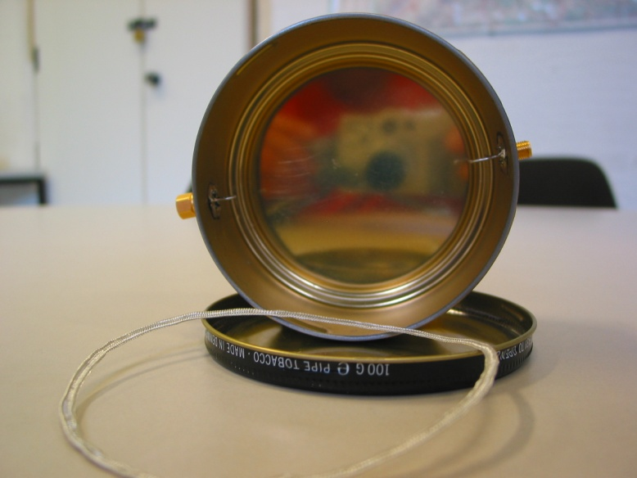
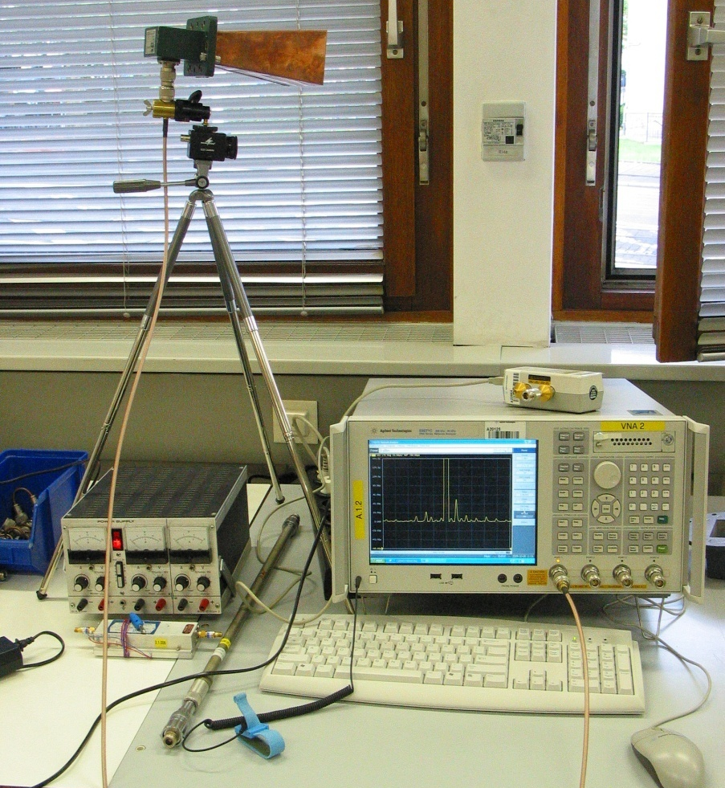
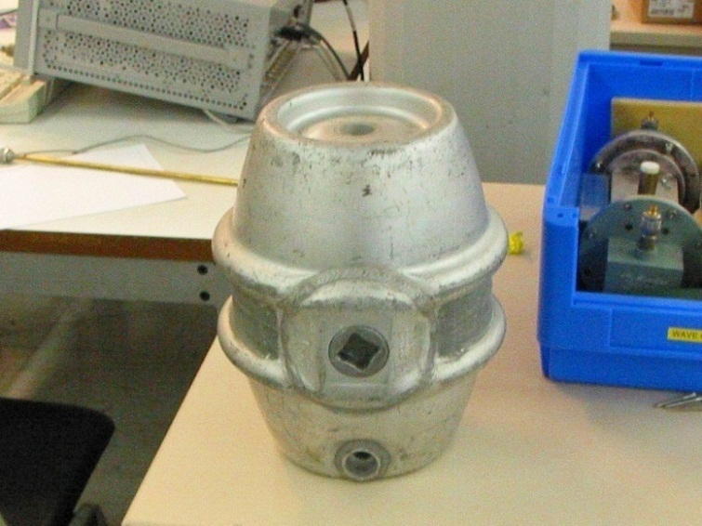
Invent your own experiment!
or „Tabacco-box” cavity
Build e.g. Doppler traffic radar
(this really worked in practice during CAS 2009 RF-lab)
or test a resonator of any other type.
17

Slide 18
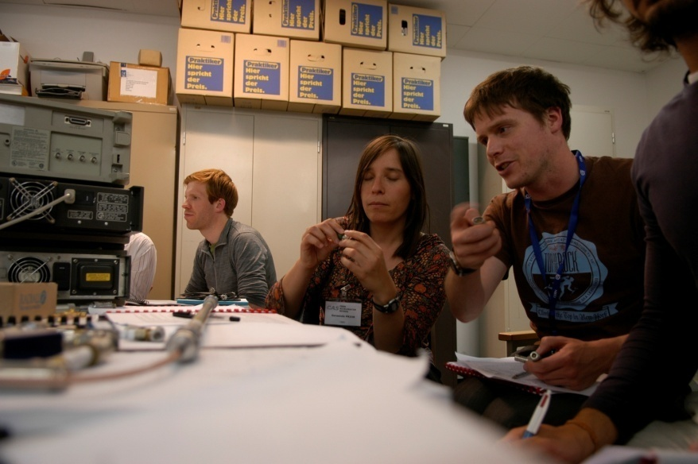
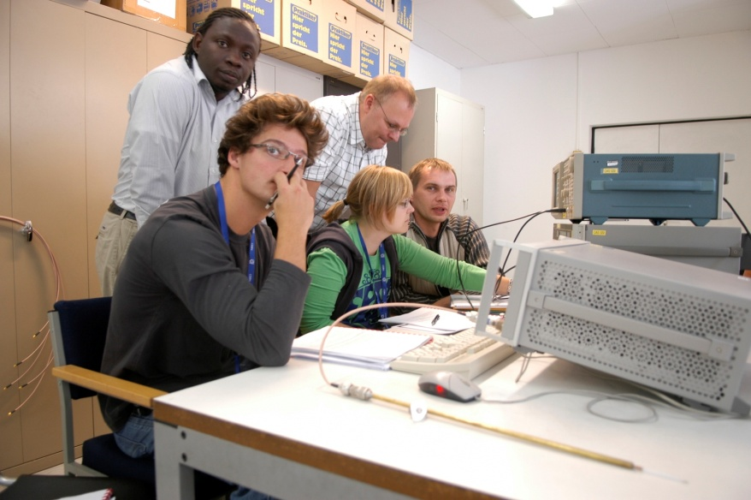
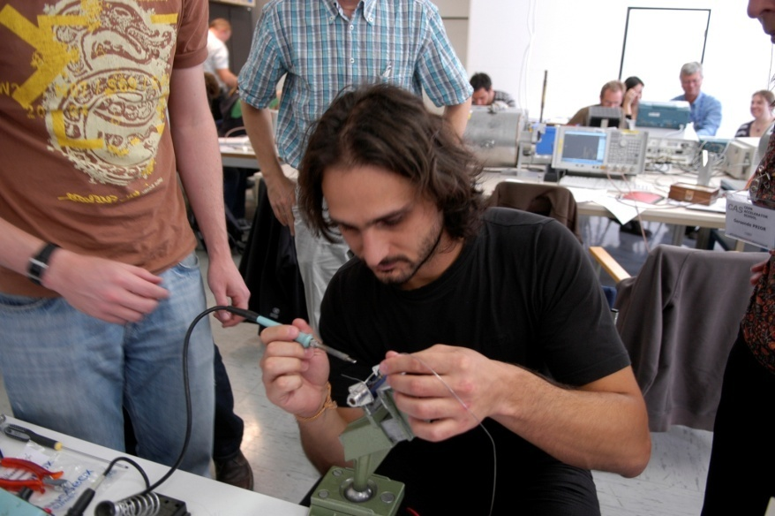
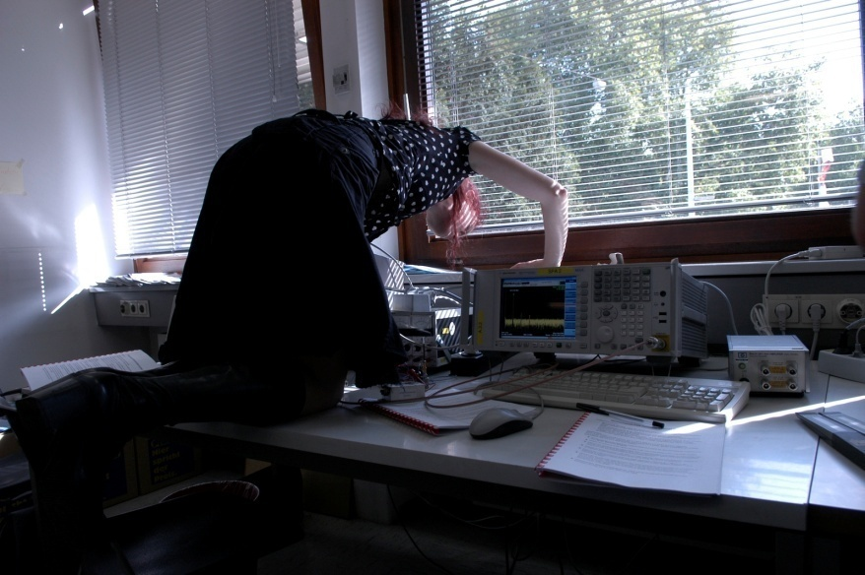
You will have enough time to think
and have a contact with hardware and your colleges.
18

Slide 19
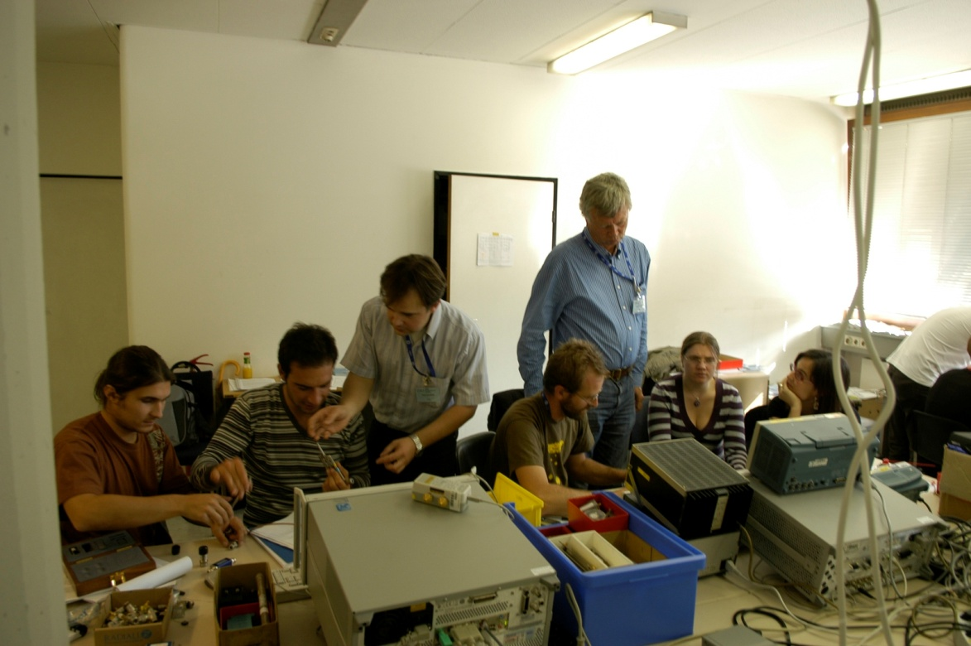
We hope you will have a lot of fun…
19

