Slide 1
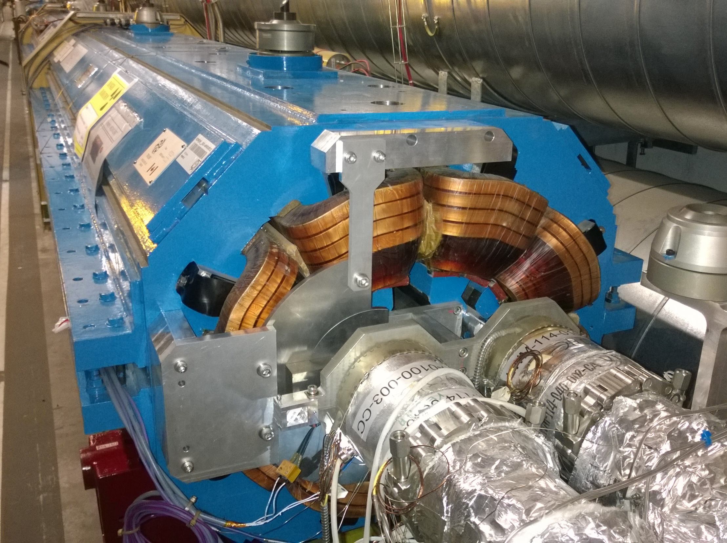
Radiation Levels of MBWs and MQWs:
Experimental verifications and
Long Term Strategy Update
F. Cerutti, E. Skordis, P. Fessia, N. Mariani,
CERN EN/STI, ATS/DO, TE/MSC
With contributions from:
J.M. Flores Vega, R. Lopez, G. Perrin-Bonnet, A. Sanz Ull, P. Schwarz, P. A. Thonet, TE/MSC/MNC
S. Clement, R. Gauthier, R. Gavaggio, CERN Polymer Laboratory
L. Bianchi, E. Gallay, M. Guichard, O. Sacristan de Frutos, CERN Mechanical Laboratory
C. Bahamonde, A. Lechner, A. Tsinganis, FLUKA Team, A. Riviere, B. Teissandier, CERN Chemical Laboratory
C. Adorisio, I. Brunner, S. Roesler, C. Tromel, J.B. Trummer, HSE/RP
L. Favre, EN/MME, L. Lambert, TE/MSC, R.F. Gomez TE/VSC/DLM,
B. Salvachua, BE/OP, S. Redaelli, BE/ABP, C. Martinella, E. Guillermain, M. Brugger, EN/EA
14th HL-LHC TCC 01/09/2016

Slide 2
Outline
Introduction to LHC Warm Magnets MBWs and MQWs
LHC Warm magnets Long Term Strategy
Overview of MQW Damage evaluations Tests
      Mechanical Loads: MQW life Test
      Thermal Loads: MQW Heat Test
  Radiation induced degradation of Warm Magnets
    Dose Monitoring & Forecast Updates
    Materials Damage Evaluation
  Update of Long Term Strategy
Conclusions & Next Steps

Slide 3
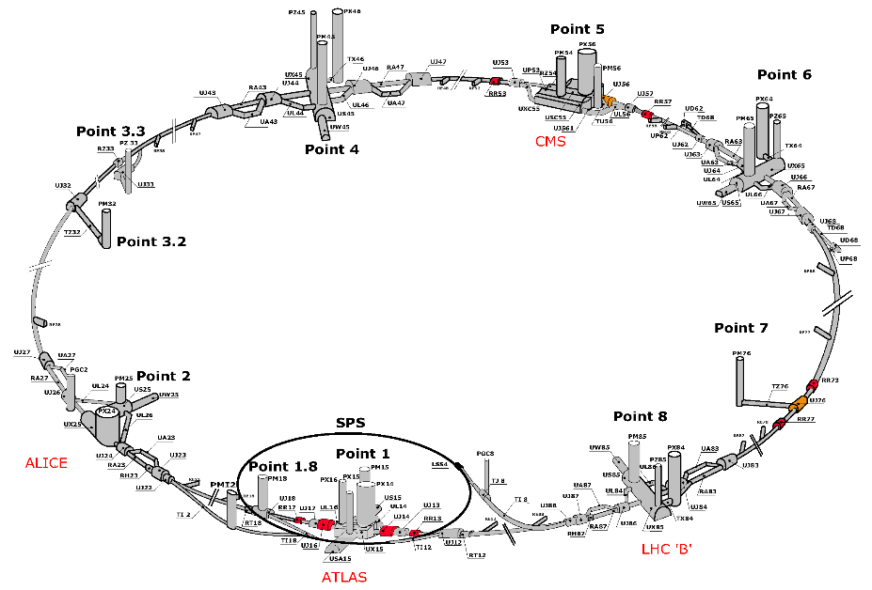
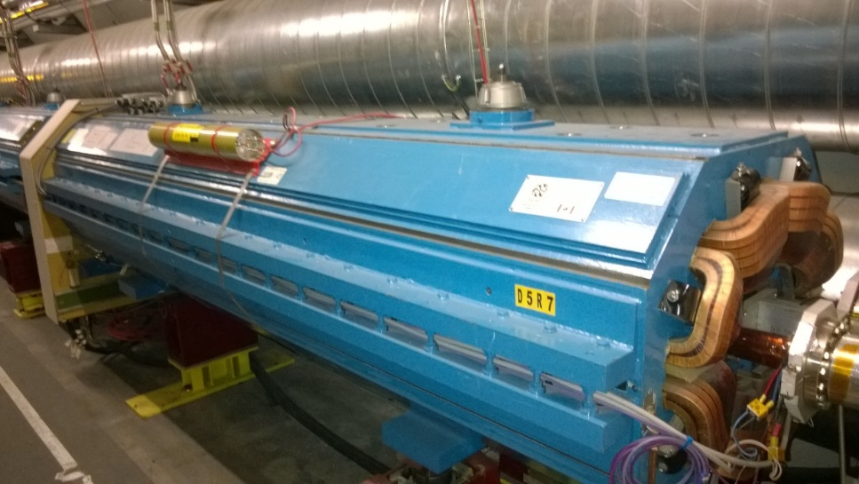
Introduction to LHC Warm Magnets
Beam cleaning areas (IR3 and IR7) high radiation level ➔ quenches in SC cables.
Use of robust warm magnets (MQWs and MBWs) instead of SCs, however…
High activation of equipment, maintenance in next 10 years might become very challenging!
➔ Paramount to predict in advance eventual mechanical, thermal or radiation induced failures on LHC warm magnets and adopt effective counter measurements…
Long term Strategy already proposed by P. Fessia in ECRs
LHC-MW-EC-0001 and LHC-MW-EC-0002 involves dose and damage prediction, magnets protection and preventive magnet’s exchange plan to guarantee smooth operations up to end of HL-LHC era!
We are now updating the previous estimations with fresh data in order to give a more reliable picture of the problem.

Slide 4
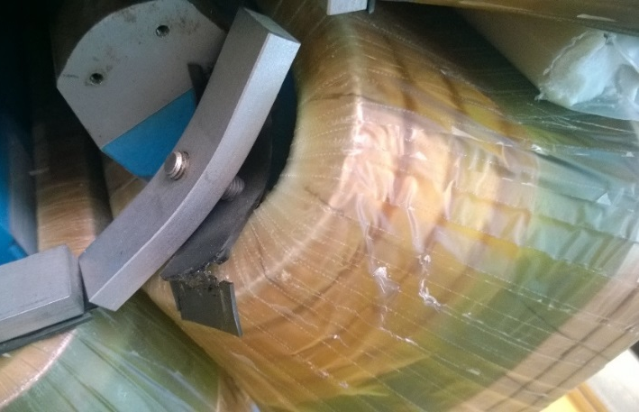
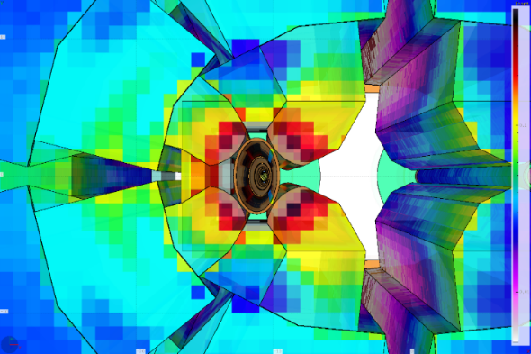
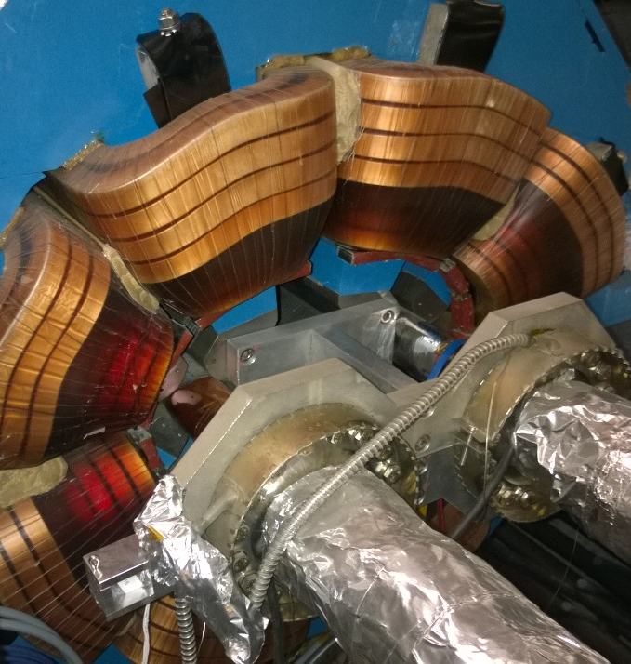
LHC Warm Magnets Damage Evaluations
Prediction of eventual MBWs/MQWs failures on three fronts:
1) Mechanical induced damage on MQWs:
➔ MQW Life Test: Endurance fatigue test on spare MQW to simulate LHC powering cycles (@7 TeV) while acquiring key parameters to verify life span.
2) Heat induced damage on MQWs:
➔ Ad hoc Heat Test to simulate Beam Losses Energy Deposition inside tunnel environment and verify absence of hot spots and MQWs cooling capabilities.
3) Radiation induced damage on MBWs and MQWs:
➔ Verification of doses received by coils with Dosimetry Campaign: installation of 114 Radio-Photoluminescence Glass Dosimeters (RPLGD) in meaningful locations and BLMs for long term predictions…
➔ Irradiation and testing of materials samples to measure the properties loss due to ionizing radiation!

Slide 5
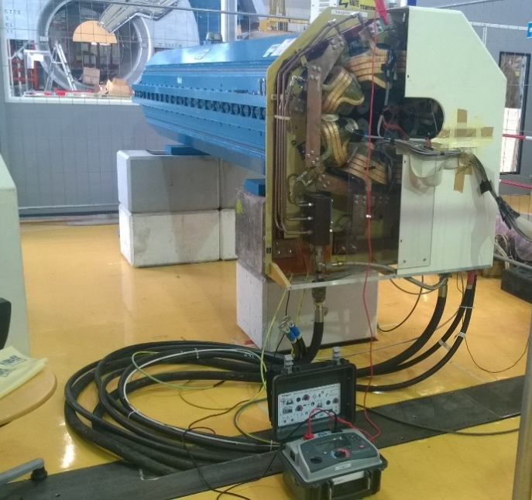
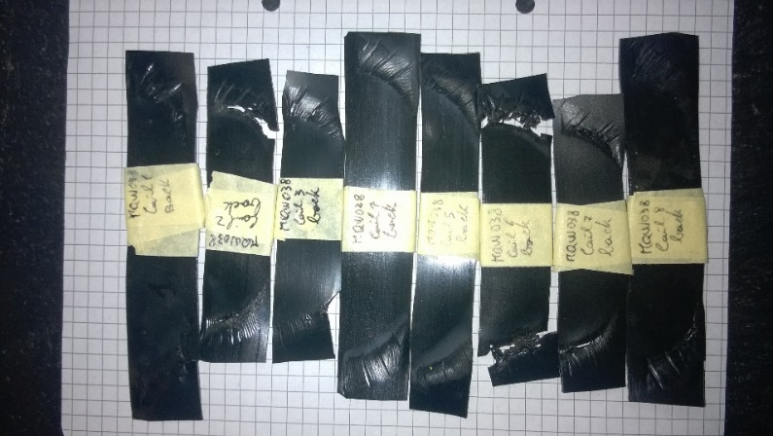
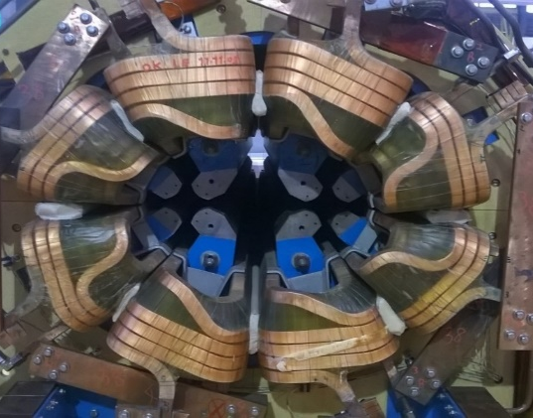
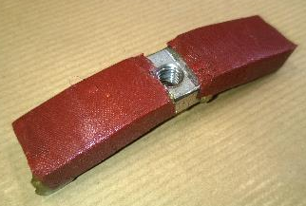
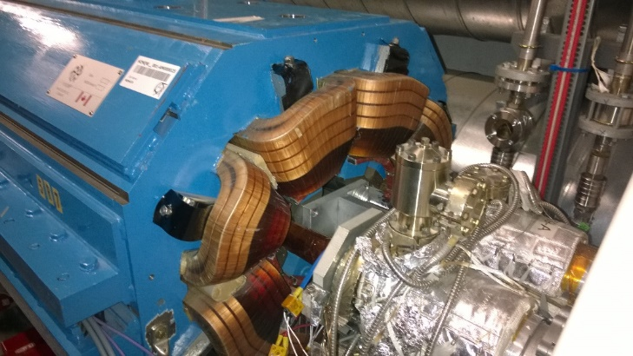
MQW Life Test Experiment
  Verify the magnet life time in LHC working conditions up to end of HL-LHC (estimated in 60’000 power cycles of MQW magnets):
  Cycle number limit for damages on coils and spacers, like loss of insulation, movement of coils...
  Acquire fundamental parameters (Coils displacements, T, strains, electrical insulation) to evaluate magnets behaviour.
No significant increase of Coils displacements or strains, however a degradation of MQW Brackets insulation has been detected:
Final Insulation check at 60’000 cycles showed 50 MOhm (Previous value: ~350 MOhm, MQW specification >100 Mohm)!
Replacing of rubber insulations with Polyimide-Polyurethane sandwich restored magnet’s conditions (insulation at 1 GOhm as before test)…
Substitution of brackets in tunnel with new, more insulated ones featuring Polyurethane and Polyimide sandwich wrapped in epoxy resin performed in 2015 End of the Year Technical Stop to avoid any possible failure!
8-1
6-7
1-2
2-3
4-5

Slide 6
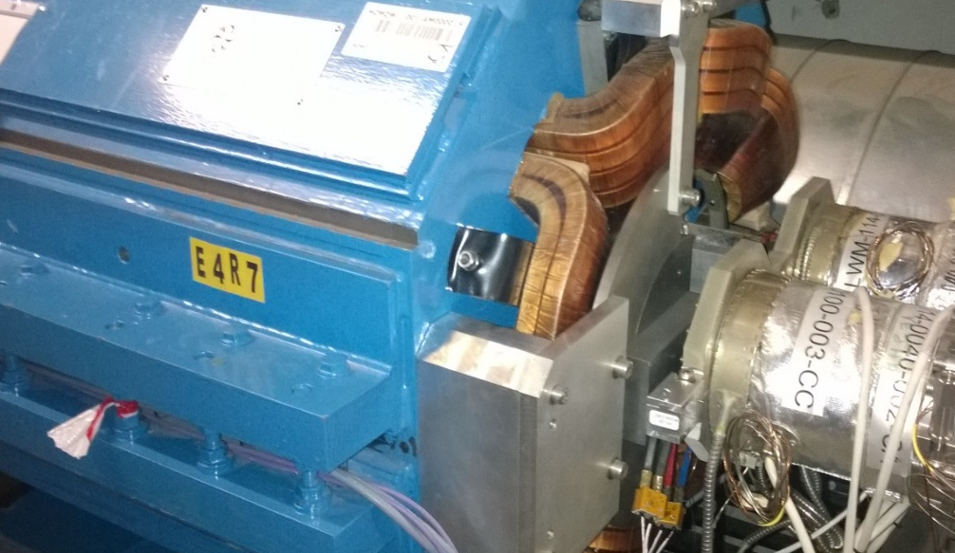
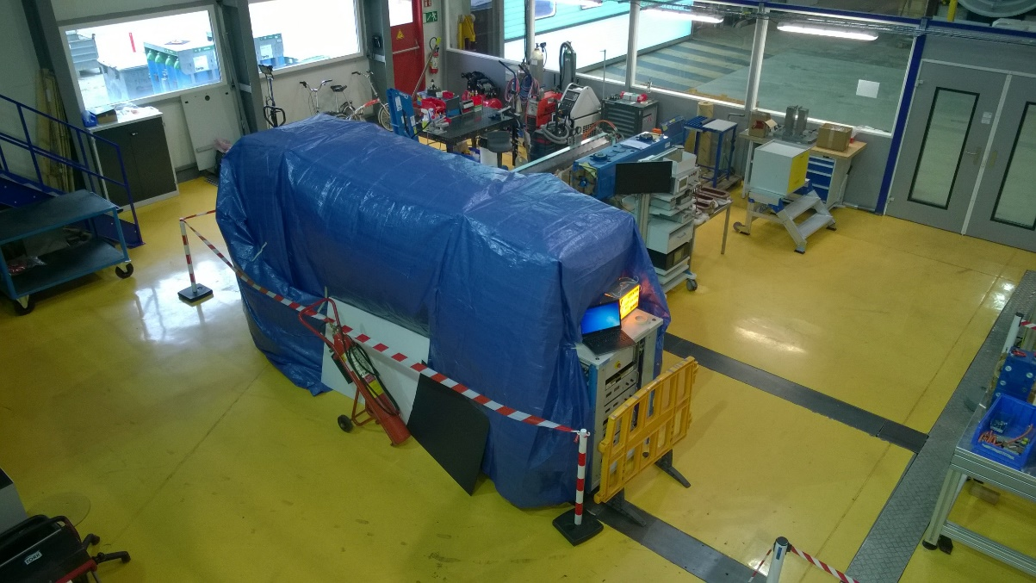
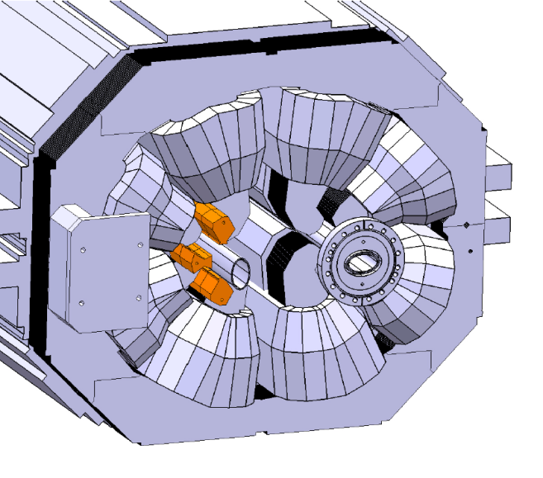
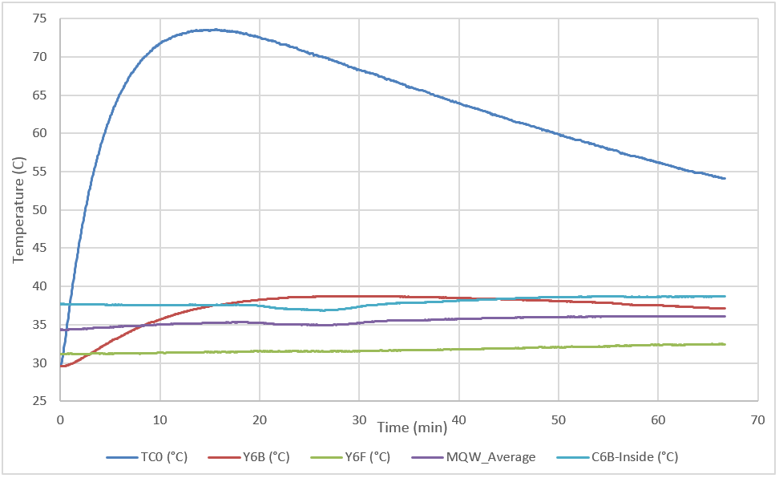
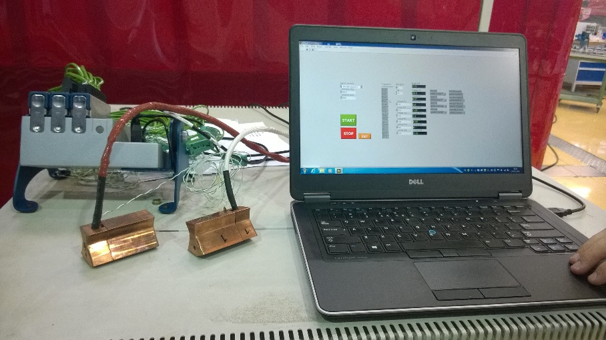
MQW Heat Test Experiment
Installation in LS1 of Tungsten Heavy Alloy (WHA) shielding to protect coils from radiation…
Tunnel ventilation in IR7 will be blocked due to high radiation levels…
Heat generated by coils operating at maximum Current (610 A @ 7 TeV)…
Danger of hot spots or high coils temperatures due to high energy deposition on shields (with limited cooling capability)…
Case 4: Continuous Operations
Absence of risks concerning the heat deposition on the Tungsten Heavy Alloy shields in MQWs for Fast Losses and Continuous Operations loads.
Inserts equipped with heating cartridges controlled by a LabVIEW PC.

Slide 7
Outline
Introduction to LHC Warm Magnets MBWs and MQWs
LHC Warm magnets Long Term Strategy
Overview of MQW Damage evaluations Tests
      Mechanical Loads: MQW life Test
      Thermal Loads: MQW Heat Test
  Radiation induced degradation of Warm Magnets
    Dose Monitoring & Forecast Updates
    Materials Damage Evaluation
  Update of Long Term Strategy
Conclusions & Next Steps

Slide 8
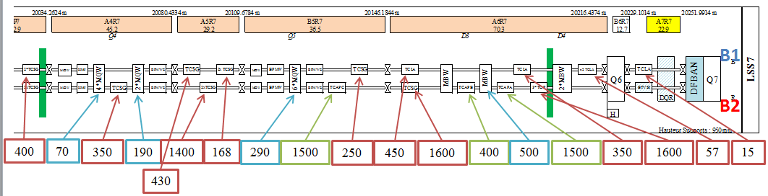

Dose Monitoring in IR3 and IR7 – History
Crucial task to define dose levels on sensitive equipment:
  Past studies relied on FLUKA calculations, RP Surveys and old dosimetry data from Collimation (with not well defined and reproducible positions) to establish dose on magnets…
Comparison between BLM dose rates and FLUKA/Sixtrack analysis
used for past estimations,
R2E and availability workshop 10/15/2014
E. Skordis
Activation Studies do not allow for precise evaluation of dose received by sensitive parts (i.e. magnets coils)
SixTrack/FLUKA predictions have to be compared to experimental data to gain confidence about results…
Ambient dose equivalent rates in µSv/h at 40cm
measured on Dec 20, 2012,
Remote Manipulations Workshop, 6 May 2013
S. Roesler

Slide 9

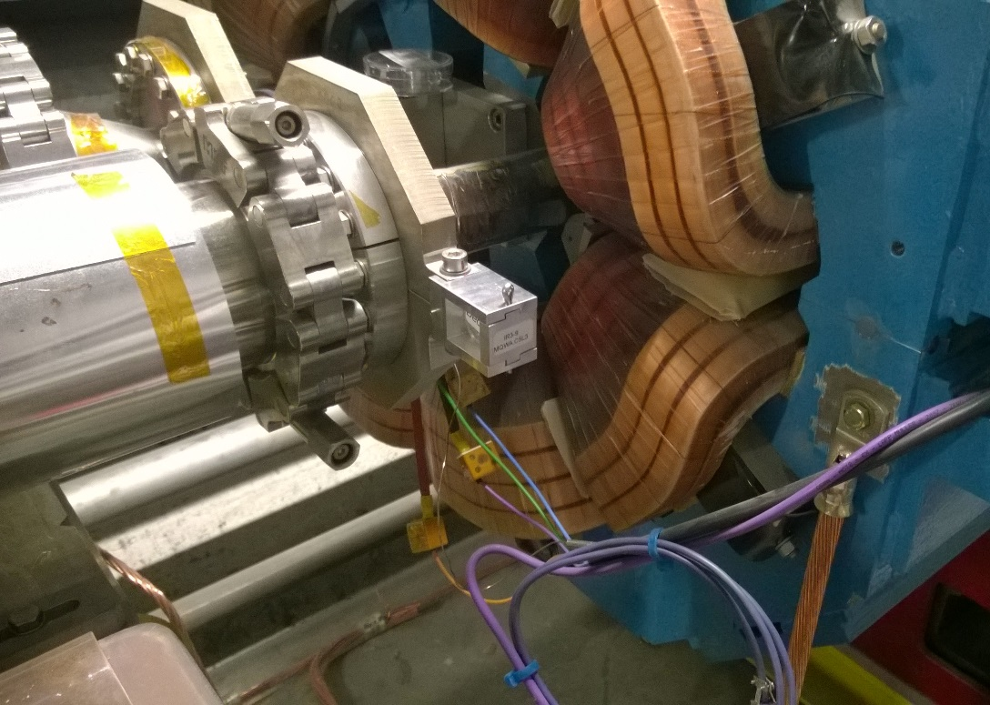
Dosimeters Installation
Preparation and follow-up of a long term monitoring campaign in LHC IR1, IR3, IR5 and IR7 made using RPL Dosimeters…
Objectives of monitoring campaign:
Provide new data with a more focused view of LHC Warm Magnets;
Extend and maintain the database of critical locations along the ring proposing a reading time-schedule up to LS3 to prevent radiation damage induced failures on warm magnets;
Establish a correlation between BLM signal and dose received by magnets;
Verify the spatial distribution of losses on magnets and on BLMs;
Have fix dosimeters holders for fast and reliable readings in future years, guaranteeing a fair comparison among readings in different stages.
8 dosimetrs
Key for cap removal
Cap with Label
45 dosimetrs
Fixing screw
14 dosimetrs
46 dosimetrs
Capsule (with labels)
➔ Long terms strategy to strictly monitor the dose received by magnet’s coils and BLMs in hot LHC locations to allow for precise evaluation of dose received by magnets by the end of HL-LHC!

Slide 10
IR3/IR7 Dosimeters Activities
First exchange of dosimeters in February 2016, dose recorded during all 2015 LHC Run:
IR3 vs IR7 and Left vs Right dose comparison:
  Beam loss ratio IR3/IR7;
  Beam 1 vs Beam 2 (Left vs Right) a-symmetry verification;
Comparison between Doses read by Dosimeters installed on BLMs and BLMs Integrated Doses (C. Martinella) to verify dosimeters readings with respect to BLMs;
Implementation of Dosimeters locations in FLUKA model to compare Dose read by Dosimeters installed on magnets and FLUKA maps at same location;
IR3 vs IR7 analysis:
A-symmetry between Beam 1 and Beam 2 for both IRs:
Confirmed beam loss ratios between IR3 and IR7 (but with a-symmetry);
➔ new corrective factors implemented for long term forecasts based on FLUKA maps.

Slide 11
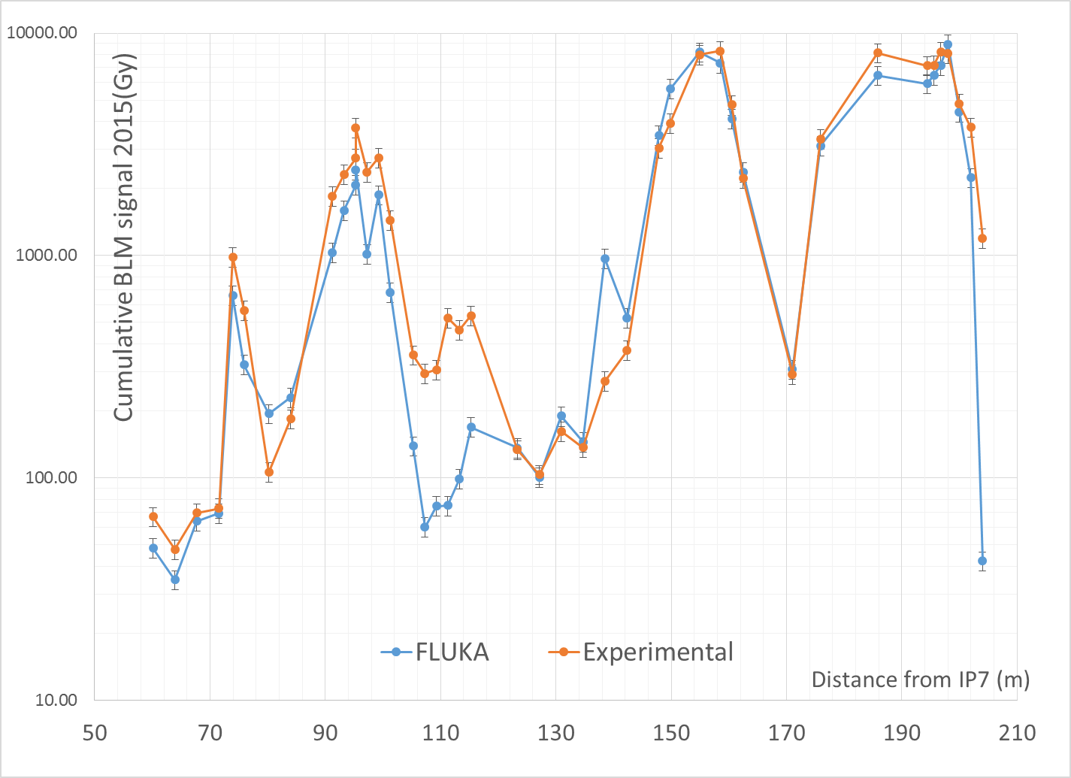
BLM VIEW ON 2015 (R7)
mispositioning?
relevant contribution
from B1 to be added
simulated 6.5 TeV protons
hor losses only

Slide 12
2015 LOSSES
the simulated BLM pattern in the previous plot was normalized to
6.22 10¹⁴ 6.5 TeV (B2) protons lost in IR7 (per 4.2fb⁻¹)
B2 BCT indication for 5.5 10¹⁴ 6.5 TeV lost protons [B. Salvachua]
95–80% in P7 (from BLM ratio @ TCP(C), dosimeter ratios, loss map matrix)
this would imply a 20–40% effective increase mimicking the contribution of ion/injection/ramp/… losses
corresponding to 7.5 10¹⁵ proton equivalent losses per 50 fb⁻¹ (IR7 only, one beam only)
Previous assumption of 1.15 10¹⁶ proton (equivalent) losses per 50 fb⁻¹ (IR7 only, one beam only),
somewhat in line with the 2005 estimate of 1.15 10¹⁶ annual proton losses [M. Lamont, LHC Project Note 375]
Based on the next slide, for lifetime projection purposes we conservatively stick to the old loss to lumi ratio

Slide 13
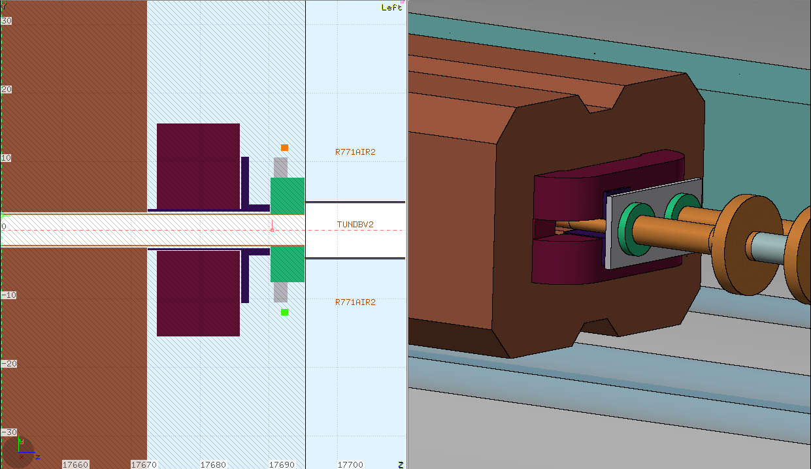
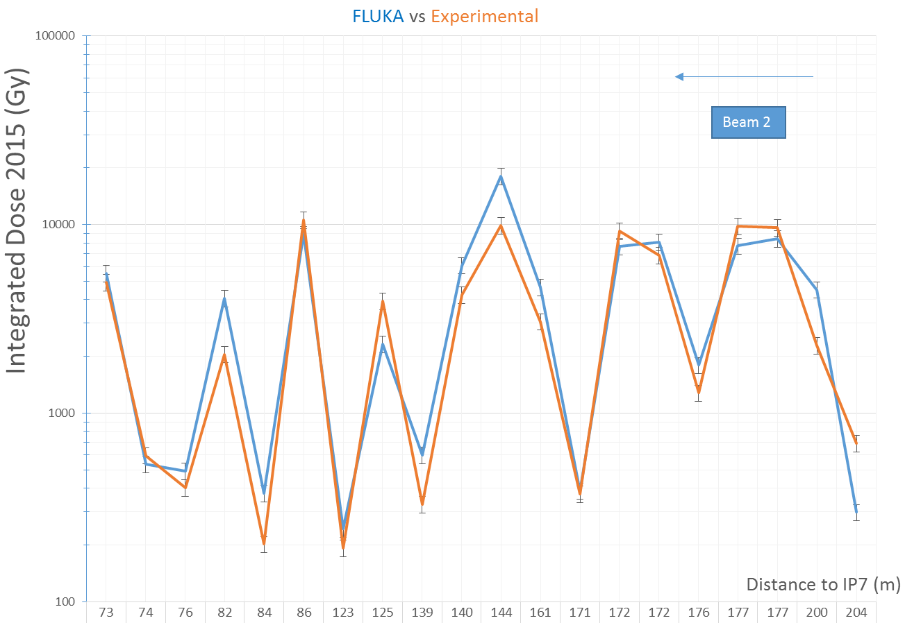
DOSIMETER VIEW ON 2015 (R7)
same normalization as before,
i.e. 6.22 10¹⁴ 6.5 TeV (B2) protons lost in IR7
N.B. this is not the peak dose absorbed by the magnet coils!

Slide 14
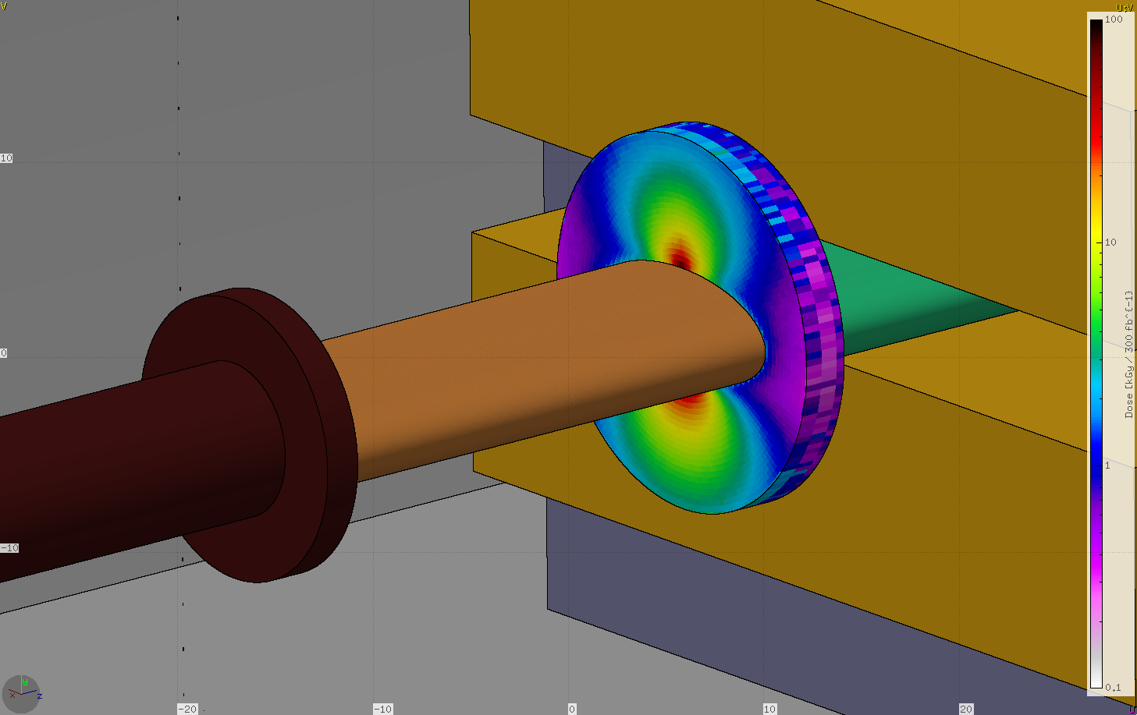
WARM D1
A. Tsinganis
at P1, 40-50 MGy after 300 fb⁻¹ (for 145 µrad half crossing angle)
better controlled source term (integrated lumi)
benchmark against future 2016 dosimeter data (2015 values not really usable)

Slide 15
Conclusions on Dose Monitoring and Forecast
The implemented activities allowed to closely monitor the dose received by the most exposed magnets in LHC tunnel;
Acquired data have been compared to RP Surveys, FLUKA maps and BLMs readings:
  BLM readings and Dosimeters Readings are consistent, more data will be needed to establish a correlation;
  FLUKA maps, once suitably scaled, fit pretty well the experimental readings, thus have been validated;
  New Dosimeters readings allowed for a more actual and precise evaluation of Beam Losses A-Symmetry with respect to old ratios obtained from RP Activation Surveys;
New forecasts for each magnet that will be updated each year basing on fresh dosimeters data!

Slide 16
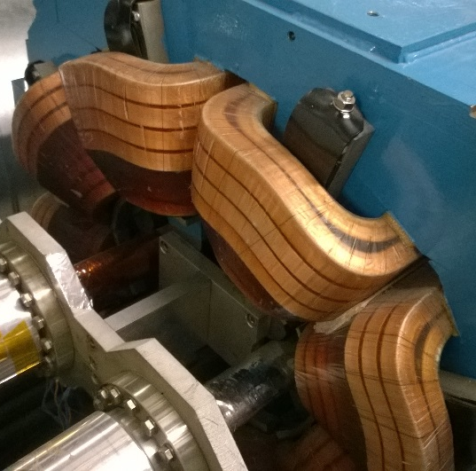
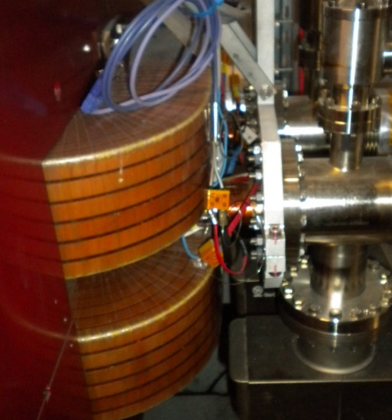
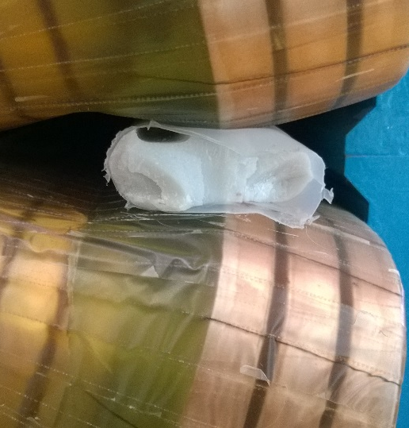
MQW and MBW Materials Radiation Resistance
MQW and MBW Coils both made with Epoxy Resins Blends with Type E Glass Fibres, MQW Spacers made with Epoxy reinforced with Silica
 | MQW Coils | MBW Coils | MQW Spacers
Resin used | EPN1138 42%+ GY 6004 42% + CY 221 16% + HY 905 100 %+ 30ml DY 073 | EPC-1: resin ED-16 100 Hardener MA 2.28 K Plasticizer MGF-9 20 TEa accelerant 0.5 | EPON 826 + RP 1500 Hardener
Dielectric resin | > 20 kV/mm | >15 kV/mm | -
Reinforcement | Type E Glass Fibre – 1 mm inter-turn | Type E Glass Fibre – 0.6 mm inter-turn | MIN-SIL 120 F silica particles
Picture
Possible Radiation Induced Failure Modes:
Coils: Loss of Insulation between Coils and Ground, or between Coils (Interlayer).
Spacers: Loss of mechanical strength.

Slide 17
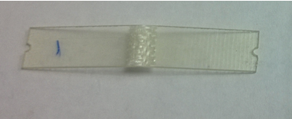
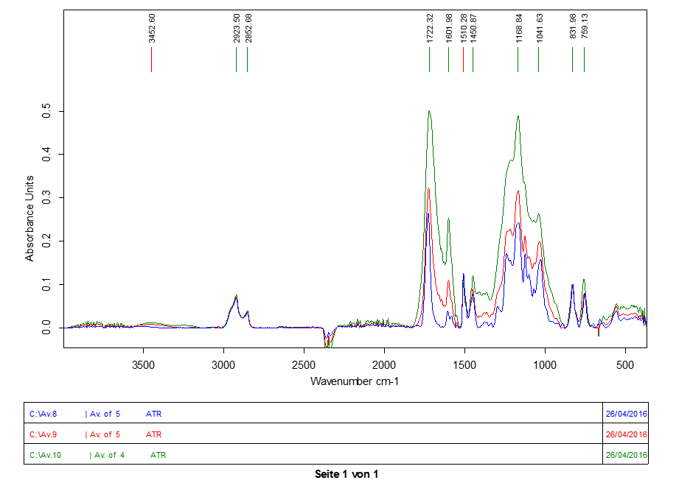
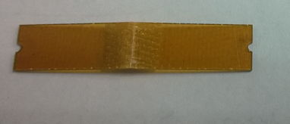
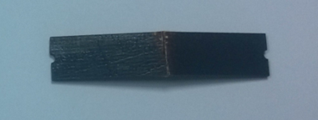
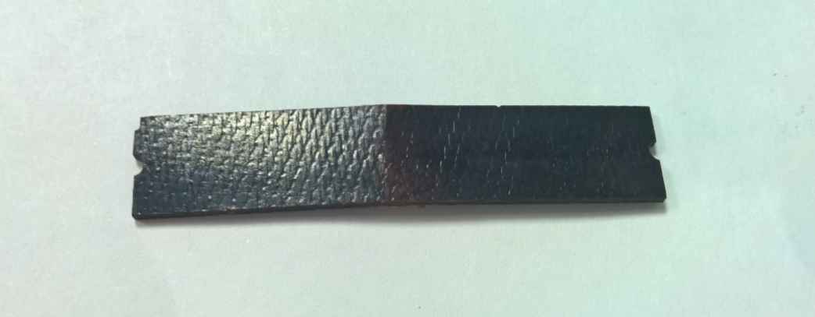
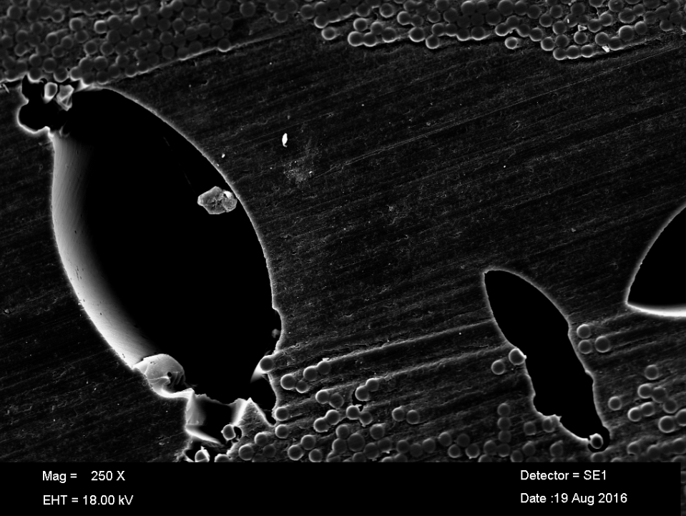
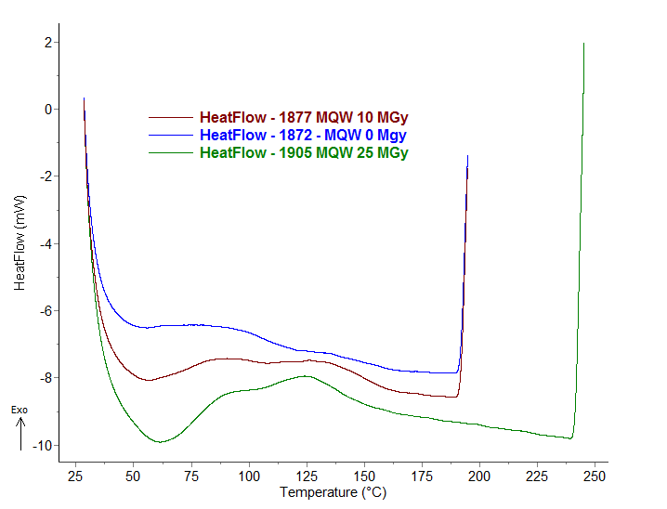
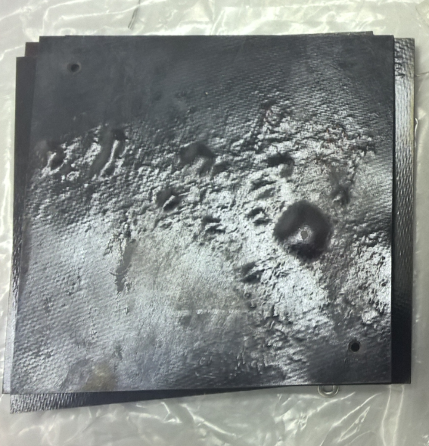
MQW Coils: Properties Evolution with Dose
25 MGy
0 MGy
0 MGy
10 MGy
25 MGy
Peaks increasing with dose
10 MGy
Normalization peak
Old limit for 10 MPa stress
25 MGy
75 MGy
50 MGy
No significant loss of mechanical properties after 50 MGy.
At 50 MGy first reduction of Electrical Properties,
Degradation prosecuting with extensive formation of bubbles at 75 MGy
Glass Fibres increase significantly mechanical limit with respect to pure resin data!
Previously estimated limits were largely conservative from the point of view of materials damage.
75 MGy

Slide 18
MQW mechanical resistance updated results

Slide 19
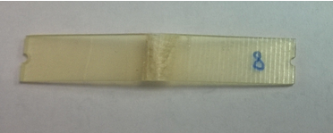
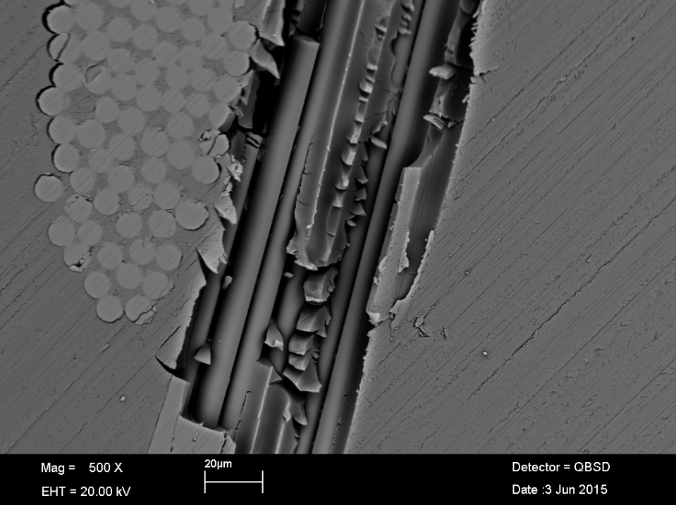
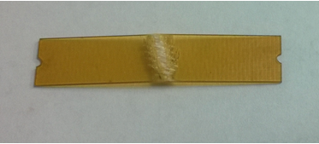
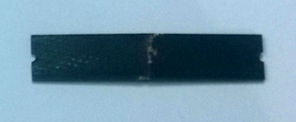
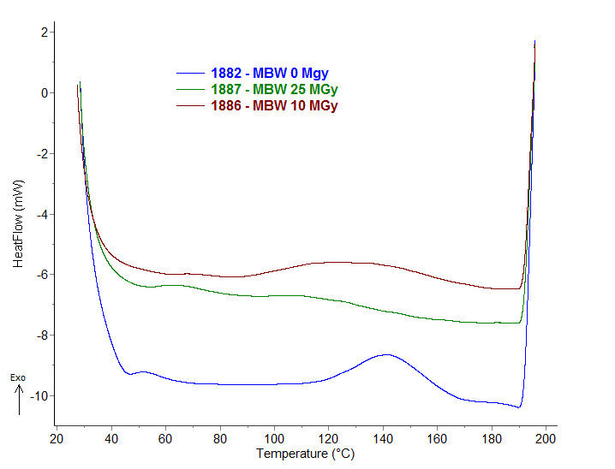
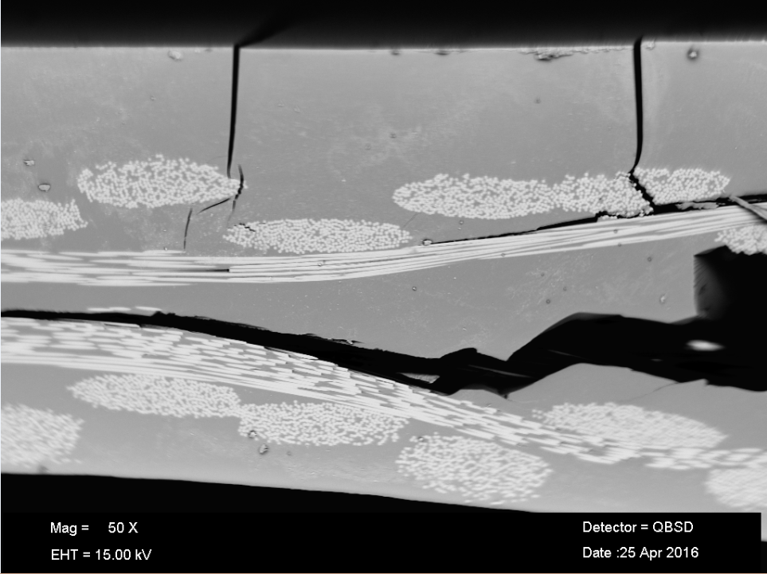
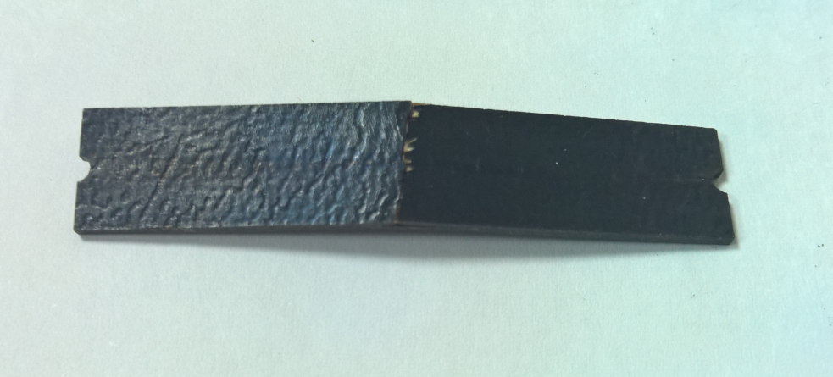
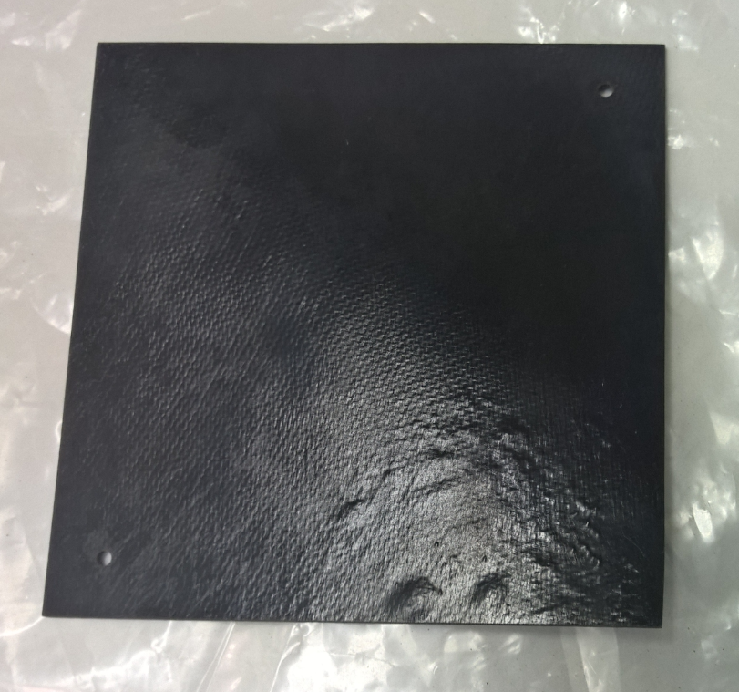
MBW Coils: Mechanical Properties
0 MGy
Peaks increasing with dose
0 MGy
0 MGy
10 MGy
25 MGy
Normalization peak
10 MGy
Old limit for 10 MPa stress
25 MGy
25 MGy
50 MGy
Initial increase of properties due to end of polymerisation, after the strength reduces but is still comparable to unirradiated material after 50 MGy.
At 75 MGy first reduction of electrical properties and observation of first bubbles
Glass Fibres effect is lower with respect to MQW due to lower Fibres amount.
Resin matrix suffers less from gas (and bubbles) formation with respect to MQW.
Electrical limit can be increased with respect to previous estimations.
75 MGy

Slide 20
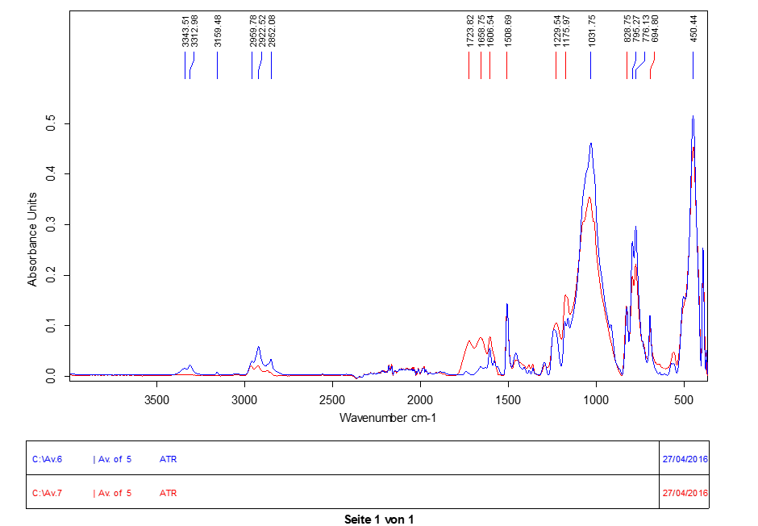
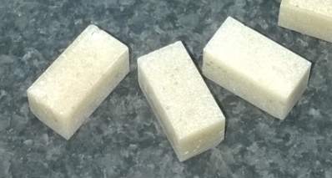
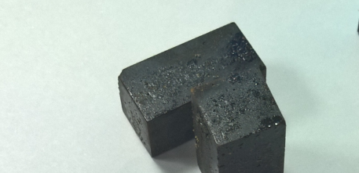
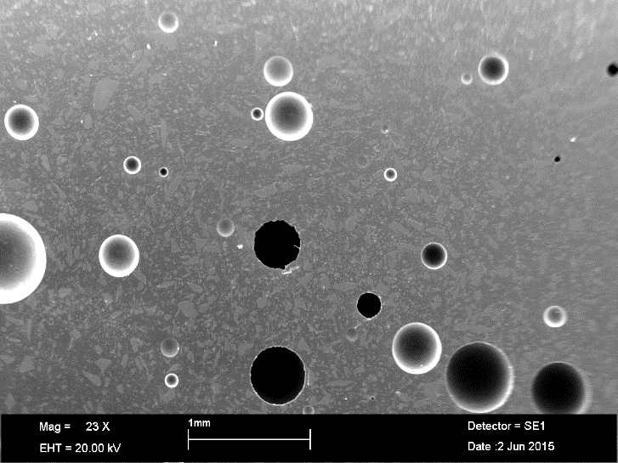
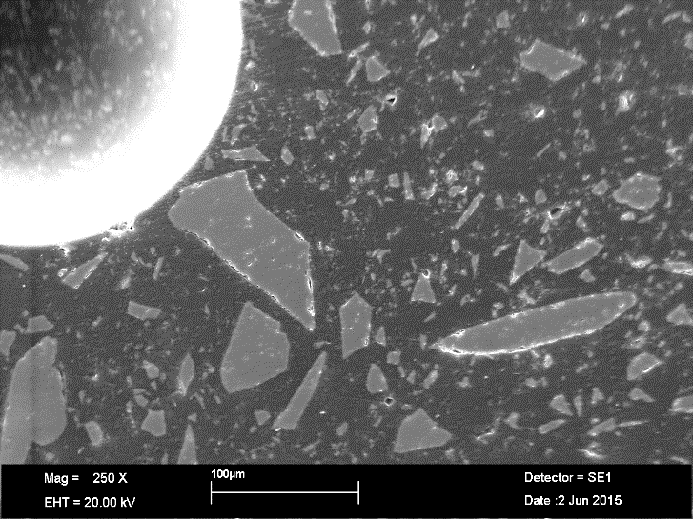
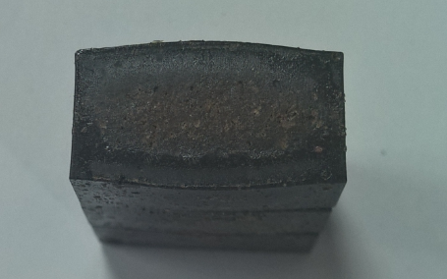
MQW Spacers: Mechanical Properties
0 MGy
Peaks increasing with dose
Normalization peak
5 MGy
Old limit for 10 MPa stress
0 MGy
10 MGy
Use of Compression samples to better match magnet’s loading conditions;
At 5 MGy colour variation but properties (and size/shape) unchanged;
At 10 MGy, significant samples expansion with important loss of properties, but material still capable to withstand required loads (estimated stress ~0.1 Mpa, used limit 10 Mpa, same as MQW Coils).
➔ Previously estimated limits for MQW Spacers material have been reduced to take into account the important gas formation starting at 10 MGy.
0 MGy

Slide 21
Conclusions on Materials Tests
  First results up to 75 MGY have been analysed showing slightly greater resistance with respect to expectations:
    Glass fibres effect (MQW have more Fibres than MBW) enhances MQW Coils Mechanical Properties, which remain good after 50 MGy;
    MBW Coils material was not 100% polymerised after curing, initial increase of mechanical properties after 10 MGy with sequential gradual degradation, at 50 MGy strength is still comparable to non irradiated samples;
    At 50 MGy (MQW) and 75 MGy (MBW) start of bubbles formation with detrimental effect on electrical properties, which remain however well above reference valueses.
    MQW Spacers matrix after 10 MGy is already heavily damaged.
  Update of Materials Limits with new definitions:
Material | Beginning of Damage (no bubbles, limited variation in properties) | Moderate Damage (bubbles formation and beginning of properties reduction) | Failure on Component (extensive bubbles, properties loss)
MQW Coils | 10-50 | 50-75 | >75
MBW Coils | 50-75 | 75-90 | >90
MQW Spacers | 5-10 | 10-15 | >15

Slide 22
Magnets Dose Forecast Update IR3
Updated values of foreseen peak dose for each involved magnet of IR3 after shielding.
NEW Materials Limits Applied: MQW: 10-50, 50-75, 75+ . MBW: 50-75, 75-90, 90+
IR3 | Dose [Mgy] for integrated luminosity 150 fb⁻¹ (LS2) |  | Dose [Mgy] for integrated luminosity 350 fb⁻¹ (LS3) |  | Dose [Mgy] for integrated luminosity 3000 fb⁻¹ (LS6) |  | Dose [Mgy] for integrated luminosity 4000 fb⁻¹ (End of HL-LHC) |  | OLD Forecast Dose [Mgy] for integrated luminosity 3000 fb⁻¹ – OLD LIMITS
 | R | L | R | L | R | L | R | L | R | L
MQWA.A4 | 0 | 0 | 0 | 0 | 3 | 3 | 3 | 3 | 1 | 3
MQWA.B4 | 0 | 0 | 0 | 0 | 3 | 3 | 4 | 4 | 1 | 3
MQWB.4 | 0 | 0 | 0 | 0 | 3 | 3 | 4 | 4 | 0 | 1
MQWA.C4 | 0 | 0 | 0 | 0 | 4 | 4 | 5 | 5 | 1 | 1
MQWA.D4 | 0 | 0 | 1 | 1 | 9 | 9 | 12 | 12 | 1 | 3
MQWA.E4 | 2 | 2 | 3 | 3 | 15 | 15 | 20 | 20 | 7 | 14
MQWA.A5 | 1 | 1 | 2 | 2 | 10 | 10 | 13 | 13 | 5 | 10
MQWA.B5 | 2 | 2 | 3 | 3 | 12 | 12 | 16 | 16 | 6 | 12
MQWB.5 | 4 | 4 | 6 | 6 | 29 | 29 | 38 | 38 | 14 | 29
MQWA.C5 | 10 | 10 | 14 | 14 | 68 | 68 | 88 | 88 | 34 | 68
MQWA.D5 | 2 | 2 | 3 | 3 | 16 | 16 | 21 | 21 | 7 | 15
MQWA.E5 | 5 | 5 | 6 | 6 | 30 | 30 | 39 | 39 | 14 | 27
MBW.A6 | 4 | 4 | 6 | 6 | 28 | 28 | 37 | 37 | 13 | 25
MBW.B6 | 3 | 3 | 4 | 4 | 20 | 20 | 26 | 26 | 9 | 18
MBW.C6 | 3 | 3 | 4 | 4 | 17 | 17 | 23 | 23 | 8 | 16
Exchanged in LS3
New updated doses and limits give a similar picture with respect to 2013 forecasts, however the Right magnets have now the same dose as Left magnets due to the new R/L ratios measured by dosimeters and the new materials limits increase safety.

Slide 23
Magnets Dose Forecast Update IR7
Updated values of foreseen peak dose for each involved magnet of IR7 after shielding.
NEW Materials Limits Applied: MQW: 10-50, 50-75, 75+ . MBW: 50-75, 75-90, 90+
IR7 | Dose [Mgy] for integrated luminosity 150 fb⁻¹ (LS2) |  | Dose [Mgy] for integrated luminosity 350 fb⁻¹ (LS3) |  | Dose [Mgy] for integrated luminosity 3000 fb⁻¹ (LS6) |  | Dose [Mgy] for integrated luminosity 4000 fb⁻¹ (End of HL-LHC) |  | OLD Forecast Dose [Mgy] for integrated luminosity 3000 fb⁻¹ – OLD LIMITS
 | R | L | R | L | R | L | R | L | R | L
MQWA.A4 | 0 | 0 | 1 | 1 | 9 | 7 | 13 | 10 | 5 | 7
MQWA.B4 | 1 | 1 | 1 | 1 | 14 | 11 | 19 | 14 | 4 | 11
MQWB.4 | 1 | 1 | 2 | 1 | 9 | 7 | 12 | 9 | 3 | 7
MQWA.C4 | 4 | 3 | 5 | 4 | 26 | 20 | 34 | 26 | 20 | 20
MQWA.D4 | 2 | 1 | 2 | 2 | 15 | 11 | 20 | 15 | 11 | 11
MQWA.E4 | 1 | 1 | 2 | 2 | 25 | 19 | 33 | 25 | 9 | 19
MQWA.A5 | 2 | 1 | 2 | 2 | 13 | 10 | 17 | 13 | 10 | 10
MQWA.B5 | 3 | 2 | 4 | 3 | 18 | 14 | 24 | 18 | 14 | 14
MQWB.5 | 3 | 2 | 4 | 3 | 18 | 14 | 24 | 18 | 14 | 14
MQWA.C5 | 3 | 2 | 4 | 3 | 18 | 14 | 23 | 18 | 6 | 14
MQWA.D5 | 3 | 2 | 5 | 4 | 31 | 24 | 41 | 31 | 17 | 24
MQWA.E5 | 3 | 2 | 6 | 5 | 59 | 45 | 78 | 60 | 135 | 45
MBW.A6 | 4 | 2 | 7 | 5 | 71 | 48 | 95 | 64 | 67 | 48
MBW.B6 | 4 | 3 | 9 | 6 | 89 | 60 | 119 | 80 | 120 | 60
Exchanged in LS3
Removed in LS2 + Cell Reconfiguration
Exchanged in LS3
Exchanged in LS3
MQW: new updated values are slightly higher than 2013 forecasts, due to the new Right/Left ratios measured by the dosimeters, but with an higher materials limits.
MBW: new forecasts are lower than previous estimations giving more margin.

Slide 24
MQW Spacers Dose Forecast in IR7
Values of foreseen peak dose for each involved MQW Spacer of IR7 after shielding.
NEW Materials Limits Applied: MQW: 5-10, 10-15, 15+ .
IR7 | Dose [Mgy] for integrated luminosity 150 fb⁻¹ (LS2) |  | Dose [Mgy] for integrated luminosity 350 fb⁻¹ (LS3) |  | Dose [Mgy] for integrated luminosity 3000 fb⁻¹ (LS6) |  | Dose [Mgy] for integrated luminosity 4000 fb⁻¹ (End of HL-LHC)
 | R | L | R | L | R | L | R | L
MQWA.A4 | 0 | 0 | 0 | 0 | 2 | 2 | 3 | 2
MQWA.B4 | 0 | 0 | 0 | 0 | 3 | 2 | 4 | 3
MQWB.4 | 0 | 0 | 0 | 0 | 2 | 1 | 2 | 2
MQWA.C4 | 1 | 1 | 1 | 1 | 5 | 4 | 7 | 5
MQWA.D4 | 0 | 0 | 1 | 0 | 3 | 2 | 4 | 3
MQWA.E4 | 1 | 1 | 3 | 2 | 28 | 21 | 37 | 28
MQWA.A5 | 1 | 0 | 1 | 1 | 4 | 3 | 5 | 4
MQWA.B5 | 1 | 1 | 1 | 1 | 6 | 5 | 8 | 6
MQWB.5 | 1 | 1 | 1 | 1 | 6 | 5 | 8 | 6
MQWA.C5 | 1 | 1 | 2 | 1 | 7 | 5 | 9 | 7
MQWA.D5 | 1 | 1 | 2 | 1 | 9 | 7 | 12 | 9
MQWA.E5 | 2 | 2 | 5 | 4 | 43 | 33 | 58 | 44
Exchanged in LS3
Removed in LS2 + Cell Reconfiguration
MQW Spacers are critical only on magnets that will anyway be removed because of coils damage, however, it might be necessary to extend the shields and increase protection on C5 and D5 magnets spacers during LS2.

Slide 25
Conclusions about Warm magnets Long Term Strategy
Very consistent comparison between BLM readings, Dosimeters and FLUKA maps of IR7 bring high confidence about dose forecast made using FLUKA/Sixtrack calculations with some conservative margins.
New materials limits verified experimentally allow for a more precise and reliable evaluation of interventions to be performed in IR3 and IR7 on Warm Magnets, in particular:
  For MQW we propose the following slight changes to original plan:
    Reduction of the number of spare magnets since we are less critical (from 4 spares to 2 spares)
    Exchange as planned 4 magnets, remove 2 magnets (substituted with absorber and re-cabling of the presently unused trim).
    On Spacers, new estimations could lead to the need to increase shielding protection on spacers on most exposed magnets during LS2;
    Production in collaboration with TRIUMF of 7 new MQW magnets (6 and 1 prototype) featuring Cyanate Esther blend coils.
  For MBW, as the dose on magnets is greatly reduced we propose to re-use the yokes of the exposed magnets once the coils are removed:
    production of 4 sets of coils in Cyanate Esther blend, to be installed on spare magnets available at CERN;
    The magnets with new coils will be installed instead of the most exposed magnets;
    The coils of removed magnets could be substituted with the present available spare coils in order to have 4 fresh spare magnets.

Slide 26
Next Steps
LHC:
Prosecution of radiation hardness characterization, final results at 90 MGy will follow;
Update of LHC Warm Magnets Long Term Strategy with new data and preparation of new ECR;
  Update of magnets exchange and protection planning.
Perform update of present forecasts with the new data available in End of the Year tech stop 2016 (having with much greater statistic, 25-30 fb⁻¹, at β* 40 cm) and modify the actions if required.
HL-LHC
Definition of new materials combinations for future MQW-MBW coils (i.e. Cyanate Esther + Mica + Fibres);
Study on possible new shields design to improve protection on MBWs and on MQW Spacers Materials to be implemented in LS2.

Slide 27
`
Thanks for your attention

Slide 28
Warm Magnets Protection Strategy
Dose estimations based on calculations & measurements available in 2013.
Materials damage evaluated using old literature data on similar resins and adapting them to the used system (fibers addition), details in Slide 43.
 | Dose [MGy] for integrated luminosity 150 fb^-1 |  | Dose [MGy] for integrated luminosity 350 fb^-1 |  | Dose [MGy] for integrated luminosity 3000 fb^-1
 | R | L | R | L | R | L
MQWA.A4 | 0 | 0 | 0 | 0 | 1 | 3
MQWA.B4 | 0 | 0 | 0 | 0 | 1 | 3
MQWB.4 | 0 | 0 | 0 | 0 | 1 | 3
MQWA.C4 | 0 | 0 | 0 | 0 | 2 | 4
MQWA.D4 | 0 | 0 | 1 | 1 | 5 | 9
MQWA.E4 | 1 | 2 | 3 | 5 | 23 | 45
MQWA.A5 | 1 | 1 | 2 | 3 | 14 | 29
MQWA.B5 | 1 | 2 | 2 | 4 | 18 | 36
MQWB.5 | 2 | 4 | 5 | 10 | 43 | 86
MQWA.C5 | 5 | 10 | 12 | 24 | 101 | 202
MQWA.D5 | 1 | 2 | 3 | 6 | 24 | 49
MQWA.E5 | 2 | 5 | 5 | 11 | 45 | 90
MBW.A6 | 2 | 4 | 5 | 10 | 42 | 85
MBW.B6 | 2 | 3 | 4 | 7 | 30 | 60
MBW.C6 | 1 | 3 | 3 | 6 | 26 | 52
 | Dose [MGy] for integrated luminosity 150 fb^-1 |  | Dose [MGy] for integrated luminosity 350 fb^-1 |  | Dose [MGy] for integrated luminosity 3000 fb^-1
 | R | L | R | L | R | L
MQWA.A4 | 0 | 0 | 1 | 1 | 5 | 7
MQWA.B4 | 0 | 1 | 1 | 1 | 4 | 11
MQWB.4 | 0 | 1 | 1 | 2 | 8 | 21
MQWA.C4 | 3 | 3 | 7 | 7 | 60 | 60
MQWA.D4 | 2 | 2 | 4 | 4 | 36 | 36
MQWA.E4 | 3 | 7 | 8 | 15 | 66 | 132
MQWA.A5 | 1 | 1 | 3 | 3 | 27 | 27
MQWA.B5 | 2 | 2 | 5 | 5 | 42 | 42
MQWB.5 | 2 | 2 | 5 | 5 | 42 | 42
MQWA.C5 | 1 | 2 | 2 | 6 | 19 | 48
MQWA.D5 | 2 | 3 | 5 | 8 | 46 | 66
MQWA.E5 | 20 | 7 | 46 | 15 | 396 | 132
MBW.A6 | 11 | 8 | 25 | 18 | 218 | 156
MBW.B6 | 18 | 9 | 42 | 21 | 360 | 180
IR3
IR7
Estimated Damage on pure resin
Estimated damage on reinforced resin
Estimated beginning of failure on reinforced resin
Magnet’s protection & exchange strategy of 2013 (ECRs LHC-MW-EC-0001 and LHC-MW-EC-0002) to guarantee smooth operations up to end of HL-LHC era!
Docs available in EDMS N. 1321044 and 1321045

Slide 29
Long Term Strategy with Protection Effect
Plan: protect most exposed MBWs and MQWs in LS1 and LS2, removal of worst magnets (MQWA.C5R3, C5L3, E5R7, C5L7) during LS2 with optics reconfiguration…
Dose and Damage forecasts After Shielding (magnets shielded are underlined):
 | Dose [MGy] for integrated luminosity 150 fb^-1 |  | Dose [MGy] for integrated luminosity 350 fb^-1 |  | Dose [MGy] for integrated luminosity 3000 fb^-1
 | R | L | R | L | R | L
MQWA.A4 | 0 | 0 | 0 | 0 | 1 | 3
MQWA.B4 | 0 | 0 | 0 | 0 | 1 | 3
MQWB.4 | 0 | 0 | 0 | 0 | 0 | 1
MQWA.C4 | 0 | 0 | 0 | 0 | 1 | 1
MQWA.D4 | 0 | 0 | 0 | 0 | 1 | 3
MQWA.E4 | 0 | 1 | 1 | 2 | 7 | 14
MQWA.A5 | 1 | 1 | 1 | 2 | 5 | 10
MQWA.B5 | 1 | 2 | 1 | 3 | 6 | 12
MQWB.5 | 2 | 4 | 3 | 6 | 14 | 29
MQWA.C5 | 5 | 10 | 7 | 14 | 34 | 68
MQWA.D5 | 0 | 1 | 1 | 2 | 7 | 15
MQWA.E5 | 1 | 1 | 2 | 3 | 14 | 27
MBW.A6 | 1 | 1 | 1 | 3 | 13 | 25
MBW.B6 | 0 | 1 | 1 | 2 | 9 | 18
MBW.C6 | 0 | 1 | 1 | 2 | 8 | 16
 | Dose [MGy] for integrated luminosity 150 fb^-1 |  | Dose [MGy] for integrated luminosity 350 fb^-1 |  | Dose [MGy] for integrated luminosity 3000 fb^-1
 | R | L | R | L | R | L
MQWA.A4 | 0 | 0 | 1 | 1 | 5 | 7
MQWA.B4 | 0 | 1 | 1 | 1 | 4 | 11
MQWB.4 | 0 | 1 | 1 | 1 | 3 | 7
MQWA.C4 | 3 | 3 | 4 | 4 | 20 | 20
MQWA.D4 | 1 | 1 | 2 | 2 | 11 | 11
MQWA.E4 | 0 | 1 | 1 | 2 | 9 | 19
MQWA.A5 | 1 | 1 | 2 | 2 | 10 | 10
MQWA.B5 | 2 | 2 | 3 | 3 | 14 | 14
MQWB.5 | 2 | 2 | 3 | 3 | 14 | 14
MQWA.C5 | 1 | 2 | 1 | 3 | 6 | 14
MQWA.D5 | 2 | 2 | 3 | 4 | 17 | 24
MQWA.E5 | 7 | 2 | 16 | 5 | 135 | 45
MBW.A6 | 3 | 2 | 8 | 6 | 67 | 48
MBW.B6 | 6 | 3 | 14 | 7 | 120 | 60
IR3
IR7
Exchanged in LS3
Exchanged in LS3
Removed in LS2
Exchanged in LS3
Exchanged in LS3
However, uncertainties in materials behaviour, dose expectations and machine parameters bring to the need to verify the magnets behaviour with respect to mechanical, thermal and radiative loads to update this picture with more reliable data.

Slide 30
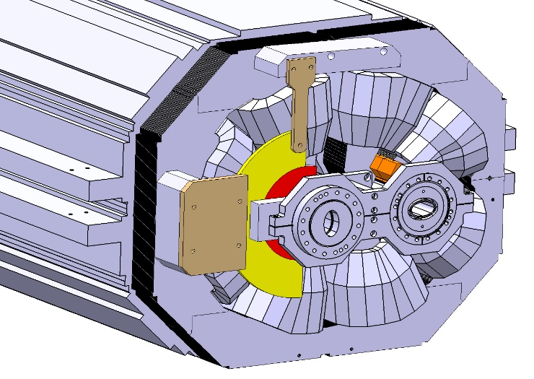
Overview of MQW Magnets Damage Evaluations tests
Prediction of eventual MQWs failures on two fronts:
Mechanical induced damage on MQWs:
MQW Life Test: Endurance fatigue test on spare MQW to simulate LHC powering cycles (@7 TeV) while acquiring key parameters to verify life span.
Simulation of entire HL-LHC magnets life with respect to purely mechanical loads
Verification of weaknesses on magnets design and application of needed counter measurements.
Heat induced damage on MQWs:
MQW and MBW magnets have been protected with WHA shields to reduce dose on coils,
The energy deposited on the shields has to be evacuated by the magnet’s cooling circuit
➔ Ad hoc Heat Test to simulate Beam Losses Energy Deposition inside tunnel environment and verify absence of hot spots and MQWs cooling capabilities.
WHA Shields for MQWs and FLUKA map of dose on MQWs front face

Slide 31
LHC Warm Magnets:
Radiation Induced Degradation
Radiation induced degradation will affect the Breakdown Voltage, until discharges might happen between coils and/or ground blocking LHC machine operations:
  ➔ Need to replace and dismantle the broken magnet, but…
  ➔ High activation of the magnet itself hampers the dismantling!
  Need to reliably verify lifetime and adopt preventive countermeasures (shielding, magnets replacements, development of rad hard coils, ecc…).
Dosimeters Installation in LHC to monitor doses on critical locations and have a verified forecast of dose on coils
  More than 100 dosimeters have been installed on MQWs, MBWs and BLMs in 2014, recording dose on coils during all 2015 activities.
Radiation resistance evaluation of materials (coils insulation and spacers) to find the maximum sustainable dose
  Test campaign launched in collaboration with Fraunhofer Institute (DE) to measure electrical and mechanical properties after irradiation up to 90 MGy.

Slide 32
Dosimeters Lists: IR3 Left Example
Id N. | Equipment | Side | Position | Beam | Related Equipment | Absorbed Dose 27/06/2012 (KGy)
IR3-1 | MQWA.A4L3 | Left | Flange side | B1
IR3-2 | MQWA.D4L3 | Left | Flange side | B1 |  | -
IR3-3 | MQWA.E4L3 | Left | Flange side | B1 |  | -
IR3-4 | BLMQI.F4L3 | NB | BLM center |  | On MQWA.E4L3 | -
IR3-5 | BLMEI.A4L3 | NB | BLM center |  | On TCSG.4L3.B2 | -
IR3-6 | MQWA.A5L3 | Left | Flange side | B1
IR3-7 | MQWB.5L3 | Left | Flange side | B1 |  | -
IR3-8 | MQWA.C5L3 | Left | Flange side | B1 |  | 2.7-6.6
IR3-9 | BLMEI.H5L3 | NB | BLM center |  | On TCSG.5L3.B1 | -
IR3-10 | MQWA.D5L3 | Left | Flange side | B1 |  | -
IR3-11 | BLMQI.E5L3 | NB | BLM center |  | On MQWA.E5L3 | -
IR3-12 | MQWA.E5L3 | Left | Flange side | B1 |  | 1.6/6.7
IR3-13 | MBW.A6L3 | Left | Over beamline | B1 |  | -
IR3-14 | MBW.B6L3 | Left | Over beamline | B1 |  | -
IR3-15 | MBW.C6L3 | Left | Over beamline | B1 |  | 15.7-18
IR3-16 | MBW.C6L3 | Left | Below beamline | B1 |  | 6.3-9.2
IR3-17 | BLMEI.C6L3 | NB | BLM top |  | On TCP.6L3.B1
IR3-18 | BLMEI.C6L3 | NB | BLM centre |  | On TCP.6L3.B1
IR3-19 | BLMEI.C6L3 | NB | BLM bottom |  | On TCP.6L3.B1
IR3-20 | BLMEI.B6L3 | NB | BLM centre |  | On TCHSH.6L3.B1 | -
IR3-21 | BLMEI.A6L3 | NB | BLM centre |  | On TCAPA.6L3.B1
Example of Dosimeter summary for IR3 Left stating position and related equipment of each dosimeter, including the absorbed dose measured during the campaign of 2012.
Related Docs: LHC-SI-ES-0001-0-6, EDMS N. 1470754.

Slide 33
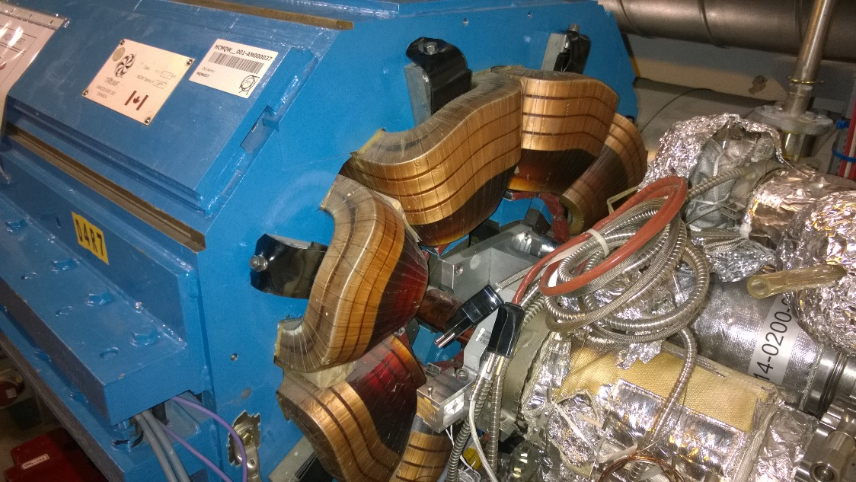
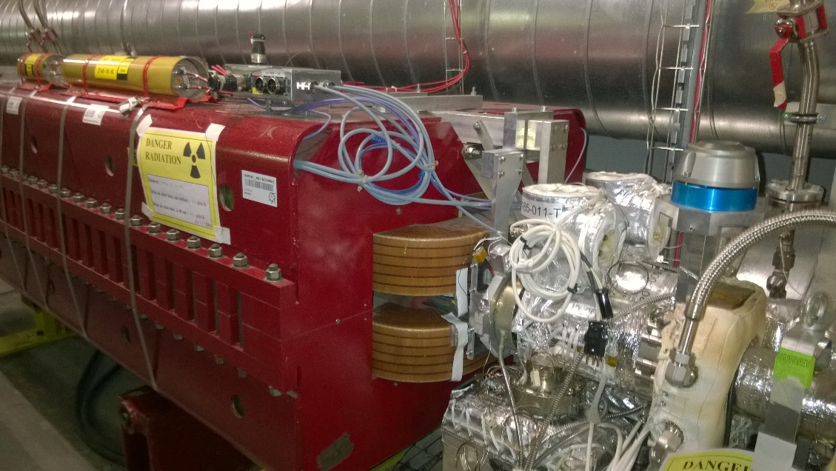
Objectives of Dosimeters Installation
  Main Goals:
  Monitor critical locations
  ➔ Forecast of radiation damage induced failures on warm magnets;
  Benchmark the present magnet lifetime estimation (FLUKA computations, operational assumptions, etc….);
  Have fix dosimeters holders for fast and reliable readings in future years,
  fair comparison among readings in different stages,
  If possible, establish a correlation between BLM signal and dose received by magnets.

Slide 34

Criteria for locations choice
Critical locations discussed with FLUKA and Collimation Team basing on FLUKA maps and RP surveys, here the general guidelines:
Keep monitored highly loaded magnets;
Instrument BLMs on magnets with medium-high dose to have the correspondence between BLM readings, dosimeter and magnet face;
Verify a-symmetry between beams;
Provide indication of radiation load gradient in space;
Verify dose evolution along magnets cells;
Avoid dosimeters saturation.
Reference: “Prompt radiation levels at critical locations”, E. Skordis On behalf of the FLUKA team, R2E and availability workshop 10/15/2014

Slide 35


Layout IR3 Left Cell 4 and 5
BLMQI.E4L3
1 RPL centre
IR3-4
BLMTI.A4L3 1 RPL centre
IR3-6
MQWA.E4L3
1 RPL Left B1
Flange side
IR3-3
MQWA.E4L3
1 RPL Right B2
Flange side
IR3-5
MQWA.D4L3
1 RPL Left B1
Flange side
IR3-2
MQWA.A4L3
1 RPL Left B1
Flange side
IR3-1
BLMQI.E5L3 1 RPL centre
IR3-12
BLMTI.A5L3 1 RPL centre
IR3-10
Beam1
MQWA.E5L3
1 RPL Left B1
Flange side
IR3-13
MQWA.D5L3
1 RPL Left B1
Flange side
IR3-11
MQWA.C5L3
1 RPL Left B1
Flange side
IR3-9
MQWB.5L3
1 RPL Left B1
Flange side
IR3-8
MQWA.A5L3
1 RPL Left B1
Flange side
IR3-7
Beam2

Slide 36




Dosimeters Supports
Dosimeter single support for BLMs, Inox 316LN thin frame cut and bended to accommodate a dosimeter capsule.
Attached to BLMs through a PEEK cable tie, capsules can be removed without detaching the support (bend the frame by hands).
Dosimeter single support for Magnets, AW6082 Al alloy holders.
Fixed to flanges with 1.5 Allen screw having removable caps for fast dosimeter exchange.
Clear labels on the support stating the Id of the dosimeter and of the related equipment
Id label on one side of the capsule, on the other the installation date.

Slide 37





Installation Pictures

Slide 38




Dose Gradients locations
Multiple RPL on BLMs to check distribution along BLM active surface:BLMTI.C6L3, BLMTI.06L7
3 RPL each, top, centre & bottom
Radial dose profile on highly loaded quadrupoles in IR3 and IR7: MQWA.E5R3 and MQWA.C4L7. 4 dosimeters in a row, placed radially at fixed distance from one beam line.

Slide 39
Magnets Dose Forecast Update
Previous magnets dose forecasts (LHC-MW-EC-0001 & 0002) were based on FLUKA calculations of 2013-2014 made By E. Skordis and F. Cerutti.
New Dosimeters data allows for validation of previous calculations, but a normalization is needed!
The comparison between FLUKA maps and BLM readings 2015 (C. Martinella, E. Skordis) allows to estimate the number of protons lost in IR7 (“Considerations on Warm Magnet Measured Dose”, F. Cerutti, ColUSM N.77):
Taking into account scaling factors we obtain 8 10¹⁵ proton equivalent losses per 50 fb⁻¹.
NOTE: it has been decided to keep conservatively in all future calculations the previous value of 1.15 10¹⁶ proton equivalent losses per 50 fb⁻¹, as by present LHC Design Parameters.
New estimation of proton losses allows for a meaningful normalization of FLUKA maps to LHC 2015 Run losses, thus allowing direct comparison with dosimeters readings.

Slide 40
Magnets Dose Forecast Update
Implementation of dosimeters locations in FLUKA model to obtain dose received by RPL Dosimeters on magnets and BLMs.
Normalization of FLUKA data with respect to new estimated number of protons equivalent losses to compare FLUKA calculated dose on dosimeters and dosimeters readings.
Dosimeters Implemented in FLUKA Model
Very good agreement FLUKA/Dosimeters once normalized with value obtained from BLM/FLUKA comparison (8 10¹⁵ proton equivalent losses):
➔ Maps are still valid and have been only corrected with updated factors!

Slide 41
Conclusions on Dose Monitoring and Forecast
The implemented activities allowed to closely monitor the dose received by the most exposed magnets in LHC tunnel;
Acquired data have been compared to RP Surveys, FLUKA maps and BLMs readings:
  BLM readings and Dosimeters Readings are consistent, more data will be needed to establish a correlation;
  FLUKA maps, once correctly scaled, fit very well the experimental readings, thus have been validated;
  New Dosimeters readings allowed for a more actual and precise evaluation of Beam Losses A-Symmetry with respect to old ratios obtained from RP Activation Surveys;
New forecasts for each magnet that will be updated each year basing on fresh dosimeters data!

Slide 42
BLM VIEW ON 2015 (R7)
mispositioning?
relevant contribution
from B1 to be added
simulated 6.5 TeV protons
hor losses only

Slide 43
2015 LOSSES
the simulated BLM pattern in the previous plot was normalized to
6.22 10¹⁴ 6.5 TeV (B2) protons lost in IR7
B2 BCT indication for 5.5 10¹⁴ 6.5 TeV lost protons [B. Salvachua]
95–80% in P7 (from BLM ratio @ TCP(C), dosimeter ratios, loss map matrix)
this would imply a 20–40% effective increase mimicking the contribution of ion/injection/ramp/… losses
and 8–9 10¹⁵ proton equivalent losses per 50 fb⁻¹

Slide 44
DOSIMETER VIEW ON 2015 (R7)
same normalization as before
N.B. this is not the peak dose absorbed by the magnet coils!

Slide 45
WARM D1
A. Tsinganis
at P1, 40-50 MGy after 300 fb⁻¹
better controlled source term (integrated lumi)
benchmark against future 2016 dosimeter data (2015 values not really usable)

Slide 46
Complete Lists of Dosimeters

Slide 47
IR1 & IR5
Id N. | General Location | Equipment | Side | Position | Absorbed Dose 27/06/2012 (KGy)
IR1-1 | IP1 Left | MBXW.A4L1 | Right | Over beamline | 171.8
IR1-2 | IP1 Left | MBXW.A4L1 | Right | Below beamline | 26.5
IR1-3 | IP1 Left | MBXW.A4L1 | Right | Left beamline | 4.9
IR1-4 | IP1 Left | MBXW.A4L1 | Right | Right beamline | 3.9
IR1-5 | IP1 Left | MBXW.A4L1 | Left | Over beamline | -
IR1-6 | IP1 Left | MBXW.B4L1 | Right | Over beamline | -
IR1-7 | IP1 Left | MBXW.F4L1 | Right | Over beamline | -
IR1-8 | IP1 Right | MBXW.A4R1 | Left | Over beamline | 289.7
IR1-9 | IP1 Right | MBXW.A4R1 | Left | Below beamline | -
IR1-10 | IP1 Right | MBXW.A4R1 | Right | Below beamline | -
IR1-11 | IP1 Right | MBXW.A4R1 | Left | Right beamline | -
IR1-12 | IP1 Right | MBXW.A4R1 | Right | Over beamline | -
IR1-13 | IP1 Right | MBXW.B4R1 | Left | Over beamline | -
IR1-14 | IP1 Right | MBXW.F4R1 | Left | Over beamline | -
Id N. | General Location | Equipment | Side | Position | Absorbed Dose 27/06/2012 (KGy)
IR5-1 | IP5 Left | MBXW.A4L5 | Right | Over beamline (10 cm) | -
IR5-2 | IP5 Left | MBXW.A4L5 | Right | Below beamline (10 cm) | -
IR5-3 | IP5 Left | MBXW.B4L5 | Right | Over beamline (10 cm) | -
IR5-4 | IP5 Left | MBXW.F4L5 | Right | Over beamline (10 cm) | -
IR5-5 | IP5 Right | MBXW.A4R5 | Left | Over beamline (10 cm) | -
IR5-6 | IP5 Right | MBXW.A4R5 | Left | Below beamline (10 cm) | -
IR5-7 | IP5 Right | MBXW.B4R5 | Left | Over beamline (10 cm) | -
IR5-8 | IP5 Right | MBXW.F4R5 | Left | Over beamline (10 cm) | -

Slide 48
IR3 Left
Id N. | Equipment | Side | Position | Beam line | Related Equipment | Absorbed Dose 27/06/2012 (KGy)
IR3-1 | MQWA.A4L3 | Left | Flange side | B1
IR3-2 | MQWA.D4L3 | Left | Flange side | B1 |  | -
IR3-3 | MQWA.E4L3 | Left | Flange side | B1 |  | -
IR3-4 | BLMQI.F4L3 | NB | BLM center |  | On MQWA.E4L3 | -
IR3-5 | BLMEI.A4L3 | NB | BLM center |  | On TCSG.4L3.B2 | -
IR3-6 | MQWA.A5L3 | Left | Flange side | B1
IR3-7 | MQWB.5L3 | Left | Flange side | B1 |  | -
IR3-8 | MQWA.C5L3 | Left | Flange side | B1 |  | 2.7-6.6
IR3-9 | BLMEI.H5L3 | NB | BLM center |  | On TCSG.5L3.B1 | -
IR3-10 | MQWA.D5L3 | Left | Flange side | B1 |  | -
IR3-11 | BLMQI.E5L3 | NB | BLM center |  | On MQWA.E5L3 | -
IR3-12 | MQWA.E5L3 | Left | Flange side | B1 |  | 1.6/6.7
IR3-13 | MBW.A6L3 | Left | Over beamline | B1 |  | -
IR3-14 | MBW.B6L3 | Left | Over beamline | B1 |  | -
IR3-15 | MBW.C6L3 | Left | Over beamline | B1 |  | 15.7-18
IR3-16 | MBW.C6L3 | Left | Below beamline | B1 |  | 6.3-9.2
IR3-17 | BLMEI.C6L3 | NB | BLM top |  | On TCP.6L3.B1
IR3-18 | BLMEI.C6L3 | NB | BLM centre |  | On TCP.6L3.B1
IR3-19 | BLMEI.C6L3 | NB | BLM bottom |  | On TCP.6L3.B1
IR3-20 | BLMEI.B6L3 | NB | BLM centre |  | On TCHSH.6L3.B1 | -
IR3-21 | BLMEI.A6L3 | NB | BLM centre |  | On TCAPA.6L3.B1

Slide 49
IR3 Right
Id N. | Equipment | Side | Position | Beam line | Related Equipment | Absorbed Dose 27/06/2012 (KGy)
IR3-22 | MQWA.A4R3 | Right | Flange side | B2
IR3-23 | MQWA.D4R3 | Right | Flange side | B2 |  | -
IR3-24 | MQWA.E4R3 | Right | Flange side | B2 |  | -
IR3-25 | BLMQI.E4R3 | NB | BLM center |  | On MQWA.E4R3 | -
IR3-26 | BLMEI.A4R3 | NB | BLM center |  | On TCSG.4R3.B1 | -
IR3-27 | MQWA.A5R3 | Right | Flange side | B2
IR3-28 | MQWB.5R3 | Right | Flange side | B2 |  | -
IR3-29 | MQWA.C5R3 | Right | Flange side | B2 |  | 1.6-2.4
IR3-30 | BLMEI.H5R3 | NB | BLM center |  | On TCSG.5R3.B2
IR3-31 | BLMQI.F5R3 | NB | BLM center |  | On MQWA.E5R3 | -
IR3-32 | MQWA.E5R3 | Right | Radial 10 cm | B2 |  | 1.3-2.3
IR3-33 | MQWA.E5R3 | Right | Radial 15 cm | B2 |  | -
IR3-34 | MQWA.E5R3 | Right | Radial 20 cm | B2 |  | 1.3-2.3
IR3-35 | MQWA.E5R3 | Right | Radial 25 cm | B2 |  | -
IR3-36 | MQWA.D5R3 | Right | Flange side | B2 |  | 1.3-2.3
IR3-37 | MBW.A6R3 | Right | Over beamline (10 cm) | B2 |  | -
IR3-38 | MBW.B6R3 | Right | Over beamline (10 cm) | B2
IR3-39 | MBW.C6R3 | Right | Over beamline (10 cm) | B2 |  | 2.3-5.5
IR3-40 | MBW.C6R3 | Right | Below beamline (10 cm) | B2 |  | 4.4
IR3-41 | BLMEI.A6R3 | NB | BLM Center |  | On TCAPA.6R3.B2 | -
IR3-42 | BLMEI.C6R3 | NB | BLM Top |  | On TCP.6R3.B1
IR3-43 | BLMEI.C6R3 | NB | BLM Centre |  | On TCP.6R3.B1
IR3-44 | BLMEI.C6R3 | NB | BLM Bottom |  | On TCP.6R3.B1
IR3-45 | BLMEI.B6R3 | NB | BLM Center |  | On TCHSH.6R3.B2 | -

Slide 50
IR7 Left
Id N. | Equipment | Side | Position | Beam Line | Related Equipment | Absorbed Dose 27/06/2012 (KGy)
IR7-1 | MQWA.C4L7 | Left | Radial 10 cm from beamline | B1 |  | -
IR7-2 | MQWA.C4L7 | Left | Radial 14 cm from beamline | B1 |  | -
IR7-3 | MQWA.C4L7 | Left | Radial 18 cm from beamline | B1 |  | -
IR7-4 | MQWA.C4L7 | Left | Radial 22 cm from beamline | B1 |  | -
IR7-5 | MQWA.E4L7 | Right | Flange side | B1
IR7-6 | MQWA.E4L7 | Left | Flange side | B1
IR7-7 | BLMEI.R4L7 | NB | Centre |  | MQWA.E4L7 | -
IR7-8 | BLMEI.P4L7 | NB | Centre |  | TCSG.D4L7.B1 | -
IR7-9 | BLMEI.O4L7 | NB | Centre |  | (TCSM.D4L7.B1)
IR7-10 | MCBWH.5L7 | Right | Flange side | B2 |  | -
IR7-11 | MQWA.A5L7 | Left | Flange side | B1
IR7-12 | MQWA.D5L7 | Left | Flange side | B1 |  | -
IR7-13 | MQWA.E5L7 | Left | Flange side | B1 |  | 25.7-59.6
IR7-14 | BLMQI.A5L7 | NB | Centre |  | MQWA.A5L7 | -
IR7-15 | BLMQI.E5L7 | NB | Centre |  | MQWA.D5L7
IR7-16 | MBW.A6L7 | Left | Over beamline (10 cm) | B1 |  | -
IR7-17 | MBW.A6L7 | Left | Below beamline (10 cm) | B1 |  | -
IR7-18 | BLMEI.H6L7 | NB | centre |  | MBW.A6L7 | -
IR7-19 | MBW.B6L7 | Left | Over beamline (10 cm) | B1 |  | -
IR7-20 | MBW.B6L7 | Left | Below beamline (10 cm) | B1
IR7-21 | BLMEI.I6L7 | NB | Centre |  | MBW.B6L7
IR7-22 | BLMEI.E6L7 | NB | Centre |  | TCSG.A6L7.B2 | -
IR7-23 | BLMEI.Q6L7 | NB | Top |  | TCP.D6L7.B1
IR7-24 | BLMEI.Q6L7 | NB | Centre |  | TCP.D6L7.B1
IR7-25 | BLMEI.Q6L7 | NB | Bottom |  | TCP.D6L7.B1
IR7-45 | BLMEI.O6L7 | NB | Centre |  | TCP.B6L7.B1

Slide 51
IR7 Right
Id N. | Equipment | Side |  | Position | Beam Line | Related Equipment | Absorbed Dose 27/06/2012 (KGy)
IR7-26 | MQWA.C4R7 |  | Right | Flange side | B2 |  | -
IR7-27 | MQWA.D4R7 |  | Right | Flange side | B2
IR7-28 | MQWA.E4R7 |  | Right | Flange side | B2 |  | -
IR7-29 | BLMQI.F4R7 |  | NB | Centre |  | MQWA.E4R7 | -
IR7-30 | BLMEI.L4R7 |  | NB | Centre |  | TCSG.D4R7.B2
IR7-31 | BLMEI.K4R7 |  | NB | Centre |  | (TCSM.D4R7.B2)
IR7-32 | MQWA.A5R7 |  | Right | Flange side | B2
IR7-33 | MQWA.D5R7 |  | Right | Flange side | B2
IR7-34 | MQWA.E5R7 |  | Right | Flange side | B2 |  | 19.1-43.7
IR7-35 | BLMQI.A5R7 |  | NB | Centre |  | MQWA.A5R7
IR7-36 | BLMQI.E5R7 |  | NB | Centre |  | MQWA.D5R7
IR7-37 | BLMEI.H6R7 |  | NB | Centre | B2 | MBW.A6R7
IR7-38 | MBW.A6R7 |  | Right | Over beamline (10 cm) | B2
IR7-39 | MBW.A6R7 |  | Right | Below beamline (10 cm) | B2
IR7-40 | BLMEI.I6R7 |  | NB | Centre |  | MBW.B6R7
IR7-41 | MBW.B6R7 |  | Right | Over beamline (10 cm) | B2 |  | 487.3
IR7-42 | MBW.B6R7 |  | Right | Below beamline (10 cm) | B2 |  | 329.4
IR7-43 | BLMEI.E6R7 |  | NB | Centre |  | TCSG.A6R7.B2
IR7-44 | BLMEI.Q6R7 |  | NB | Centre |  | TCP.D6R7.B2
IR7-46 | BLMEI.O6R7 |  | NB | Centre |  | TCP.B6R7.B2

Slide 52

Detailed Dosimeters Positions

Slide 53

IR1 Left Cell 4
WEEK 48-49
MBXW.F4L1
1 RPL Right
Over beamline
IR1-7
MBXW.B4L1
1 RPL Right
Over beamline
IR1-6
MBXW.A4L1
1 RPL Left
Over beamline
IR1-5
MBXW.A4L1
4 RPL Right
Over, Top, Left Right beamline
IR1-1, IR1-2, IR1-3, IR1-4

Slide 54

IR1 Right Cell 4
WEEK 48-49
MBXW.A4R1
4 RPL Left
Over Top Left Right beamline
IR1-8, IR1-9, IR1-10, IR1-11
MBXW.A4R1
1 RPL Right
Over beamline
IR1-12
MBXW.B4L1
1 RPL Left
Over beamline
IR1-13
MBXW.F4L1
1 RPL Left
Over beamline
IR1-14

Slide 55
IR3 Left Cell 4 and 5
BLMQI.E4L3
1 RPL centre
IR3-4
BLMTI.A4L3 1 RPL centre
IR3-6
MQWA.E4L3
1 RPL Left B1
Flange side
IR3-3
MQWA.E4L3
1 RPL Right B2
Flange side
IR3-5
MQWA.D4L3
1 RPL Left B1
Flange side
IR3-2
Beam1
MQWA.A4L3
1 RPL Left B1
Flange side
IR3-1
Beam2
BLMQI.E5L3 1 RPL centre
IR3-12
BLMTI.A5L3 1 RPL centre
IR3-10
MQWA.E5L3
1 RPL Left B1
Flange side
IR3-13
MQWA.D5L3
1 RPL Left B1
Flange side
IR3-11
MQWA.C5L3
1 RPL Left B1
Flange side
IR3-9
MQWB.5L3
1 RPL Left B1
Flange side
IR3-8
MQWA.A5L3
1 RPL Left B1
Flange side
IR3-7

Slide 56
IR3 Left Cell 5
Beam1
Beam2
WEEK 46
BLMQI.E5L3 1 RPL centre
IR3-12
BLMTI.A5L3 1 RPL centre
IR3-10
MQWA.E5L3
1 RPL Left B1
Flange side
IR3-13
MQWA.D5L3
1 RPL Left B1
Flange side
IR3-11
MQWA.C5L3
1 RPL Left B1
Flange side
IR3-9
MQWB.5L3
1 RPL Left B1
Flange side
IR3-8
MQWA.A5L3
1 RPL Left B1
Flange side
IR3-7

Slide 57

IR3 Left Cell 6
Beam1
Beam2
WEEK 46
BLMTI.B6L3 3 RPL top, centre & bottom
IR3-18, IR3-19, IR3-20
BLMTI.A6L3 1 RPL centre
IR3-22
BLMEI.B6L3 1 RPL centre
IR3-21
MBW.C6L3
2 RPL Left B1
Over/below beamline
IR3-16
IR3-17
MBW.B6L3
1 RPL Left B1
Over beamline
IR3-15
MBW.A6L3
1 RPL Left B1
Over beamline
IR3-14

Slide 58

IR3 Right Cell 4
Beam1
Beam2
BLMTI.A4R3 1 RPL centre
IR3-28
BLMQI.E4R3
1 RPL centre
IR3-27
MQWA.A4R3
1 RPL Right B2
IR3-23
MQWA.D4R3
1 RPL Right B2
IR3-24
MQWA.E4R3
1 RPL Left B1
IR3-26
MQWA.E4R3
1 RPL Right B2
IR3-25

Slide 59

IR3 Right Cell 5
Beam1
Beam2
WEEK 46
BLMTI.E5R3 1 RPL centre
IR3-32
BLMQI.F5R3 1 RPL centre
IR3-33
MQWA.A5R3
1 RPL Right B2
Flange side
IR3-30
MQWB.5R3
1 Right B2
Flange side
IR3-29
MQWA.C5R3
1 RPL Right B2
Flange side
IR3-31
MQWA.D5R3
1 RPL Right B2
Flange side
IR3-38
MQWA.E5R3
4 RPL Right B2
Radially from flange
IR3-34, IR3-35, IR3-36, IR3-37

Slide 60

IR3 Right Cell 6
Beam1
Beam2
WEEK 46
BLMEI.B6R3
1 RPL centre
IR3-47
BLMTI.B6R3 3 RPL Top, Centre, Bottom
IR3-44, IR3-45, IR3-46
BLMTI.A6R3 1 RPL centre
IR3-43
MBW.A6R3
1 RPL Right B2
Over Beamline
IR3-39
MQWA.B6R3
1 RPL Right B2
Over Beamline
IR3-40
MBW.C6R3
2 RPL Right B2
Over/below Beamline
IR3-41, IR3-42

Slide 61

IR5 Left Cell 4
WEEK 46
MBXW.F4L5
1 RPL Right
Over beamline
IR5-4
MBXW.B4L5
1 RPL Right
Over beamline IR5-3
MBXW.A4L5
2 RPL Right
Over/Below beamline
IR5-1, IR5-2

Slide 62

IR5 Right Cell 4
MBXW.A4R5
2 RPL Left
Over/below beamline
IR5-5, IR5-6
MBXW.B4R5
1 RPL Left
Over beamline
IR5-7
MBXW.F4R5
1 RPL Left
Over beamline
IR5-8

Slide 63

IR7 Left Cell 4
Beam1
Beam2
BLMTI.04L7 1 RPL centre
IR7-8
BLMEI.04L7 1 RPL centre
IR7-9
BLMEI.R4L7 1 RPL centre
IR7-7
MQWA.E4L7
1 RPL Left B1 Flange side
IR7-6
MQWA.E4L7
1 RPL Right B1 Flange side
IR7-5
MQWA.C4L7
4 RPL Left B1
Radially from flange
IR7-1, IR7-2, IR7-3, IR7-4

Slide 64

IR7 Left Cell 5
Beam1
Beam2
BLMQI.05L7 1 RPL centre
IR7-15
BLMQI.A5L7 1 RPL centre
IR7-14
MQWA.E5L7
1 RPL Left B1
Flange side
IR7-13
MQWA.E5L7
1 RPL Right B1
Flange side
IR7-12
MQWA.A5L7
1 RPL Left B1
Flange side
IR7-11
MCBWH.5L7
1 RPL Right B2
Flange side
IR7-10

Slide 65

IR7 Left Cell 6
Beam1
Beam2
W2 2015
BLMTI.C6L7 3 RPL Top, Centre, Bottom
IR7-23, IR7-24, IR7-25
BLMTI.E6L7
1 RPL centre
IR7-45
BLMEI.I6L7
1 RPL centre
IR7-21
BLMEI.H6L7 1 RPL centre
IR7-18
BLMTI.G6L7
1 RPL centre
IR7-22
MBW.B6L7
2 RPL Left B1
Over/below beamline
IR7-19, IR7-20
MBW.A6L7
2 RPL Left B1
Over/below beamline
IR7-16, IR7-17

Slide 66

IR7 Right Cell 4
Beam1
Beam2
BLMTI.04R7 1 RPL centre
IR7-31
BLMEI.0 4R7
1 RPL centre
IR7-30
BLMQI.F4R7 1 RPL centre
IR7-29
MQWA.C4R7
1 RPL Right B2
Flange side
IR7-26
MQWA.D4R7
1 RPL Right B2
Flange side
IR7-27
MQWA.E4R7
1 RPL Right B2
Flange side
IR7-28

Slide 67

IR7 Right Cell 5
Beam1
Beam2
BLMQI.A5R7 1 RPL centre
IR7-35
BLMQI.E5R7 1 RPL centre
IR7-36
MQWA.A5R7 1 RPL Right B2
Flange side
IR7-32
MQWA.D5R7 1 RPL Right B2
Flange side
IR7-33
MQWA.E5R7 1 RPL Right B2
Flange side
IR7-34

Slide 68


IR7 Right Cell 6
Beam1
Beam2
BLMTI.06R7
1 RPL centre
IR7-43
BLMEI.H6R7
1 RPL centre
IR7-37
BLMEI.I6R7
1 RPL centre
IR7-40
BLMTI.E6R7
1 RPL centre
IR7-46
BLMTI.G6R7
1 RPL centre
IR7-44
MBW.A6R7
2 RPL Right B2
Over/below
IR7-38, IR7-39
MBW.B6R7
2 RPL Right B2
Over/below
IR7-41, IR7-42

Slide 69


Magnets Dosimeters Id Cards
A4 papers attached to the magnets stating the Id, Number and Locations of each dosimeter installed on the magnet itself.
Example of MQWA.E4L7: one dosimeter installed on Beam 1 on the Left side of the magnet, one on Beam 1 on the Right side, and one to the BLMEI.R4L7 attached to the magnet
Names and telephones of contact persons are listed here: in case of any doubt, intervention or whatever call before to remove the supports!

