Slide 1
Travel Request form
https://edh.cern.ch/Document/Claims/TravelRequest

Slide 2
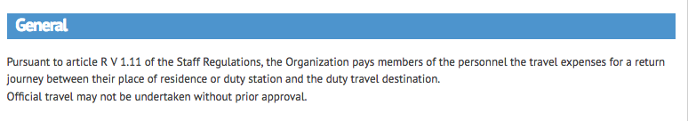
The new EDH official travel request form is a CERN wide document and used by all the departments.

Slide 3
Paper form

Slide 4
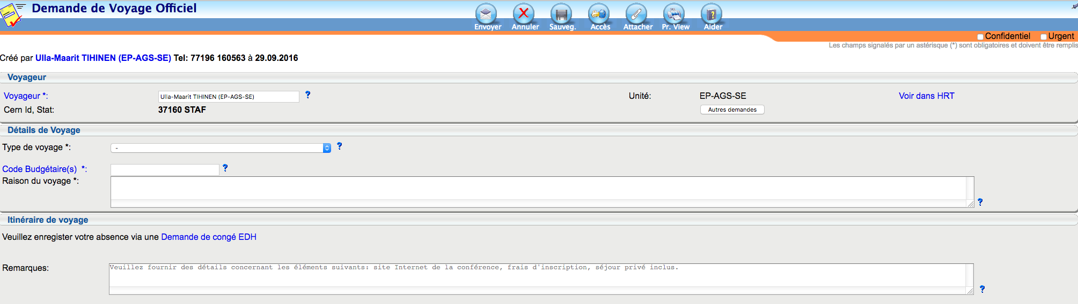
The new EDH form
Official travel leave request on EDH
Select the type of travel
The very important box: put ALL the information about the trip:
website, if private parts, if conference fees to be paid by secretariat or you pay them,
If you need a rental car, etc etc…. => everything !
Budget code : 33500
The name of the conference, meeting,
workshop… and dates

Slide 5
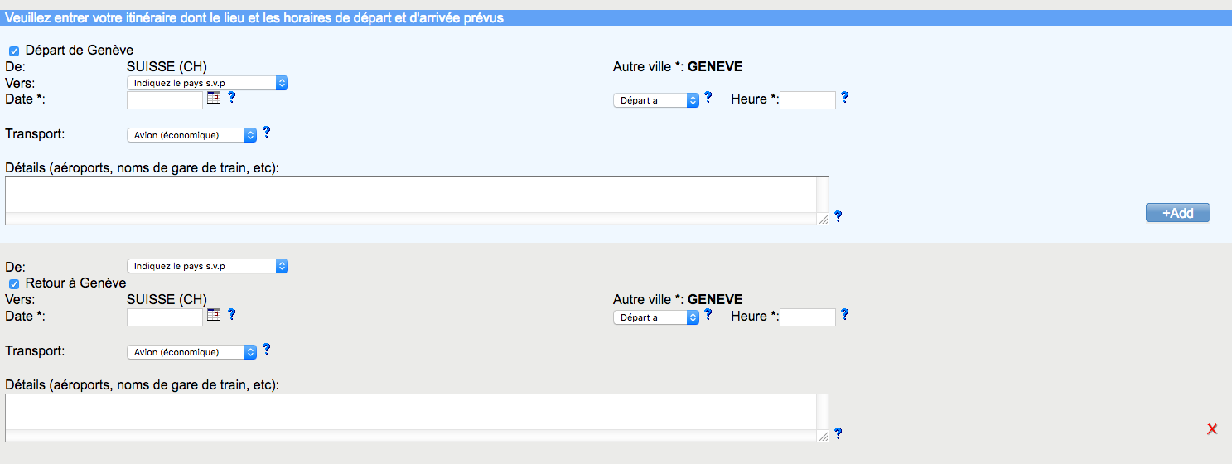
The new EDH form
Indicate the destination, departure date and time and eventual other information concerning the travel details
NOTE: if you select PRIVATE CAR,
the insurance box will open automatically
REMINDER: reimbursement train 2nd class ticket

Slide 6
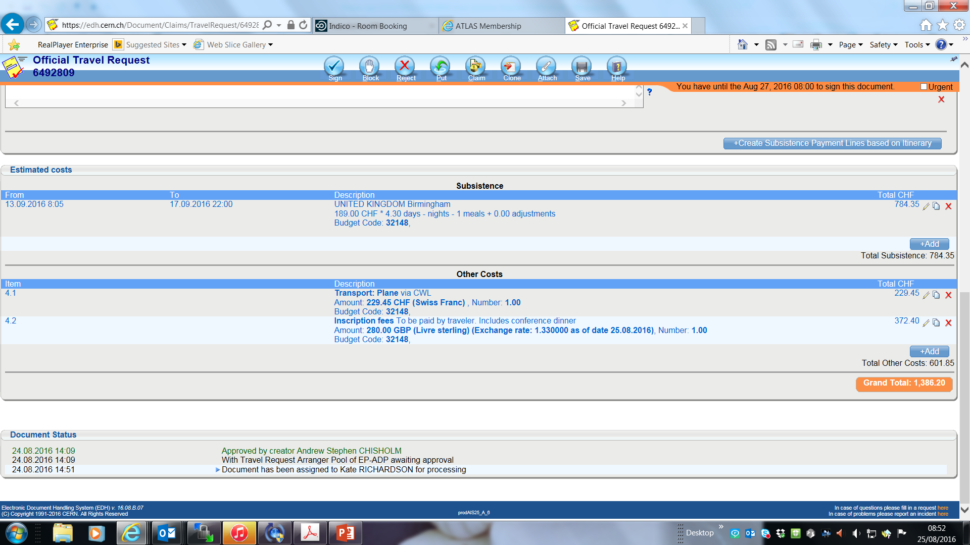
The new EDH form
Secretariat enters the estimated subsistence amounts and any other foreseen expenses
NOTE: nothing is final at this stage, all the information can be modified on the final reimbursement claim

Slide 7
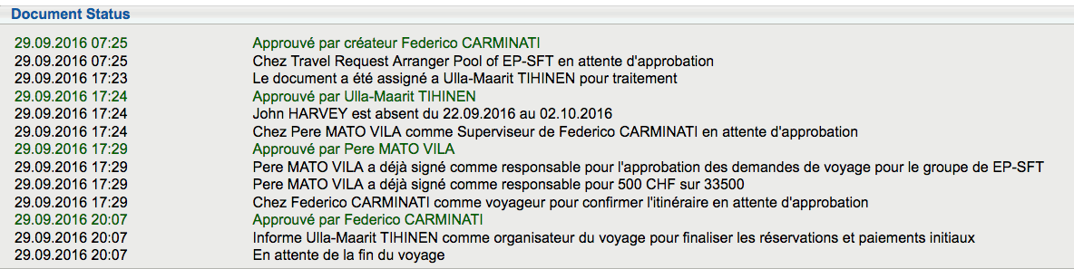
ROUTING OF THE REQUEST
Creator = traveller
Travel arranger
Supervisor
Creator = traveller

Slide 8
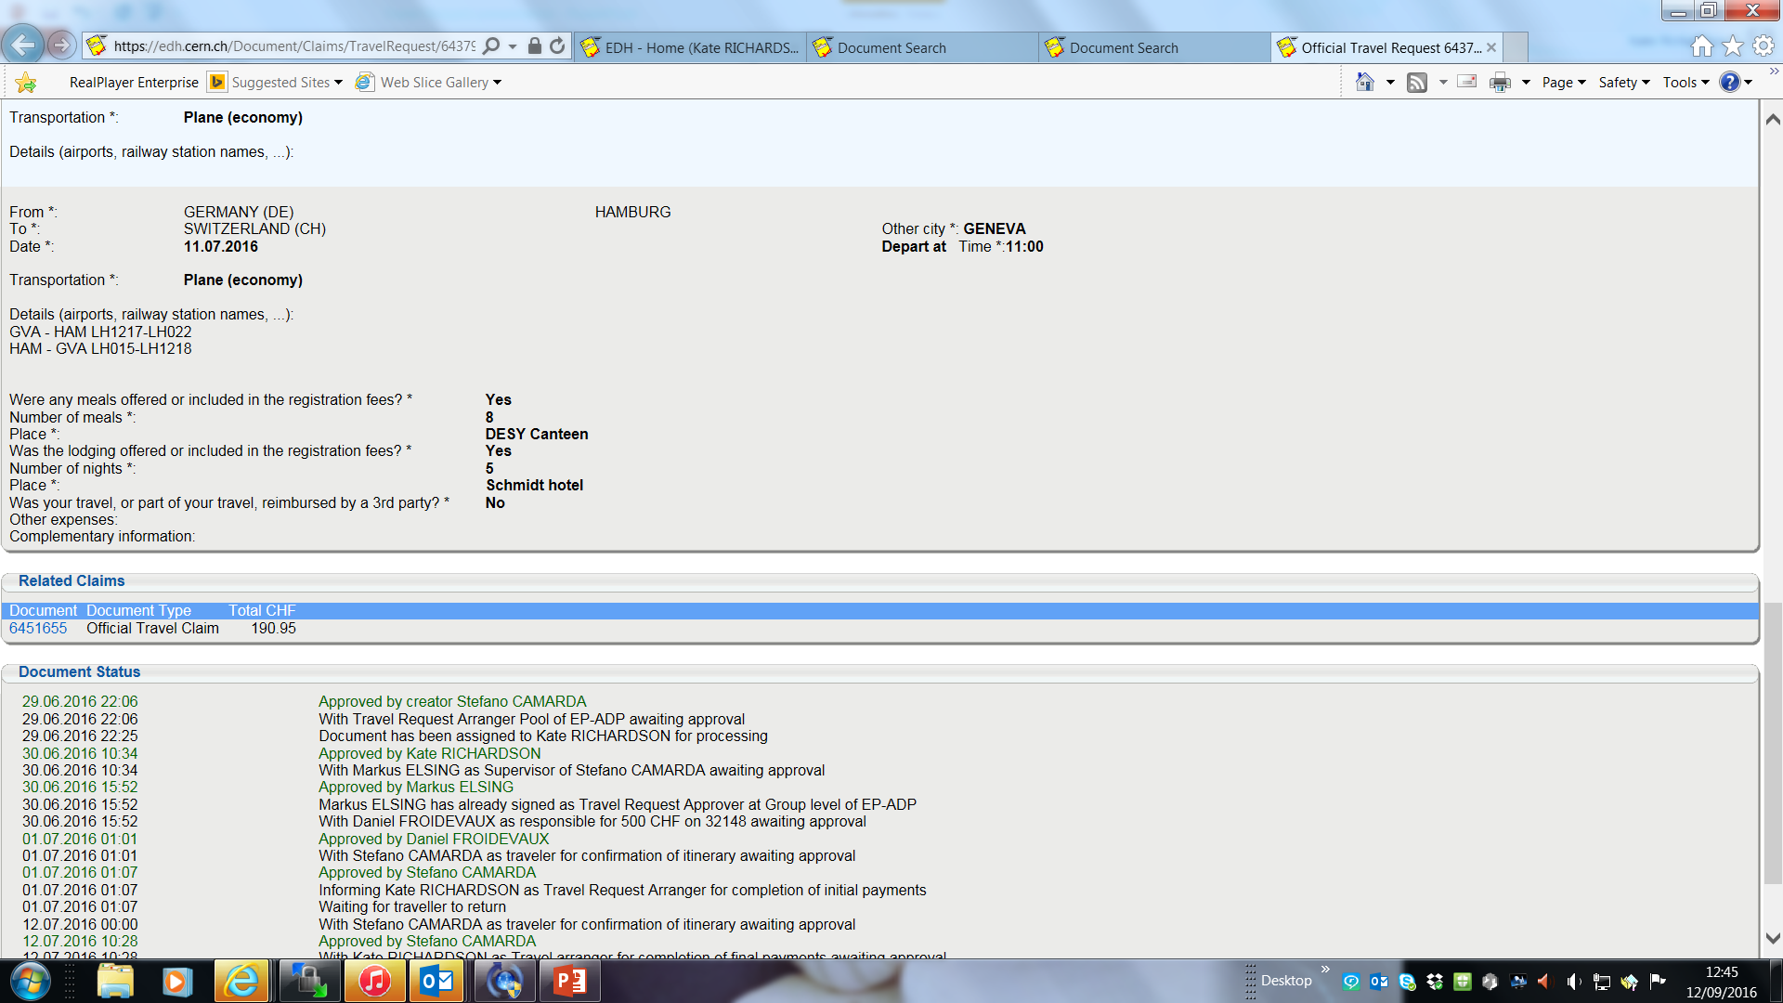
Return of traveller
Traveller returns from their trip traveller receives automated email from EDH on last day of trip traveller can see the estimated reimbursement & answers several questions traveller signs.

Slide 9
Added value of Travel Request Form
Advantages for the secretariats
Reinforces the accuracy of the costing.
Flow is quicker and easier, especially upon return of the traveller.
Completion of official travel claim faster as the claim is automatically pre-filled.
Overview of the cost of the entire trip.
The traveller can visualise how much he/she can spend on hotel & meals.
No need to chase signatures from the supervisor and budget code holder on a paper copy.
Advantages for the traveller & budget code holder
Transparency in terms of costing for both the assistants, traveller and budget code holders.
Global improvement

Slide 10
Future Improvements to Travel Request Form
Itinerary lines
Automated email to traveller upon signing the TR request that original receipts should be taken to his/her secretariat
Possibility to modify the travel request form once the routing has started – now we have to cancel and create again
Integration with e-Travel (project with CWL)
Future
Improvements

Slide 11
Conclusion
The travel request form will continuously evolve and improve.
Don’t hesitate to send feedback to me. I gladly transmit all the requests to the AIS team.
SFT specific :
In practise:
Before creating the request, ensure that your trip is approved by John Harvey (email, verbally)
Contact me for the travel arrangements : plane, train tickets.. As usual..
=> and create the request
Thanks to Kate Richardson from ATLAS for part of her slides ☺

