Slide 1
CRAB CAVITIES – WELDING
PROGRESS
Paula Freijedo
Thierry Tardy
CERN – 05/10/2016

Slide 2
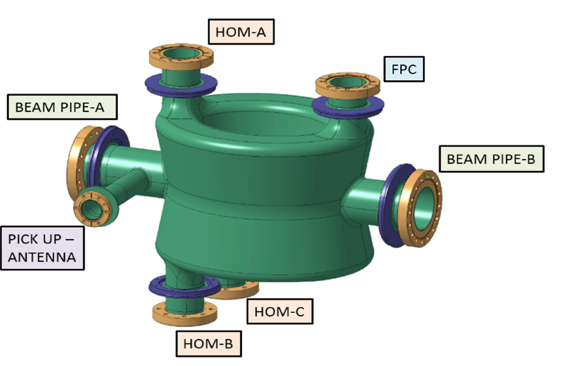
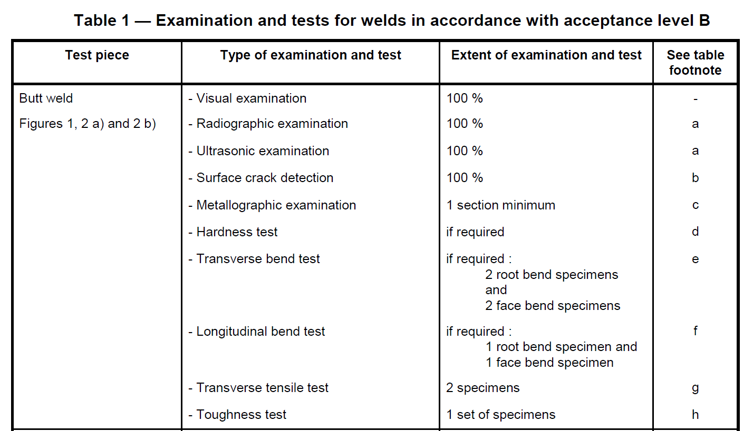
CAVITY DQW- WELDING QUALIFICATIONS
All qualifications DONE except NbNbTi 8mm
Welding Specimens according to the standard EN15614-11:
  NON-DESTRUCTIVE TEST:
  Visual Examination according to EN17637
  Radiographic Examination to EN 17636
  NDT’s SATISFACTORY according to ISO 13919-2 Level B
  DESTRUCTIVE TEST: ON-GOING
  Transverse Tensile test according to EN ISO 4136:
  Transverse Bending test according to EN 910:
          Face
          Root
  Metallographic examination
  According to EN ISO 17639.

Slide 3
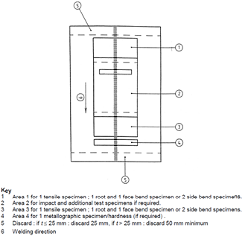
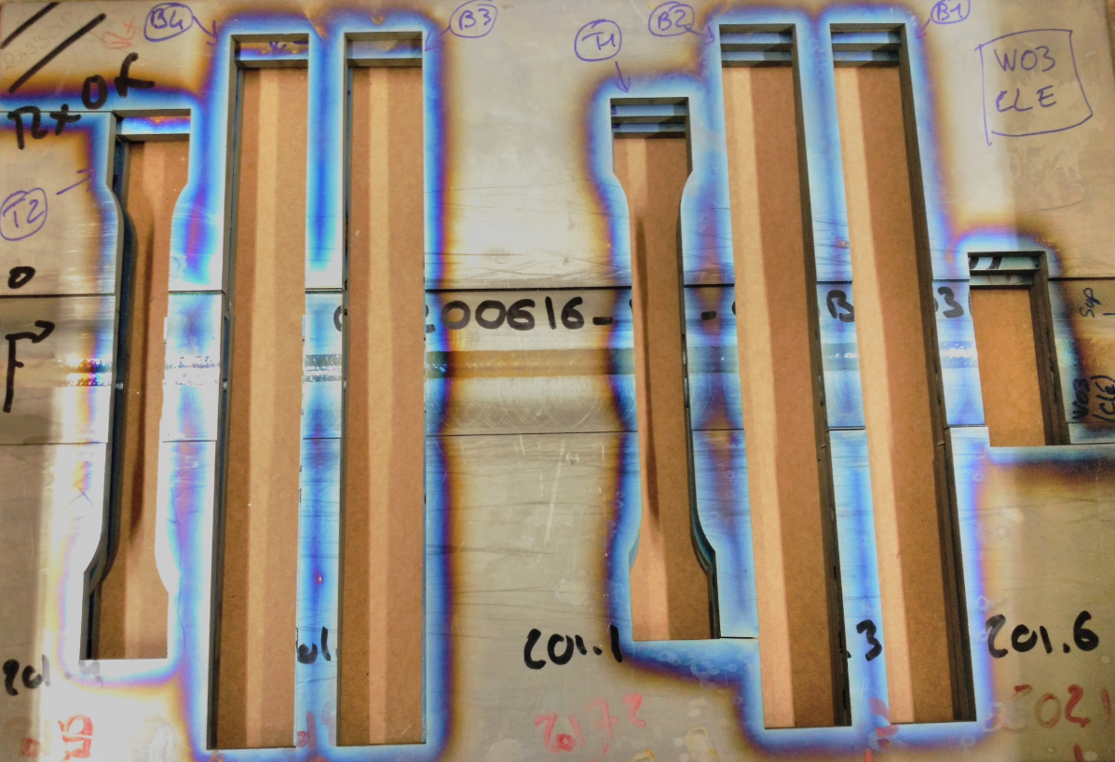
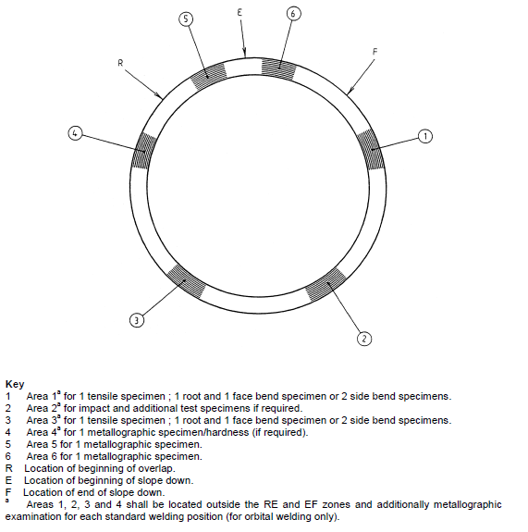
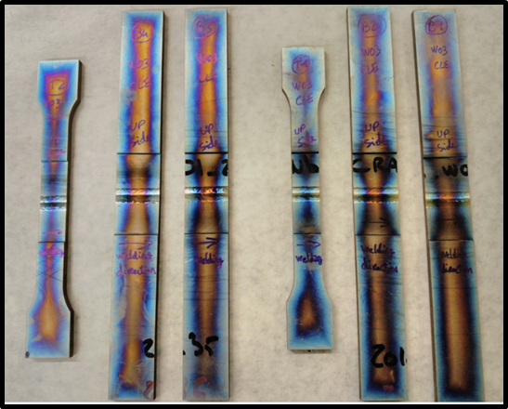
Cut and identification of the specimens
FOR LINEAL WELDS
PLATE
FOR CIRCUNFERENTIAL
WELDS
TUBE

Slide 4
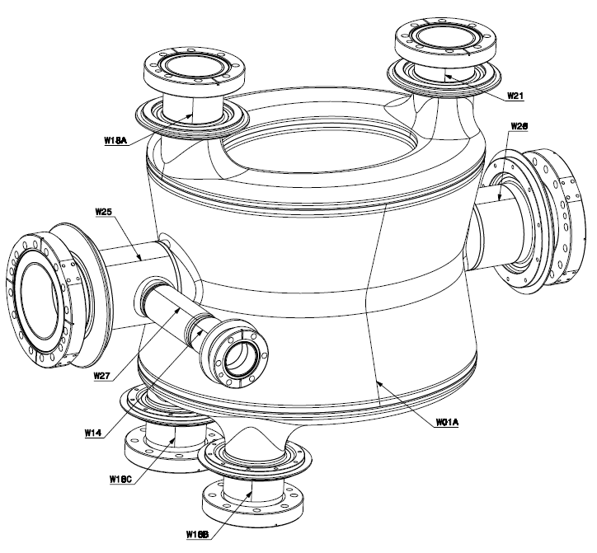
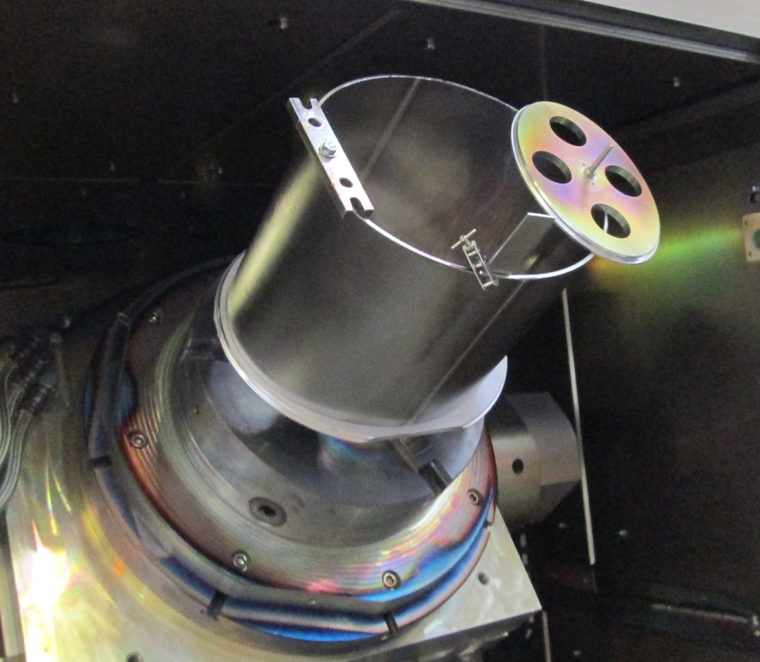
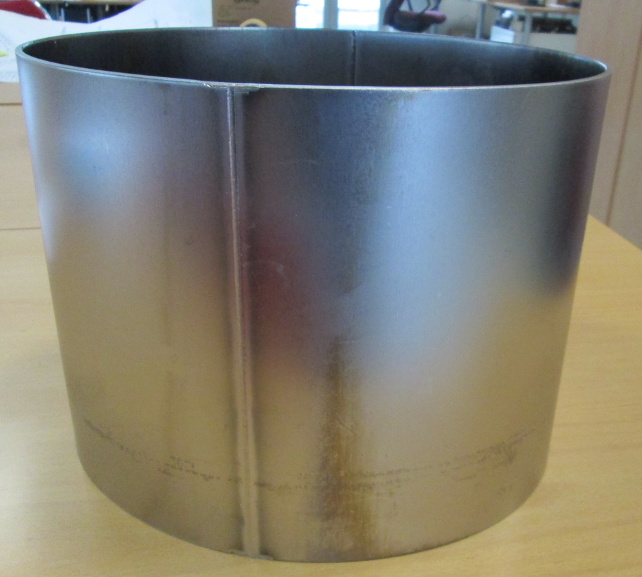
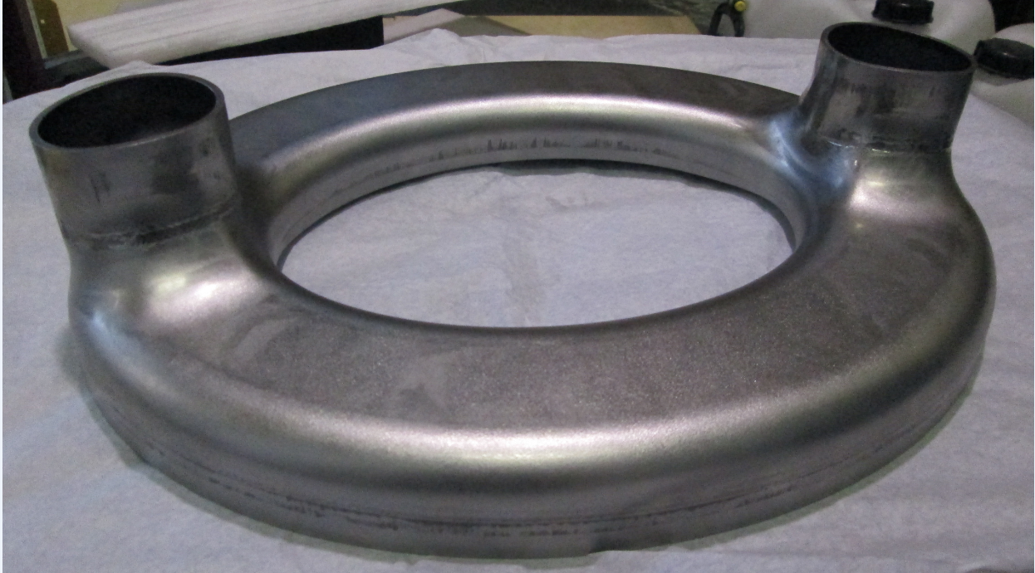
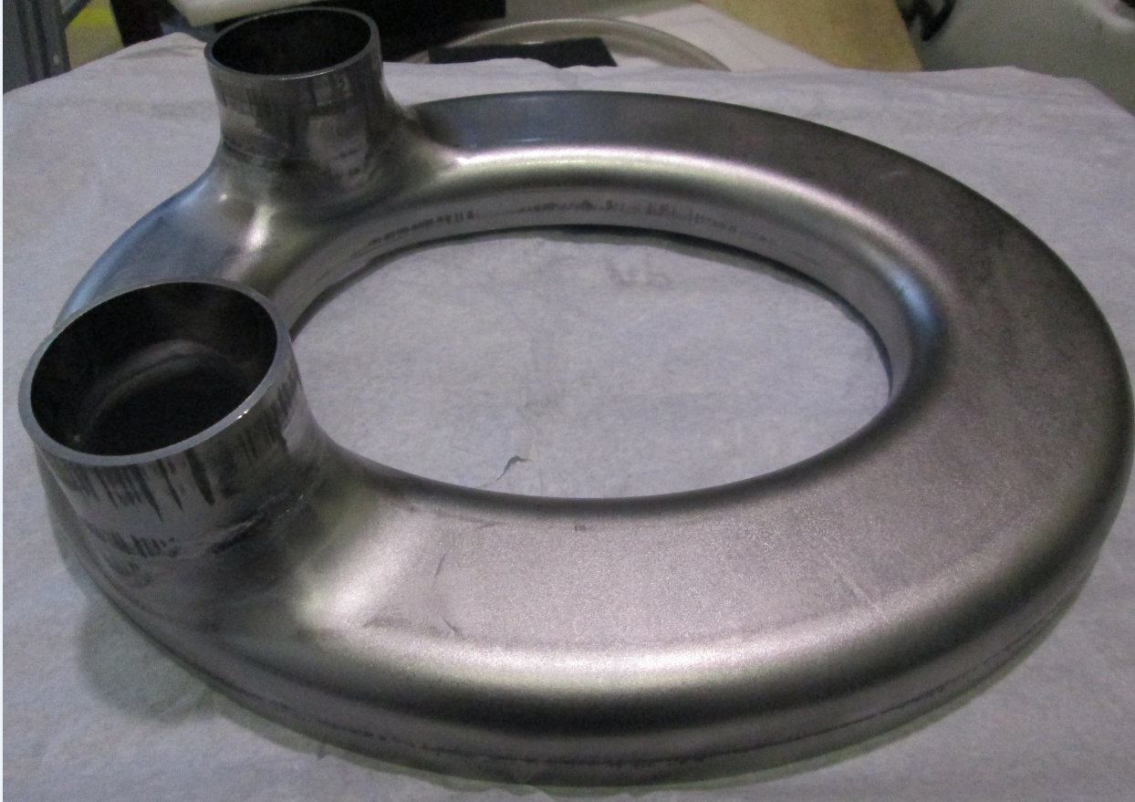

CAVITY-DQW
W29
W31
WELDING DURING FORMING
DIABOLO
W01A/B Longitudinal welds 3 diabolos (6 long.): 2 Cavities+ 1 spare
W28A
W30A
W01A/B
W28C
W30C
W28B
W30B
LUNETTE
W28A/B/C & W29 Longitudinal “manchette” (x12) + W30A/B/C & W31 circumferential “manchette-Lunette” (x12)
TOP
BOTTOM
6 Lunettes:
4(Tokyo Denkai): 2 cavities+1spare
2(Test - Ningxia)
100% VISUAL & RADIOGRAPHIC EXAMINATION
RESULTS SATISFACTORY according EN13919 level B

Slide 5
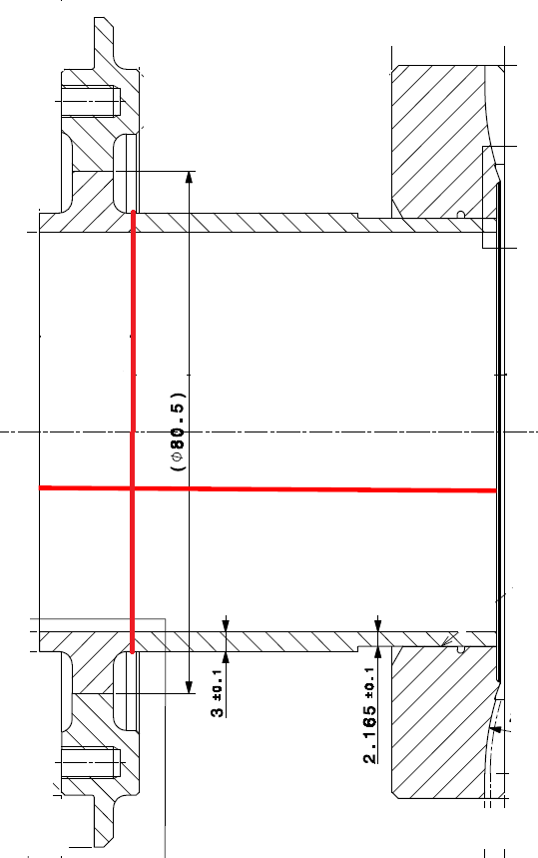
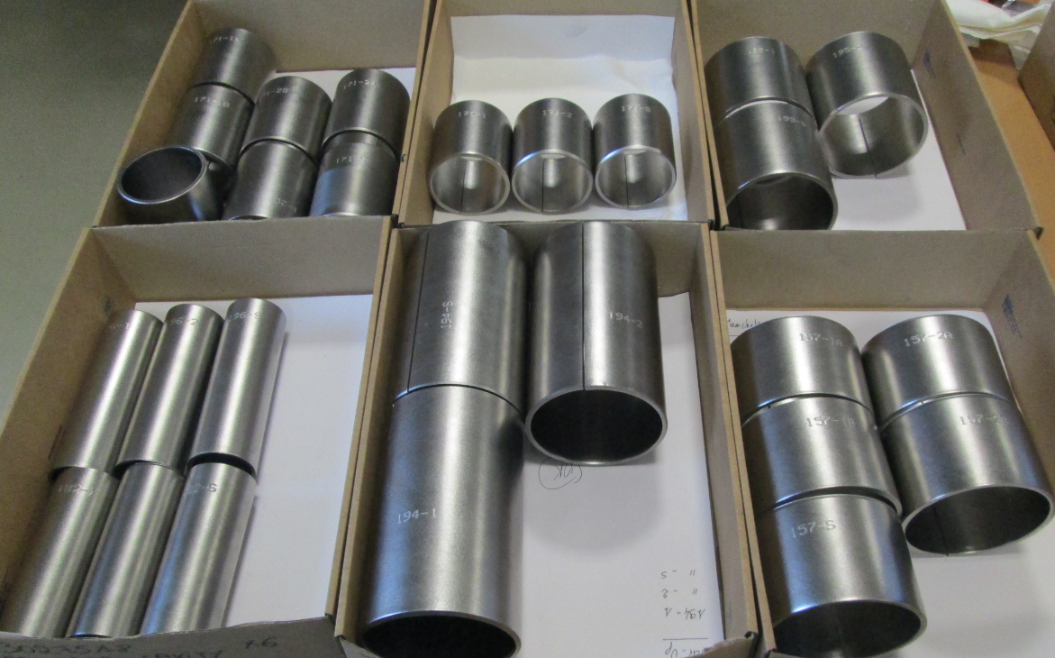
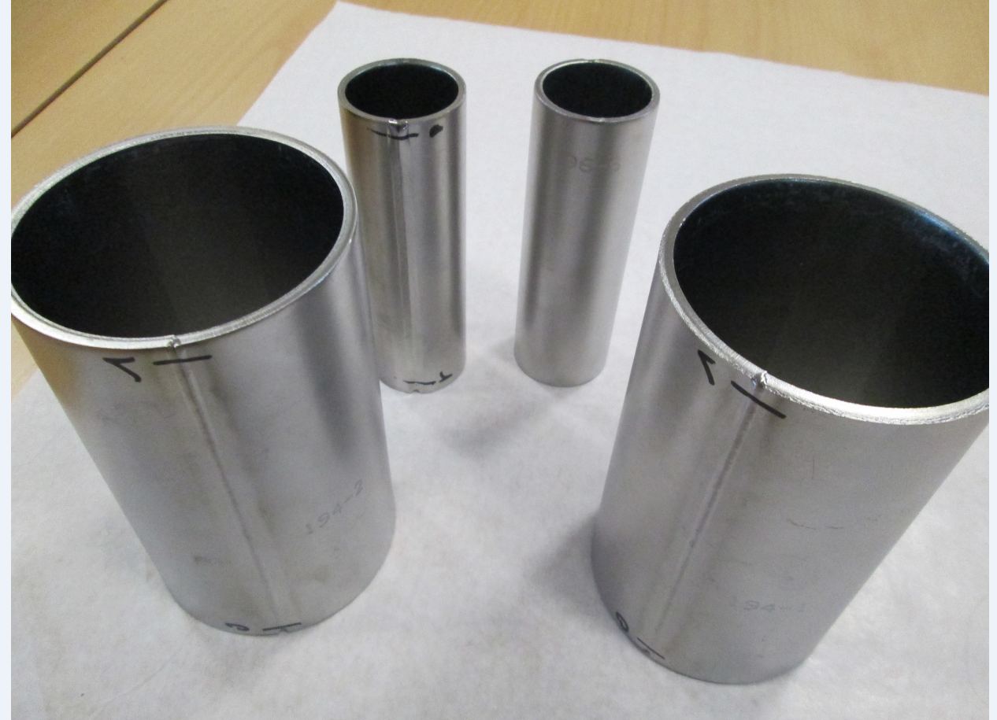
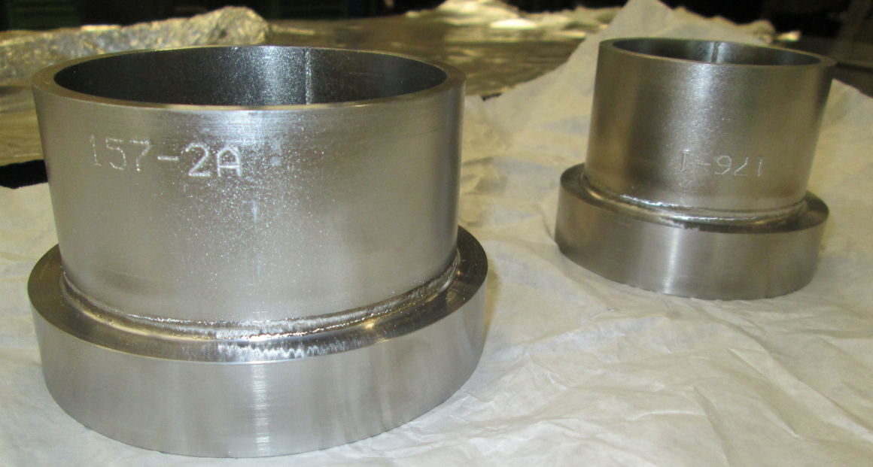
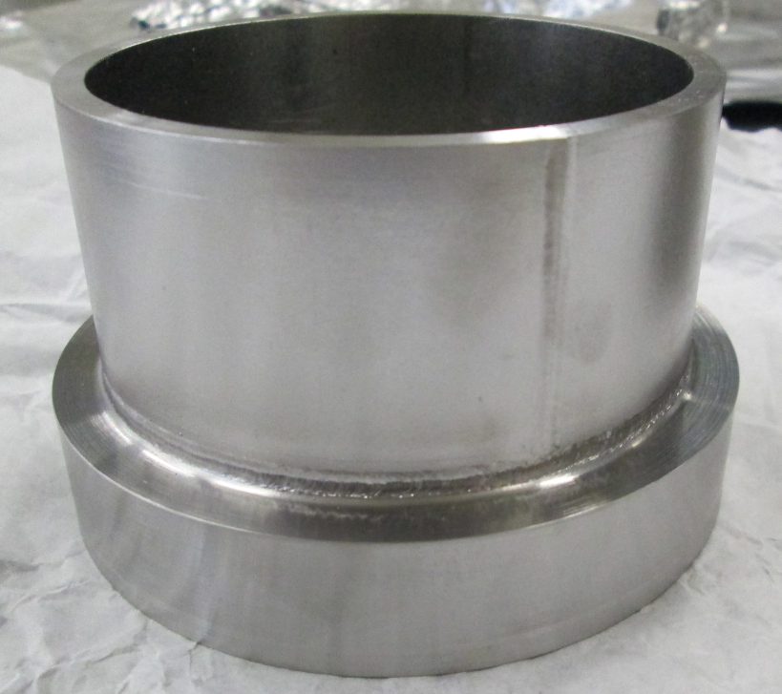
EXTREMITIES-DQW
WELDED ALL TUBES FOR EXTREMETIES: 2 cavities + 1 Spare
LONGITUDINAL (x27) - 100% RX
Circular
Longitudinal
CIRCULAR NbNb (x16)- SPOT RX (25%)
RADIOGRAPHIC EXAMINATION SATISFACTORY

Slide 6
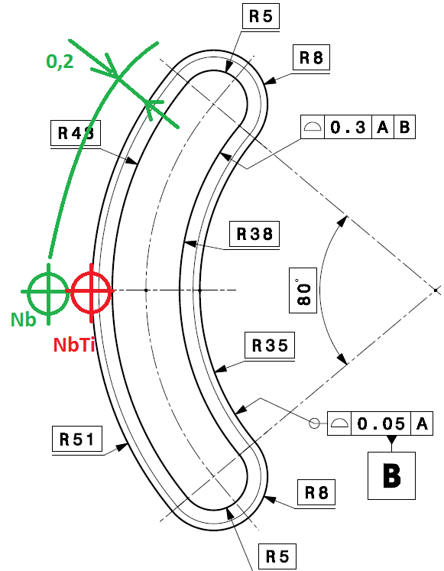
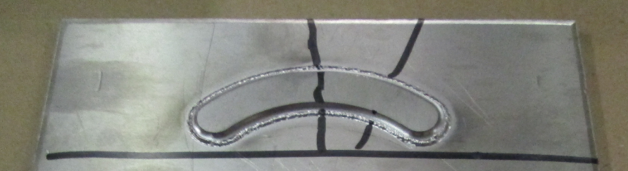
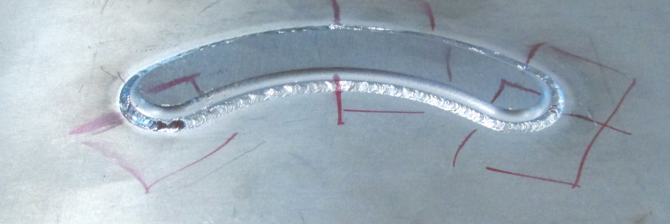
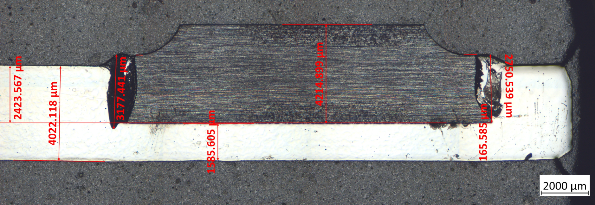
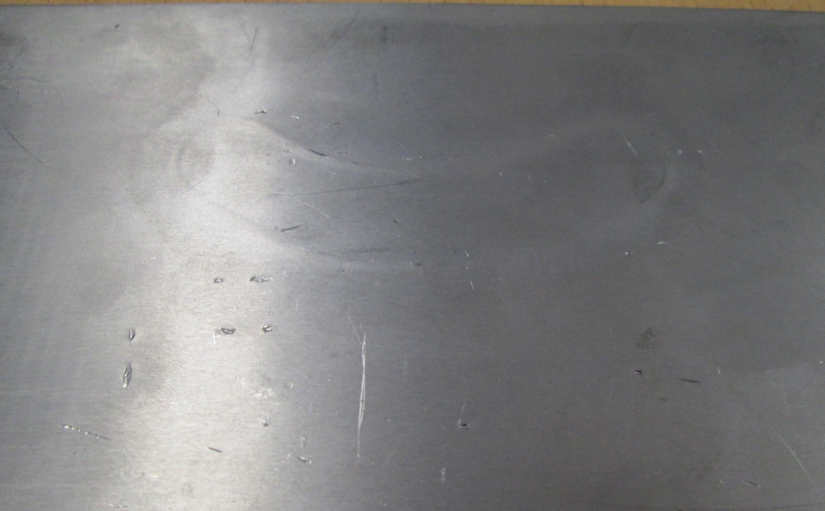
“HARICOT” Banana Shape
The program to follow the “haricot” shape developed works perfectly
FIRST TEST NbTi-Nb
SECOND TEST NbTi-Nb
RF surface:
No contamination
THIRD TEST ON-GOING

Slide 7
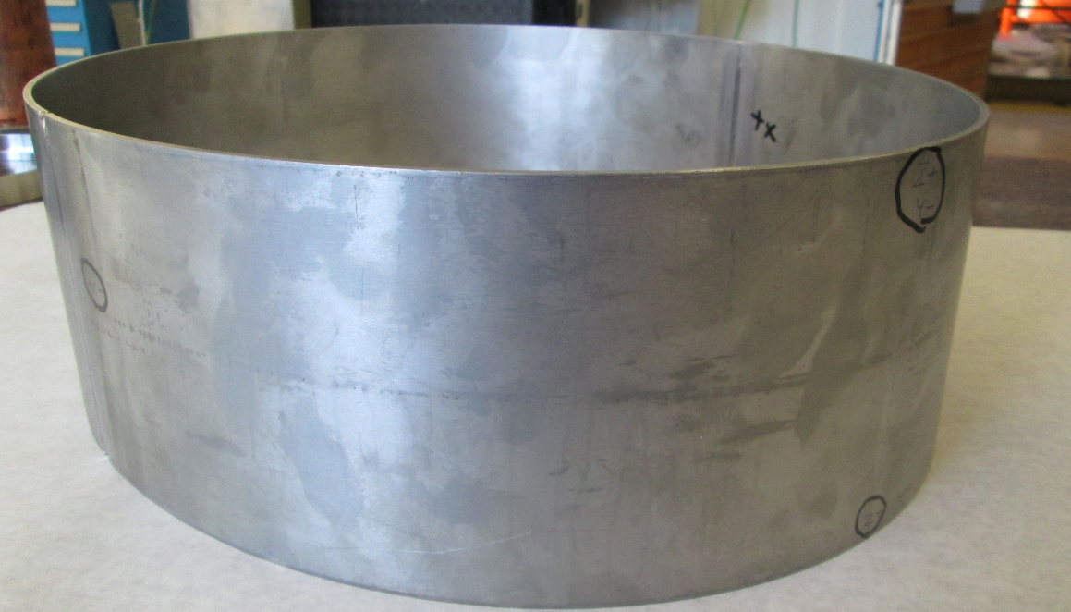
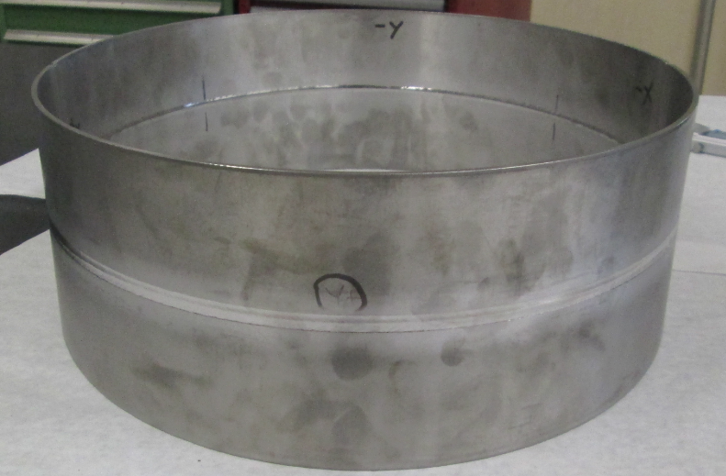
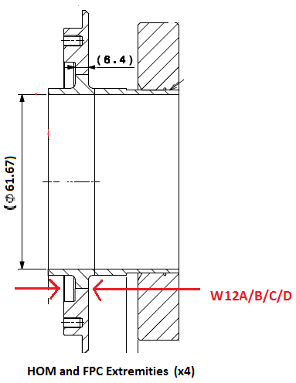
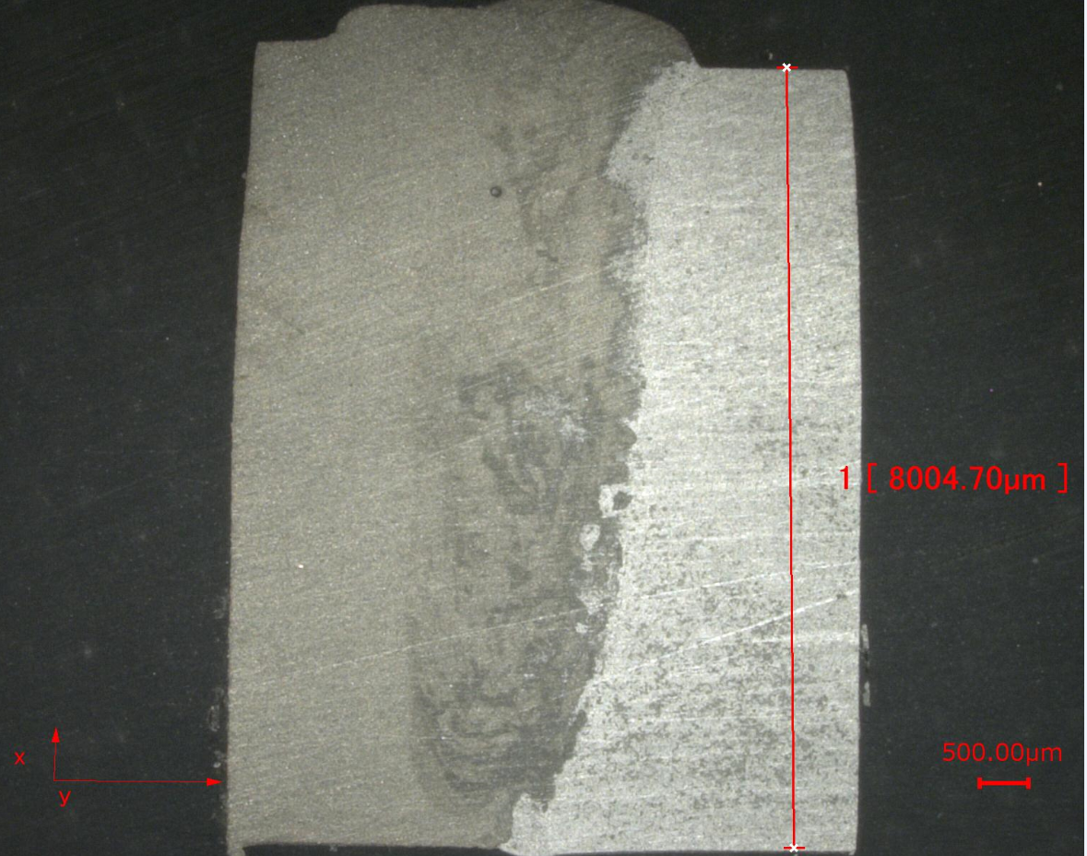
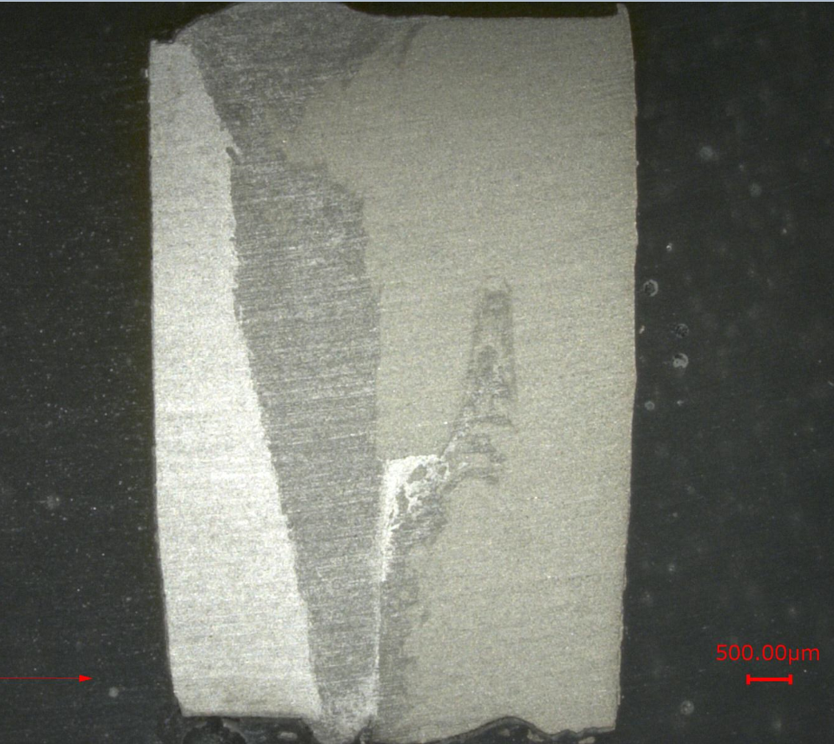
OTHERS
W03- ELLIPTICAL LAST WELDS IN NIOBIUM
The program will be adjusted to follow
the shape in the curves
2 NEW PIECES
WILL BE WELDED
BEFORE WELDING
AFTER WELDING
Nb-NbTi weld
Nb-NbTi for extremities in 8mm
6.4mm after machining
BW
Both configuration tested
KEY
Metallographic images Courtesy of Ignacio Aviles

Slide 8
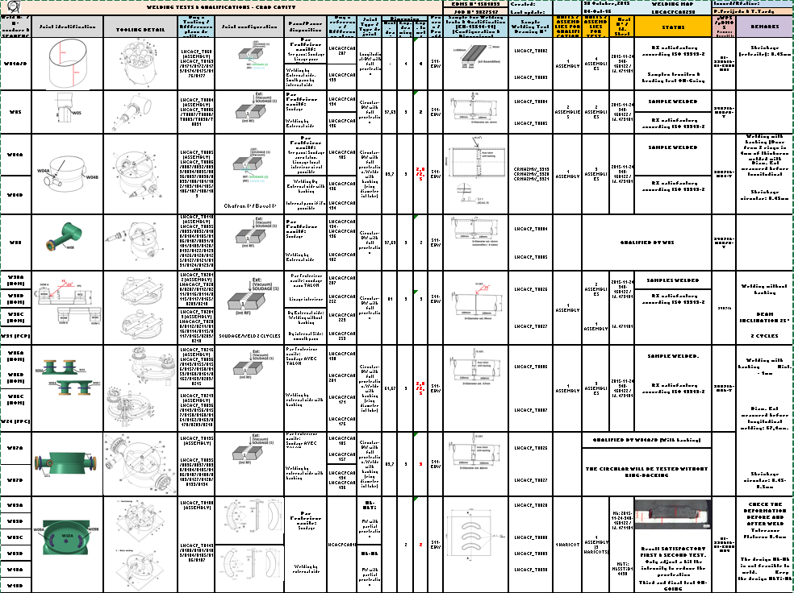

Slide 9
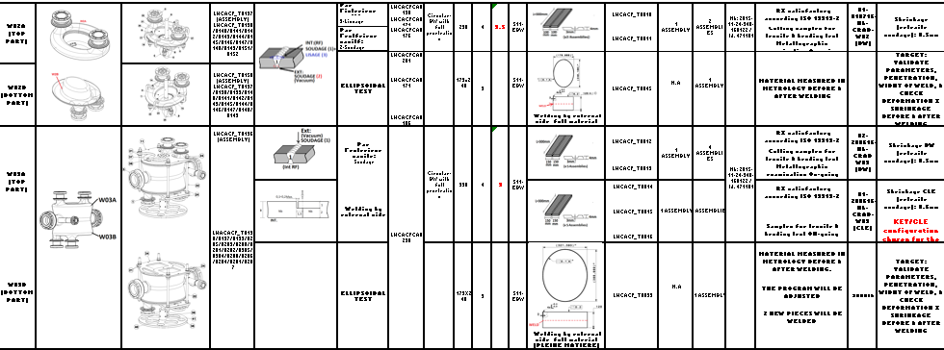
Welding documentation
- QUALIFICATIONS & TEST: https://edms.cern.ch/document/1581039/1
WELDING BOOK:
HOM
https://edms.cern.ch/document/1688036/1
EXTREMETIES & FINAL ASSEMBLY:
https://edms.cern.ch/document/1685099/1

Slide 10
Thanks for your attention
Questions???
Special Thanks to J-P. Brachet, M. Garlasche, L. Giordanino, R. Leuxe, L. Prever-Loiri, Rene Claret for their contribution

