Slide 1
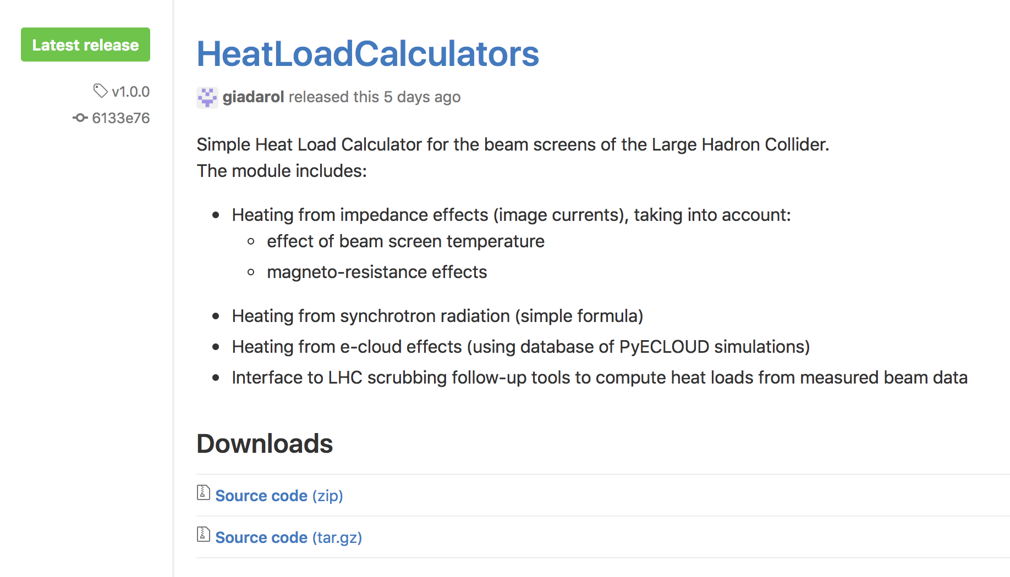
Little module (HeatLoadCalculator) available at: https://github.com/giadarol/HeatLoadCalculators/

Slide 2
Output from the HeatLoadCalculators module – Nominal LHC:
Evaluated scenario: Design report
- Beam energy 7000.0 GeV
- Bunch intensity: 1.15e+11 p
- Bunch length (4*sigma): 1.00 ns
- N. bunches: 2808
Heat load contribution:
- Impedance load (average half-cell): 115.0 mW/m/beam
- Synchrotron radiation load (average half-cell): 173.0 mW/m/beam
Impedance contribution breakdown:
- Impedance load in the dipoles: 119.5 mW/m/beam
- Impedance load in the quadrupoles: 105.2 mW/m/beam
- Impedance load in the drifts: 91.7 mW/m/beam

Slide 3
Output from the HeatLoadCalculators module – HL-LHC:
Evaluated scenario: HL-LHC
- Beam energy 7000.0 GeV
- Bunch intensity: 2.20e+11 p
- Bunch length (4*sigma): 1.20 ns
- N. bunches: 2748
Heat load contribution:
- Impedance load (average half-cell): 313.4 mW/m/beam (x2.7)
- Synchrotron radiation load (average half-cell): 323.9 mW/m/beam (x1.8)
Impedance contribution breakdown:
- Impedance load in the dipoles: 325.7 mW/m/beam
- Impedance load in the quadrupoles: 286.6 mW/m/beam
- Impedance load in the drifts: 250.0 mW/m/beam

Slide 4

Check synchrotron radiation vs design report

Slide 5
Synchrotron radiation
Model presently implemented:
  Compute energy loss per particle and per turn (formula)
  Rescale to get total power loss (*N_{beam}/T_{rev})
  Assume that it is all deposited in the arcs (divide by 8*L_{arc} to get average deposited power)

Slide 6
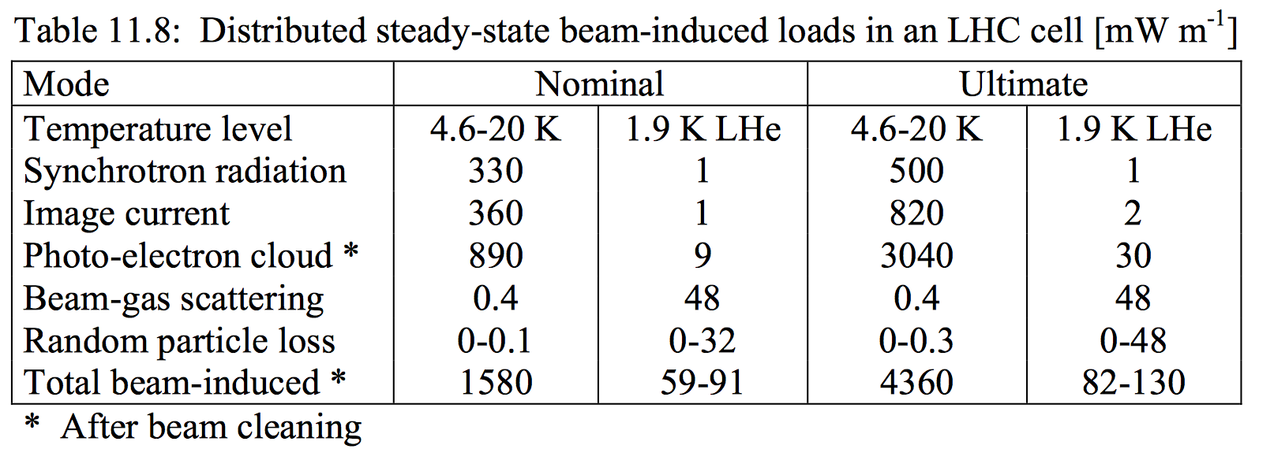
Check synchrotron radiation against design report
Our calculation:
Synchrotron radiation load (average half-cell): 173.0 mW/m/beam
Design report:
We reconstructed that this is for 2 beams
Consistent within 4%

Slide 7
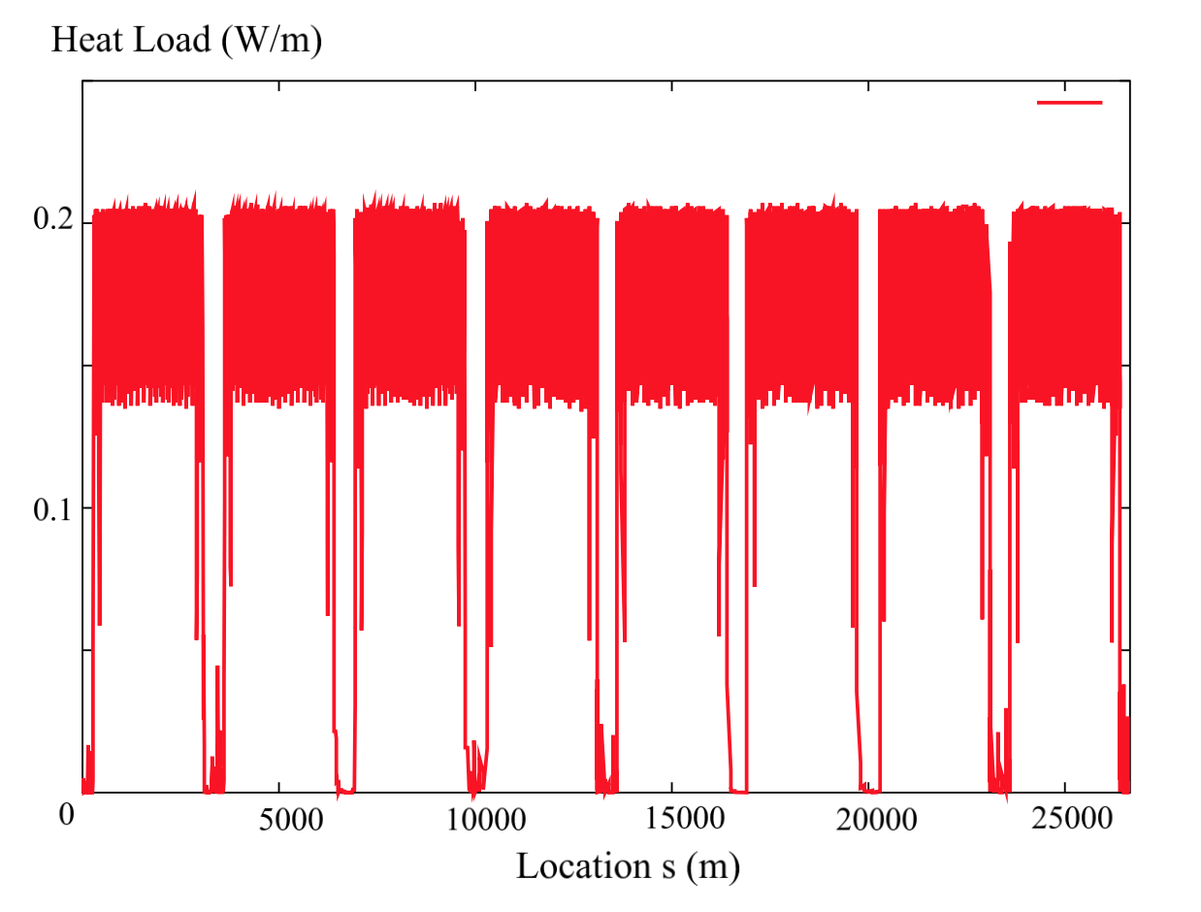
Check synchrotron radiation against design report
Our calculation:
Synchrotron radiation load (average half-cell): 173.0 mW/m/beam
Design report:
Consistent!

Slide 8
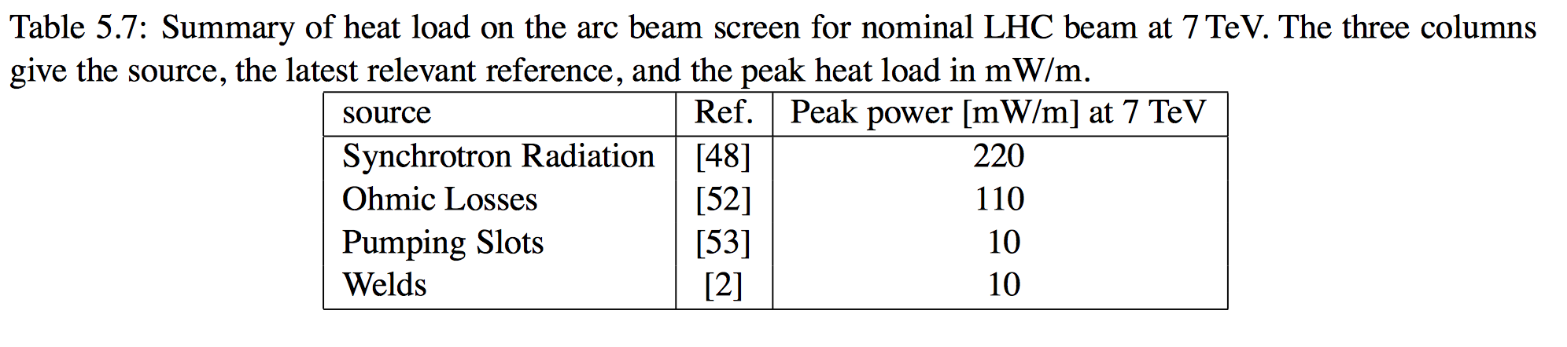
Check synchrotron radiation against design report
Our calculation:
Synchrotron radiation load (average half-cell): 173.0 mW/m/beam
Design report:
We reconstructed that this is for 1 beam
Inconsistent with our estimate and with Fig. 5.2 of the DR itself!
(220 mW/m/beam is the local emitted power in the bends, but photons are not emitted elsewhere)

Slide 9
Check impedance vs design report

Slide 10
Check impedance against design report
Model presently implemented in our module:
  Resistivity:
    Dependence of temperature: curve from N. Kos
    Dependence on magnetic field: Elias’s procedure
    Different values evaluated for dipoles, quadrupoles and drifts
  Weld effect:
    Simple formula (see LSS note)

Slide 11
Check impedance against design report
Our calculation:
Impedance load (average half-cell): 115.0 mW/m/beam
Design report:
We reconstructed that this is for 1 beam
Consistent within 5 %

Slide 12
Check impedance against design report
Our calculation:
Impedance load (average half-cell): 115.0 mW/m/beam
Design report:
We reconstructed that this is for 2 beams
180 mW/m/beam → Inconsistent also with respect to table 5.7 of the DR
Daniel looked into minutes of the heat load working group (2000), it seems they account for BPM bellow contribution → being investigated by Elias/Benoit

Slide 13
Check against machine data

Slide 14
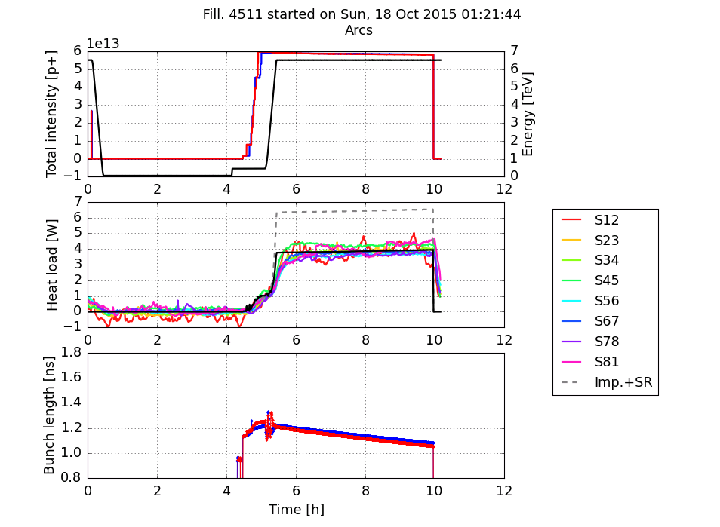
Comparison against machine data
More here
100 ns, run with β*=90 m in 2015
Measured:
Timber
(SR overestimated by factor 2, different assumptions for impedance)
Calculated:
HeatLoadCalculators
Module (used now)

Slide 15
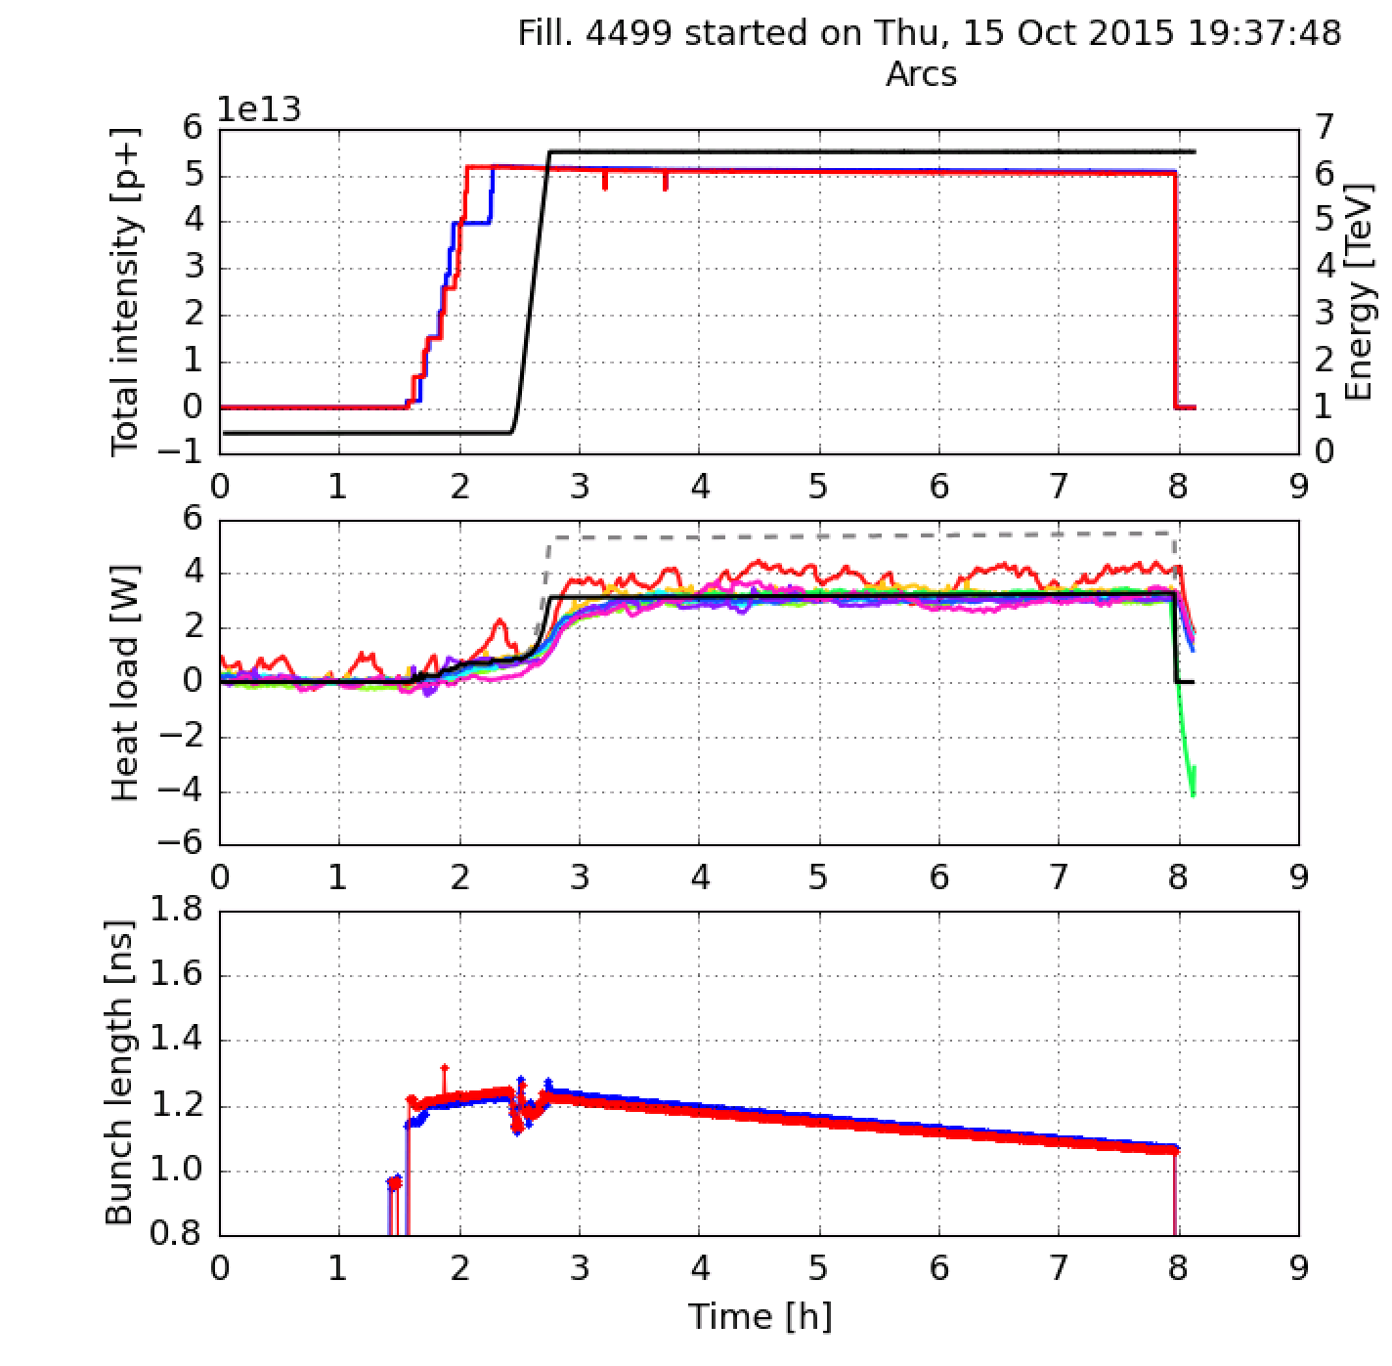
Comparison against machine data
More here
100 ns, run with β*=90 m in 2015
Measured:
Timber
(SR overestimated by factor 2, different assumptions for impedance)
Calculated:
HeatLoadCalculators
Module (used now)

Slide 16
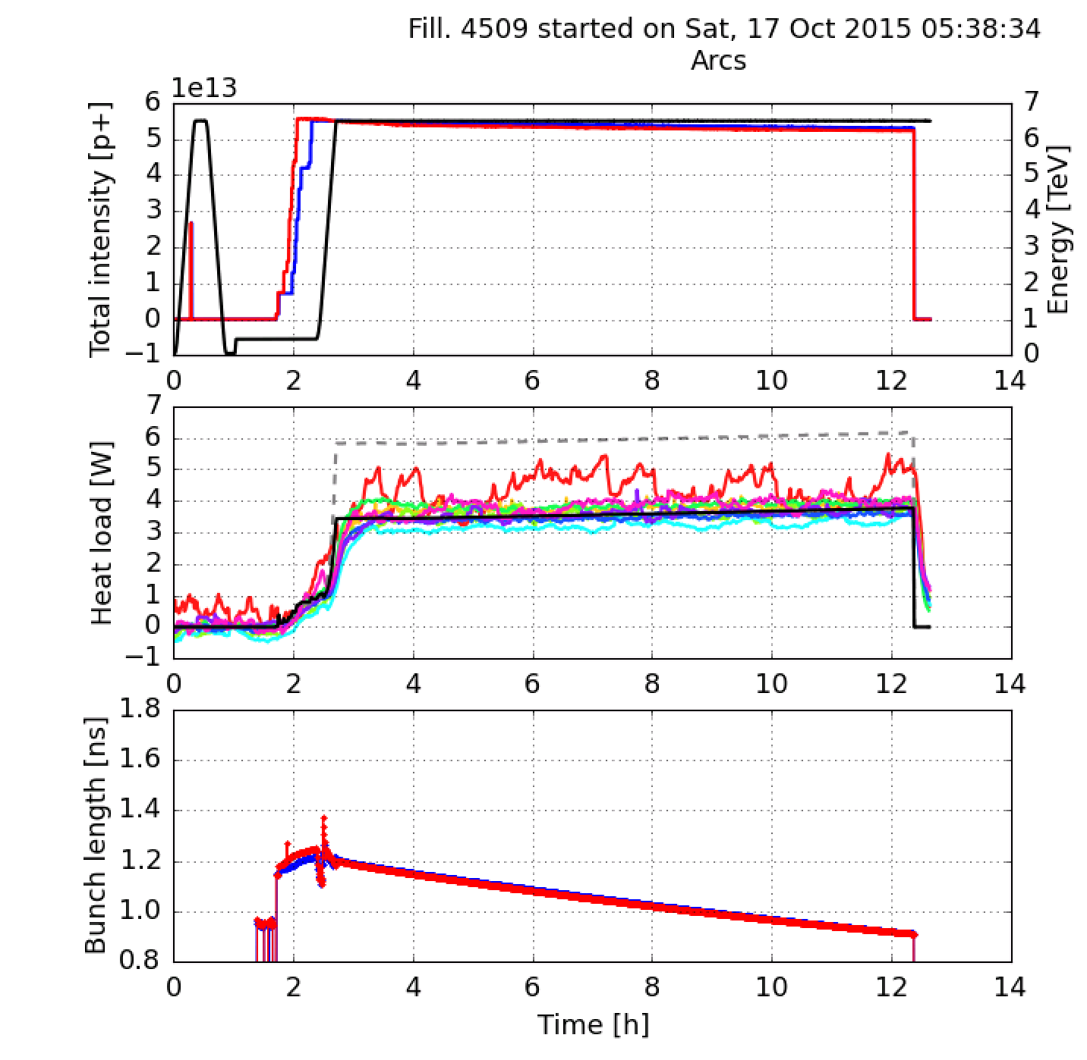
Comparison against machine data
More here
100 ns, run with β*=90 m in 2015
Measured:
Timber
(SR overestimated by factor 2, different assumptions for impedance)
Calculated:
HeatLoadCalculators
Module (used now)

Slide 17
Comparison against machine data
More here
100 ns, run with β*=90 m in 2015
Measured:
Timber
(SR overestimated by factor 2, different assumptions for impedance)
Calculated:
HeatLoadCalculators
Module (used now)

Slide 18
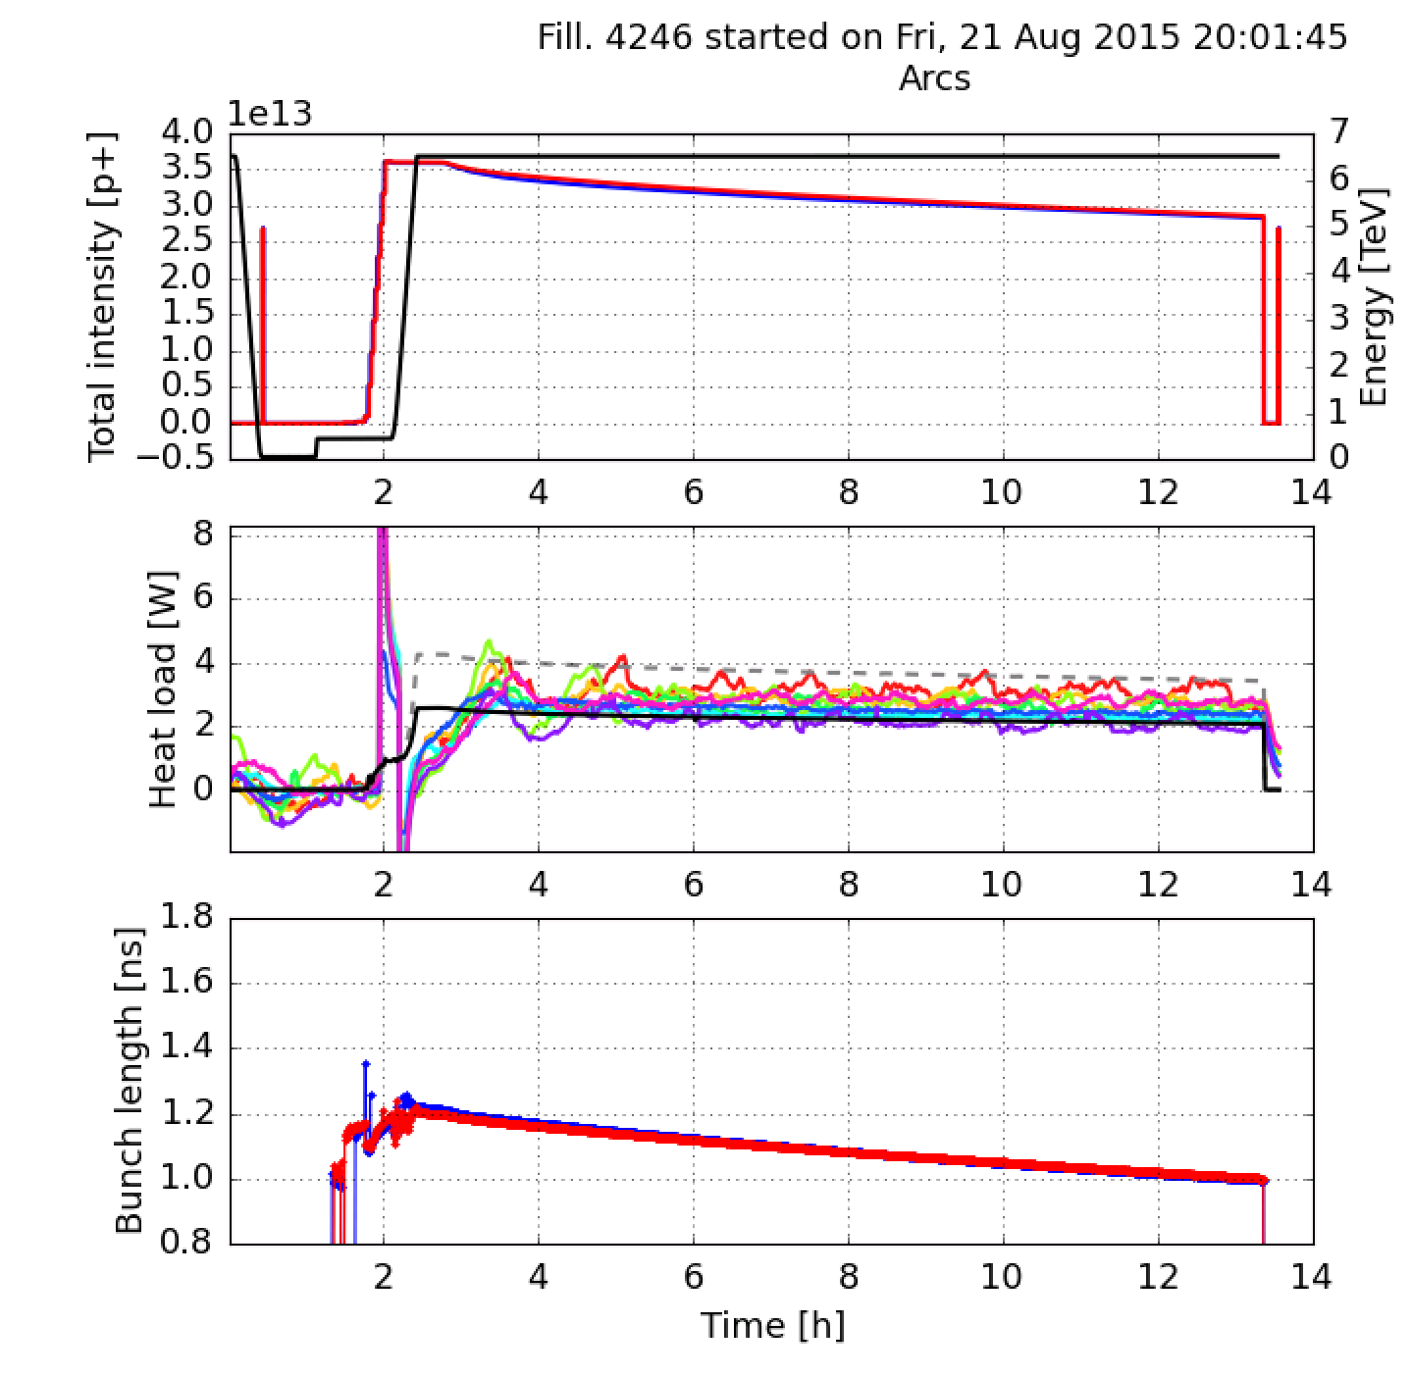
Comparison against machine data
More here
50ns, physics 2015
Measured:
Timber
(SR overestimated by factor 2, different assumptions for impedance)
Calculated:
HeatLoadCalculators
Module (used now)

Slide 19
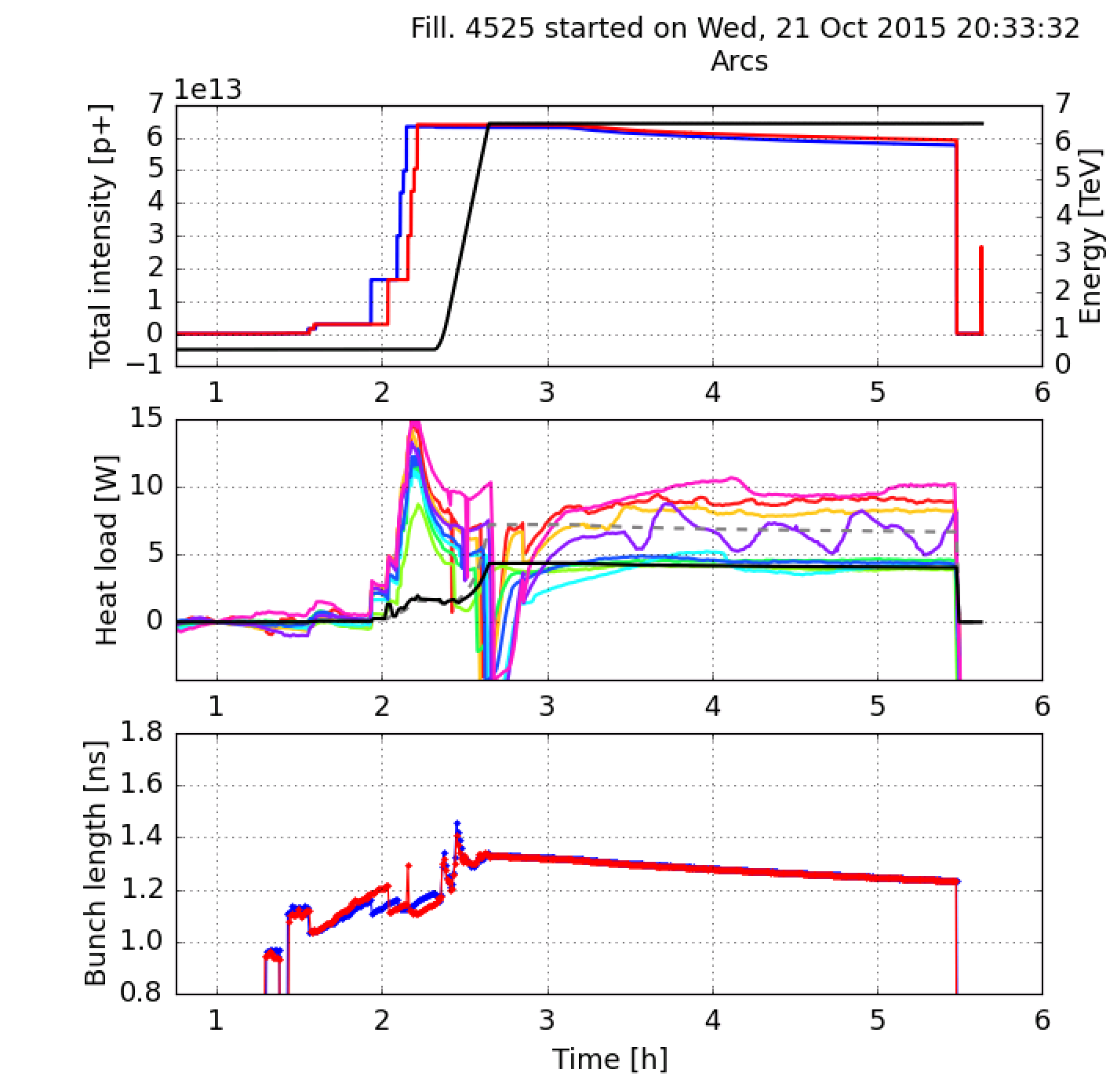
Comparison against machine data
More here
8b4e test 2015
Measured:
Timber
(SR overestimated by factor 2, different assumptions for impedance)
Calculated:
HeatLoadCalculators
Module (used now)

