Slide 1

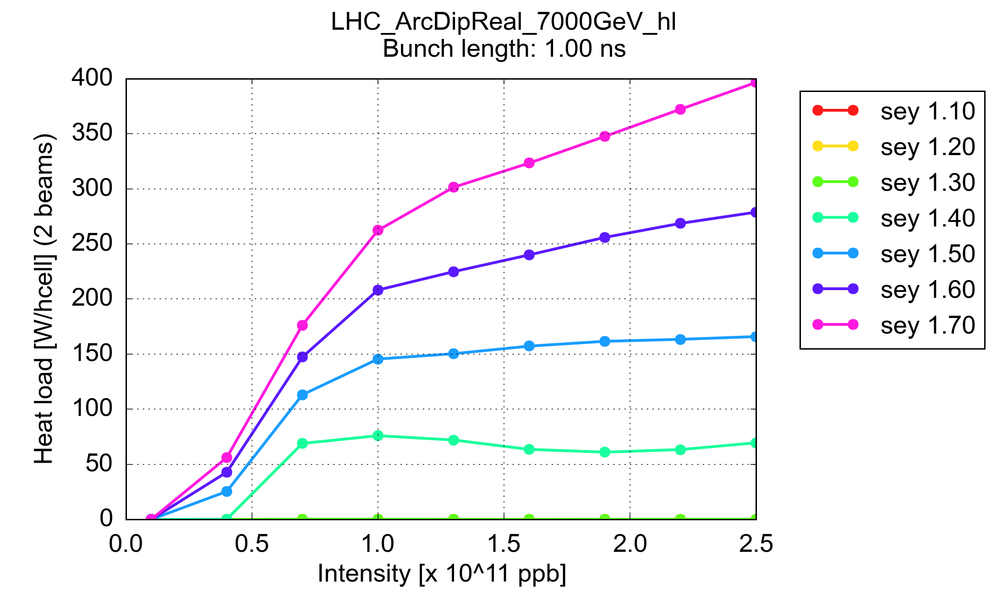
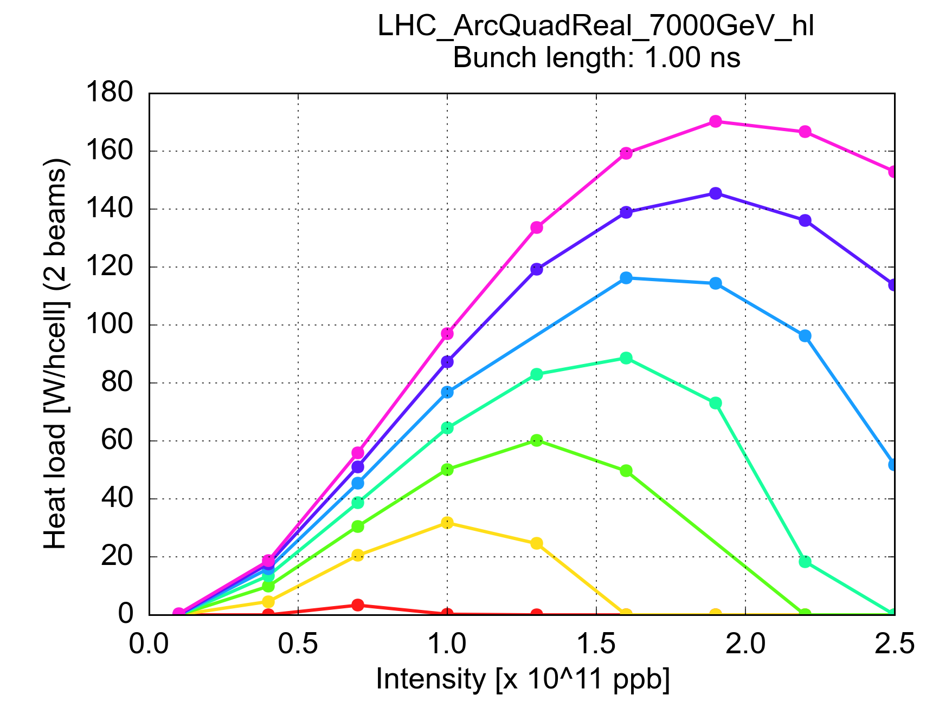
e-cloud dependence on bunch intensity
Heat load scales non monotonically with bunch intensity
  → Start of fill might not be the most critical moment

Slide 2
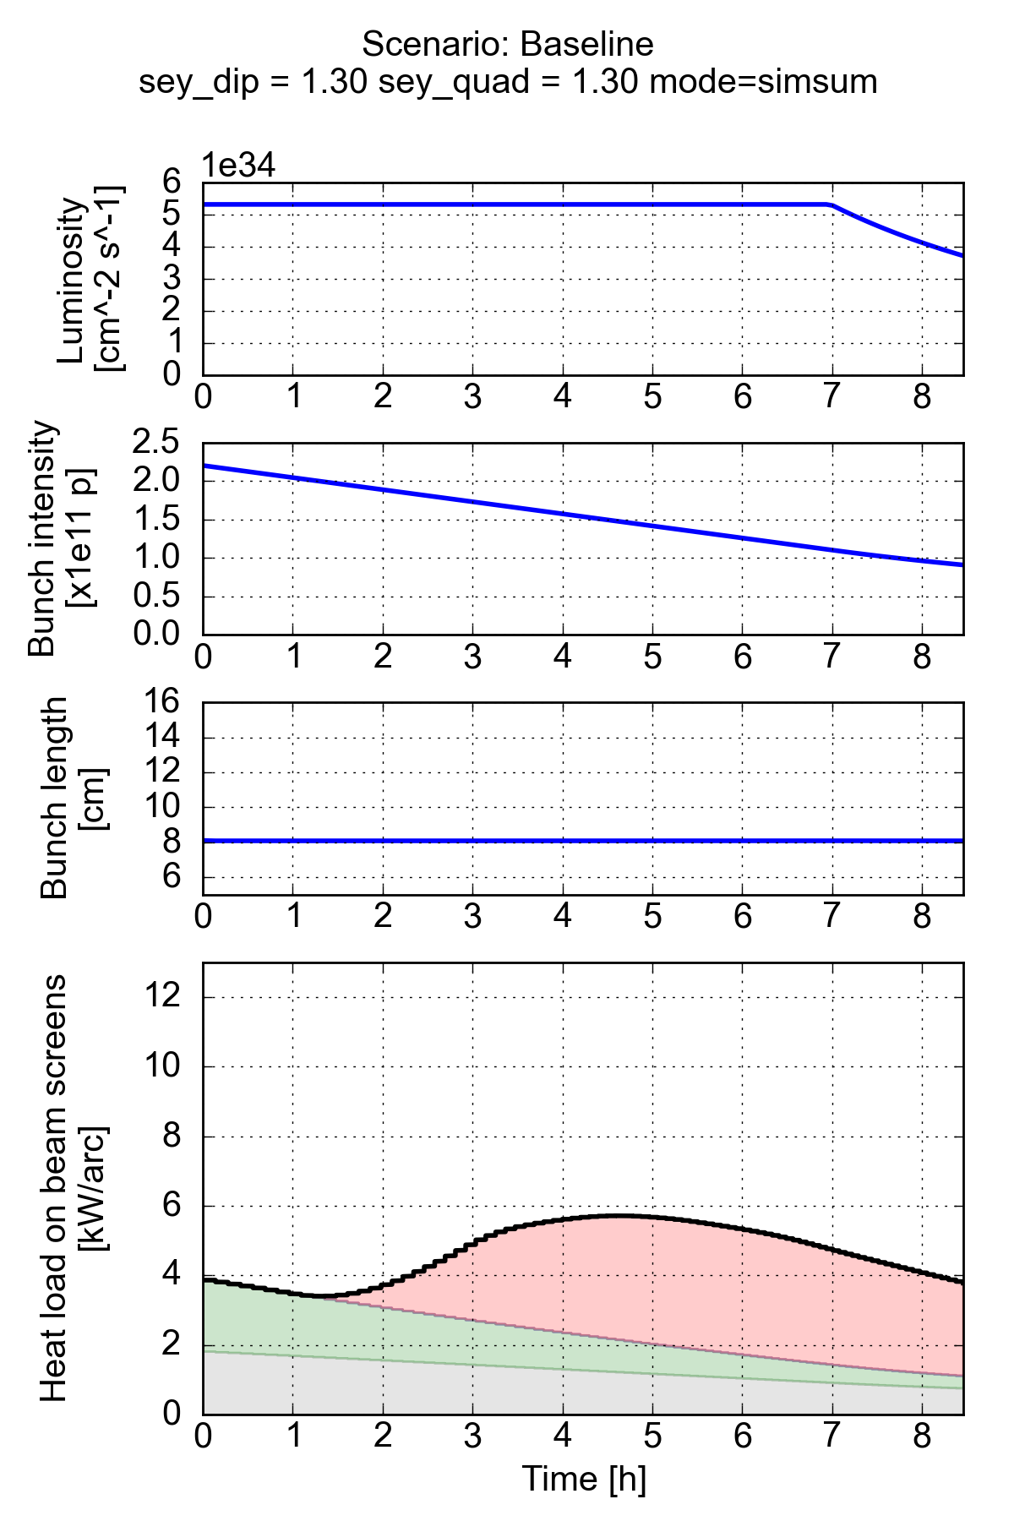
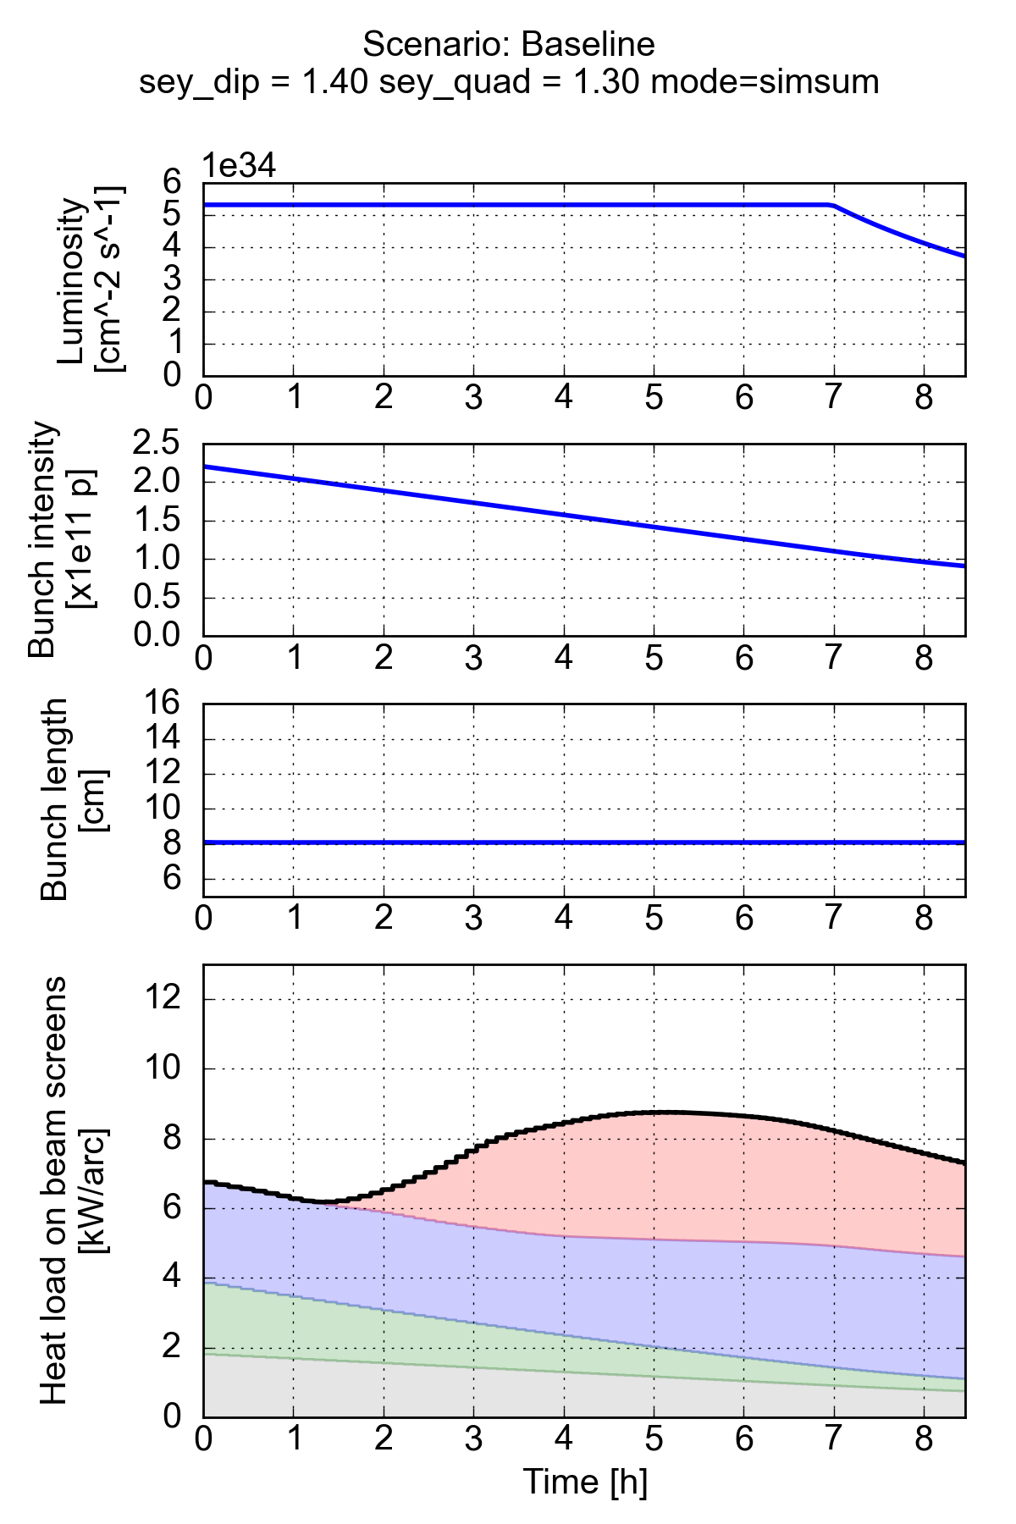
e-cloud quad.
Impedance
e-cloud dip.
Syn. radiation

Slide 3
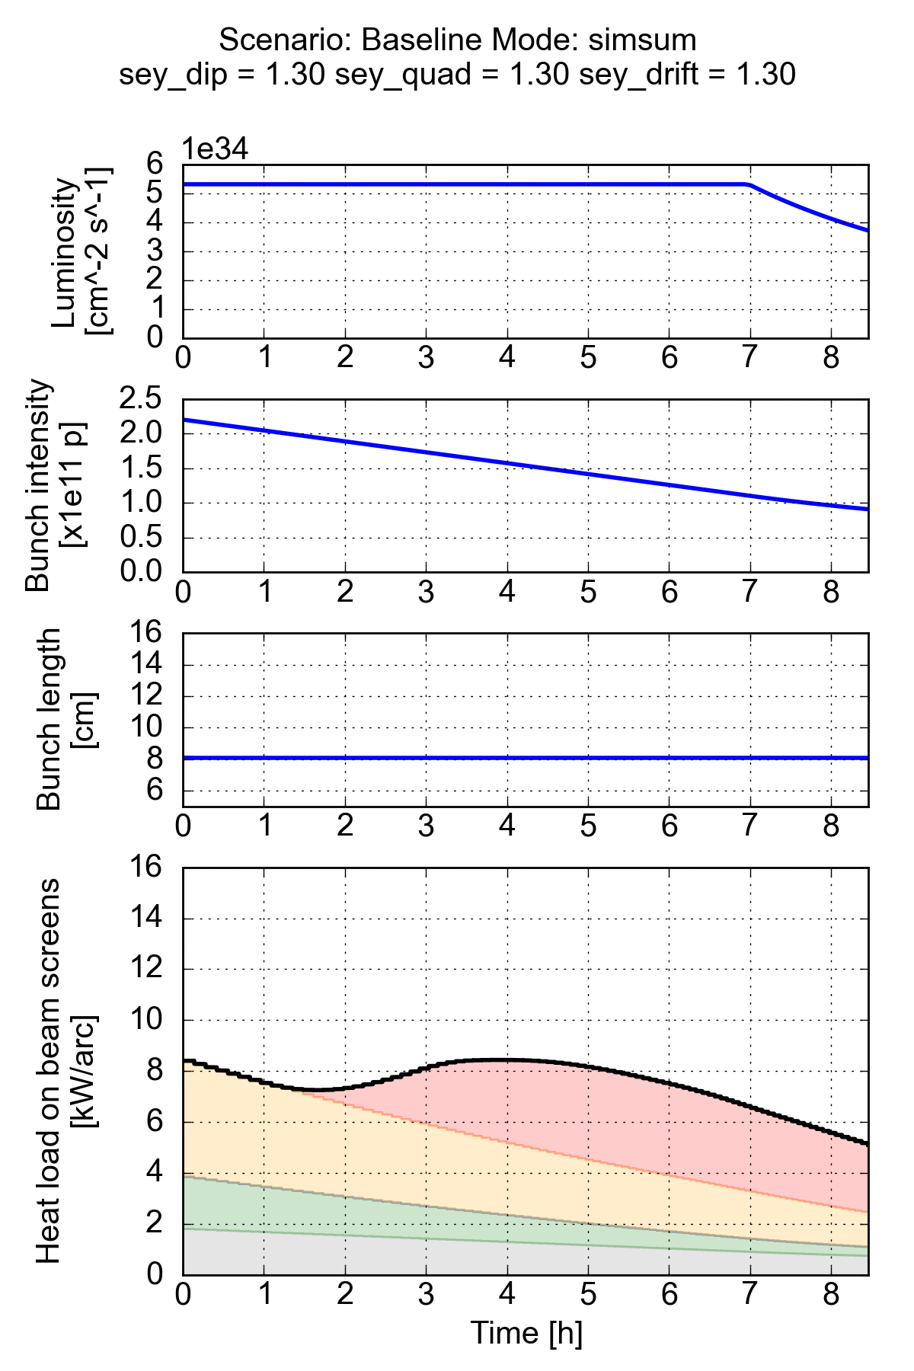
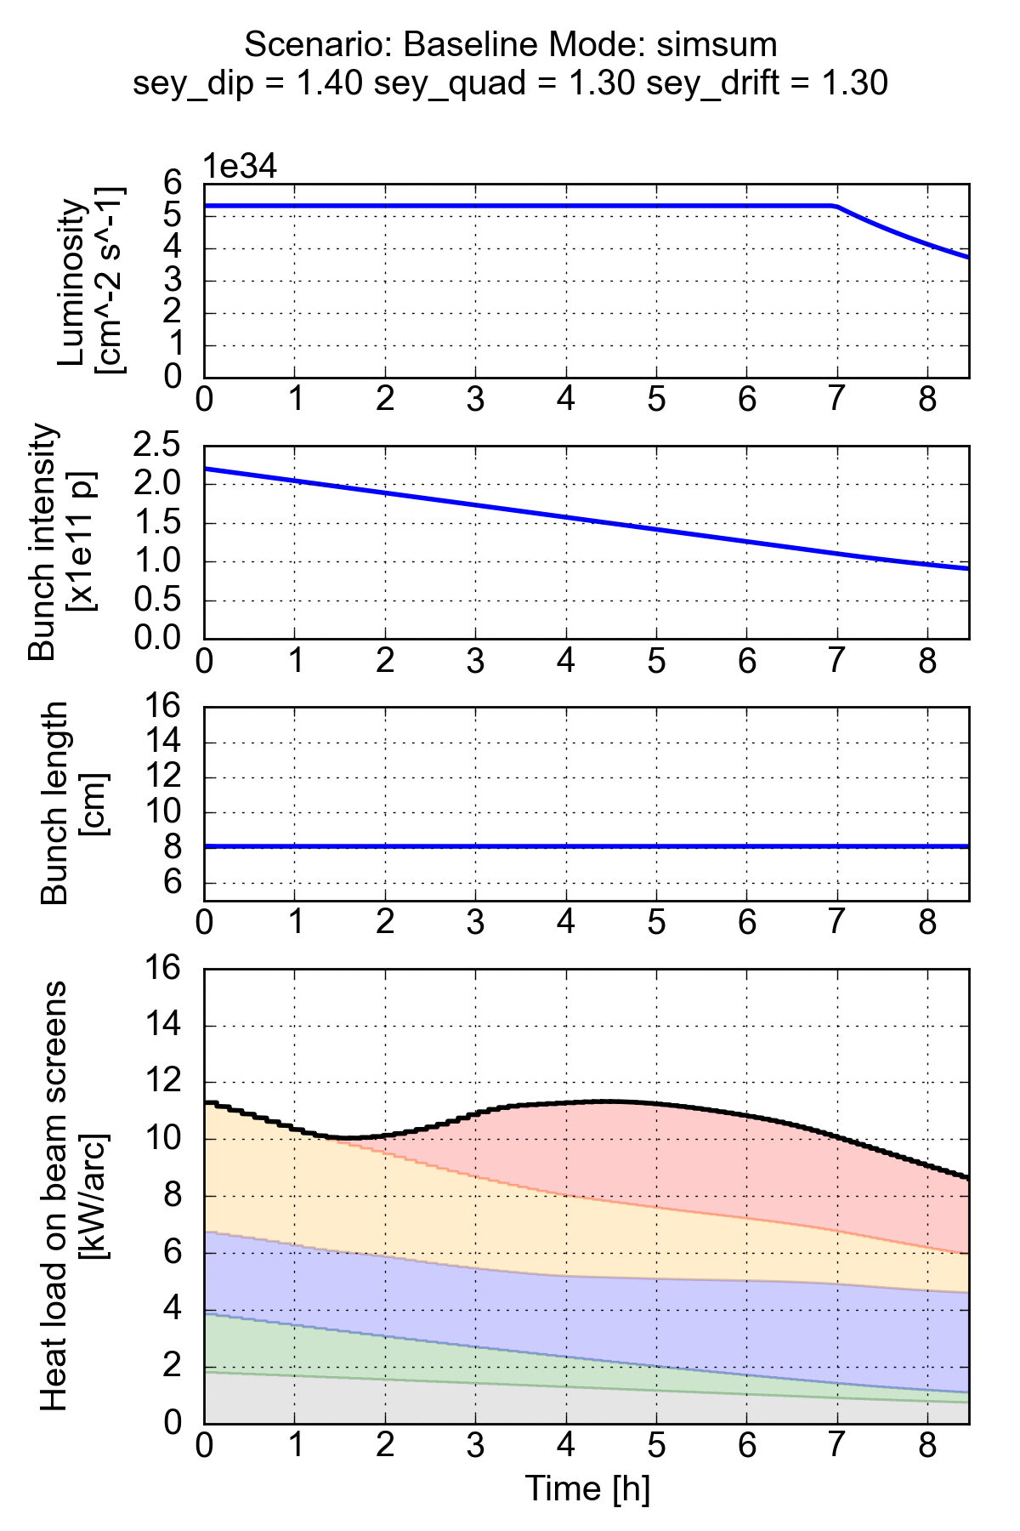
e-cloud quad.
Impedance
e-cloud drifts
e-cloud dip.
Syn. radiation

