Slide 1
Report on DESY
Overview and Highlights
European XFEL
DESY Testbeam
LHC phase II in Germany
Strategy discussions in Germany
Joachim Mnich
Plenary ECFA Meeting
CERN, November 2016

Slide 2

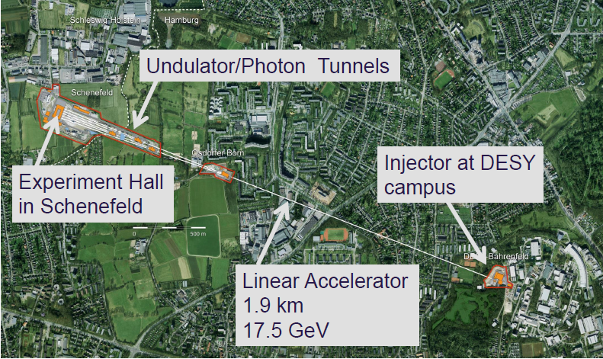












EUROPEAN XFEL
X-Ray Laser
Femto-Flashes
2,5 km
Ultrarelativistic Electrons

Slide 3
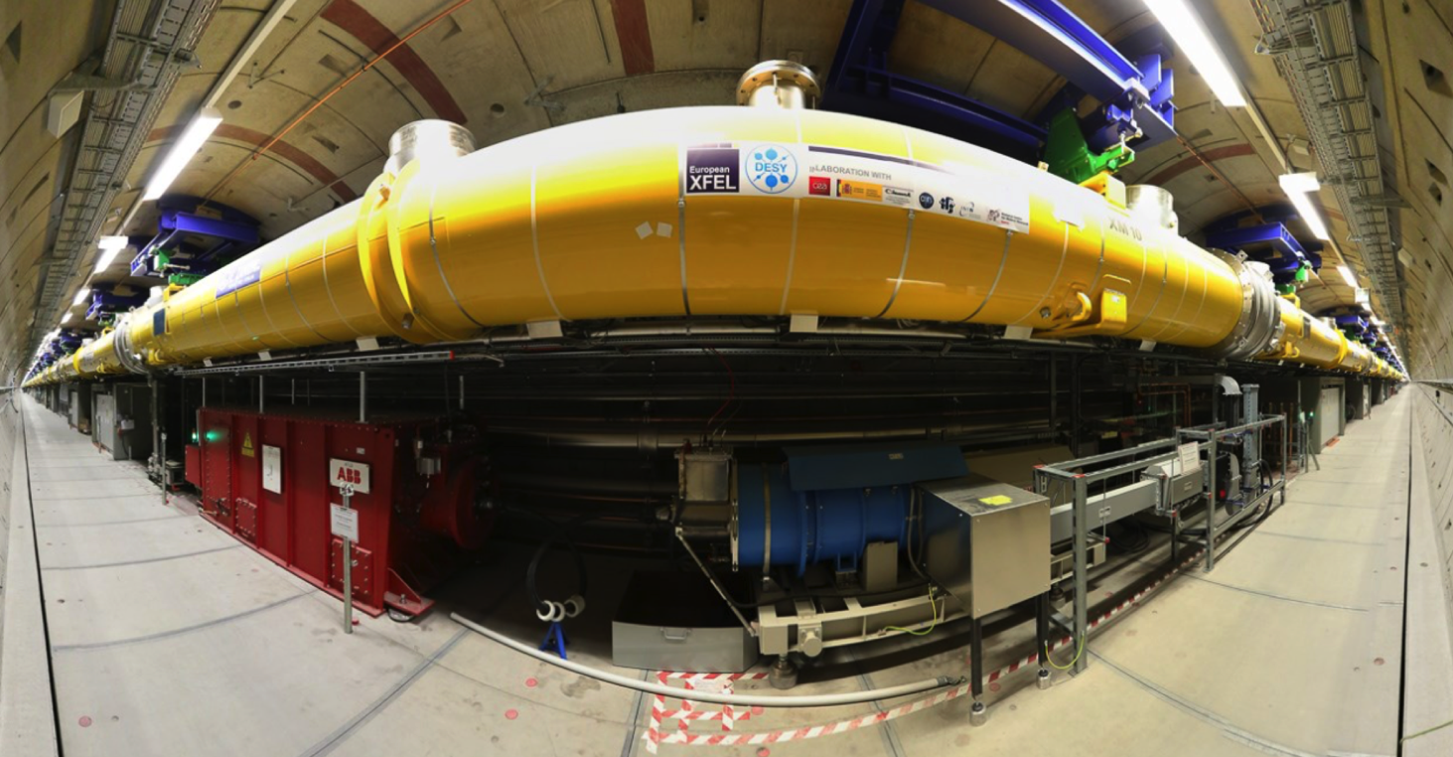
XFEL – ACCELERATOR
100% of SC linac installed (96 cryomodules)
Warm beamline section installation completed
Injector commissioning completed 7/2016

Slide 4
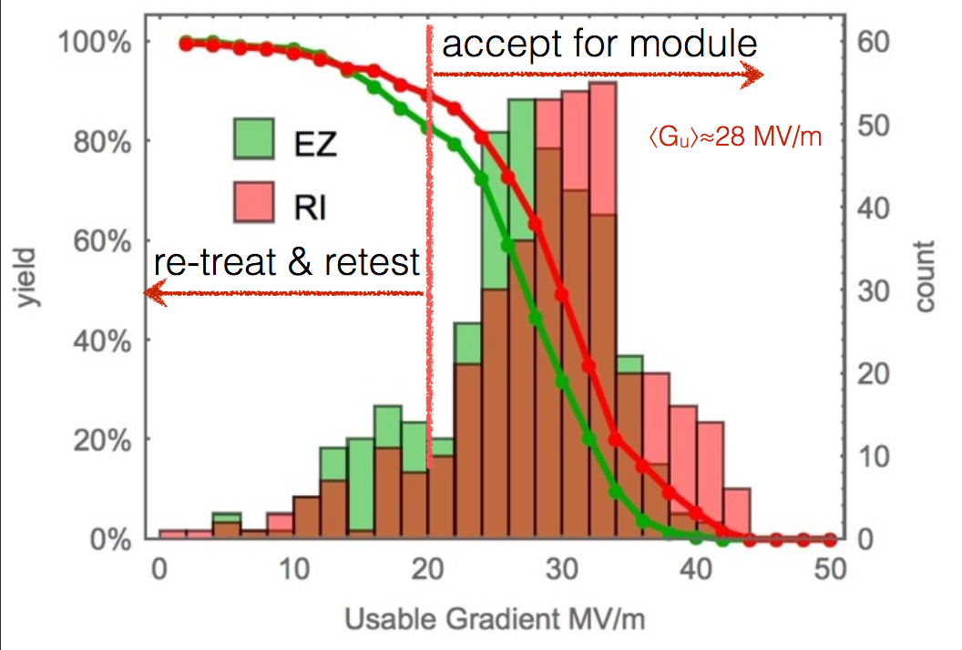
CAVITY PERFORMANCE AFTER RE-TREATMENT
Very close to ILC specs, on an industrial scale!

Slide 5
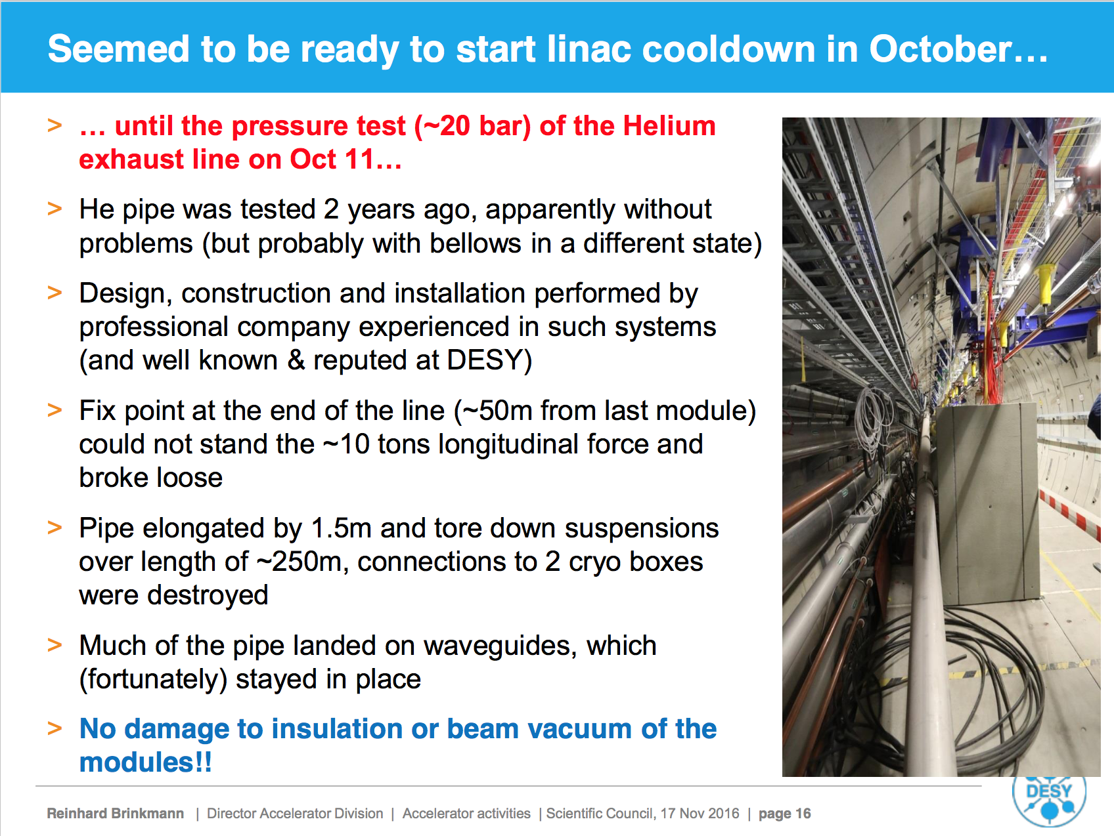
Cooldown schedule delayed by 6 weeks
No significant effect on other activities (e.g. DAF etc.)

Slide 6
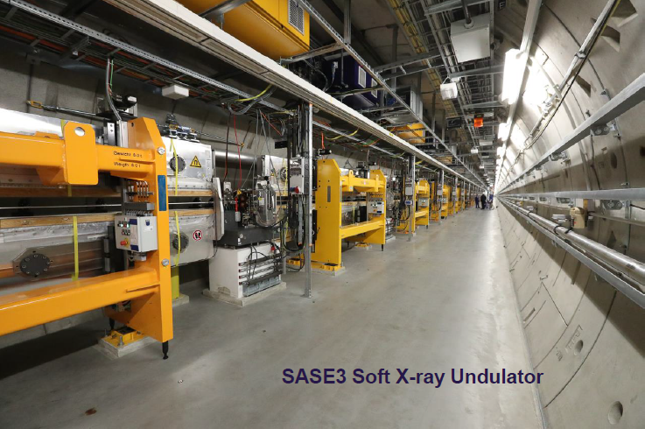
XFEL – UNDULATORS

Slide 7
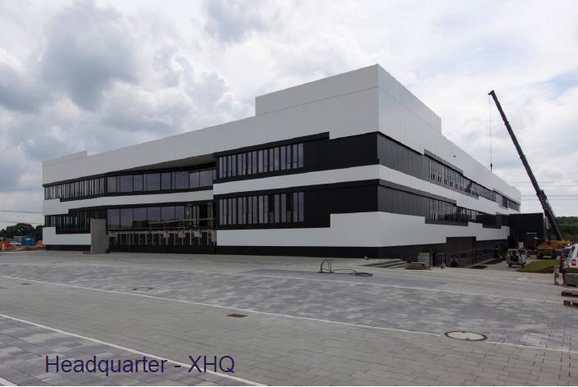
XFEL – MOVED TO SCHENEFELD IN JUNE 2016

Slide 8
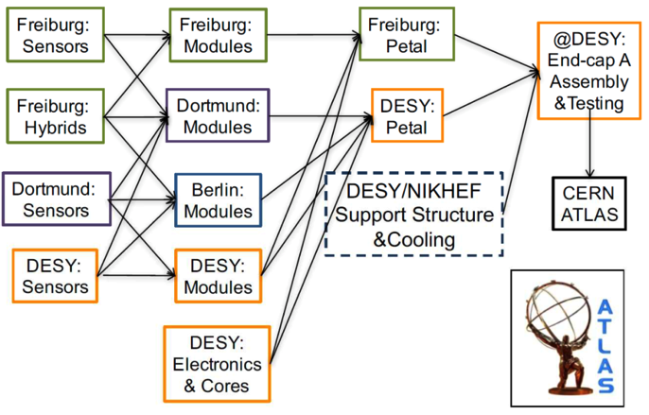
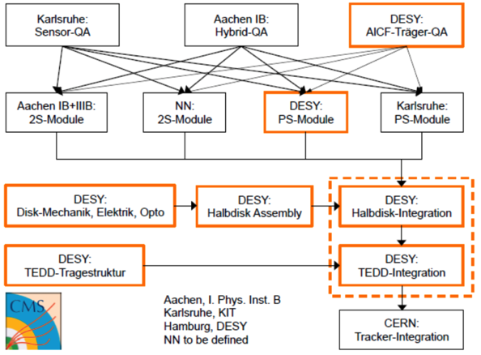
LHC PHASE 2 UPGRADES (HL-LHC) IN GERMANY
Major contributions from universities and DESY in both experiments:
ATLAS: Strip & pixel Si detectors, calorimetry, muon system, trigger&DAQ
CMS: Outer tracker, pixel detector, muon spectrometer
90 M€ funds for universities from German ministry (BMBF)
Helmholtz contribution: 15.7 M€ strategic investment funds for tracker end-caps @ DESY (wrt. 20 M€ requested)
Strong cooperation between universities and DESY
  Assembly and system tests of tracker end-caps for CMS and ATLAS @ DESY

Slide 9
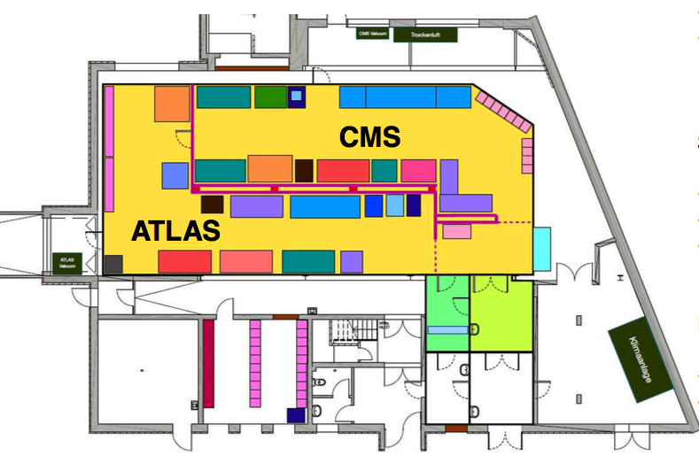
BUILDING 25c – GROUND FLOOR
Module production and
testing
Clean room ISO6
  ~255 m²
  Storage
  Technical equipment
Status:
  Old infrastructure /
  walls removed
  Preparing for clean room
  installation
  Tender for clean room
  in progress
Plan:
  Clean room installation at the beginning of 2017
  Ready for users mid-2017

Slide 10
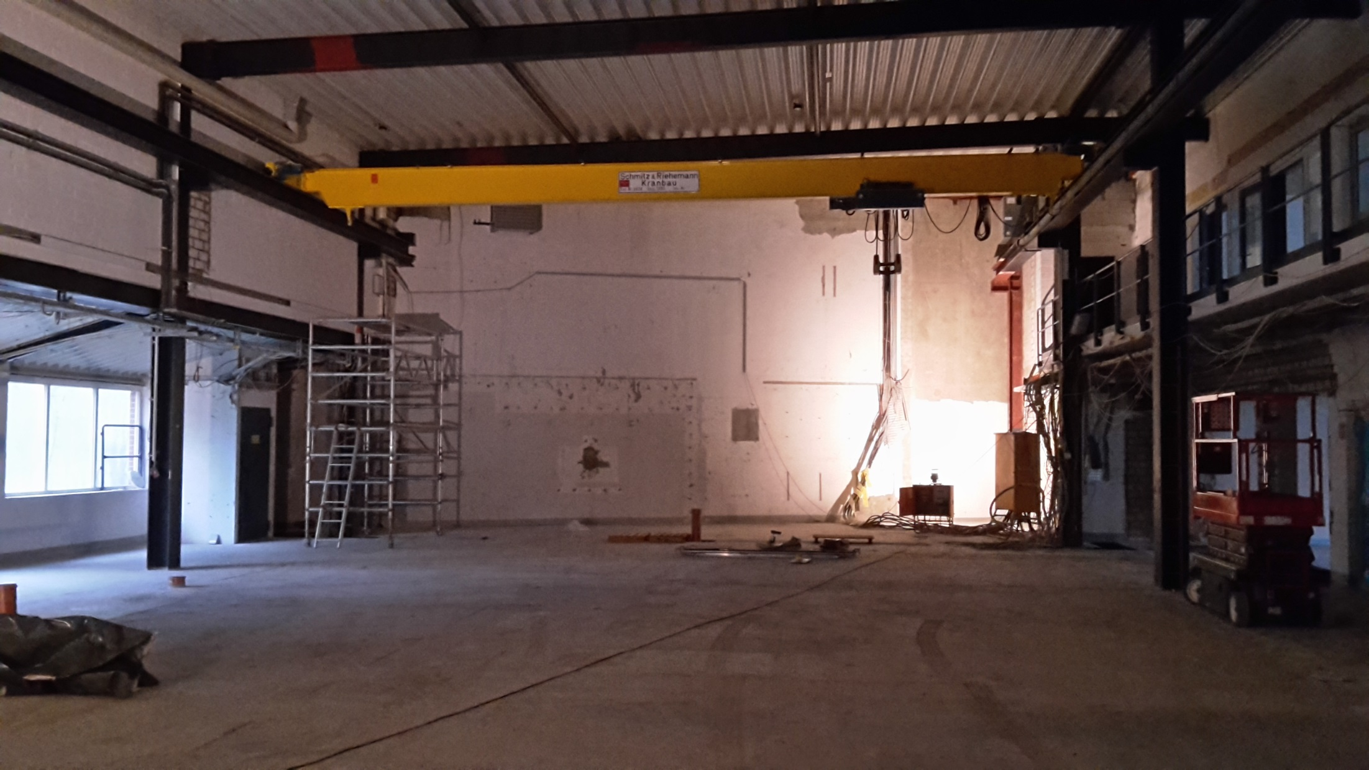
BUILDING 25c: 15 NOVEMBER

Slide 11
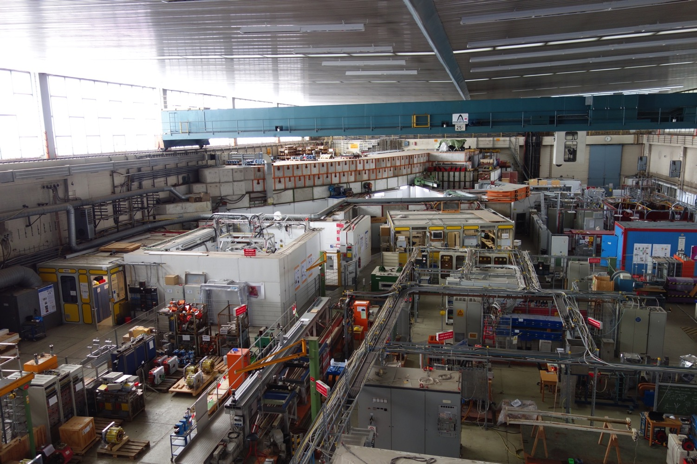
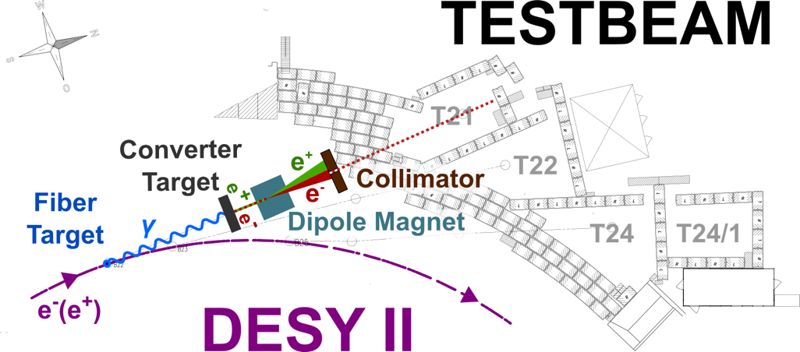
DESY-II TEST BEAM FACILITY

Slide 12
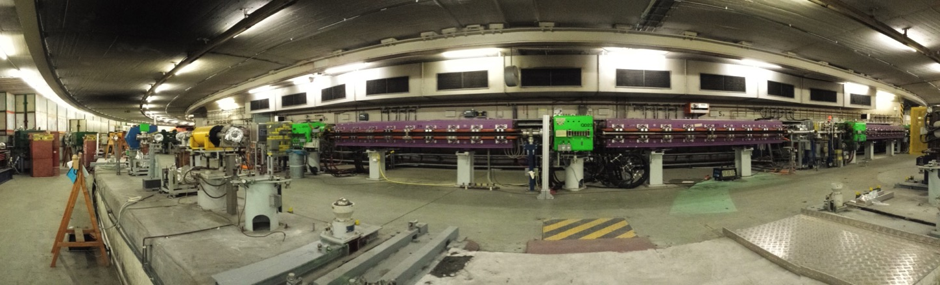
TEST BEAM FACILITY
Unique infrastructures at DESY
  Two pixel beam telescopes
    High demand – requested by >70% of users
  PCMAG
    1 T superconducting solenoid with 1 m diameter
    unique infrastructure worldwide
Shutdown 2015-2016
  Complete overhaul of beam diagnostics in DESY-II Tunnel
  New Gas Safety System
  Laser Alignment System in each area
  New cabling & fiber links
Further upgrades of the facility are being discussed

Slide 13
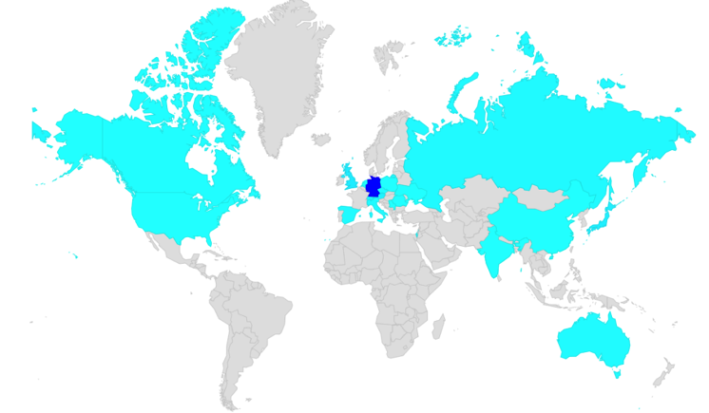
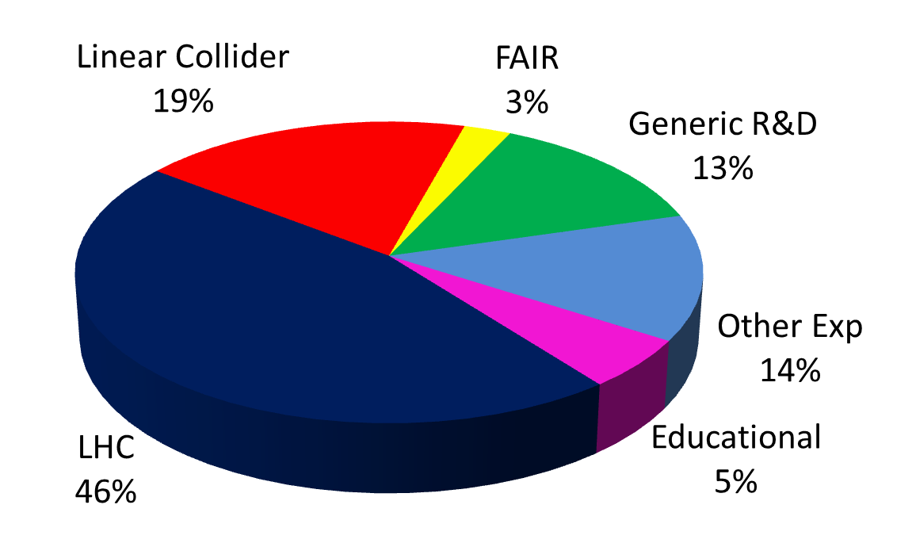
DESY-II TEST BEAM FACILITY
Run 2016
  March 14th -December 23rd
  Availability of synchrotron ~99%!
Requests 2016
  ~ ½ from LHC groups
  70% of groups request telescopes
  243 users from 20 countries
  62 % booked, 38% new users,
  47 % students
Highlights
  Belle II tracking system test
  with 66 users
  First time: physics teachers from
  Hamburg to perform experiments
Perspective:
  2017 call out; so far 30 weeks requested
  2016: 243 Users from 20 countries

Slide 14
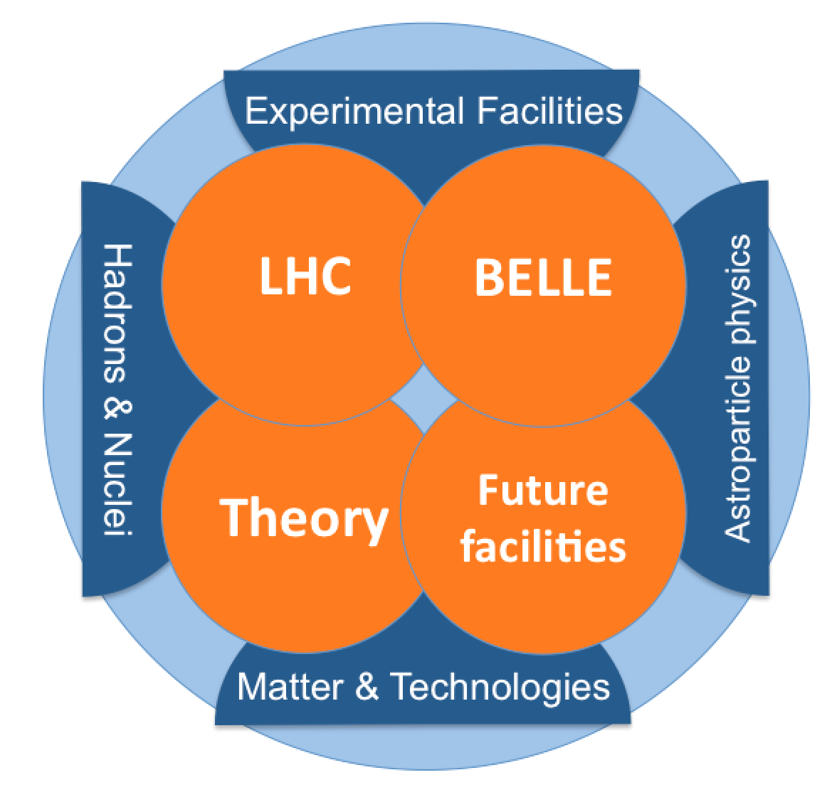
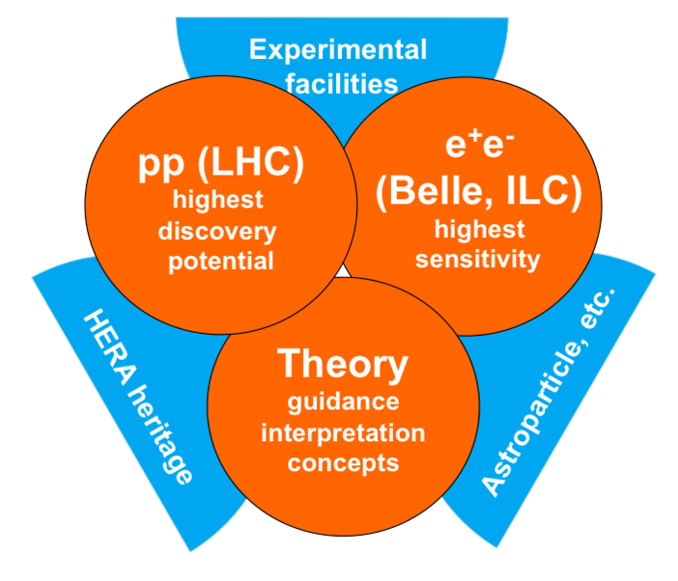
DESY: FROM POF 3 TO POF 4
POF 3 (2015-19)
POF 4 idea (2020++)
LHC (+ Belle + Theory) will remain the backbone of DESY particle
physics in next funding period.
  Explore potential in neutrinos (LBNF, CERN platform), axions (IAXO)
  and collider-based experiments (ILC, CLIC, FCC, CEPC, …)

Slide 15
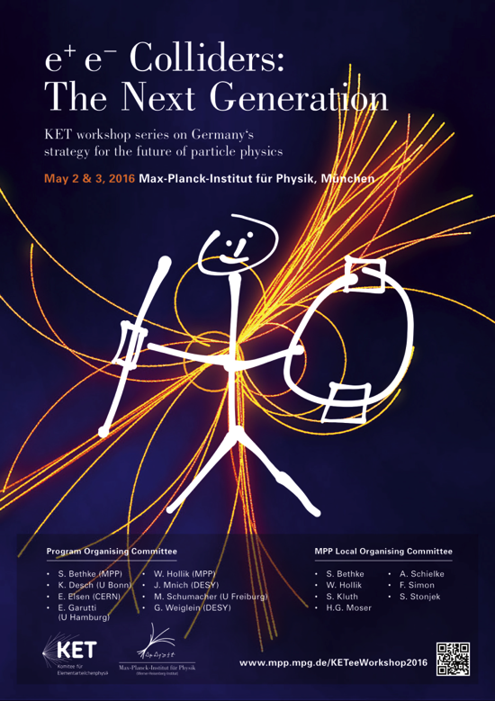
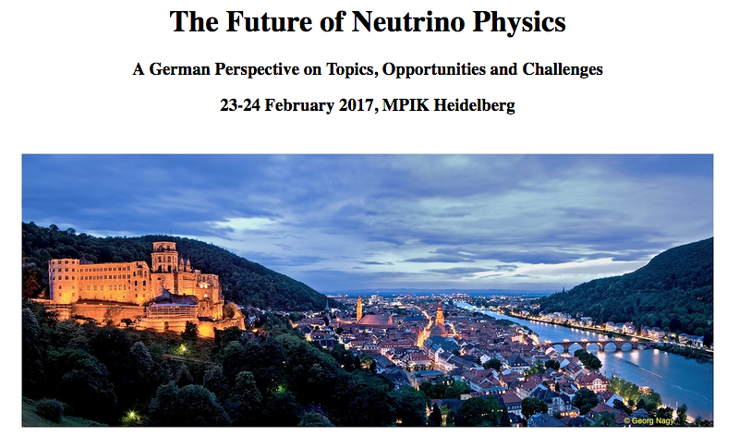
German Strategy Developments
Series of workshops organised by KET (+KAT+KHuK):
May 2016: future e⁺e⁻ machines (Munich)
February 2017: neutrino physics (Heidelb.)
April 2017: non-collider expts. (tbd)
..
Discussions results to serve as German input for European strategy

Slide 16
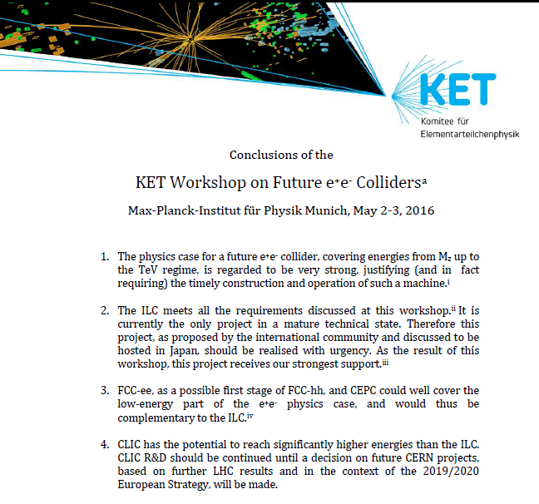
FUTURE ELECTRON-POSITRON COLLIDERS
Series of Workshops
is being organised by
German particle physics
community
First on future e+e-colliders
Conclusions:

Slide 17

ADVERTISEMENT

Slide 18
Backup

Slide 19
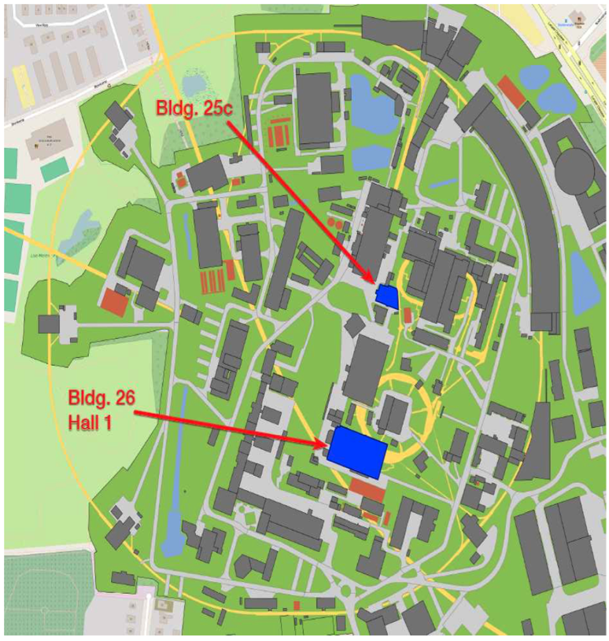
DETECTOR ASSEMBLY FACILITY (DAF) AT DESY
10 M€ investment into
DESY infrastructure
Started 06/16
Building 25c:
  Lab space and clean rooms
  QA
  Module production
  Module testing
Starting 2017
Building 26 (hall 1):
  Hall with cleanrooms
  Petal & DEE assembly
  End-cap integration
  System test
Shared by ATLAS and CMS

