Slide 1

Report to ECFA, November 24th 2016
Hans Peter Beck: IPPOG Co-chair, Bern University
Marjorie Bardeen: IPPOG Co-chair, Fermilab

Slide 2
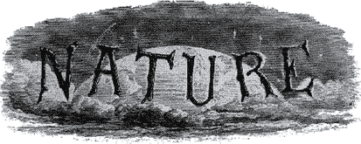
1st issue of
http://www.nature.com/nature/about/first
Nov 4, 1869
A WEEKLY ILLUSTRATED JOURNAL OF SCIENCE
'The objective which it is proposed to attain by this periodical may be broadly stated as follows. It is intended, First, to place before the general public the grand results of scientific work and scientific discovery; and to urge the claims of science to move to a more general recognition in education and in daily life.
'Secondly, to aid scientific men themselves, by giving early information of all advances made in any branch of natural knowledge throughout the world, and by affording them an opportunity of discussing the various scientific questions which arise from time to time.'

Slide 3
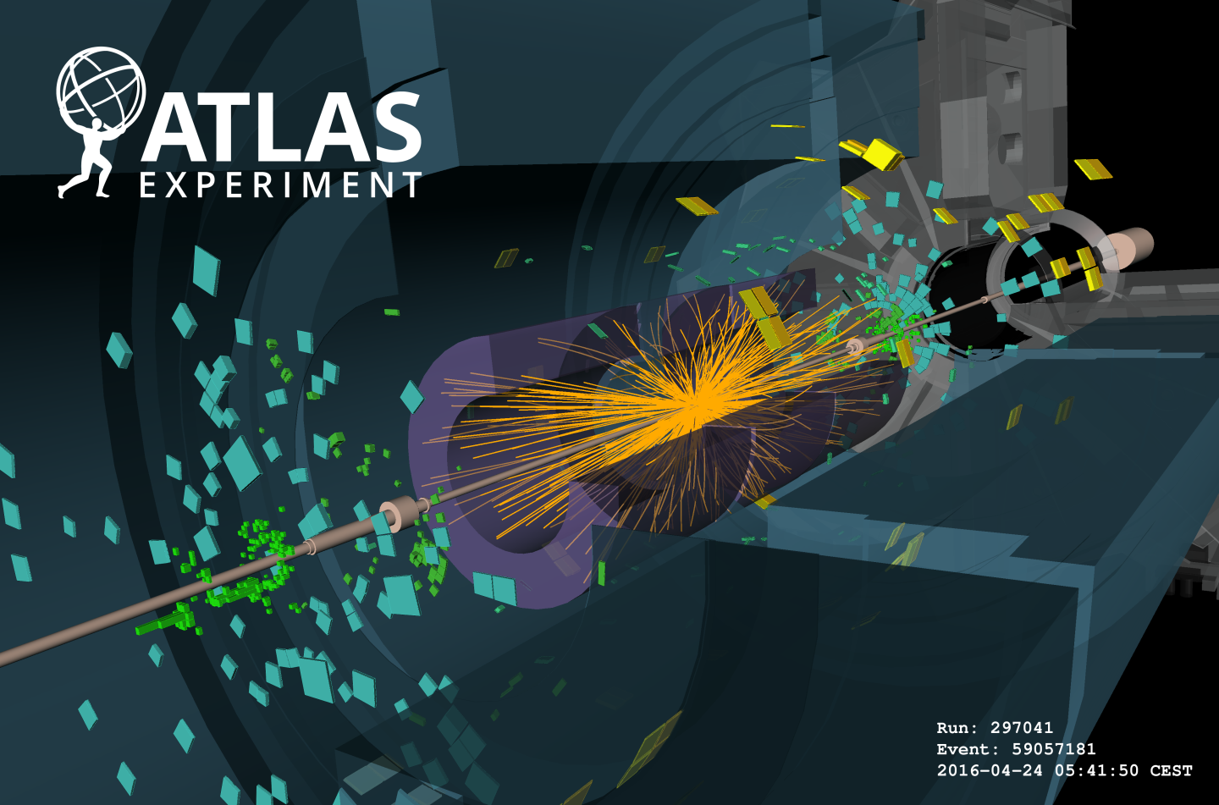
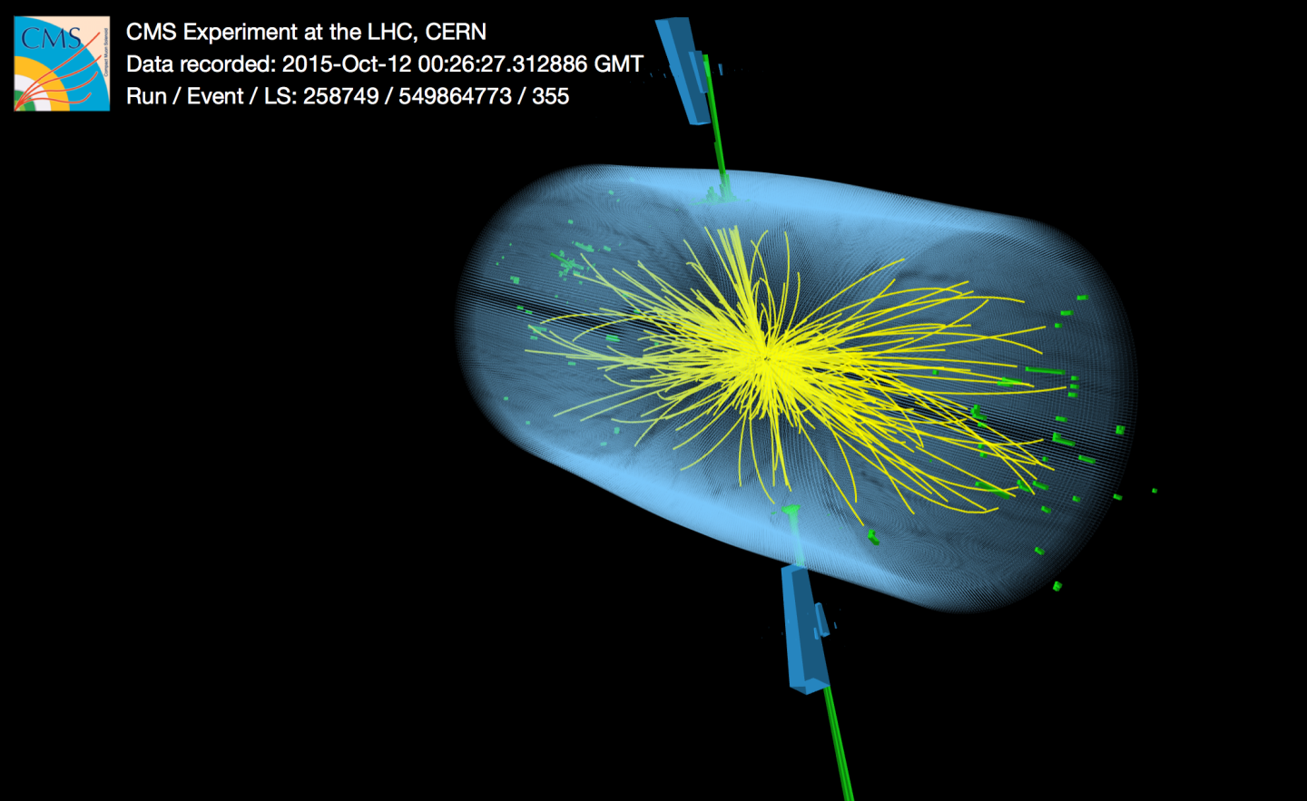
13 TeV pp Collisions
Truly an amazing achievement
the biggest complex machinery ever built
possible with a world-spanning collaborative effort,
advancing knowledge in the most fundamental questions
about our Universe!
Notes:
We all know this picture, its one of the first 13 TeV proton proton collisions inside one of the detectors at the LHC.
We heard at the beginning of the week about the ground breaking work the LHC accelerator people have done, not just to build this machine, but to get it working so well at ever higher energies, and we have heard of neutrino experiments and gravity wave experiments, thousands of people working worldwide in international collaborations, all on the same quest, of exploration.
We do something amazing! We get to think about, and try to answer some of the most fundamental questions about our Universe. And we do this through developing hugely advanced mathematical theories and performing experiments using some of the biggest, most complex machines on earth! We have this great opportunity to advance the knowledge of mankind in the field of high energy physics, and we claim this work is fundamental to the development of our societies, our technology, to propagate scientific culture and knowledge, and may inspire people all over the world. That’s why the general public fund us, and im going to talk about what we have the responsibility to give back.

Slide 4
Critical Outreach
Explaining and reaching out particle physics is a critical necessity for all involved in particle physic research to engage in.
  Planting seeds
    building up the next generation of curious minds
    some may even chose particle physics
  Satisfying the curios minds
    Curious minds want to get fed
      and particle physics is offering a lot of food
        Fundamental physics and the whereabouts of the Universe
        Human endeavor and human culture
        Bridging cultures and nations in world-wide collaborations and show-casing how we can work together
        Advances and pushes technology and creating spin-offs (www, medical, and much, much more)

Slide 5
Critical Outreach
Whom to reach out
  Young students
    Planting seeds in young curious minds is most effective
      these will continue being curious minds in society, some may become scientists or even particle physicists, some will become decision makers
      all will be tax payers and voters
  Broad public
    To allow for transparency as is natural in all open, democratic societies
    Be aware that not all are interested
  Decision makers
    Politicians and funding agencies
The right level of language is crucial to whomever you talk and needs reflecting the message and complexity you want to convey

Slide 6
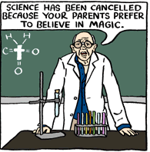
Don’t care and don’t want to know
  Not everybody wants to know and not everybody cares in advancing knowledge
  some ignore science
  some are even against science
Should we care ?
  Yes !
  Science literacy of a society is as important as literacy itself
    We live in a modern world
    A basic understanding of the tools and methods developed by a scientific approach that shape so much our daily live is indeed relevant
If we fail, we risk an unbridgeable gap in society
©Brian McFadden (2001-2009)

Slide 7
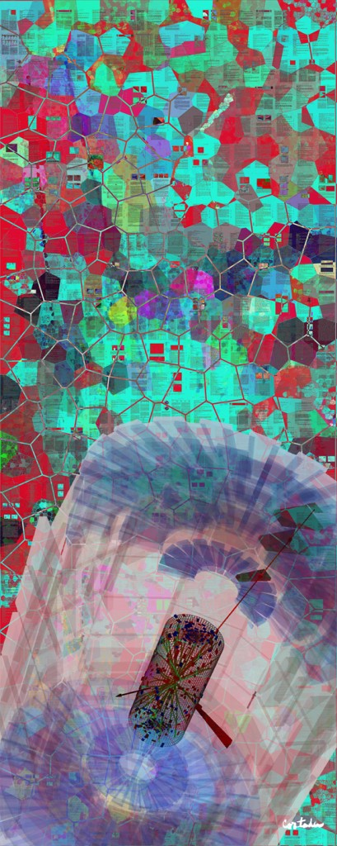
Reaching out further
  How to reach out to the non-interested?
  This is a challenge that cannot be addressed with exposing scientifc tools and methods even stronger
  However, different routes can share our enthusiasm with a wider audience
Art involving science topics are a possible way to widen the audience
to share excitement
to trigger reflections inside peoples minds on the universe, on science, etc. that otherwise would never happen
There is no need for everybody to become an expert – but enabling curiosity and apprehension matters
Xavier Cortada (2013)

Slide 8
Things that need correcting
prejudices and perceptions
of the broad public
that could come up

Slide 9

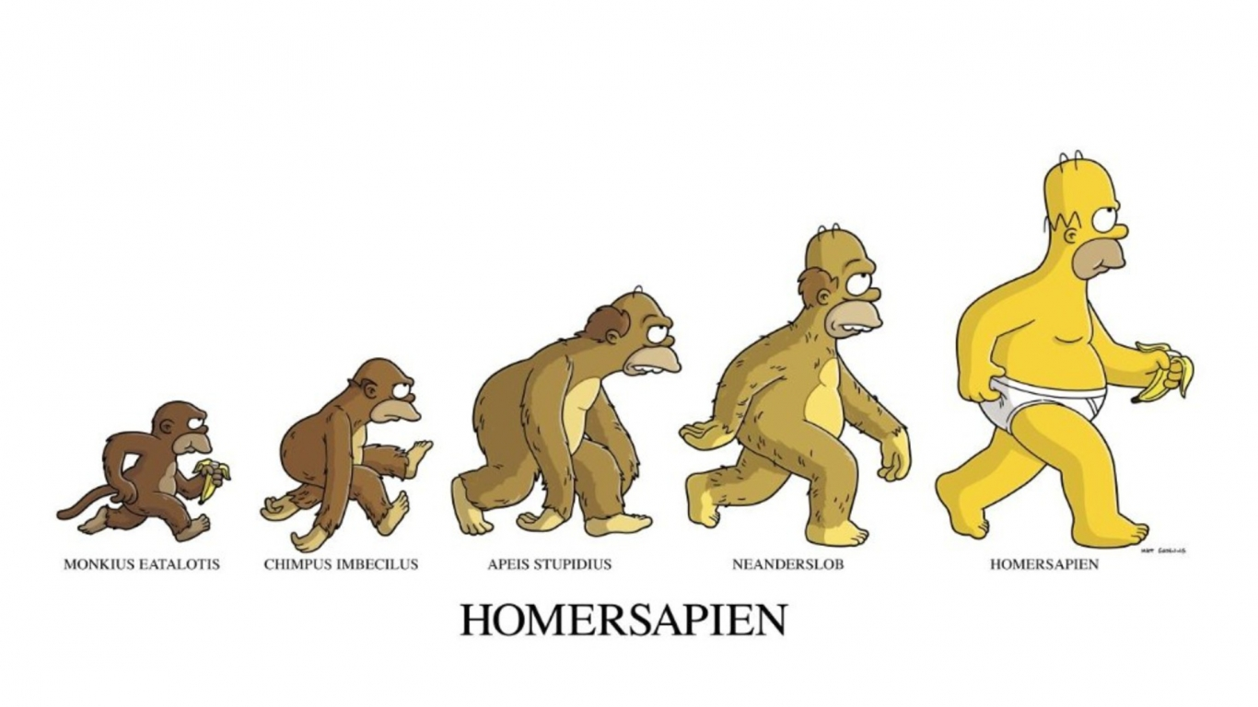
‘irrelevant science of things’
Prejudice: Physics is often perceived as the ‘science of things’
and therefore detached (i.e. irrelevant) from life, the universe and everything.
Don’t be shy to state that
(particle-) physics is the fundamental
base for all understanding of life,
the universe and everything
I.e. Chemistry is based on physics
quantum mechanics, (quantum-)electrodynamics
Biochemistry is based on chemistry
Life is based on biochemistry
No Hydrogen without particle physics!

Slide 10

‘it’s calculated – why measure?’
Prejudice: Everything can be calculated and there is no need for experiments accelerators and other infrastructure are just toys for boys and girls
Use the chess analogy to counter state
Physics elaborates on finding the rules
on how the Universe works
These rules are like the rules of
the game chess
Knowing the rules opens up to understand
chess and play the game
However, an individual chess game is way open on how it can
evolve.
Further, the rules we found have been validated only within a limited energy scale (high energy frontier, low energy precision measurements), that we cannot rely on these rules beyond the limits these are validated.
New physics, i.e. extending the rules we know, is possible and is a big driving force in fundamental research.

Slide 11
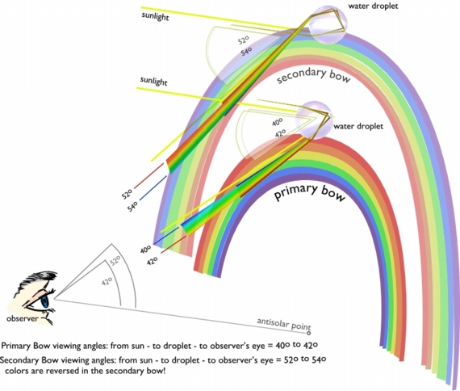
‘it’s calculated – now its dull!’
Prejudice: Whatever is explained by science becomes
dull and looses its mysteries, fascination
and wonders.
The contrary is true !
Use the archeological site analogy
If you don’t know about the site you are visiting, all you see is a pile of old stones and perhaps some funny (maybe appealing) ornaments and scripture.
The more you know about the ancient culture, their habits and their lives, the more interesting the archeological site becomes.
Physics opens up understanding nature, and allows enjoy nature more and more.

Slide 12
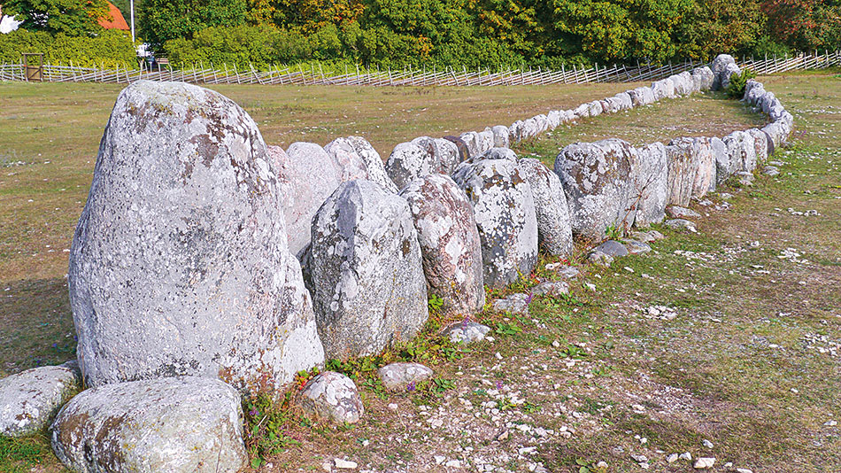
‘it’s calculated – now its dull!’
Prejudice: Whatever is explained by science becomes
dull and looses its mysteries, fascination
and wonders.
The contrary is true !
Use the archeological site analogy
If you don’t know about the site you are visiting, all you see is a pile of old stones and perhaps some funny (maybe appealing) ornaments and scripture.
The more you know about the ancient culture, their habits and their lives, the more interesting the archeological site becomes.
Physics opens up understanding nature, and allows enjoy nature more and more.
The Gannarve megalithic ship grave on the island Gotland in Sweden.

Slide 13
‘particle physics detached from life’
Prejudice: New findings by particle physics experiments are so detached from real life and from real problems that these are of no concern anyhow and therefore of no use.
It’s true that knowing the Higgs existing and its mass doesn’t change every days life.
Knowing that there is a Higgs mechanism responsible for mass of elementary particles, and that mass is fundamentally needed for allowing structure to build up in the Universe, put’s this knowledge on a different scale. We simply wouldn’t exist without the Higgs mechanism in place!
All after all, it’s all about the Universe in the end being Intelligible
and in a combined effort, we can learn how it works.

Slide 14
‘science findings don’t last’
Prejudice: Established knowledge is only valid for a short moment in time and thrown over board immediately when new findings come in. As this happens iteratively, there will never be anything useful worth trusting. Science (and scientists) can’t be trusted.
Although bad examples do exist e.g. in clinical studies based on too small or biased samples, this is not true in general.
The work and findings of e.g. Newton and many, many more, is still valid today;
although general relativity supersedes Newtonian mechanics, we now know exactly how well Newtonian mechanics works and where the limits are.
Empirical established knowledge will stay forever as part of human culture.
The existence of the Higgs boson will stay, but it’s role in nature is still open for future refinements.

Slide 15
IPPOG
International Particle Physics Outreach Group
an example for concerted and systematic effort for outreach
Enabling Outreach Globally
as a Collaboration in a collaborative effort

Slide 16
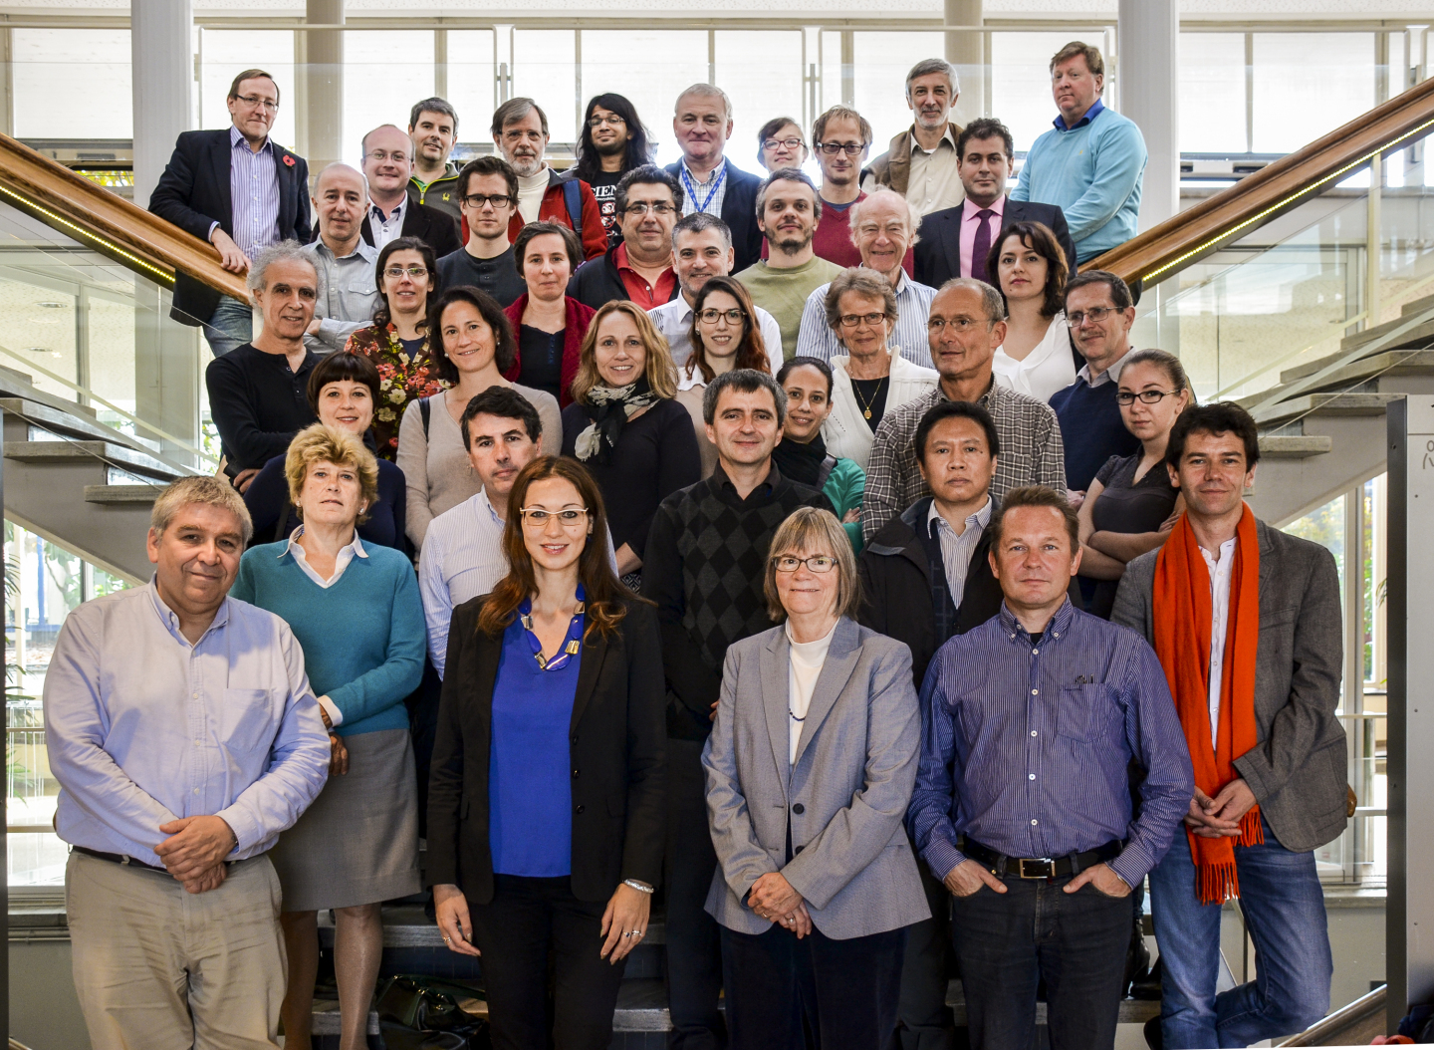
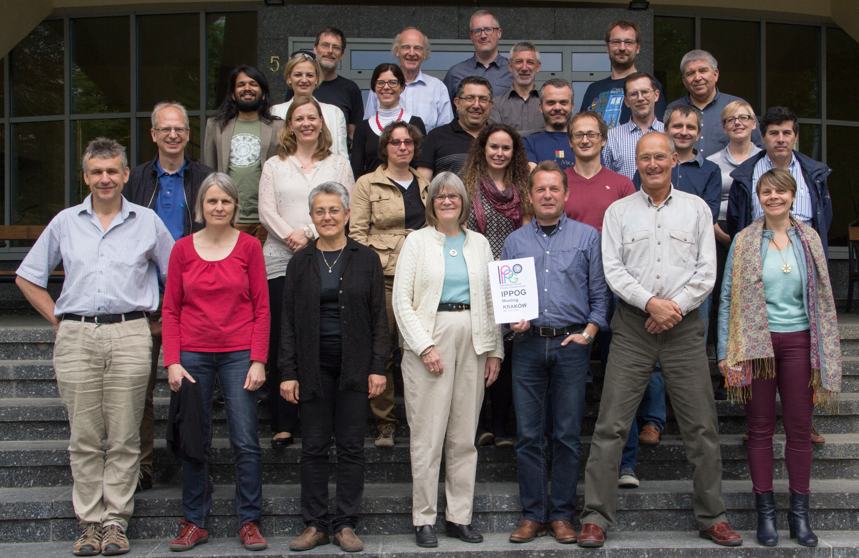
IPPOG
– an International Network
Current members come from the 22 member states of CERN, Australia, Ireland, Slovenia, South Africa, the USA, and from DESY, CERN and five of the major experiments at the Large Hadron Collider (LHC).
http://ippog.web.cern.ch
International network of (mainly) physicists who commit a fraction of their time in education and outreach.
These are your local contacts
in your country, laboratory,
and experiment when you need,
advice, help, support,
in your education and
outreach activities.
IPPOG meets twice a year
in Spring and Autumn to discuss
and exchange thoughts and
success stories, get inspirational
ideas, and getting organized world-wide.
IPPOG Fall meeting 2015 – CERN
Incl. half-day session with EPPCN
IPPOG Spring meeting 2016 – Krakow, IFJ PAN

Slide 17
IPPOG’s purpose
  Strengthening the sustainability, reproduction and growth of outreach activities in particle physics
    through the provision of reliable and regular discussion forums and information exchange for science institutions and laboratories as well as for individual scientists engaged in science outreach and informal science education world-wide
  Raising standards
    for outreach and informal science education initiatives by proposing and implementing strategies designed to share lessons learned and best practices for outreach in particle physics and related fields
  Providing explanatory materials
    for helping disseminate results from particle physics and related subjects.

Slide 18
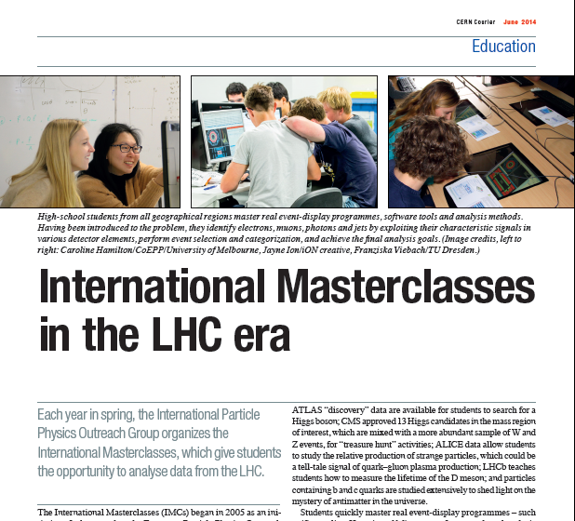
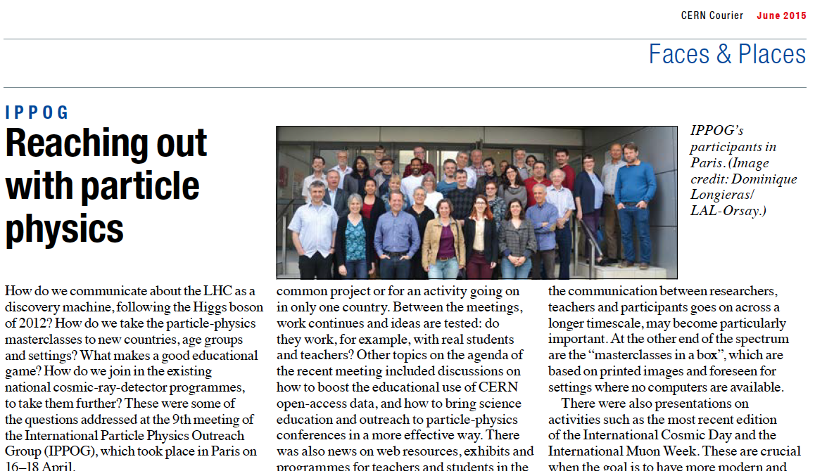
IPPOG an umbrella for making outreach global
International Masterclasses,
the flagship activity of IPPOG
trained over 13’000 students
and 1’000 teachers in
Spring every year !
Over 200 institutions in over 46
countries participating.
CERN Courier
June 2014 edition
    &
June 2015 edition

Slide 19
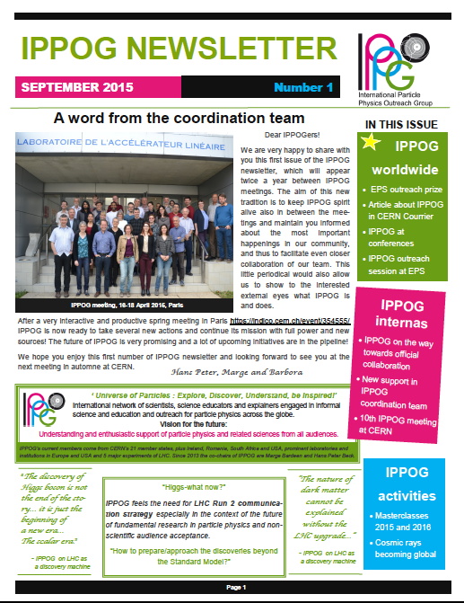
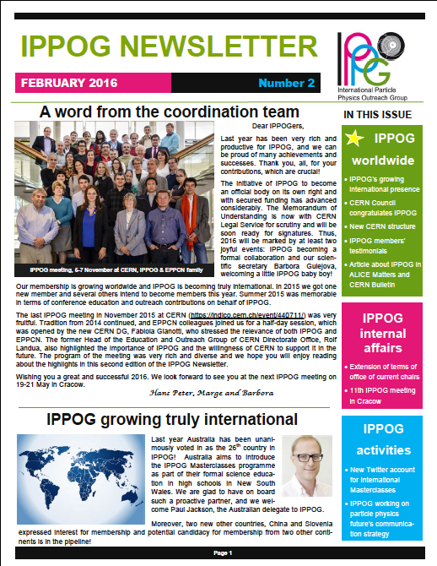
IPPOG Newsletter
http://ippog.web.cern.ch/ → IPPOG NEWS

Slide 20
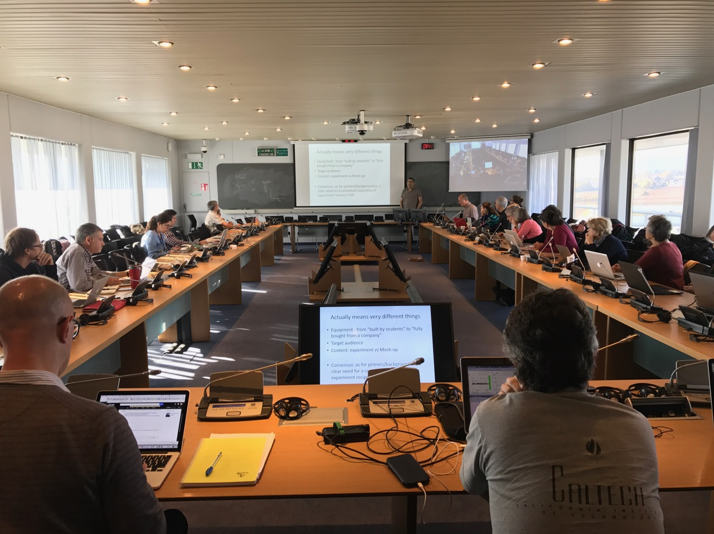
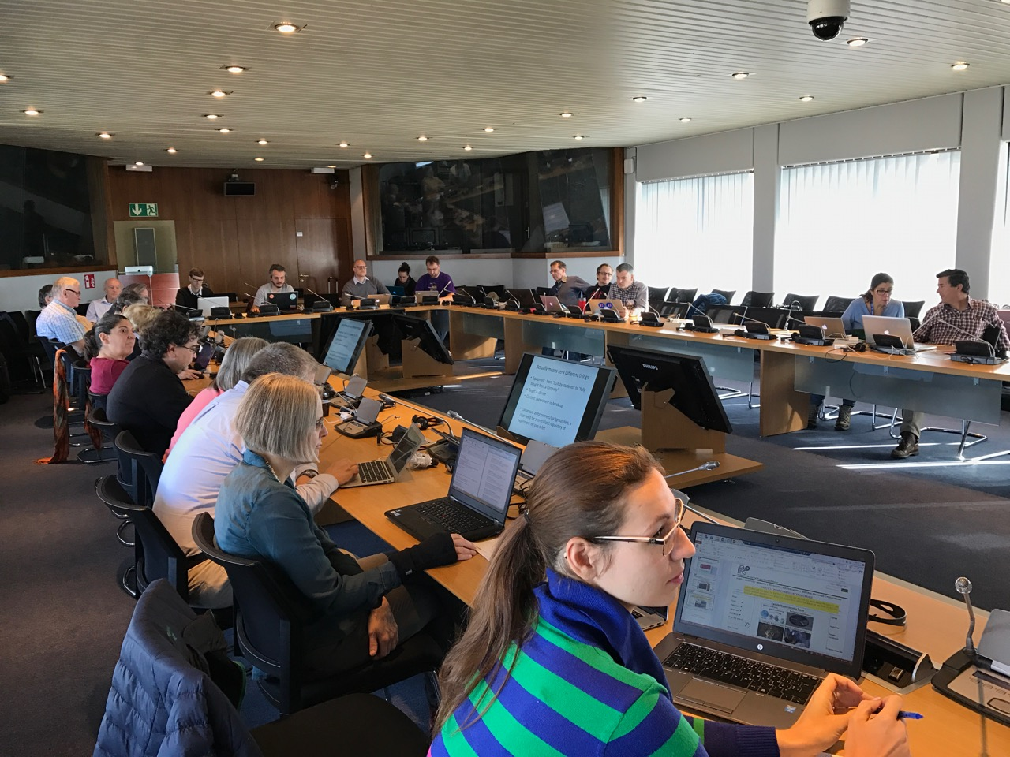
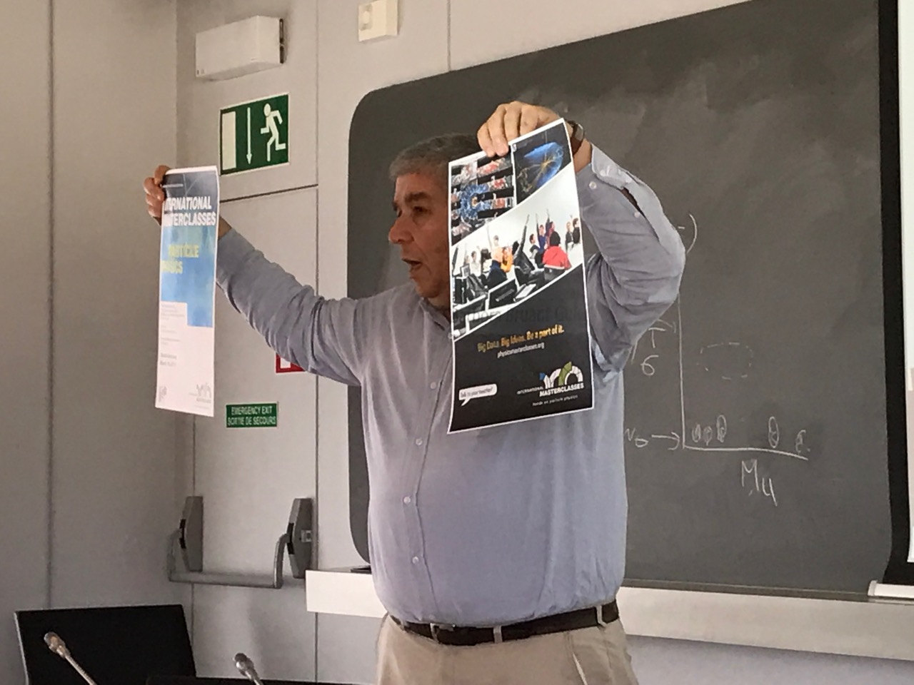
12th IPPOG Meeting Nov 10-12, 2016
https://indico.cern.ch/event/573645
Explaining PP hot topics to lay audience
Organising E&O sessions for LHCP and ICHEP
Table top experiments
Beamline for schools 2016 and call for 2017
Masterclasses in New Countries
Broadening the physics scope of Masterclasses
Inspiring success stories
Special events and exhibitions
Masterclasses 2016
IPPOG website
MoU discussion
Country highlights
An inside view from IPPOG
Impact and usage of worldwide open data
Ethics in particle physics
Physics for everyone - The Higgs particle
Election of new chairs

Slide 21
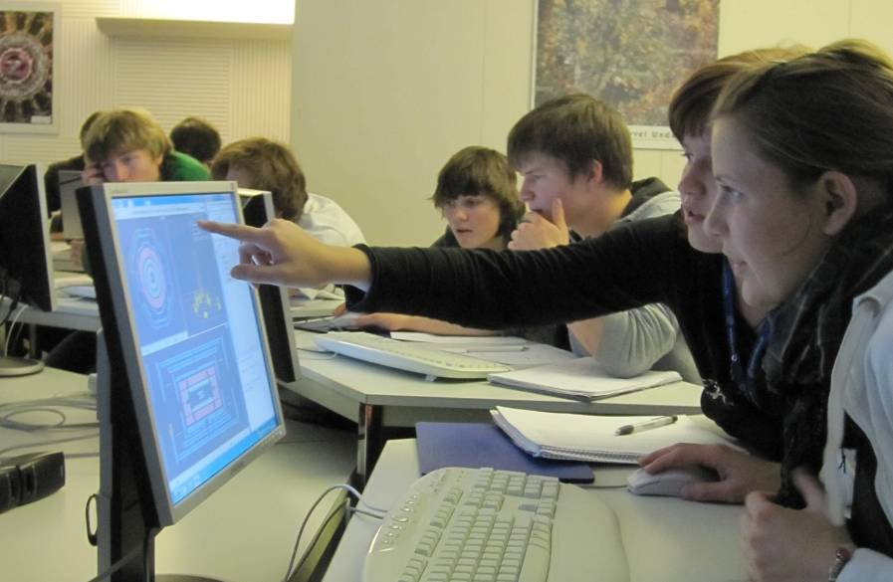
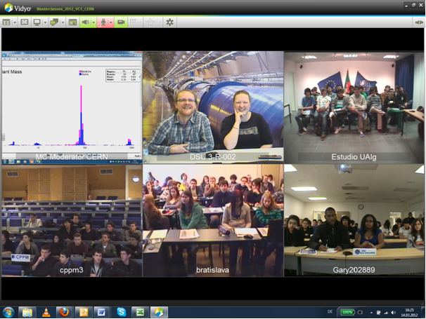
IPPOG’s Flagship:
International Masterclasses
High school students (15 – 19) are „scientists for one day“
Get invited to a research institute or university
Introductory talks (standard model, detectors, accelerators)
2 h measurement with LHC data
  New also with Icecube data
International video conference
( 2 – 5 inst. + CERN/Fermilab)

Slide 22
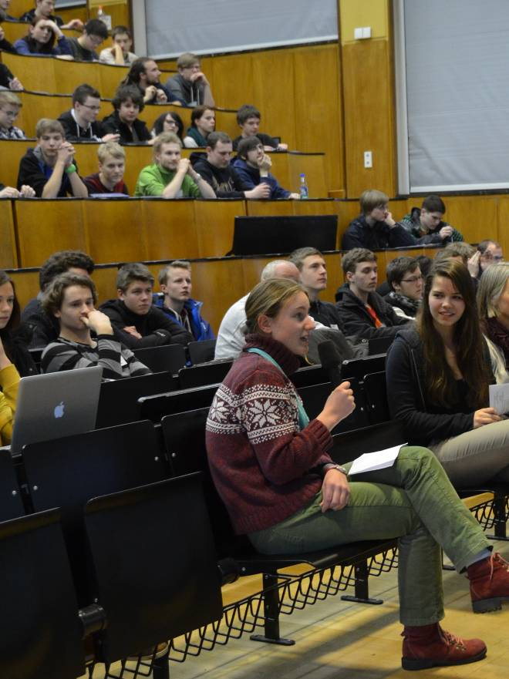
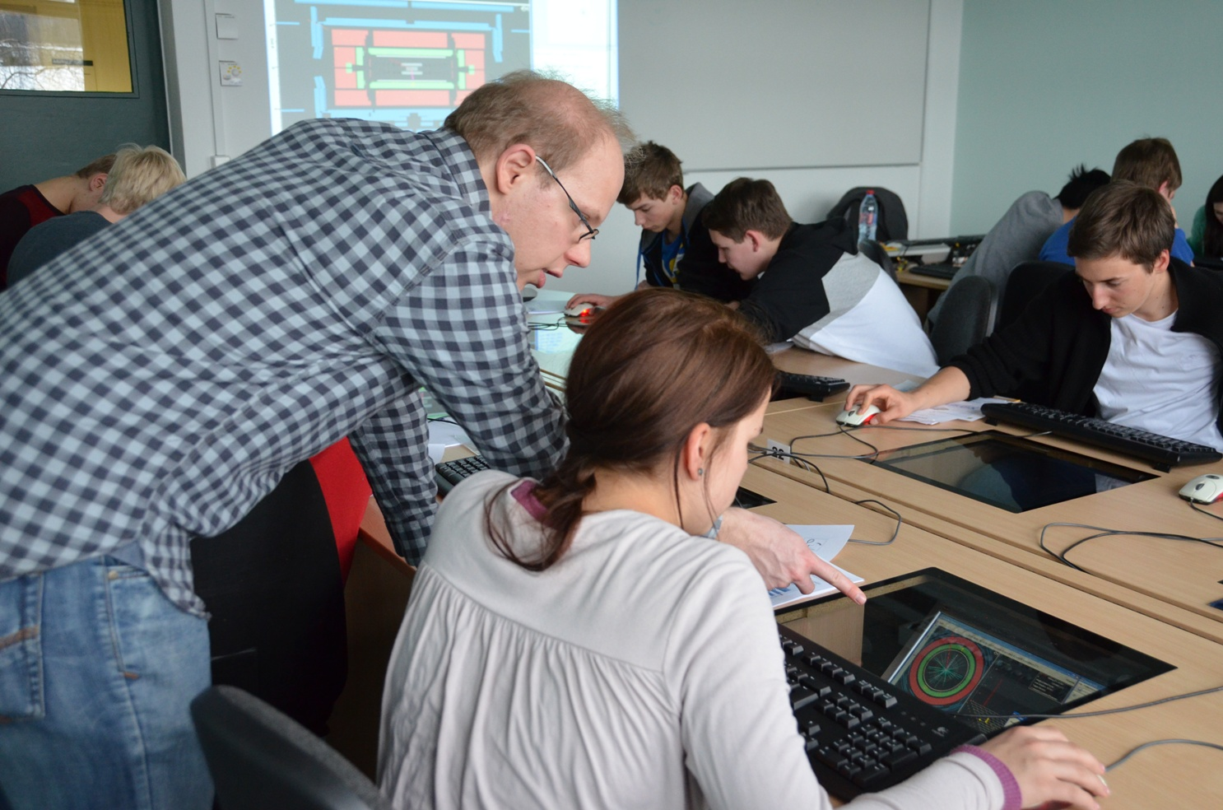
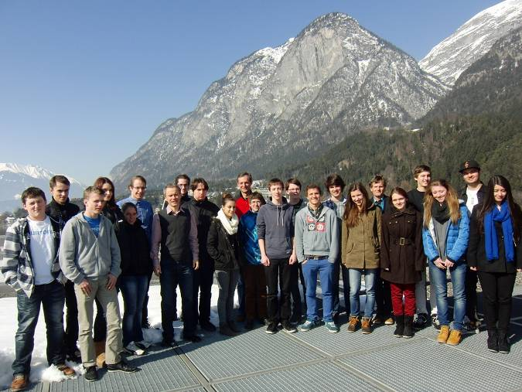
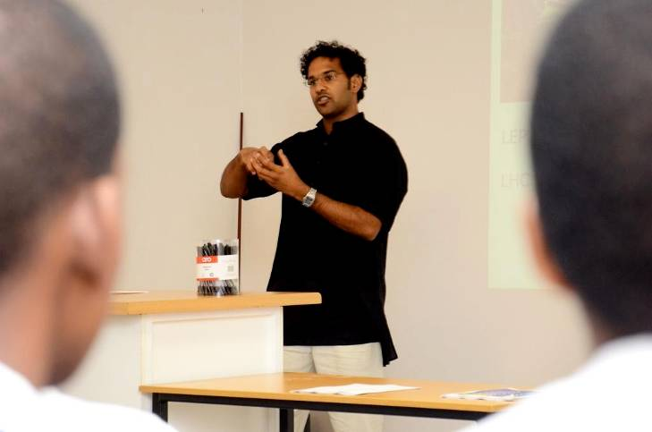
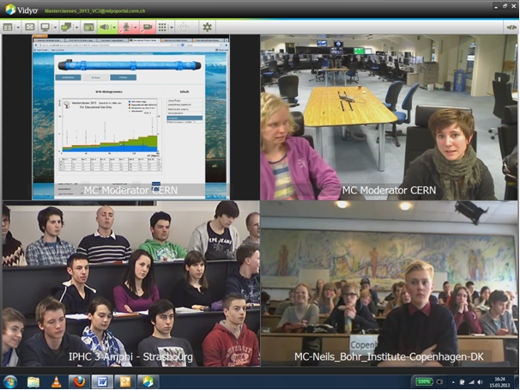
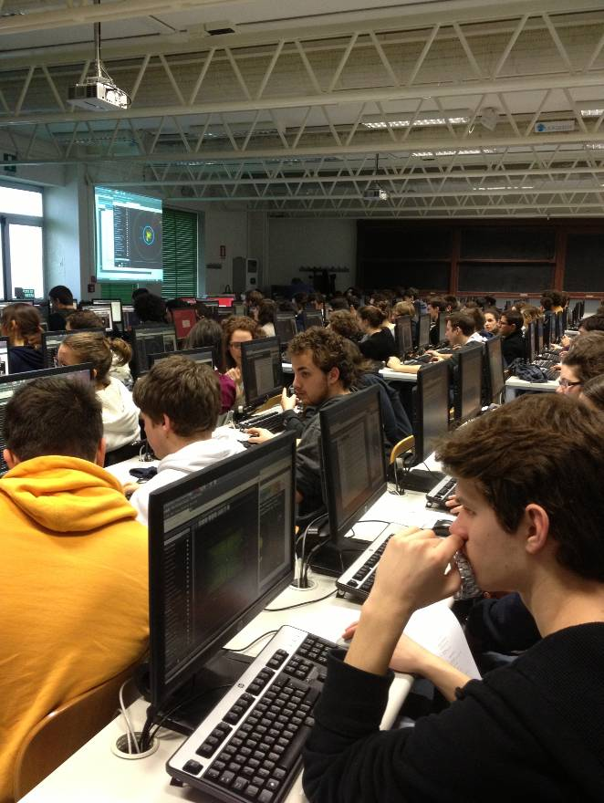
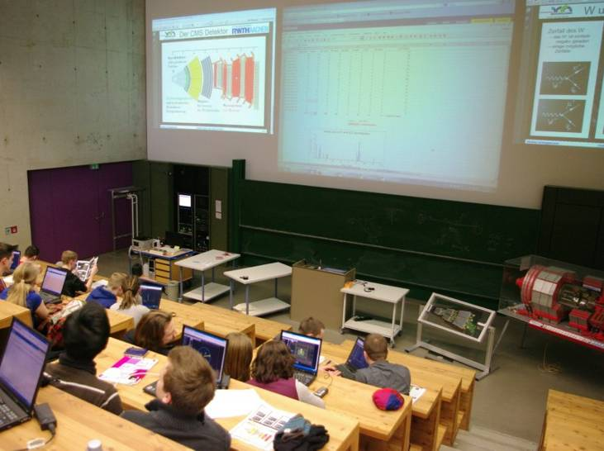
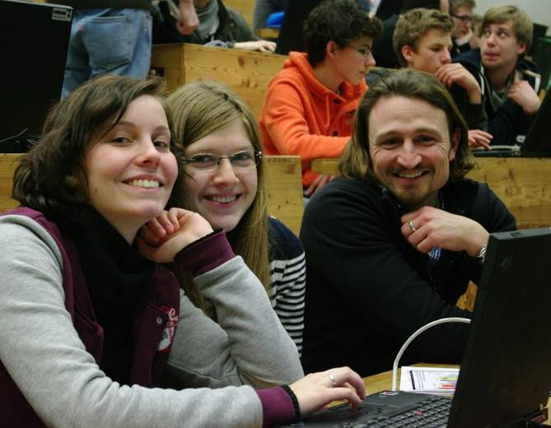

Slide 23
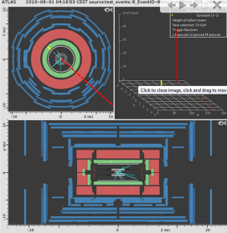
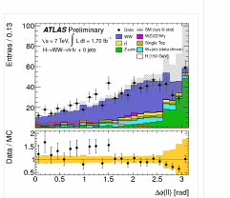
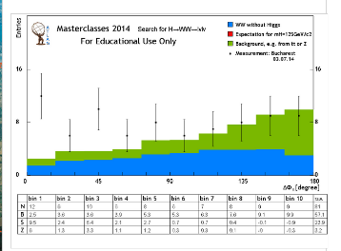
High-school students analyze LHC data
ATLAS
  W path (Higgs → WW)
  Z path (discover Extra Z’ Bosons)
CMS
  WZH measurements
ALICE
  Looking for Strange Particles
  R_AA
LHCb
  D⁰→Kπ measurement
in the future: TOTEM, …
Measurements are kept up to date
and continuously improve
  Exploit known Standard Model Processes, e.g.
    W⁺/W⁻ ratio corresponding to (uud) quarks in proton
    Understand mass peaks of J/Psi and Z
  On the way to discover new particles
    Higgs → WW
    Extra Z Bosons
    …
Notes:
23
Follow up closely, what the scientists are doing

Slide 24
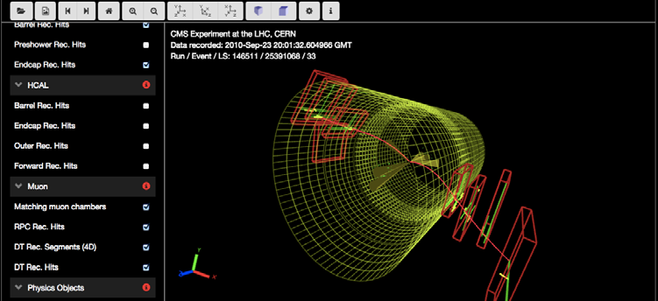
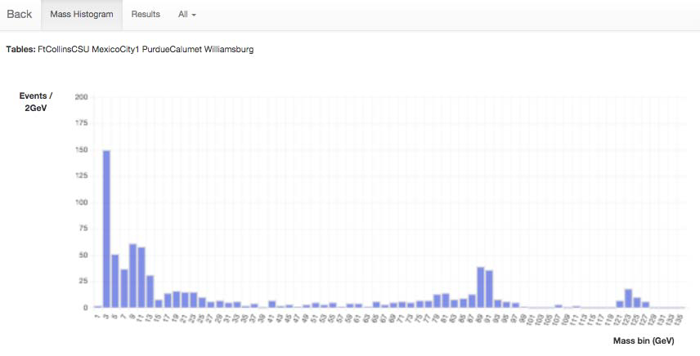
For example:
The CMS WZH measurement
Students visually characterize, W, Z, and H candidates in event display and extracting kinematics from objects ‘they see’ and fill spread sheets.
Create mass plots of SM particles that decay in 2 leptons plus H
Measure W⁺/W⁻ ratio in e and μ leptonic channels
3000 events can be analyzed – with misfits, surprises, interpretation
Website in 12 languages for 2016
Notes:
24
Follow up closely, what the scientists are doing

Slide 25
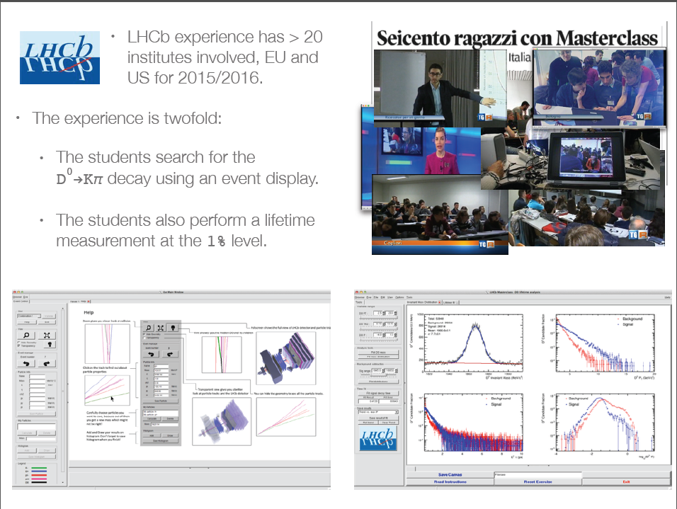
For example:
The LHCb D⁰→Kπ measurement

Slide 26
Evolution of Masterclass participation
2005
2006
2007
2008
2009
2010
2011
2012
2013
2014
2015
2016
18
countries
46
58
institutes
213
72
masterclasses
276
3k
students
13k
12
video conferences
75

Slide 27
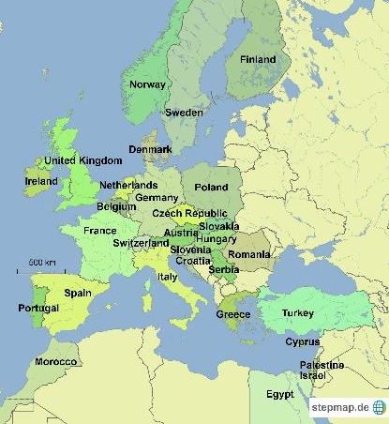
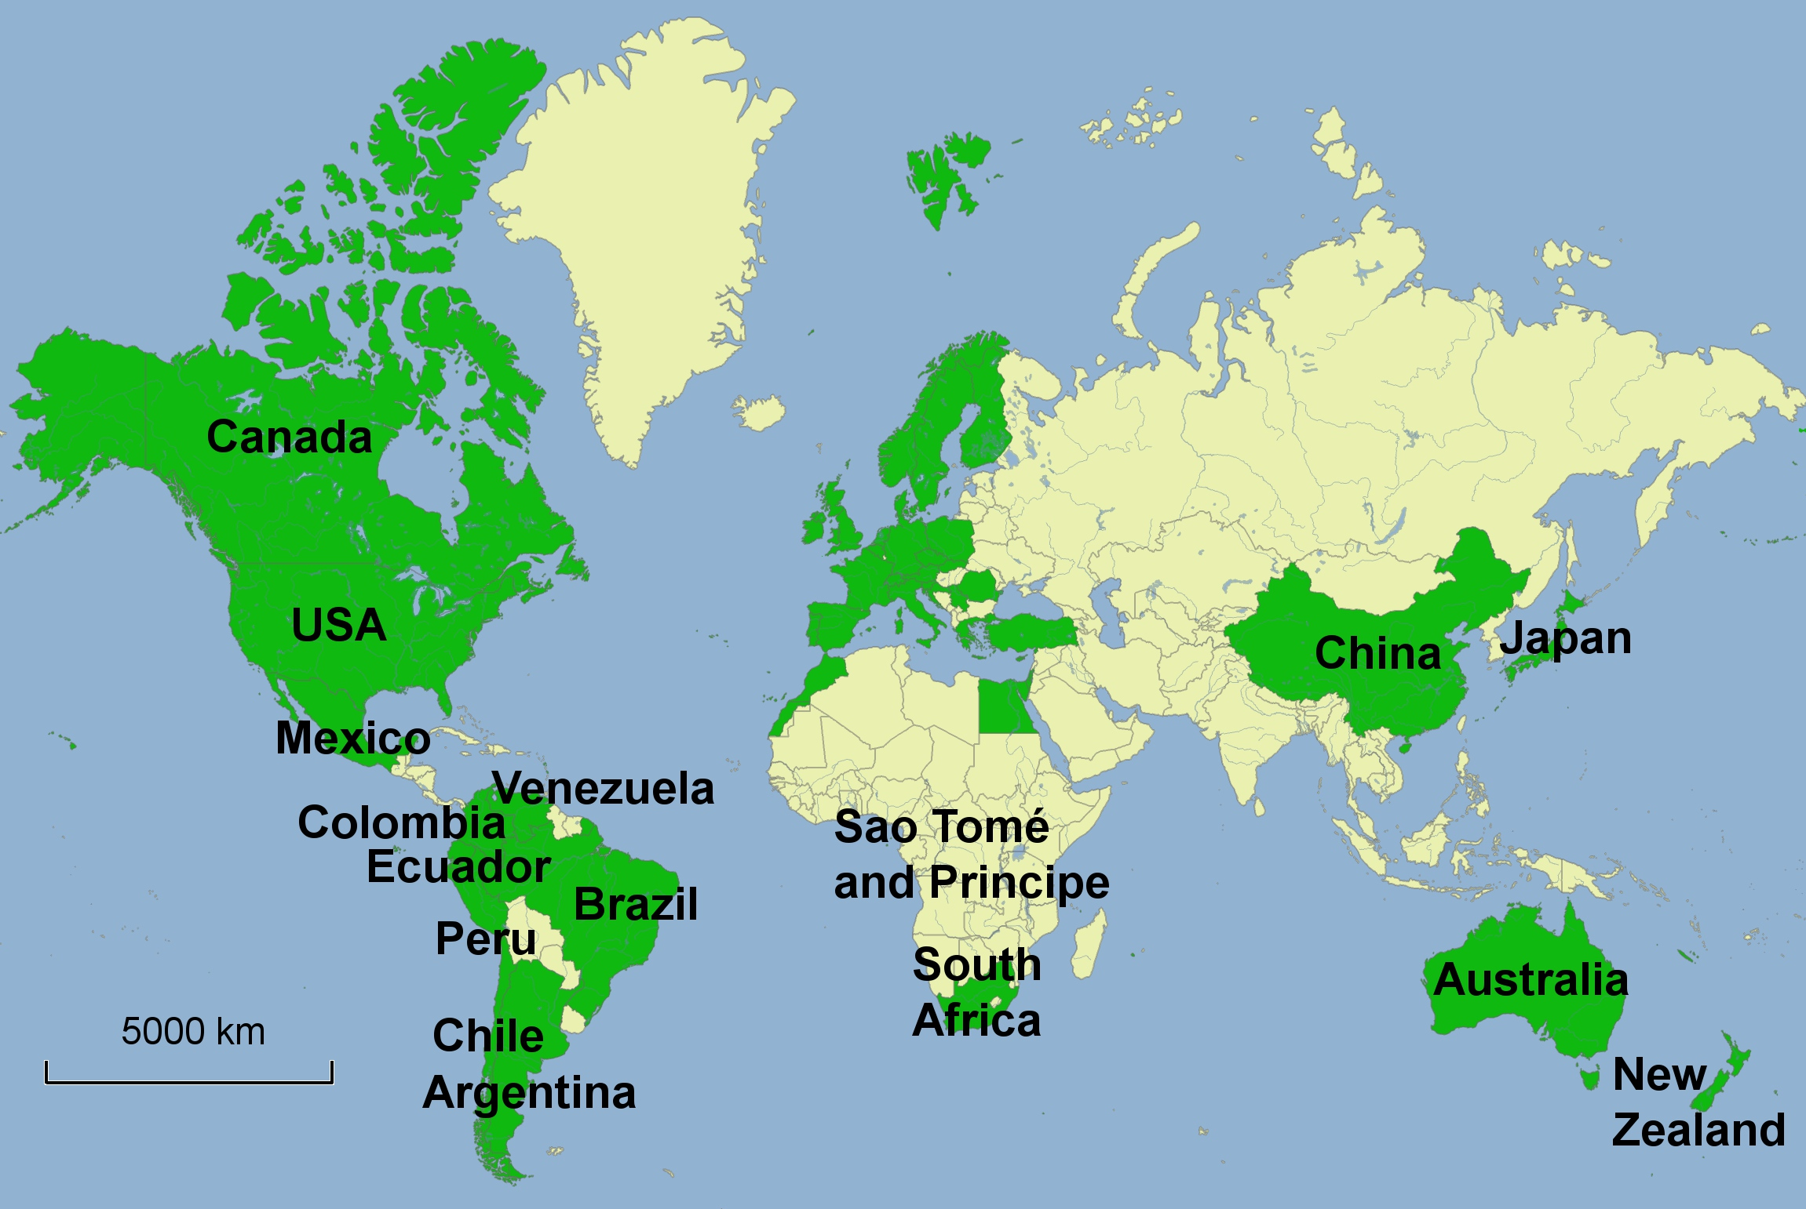
International Masterclasses
11 February – 23 March 2016
46 countries – 213 institutes – 13’000 high-school students – 1’100 teachers

Slide 28
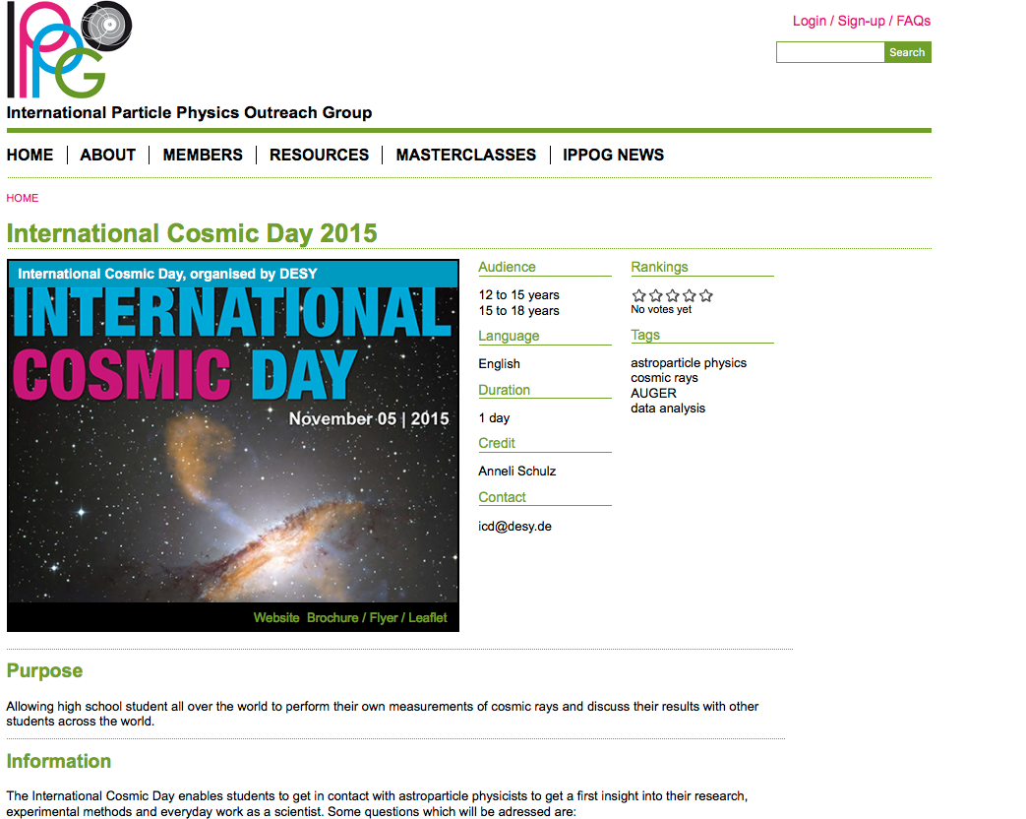
Expanding to Astroparticle physics – discussions and pilot tests
IceCube Masterclass
http://icecube.wisc.edu/masterclass/home
Auger Masterclass
http://auger.colostate.edu/ED/
Pilot tests in German Netzwerk Teilchenwelt
International Muon Week
Quarknet
http://Internationalmuonweek.org
International Cosmic Day
http://icd.desy.de
IPPOG is embracing all particle physics activities.
Although, historically, there is a strong bias towards LHC physics.
This bias is lingering with a broader base.

Slide 29
IPPOG at Conferences
Education & Outreach becoming an integral part in international HEP conferences,
where IPPOG is an active player and driver
EPS HEP 2015 – Vienna
  Parallel sessions on education and outreach
  – sessions chairs are IPPOG members
  Panel discussion "IPPOG: Experts in bringing new discoveries to the public" (Michael Kobel –IPPOG Germany)
Lepton Photon 2015 – Ljubljana
  plenary talk “education & outreach” (Kate Shaw – IPPOG ATLAS)
LHCP 2016 – Lund
  Parallel sessions on education and outreach ← this session here !
ICHEP 2016 – Chicago
  Parallel sessions on education and outreach (IPPOG engaged and invited)
Physics, Technology, Ethics– Žilina
  Invited contribution on Some Ethical Questions related to Particle Physics (Ivan Melo – IPPOG Slovakia; Thomas Naumann – IPPPOG DESY; HPB)
WCPE 2016 – Sao Paulo
  CERN Masterclass courses and the impact on school physics (Uta Bilow – IPPOG Masterclasses)
…

Slide 30

Fourth Annual Large Hadron Collider Physics Conference
Lund, Sweden, 13th - 18th June 2016
Outreach parallel session (6 invited talks + interactive panel session!
CERN: Outreach in the International Context
Sascha Schmeling on behalf of CERN
LHC Masterclasses. Bringing Particle Physics into the Classroom
Vladimir Gligorov on behalf of ALICE, ATLAS, CMS, & LHCb
IPPOG: Worldwide Outreach
Hans Peter Beck on behalf of IPPOG
LHC Communication & Enagement with New Audiences
Despina Hatzifoadou on behalf of ALICE, ATLAS, CMS, & LHCb
Education and Communication with Art at ATLAS and CMS
Pierluigi Paolucci
on behalf of ATLAS & CMS
ATLAS & CMS Data Release and Tools
Felix Socher on behalf on ATLAS &CMS

Slide 31
ICHEP, Chicargo, USA
3th - 10th August 2016
Outreach parallel sessions
3 sessions, 260 minutes in total
45 abstract submissions!!
18 talks (some merged) + 14 posters
Very popular sessions! Full house!
Fruitful panel session

Slide 32
IPPOG is becoming a Collaboration
Today, particle physics has become a global activity, with experimental collaborations featuring thousands of researchers from all over the world.
Commensurate with this reality, IPPOG as well needs to evolve to cover more countries, laboratories and experiments in the areas of particle physics, astrophysics and associated technologies.
In particular, IPPOG should be given a formal, albeit simple, organizational structure so as to guarantee the sustainability of its work. This means as well that IPPOG should be able to rely on some basic regular funding as well as in-kind contributions.
Based on the existing IPPOG model, we have over the past few months carefully examined various elements for such a formal structure, and we have extensively consulted with stakeholders.
A Memorandum of Understanding (‘MOU’), which is similar to existing instruments used for international scientific collaborations in particle physics, reflects these efforts.

Slide 33

IPPOG MoU
Collaboration will be considered starting when 10 Member have signed.
Today signed, or clear commitment to sign:
B, CH, D, I, F, FIN, N, NL, P, RO, S, SK
The IPPOG Collaboration will be achieved in a few weeks form now!
Other members have two years to resolve their internal discussions on how to sign the MoU.
IPPOG intents to grow internationally.

Slide 34
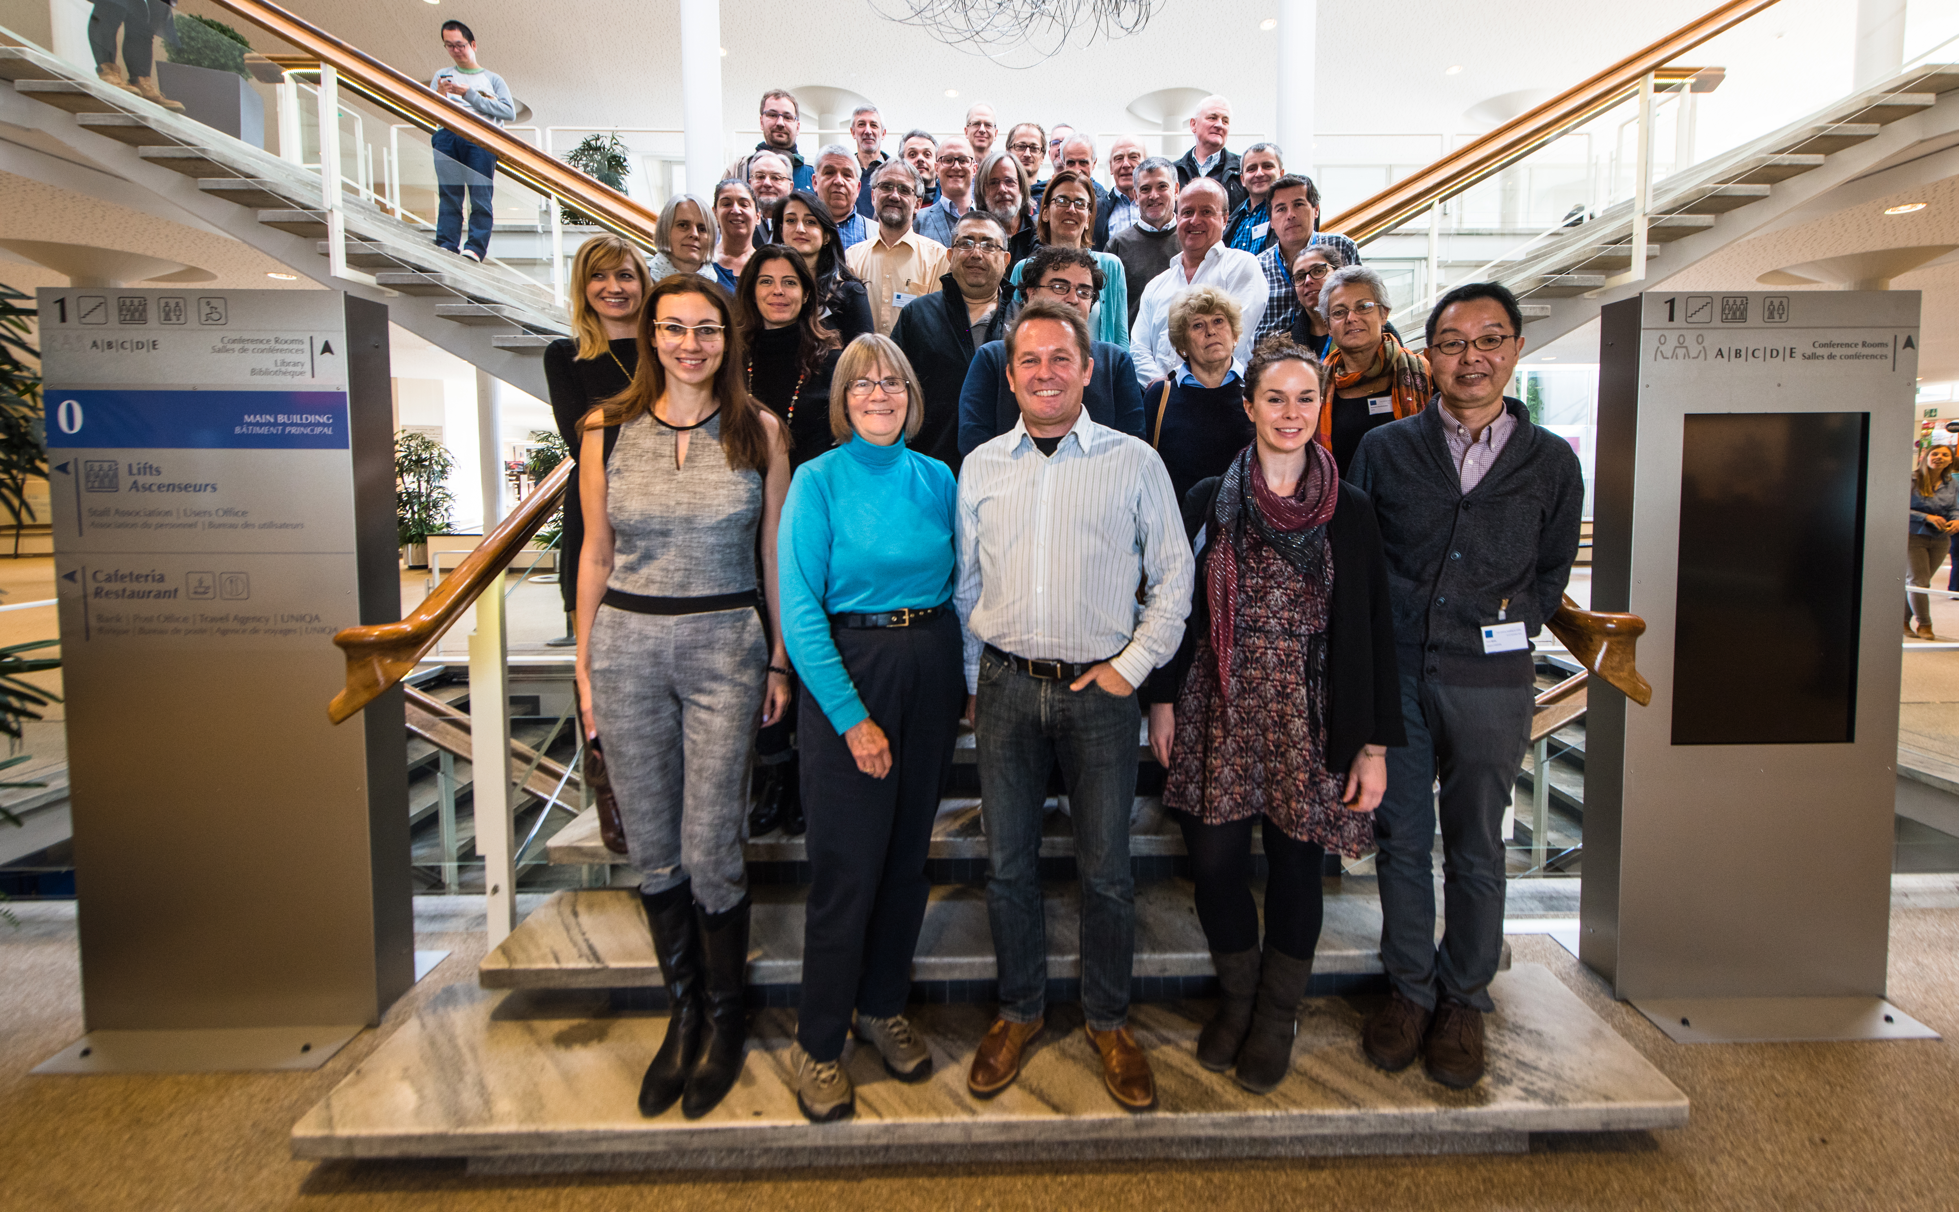
IPPOG in Nov 2016

