Slide 1
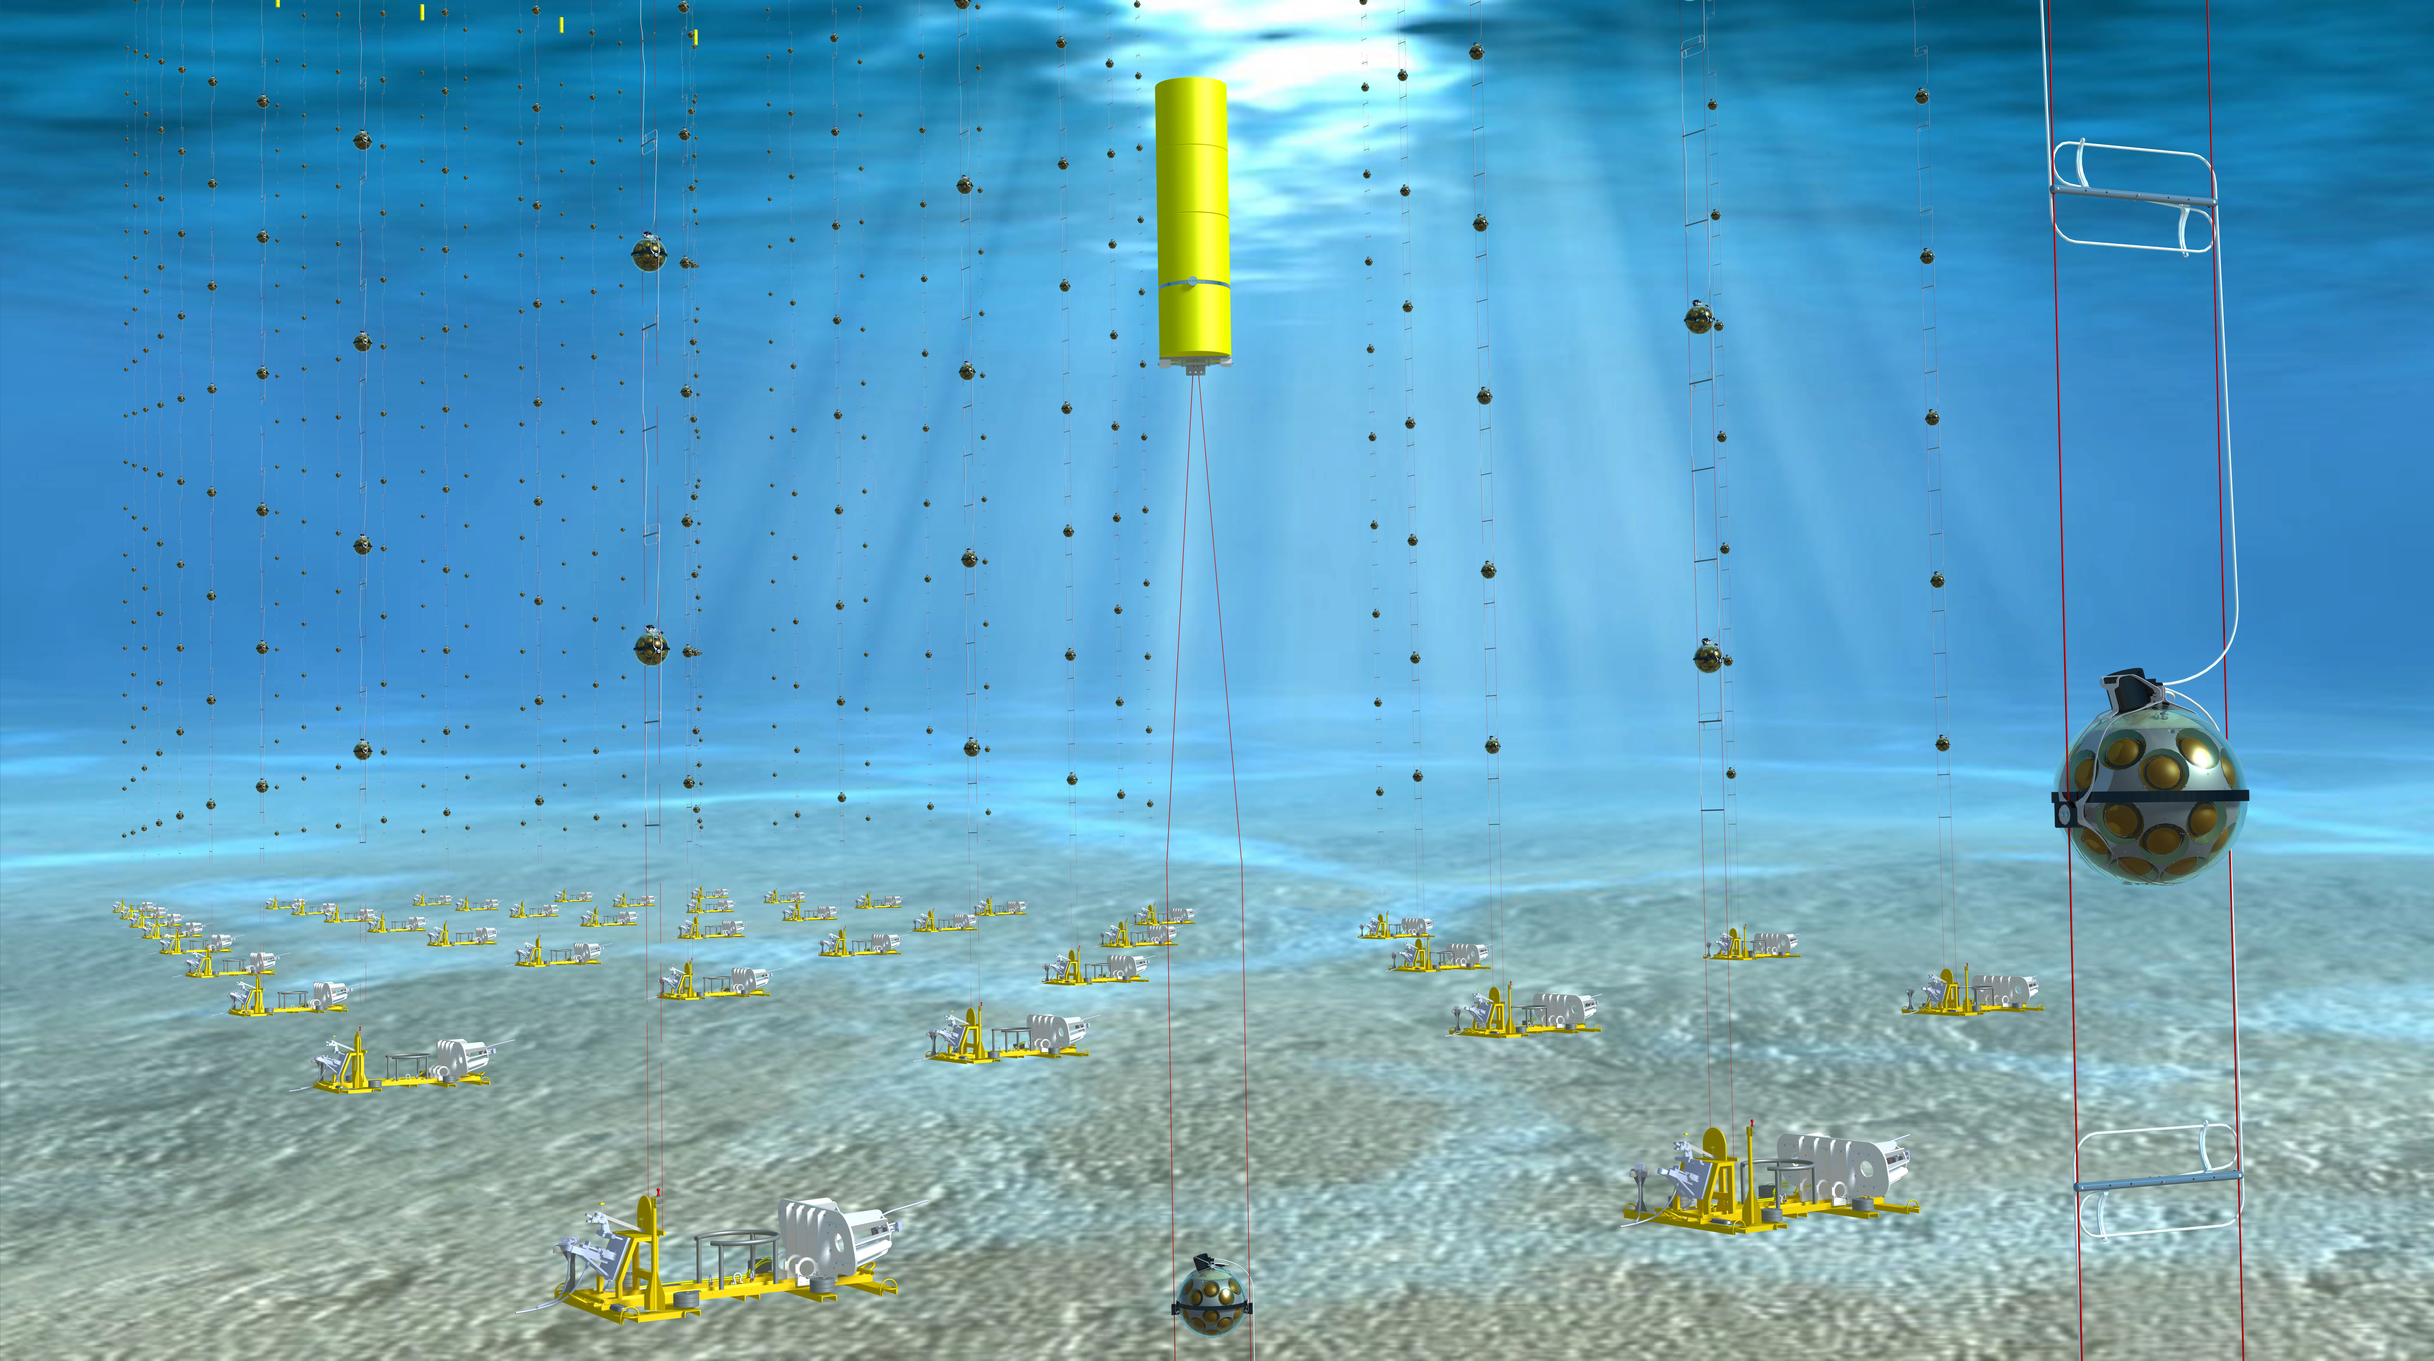
KM3NeT
Astro-particle and Oscillations Research
with Cosmics in the Abyss
(ARCA & ORCA)
PECFA
24−25 November 2016, CERN
Maarten de Jong

Slide 2
Introduction
KM3NeT is a new Research Infrastructure
  network of cabled observatories
  located in deep waters of Mediterranean Sea
  hosting multi-km³ Neutrino Telescope
Discovery and subsequent observation of
high-energy neutrino sources in Universe
Measurement of neutrino mass hierarchy
Synergy with Earth & Sea sciences

Slide 3
Phased implementation
Phase | Blocks | Primary deliverables
1 | 0.2 | Proof of feasibility and first science results
2.0 | 2 ARCA | Measurement of neutrino signal reported by IceCube All flavor neutrino astronomy
 | 1 ORCA | Neutrino mass hierarchy
3 | 6 (+1) | Neutrino astronomy including Galactic sources

Slide 4

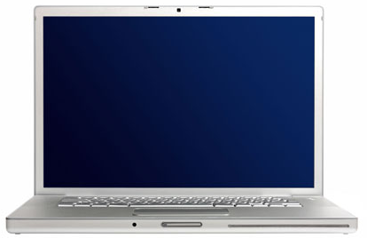
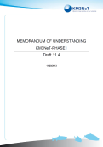
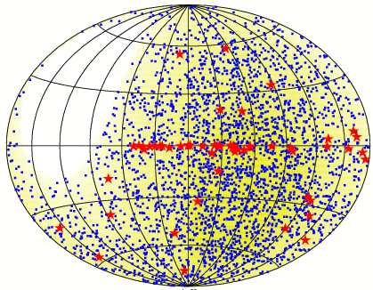
Architecture
10−100 Mb/s
computer
center
0.1−1 Tb/s
shore station
neutrino telescope
KM3NeT
remote
operation
remote access
to data
on
off

Slide 5
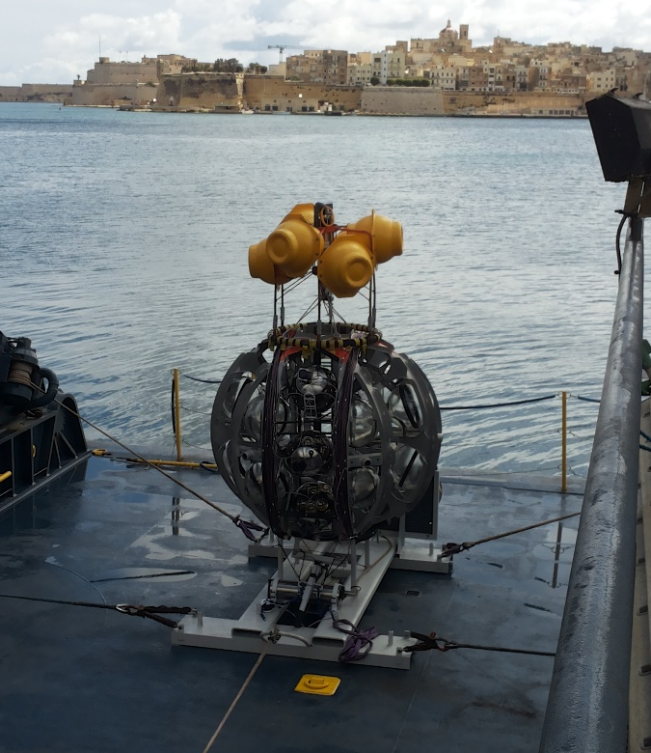
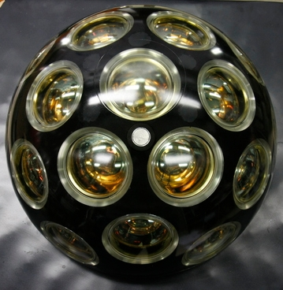

Design
Launcher vehicle
Optical module
~ 600 m
17”
31 x 3” PMTs
low-power HV
LED & piezo sensor
FPGA readout
White Rabbit
DWDM
rapid deployment
autonomous unfurling
recoverable

Slide 6
Optical module
Key features?
  it is expensive
  it is complicated
  it is expensive and complicated
  none of the above
Interest from Hyper-K, NUPRISM, CHIPS,
IceCube-Gen2, Juno…

Slide 7
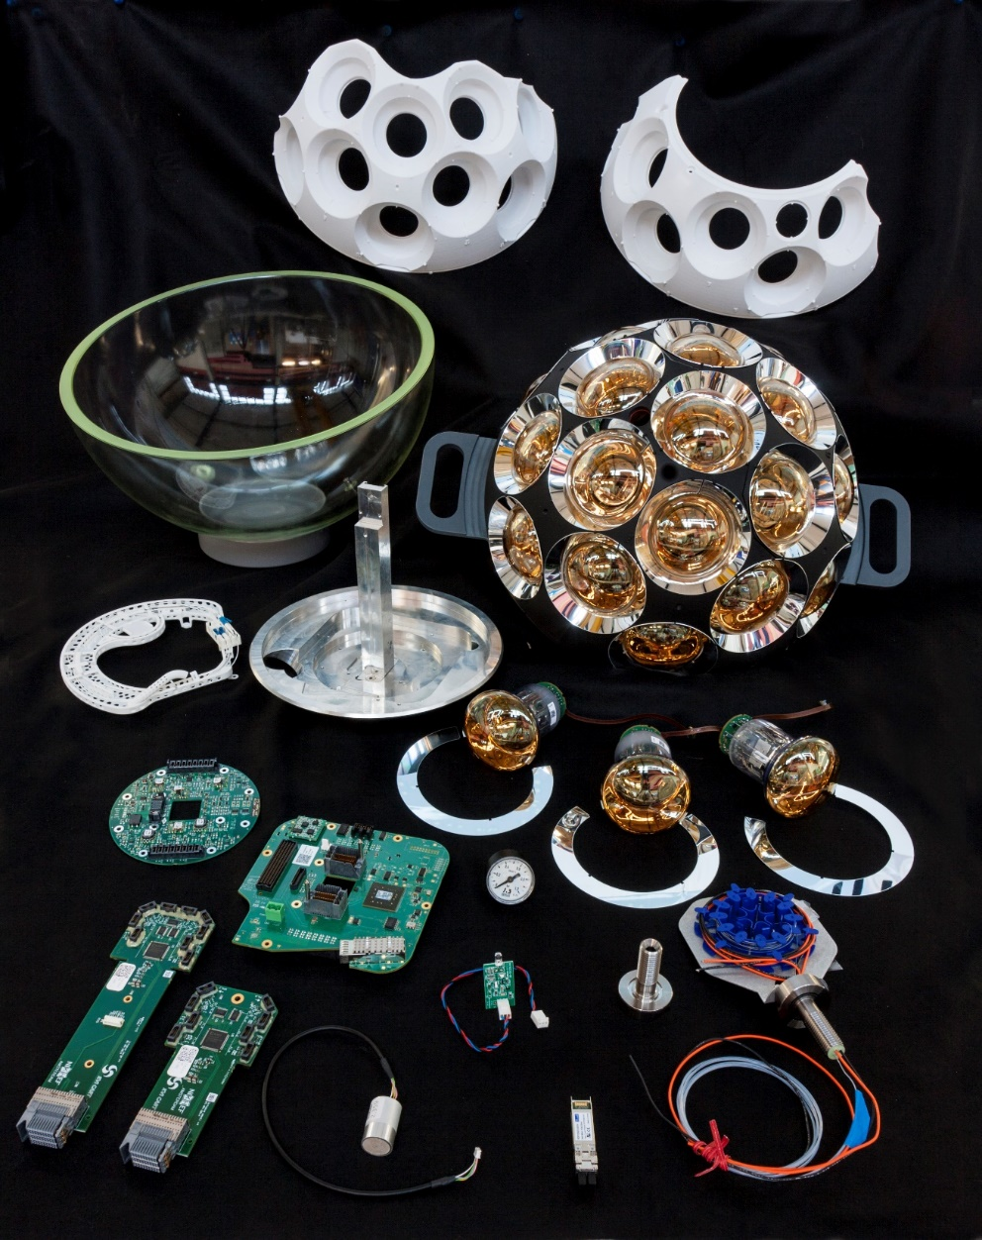
Optical module building kit

Slide 8
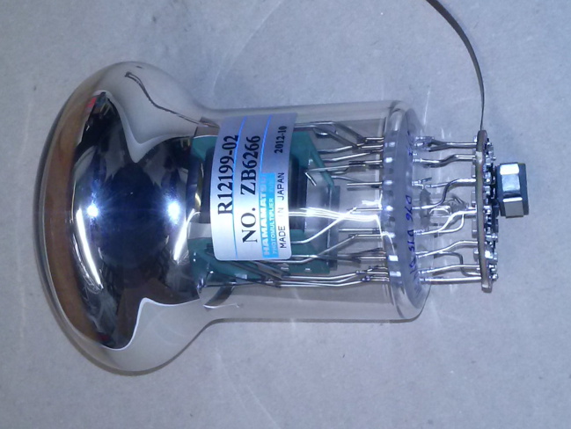
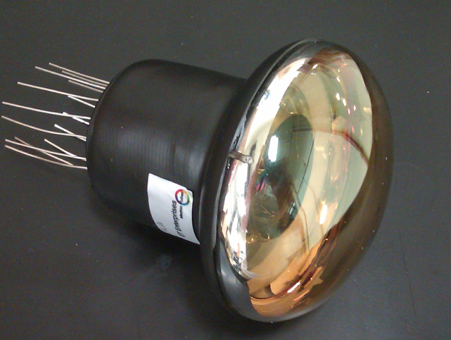
3-inch PMTs
Key specifications:
  timing 2 ns (RMS)
  QE(λ = 400 nm) 25−30%
  collection efficiency 90−95%
  photon counting purity 100% (by hits, no ADC)
  price/cm² ≤ 10” PMT
ETEL
ETEL D792
Hamamatsu R12199
HZC XP82B20

Slide 9
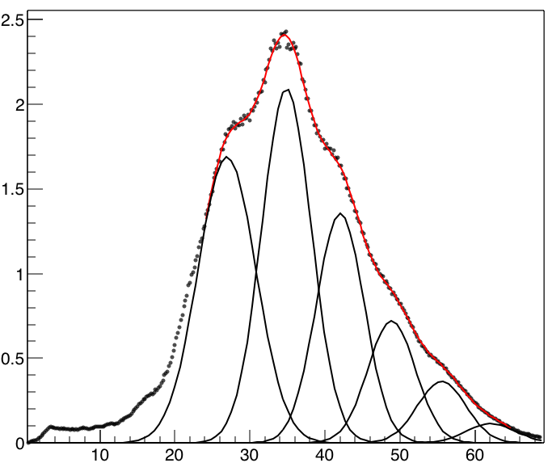

Signal processing
2
PMT
test bench
$$\left\langle \text{p}\text{.}\text{e}\text{.}\right\rangle ≅2$$
1
3
ASIC 0.3 p.e.
4
Rate [a.u.]
5
FPGA
6
time of leading edge (ns)
time over threshold (ns)
time over threshold [ns]

Slide 10
Real time data filter
FPGA
FPGA
FPGA
FPGA
FPGA
FPGA
time
off-shore
on shore
Ethernet switch
CPU
CPU
CPU
data filter
data filter
data filter

Slide 11
Real time data filter
FPGA
FPGA
FPGA
FPGA
FPGA
FPGA
time
off-shore
on shore
Ethernet switch
CPU
CPU
CPU
data filter
data filter
data filter

Slide 12
Real time data filter
FPGA
FPGA
FPGA
FPGA
FPGA
FPGA
time
off-shore
on shore
Ethernet switch
CPU
CPU
CPU
data filter
data filter
data filter

Slide 13
CPU usage

Slide 14
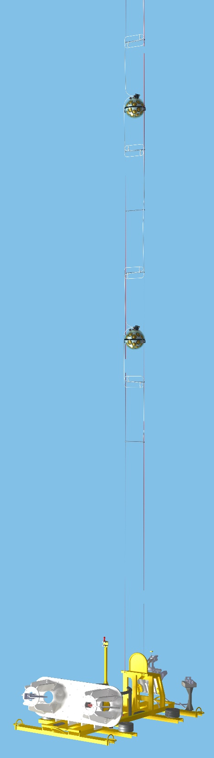
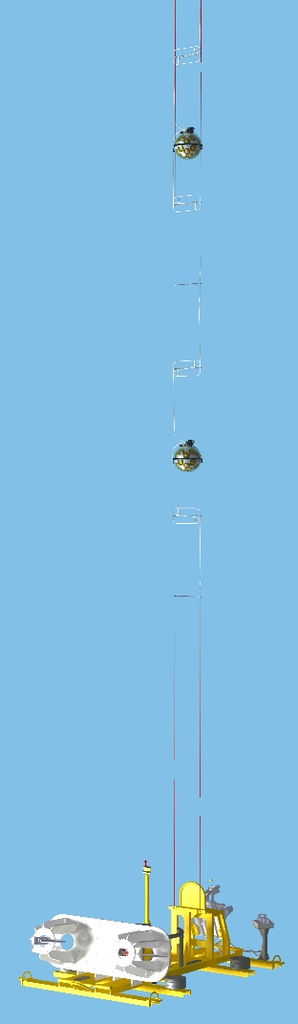
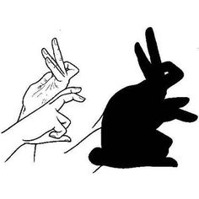


Time synchronisation
White Rabbit & broadcast
full synchronisation
passive optical network
standard Ethernet switches
for data processing
1 km
100 km
1 km

Slide 15
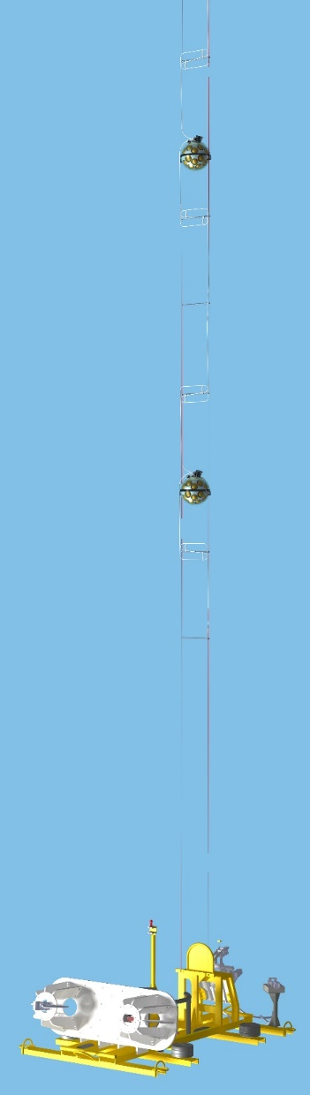
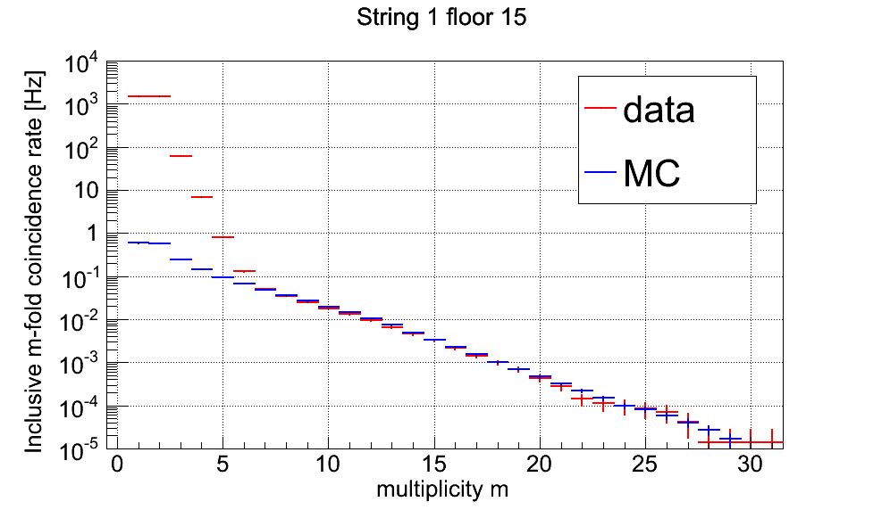
Rate
10⁴
10³
10²
10¹
1
10⁻¹
10⁻²
10⁻³
10⁻⁴
10⁻⁵
KM3NeT
data
Muon Monte Carlo
Rate [Hz]
Muons
⁴⁰K
0
5
10
15
20
25
30
Multiplicity

Slide 16
Time & efficiency calibration
⁴⁰K decays
Atmospheric muons
data
Monte Carlo
data
KM3NeT
KM3NeT
Rate [Hz]
number of events [a.u.]
Δt [ns]
PMT pair
Δt [ns]
intra-optical module
inter-optical module

Slide 17
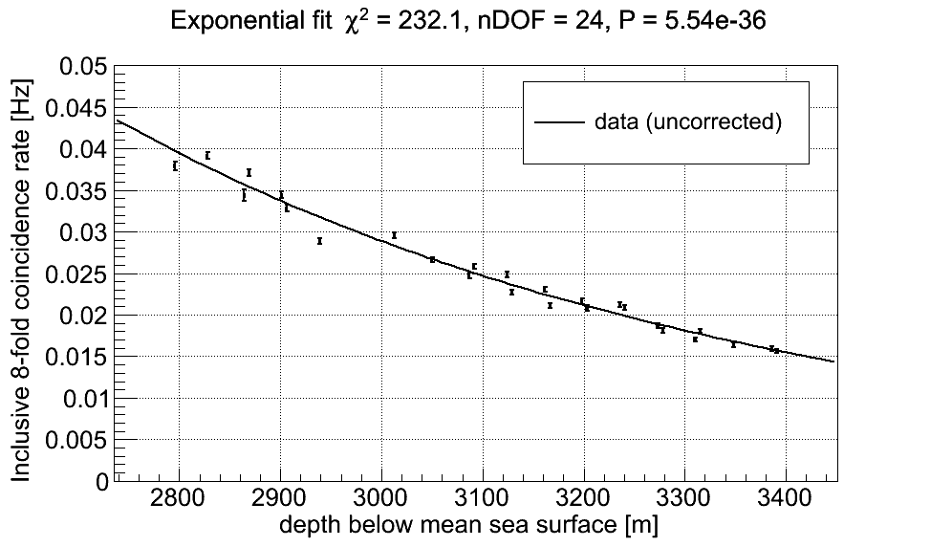
Muon depth dependence
0.05
0.04
0.03
0.02
0.01
0.0
KM3NeT
data
fit
Rate [Hz]
2.8
2.9
3.0
3.1
3.2
3.3
3.4
Depth [km]

Slide 18
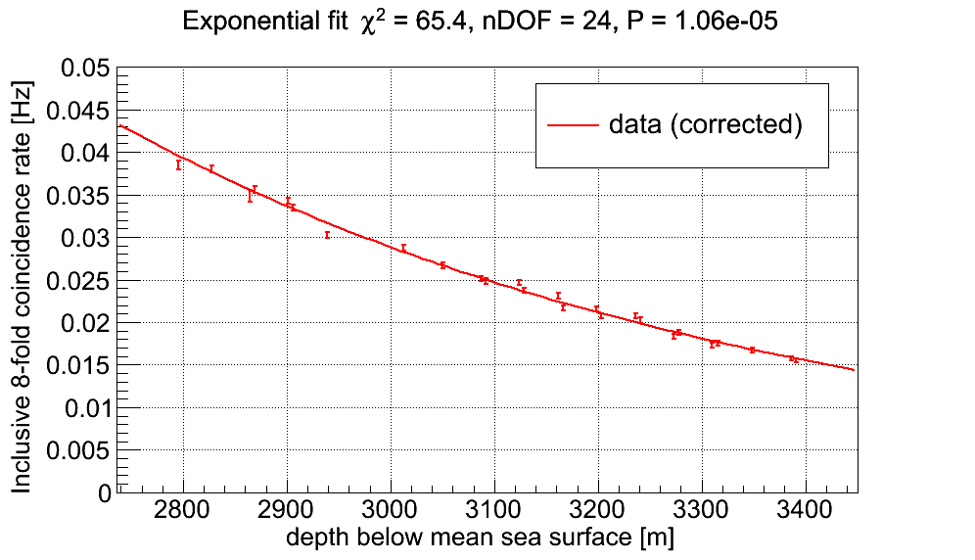
Muon depth dependence
0.05
0.04
0.03
0.02
0.01
0.0
KM3NeT
data (corrected)
fit
Rate [Hz]
2.8
2.9
3.0
3.1
3.2
3.3
3.4
Depth [km]

Slide 19
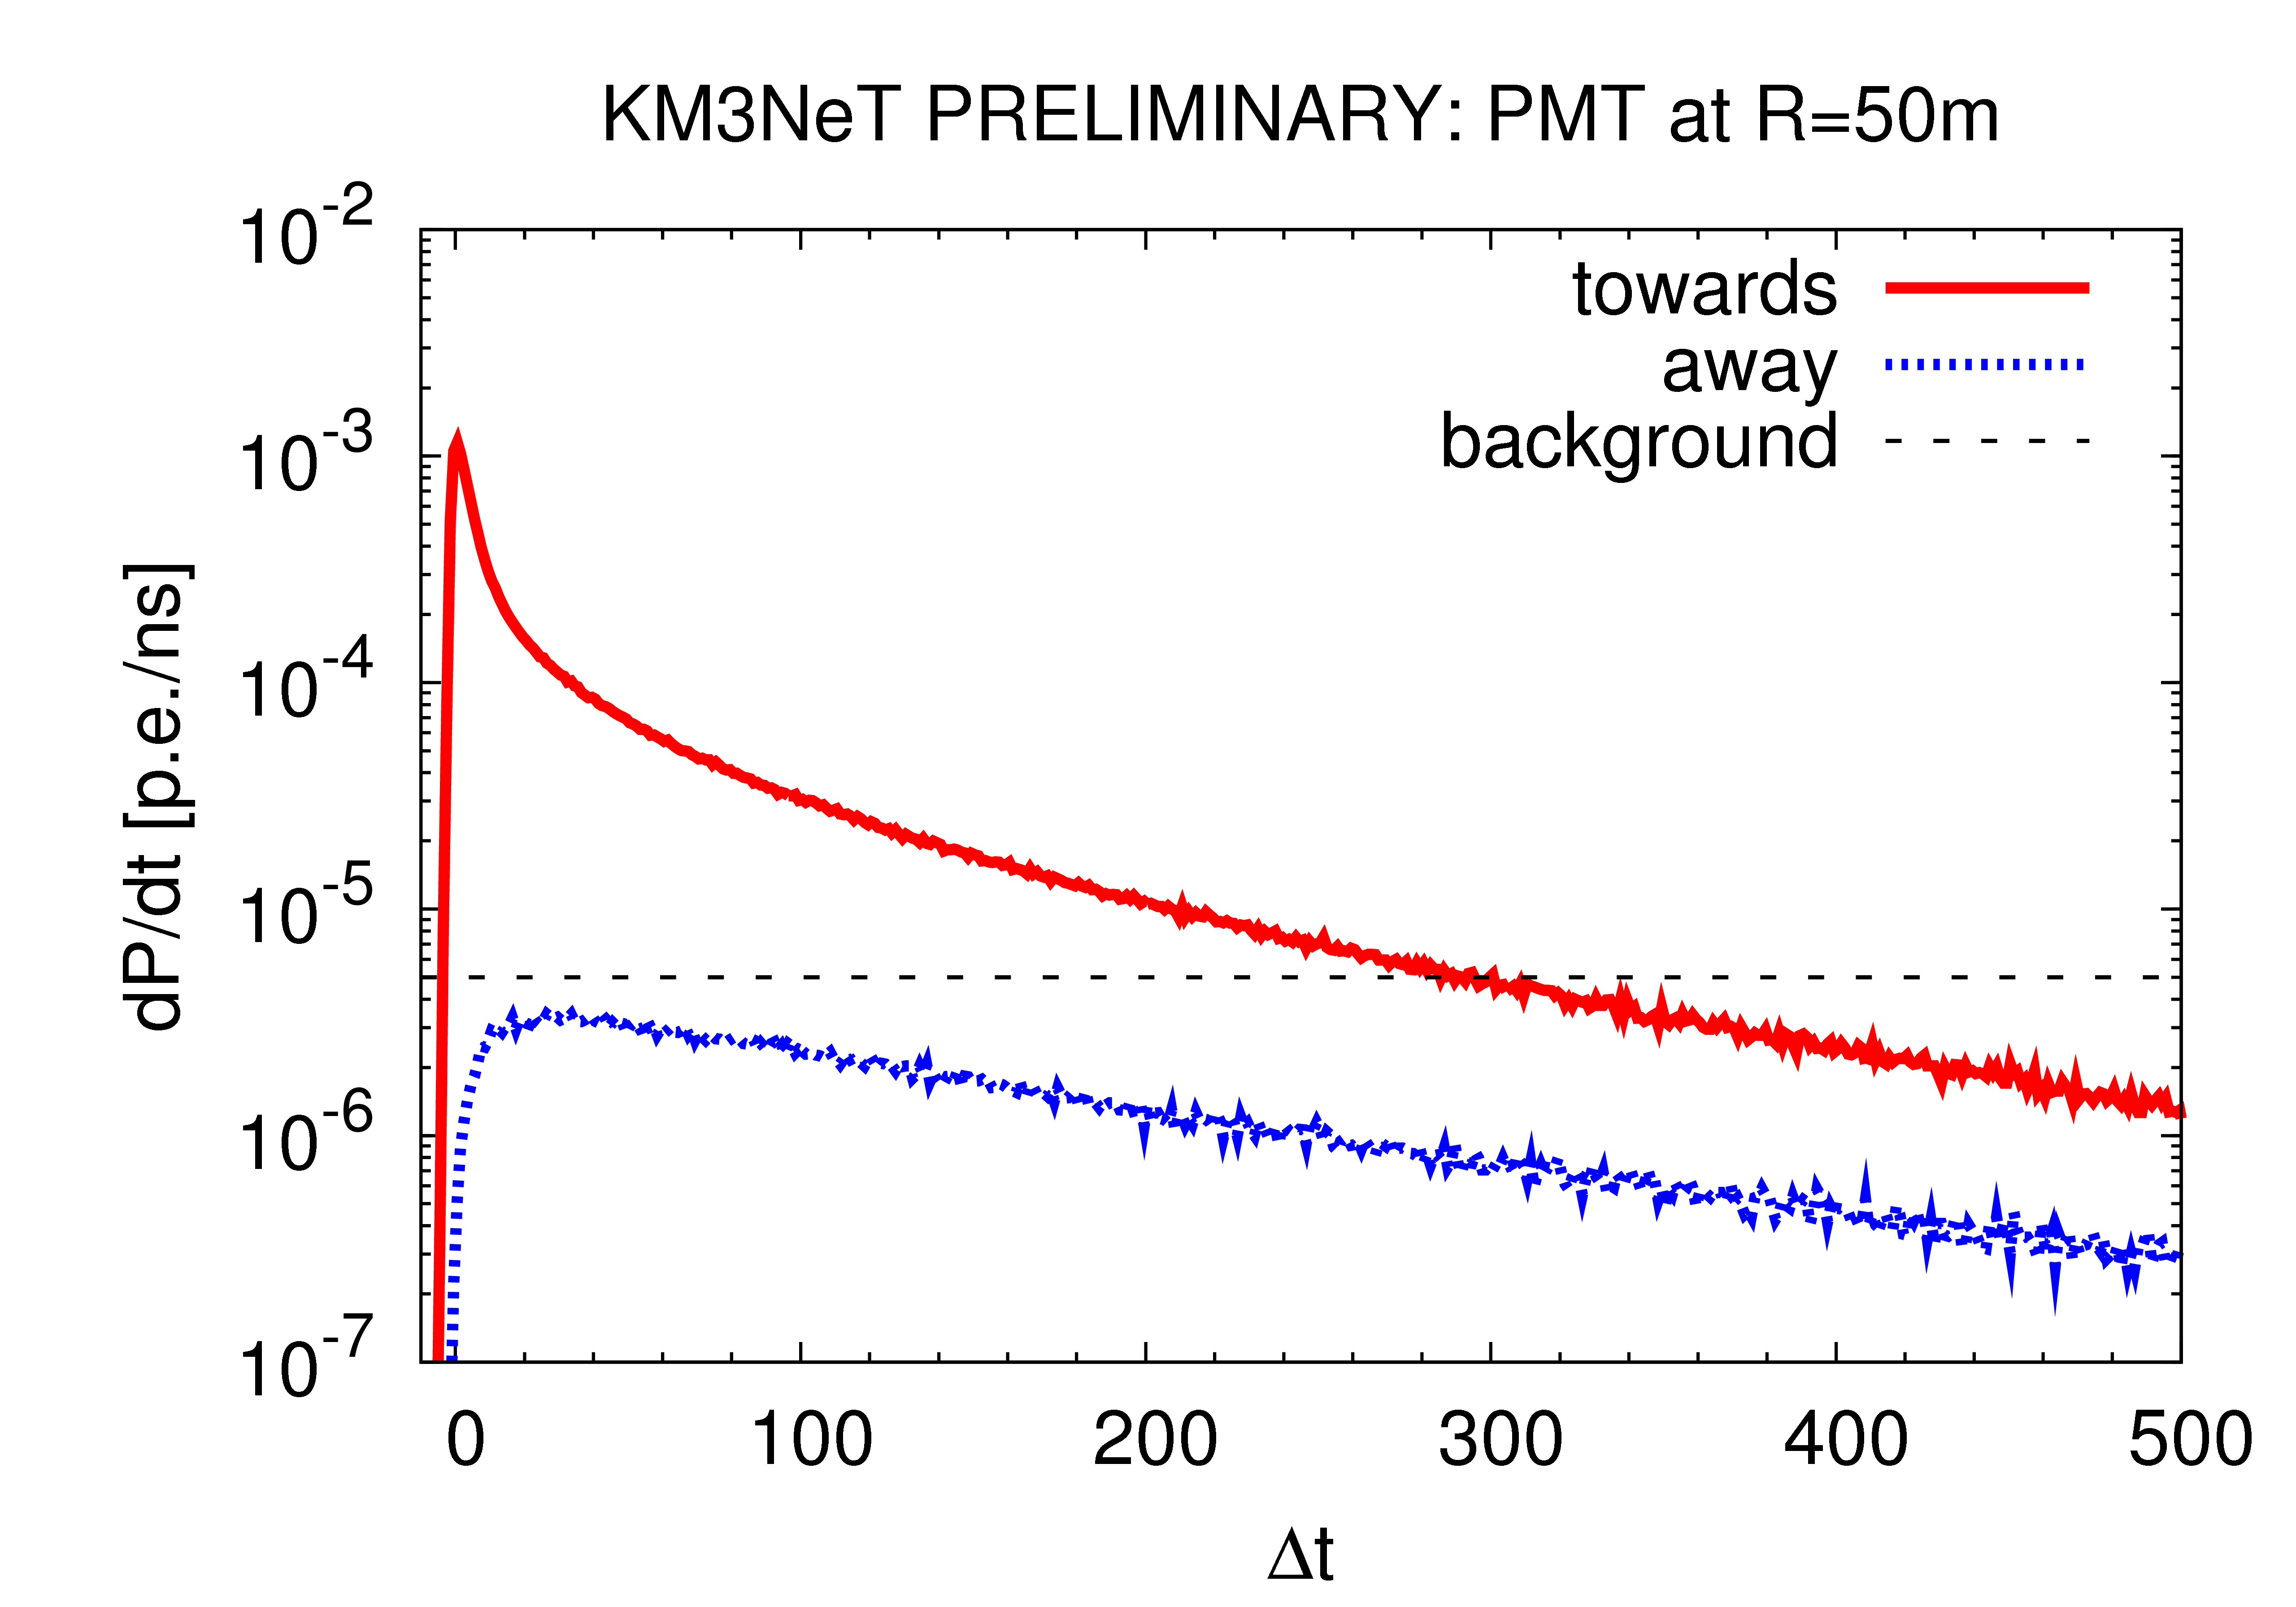
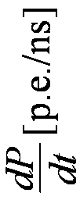

PDF of muon light
PMT
50 m
1 TeV muon
Δt [ns]

Slide 20
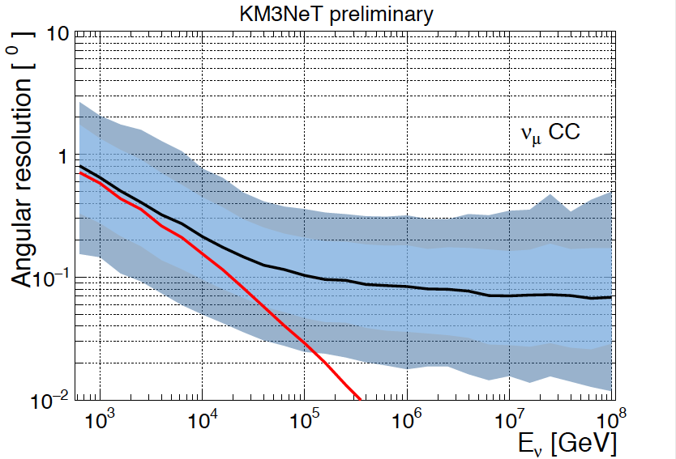
Angular resolution
ν_{μ}
μ
ν_{e}
e
Track:
W±
Cascade:
W±
10
1
0.1
0.01
N
X
N
X
10
9
8
7
6
5
4
3
2
1
0
KM3NeT
angle [deg]
10³
10⁴
10⁵
10⁶
10⁷
10⁸
10⁵
10⁶
10⁷
E_{ν} [GeV]
E_{ν} [GeV]

Slide 21
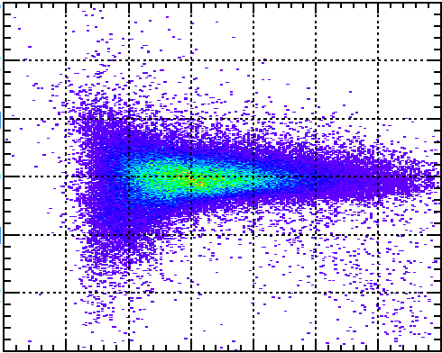
Energy resolution
ν_{μ}
μ
ν_{e}
e
Track:
W±
Cascade:
W±
N
X
N
X
10³
10²
10¹
1
10⁻¹
10⁻²
10⁻³
1.5
1.4
1.3
1.2
1.1
1
0.9
0.8
0.7
0.6
0.5
KM3NeT
E_{fit}/E_{true}
10²
10³
10⁴
10⁵
10⁶
10⁷
10⁸
10⁵
10⁶
10⁷
E_{ν} [GeV]
E_{ν} [GeV]

Slide 22
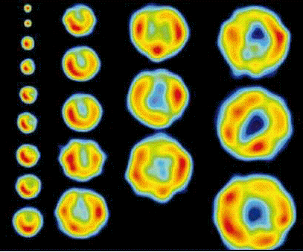


Fermi shock acceleration
Acceleration $∆E$ $=αE$
Probability $P$ $=β$
k steps $E$ $=E_{0}{\left(1+α\right)}^{k}$
$N$ $=N_{0}{\left(β\right)}^{k}$
particle

Slide 23



Energy spectrum
$$\frac{\ln\left(N/{N_{0}}\right)}{\ln\left(E/{E_{0}}\right)}=\frac{\ln\left(β\right)}{\ln\left(1+α\right)}$$
$$\frac{N}{N_{0}}={\left(\frac{E}{E_{0}}\right)}^{\frac{\ln\left(β\right)}{\ln\left(1+α\right)}}$$
Thermodynamics
Escape probability (A.R. Bell)
$$\frac{∂N}{∂E}=E^{ \frac{\ln\left(β\right)}{\ln\left(1+α\right)} −1}= E^{−2} ≅$$
measured
Relativity

Slide 24
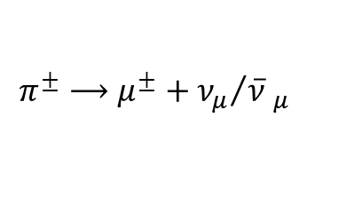

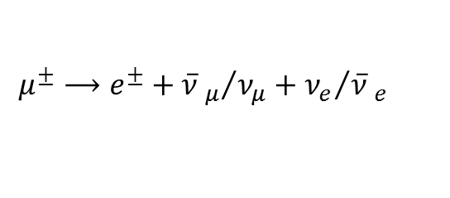
Astro-particle physics
astronomy
particle physics
p
π⁺
Synchrotron
radiation
Δ⁺
e
$$\overline{B}$$
n
inverse
Compton
scattering
$$π^{±}⟶μ^{±}+{ν_{μ}}/{\overline{ν} _{μ}}$$
e
$$μ^{±}⟶e^{±}+{\overline{ν} _{μ}}/{ν_{μ}}+{ν_{e}}/{\overline{ν} _{e}}$$

Slide 25
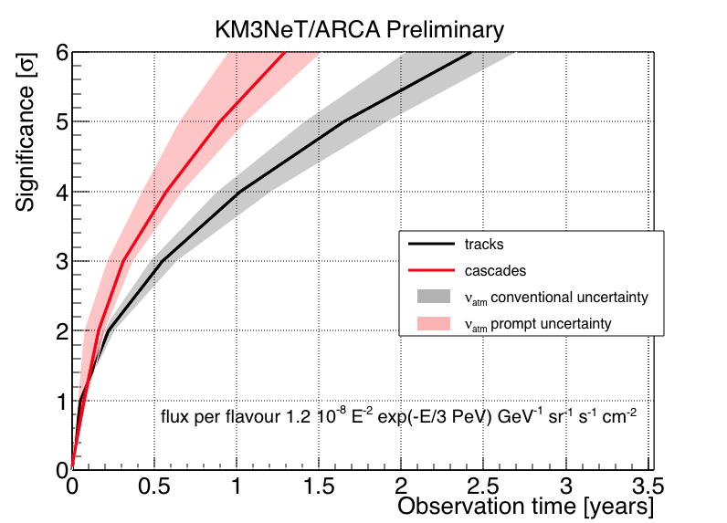
ARCA
IceCube signal
Supernova remnants
6
5
4
3
2
1
0
5
4
3
2
1
0
KM3NeT
KM3NeT
significance [σ]
tracks
cascades
RXJ1713
Vela X
0
1
2
3
0
2
4
6
8
10
12
observation time [y]
observation time [y]

Slide 26
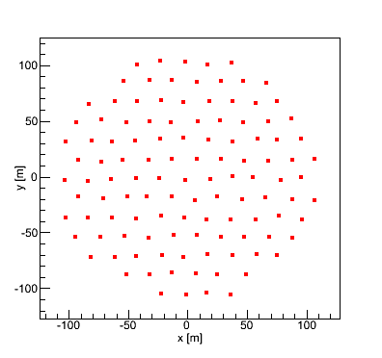
ORCA
Measurement of
neutrino mass hierarchy
1 building block
“same as ARCA but
100 times smaller”
200 m

Slide 27
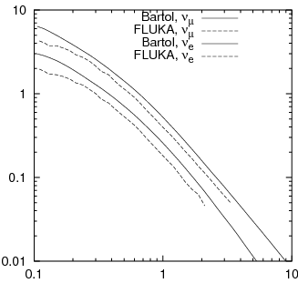
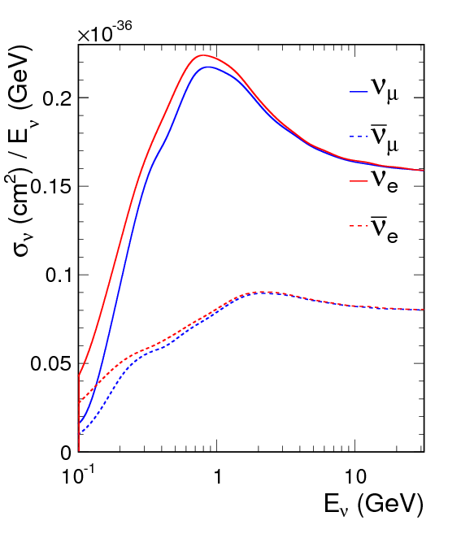
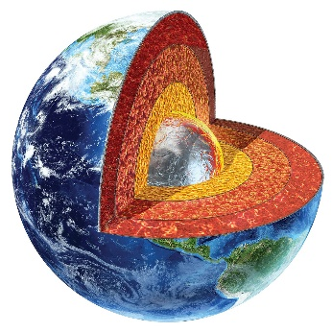
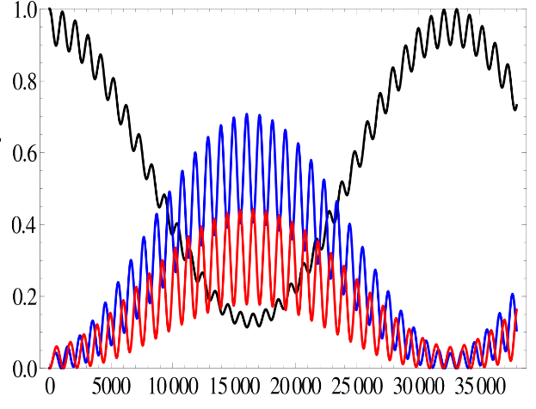
Neutrino mass hierarchy
fluxes
cross sections
E ∂N/∂E [cm⁻² s⁻¹]
event rate
σ [10⁻³⁶ cm²]
E [GeV]
E [GeV]
matter
cos(θ)
oscillations
E [GeV]
probability
L/E [km/GeV]

Slide 28
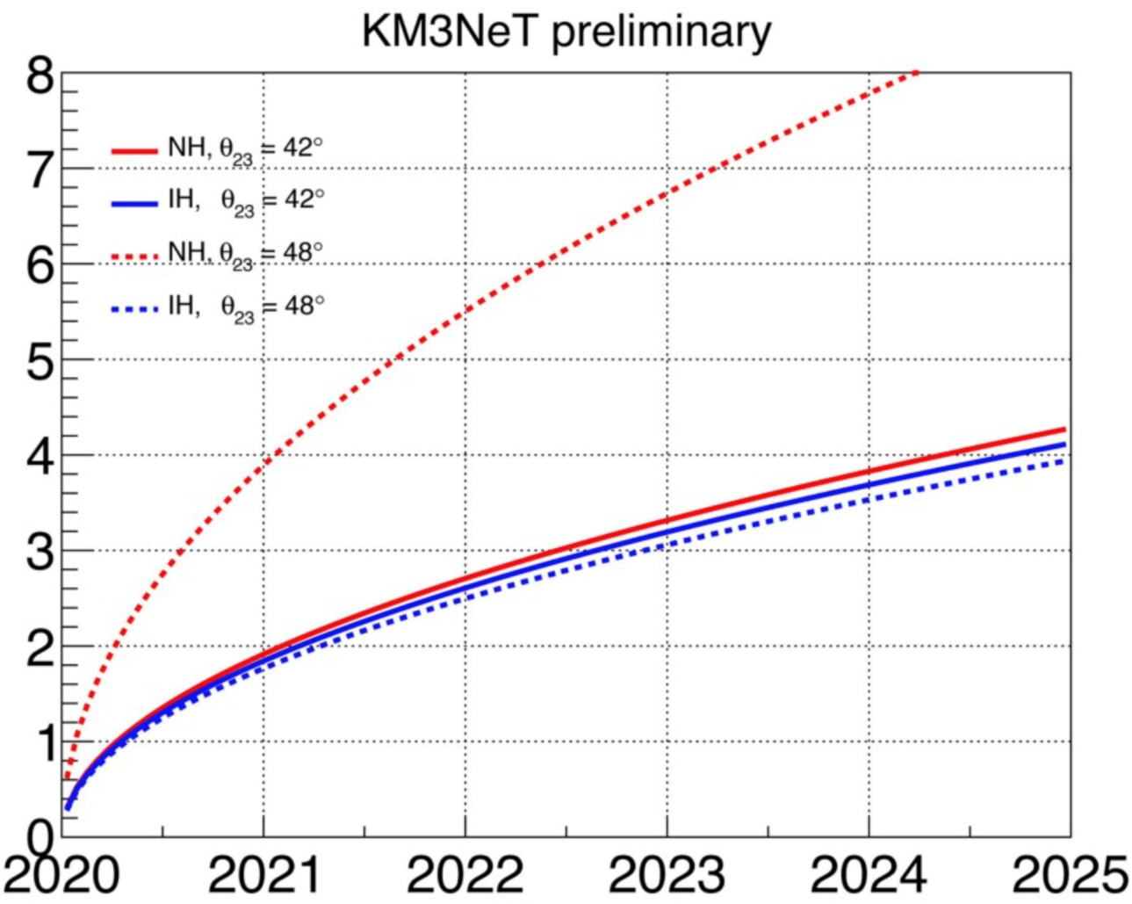
ORCA
¶
significance [σ]
Date
¶ Using prior for θ₂₃ octant and δ_{CP} = 0 angle.

Slide 29
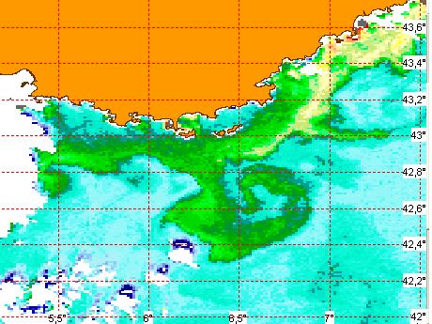
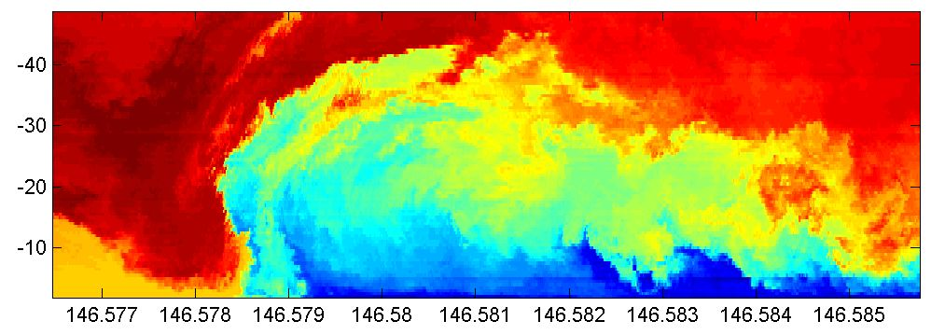
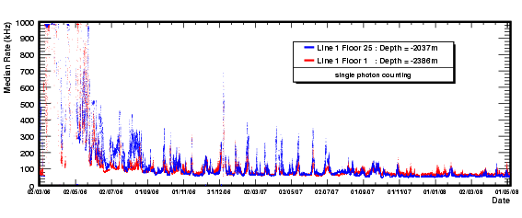
Earth & Sea sciences¶
France
short lived (rare) events
dominate life in deep-sea
permanent observatory
Temperature
Antares
sudden
Eddy currents
food supply
observatory
time profile
¶ Antares

Slide 30
KM3NeT status & outlook
R&D
  developed cost-effective technology
  feedback from prototypes confirm key specifications
Phase-1
  going ahead as planned
Phase-2 on ESFRI roadmap 2016
  ARCA
    measurement of IceCube signal with different methodology,
    complementary field of view and improved resolution
    all flavour neutrino astronomy
  ORCA
    measurement of neutrino mass hierarchy

