Slide 1
Powering test and shift planning

Slide 2
General Planning with the Powering Tests
Overview of the new Draft

Slide 3
Target = gain time !
How to gain time :
Starting as soon as possible
Performing all what can be performed
Finding more human resources
Works in parallel
2 or 3 shifts

Slide 4
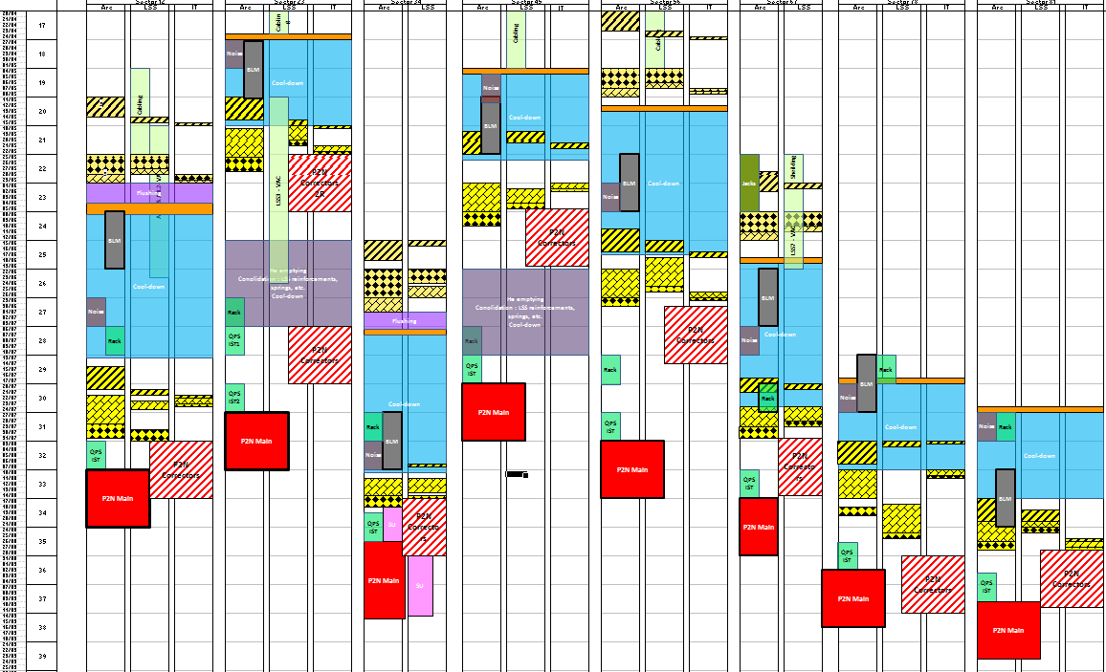
Draft in work – 9th, April 09
Start week 22
End of May
Racks end-June

Slide 5
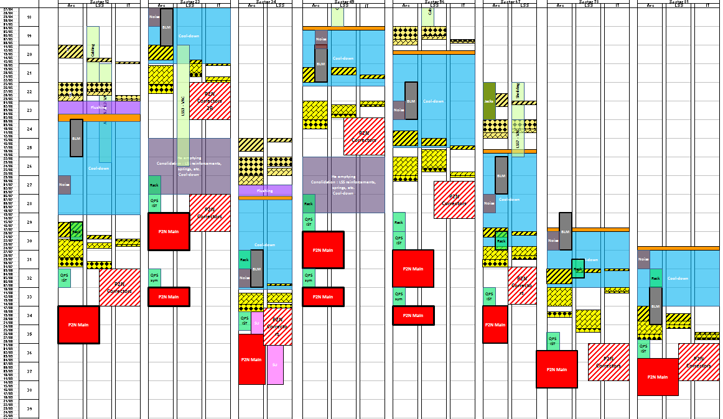
New Schedule – to be defined in details
Start week 22
End of May
Racks end-June – wk.27
Q-sym August – wk.32

Slide 6
New Schedule – to be defined in details
Phase 1
QPS IST (without Q-sym)
Phase 2
QPS IST (Q-sym)

Slide 7
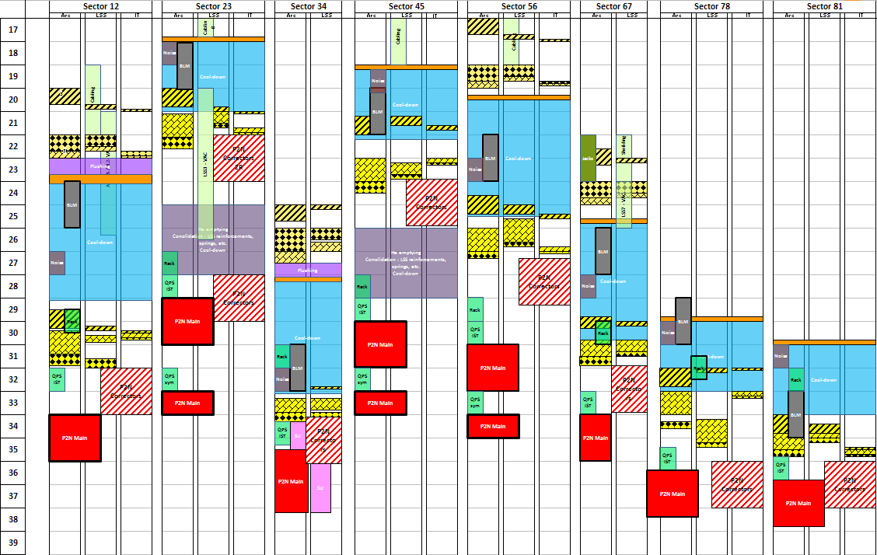
Summary – starting dates
wk.17 20.04
ELQA @ warm
ELQA @ cold
wk.20 11.05
wk.20 11.05
PT Phase 1
wk.21 18.05
PT Phase 2
wk.22 25.05
wk.22 25.05
wk.24 08.06
wk.25 15.06
wk.24 08.06
wk.27 29.06
wk.29 13.07
wk.29 13.07
wk.30 20.07
wk.30 20.07
wk.31 27.07
wk.32 03.08
wk.32 03.08
wk.32 03.08
wk.33
wk.34 17.08
wk.34
wk.34 17.08
wk.34 17.08
wk.35 24.08
wk.36 31.08
wk.36 31.08
wk.39 21.09

Slide 8
Shift planning

Slide 9
Powering Test Shifts: a proposal
1 shift (9H-17H): 1 EIC + 1 Operator (+ 1 non-OP person for giving accesses)
2 shifts (M – A): 1 EIC + 2 Operators (same as last year)
3 shifts (M – A – N):
- Morning: 1 EIC (EIC or experienced operator)
- Afternoon: 1 EIC + 2 Operators
- Night: 1 EIC + 1 Operator

