Slide 1
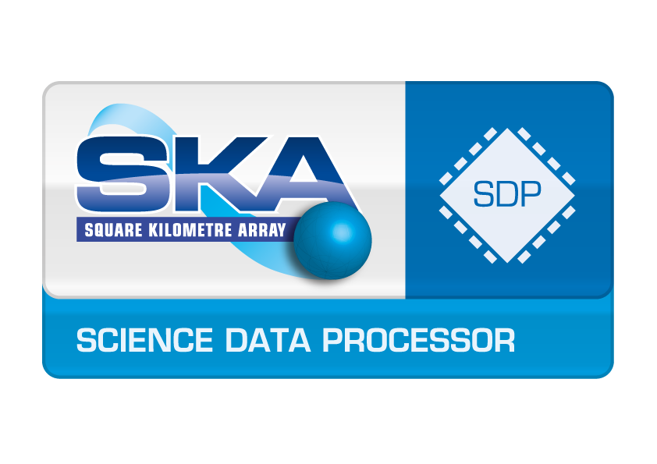



AENEAS, UK focus
Rosie Bolton
Anna Scaife
Michael Wise

Slide 2
AENEAS Aims
Develop a concept and design for a distributed, federated European Science Data Centre (ESDC) to support the astronomical community in achieving the scientific goals of the SKA
Include the functionality required by the scientific community to enable the extraction of SKA science
Integrate the necessary underlying infrastructure not currently provided as part of the SKA Observatory to support that extraction

Slide 3
AENEAS – ESDC view

Slide 4
SKA-SDP in context: What is the Science Data Processor?
SKA Regional Centres
Central Signal Processor
Receivers
SDP
“What do these results mean?”
Real time, instinctive aspect
Off-real time analysis of complete data set.
Has this experiment been successful?
Largely automated functioning with some reflexive aspects
Not very flexible
Must be flexible but predictable
Completely automated
Many and varied users and workflows

Slide 5
SKA-SDP in context: What is the Science Data Processor?
Culture
Meaning of things in community
Sub-conscious
Emotions
Unconscious
Conscious Mind
Analytical mind, Rationalisation
Will Power
Short Term memory
Curation of important artifacts
Habits
Automatic functions (vital signs)
Reflexes

Slide 6
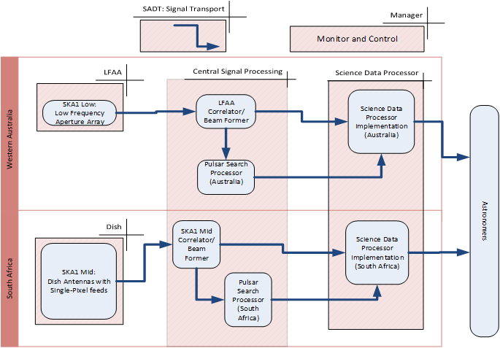
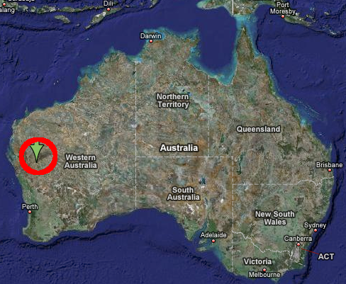
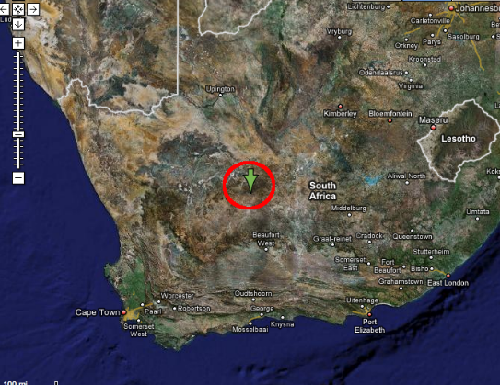
SKA-SDP Context Diagram
SDP facilities are off-site! (In Perth & Cape Town). Cannot be in the desert. Dedicated HPC facilities.
Notes:
Main point: the data processor is off site at a benign location.
Complicated: two receptor technologies at two different sites (on different continents) . Logistical complications – hardware duplication is minimal (except perhaps for load balancing). Designs for Central Signal Processing and Science Data Processor very similar (and re-used) for the two sites. The general purpose processing is located off-site, so much more benign environment.

Slide 7

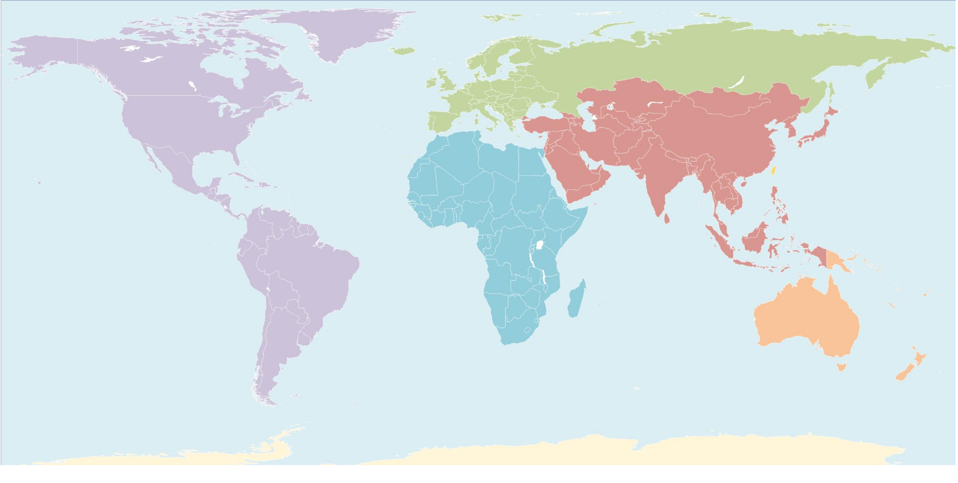


And Finally Regional Centre Network
•
•
10 year IRU per 100Gbit circuit 2020-2030
Guesstimate
US$.1M/Year
of
Regional
Centres locations
US$.1M/Year
US$.5-2M/Year
US$1-3M/Year
US$.2-.5M/Year
US$1-2M/Year
US$.5-2M/Year
US$1-3M/Year
US$1-3M/Year
Notes:
Up to now we have spoken about large HPC “on-premise” clouds as part of the instrument. Science Regional Centres are also part of the SKA project and will potentially be of similar performance to on-premises SDP systems or could use public cloud where appropriate. Discussions are now starting on the potential use of OpenStack for these platforms too.

Slide 8
Telescope Manager
Science Data Processor
CSP
SDP Local Monitoring & Control
2 x 400 Gbyte/s
Data Processor
Data Preservation
Delivery System
Observatory & Regional Centres
2 x 10 Gbyte/s
2 x 10 Gbyte/s
High Performance
~400 PetaFLOPS
Data Distribution
High Volume & High Growth Rate
Data Intensive
~100 PetaByte/year from Cape Town & Perth to rest of World
~30 PetaByte/observation (job)
~100-300 PetaByte/year
Infrequent Access
Data Discovery
Partially real-time
Visualisation of 100k by 100k by 100k voxel cubes
~10s response time
~few times/year max
Partially iterative
~10 iterations/job (~6hour)
NB Numbers are approximate!
Notes:
Capture here the key performance requirements for the SDP.
The data processor is off site at a benign location.

Slide 9
SDP Challenges:
Input
400 Gbyte/s INGEST
Distribute
400 million tasks in the graph
Generate (and destroy)
1.3 ZettaBytes intermediate data products
Preserve and ship
1 PetaByte per day of Science Data Products
Half an Exaflop/s total peak
Notes:
Power efficiency
Current Exascale roadmap (US) indicates 20-25MW(!) for ExaFlop by 2023.
We require about one quarter of this.
Cost
Are our assumptions correct? How will growth-rates pan-out (processor, memory, networking and storage).
Complexity of Hardware and Software
Orchestration required for data ingest, processing, control, preservation and delivery
Flexibility required to test new pipelines as Instrument matures
Scalability
Hardware roadmaps
Demonstrated software scaling is uncertain
Extensibility, scalability, maintainability
SKA1 is the first “milestone” – expecting significant expansion in the 2020s with a 50yr observatory lifetime

Slide 10



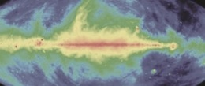

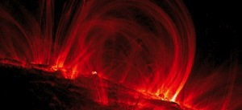




SKA Science Working groups
Astrobiology (“The Cradle of Life”)
Continuum
Cosmic Magnetism
Cosmology
Epoch of Reionisation & the Cosmic Dawn
HI Galaxies
Pulsars (“Strong field tests of gravity”)
Transients

Slide 11
AENEAS
A whole range of different scientific applications and techniques.
Definition of the Key Science Projects is underway
KSPs will make up the bulk (~70%) of time allocated to SKA
Scientists involved in KSPs will interact with their data via Regional Centres
What are the workflows?
How much processing is needed?
What balance between processing, memory, and long term preservation / archive functionality?
How is data transfer likely to work best?
What simulation / modelling work is required in the SRCs?
How can we manage federated access, authorisation and bookkeeping?
What should the policies be?
How do these use cases fit into national facility planning roadmaps in Europe?

Slide 12



ANEAS UK: This meeting
UK AENEAS members
UCAM, UMAN, STFC, GEANT
SKAO (unfunded)
UK contribution to
WP2 “Development of ESDC Governance Structure and Business Models”
WP3 “Computing Requirements”
WP4 “Analysis of Global SKA Data Transport and Optimal European Storage Topologies”
WP5 “WP5: Access and Knowledge Creation”

Slide 13
Aims of this meeting
(Rosie’s views)
Better understanding of the existing expertise in academic HPC within the UK
Oh, you guys faced and solved these problems already?
How can we collaborate effectively, without duplicating effort or missing opportunities to utilise existing work?
Where can I get access to this detailed knowledge? Who can help me? We need an environment where it’s OK to ask questions and with some shared resources.
Do we need a formal collaboration?
Does this help with funding and reporting?
Better understanding of SKA / GridPP / HPC language
Where’s the dictionary?
Where is funding coming from (and how many FTEs, and who) to progress this work over the next decade? What is the UK view?

Slide 14
AENEAS WP3 details
(Thursday)

Slide 15
WP3: Computing requirements
3.1 & 3.2
Inventory of SKA science cases and post-SDP computing and data storage requirements
3.3
Evaluation of existing HPC, cloud and distributed computing technologies
3.4
Design and costing for distributed ESDC computing architecture
3.5
Requirements for interfaces to SKA Science Archives & Other Repositories
Validation, Verification & Proof of concept activities utilizing SKA pathfinder and pre-cursor facilities
3.6

Slide 16
3.1 & 3.2
Inventory of SKA science cases and post-SDP computing and data storage requirements
The SKA has developed a list of 13 High-Priority Science Objectives (HPSOs) which are being used to generate survey strategies for the SKA in its first several years of observations. These are large projects with many thousands of observing hours each. Since these will be made up of tens to hundreds of separate data sets substantial processing and manipulation of the SKA data products will be required in the regional data centres to deliver the survey science at anticipated fidelity. This task will focus specifically on the delivery of these key experiments and their compute processing requirements and data storage and access requirements, and provide a basis on which to proceed with the sizing and costing efforts.
Once these large surveys are complete, enormous benefits will be available if we can combine data from other observatories (e.g. LSST, Euclid). Using results and insights from the Asterics programme we will make estimates for ESDC resources needed to support these efforts and maximise scientific return on the ESFRI astronomy projects.
Further work will investigate whether specific Science Use Cases (more representative of open time programmes) could have significantly different ESDC compute requirements. We will also consider the options for “Discovery Products” which would be generic products not covered by specific experiments, but piggy-backing on observing time.
The output of this task will be a series of system-sizing and functional requirements to appear in deliverable 3.1.

Slide 17
3.3
Evaluation of existing HPC, cloud and distributed computing technologies
This task will enumerate the key elements needed for the software infrastructure required for the ESDC, and evaluate options for fulfilling them, these include:
1) Middleware – i.e. infrastructure to support distributed compute models within, for example a cloud-like environment although also including HPC facilities. Different software products and middleware solutions for allowing access to distributed computing facilities and capabilities will be analysed and compared to the data analysis requirements collected in Tasks T3.1 and T3.2. This will include products and solutions for compute (cloud compute, HTC (High Throughput Computing), HPC (High Perfomance Computing) and container-based cloud compute).
This will include an evaluation of OpenStack, and other cloud middleware stacks with the aim of ensuring portability of data and applications in the distributed environment to be implemented in the ESDC. It will also include an analysis of available replica management and data transport organisation tools such as PHEDEX & PANDA.
2) Elements required for a federated ESDC, including services. The ESDC must provide resources to users in a way which combines many different computing resources but presents these in a harmonized way to each user, and which can validate users’ requests for data access and keep accounts of computing and storage resources for each user or use group, while avoiding un-necessary data movement between sites. Some of this federation functionality may be present in a selected middleware layer, but other aspects may not and these must be considered: for example Authentication and Authorization Infrastructure (AAI), efficient movement of data based on policies; integration with HPC software stacks so that (as needed) the ESDC is able to utilise HPC resources for processing; accounting elements and ensuring proper and fair use of resources.
3) The top-level software stack providing an environment for efficient distributed analysis of data – the task should certainly look at the possibility of building on top of industry-standard Big Data / data-science stacks such as Spark (now beginning to take over from Hadoop).
The deliverable of this task will be D3.2: “Report on suggested solutions to address each of the key software areas associated with running a distributed ESDC”, which will include a list of options, each assessed for suitability.

Slide 18
3.4
Design and costing for distributed ESDC computing architecture
Based on input from the evaluations in D3.1 and D3.2 this task will provide a top-level architecture and functional design for the ESDC.
To proceed we will make use of the inventory of national roadmaps from WP2 (D 2.1) and determine the potential for incorporation / co-use of existing or planned facilities to achieve economies of scale.
We will develop a costing of additional resources needed (over and above existing facilities) to bring about a functioning ESDC, considering the full SKA observatory lifecycle from commissioning as the SKA is built and well into full operations as the SKA observatory develops and undergoes upgrade cycles.
The outputs of this task will be a 1) A preliminary system sizing estimate (D3.3) and 2) a documented design for a ESDC model

Slide 19
3.5
Requirements for interfaces to SKA Science Archives & Other Repositories
The work in this task includes the assessment of existing policies for interactions between science facilities and data centres, incorporating an evaluation of policy items with respect to their technical applicability in the SKA case, as well as a gap analysis for SKA-specific needs. This technical assessment will feed into more general policy recommendations.
The ESDC will incorporate multiple interfaces, both functional and digital (data IO). This task will assess the requirements both for ensuring controlled and managed ingest of data across these interfaces, and of the subsequent storage strategy. This requires an assessment of existing data-moving tools and protocols (commercial and academic – for example WLCG (Worldwide LHC Computing Grid), their compatibility with an ESDC architecture, as well as verified assessments of data ingest from global sources including the SKA Science Data Processors, other nodes within the ESDC, and external archives (e.g. LSST, EUCLID, JWST etc). It will also ensure the compatibility of recommended ESDC standards with the widely used VO standards. In doing this it will also form recommendations on minimum meta-data requirements for ESDC-held data, inline with analyses from the ASTERICS project.
A major functional interface within an ESDC will be the mapping of user specifications onto data processing work flows, from ingest to delivery. This mapping should incorporate both a translation between user-defined parameters (data product specific) and processing parameters (function specific) as well as the impact of different parameter choices mapped onto different types of compute system (data access patterns, distribution of processing etc). This task will also inform policy decisions governing the persistence of user work-flows to enable reproducibility of results or regeneration of data.

Slide 20
3.6
Validation, Verification & Proof of concept activities utilizing SKA pathfinder and pre-cursor facilities
This task contains the technical work required to verifying the design recommendations developed for the ESDC in T3.1 - T3.5 using, where appropriate, data from precursor and pathfinder instruments.
The work in this task includes the provision of a standardised set of appropriate test data, incorporating output from existing facilities and pathfinder instruments. The task also includes the provision of prototype software blocks to verify and validate the functional requirements derived in T3.3, as well as the incorporation of these software blocks into pilot workflows to verify recommendations in T3.3 on applicability of different middleware environments. This work will specifically address the potential distribution of functionality, given a particular processing need, as well as the required data access patterns and the evaluation of appropriate replica managers.
This task will provide technical effort to address a number of technical interface requirements between WP3 and WPs 4&5. This task will verify that user interface requirements from WP5 can be mapped effectively to workflow models for ESDC processing needs (see Table 3.22), as well as evaluating the ingest requirements are met for data transfers utilising data moving tools assessed jointly between WP3 and WP4 (joint milestone).
Furthermore, this task will provide technical work to verify the scaling of critical elements for the system sizing in T3.4. This will involve prototyping system elements identified as critical by T3.4 and verifying the sizing of these elements.

Slide 21
Discussion on UK work in AENEAS
Can we identify individuals to contribute?
Who are we missing from the current assumed contributors?
Where is there in-kind contribution available? (This is likely to depend very much on the individuals concerned and overlap with existing commitments)
What work can we get started ahead of time?

Slide 23
END

