Slide 1
ASTERICS
&
Work Flows within the SRC
Paul Alexander

Slide 2
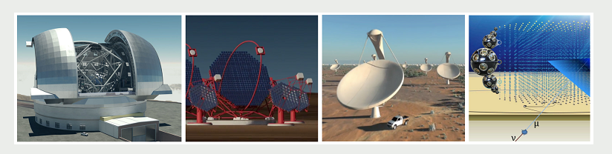
ASTERICS
ASTERICS:
Support and accelerate the implementation of the ESFRI telescopes, to enhance their performance beyond the current state-of-the-art, and to see them interoperate as an integrated, multi-wavelength and multi-messenger facility
E-ELT
CTA
SKA
KM3NET

Slide 3
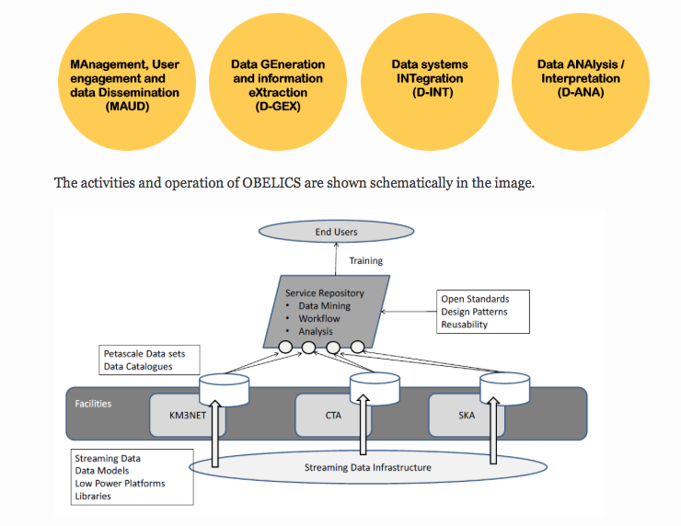
ASTERICS: OBELICS
Maximise software re-use and co-development of technology for Petascale data
Adapt and optimise extremely large database systems to fulfil the requirements of the ASTERICS ESFRI projects.
Study and demonstrate data integration across ASTERICS ESFRI and pathfinder projects using data mining tools and statistical analysis techniques on Petascale data sets.

Slide 4
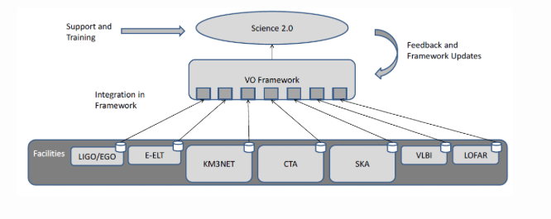
ASTERICS: DADI
Adapt the VO framework and tools to the ESFRI project needs, and make sure European astronomers remain lead actors in the IVOA, influencing it in the interest of the European infrastructures and the European scientific community

Slide 5
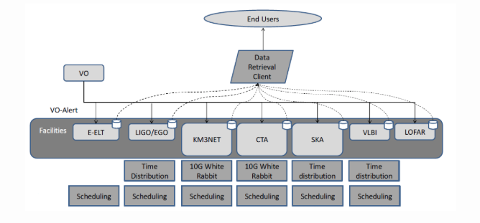
ASTERICS: CLEOPATRA
Develop technology for the enabling of long-haul and many-element time and frequency distribution over fibre connections.
Develop methods for relaying alerts, which will signal transient event detections between the facilities and enable joint observing programmes, including scientific strategies and methods for joint observing.
Foster the development of advanced scheduling algorithms, using AI approaches for optimal usage of the ESFRI facilities. CLEOPATRA's tasks reflect a consistent set of enhancements of the facilities based on developments in connectivity and data transport.

Slide 6
Data Products: From Science Case

Slide 7
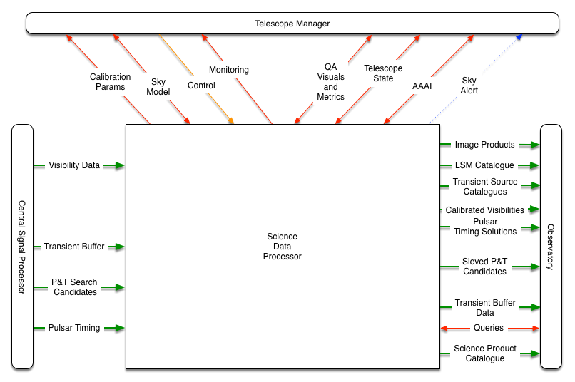
Scope of the SKA Science Data Processor (SDP)

Slide 8
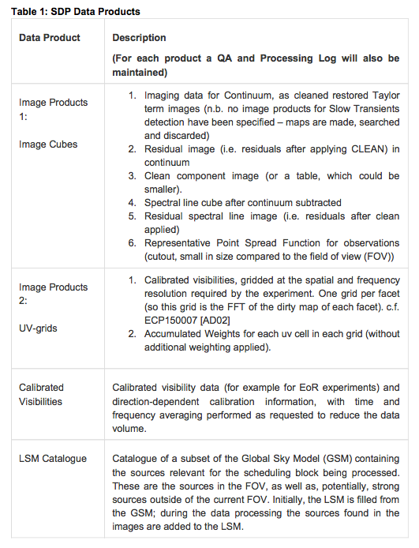
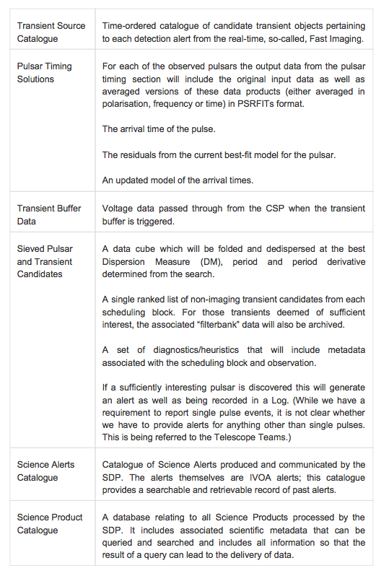
SKA Data Products

Slide 9
Image-based types of Analysis
Multi-dimensional image data size up to 50k x 50k x 64 k
General Image Processing
  Visualisation
  Noise estimation
  Basic image operations, weighted averaging
  Filtering and masking
  Deconvolution and smoothing
  Standard image-based feature detection and extraction
Specialised Image Processing
  Source Detection in noisy data
  Faraday and rotation-measure imaging
Feature detection Classification
  Model fitting (simple or statistically robust)
  Representation in a new basis (wavelets, compressed sensing, …)
  Direct machine learning classification in image space
  High-dimensional classification prior to scientific statistical analysis
    E.g. based on image features + spectral features + polarization features
Spatial
Spectral / velocity
Polarization

Slide 10
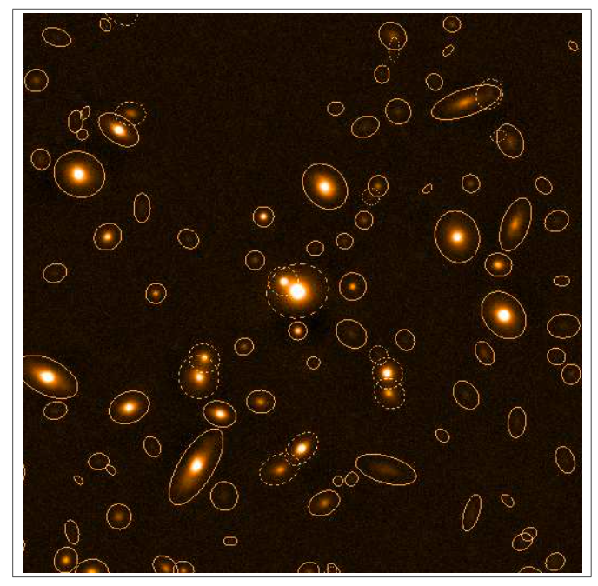
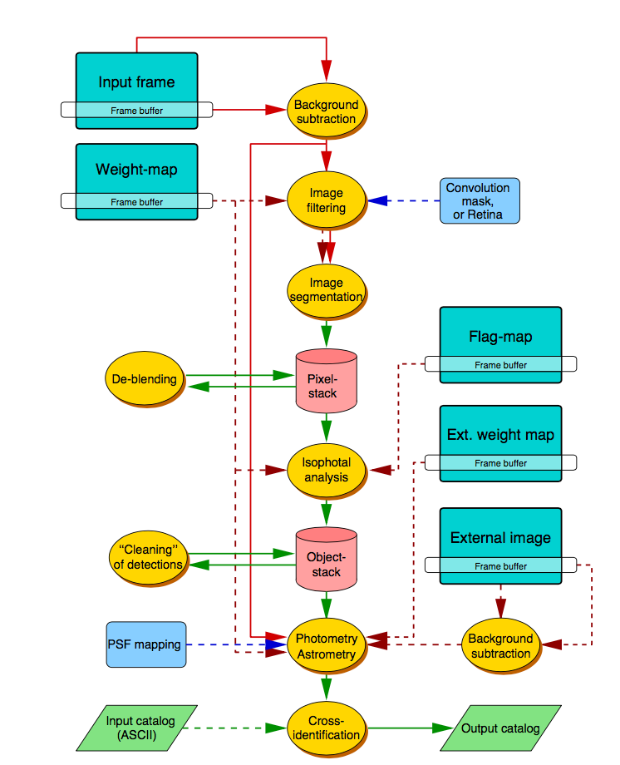
Source detection and feature extraction
Sextractor very widely used algorithm
Key aspects of algorithm
Filtering
Noise measurement
Segmentation
Object identification
Classification

Slide 11
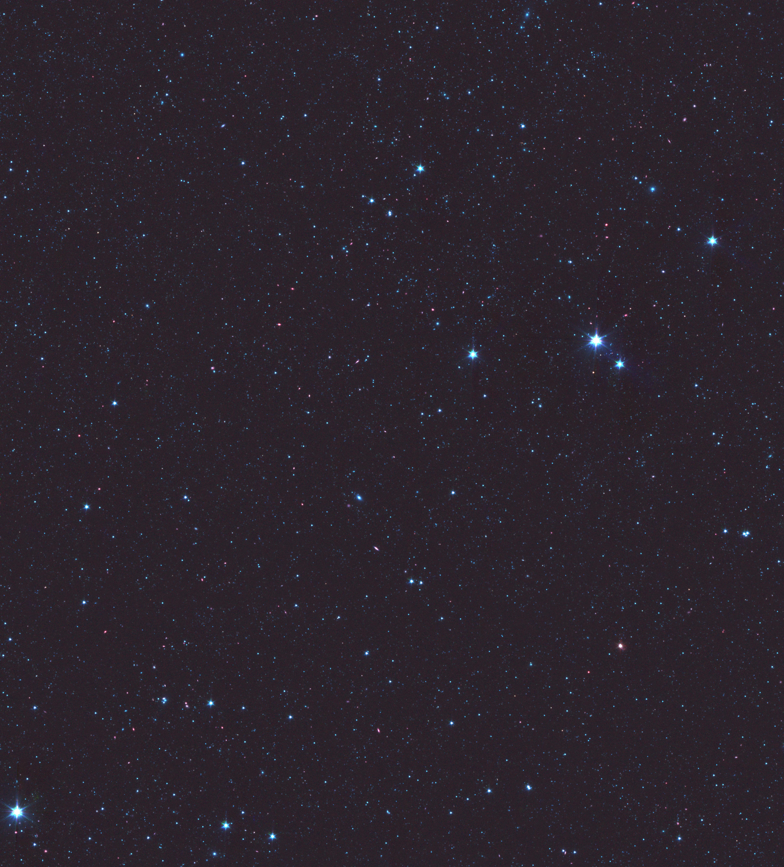
Source detection and feature extraction
Sextractor very widely used algorithm
Key aspects of algorithm
Filtering
Noise measurement
Segmentation
Object identification
Classification
Embarrassingly parallel
Distribute with simple guard region
Simple extension to multi dimensions

Slide 12
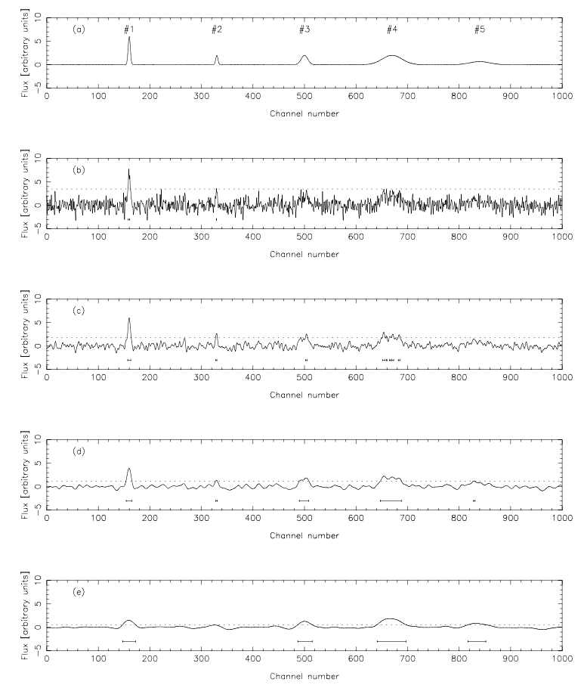
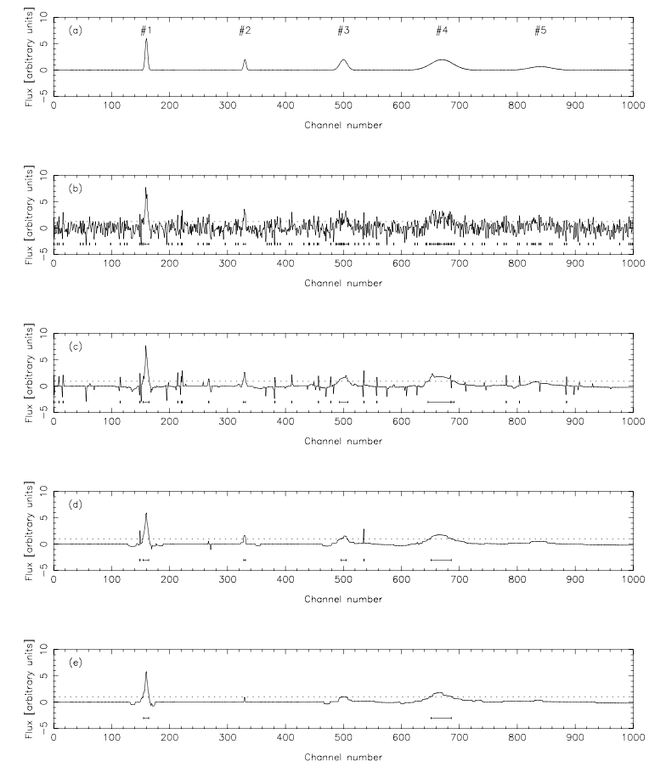
Extension to multi-scale: Duchamp
Multi-scale smoothing
Wavelet representation

Slide 13
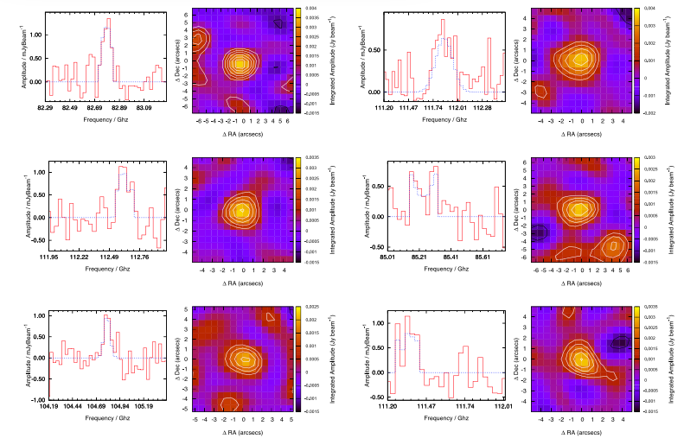
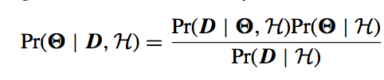
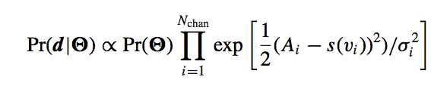
Full Bayesian Source Finding
likelihood
prior
posterior
Bayesian evidence
Full Bayesian analysis
Model for the source simple or complex
Compare evidence – is there evidence of 1, 2, … N sources
Quantifies detectability
Can get very computationally challenging
Image-space parallel
Visibility space very computationally expensive
Finding galaxies in Alma fields
Building source detection as part of deconvolution step using Bayesian / MEM approach

Slide 14
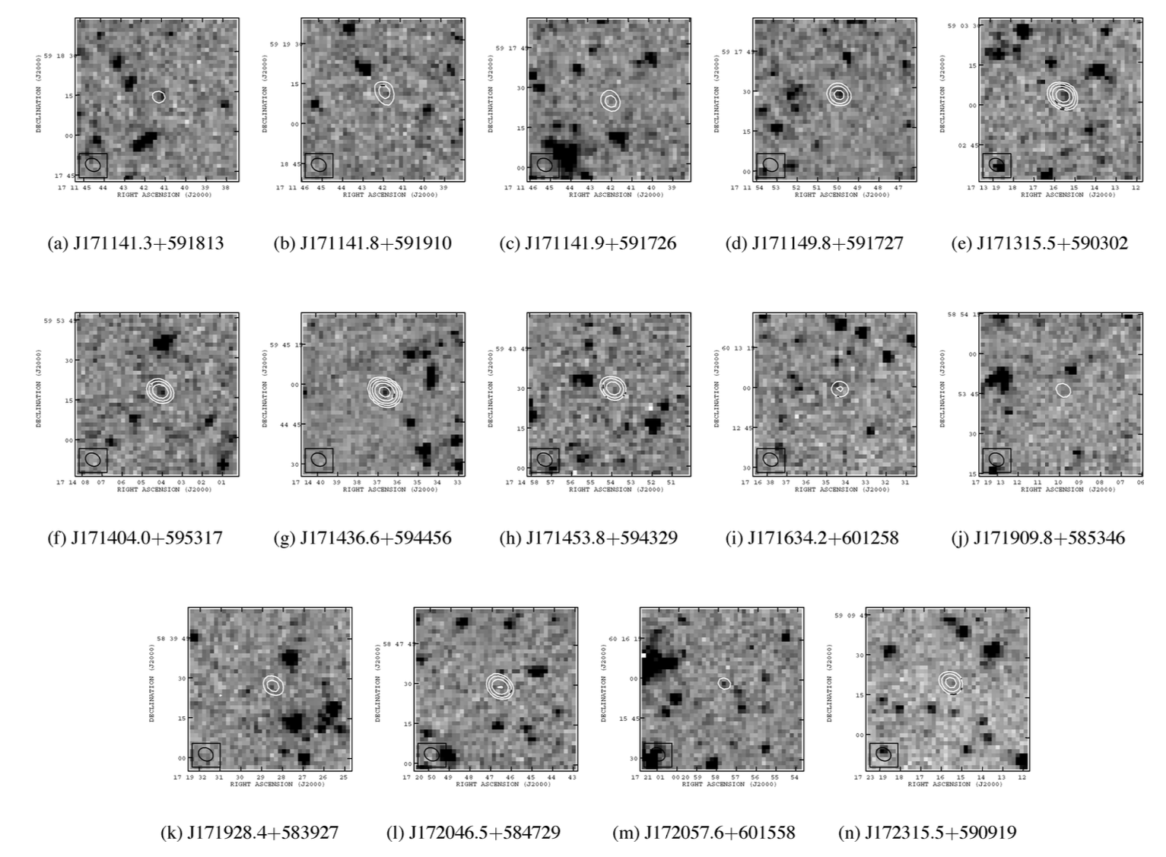
Comparison between wavebands
Currently source detection in both and compare lists (catalogues)
ASTERICS task is to develop joint Bayesian analysis

Slide 15
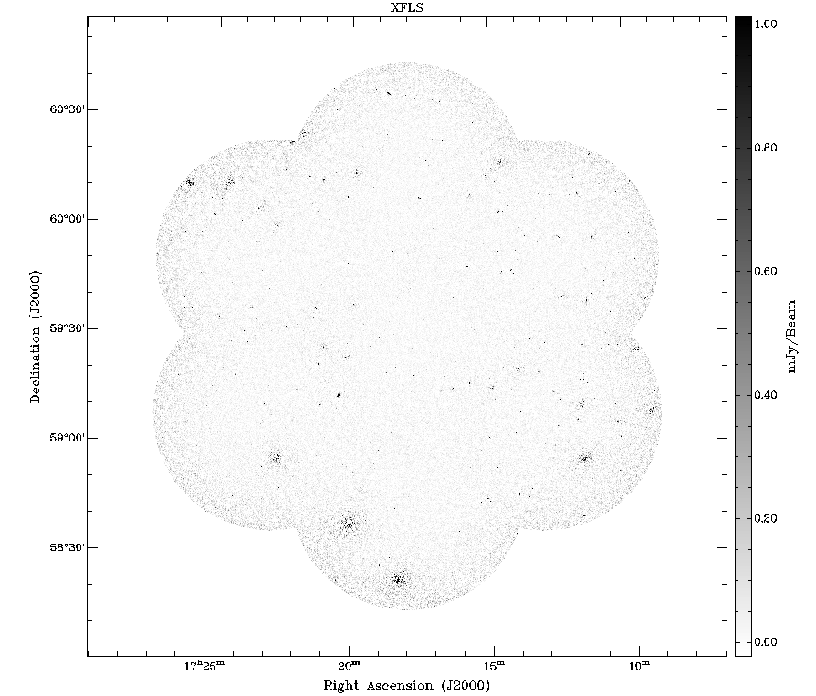
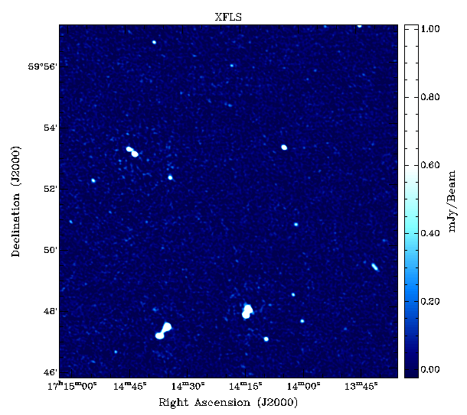
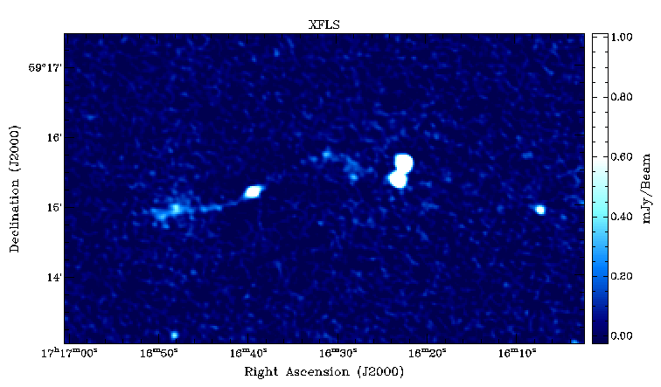
Comparison between wavebands: Stacking
Stacking is simply adding image and/or spectral data referenced to give better sensitivity
E.g. emission detected in one waveband for a class of object and not in another
Use positions from detected band for referencing
SPITZER LOCKMAN HOLE

Slide 16
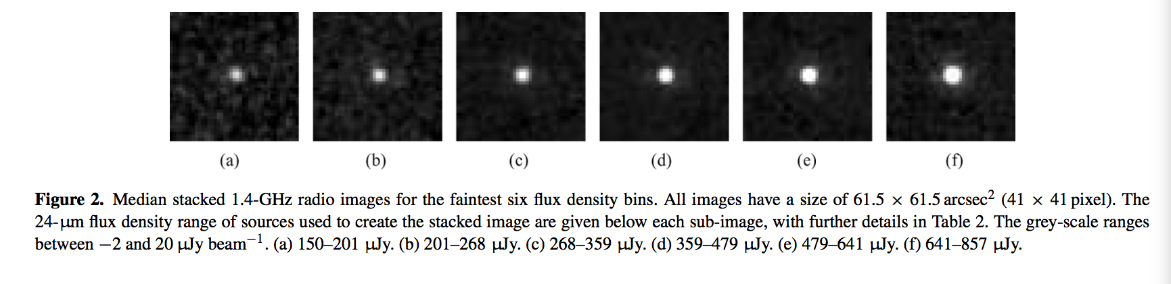
Comparison between wavebands: Stacking
ASTERICS task is to develop Bayesian approach
Extension of joint analysis
Stacking is simply adding image and/or spectral data referenced to give better sensitivity
E.g. emission detected in one waveband for a class of object and not in another
Use positions from detected band for referencing

Slide 17
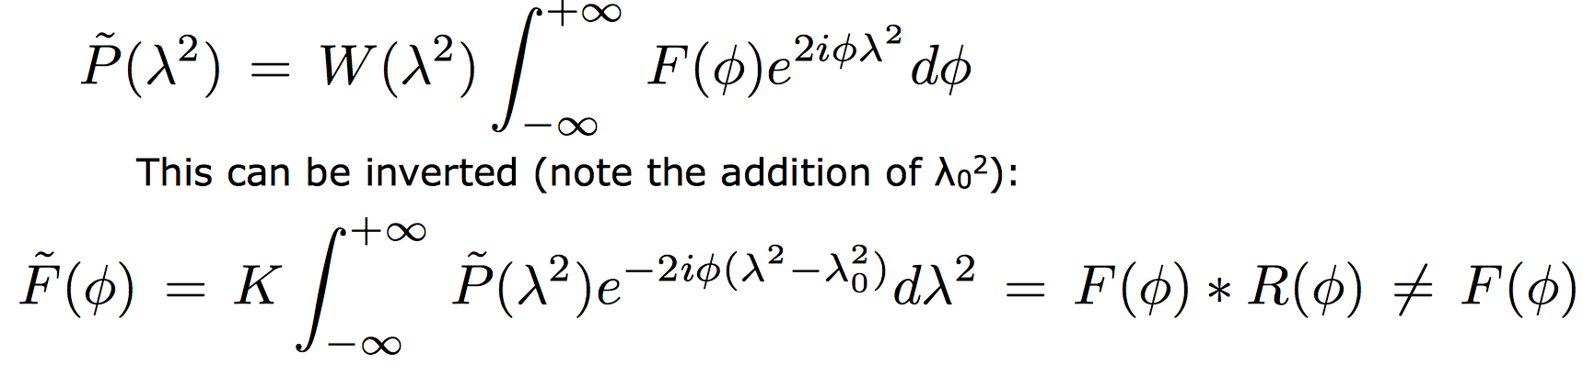
Rotation Measure Synthesis
Vazzaet al. 2010
Govoni et al. 2006
Use RM Grid to probe evolution of field in clusters
RM Synthesis gives much more information

Slide 18
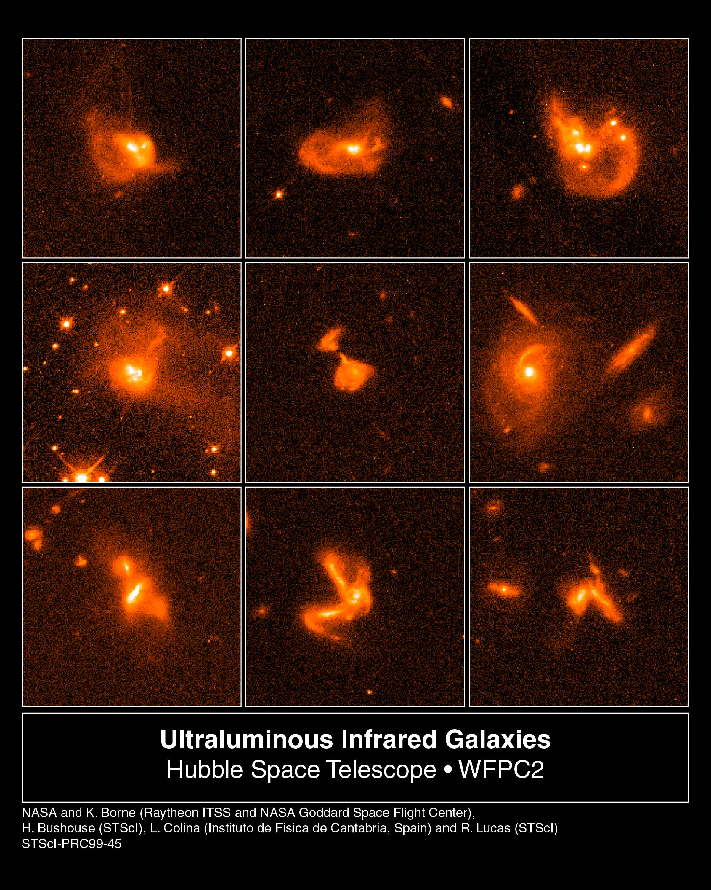
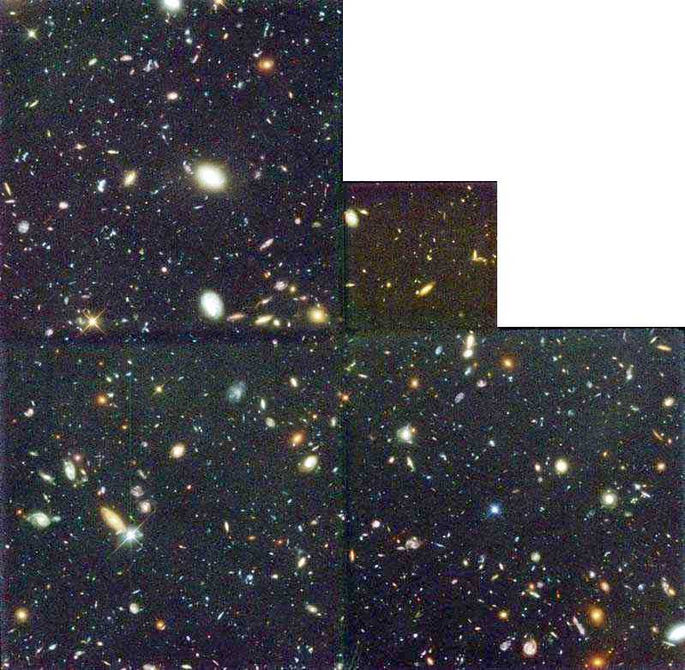
Feature extraction and classification:
galaxy types
Representation in a basis
Machine learning
  Deep neural nets
  Gaussian processes
Demanding use case is weak lensing
Determine systematic background image distortion around a foreground gravitating mass

Slide 19
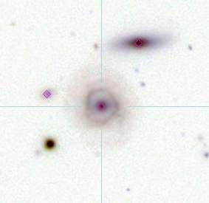
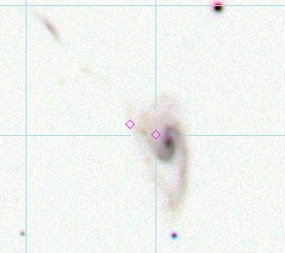
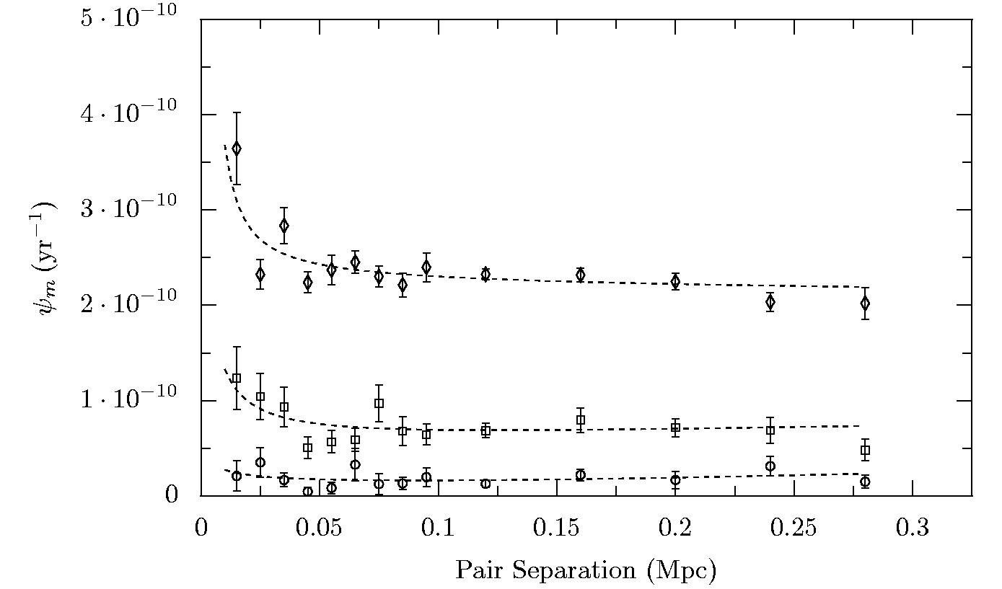
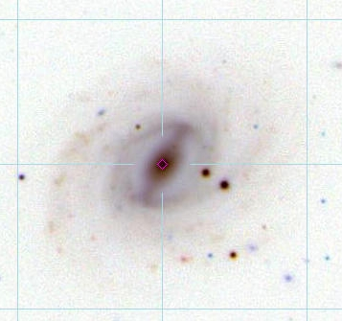
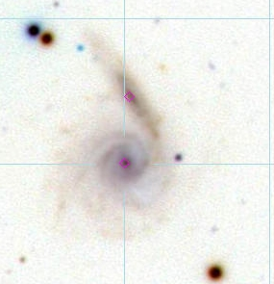
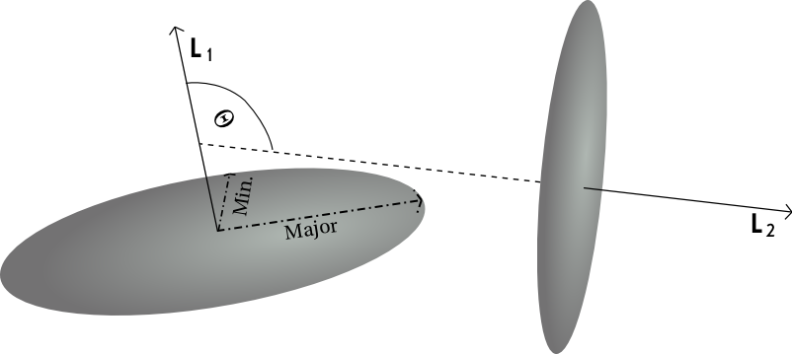
Feature extraction and classification: dynamics
Identify in image-velocity space physically close pairs
Estimate dynamics from imaging
Measure Star formation from spectroscopy or multi-waveband images
Star formation increased by spin-aligned interactions

Slide 20
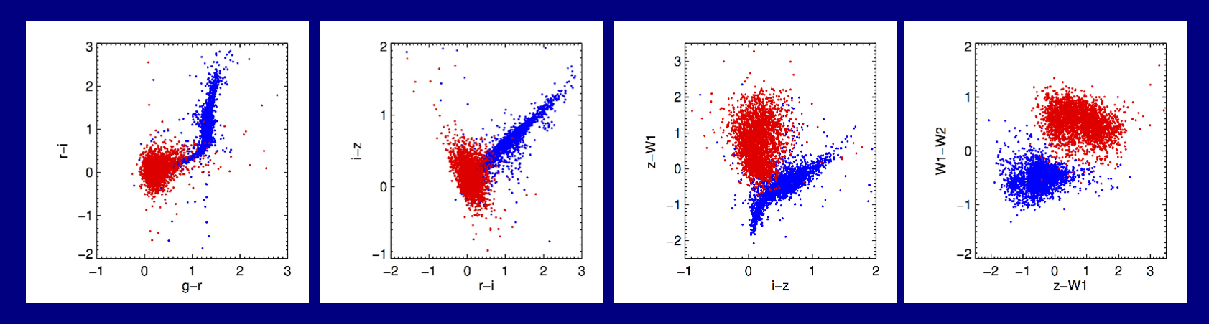
Classification based on features
Simple problems tackled via PCA
Machine learning preferred approach
Gaussian processes particularly suited to this sort of classification
Deep learning is potentially very computationally intensive
Likely to be a major activity to extract science once initial analysis is done

Slide 21
Visibility-based types of Analysis
Re-imaging needed in most demanding cases and learning about instrument
Imaging
  Re-imaging from “visibility data” similar to SDP processing
  Re-imaging from gridded “visibility data”
Power-spectral estimation and model comparison
  Estimate information direct in the visibility space
  Model fitting
  Bayesian analysis
Extremely compute intensive

Slide 22
Standard interferometer
Imaging
s
Astronomical signal (EM wave)
B . s
Visibility:
V(B) = E₁ E₂*
= I(s) exp( i ω B.s/c )
Resolution determined by maximum baseline
θ_{max} ~ λ / B_{max}
Field of View (FoV) determined by the size of each dish
θ_{dish} ~ λ / D
Detect & amplify
1
B
2
Digitise & delay
Correlate
X
X
X
X
X
X
Integrate
Process
Calibrate, grid, FFT
SKY Image

Slide 23
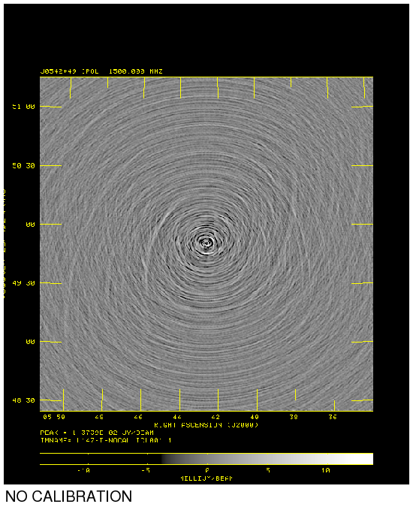
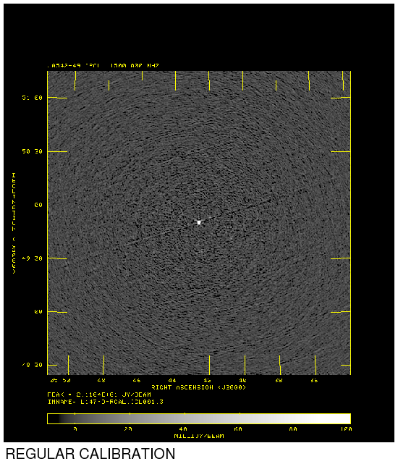
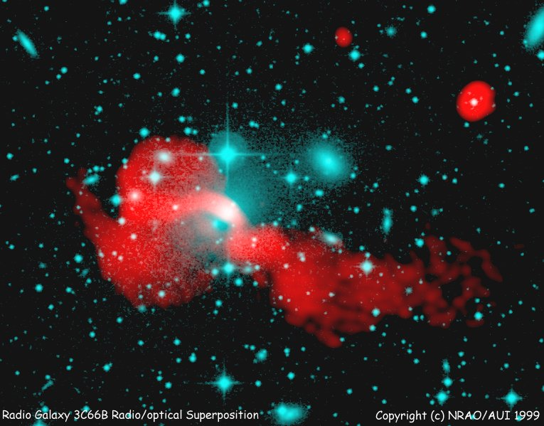
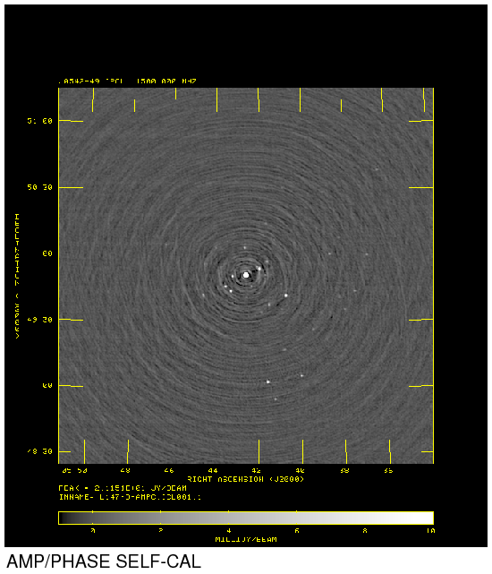
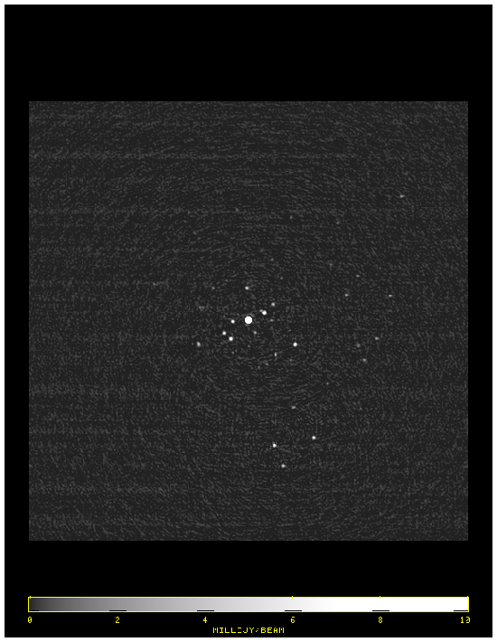
Imaging
Images formed by an inverse
algorithm similar to that used
in MRI
Typical image sizes up to:
30k x 30k x 64k voxels
Notes:
Obvious tie up with ALMA, NGST, next generation of ground based optical telescopes, SKA has resolution advantage to look in more detail at objects detected in other wavebands.
Will see things that are not visible in the optical – see next slide – this is the story about distant dust-enshrouded galaxies as seen in the sub-mm regime.

Slide 24
Imaging Workflow
Correlator
RFI excision and phase rotation

Slide 25
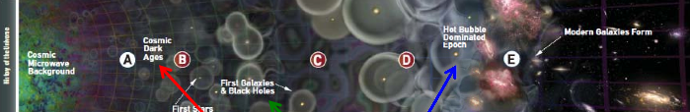
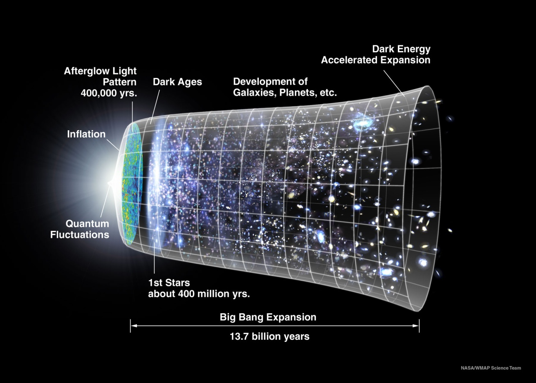
Notes:
Obvious tie up with ALMA, NGST, next generation of ground based optical telescopes, SKA has resolution advantage to look in more detail at objects detected in other wavebands.
Will see things that are not visible in the optical – see next slide – this is the story about distant dust-enshrouded galaxies as seen in the sub-mm regime.

Slide 26
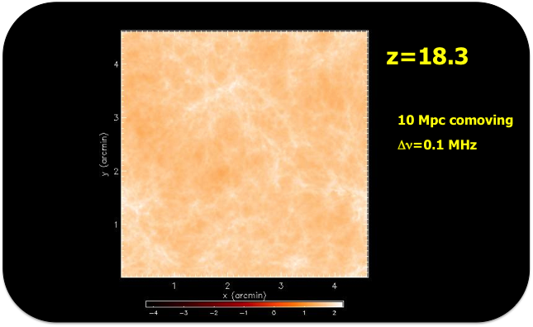
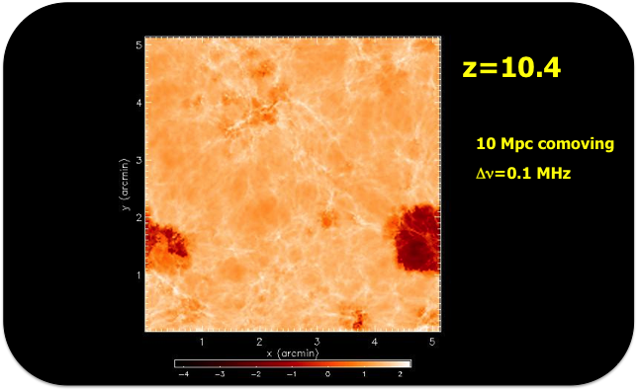
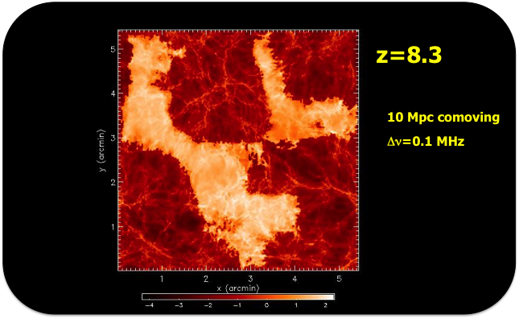
Notes:
Obvious tie up with ALMA, NGST, next generation of ground based optical telescopes, SKA has resolution advantage to look in more detail at objects detected in other wavebands.
Will see things that are not visible in the optical – see next slide – this is the story about distant dust-enshrouded galaxies as seen in the sub-mm regime.

Slide 27
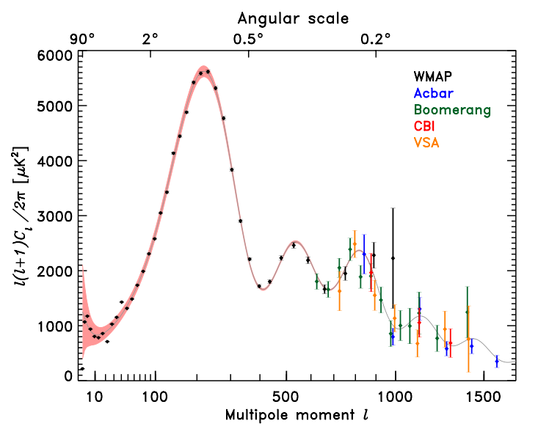
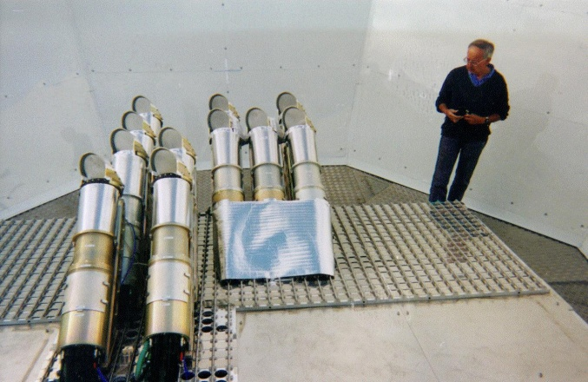
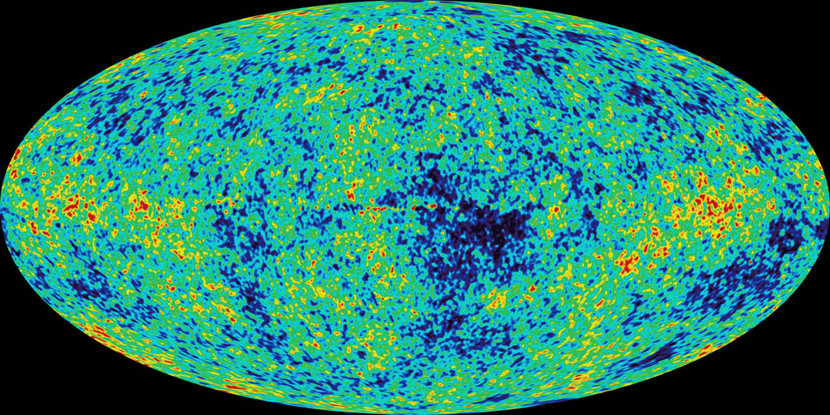
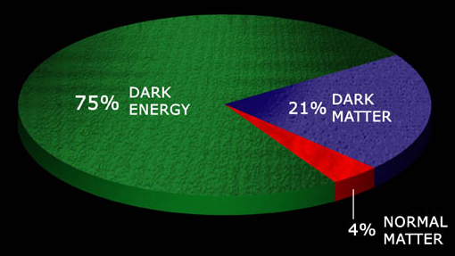
VSA experiment
Measurements of CMB power-spectrum have established era of “precision cosmology”
Universe has a flat geometry
Ω = 1
Matter contribution
Ω_{m} ~ 0.25
Normal (baryonic) matter
Ω_{B} ~ 0.04
Cold Dark Matter (CDM)
Ω_{m} ~ 0.21
Dark energy
Ω_{Λ} ~ 0.75
WMAP CMB sky

Slide 28
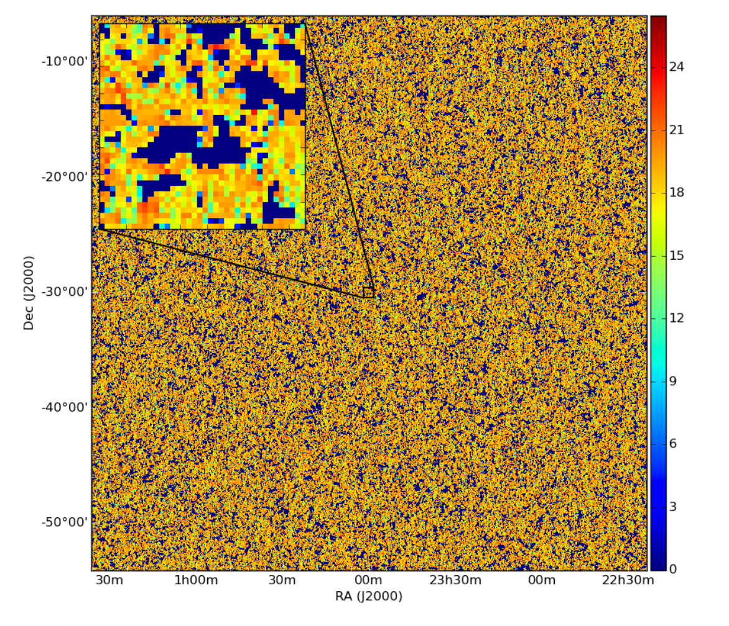
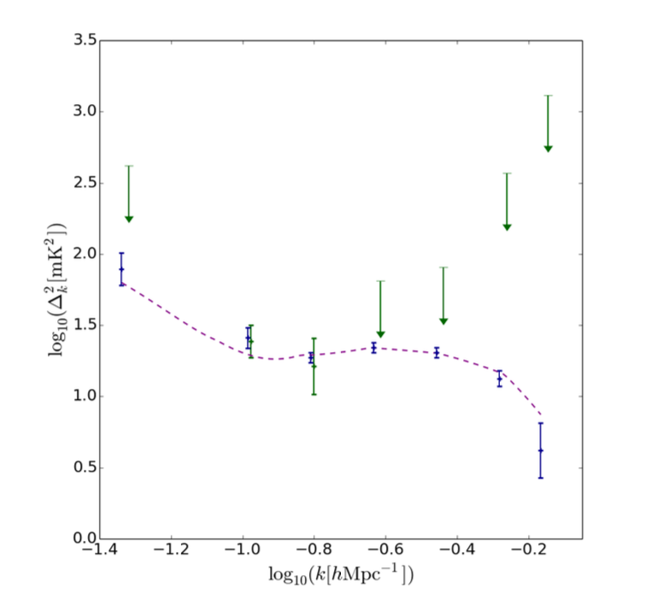
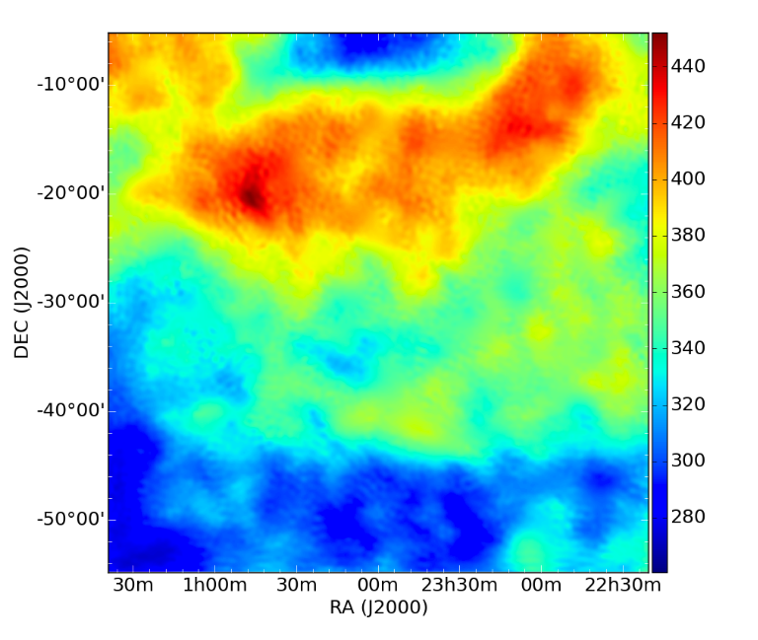
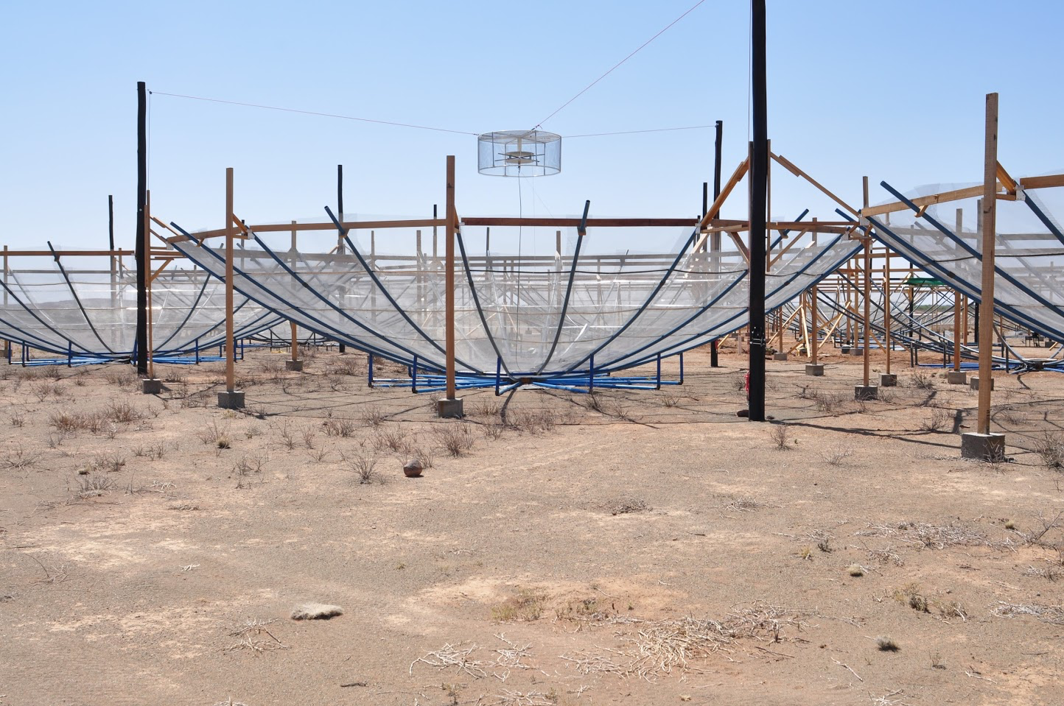
HERA SKA Precursor
Signal
Foreground

Slide 29
HERA SKA Precursor
Signal
Work from visibility data
Improve calibration via imaging-like workflow
Solve for time varying phase screen
Remove foreground emission
Direct Bayesian estimation of the power spectrum
Model is a spherically symmetric
Marginalise over residual foreground
Foreground

Slide 30
Science analysis and data mining
Total SKA Archive can grow at 300 Pbytes / yr
Science Analysis
  Visualisation
  Standard data analytics
  Model fitting including model generation
Data mining
  Data-base like analytics on SKA and other data
  Importing data from multiple sources
  Context based searches
    Users will expect to be able to do the same searches as they see on Google / Facebook
    Find me all images including extended spiral larger than 100 arcsec …
Even “Standard” analysis now challenging
Could be very challenging

Slide 31
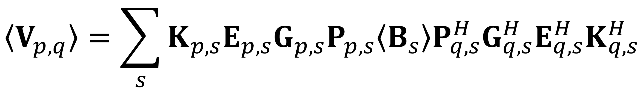
Experiment definition
How much simulation will need to be done at SRC?
Science Simulation
  Simulation of science target space
Experimental simulation
  Simulate experimental response
  Simulate analysis procedure
    E.g. co-adding (averaging) many separate observations on
    a field → does the experiment need to average in image
    or UV-space?
Experimental simulation requires running a data generator plus the SDP environment as run at the observatory

Slide 33
Possible SKA1 Continuum Survey Strategy
Deep / Multi-tier
Star formation & BH accretion history
Role of AGN feedback over cosmic Time
Evolution of FIR-Radio correlation
Role of environment
Wide / All Sky
First galaxies, BHs & protoclusters
Galaxy clusters, cosmic web
RL AGN physics/lifecycle
RQ/RL AGN dichotomy
ISM and SF physics in nearby galaxies
Origin of FIR-Radio correlation
Strong lensing

Slide 34
Galaxy Evolution: Star formation and feedback
Hopkins et al. 2004
Murphy, Sargent et al 2015
Radio continuum excellent tracer of SF in SKA era
AGN Feedback radio essential

Slide 35
Galaxy Evolution: Star formation and feedback
One source from e-MERGE showing embedded AGN and ring of star formation across massive spheroidal
e-MERLIN demonstrated the power of resolving AGN and star-forming contributions
e-MERLIN follow up of brighter galaxies to probe detailed star-formation / AGN interactions and feedback
Large fraction of wide-field sample will be accessible to e-MERLIN

Slide 36
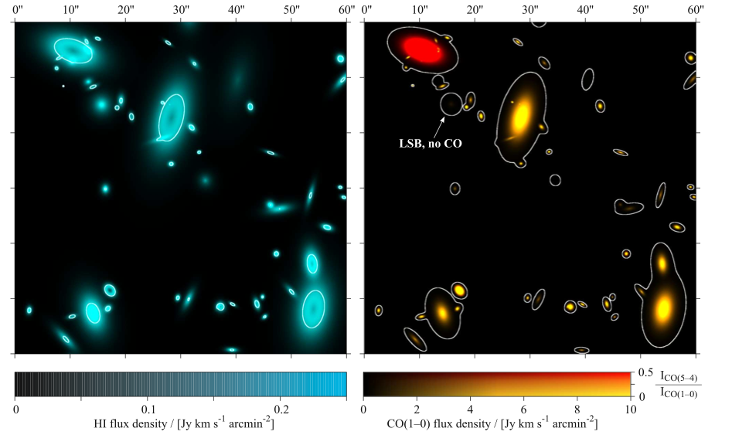






Galaxy Evolution: SKA / ALMA / E-ELT /e-MERLIN synergy
NGC3079 HI, OH and H₂CO absorption
(Beswick et al)
ALMA, SKA and e-MERLIN are natural IFUs at different scales and transitions
E-ELT IFU maps, e.g. Halpha
Continuum imaging e-MERLIN + VLBI

Slide 37





Tom Muxlow/Rob Beswick: Star-formation Across Cosmic Time: M82
e-MERLIN 4.75-5.25GHz Beam 50mas
HII Region
M82 (3.6Mpc)
Breakout
M82 – JVLA(A+B) C-Band - Beam 0.35”
SNR
Marvel, Owen, & Eilek
Calibrate star-formation rate derivation on nearby galaxies like M82
Separate AGN / S-F (& SNR from HII) by sensitive high resolution imaging at C- & L-Band
Extend to distant galaxies 1000 times further away and 1 million times fainter
e-MERLIN 1.25-1.75GHz

Slide 38

Tom Muxlow/Rob Beswick: Star-formation Across Cosmic Time: M82
e-MERLIN 4.75-5.25GHz Beam 50mas
HII Region
M82 (3.6Mpc)
Breakout
M82 – JVLA(A+B) C-Band - Beam 0.35”
e-MERLIN + JVLA(A) C-Band
SNR
Marvel, Owen, & Eilek
Calibrate star-formation rate derivation on nearby galaxies like M82
Separate AGN / S-F (& SNR from HII) by sensitive high resolution imaging at C- & L-Band
Extend to distant galaxies 1000 times further away and 1 million times fainter
e-MERLIN 1.25-1.75GHz

Slide 39




Star-formation Across Cosmic Time: e-MERGE Tier 1
                J123634+621213:
Extended steep-spectrum (α=0.74) starburst (S_{1.4GHz}=230μJy) ISO detection
            L_{1.4} =2.7x10²³ W/Hz → Star-formation rate ~64 M๏/yr (0.1-100M๏ assuming Salpeter IMF)
Star-formation follows ridge line of merging system. Full resolution imaging shows a resolved nuclear starburst – size~1kpc
Beam 0.3” CI=7.5µJy/bm
Beam 0.5” CI=10µJy/bm
HST ACS: I=18.7^{mag} galaxy
possible merger with dust lane
JVLA C-band C-array

Slide 40


Cosmology: Variation of fundamental constants?
Z = 6.4
Z = 4.7
$$F= \frac{α^{2}}{{m_{p}}/{m_{e}}}$$
$\frac{∆F}{F}=−3.3 ±2.3 × {10}^{−4}$ (12.9 Gyr)
Z = 4.7
Observe different types of transitions (e.g. electronic vs rotational) in galaxies at range of z
Use differences in inferred redshits of the lines to look for evidence of variation in fundamental constants
Problem
  Are we tracing same gas in the two transitions?
  Do we observe astrophysics or physics?
Here resolution of e-MERLIN very helpful
  HI / OH
  More transitions
Lentati et al 2013
DF/F = -3.3

Slide 41
Transient Universe
Traditional area of big impact e-MERLIN science
SKA1 Discovery +
  Power of responsive observing
  Resolution
  Link to EVN

Slide 42
Transient Universe
Traditional area of big impact e-MERLIN science
SKA1 Discovery +
  Power of responsive observing
  Resolution
  Link to EVN

Slide 43




Transient Universe: SN2014C
AMI-LA 15GHz light curve
SN2014C (Lick discovery)
D=15.1Mpc in NGC7731
Unusual double peak
Indicative of shell interaction with dense CSM
Possibly radio bright SN1b
Now trigger VLBI follow-up pending
e-MERLIN resolution vital to remove confusion
D=470
D=488
DSS/NVSS
Anderson, Fender et al
450

Slide 44
AGN Physics
Physics of RL AGN physics/lifecycle
Physics of RQ/RL AGN dichotomy
How do RL / RQ AGN provide feedback
Jet Physics: origin and propagation
Radio Astronomy and AGN Physics !!
Much progress but still many unsolved problems
Interesting in own right as well as importance in overall galaxy evolution
AGN physics is interesting

Slide 45

AGN Physics
Cygnus A radio and X-ray

Slide 46
Cosmology: Variation of fundamental constants?
Z = 6.4
Z = 4.7
$$F= \frac{α^{2}}{{m_{p}}/{m_{e}}}$$
$\frac{∆F}{F}=−3.3 ±2.3 × {10}^{−4}$ (12.9 Gyr)
Z = 4.7
Observe different types of transitions (e.g. electronic vs rotational) in galaxies at range of z
Use differences in inferred redshits of the lines to look for evidence of variation in fundamental constants
Problem
  Are we tracing same gas in the two transitions?
  Do we observe astrophysics or physics?
Here resolution of e-MERLIN very helpful
  HI / OH
  More transitions
Lentati et al 2013
DF/F = -3.3

Slide 47



A new period of activity in NGC660
Witnessing the (re-)birth of an AGN
Joint eMERLIN/EVN/WSRT study of spectral lines and continuum
New source discovered in Arecibo monitoring (2008-2010)
Nuclear continuum source peaked at ~0.5Jy – now in steady decline
Pre-outburst MERLIN L-band and post outburst X-ray (Chandra)
EVN
Epoch1 Oct 2013
Argo et al MNRAS in press

Slide 48



Nuclear source & Gas?
Outburst provide chance of high-res/sen line observations of neutral molecular ISM
Wide-band continuum SED
- New GPS source
EVN/e-MERLIN H1 against Core
Multi-epoch WSRT
H1 monitoring
- super-res trace of source evolution
Argo et al MNRAS in press
van Bemmel in prep

