Slide 1

Data Transfer Approaches
Brian Davies
GRIDPP/SKA
Manchester, November 2016

Slide 2
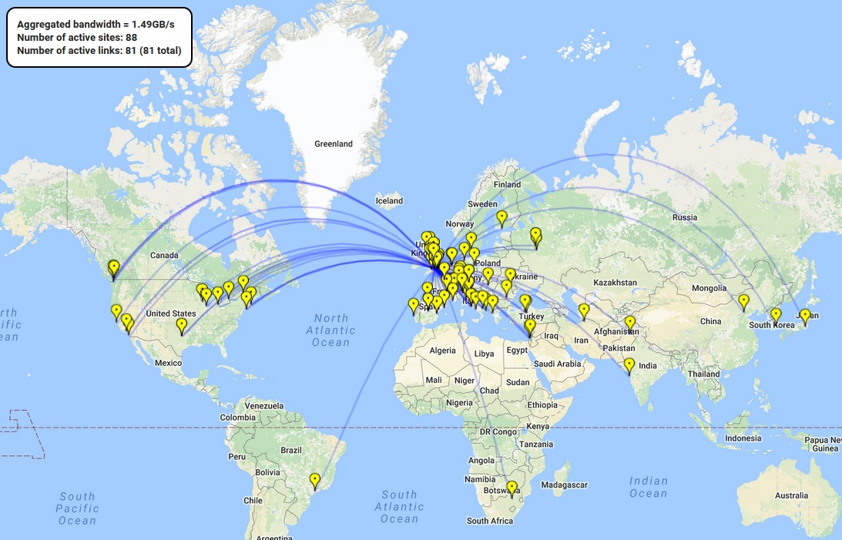
Transfers to a single site/1day/1VO

Slide 3
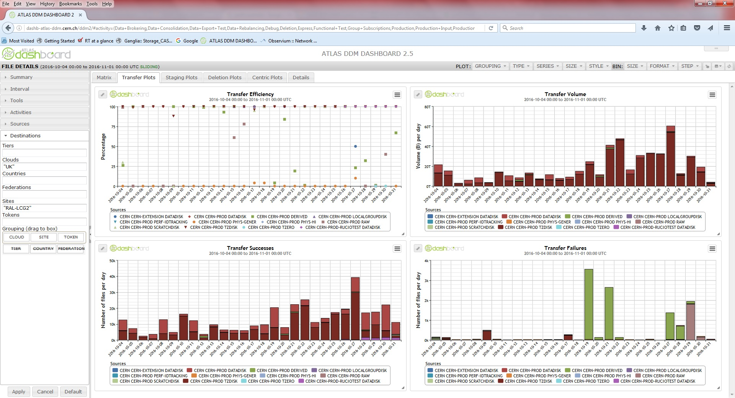
TB/day between sites now normal

Slide 4
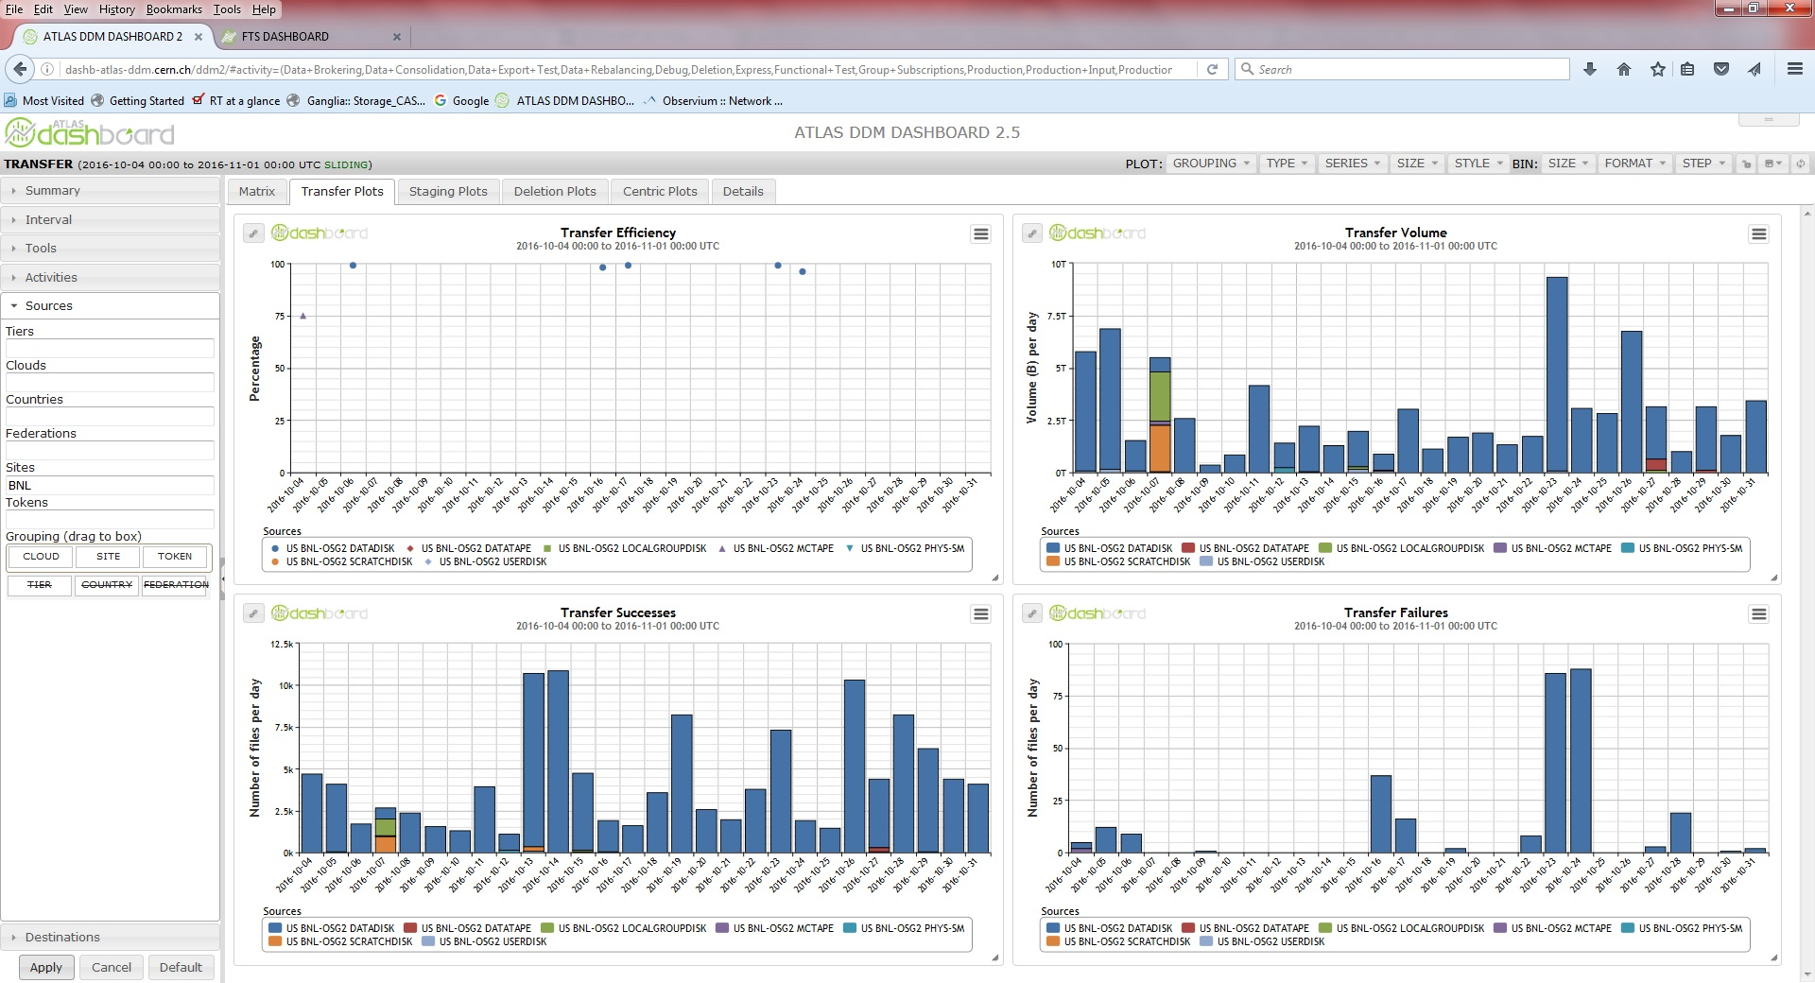
With Decent rates for Intercontinental transfer

Slide 5
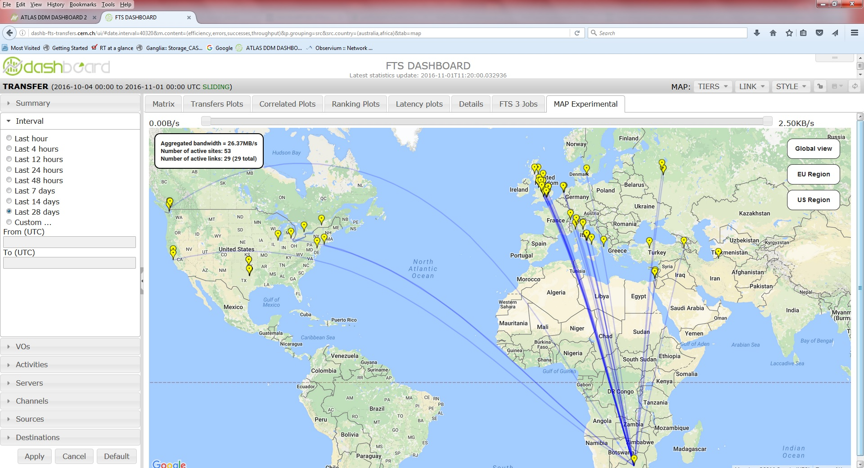
Already Transferring from AU/SA

Slide 6
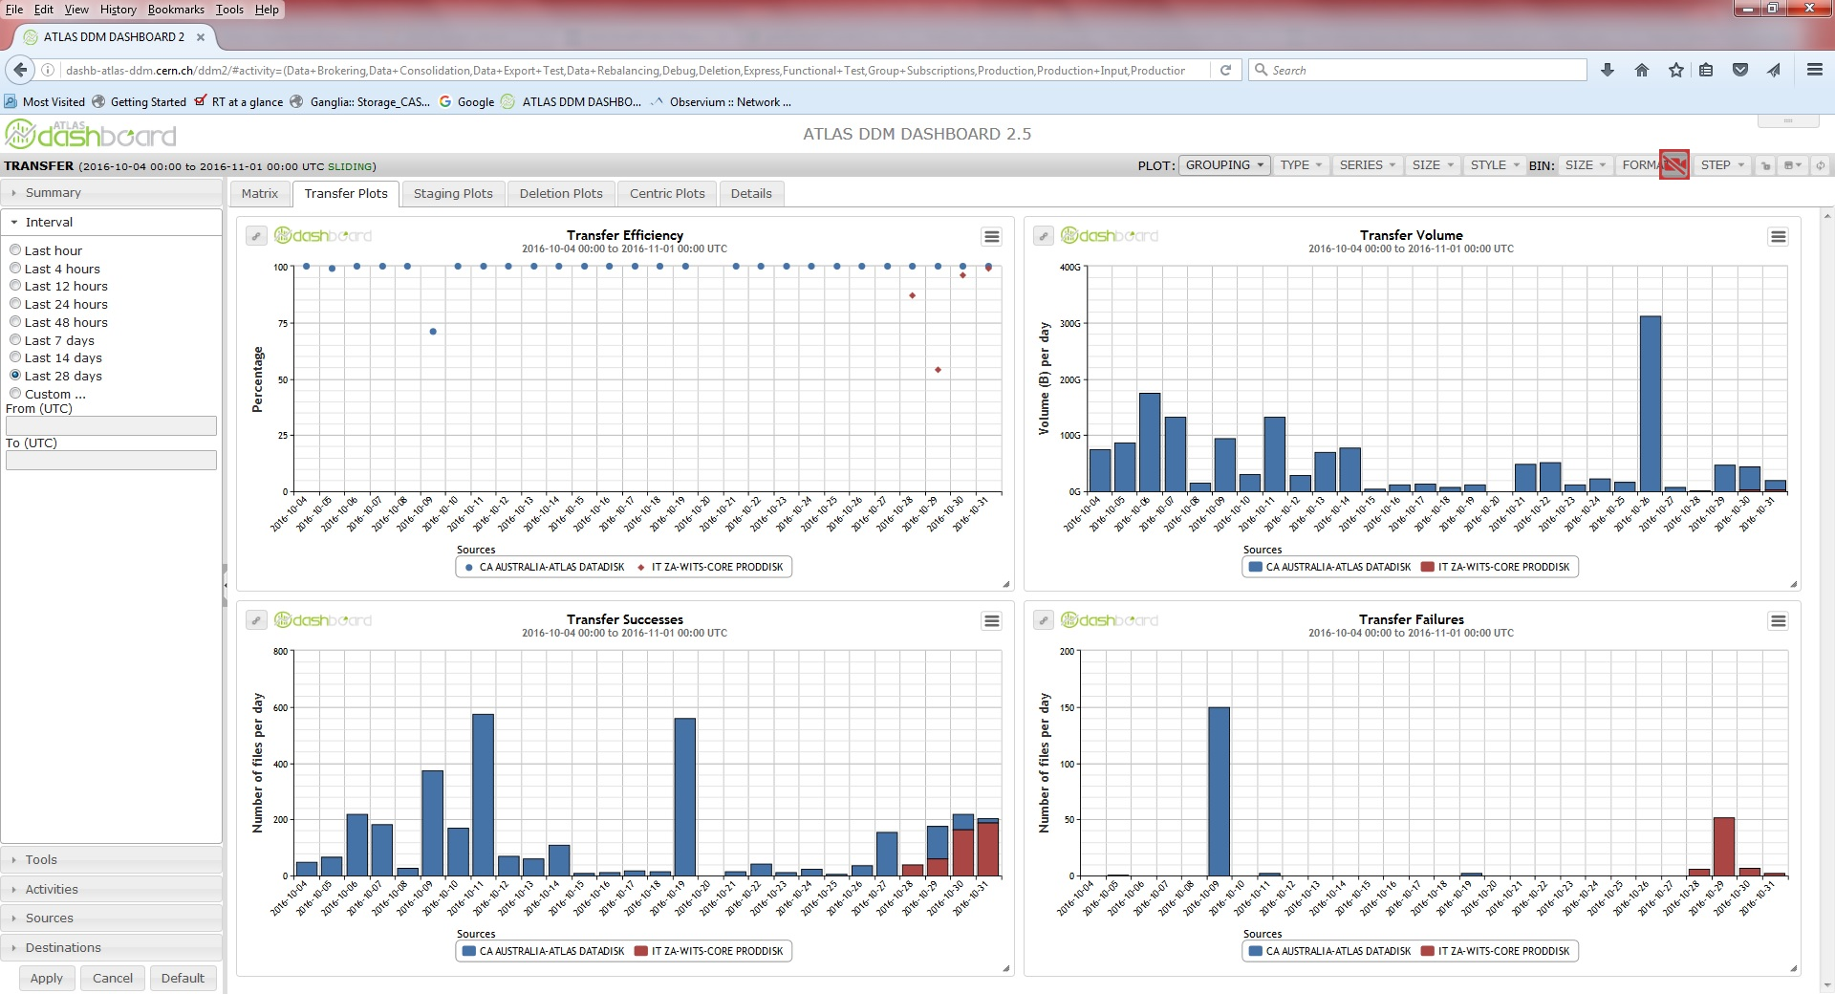
Rates Lower from smaller sites

Slide 7
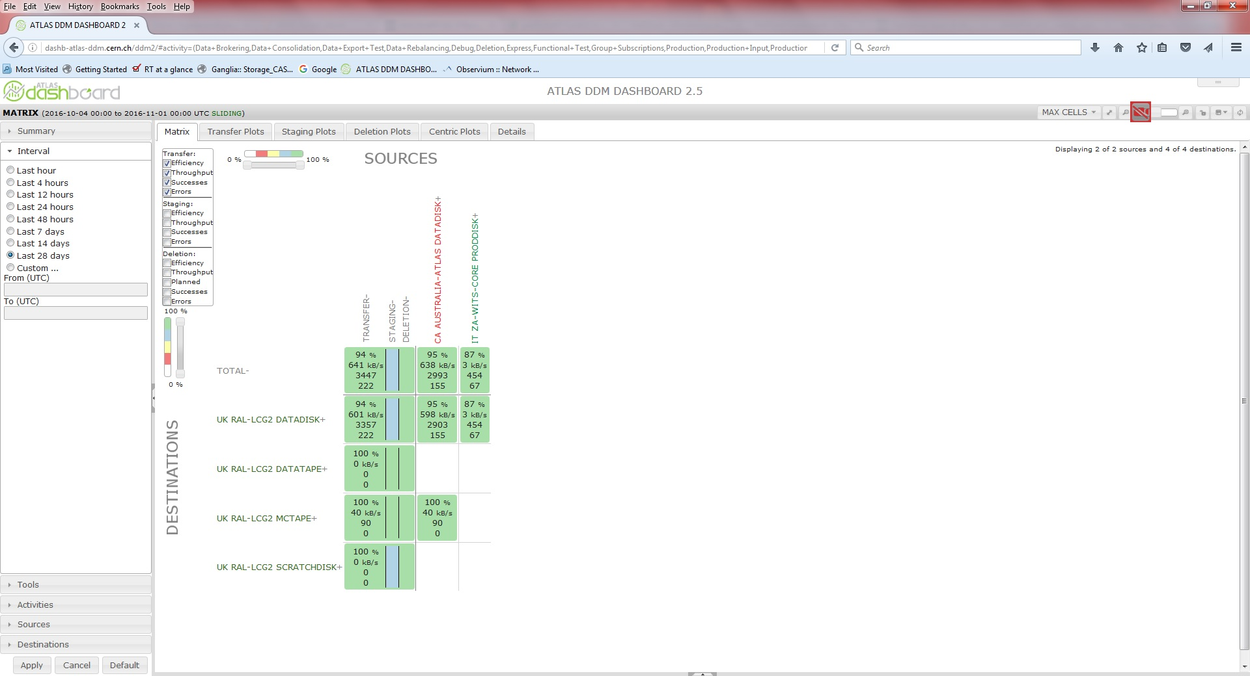
Transfers to Disk and Tape Seamless*

Slide 8
WLCG Has a lot of Data transfers to monitor
167 Sites in 43 Countries on six Continents
Storage endpoints containing 250PB (disk) 300PB (tape)
  Organised and chaotic access
  Supporting Single/Multiple endpoints for Single/Multiple Virtual Organisations
  Vary in size and scope
    10TB-10s of PB of Total Storage (Disk and Tape)
    1/10 GE NICs, 1/10/100 Gbps, R&E networks and private OPN
    10TB-1PB filesystems/object stores, 1-300 diskservers per site
    Multiple filesystems (XFS,HDFS,CEPH,GPFS,Lustre)
Central Production and User initiated
Last two years WLCG has moved 0.5EB of data
  Over 1billion files.
WN jobs produce a lot of data which also has to be stored/moved
  One VO runs 200k concurrent jobs which last 10mins to 72 Hours.
  0-100s of Input files, 2-3 Output files
    Individual file open times 1-10000s

Slide 9
Data movements vary greatly
File size from ~10B to ~10GB
Latency between hosts from 0.1ms to 350ms (just for the UK )
Different workflows require different data movement
  WAN SE<->SE, SE->WN, WN->SE
  LAN WN<->SE, SE<->SE
    Different Tools to monitor different workflows
Different storage middleware
  Native gridFTP, BeSTMan, DPM, dCache, SToRM
Different transfer protocols
  gsiFTP, http/WebDaV, xrootd, NFSv4.1, S3

Slide 10
File Transfer Service (FTS) Moves data!
EGI Middleware Stack
Can handle many VOs
  22 (HEP and non-HEP)
Checksum validation of files
Retry of failed transfers
Auto-optimisation of transfer parameters to maximise throughput
Ability to set limits suitable for varied storage setups
Web friendly GUI also available!! Federated Failover
  Mainly use Command line tools or higher level control systems.
Handle many file transfers (~1.5M a day)
  Single to thousands of files per single submission

Slide 11
File Transfer Service (FTS) Moves data!
High Available service
1/4 of main FTS services used by WLCG run by RAL
IpV6
Work with Developers

Slide 12
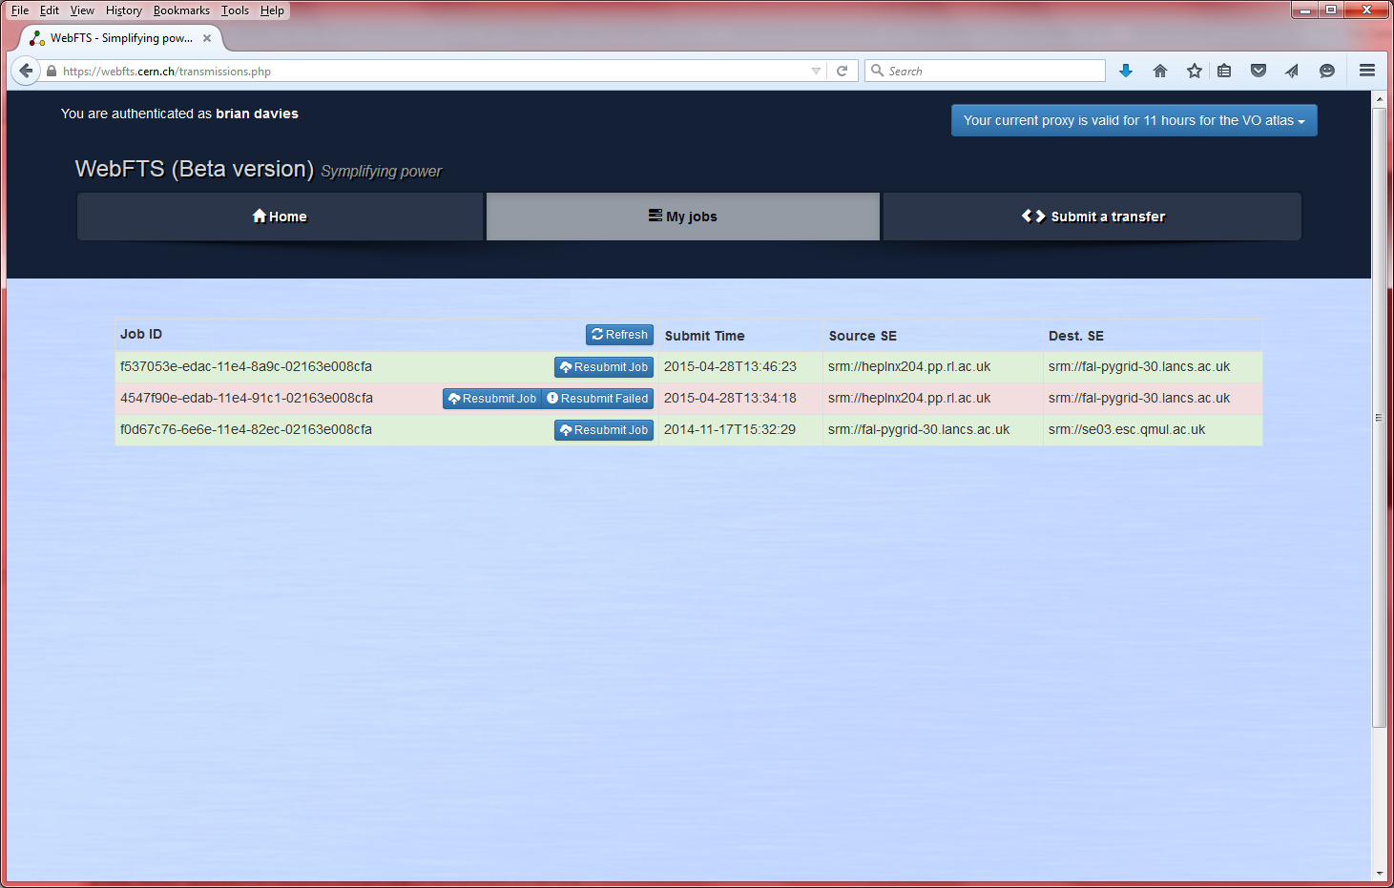
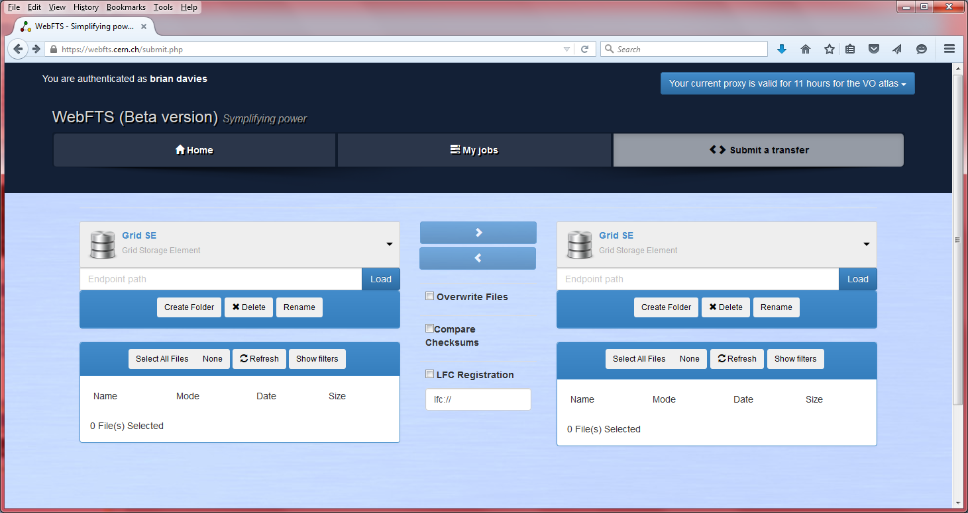
Web GUI

Slide 13
History/Future of Data movement
Scp/rsync
Globus-url-copy
  Single machines
  gridftp
Multiple Machines with Storage Resource Management Frontends controlling Hierachal Storage Systems
  Disk/Tape
  Multiple transfer protocol
Distributed filesystems with gateway head nodes
Lustre/GPFS
Object Store /Cloud infrastructures with new/old protocols
  CEPH/Amazon S3/Swift/gsiFTP/http/NFS4.1/xrootd
Globus Online

Slide 14
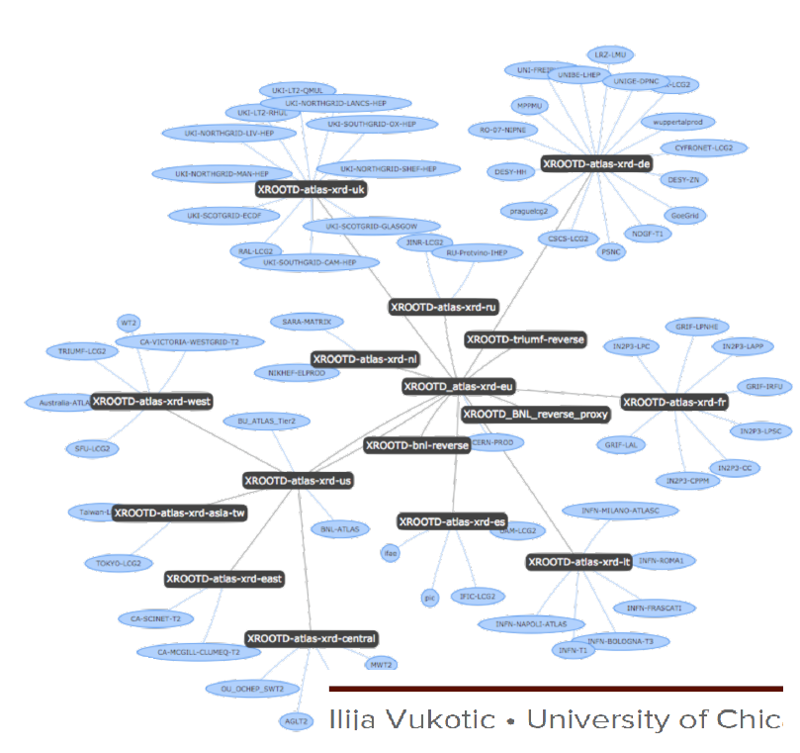
Example of global network for Federated Data Access
Job Access data from any site in world
Automated re-direction
Xrootd transfer protocol

Slide 15
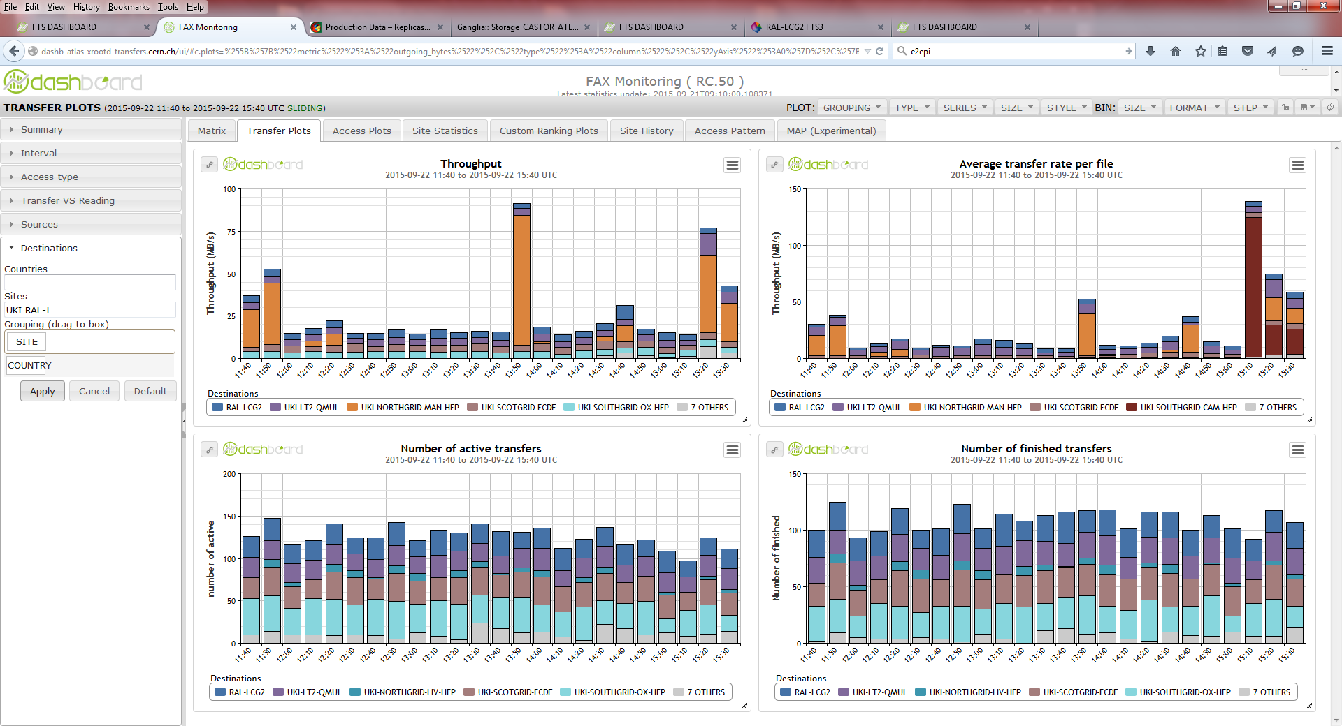
FAX backup transfer mechanism also monitored

Slide 16
DiRAC Data Movement Case
DiRAC an HPC collaboration Astro/Cosmo/PP theoretical modellers.
Needed a method to archive PB of data from various sites to Tape Store (at Rutherford Appleton Laboratory.)
Use knowledge base from GridPP
Bespoke solution for specific needs.
  No Data Management
Took FTS experience and simplified the middleware stack to bare bones. (Simplified Authen’|Author’)

Slide 17
Four sites
  Durham progressing (L.Heck)
  Leicester setup and ready for transfers (J.Wakelin)
    Site had no previous GrridPP Resources
  Currently Setting up Cambridge (No previous GridPP experience) and ECDF ( Colleagues have GridPP Experience.)
Document available to setup further sites
Looking to compliment with Globus Online/Connect

Slide 18
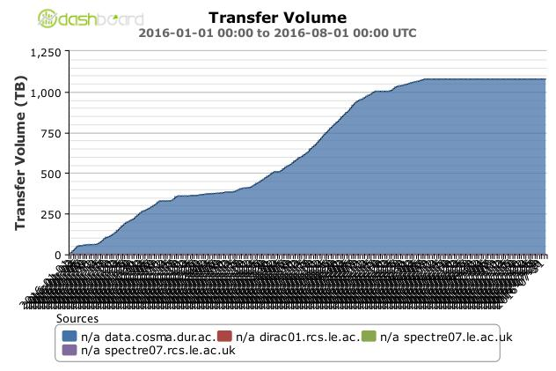
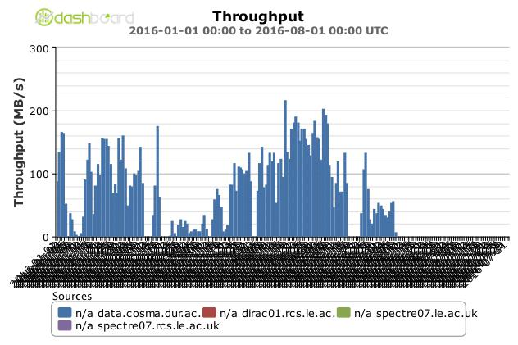
Vo.dirac.ac.uk
1.2PB copied in 5 Months
(Periods of reduced activity as site admin calculates what to move
Peak Values 350MB/s
Daily Averages can reach over 200MB/s

Slide 19
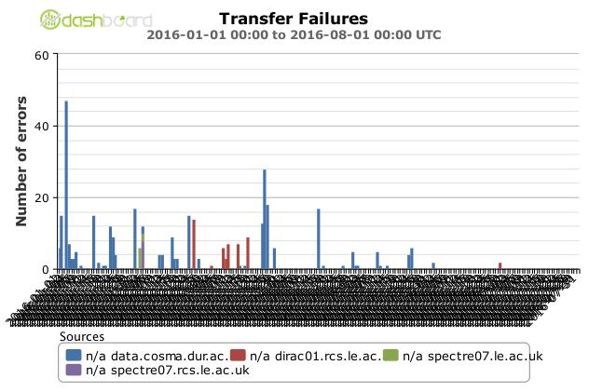
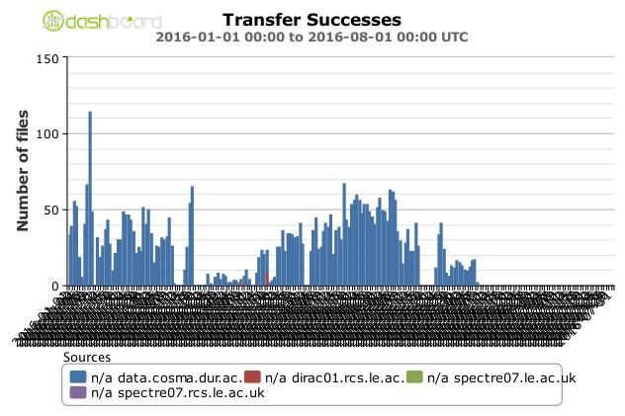
Vo.dirac.ac.uk
Low number of transfers since change to large file size
Low failure rate

Slide 20
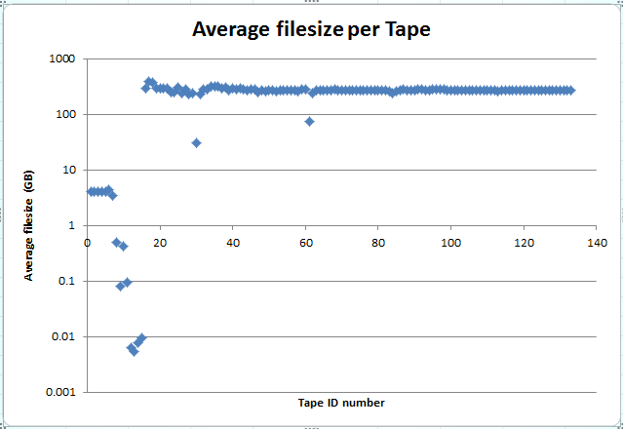
Durham
126k files in total
Mean file size 9.45GB ( 96% files are smaller than this.)
Largest file 1.69TB
Median 6.5KB
3966 files larger than 100GB
Newer 250GB files leave unused space on tapes.
22TB over 126 Tapes ( 2.2% inefficiency (0.75/0.5 % for ATLAS/CMS.)
File/Object size effects transfers!
(Rates and Mechanisms.)
Moving data v’ simple compared to managing it
(Over to Sam…)

