Slide 1

Networking & Janet
GridPP & SKA meeting – Manchester – 2-3 Nov 2016
03/11/2016
David Salmon
Notes:
Go to ‘View’ menu > ‘Header and Footer…’ to edit the footers on this slide (click ‘Apply’ to change only the currently selected slide, or ‘Apply to All’ to change the footers on all slides).
To add a background image to this slide; drag a picture to the placeholder or click the icon in the centre of the placeholder to browse for and add another image. Once added, the image can be cropped, resized or repositioned to suit.

Slide 2
Introduction
Janet – UK’s National Research and Education Network – NREN
32 year of operation and growth – formed in 1984
Now operated as part of Jisc Group
Charitable entity owned and governed by Education and Research sector bodies and member institutions

Slide 3

Jisc Group structure
HEI’s and FEC’s from across the UK
Representative members of Jisc
Representative members of Jisc
Representative members of Jisc
Institutional members of Jisc
‘Holdco’ is registered charity
Jisc the charity has two subsidiary companies:
Jisc Services Limited
Jisc Commercial Limited
Notes:
Board accountable to the members. Owners can actually fire the board – in a real sense the sector has control of the organisation.
Board of Jisc comprises VCs and college principles primarily and it covers a broad range of different types of HEIs and FECs.

Slide 4




Who we serve
Colleges
Universities
Skills providers
Users

Slide 5
Our vision and mission
Vision
To make the UK the most digitally advanced education and research nation in the world
Mission
To enable people in higher education, further education and skills in the UK to perform at the forefront of international practice by exploiting fully the possibilities of modern digital empowerment, content and
connectivity
Vision
&
Mission
Strategic platforms
Impact areas
Strategic enablers and values

Slide 6
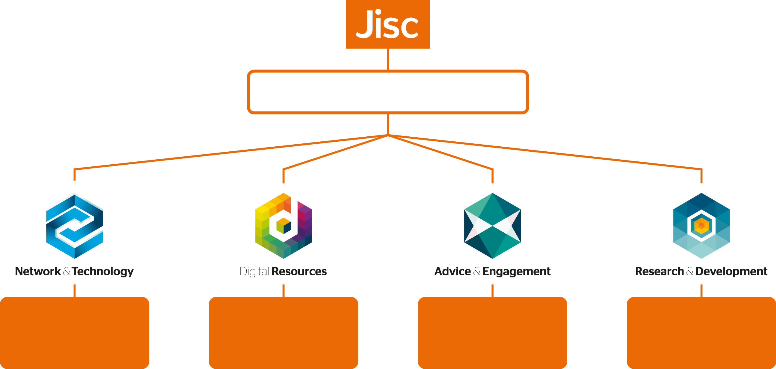
What does Jisc do?
Does 4 things…
Providing and developing a network infrastructure and related services that meet the needs of the UK research and education communities
Supporting the procurement, management and discovery of resources for UK education and research.
Our network of national and regional teams provide local engagement, advice and support to help you get the most out of our service offer
Our R&D work, paid for entirely by our major funders, identifies emerging technologies and develops them around your particular needs

Slide 7


Jisc does 4 things…
Our work in this area includes:
Security
Connectivity
Access and identity management
Procurement
Cloud
Email
Internet and IP services
Telecoms
Videoconferencing
Our work in this area includes:
Journals
e-books
Maps and geospatial data
Learning and teaching resources
Resource discovery
Film and images
Repositories
In this area we provide:
A single point of contact through a dedicated account manager
Subject specialists
Communities of practice and peer networking
Local stakeholder for a
Training
A range of online and face to face events (e.g. Digifest, Networkshop)
We are currently running 34 R&D projects including the following topic areas:
Collaboration
Curation and preservation
Data and analytics
Digital literacy
E-learning and VLEs
Libraries
Open access
Research and research data

Slide 8
What we do…
Ten core points of presence across the UK
A fibre core across the UK running at 400Gbit/s
19 regional distribution areas
Multiple connections for resilience
~900 organisations connected
IP (v4 & v6)
Point to point layer2 connections for research
Huge external connectivity
18/08/2015

Slide 9
Janet Core
Glasgow
Global Transit & Peering
Peering
Manchester
Leeds
Manchester NOC
Birmingham
Nottingham
Bristol
East Midlands
London
Telecity Powergate
London
Telehouse West
London
NOC
London
Telecity HX
London
Telehouse North
Global Transit & Peering
100G

Slide 10
Janet
Google
Akamai
BTnet
Netflix
AQL 3G
Total external connectivity > 1 Tbit/s
BBC
Bogons
Init7
Globelynx
BBC (Pacific Quay)
Microsoft EU (via TN)
InTechnology
IXLeeds
Microsoft EU (via TW)
Simplecall
SWAN (Glas)
Limelight
Updata
Glasgow
&
Edinburgh
Logicalis UK
BBC (HD 4K pilots)
Telehouse
North & West
Pipex / GXN
AQL 3G
RM for Schools
INUK
SWAN (Edin)
VM for LGfL
Voicenet
Virgin Radio
Leeds
Global Transit
Tata
LINX multicast
IXManchester
LINX
HEAnet
One Connect
Global Transit
Level3
Microsoft EU
Telecity Harbour Exch.
GÉANT
Google
Google
Gamma
Manchester
Akamai
VM for LGfL
NHS N3
RM for Schools
Synetrix
BBC (HD 4K pilots)
Gamma
GÉANT+
Exa Networks
Akamai
Redstone
InTechnology
VM for LGfL
Simplecall
Voicenet
Amazon
Datahop
Telekom Malaysia
Global Transit
Level3
100Gbit/s
Limelight
China Telecom
NHS N3
10Gbit/s
1Gbit/s

Slide 11
Points to note
Highly capable national infrastructure
  Evolving – core 400->600G, & beyond
  Contract structure 10+5 years from 2013
  We operate the infrastructure at all levels – optical transmission up to IP later
  100G Transmission system waiting for commissioning @ Jodrell
Resilience to GEANT – 2nd connection being commissioned
  100G resilient, will evolve
Typical Janet latencies very low – e.g. London- Scotland RTT 10-12mS
High-throughput data transfer support
  End-to-end initiative – support & advice on this
  Tim Chown, Duncan Rand + 1
  May be more news following Chancellor’s Autumn Statement
Connections to outsourced compute – Cloud
  IP and Layer2 (”Direct” connections to Amazon, Microsoft..)
  Jisc datacentre facilities (housing) – South (Slough), North – coming…
Charging – 2017 & beyond
  Jisc subscription model changing
  Service charges – eg UK point-to-point 10G circuit – maybe £30kpa

Slide 12
Supporting AENEAS & SKA networking….
Networking strands
  Tracking & supporting UK community requirements for access to SKA data
  Supporting AENEAS & relevant testing
  Connectivity to SKA HQ & Jodrell Bank site
Tests – requirements for first steps ?
  Locations/partner sites ?
  Network capacities required ?
Forward look as things evolve ?
  More partners ?
  More capacity ?
Governance & Project-coordination
  Who to talk to for authoritative information ?
  E.g. GridPP
    management group provide a networking forward look
    co-ordinate UK position on responses to international networking initiatives (LHCOPN, LHCOne)
    Represent UK community requirements – Tier2/3 sites

