Slide 1



Transverse Single Spin asymmetries for gauge boson production at RHIC
Akio Ogawa
Brookhaven National Laboratory
2016 Sep 26
Spin2016 @ University of Illinois

Slide 2
Contents
Gauge boson production at RHIC
  W,DY and Direct Photons
W/Z production (Run11 results, Run17 expectation)
Direct Photons (Run15 – no result, yet)
Drell-Yan (Run17 – no result)
Future plans
Summary

Slide 3
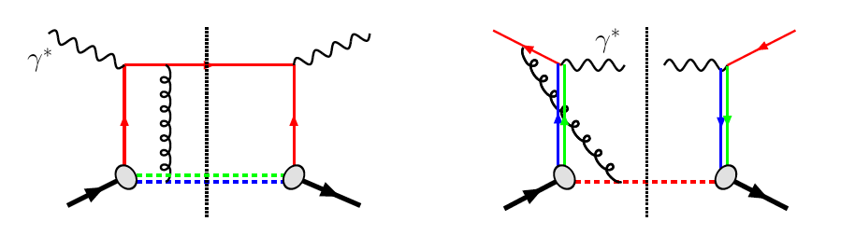
The none-universality of the Sivers function
Sivers Function and DIS vs DY (incl. W)
QCD:
DIS: γq scattering
attractive FSI
pp: annihilation
repulsive ISI
Sivers_{DIS} = - Sivers (DY or W or Z)
a fundamental prediction from the gauge invariance of QCD
Experimental test is critical test for our understanding of TMD’s and TMD factorization
Test through Drell-Yan process: COMPASS (CERN), proposed SeaQuest (FermiLab)
Strong background suppression, high lumi
@ STAR in run 2017(PostShower upgrade)
Polar. weak boson production (only at RHIC)
Very low background
Very high Q²-scale (~ W/Z boson mass)

Slide 4
Sivers Function and DY, W and direct photons
 | A_{N}(W^{+/-},Z⁰) | A_{N}(DY) | A_{N}(γ)
sensitive to sign change through TMDs | yes | yes | no
sensitive to sign change through Twist-3 T_{q,F}(x,x) | no | no | yes
sensitive to TMD evolution | yes | yes | no
sensitive to sea-quark Sivers fct. | yes | yes | no
need detector upgrades | no | yes at minimum: FMS postshower | yes pre-showers installed for run-15
biggest experimental challenge | integrated luminosity | background suppression & integrated luminosity | need to still proof analysis on data

Slide 5
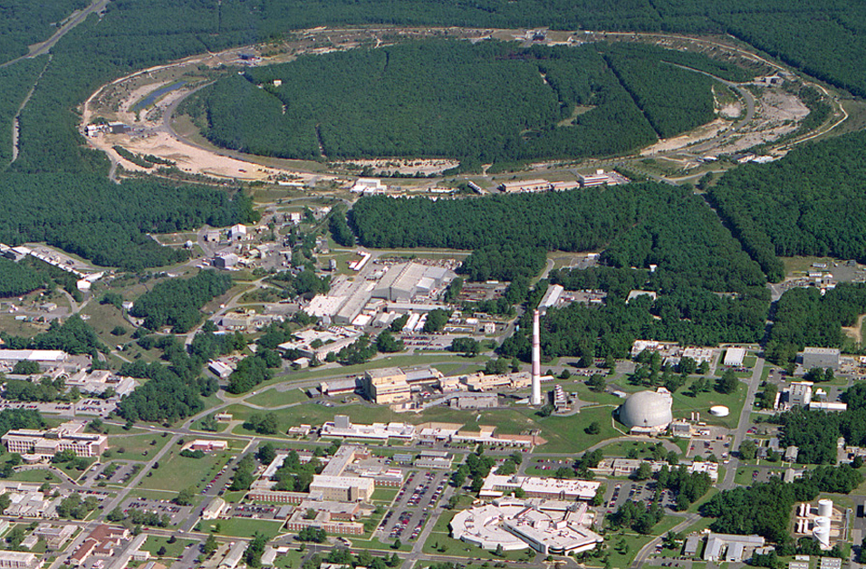
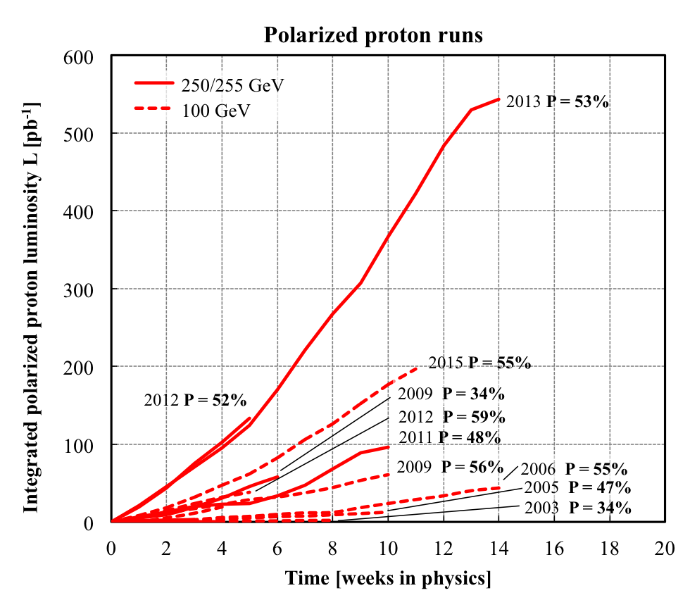
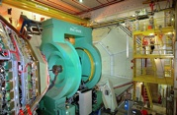
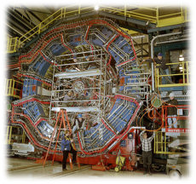
RHIC@BNL in 2016
eLens
Jet/C-Polarimeters
CeC
RHIC
PHENIX
small mid-rapitity
-0.35 < η < 0.35
forward μ-arms
RF
STAR
large rapidity
-1 < η < 4
multipurpose
LINAC
NSRL
EBIS
Booster
AGS
Tandems

Slide 6
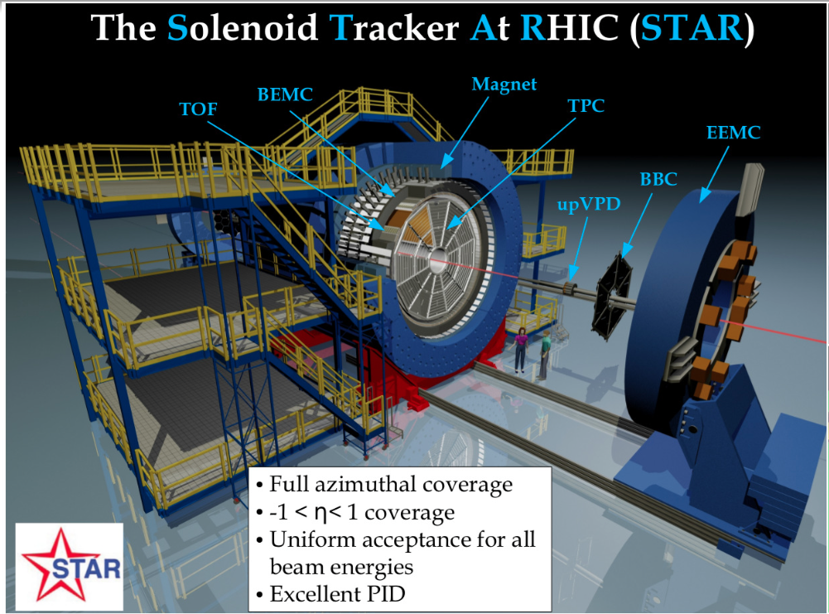

Slide 7
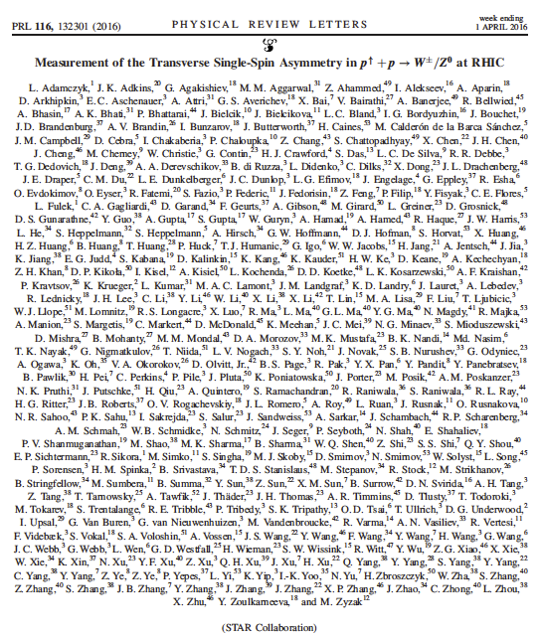
Measurement of TSSA for weak bosons @ STAR
New paper from STAR
Phys. Rev. Lett. 116, 132301 (2016)
Editor’s suggestion
[arXiv:1511.06003]
World’s first direct experimental test of the sign change in the Sivers function
RHIC is the only polarized p+p collider. Its top energy is enough to produce weak bosons
Selection of weak bosons well established at STAR
  Long. spin asymmetries:
  Phys. Rev. Lett. 113, 072301 (2014)
  Phys. Rev. Lett. 106, 062002 (2011)
  unpolarized xsec:
  Phys. Rev. D 85, 092010 (2012)
This measurement is STAR’s first attempt to reconstruct the produced boson’s kinematics

Slide 8
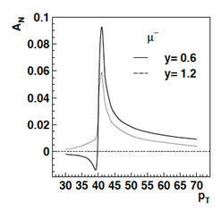
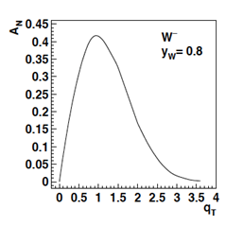
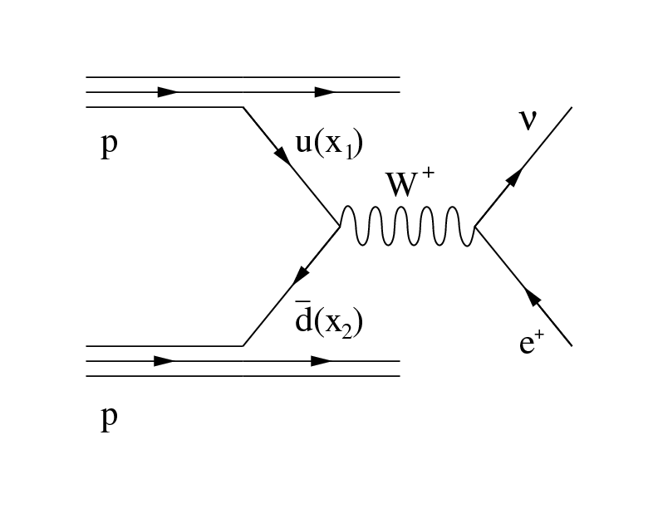
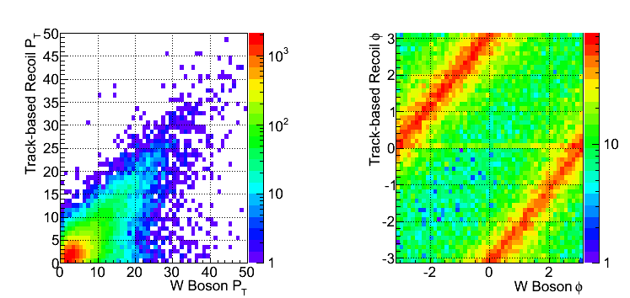
W reconstruction with recoil
Decay Lepton Asymmetries
W Asymmetries
Decay lepton A_{N} is small and hard to measure
W p_{T} ~ few GeV << ~40GeV from W decay
Z.-B. Kang & J.-W. Qui arXiv:0903.3629
W momentum reconstruction well tested at FermiLab and LHC
[CDF: PRD 70, 032004 (2004); ATLAS: JHEP 1012 (2010) 060]

Slide 9
W reconstruction DATA VS MC
GOOD data/MC agreement

Slide 10
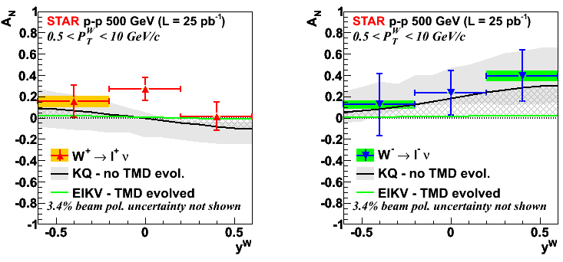
A_{N} FOR W PRODUCTION
Average RHIC
polarization
(p+p run 2011 tran.)
<P> = 53%
We use the “left-right” formula to cancel dependencies on geometry and luminosity
Results versus rapidity are compared with:
KQ model [Z.-B. Kang and J. -W. Qiu, Phys. Rev. Lett. 103, 172001 (2009)]
  It does not include TMD evolution
  Grey band is the theory uncertainty
EIKV model [M. G. Echevarria, A. Idilbi, Z.-B. Kang, I. Vitev, Phys. Rev. D89, 074013 (2014)]
  Includes the largest prediction for TMD evolution
Grey hatched area represents the current theoretical uncertainty on TMD evolution

Slide 11
TMD Q² evolution
Even the evolution formalism itself has large room to improve
Non-perturbative Sudakov needs further improvement
Large Q² coverage from SIDIS to DY to W/Z
Kang, 2015
w/o TMD evolution

Slide 12
SIVER’S SIGN CHANGE, If NO TMD EVOLUTION
A global fit to the (unevolved) KQ prediction was performed:
solid line: assumption of a sign change in the Sivers function → Chi2/d.o.f. = 7.4/6
dashed line: assumption of no sign change in the Sivers function → Chi2/d.o.f. = 19.6/6
If there are no evolution effects,
our data favor the hypothesis of Sivers sign change

Slide 13
A_{N} FOR Z⁰ PRODUCTION
Clean experimental momentum reconstruction
Negligible background
Electrons rapidity peaks within tracker accept. (|η|< 1)
Statistics limited
A_{N} measured in a single y, P_{T} bin

Slide 14
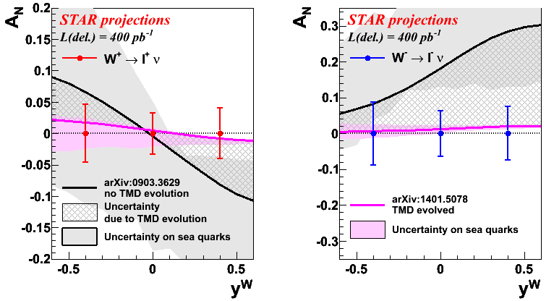
Run17 W/Z expectation
Large statistics will allow us to
Precisely measure A_{N} for Ws within a few % in several P_{T}, y bins.
Measure the very clean Z⁰ channel.
Test sign change if evolution is less than factor ~5
Run11 had 25pb⁻¹
Run17 expectation is 400 pb⁻¹

Slide 15
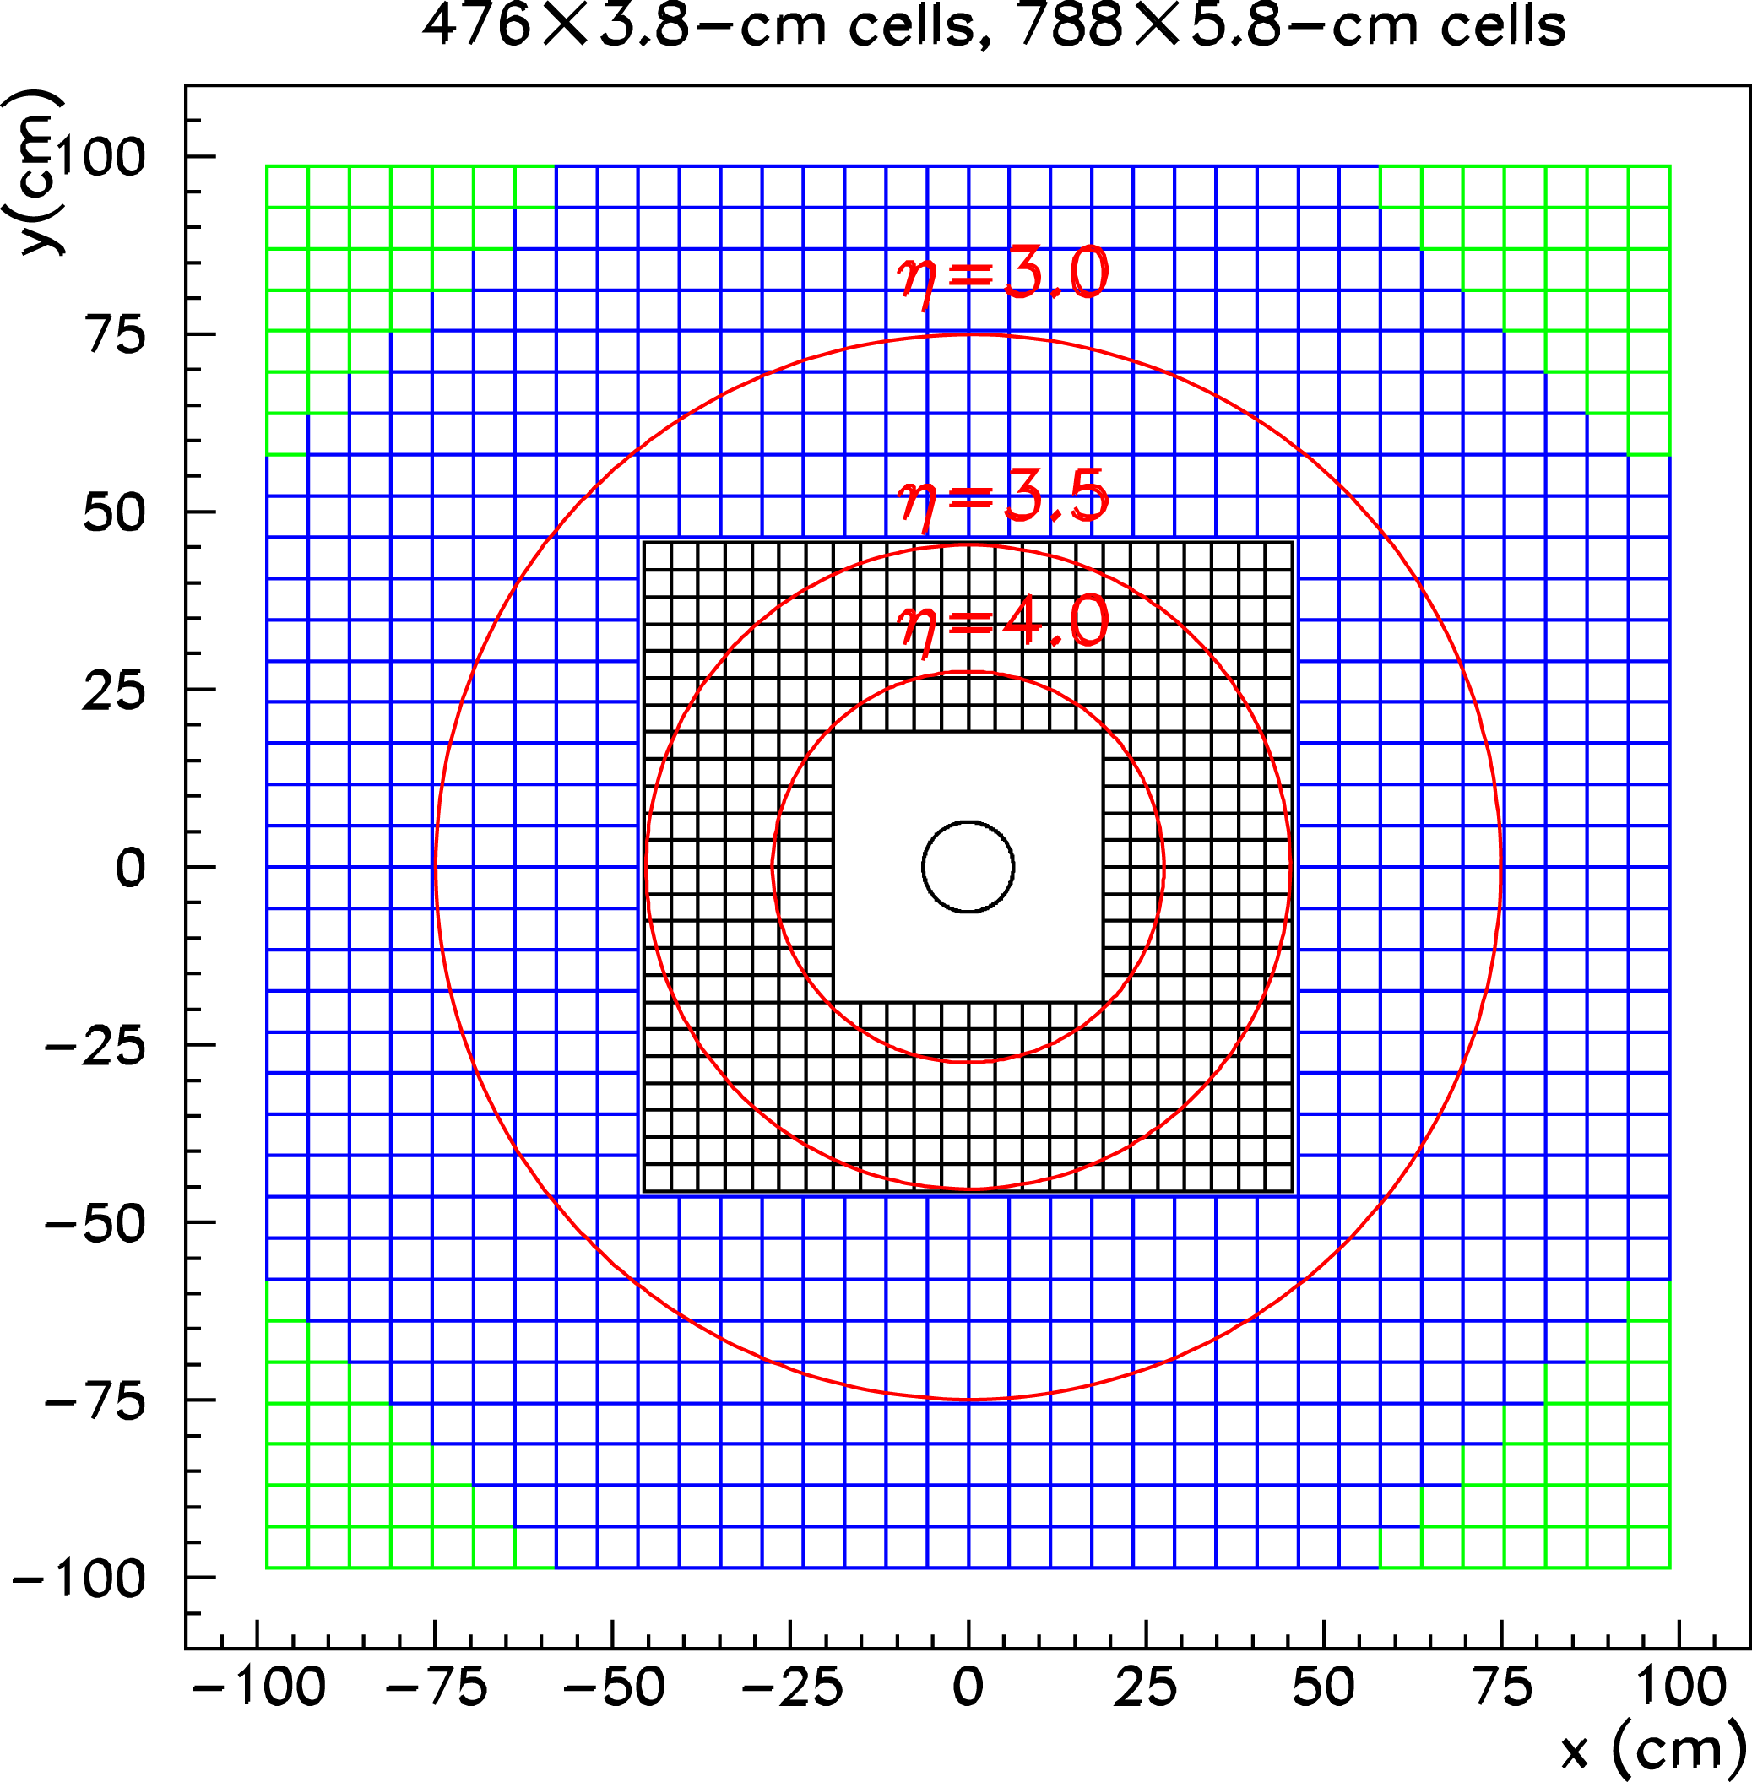
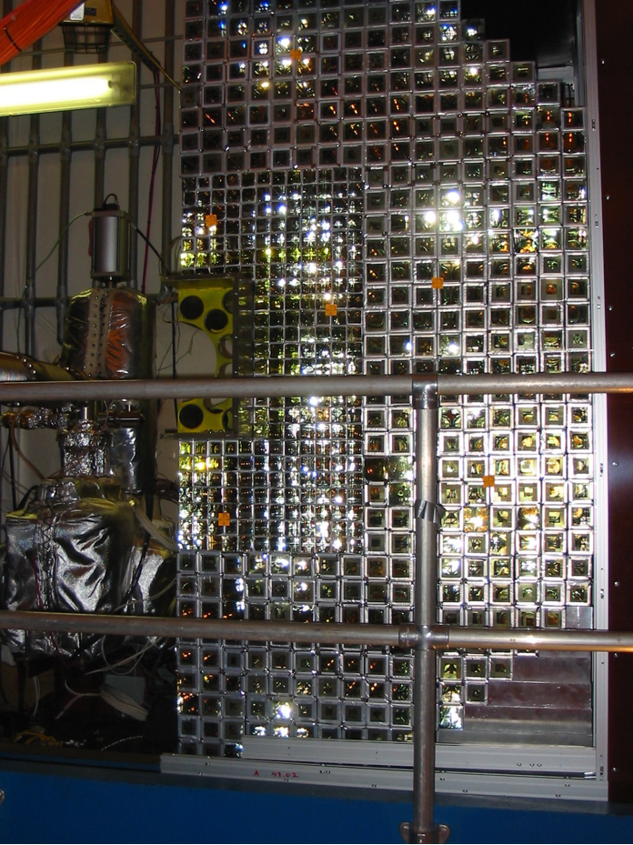
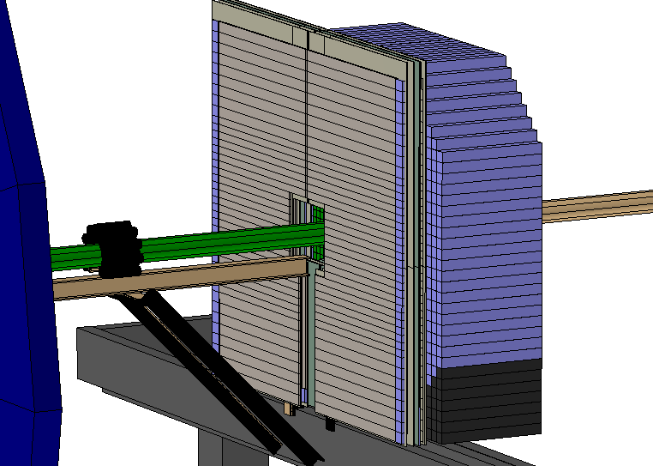
STAR Forward calorimeter (FMS)
A_{N} for pi0 / eta / EM-jet
A_{N} for direct photon (FPS)
A_{N} with diffractive tag (roman pot)
A_{N} in pAu & pAl
(unpol) Gluon Saturation
DY and J/Psi (Run 17)

Slide 16
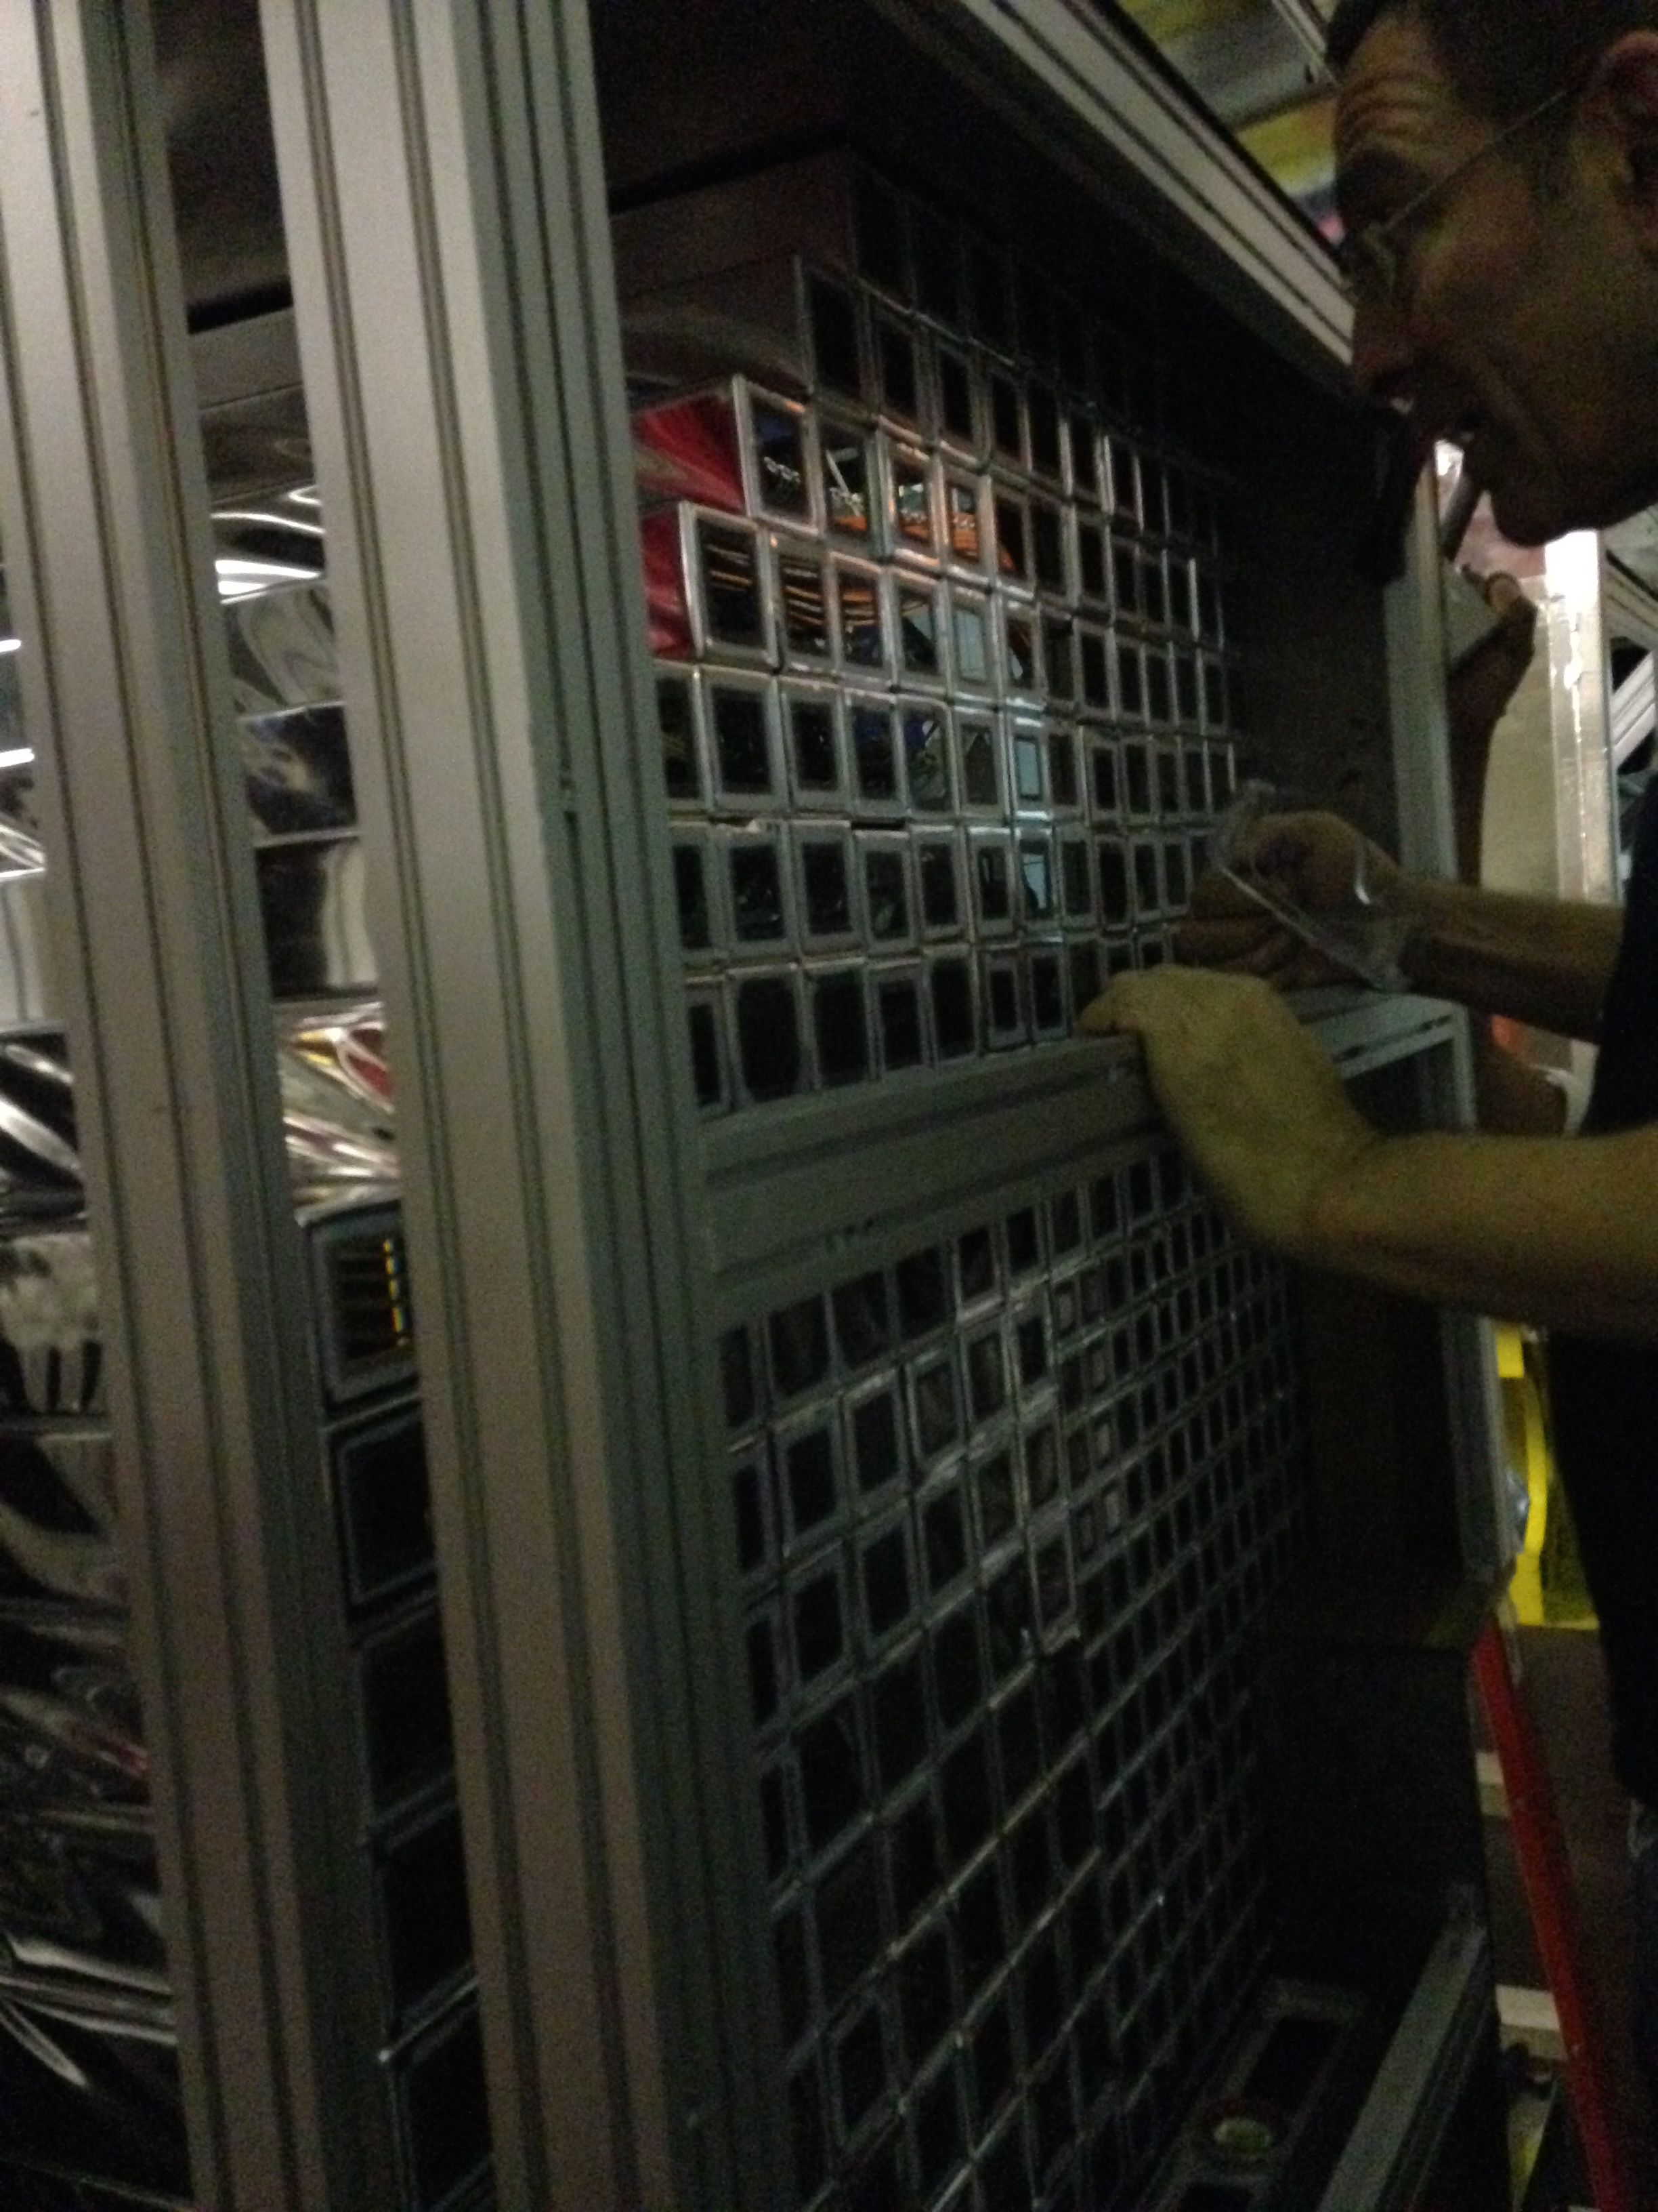
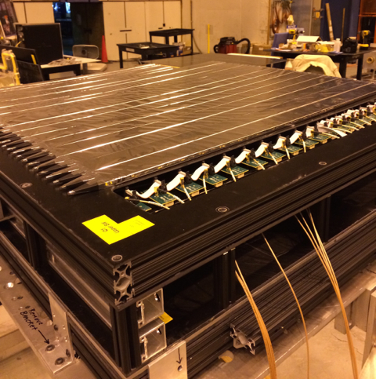
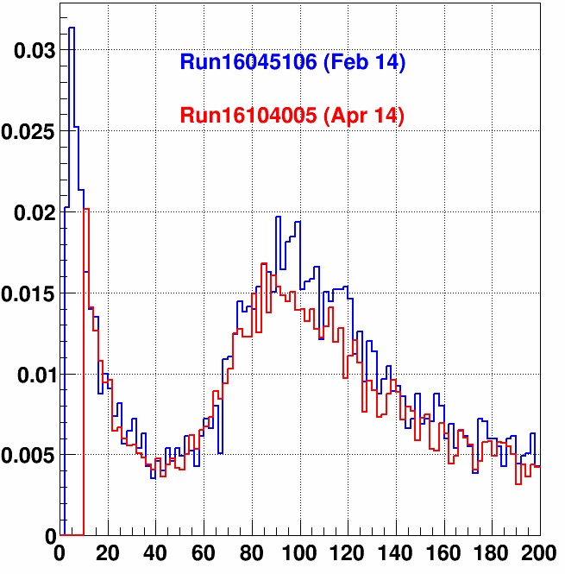
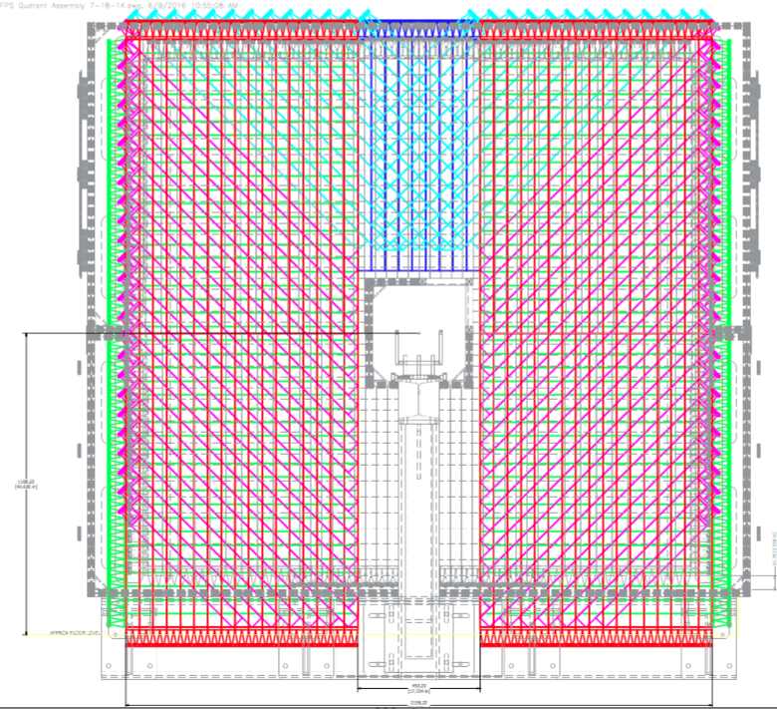
Run 15
FMS refurbishment
  Annealing PbG with sun light and re-stack
  Replaced unstable PMT-bases
  Trigger upgrade
FPS for photon/electron/hadron PID
  SiPM (Hamamatsu S12572) readout
  3 layer scinti. with Pb conveter in front of FMS
Run 17
Post Shower Detector
Design follows successful
Preshower design
→ 3 layers of u, x, y with
SiPM readout
ADC Ch (0.25pC/ch)

Slide 17
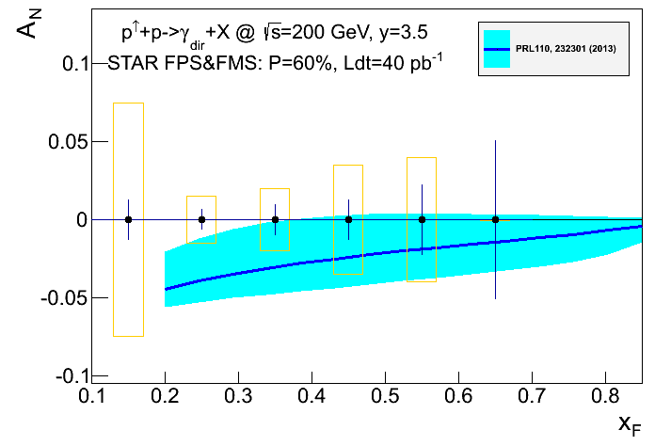
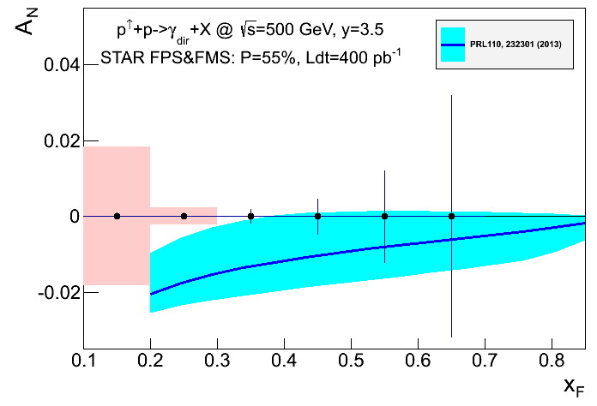
Run15 Direct Photon A_{N}
A_{N} for direct photon production:
sensitive to sign change, but in TWIST-3 formalism
indirect constraints on Sivers fct
no sensitivity to sea-quarks; mainly u_{v} and d_{v} at high x
collinear objects but more complicated evolutions than simple DGLAP
Not a replacement for a A_{N}(W^{+/-}, Z⁰, DY) measurement
but an important complementary piece in the puzzle
Analysis is on-going….

Slide 18
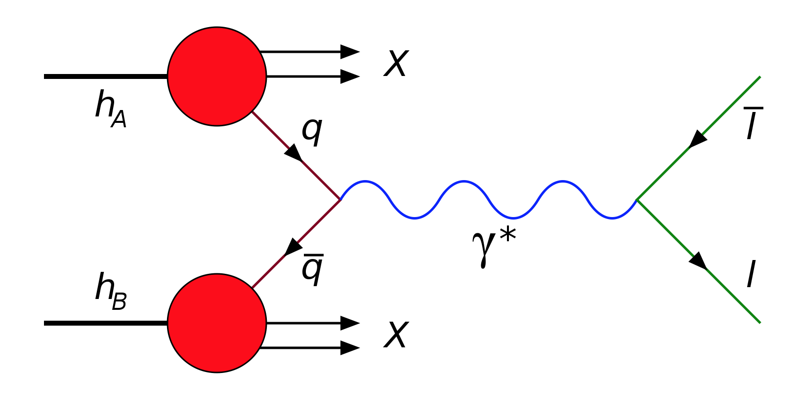
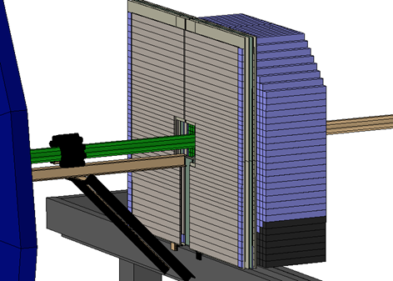
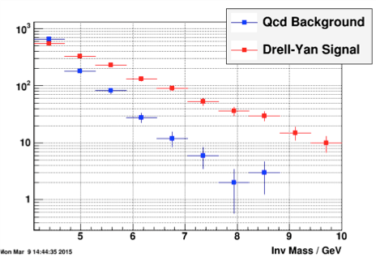
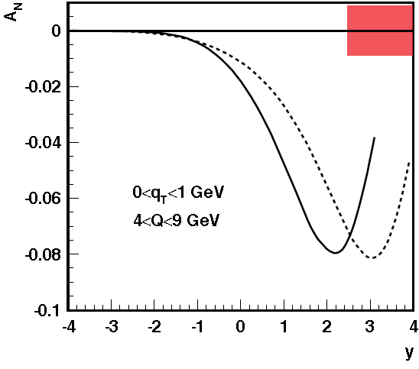
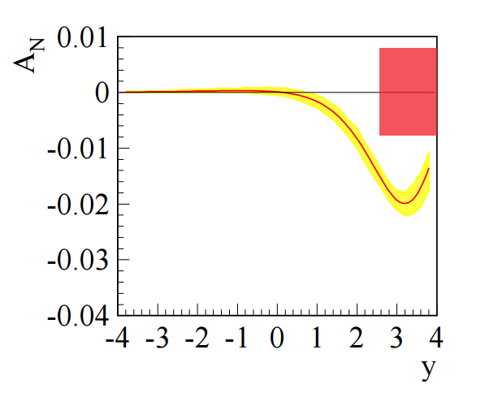
Run17 DY A_{N}
Very Challenging (RHIC QCD WP arXiv:1602.03922)
QCD background ~10⁵-10⁶ larger than DY cross-section
Need to reduce hadron background by ~10³ per particle
PID and background rejection is the key
FPS
FMS
The expected yields of DY and QCD background with FMS+FPS+PostShower
post-shower upgrade
No TMD Evolution
With TMD Evolution
Drell-Yan
500 GeV
200 GeV
Run-17 ∫L_{del}=400 pb⁻¹
A_{N} for DY to +/- 0.008
KQ: Phys.Rev.D81:054020,2010

Slide 19

RHIC polarized p+p & p+A Timeline
2015
2017
≧2021
≧ 2025
Upgrades:
FMS-Preshower
MPCEX
RP Phase-II*
Run:
p+p 200 GeV
longitudinal &
transverse
p↑+Au/Al 200 GeV
transverse
Goal:
Δg(x,Q²)
transverse spin
structure of the p
Search for exotics
Spin effects in
diffraction
J/Ψ in UPC →GPD E_{g}
nPDF: g(x,Q²)
Saturation
Upgrades:
FMS-Postshower
Run:
p+p 510 GeV transverse
Goal:
A_{N} for W±, Z⁰, DY, γ
Sea-quark Sivers fct.
sign change Sivers fct.
TMD evolution
transverse spin
structure of the p
Search for exotics
Spin effects in
diffraction
J/Ψ in UPC →GPD E_{g}
Upgrades:
Forward Ecal+Hcal
Forward tracker
RP full Phase II
Run:
p+p 510 GeV
longitudinal & transverse
In parallel to sPHENIX:
transverse pp 200 GeV
p↑+A (C, Cu, Au)
200 GeV transverse
Goal:
Δg(x,Q²) @ low x
transverse spin structure of the proton at low and high x
→ TMDs & Twist-3
Spin effects in diffraction
(un)pol FF
nPDF: g(x,Q²), q(x,Q²)
Saturation
(un)pol nFF
Needed Hardware:
  wide acceptance mid-rapidity detector with good PID (π,K,p)
  forward rapidities (4.5 > η > 1) Ecal + HCal + charge identification
  both STAR and sPHENIX have dedicated upgrades described in the RHIC Cold QCD Plan

Slide 20


RHIC polarized p+p & p+A Timeline
2015
2017
≧2021
≧ 2025
eRHIC
Upgrades:
FMS-Preshower
MPCEX
RP Phase-II*
Run:
p+p 200 GeV
longitudinal &
transverse
p↑+Au/Al 200 GeV
transverse
Goal:
Δg(x,Q²)
transverse spin
structure of the p
Search for exotics
Spin effects in
diffraction
J/Ψ in UPC →GPD E_{g}
nPDF: g(x,Q²)
Saturation
Upgrades:
FMS-Postshower
Run:
p+p 510 GeV transverse
Goal:
A_{N} for W±, Z⁰, DY, γ
Sea-quark Sivers fct.
sign change Sivers fct.
TMD evolution
transverse spin
structure of the p
Search for exotics
Spin effects in
diffraction
J/Ψ in UPC →GPD E_{g}
Upgrades:
Forward Ecal+Hcal
Forward tracker
RP full Phase II
Run:
p+p 510 GeV
longitudinal & transverse
In parallel to sPHENIX:
transverse pp 200 GeV
p↑+A (C, Cu, Au)
200 GeV transverse
Goal:
Δg(x,Q²) @ low x
transverse spin structure of the proton at low and high x
→ TMDs & Twist-3
Spin effects in diffraction
(un)pol FF
nPDF: g(x,Q²), q(x,Q²)
Saturation
(un)pol nFF
arXiv: 1212.1701
arXiv:1409.1633

Slide 21

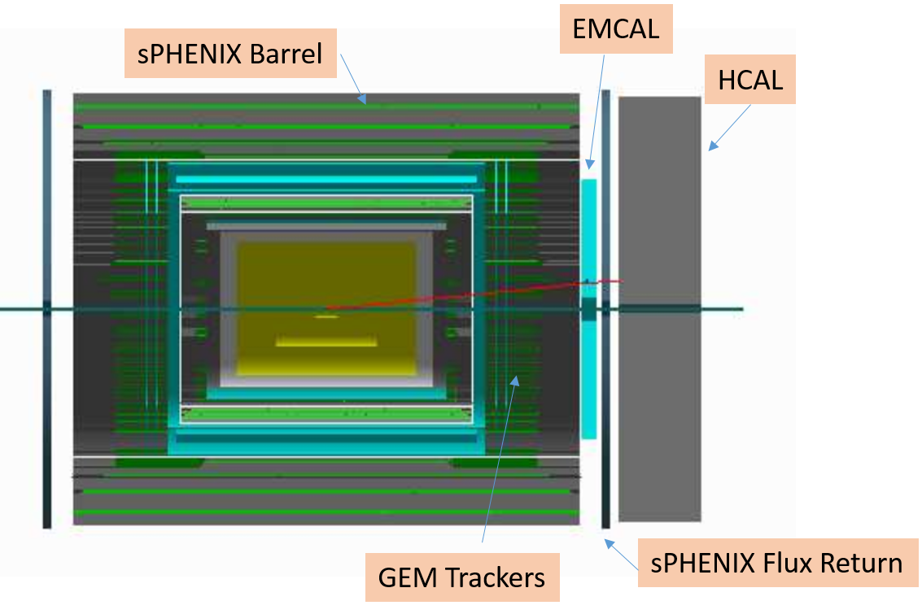

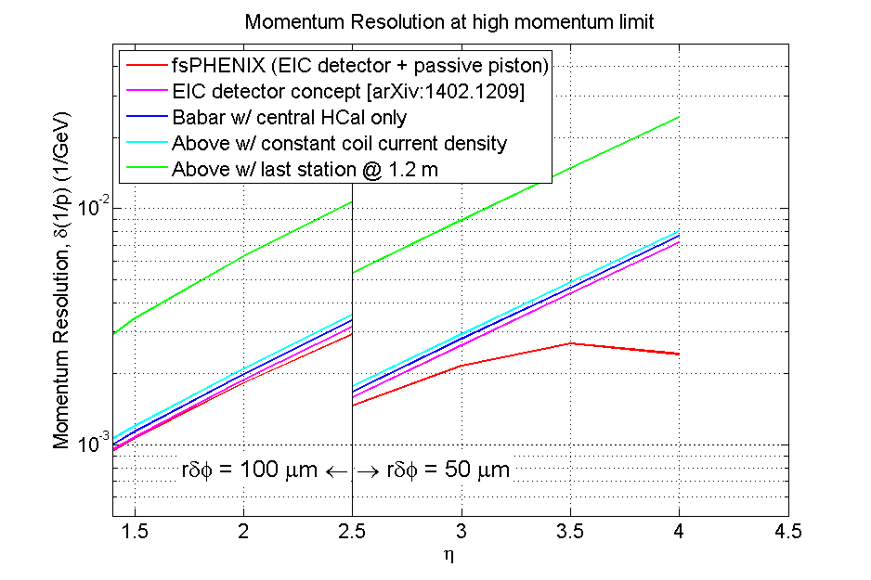
fsPHENIX Upgrade Plans
f
Ecal: reuse PHENIX Ecal
Hcal: follow design ideas from
STAR fHCal and EIC fHCal
Tracking: 3 stations of GEM Trackers
In addition to the central detector upgrade,
sPHENIX has a plan for a forward arm 1 < η < 4.5

Slide 22
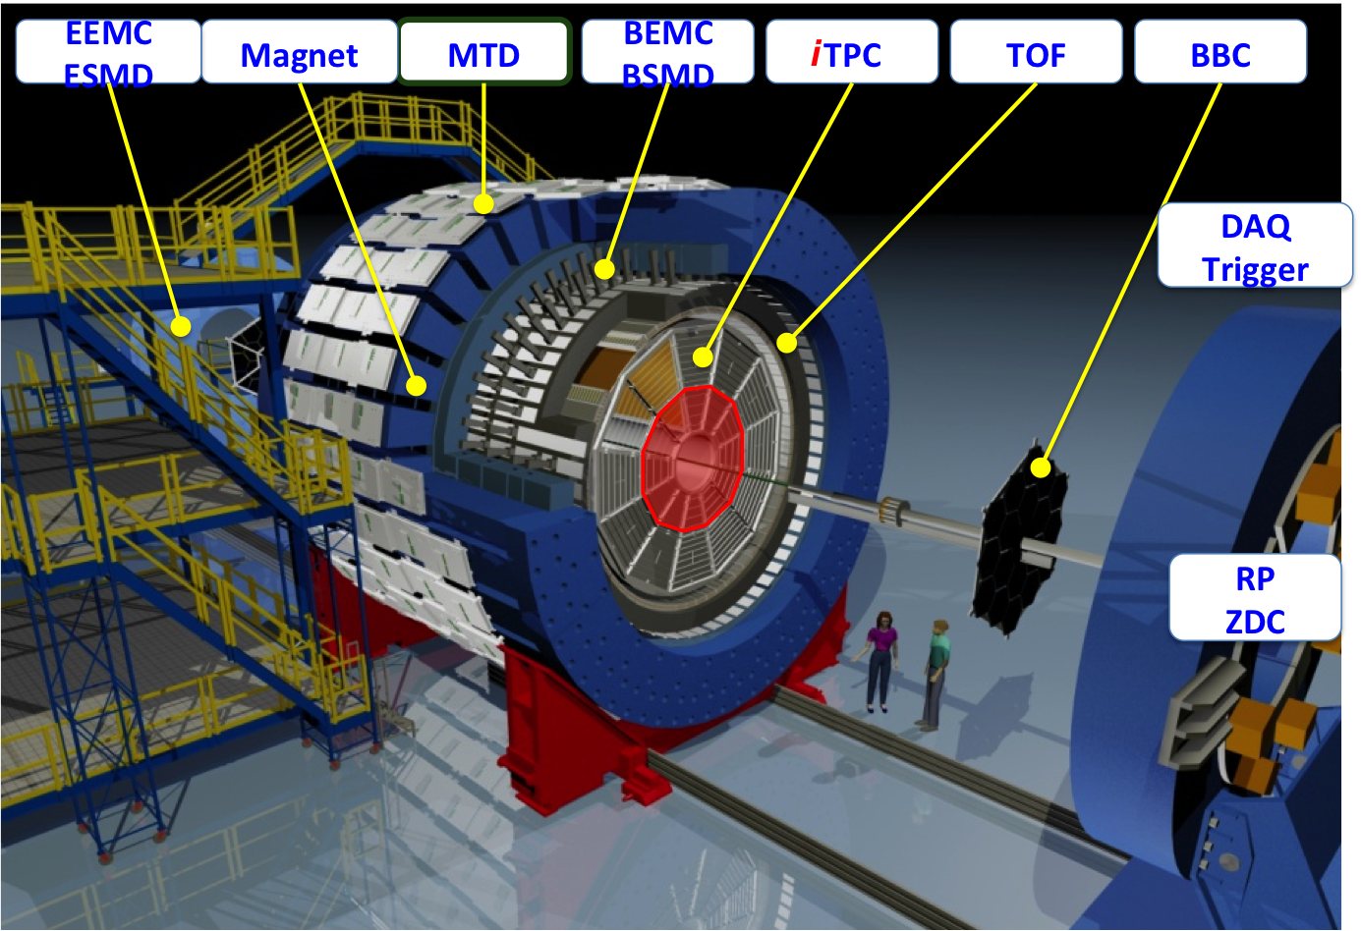
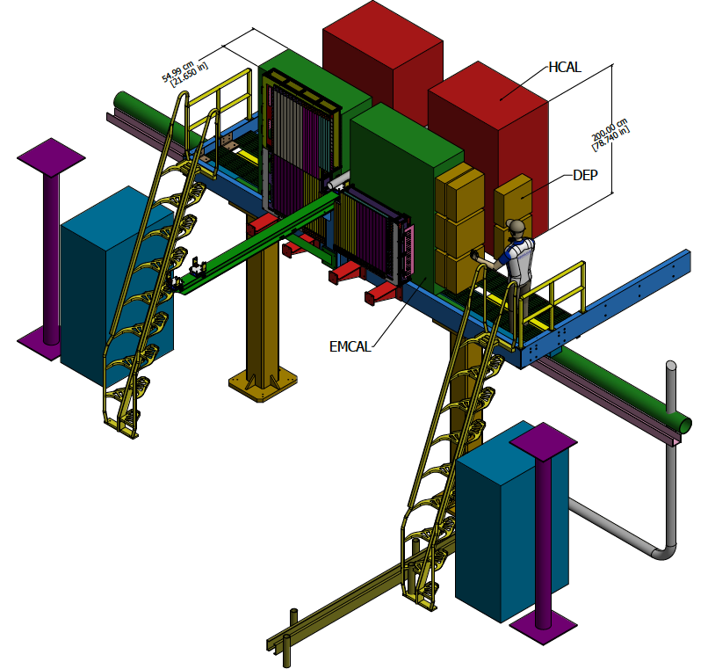
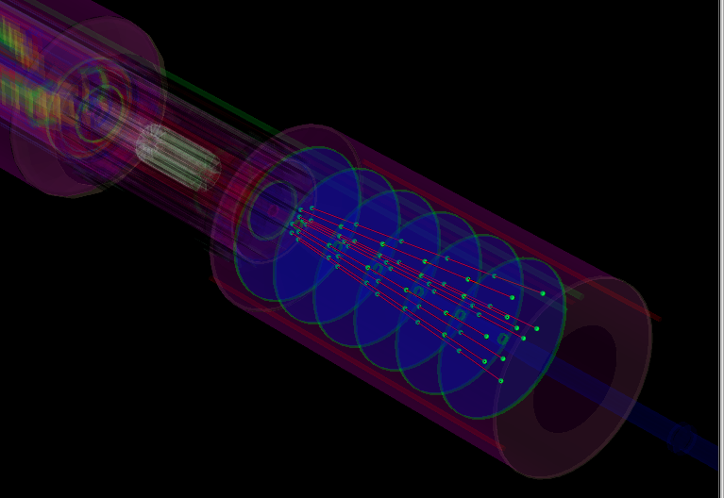
STAR forward Upgrade plans
Add to existing STAR at rapidity 2.5 < η < 4.5
Ecal: reuse PHENIX Ecal
Hcal: design ala STAR fHCal and EIC fHCal
Tracking: 4-6 Si strip-disks
Preshower &
ECal & HCal
Forward tracking
z=70, 93.33, 116.66, 140, 163.33, 186.66 cm

Slide 23
Summary
Gauge Boson (W,γ*, γ) productions at RHIC are very unique and capable probe to study proton at RHIC
Run11 (510GeV) first measurement of A_{N} for W± and Z⁰
  First indication of Siver’s sign change, if one assumes no (small) TMD Q² evolution
Run15 (200GeV) was successful with improved FMS with addition of FPS
  Direct photon analysis is underway
  Many other physics (A_{N} for pAu/pAl, A_{N} with diffractive tag, gluon saturation…)
Run17 (510GeV) expected to deliver ~400/pb with transverse polarization
  W, Z, DY, Photon
  Large Q² range from DY to W/Z to see TMD Q² evolution
  Sign change and flavor separation
Future upgrades are being discussed for both STAR and sPhenix

Slide 24
BACKUP

Slide 25
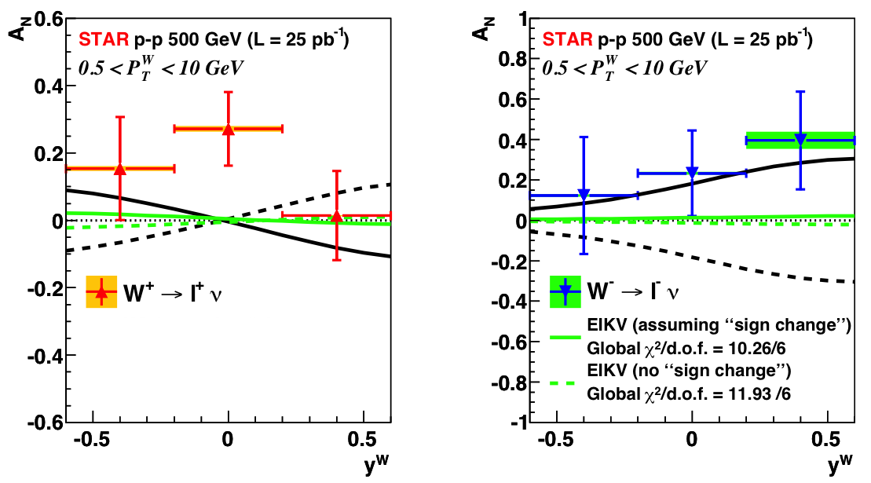
The Sivers’ sign change (strong TMD evol.)
Size of the TMD evolution still uncertain
-> terms calculable from QCD + non-perturbative terms (need data)
A global fit to the EIKV prediction (largest predicted evolution effect):
solid line: assumption of a sign change in the Sivers function → Chi2/d.o.f. = 10.26/6
dashed line: assumption of no sign change in the Sivers function → Chi2/d.o.f. = 11.93/6
Our uncertainties are still too high to compare with predictions

Slide 26
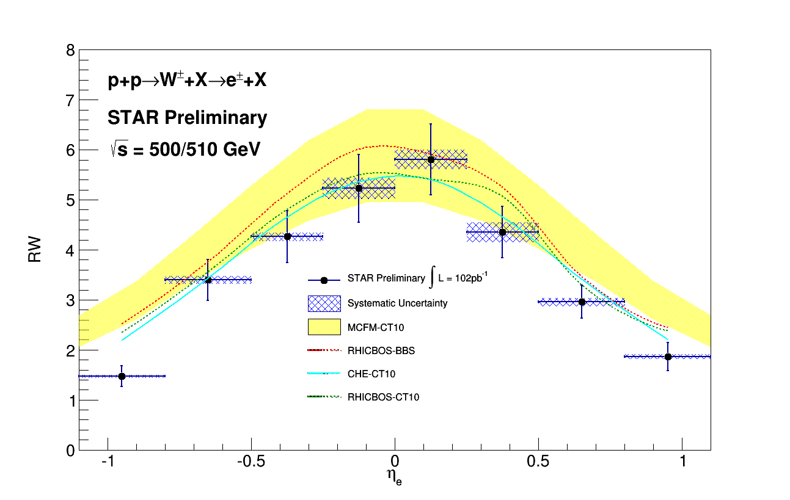
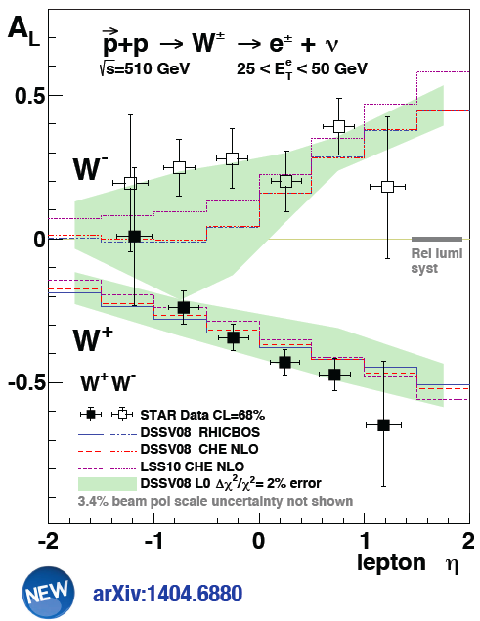
Sea quark Flavor separation
σ(W+) / σ(W-)

Slide 27
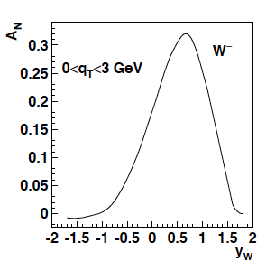
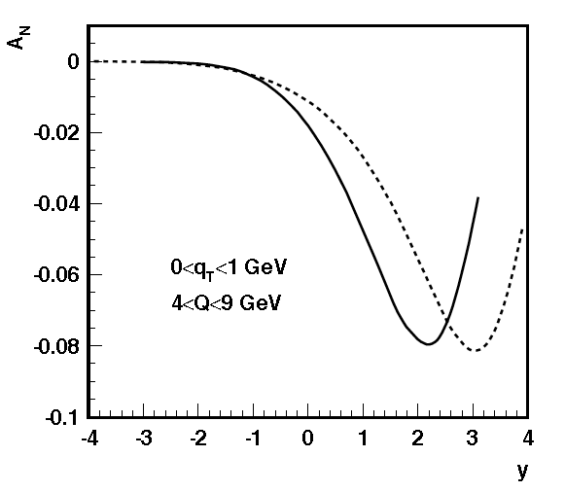
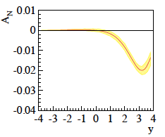
Motivations – The TMD evolution
Z.-B. Kang & J.-W. Qui arXiv:0903.3629
Z. Kang: original paper arXiv:1401.5078
before evolution
after evolution
Very strong
evolution effects
size of the effect still
under discussion
in theory community
For details see
Talk by J. Collins in this session
and
J. Collins, T. Rogers,
Phys.Rev. D91 (2015) 7, 074020
÷ ~10
Z.-B. Kang & J.-W. Qui Phys.Rev.D81:054020,2010
Z. Kang et al. arXiv:1401.5078
before evolution
after evolution
DY
200 GeV
500 GeV
÷ ~4
4 < Q < 9 GeV
0 < q_{T} <1 GeV

Slide 28
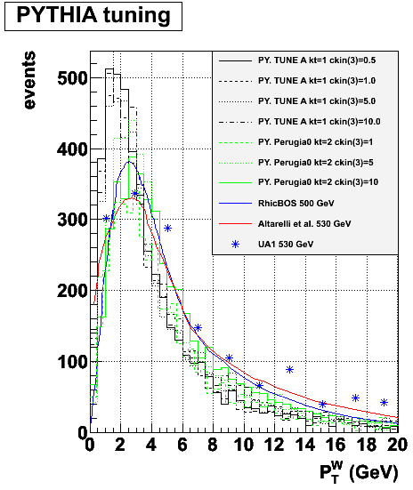
Data & MC
Monte Carlo
PYTHIA reconstructed trough GEANT simulated STAR detector
Perugia tune with hard P_{T} > 10 GeV
PYTHIA embedded into real zero-bias pp events
Data sample
pp – transverse (collected in 2011)
@ √500 GeV
Integrated luminosity: ~ 25 pb⁻¹
Events triggered in Barrel EMCAL
Signal
W → ev_{e}
Background
W → tv_{t} → ev_{e}v_{t}
Z → ee
QCD events

Slide 29
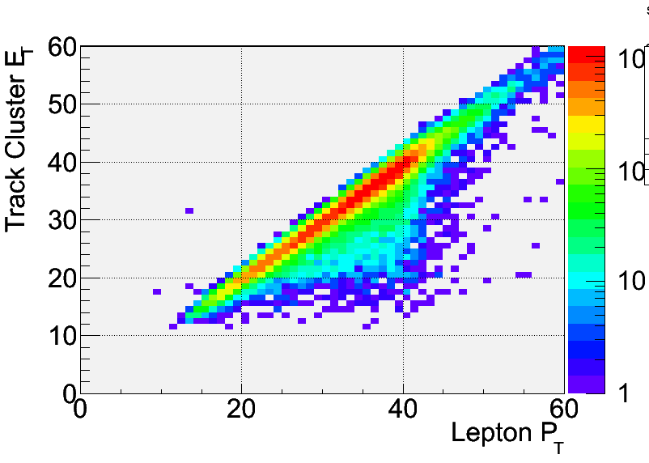
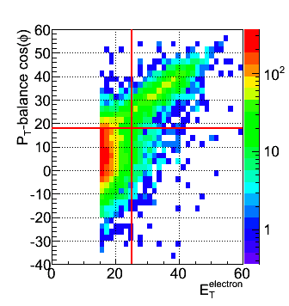
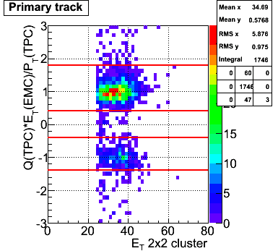
Electron identification
Isolation: (P^{track}+E^{cluster}) / Σ[P^{tracks} in R=0.7 cone] > 0.8
Imbalance: no energy in opposite cone (E<20 GeV)
E_{T} > 25 GeV
Track |η| < 1
|Z-vertex|<100 cm
Charge separation (avoids charge misidentification):
0.4 < |Charge (TPC) x E_{T} (EMC) / P_{T} (TPC)| < 1.8
Signed P_{T} balance > 18 GeV/c (rejects QCD Background)
0.5 GeV/c < P_{T}^{W} < 10 GeV /c
We calculate energy from the cluster
MC
SIGNAL
QCD

Slide 30
Background estimation
Background from W and Z boson decays estimated via Monte Carlo
PYTHIA 6.4 with Perugia 0 tune
normalized to recorded data luminosity
Data-driven QCD background estimation
Reverse of P_{T}-balance cut [PT-balance < 15 GeV] → Selects QCD events
Plot lepton-P_{T} > 15 GeV
QCD sample normalized to the first P_{T}-bin [15-19 GeV]
Positive-charge signal 1016 events
Z⁰ → ee [B/S = 0.79% ± 0.03%]
W⁺ → tv_{t} [B/S = 1.89% ± 0.04%]
QCD [B/S = 1.6% ± 0.09%]
Negative-charge signal 275 events
Z⁰ → ee [B/S = 2.67% ± 0.1%]
W⁻ → tv_{t} [B/S = 1.77% ± 0.1%]
QCD [B/S = 3.39% ± 0.23%]
Backgrounds under control!

Slide 31
STAR: A_{N}^{W}
Analysis Strategy to fully reconstruct Ws:
Follow the analysis steps of the A_{L}
→ W candidate selection via high p_{t} lepton
Data set 2011 transverse 500 GeV data set (25 pb⁻¹)
In transverse plane:
Recoil reconstructed using tracks and towers:
Part of the recoil not within STAR acceptance
→ correction through MC (Pythia)
W Rapidity reconstruction:
W longitudinal momentum (along z) can be calculated from the invariant mass:
Neutrino longitudinal momentum component from quadratic equation
GOOD data/MC agreement after P_{T} correction

