Slide 1


Calibration of the PEPPo Polarimetry
(a tale of two polarimeters)
Adeleke Adeyemi
On behalf of PEPPo collaboration
22nd International Spin Symposium, September 26, 2016

Slide 2

The PEPPo Concept
The PEPPo (Polarized Electrons for Polarized Positrons) experiment was conducted in the injector of the CEBAF accelerator at JLab to demonstrate a new technique for the production of polarized positrons.
It involves a two-step process:
Creation of circularly polarized photons from the bremsstrahlung produced by longitudinally polarized electrons in a hi-Z target.
Followed by the creation of polarized e+e- pairs via the pair production from these circularly polarized photons within the same target.

Slide 3
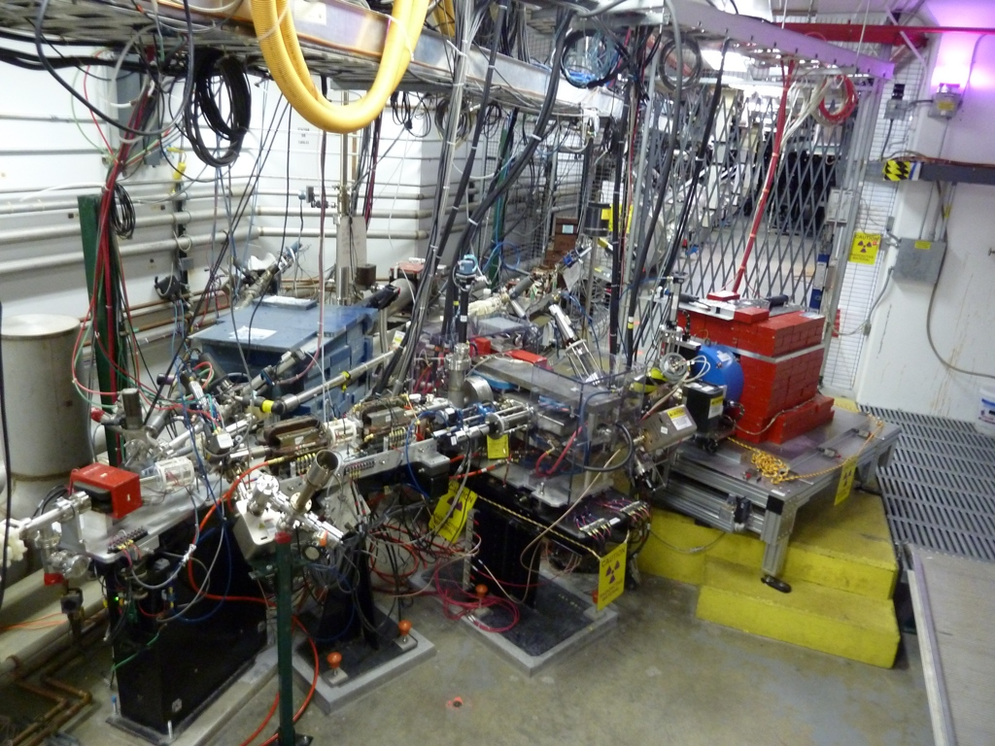
PEPPo Experimental setup
Mott polarimeter for electron polarization measurement
PEPPo Compton polarimeter for positron polarization measurement
Tungsten Target
For more on the PEPPo experiment: See Grames talk on Thursday

Slide 4
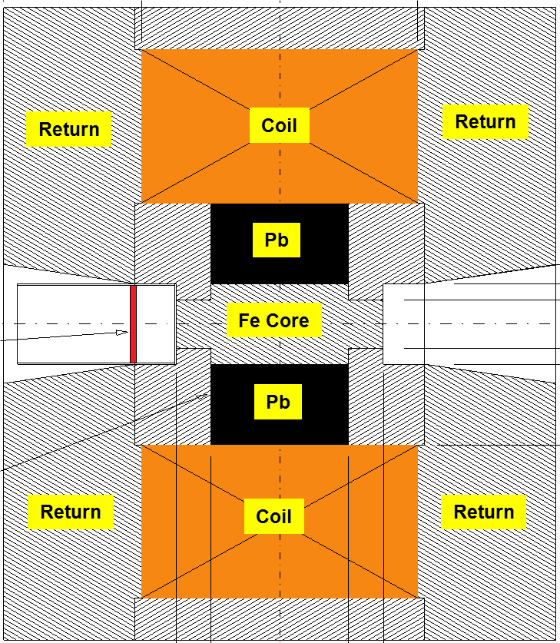

Compton Transmission Polarimetry
Electrons or Positrons radiate polarized photons by Bremsstrahlung in reconversion target. The photons transmitted by the magnetized iron core of the analyzing magnet are detected in 9 crystals of photon calorimeter and are read by PMTs
The measurement of the beam (positron or electron) polarization is essentially obtained from the transmission asymmetry (A_{T}) of the number of transmitted bremsstrahlung photons for oppositely polarized target or beam polarization orientations.
μ₁ - Compton absorption coefficient
L - target length
P₃ - photon polarization (long.)
P_{e-}
e⁻
$$γ$$
P_{e+}
e⁺
Target
P_{e} – e⁻/e⁺ polarization
P_{T} - target polarization
A_{e} - analyzing power
Electron beam polarization
P_{e-} = 83.7% ± 0.6% _{(stat)} ± 0.7% _{(sys)}
Target polarization
P_{T} = 7.06% ± 0.05% _{(sys1)} ± 0.07% _{(sys2)}

Slide 5
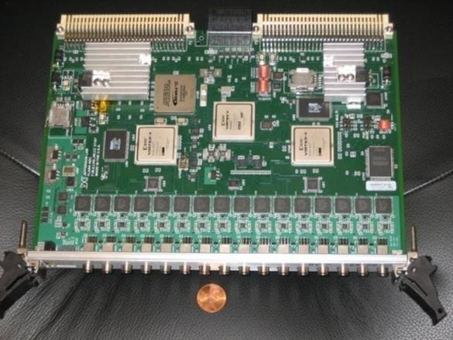
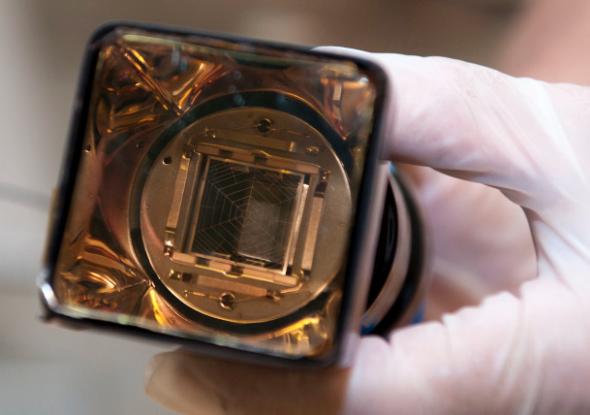
Compton Transmission Polarimeter
Reconversion target
2 mm × 48 mm diameter tungsten composite (Densimet D17K) with 90.5% W,7% Ni and 2.5% Cu.
Analyzing magnet
The core of the analyzing magnet is a magnetized iron cylinder target that is 7.5 cm long and 5 cm diameter
Photon calorimeter
9 (60 x 60 x 280 mm) Cesium Iodide crystals doped with Thallium CsI(Tl) arranged in 3 × 3 array configuration.
CsI(Tl) crystals are coupled to Hamamatsu R6236 PMTs operated at -1.5kV
Hamamatsu R6236
FADC 250
The signal from the PMTs are fed into JLab custom made FADC250 module which
samples signals at 250 MHz.

Slide 6
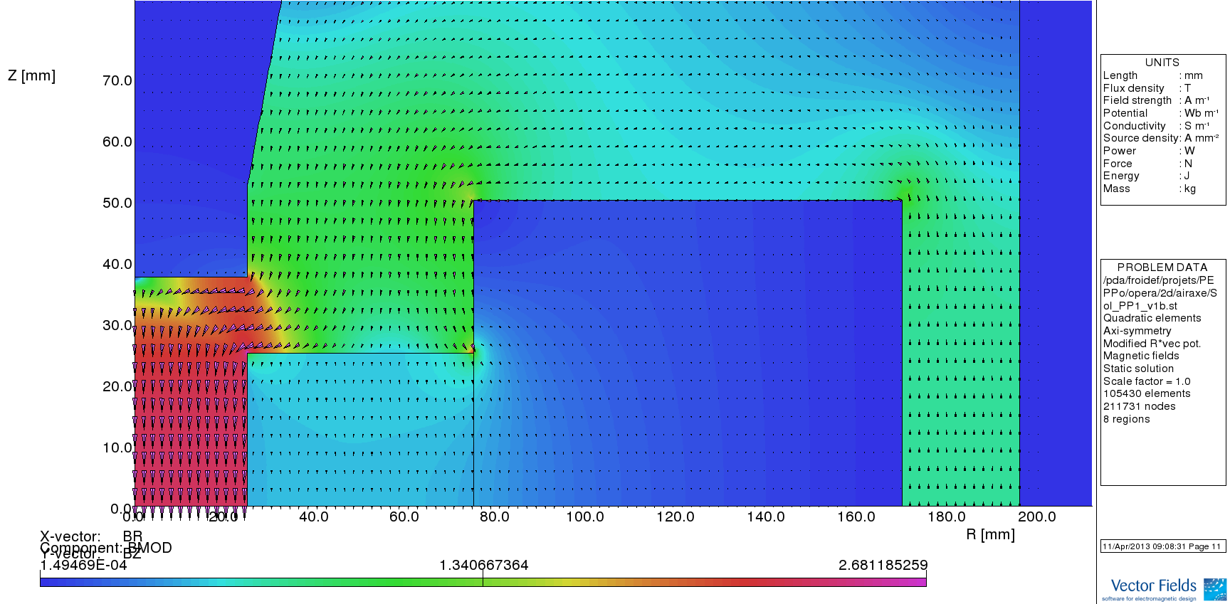
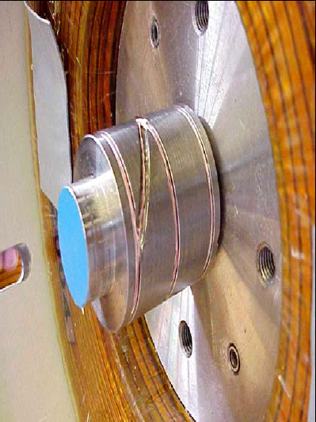
Analyzing magnet
The iron core target is equipped with 3 pick-up coils measuring the magnetic flux generated by the magnet current variation (ramping-up, polarity reversal).
Specific cycling procedures are used during the experiment to monitor the target polarization.
The magnetic field of the analyzing magnet was modeled in OPERA 2D and compared to field values measured experimentally with the pick up coils.
P_{T} = 7.06% ± 0.05%_{Stat.} ± 0.07%_{Syst.}
E. Froidefond, E. Voutier, PEPPo TN-14-02 (2014)

Slide 7
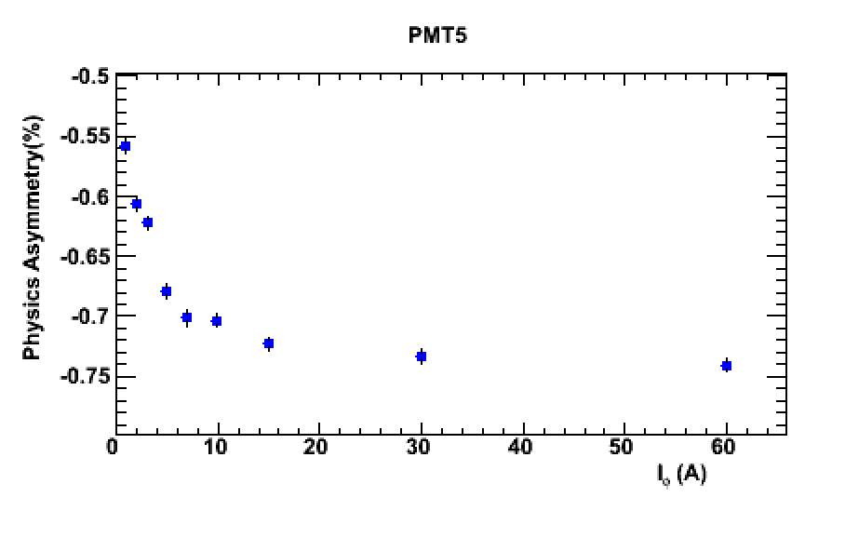
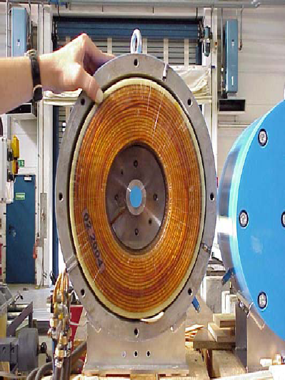
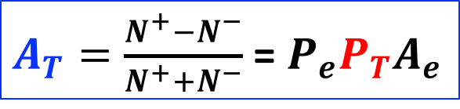
Analyzing magnet response
Experimental asymmetries are measured with respect to beam helicity ; they are linearly proportional to the target polarization, itself proportional to the target magnetization.
$A_{T}=\frac{N^{+}−N^{−}}{N^{+}+N^{−}}$ =${ P}_{e}P_{T}A_{e}$
IHWP inserted

Slide 8
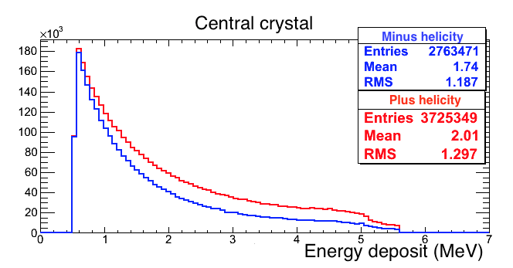
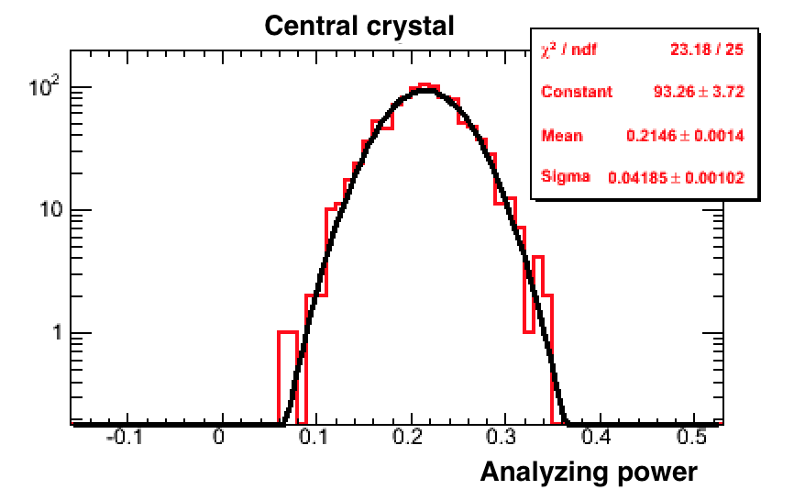
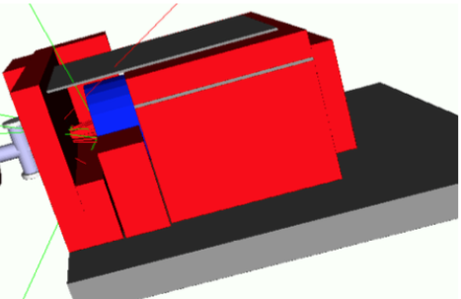
Analyzing power simulation
The analyzing power of the polarimeter can be experimentally measured with a known polarized beam or simulated with GEANT4.
A model of the PEPPo polarimeter has been developed within the GEANT4 framework, starting from E-166 Collaboration earlier work.
The simulated energy deposited into each crystal is processed according to the data read-out electronics method
Simulation of 5.34MeV/c pencil beam e⁺ beam

Slide 9
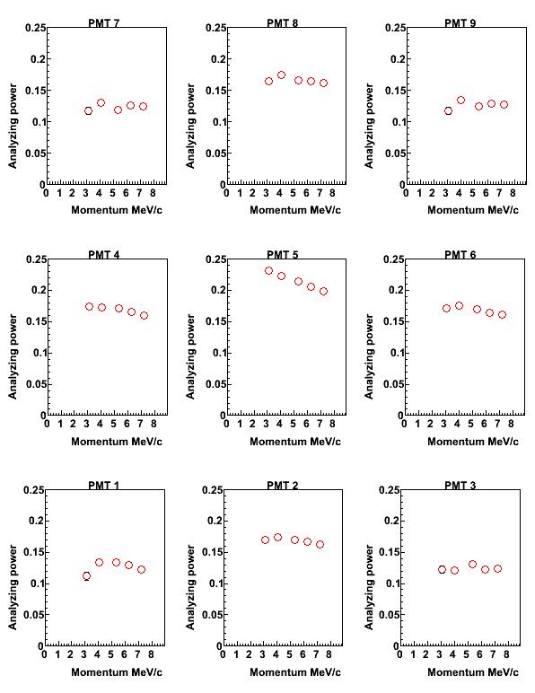
Simulated Positron Analyzing power
Positron analyzing power simulation: 3.08 - 7.19MeV/c.
Positron analyzing power is obtained directly from simulation.
The main difference between electrons and positrons is the annihilation reaction.

Slide 10
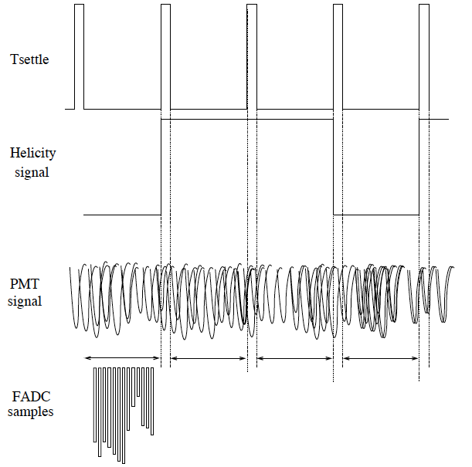
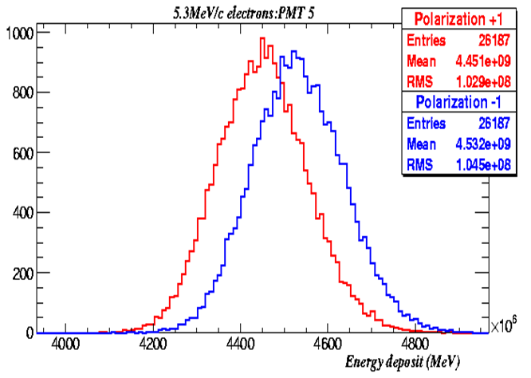
Energy Integrated Asymmetry
Electron data are recorded in energy integrated mode.
The energy integrated method is suitable for the high rate condition of the electron.
The total energy deposited in each crystal during the time corresponding to a single helicity state of the initial electron beam is recorded.
Helicity frequency=30Hz
Helicity delay= 8windows
Helicity pattern=quartet
( + - - + or - + + - )
h⁻ h⁺ h⁺ h⁻
E⁻ E⁺ E⁺ E⁻
Helicity +1
Simulation
Helicity -1

Slide 11
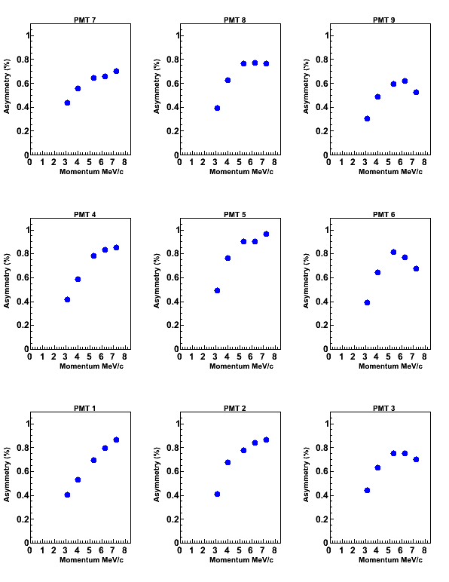
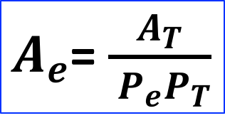
Electron physics asymmetry measurement.
Combining experimental asymmetries measured for each analyzing magnet polarity and each laser polarization orientation allows to cancel-out eventual false asymmetries and isolate physics asymmetries.
P_{e-} (MeV/c) | I_{e-} @ T2
3.08 | 60 pA
4.02 | 23 pA
5.34 | 25 pA
6.25 | 10 pA
7.19 | 10 pA
$A_{e}$= $\frac{A_{T}}{{ P}_{e}P_{T}}$

Slide 12
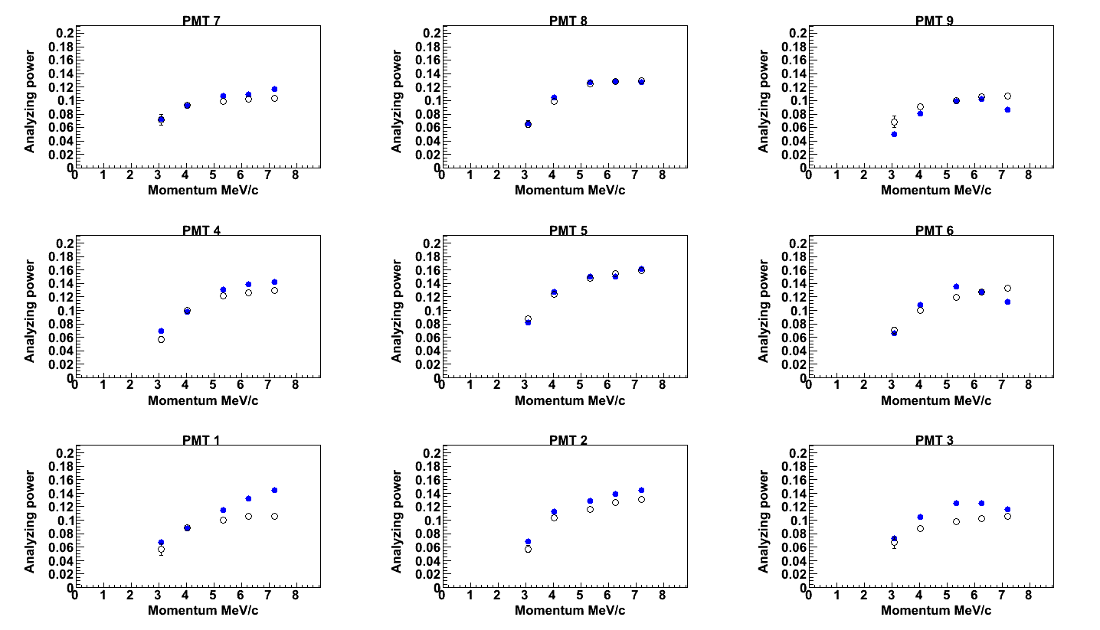
Electron Measured vs. Simulation
The calibration of the analyzing power of the polarimeter relies on the comparison between experimental and simulated electron analyzing power.
The comparison between experimental and simulated analyzing power allows to benchmark the GEANT4 physics packages
Agreement between simulation and measurement is best for central crystal; outer crystals demonstrate greatest difference at largest energies
Beam position was unknown during the experiment, thus simulation could not reproduce exact conditions
Measured e- analyzing power
Simulated e- analyzing power

Slide 13
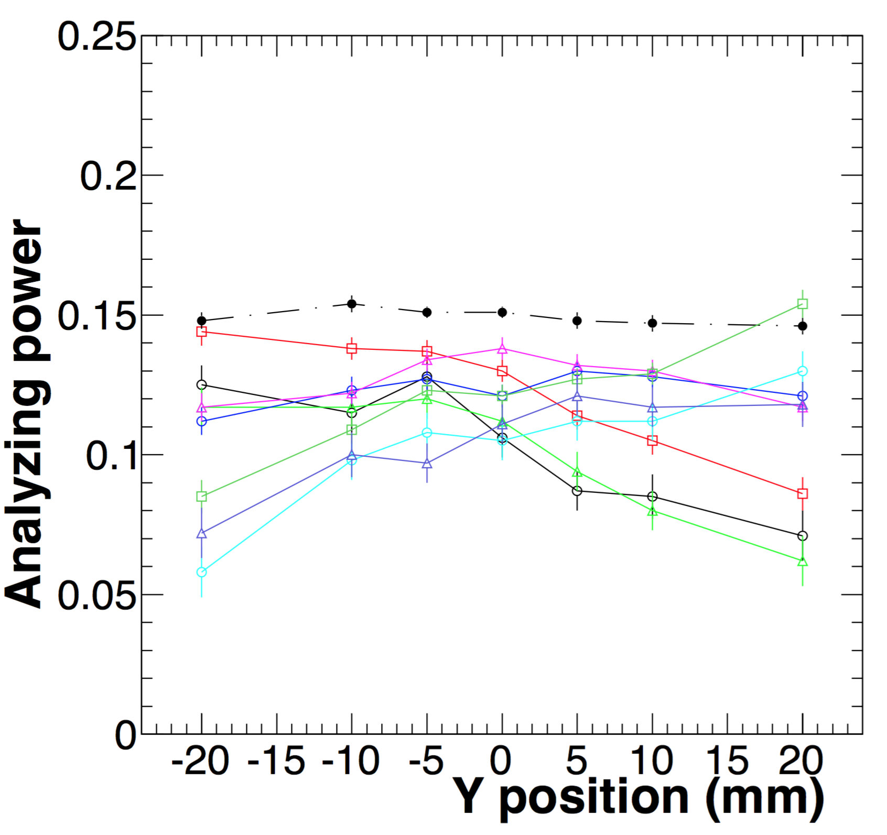
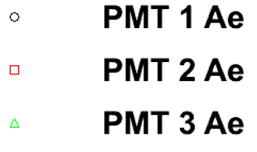
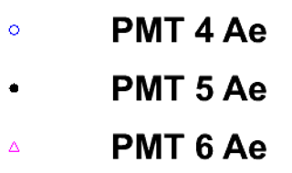
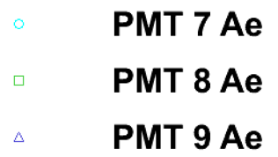
Beam position sensitivity
7 | 8 | 9
4 | 5 | 6
1 | 2 | 3
Simulation of 5.34MeV/c pencil beam e⁻ beam
Simulating the analyzing power at different positions along the Y axis (fixed along X axis) reveals a sensitivity to beam position
While the analyzing power for the central crystal remain steady throughout the scan, the values for other crystals varies depending on the position of the beam

Slide 14
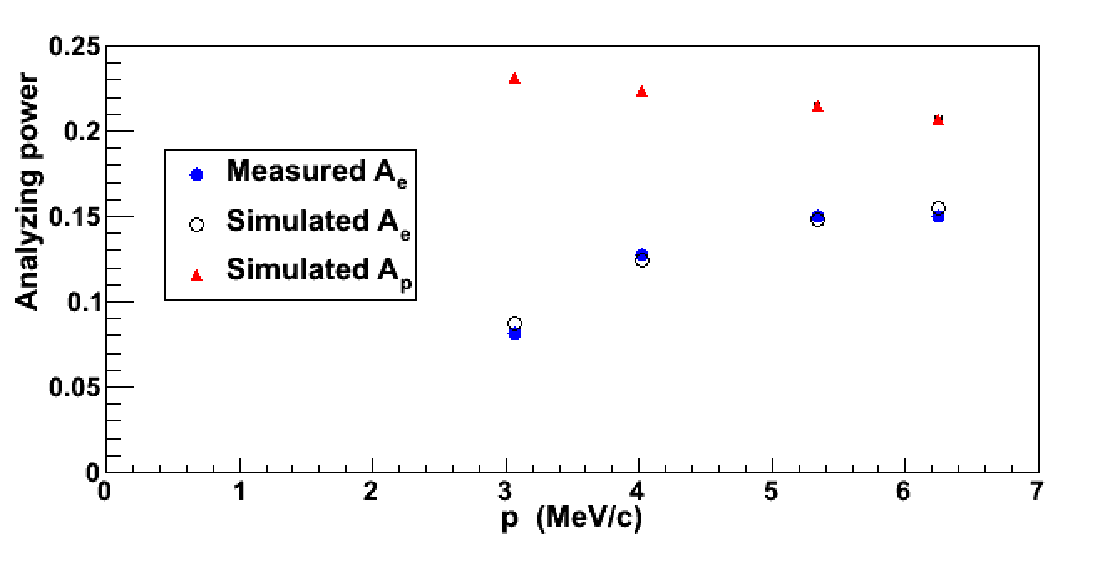
Simulated Positron Analyzing power
GEANT4 simulations allow to link the measured electron analyzing power to the expected positron analyzing power of the PEPPo Compton transmission polarimeter.

Slide 15
Summary
The electron beam was used to study and calibrate the Compton transmission polarimeter analyzing power.
Geant4 simulation of the central crystal agreed very well with measurements.
Sensitivity of outer crystals in simulation may explain difference between measurement and model.
The positron analyzing power was obtained directly from the simulation of the central crystal.

Slide 16
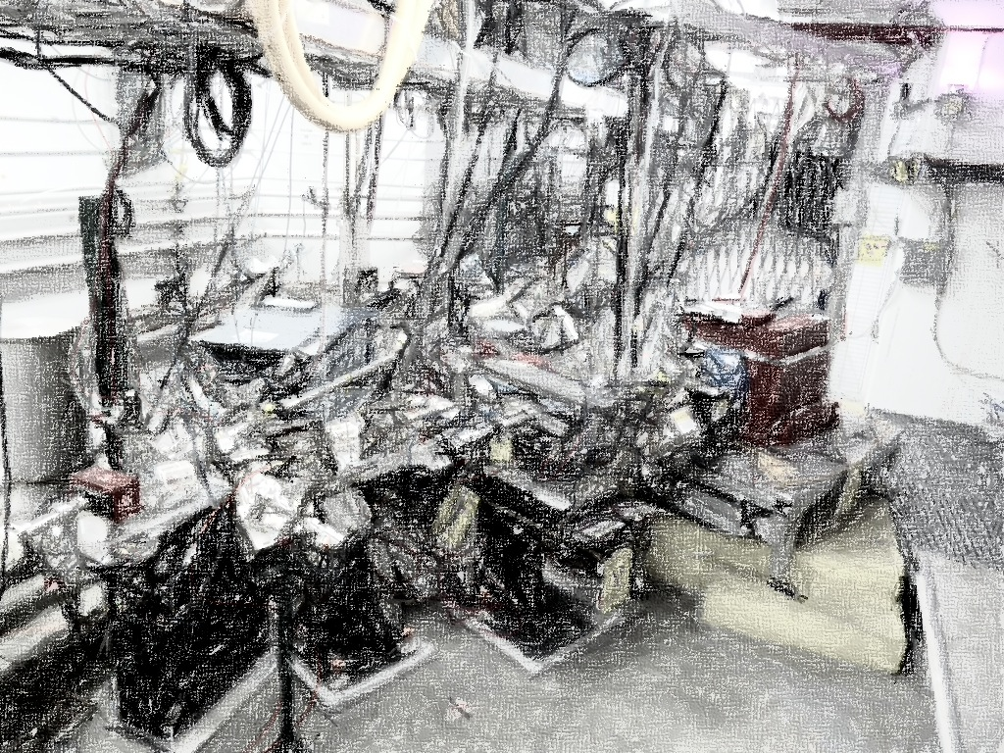
PEPPo Collaboration
P. Aderley¹, A. Adeyemi⁴, P. Aguilera¹, M. Ali¹, H. Areti¹, M. Baylac², J. Benesch¹,
G. Bosson², B. Cade¹, A. Camsonne¹, L. Cardman¹, J. Clark¹, P. Cole⁵, S. Covert¹,
C. Cuevas¹, O. Dadoun³, D. Dale⁵, J. Dumas^{1,2}, E. Fanchini², T. Forest⁵, E. Forman¹,
Freyberger¹, E. Froidefond², S. Golge⁶, J. Grames¹, P. Guèye⁴, J. Hansknecht¹,
P. Harrell¹, J. Hoskins⁸, C. Hyde⁷, R. Kazimi¹, Y. Kim^{1,5}, D. Machie¹, K. Mahoney¹,
R. Mammei¹, M. Marton², J. McCarter⁹, M. McCaughan¹, M. McHugh¹⁰, D. McNulty⁵, T. Michaelides¹, R. Michaels¹, C. Muñoz Camacho¹¹, J.-F. Muraz², K. Myers¹²,
Opper¹⁰, M. Poelker¹, J.-S. Réal², L. Richardson¹, S. Setiniyazi⁵, M. Stutzman¹,
R. Suleiman¹, C. Tennant¹, C.-Y. Tsai¹³, D. Turner¹, A. Variola³, E. Voutier^{2,11},
Y. Wang¹, Y. Zhang¹²
¹ Jefferson Lab, Newport News, VA, US ² LPSC, Grenoble, France ³ LAL, Orsay, France
⁴ Hampton University, Hampton, VA, USA ⁵ Idaho State University & IAC, Pocatello, ID, USA
⁶ North Carolina University, Durham, NC, USA ⁷ Old Dominion University, Norfolk, VA, US
⁸ The College of William & Mary, Williamsburg, VA, USA ⁹ University of Virginia, Charlottesville, VA, USA ¹⁰ George Washington University, Washington, DC, USA ¹¹ IPN, Orsay, France
¹² Rutgers University, Piscataway, NJ, USA ¹³ Virginia Tech, Blacksburg, VA, USA
Many thanks for advice, equipment loan, GEANT4 modeling support, and funding to
SLAC E-166 Collaboration
International Linear Collider Project
Jefferson Science Association Initiatives Award

