Slide 1

The Flexible Spectator Model of Spin Dependent Quark and Gluon GPDs: Implications for Deeply Virtual Lepton Scattering
Gary R. Goldstein
Tufts University
SPIN 2016
U. Illinois

Slide 2

Abstract
The "flexible" parametrization of quark and gluon Generalized Parton Distributions (GPDs), based on spectator models and Regge behavior, will be presented. The Chiral Even GPDs, constrained by nucleon form factors and PDFs, determine deeply virtual Compton scattering amplitudes and are compared with cross section and polarization data. The Chiral Odd GPDs, including "transversity", contribute to pseudoscalar leptoproduction and are compared to recent experimental data. The spectator scheme is extended to new quark-sea and gluon GPDs. Predictions for an array of spin-dependent angular distributions and asymmetries in Deeply Virtual Scattering processes related to these distributions is explored.

Slide 3
GPDs,Extension to Sea and Gluons
Collaborators: S. Liuti, O. Gonzalez Hernandez, A. Rajan, J. Poage
GRG, O. Gonzalez-Hernandez, S.Liuti, PRD(2015) arXiv:1311.0483
GRG, O. Gonzalez-Hernandez, S.Liuti, arXiv:1401.0438
Ahmad, GRG, Liuti, PRD79, 054014, (2009)
Gonzalez, GRG, Liuti PRD84, 034007 (2011)
GRG, Gonzalez, Liuti, PRD91, 114013 (2015)
    GRG, Gonzalez Hernandez, Liuti, J. Phys. G: Nucl. Part. Phys. 39 115001 (2012)
Gonzalez Hernandez, Liuti, GRG, Kathuria, PRC88, 065206 (2013)

Slide 4
OUTLINE
Collaborators: S. Liuti, O. Gonzalez Hernandez, J. Poage
GPDs, Model– Reggeized spectator “flexible parameterization”
Recall Valence quarks: Chiral Even & Odd
Gluons & sea quarks - spectator “flexible”
Preliminary results
Some Observable quantities

Slide 5
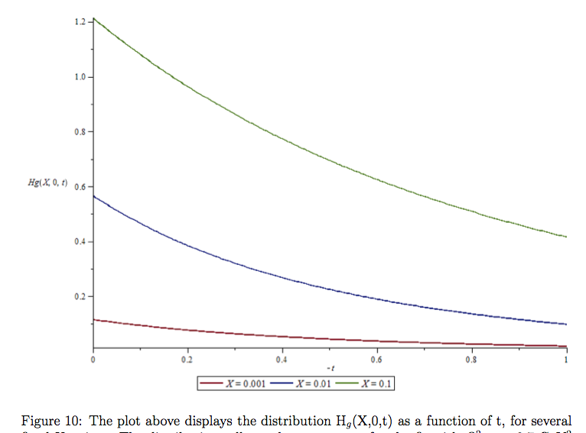
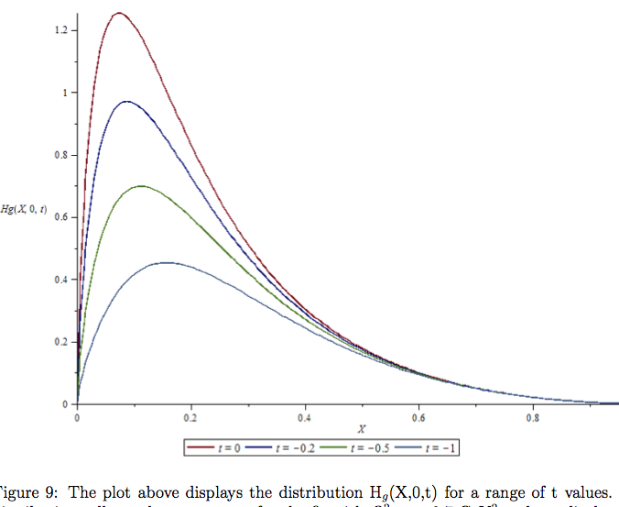
Preview
Gluon GPDs – extending the model
Preliminary: x and t dependence of H_{g}(x, 0, t) for input scale
PRELIMINARY
GG, Gonzalez Hernandez, Liuti, Poage, in progress

Slide 6
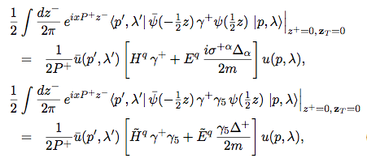
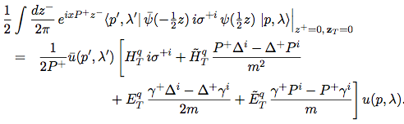
GPD definitions – 8 quark + 8 gluon (twist 2)
Momentum space nucleon matrix elements of quark field correlators
see, e.g. M. Diehl, Eur. Phys. J. C 19, 485 (2001).
Chiral even GPDs
-> Ji sum rule
Chiral odd GPDs
-> transversity
How to measure
and/or
parameterize them?

Slide 7
Normalizing & constraining quark GPDs – Chiral even
Form factor, Forward limit
Integrates to charge
→Anomalous magnetic moments
Integrates to axial charge

Slide 8
The Model for valence quarks– Reggeized Diquarks
The Model – first for Chiral Even –
Reggeized Diquark Spectator
Diquark: Color anti-3, scalar & axial vector

Slide 9
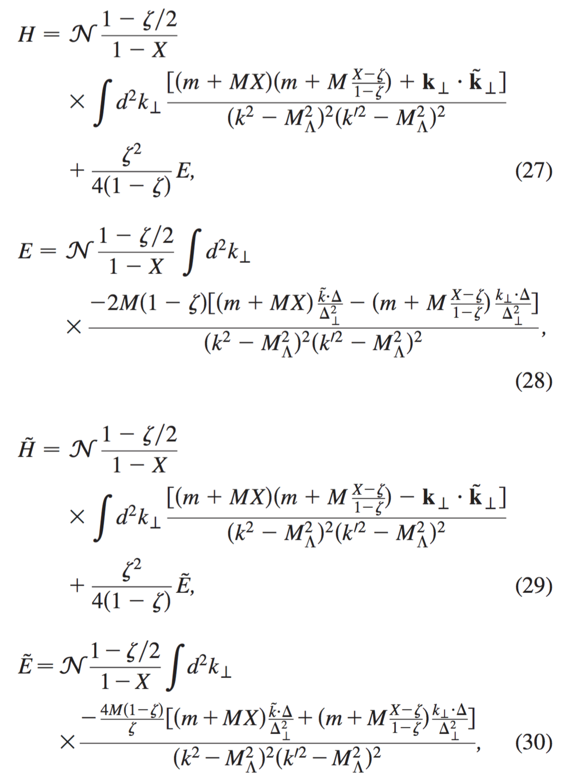
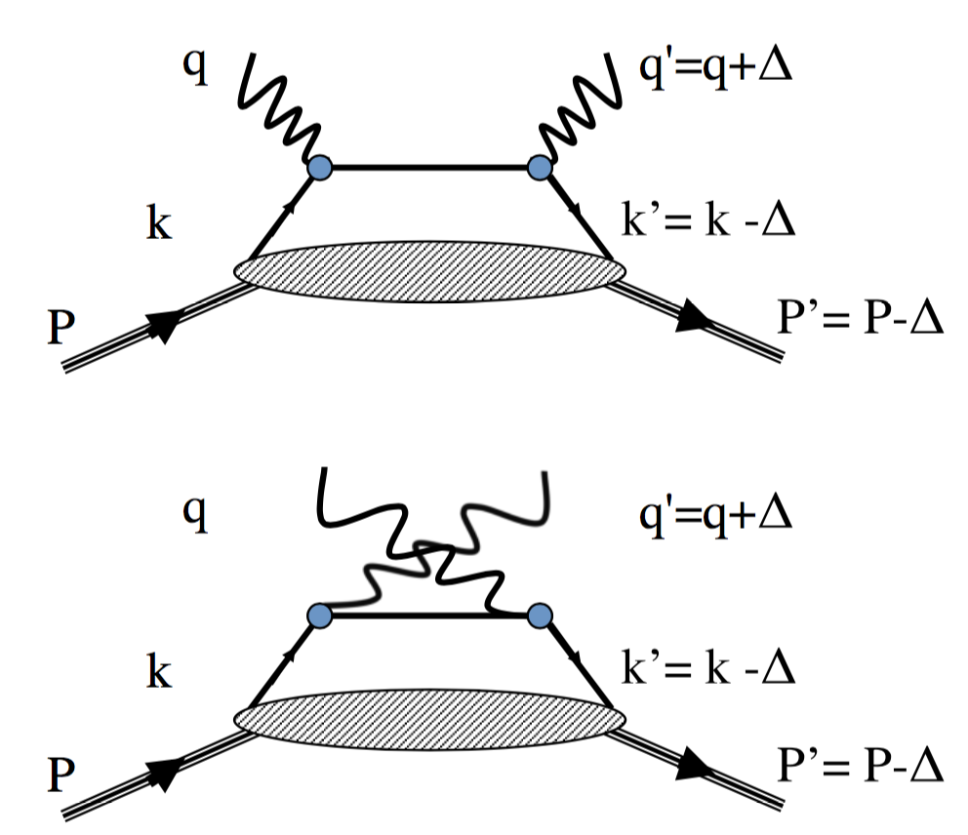
“flexible” covariant model
Gonzalez, GG, Liuti PRD84, 034007 (2011)
Diquark

Slide 10
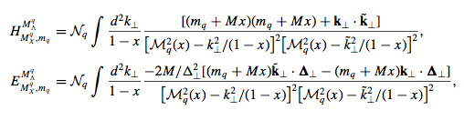


Reggeizing diquark model
Diquark+quark & fixed masses (e.g. at ξ=0)
Diquark mass “spectrum”
as in Brodsky, Close & Gunion
Phys. Rev. D8, 3678 (1973)
R✖Dq

Slide 11

Factorization in exclusive processes (DVCS, DVMP…)
t
q'=q+Δ, Λ_{γ}’
q,Λ_{γ}
g
k, λ
k’= k –Δ. λ’
k, λ
A
k’= k –Δ. λ’
Diquark
P, Λ
P’= P-Δ, Λ’
Convolution of “hard part” with quark-proton Helicity amplitudes
λ= +(-) λ’ chiral even (odd)
See Ahmad, et al. PRD75, 0904003 (2007);
ibid, EPJC63, 407 (2009) .
see Ahmad, GG, Liuti, PRD79, 054014, (2009)
for first chiral odd GPD parameterization
Gonzalez, GG, Liuti PRD84, 034007 (2011) chiral even GPD

Slide 12
EM Form Factors (t dependence) precision mesurements→tighter parameters
O.Gonzalez, GRG, S.Liuti, K.Kathuria PRC88, 065206(2013)
data: G.D. Cates, et al. PRL106,252003 (2011).

Slide 13
Chiral even GPDs
From GPDs
with evolution
to Compton
Form Factors
CFFs to helicity
amps
helicity amps to
observables
<-> parameters
t

Slide 14
DVCS: “golden” GPDs
+
BH Interference with DVCS/GPDs
Successful comparison with data
see: Gonzalez, GRG, Liuti PRD84, 034007 (2011)

Slide 15
Procedure to construct Chiral Even GPDs & observables
Spectator color anti-3 diquark model & Reggeization
𝛌, k⁺=XP⁺
S=0 or 1
𝛌’ , k’⁺=(X-ζ)P⁺
Λ
P⁺
P_{X}⁺=(1-X)P⁺
Λ’
P’⁺=(1- ζ)P⁺
Product of diquark l.c.w.f.’s →A_{Λλ;Λ´λ´=λ}
A_{Λλ;Λ´λ} → chiral even GPDs + Evolution
g ⊗ A → exclusive process helicity amps
pdf’s, FF’s, d𝝈/dΩ & Asymmetries: parameters & predictions
A_{Λλ;Λ´λ}→ all chiral even GPDs→DVCS, DVMP

Slide 16
Procedure to construct Chiral Even GPDs & observables
Spectator color anti-3 diquark model & Reggeization
𝛌, k⁺=XP⁺
S=0 or 1
𝛌’ , k’⁺=(X-ζ)P⁺
Λ
P⁺
P_{X}⁺=(1-X)P⁺
Λ’
P’⁺=(1- ζ)P⁺
Product of diquark l.c.w.f.’s →A_{Λλ;Λ´λ´=λ}
Odd
A_{Λλ;Λ´λ} → chiral even GPDs + Evolution
g ⊗ A → exclusive process helicity amps
pdf’s, FF’s, d𝝈/dΩ & Asymmetries: parameters & predictions
A_{Λλ;Λ´λ}→ all chiral even GPDs→DVCS, DVMP

Slide 17
Procedure to construct Gluon GPDs & observables
Spectator color octet “nucleon” model & Reggeization
𝛌, k⁺=XP⁺
S=1/2 or 3/2
𝛌’ , k’⁺=(X-ζ)P⁺
Λ
P⁺
P_{X}⁺=(1-X)P⁺
Λ’
P’⁺=(1- ζ)P⁺
Product of baryon l.c.w.f.’s →A_{Λλ;Λ´λ´=λ}
A_{Λλ;Λ´λ} → gluon GPDs
g ⊗ A → exclusive process helicity amps
pdf’s, FF’s, d𝝈/dΩ & Asymmetries: parameters & predictions
vertex parity?→A_{Λλ;-Λ´-λ´} → “transversity” gluon GPDs ?

Slide 18


Gluon GPDs
Even parity & Gluon helicity conserving
~
Odd parity & Gluon helicity conserving

Slide 19
Gluon & Sea quark distributions
Spectator Model
– generalize Regge-diquark spectator model
N→ g + “color octet N” spectator (8⊗8⊃1)
(could be spin ½ or 3/2)
(N→ anti-u + color 3 “tetraquark”uuud)
How to normalize?
H_{g}(x,ξ,t)_{Q}² →H_{g}(x,0,0)_{Q}² =xG(x) _{Q}²
Evolution & small x phenomenology
Sea quark distributions H_{anti-u}(x,0,0) . . .
Use pdf’s to fix x dependence
Small x ~ Pomeron

Slide 20
Gluon distribution model?
What to expect for H_{g} , E_{g}(x,ξ,t) , . . . ?
Begin with normalization
H_{g}(x,0,0) → xG(x)|_{Q}² unpolarized
Parametrize via “spectator” model by pdf’s
Follow same procedure as for valence quark chiral even GPDs

Slide 21
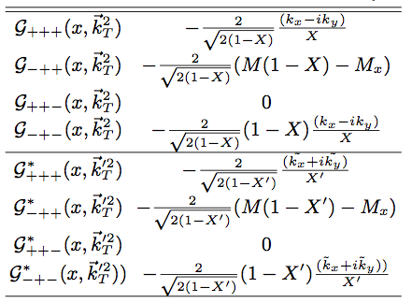

Gluon ‘vertex functions’ G_{Λx ; Λg, Λ}
𝛌, k⁺=XP⁺
P⁺
P_{X}⁺=(1-X)P⁺
Λ
𝛌’ , k’⁺=(X-ζ)P⁺
P’⁺=(1- ζ)P⁺
P_{X}⁺=(1-X)P⁺
Λ’
GG, Gonzalez Hernandez, Liuti, Poage, in progress

Slide 22
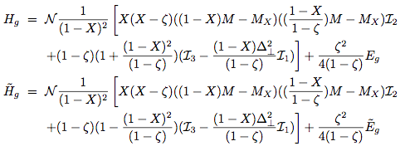

Spectator model gluon GPDs
I _{1,2,3} are k⊥ integrations & M_{X} is spectator mass

Slide 23
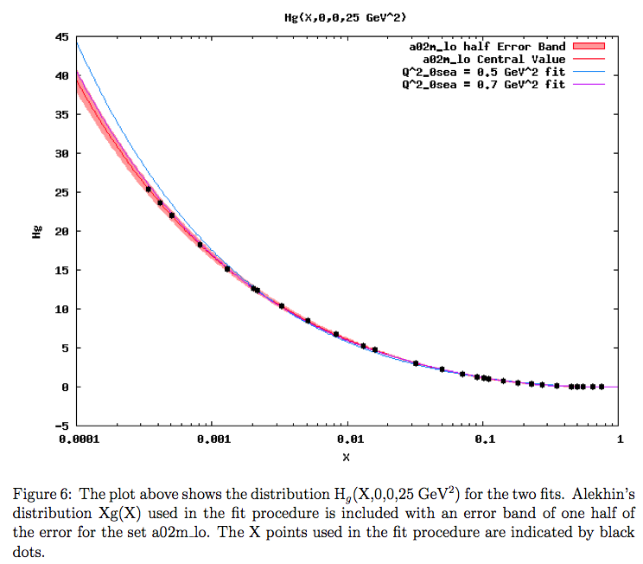
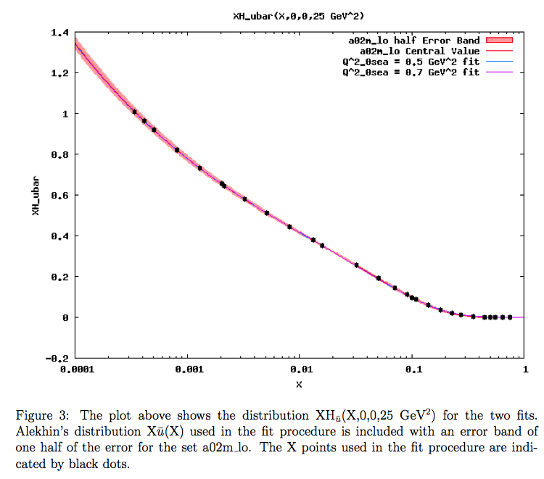
pdf’s fix x dependence
Gluon anti-u
H_{g}(X,0,0)
Q²=25 GeV²
XH_{anti-u}(X,0,0)
Q²=25 GeV²
Alekhin pdf fit
X
X
Single Q² value shown --- fit known pdf’s all Q²
from J. Poage
GG, Gonzalez Hernandez, Liuti, Poage, in progress

Slide 24
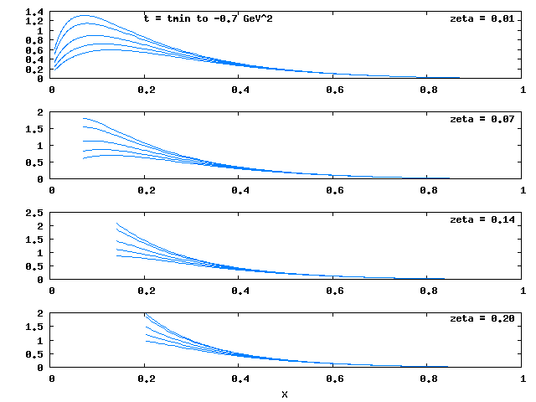
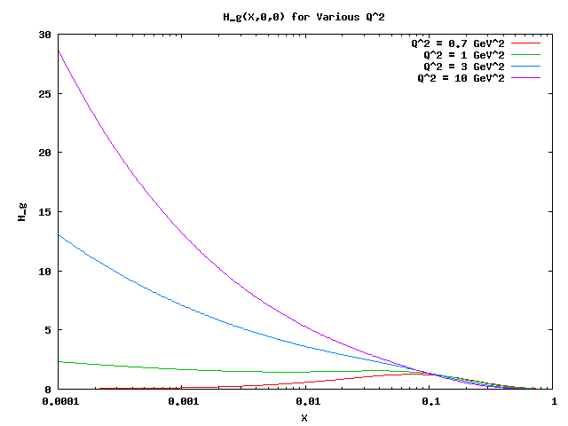
After pdf’s vs. Q² → fix x dependence
Regge behavior determines t dependence
Spectator determines ζ dependence
t=t_{min} to -0.7 GeV²
ζ=0.01
ζ=0.07
H_{g}(X,0,0)
Q²=initial to 10 GeV²
ζ=0.14
ζ=0.20
X
H_{g}(X,ζ,t)
Q²=initial
X

Slide 25
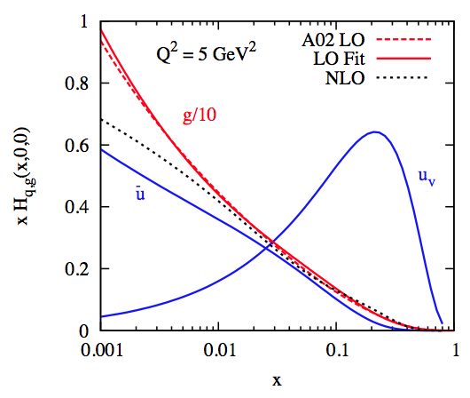
Fitting gluon pdf’s
c.f. Alekhin, .. etc.
GG, Gonzalez Hernandez, Liuti, Poage, in progress

Slide 26
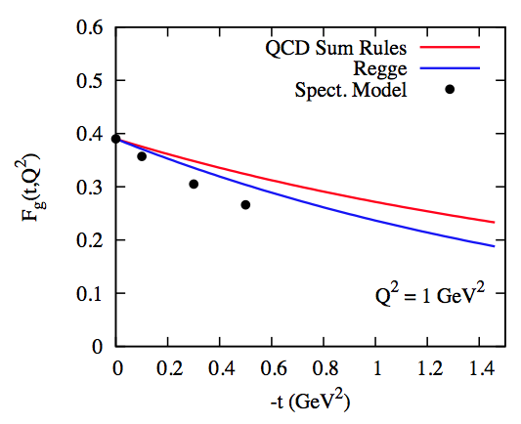
H_{g}(x,0,t) What constrains t-dependence?
Spectator t-dependence w/o Regge small x behavior:
& hybrid Regge-Spectator model combines
PRELIMINARY
Compare Gluon form factor via QCD sum rules
Braun, Gornicki, Mankiewicz, Schaefer, Phys.Lett.B302, 291 (1993)
GG, Gonzalez Hernandez, Liuti, Poage, in progress

Slide 27
Compare Gluon form factor via QCD sum rules
Braun, Gornicki, Mankiewicz, Schaefer, Phys.Lett.B302, 291 (1993)
PRELIMINARY
QCD sum rules
Regge small x
Spectator t-dependence w/o Regge small x behavior:
hybrid Regge-Spectator model combined
GG, Gonzalez Hernandez, Liuti, Poage, in progress

Slide 28
Preliminary: x and t dependence of H_{g}(x, 0, t) for input scale
H_{g}(X,0,t)
t=0
PRELIMINARY
t=-0.2
X=0.1
t=-0.5
X=0.01
t=-1.0
X=0.001
0.4
-t
0.4
X
GG, Gonzalez Hernandez, Liuti, Poage, in progress

Slide 29
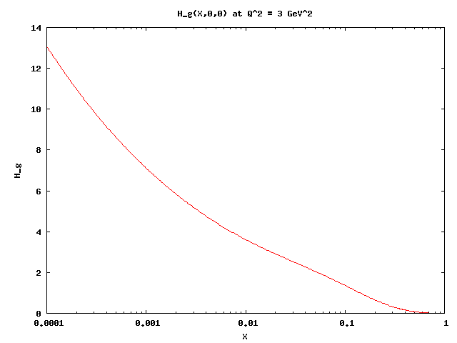
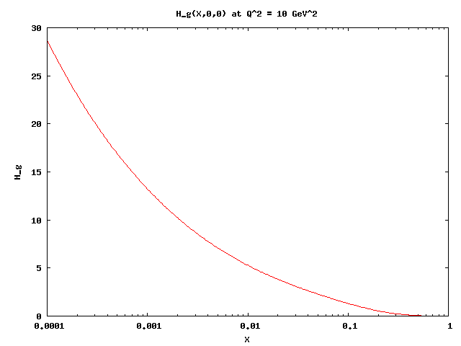
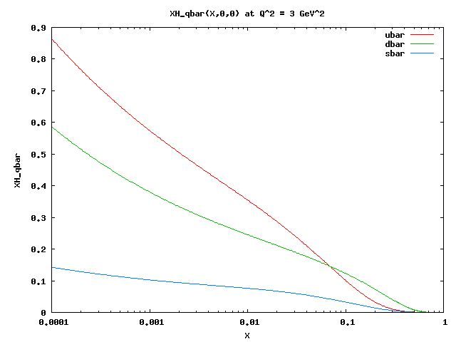
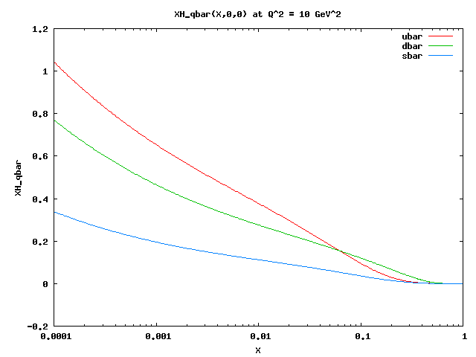

Gluon & sea distributions J. Poage
14
30
H_{g}(X,0,0)
Q²=3 GeV²
H_{g}(X,0,0)
Q²=10 GeV²
Gluon
H_{g}(x,0,0)
X
X
0.9
1.2
H_{sea}(X,0,0)
Q²=3 GeV²
H_{sea}(X,0,0)
Q²=10 GeV²
Sea
X
X
GG, Gonzalez Hernandez, Liuti, Poage, in progress

Slide 30
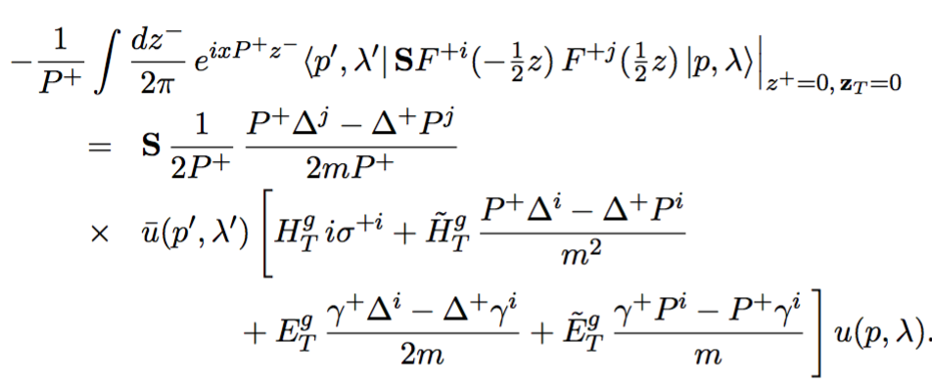
Extension to Gluon “Transversity”
Λ=±1
Λ´=∓1
4 GPDs: M.Diehl, EPJC19, 485 (2001)

Slide 31
What about Gluon “transversity”?
Transversity for on-shell gluons or photons : no |0> helicity
∧
∧
∧
Linear polarization in the plane
∧
Linear polarization normal to the plane
GG&M.J.Moravcsik, Ann.Phys.195,213(1989).

Slide 32
Using the Reggeized Spectators Model
How to Measure? What Processes?

Slide 33
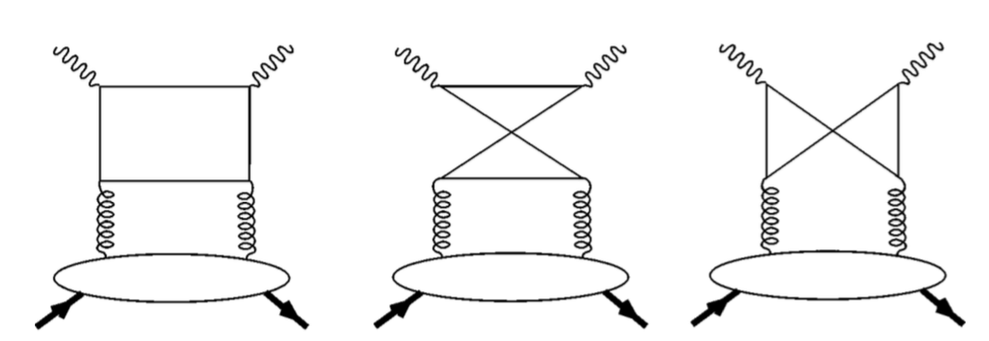
A_{Λ´,Λg’; Λ,Λg} contributes to DVCS at order 𝛼_{S}
C( x,ξ,Q² )
DVCS cross sections: dσ/dt ∝ ∑|M_{Λ’ . . . .}|²
Λ_{𝛾}=+1
Λ_{𝛾}=+1
Λ_{g}=+1
Λ_{g}=+1
Λ
Λ’
See Hoodbhoy & Ji, PRD58, 054006 (1998)

Slide 34
A_{Λ´,-1; Λ,+1} Gluon Transversity contributes to DVCS order 𝛼_{S}
C’ ( x,ξ,Q² )
DVCS cross sections: dσ/dt ∝∑ |M_{Λ’ . . . .}|²
***Interference with Bethe-Heitler contains cos3𝜑 modulation
to distinguish from (leading twist) quark contribution ***
Λ_{𝛾}=+1
Λ_{𝛾}=-1
Λ_{g}=+1
Λ_{g}=-1
Λ
Λ’
See Hoodbhoy & Ji, PRD58, 054006 (1998)

Slide 35
A_{Λ´,-1; Λ,+1} contributes to DVCS at order 𝛼_{S}
C’ ( x,ξ,Q² )
Interference with Bethe-Heitler contains cos3𝜑 modulation
to distinguish from (leading twist) quark contribution
μ⁻ μ⁺ alternative
method to extract
Λ_{𝛾}=+1
Λ_{𝛾}=-1
Λ_{g}=+1
Λ_{g}=-1
Λ
Λ’
other alternatives to extract
J/Ψ production; jets . . . .
See Hoodbhoy & Ji, PRD58, 054006 (1998)

Slide 36

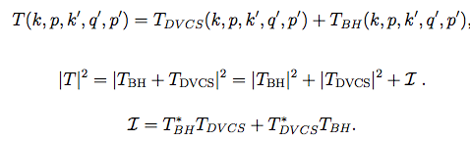

Measuring Gluons in Nucleons
DVCS
For unpolarized e+p→e’+𝛾+p’ cross section depends on azimuthal angle 𝜙.
cos3𝜙 term in interference d𝝈 measures gluon transversity GPDs (CFF’s)
ℋ _{T}^{g} ~ ∫ dx H^{g}_{T} /(x-ξ)(x+ξ) CFF’s
See Diehl, et al. PLB411, 193 (1997);
Diehl, EPJC25, 223 (2002);
Belitsky, Mueller, PLB486, 369 (2000).

Slide 37
Summary
Flexible parameterization for chiral even valence quarks from form factors, pdfs & DVCS R✖Dq
Extended R✖Dq to R✖Spectator
New Extension to gluons & the sea
Considered Gluon sector
  Helicity conserving & Helicity →gluon Transversity
Measurements?
More phenomenology to come

