Slide 1


Design of a Detector Optimized for DIS at eRHIC
Richard Petti
for the BNL EIC Science Task Force
SPIN2016
September 27, 2016

Slide 2
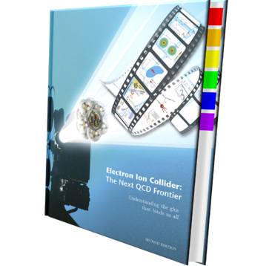
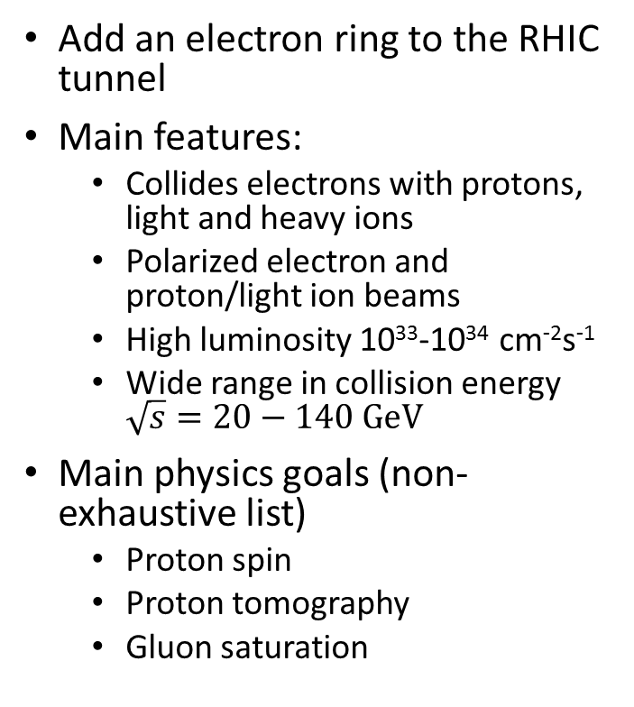
Convert RHIC to eRHIC
Add an electron ring to the RHIC tunnel
Main features:
  Collides electrons with protons, light and heavy ions
  Polarized electron and proton/light ion beams
  High luminosity 10³³-10³⁴ cm⁻²s⁻¹
  Wide range in collision energy $\sqrt{s}=20−140 GeV$
Main physics goals (non-exhaustive list)
  Proton spin
  Proton tomography
  Gluon saturation
arxiv:1212.1701

Slide 3
Detector and IR requirements
Main detector coverage over -3.5 < η < 3.5
  Electron ID from -3.5 < η < 1; π suppression up to 1:10⁴
  π/K/p separation with suppression factors ~100 required
  Spatial resolution of primary vertex ~10-20 microns
  Hcal at forward η for jet studies
Close-to-beam-line acceptance
  Recoil protons
  Neutrons in hadron going direction
  Low Q² electrons
Luminosity and polarization measurement
  photons from Bethe-Heitler for lumi
  photons and/or electron from Compton scattering for e pol

Slide 4
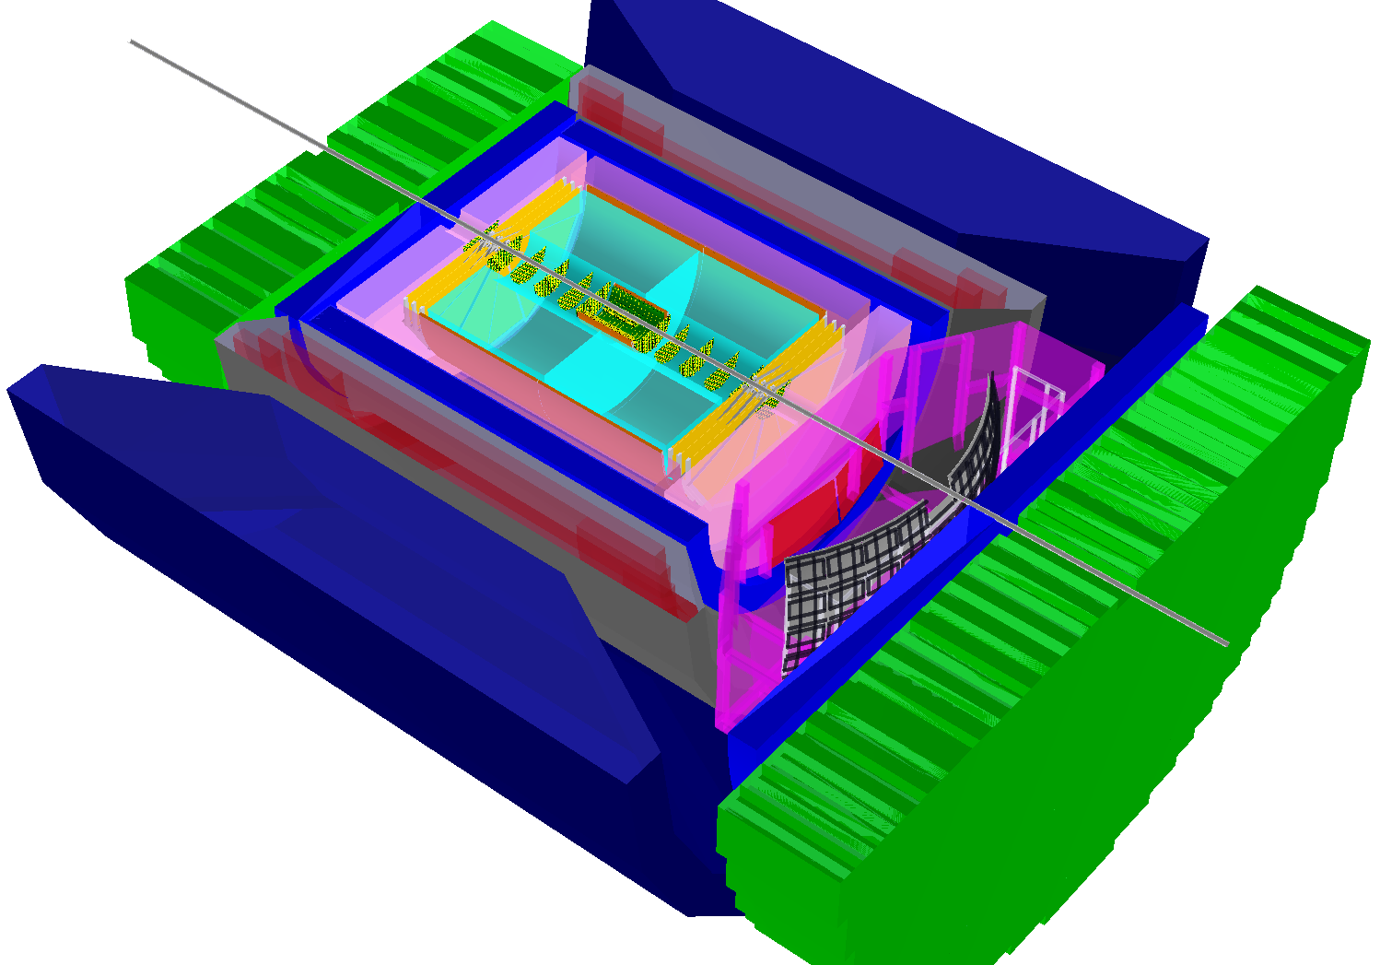
Reference detector layout: BeAST
hadronic calorimeters
e/m calorimeters
RICH detectors
9.0m
BeAST: Brookhaven eA Solenoidal Tracker
Hermetic coverage
Tracking and e/m calorimetry in the range |η| < 3.5
Active R&D for detector components
hadrons
https://wiki.bnl.gov/conferences/index.php/EIC_R%25D
electrons
silicon trackers
TPC
GEM trackers
Micromegas barrels
3T solenoid cryostat
magnet yoke

Slide 5
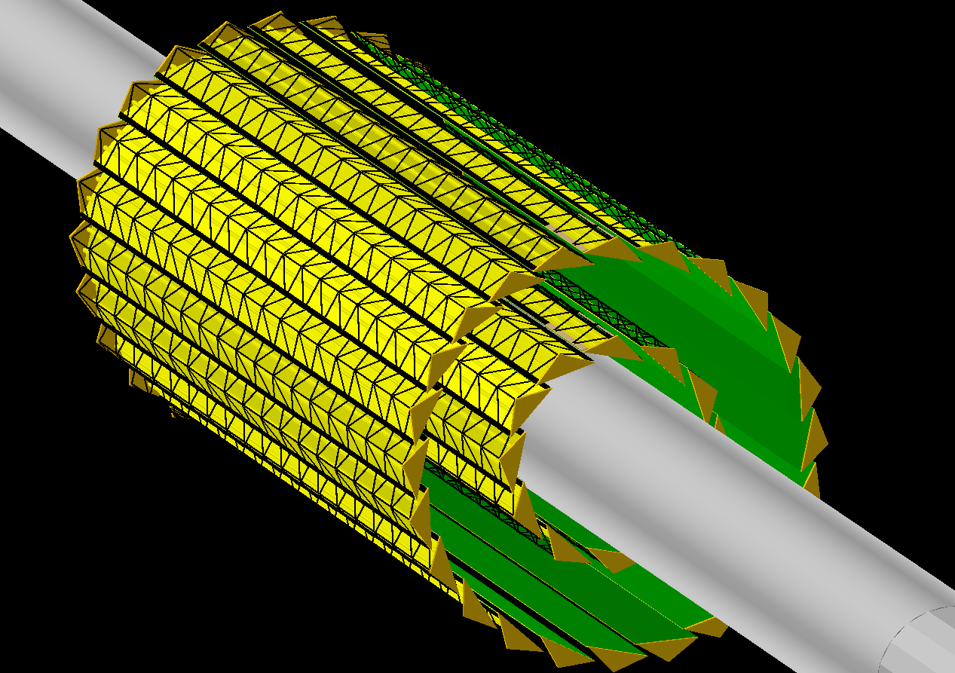
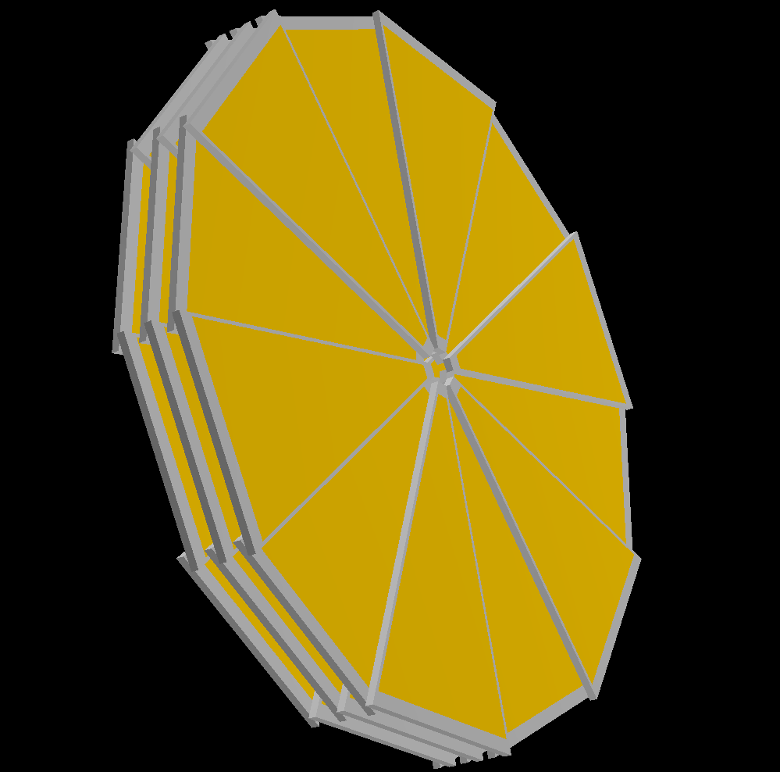
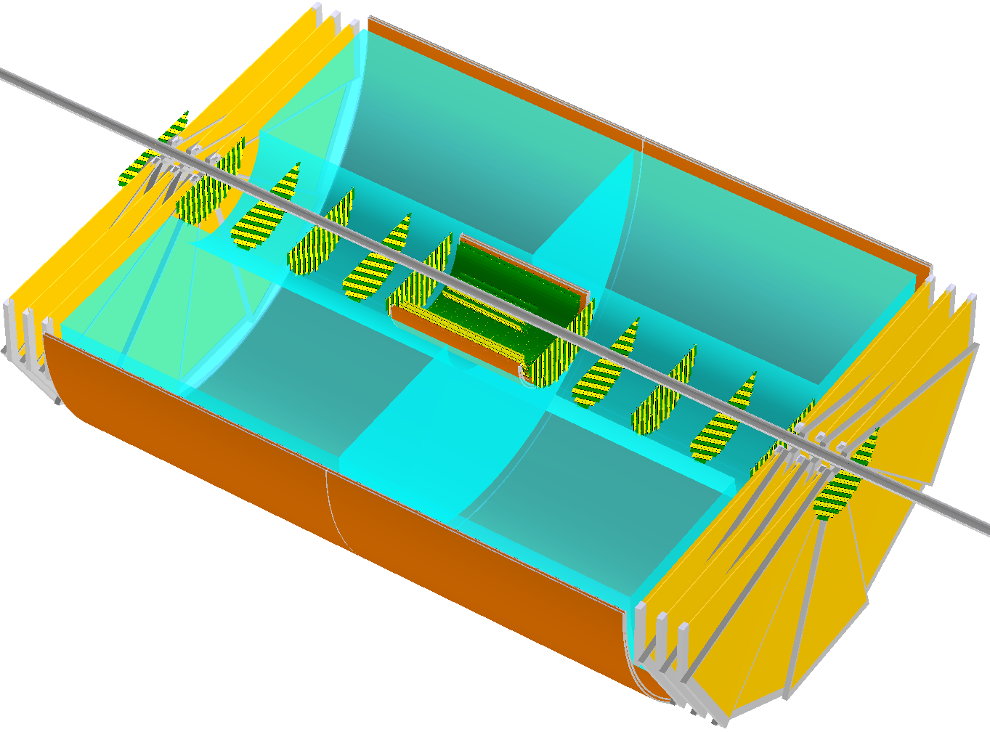
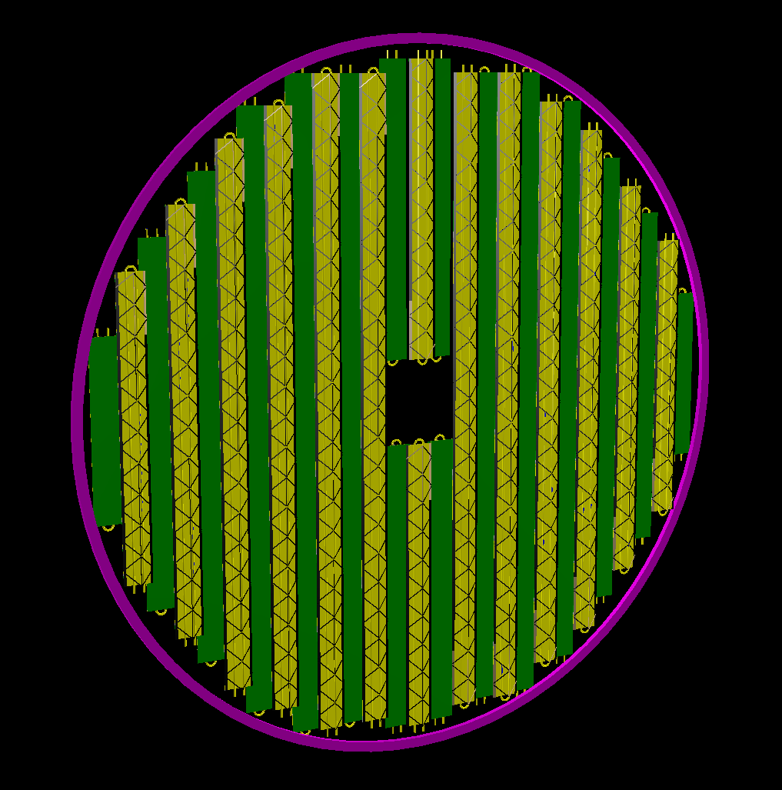
Tracker details
~75 cm
hadronic calorimeters
e/m calorimeters
RICH detectors
9.0m
~180 mm
hadrons
~2.0m
~360 mm
electrons
Real life module (Saclay)
3T solenoid cryostat
magnet yoke
silicon trackers
TPC
GEM trackers
Micromegas barrels

Slide 6
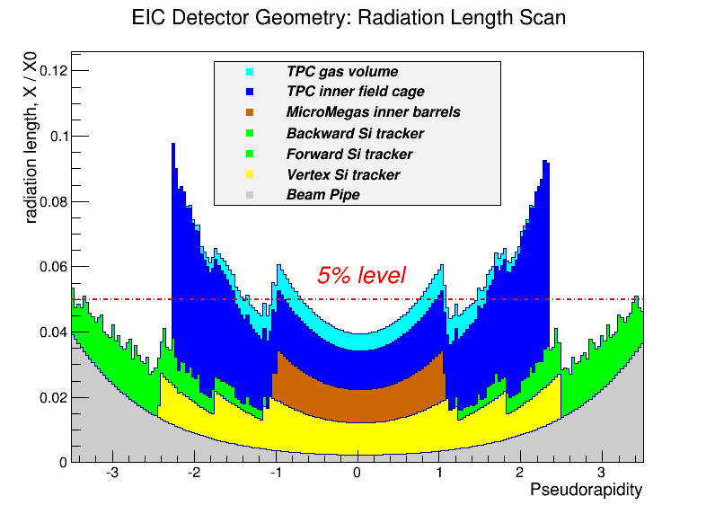
Tracker performance in simulation
Radiation length scan (inner tracking elements only)
Momentum resolution
~2.0m
π⁺
High redundancy
Low material budget
High resolution up to (at least) |η|~3

Slide 7
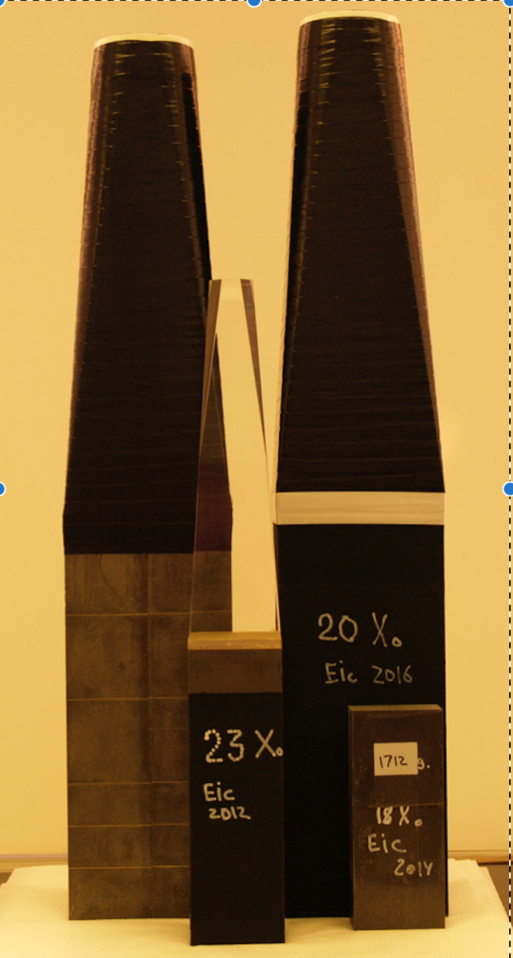
Calorimeters
May’2016 test run in FNAL
hadronic calorimeters
e/m calorimeters
RICH detectors
9.0m
hadrons
Electromagnetic Calorimeter
Very backward pseudo-rapidities (η < -2):
PWO crystals with ~2%/√E (or better) energy resolution
Pseudo-rapidity range -2 < η < 3.5:
Tungsten powder scintillating fiber technology with ~7-10%/√E energy resolution
electrons
silicon trackers
TPC
GEM trackers
Micromegas barrels
3T solenoid cryostat
magnet yoke

Slide 8
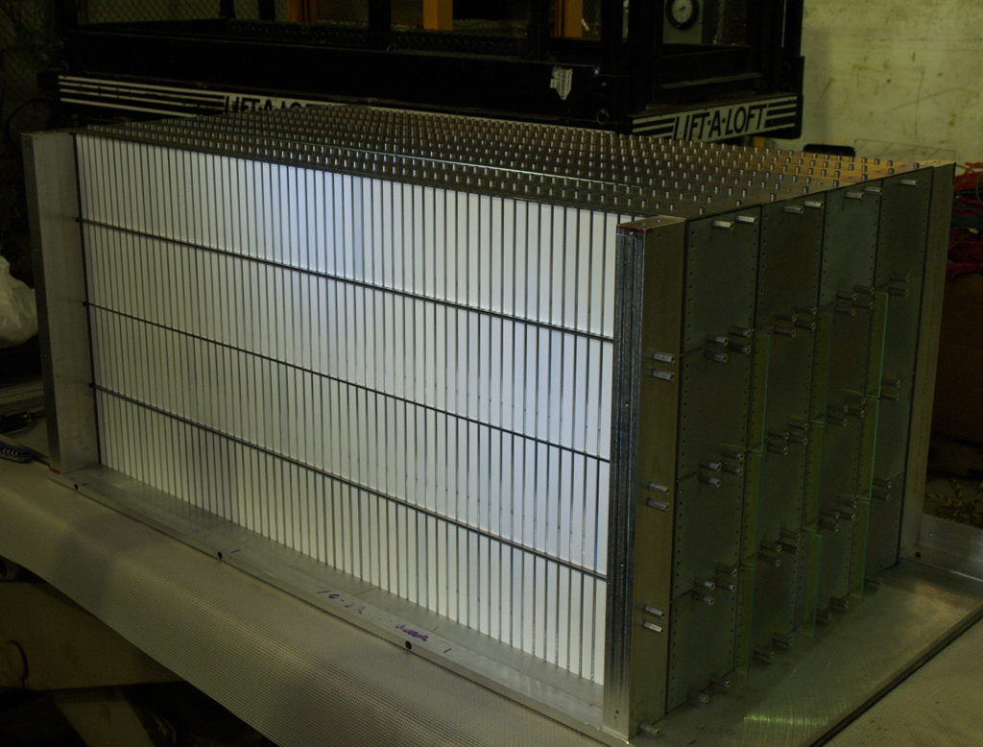
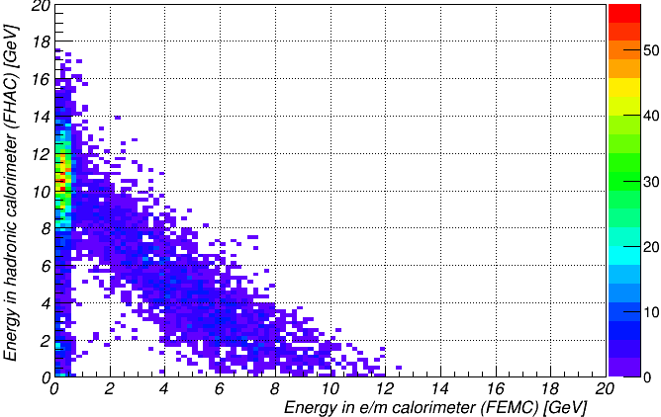
Calorimeters
hadronic calorimeters
e/m calorimeters
RICH detectors
9.0m
MC: 12 GeV pions: Hcal vs EmCal
hadrons
Hadronic Calorimeter Endcaps
Electron identification in electron-going direction; jet physics in hadron-going direction
Lead absorber scintillating plate sandwich technology
~50%/√E energy resolution looks fine
Monte-Carlo model exists in GEANT
electrons
silicon trackers
TPC
GEM trackers
Micromegas barrels
3T solenoid cryostat
magnet yoke

Slide 9
“Purity” in (x,Q²) kinematic bins
Describes migration between kinematic bins
Important to keep it close to 1.0 for successful unfolding
{PYTHIA 20x250 GeV} -> {GEANT} -> {Kalman filter track fit}
Bremsstrahlung turned on here (and it matters even for detector with ~5% X/X ₀!)
Lepton tracking only
Double-angle method
“Straightforward” lepton tracking can hardly help at Y<0.1
Hadronic final state accounting allows to recover part of the high Q² range

Slide 10
“Purity” in (x,Q²) kinematic bins, cont’d
Assume e/m calorimeter is used in addition to tracking
~2%/√E energy resolution for η < -2 (PWO crystals)
~7%/√E energy resolution for 1 < η < 2 (tungsten powder scint. fiber sampling towers)
Consider “bremsstrahlung off ” case here for simplicity
Lepton tracking only
Lepton tracking + EmCal
High-resolution e/m calorimeter allows to noticeably increase available Y range

Slide 11
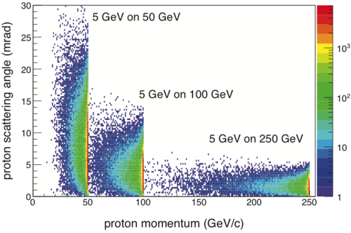
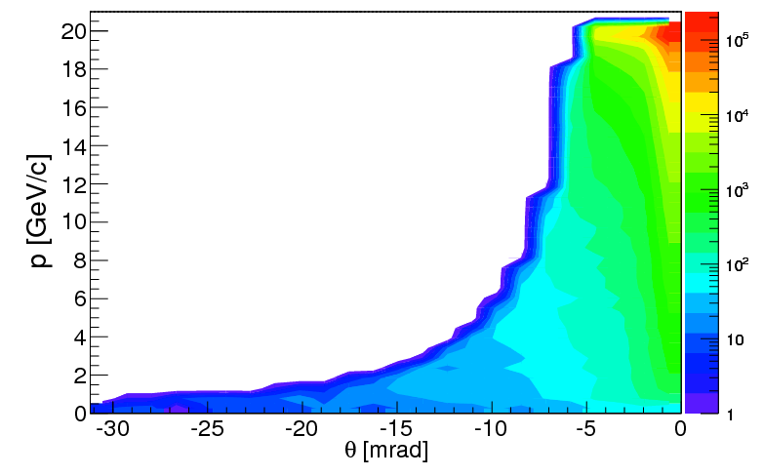
Auxiliary Detectors
In addition to the main detector, there are several auxiliary components being developed which are critical to the program
  Forward proton tagger (Roman Pots, small angle scattered protons)
  Low Q²-tagger (small angle scattered electrons)
  Luminosity monitor
  Electron beam polarimetry
p beam energy dependence from DVCS simulation
PYTHIA 20x250 GeV ep simulation Q² < 0.01 GeV²
detector acceptance: η>4.5
detector acceptance: η>4.5
(relative to electron going direction)

Slide 12
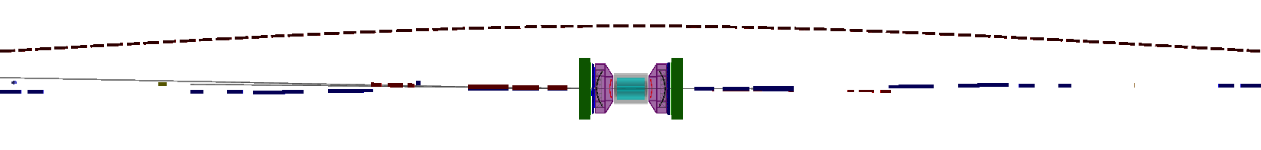
Auxiliary Detectors and the IR
hadrons electrons
-45 m
-35 m
-15 m
0 m
18 m
Ongoing R&D and optimization of the IR layout with the machine design group
Much attention given to allow acceptance of forward and backward going particles close to the beam
  Scattered protons and neutrons
  Scattered electrons
  Photons for luminosity measurement
Active R&D for machine induced backgrounds that may be present
  Synchrotron radiation from the electron beam
  Beam-gas interactions

Slide 13
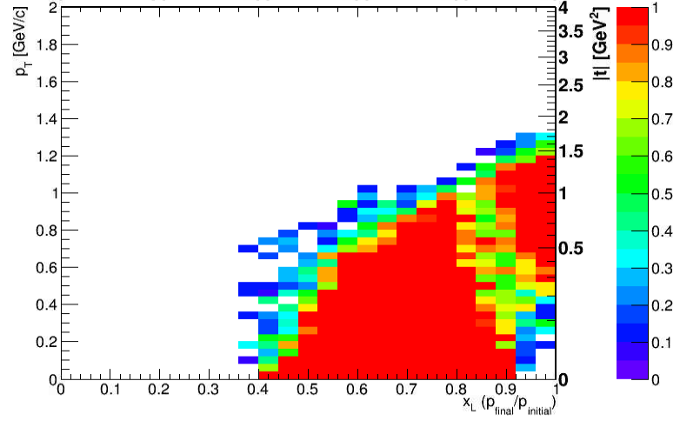
Auxiliary Detectors and the IR
hadrons electrons
generated flat in space
-45 m
-35 m
-15 m
0 m
18 m
Roman Pots
Sensors integrated into the vacuum system
Retractable to move into the beam after stable
Allows to move sensors as close to beam as possible
  Typically around 10sigma beam width
  Defined by beam optics (beta function) at the location of the roman pot
  Want small beta function with large dispersion to pull scattered protons out of the beam
Ongoing R&D with machine developers to give access
One station at ~20 m
MILOU 20x250 GeV DVCS sent into sim

Slide 14
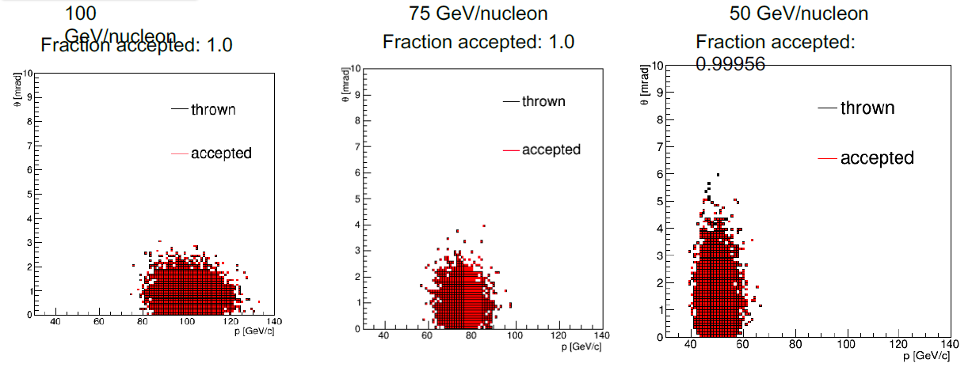
Auxiliary Detectors and the IR
hadrons electrons
-45 m
-35 m
-15 m
0 m
18 m
Expected distributions from DPMJet simulation of neutron evaporation
ZDC
Need acceptance for outgoing neutrons
  Centrality determination in e+Au collisions
  Tagging for diffractive events

Slide 15
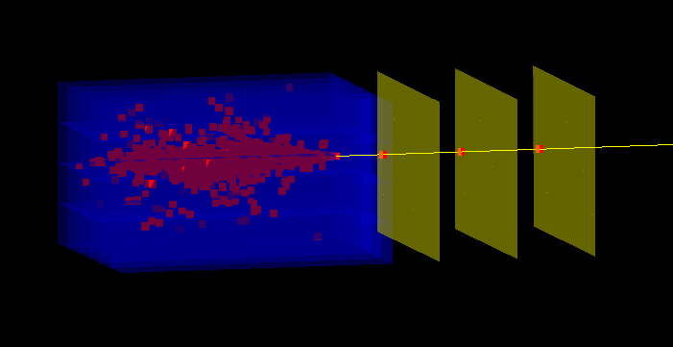
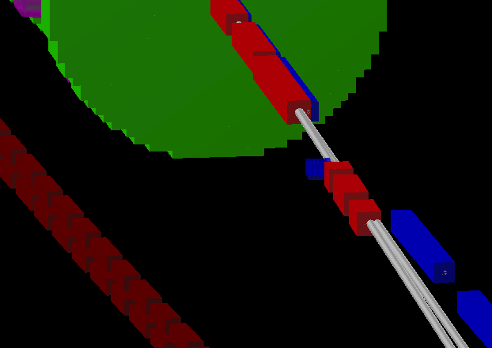
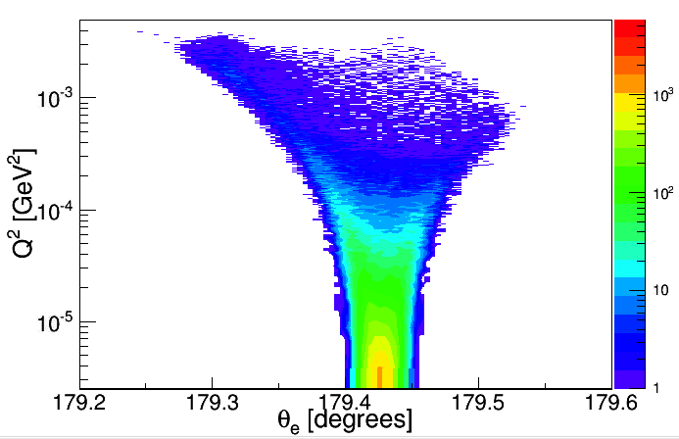
Auxiliary Detectors and the IR
hadrons electrons
-45 m
-35 m
-15 m
0 m
18 m
electron beam
Low Q²-Tagger
  Acceptance for electrons from events with Q²<0.01 GeV²
  Sits close to the beam line
pythia events
with electron reconstructed in the tagger
15

Slide 16
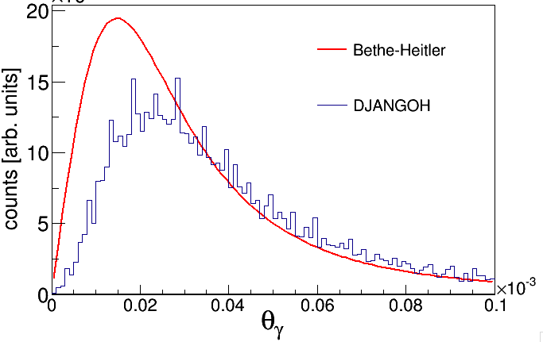
Auxiliary Detectors and the IR
hadrons electrons
-45 m
-35 m
-15 m
0 m
18 m
Luminosity Monitor
  Measure via Bethe-Heitler
    e+p -> e+p+gamma
  Emission cone dominated by beam optics

Slide 17
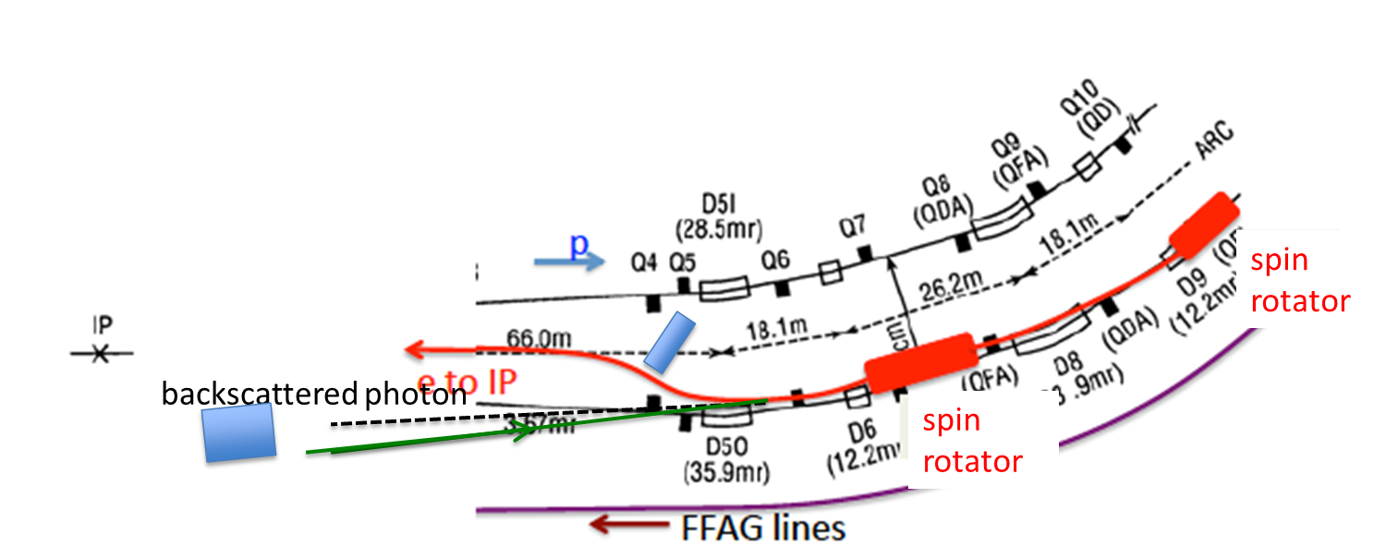
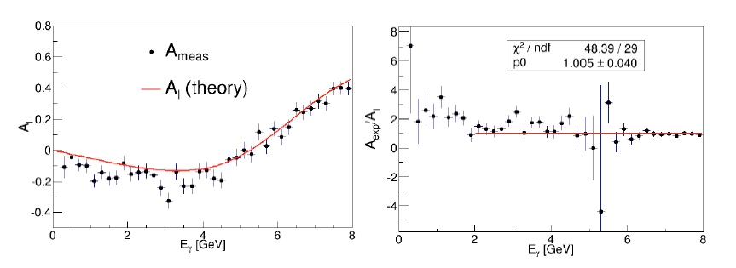
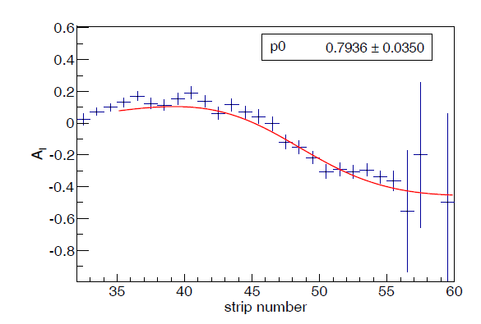
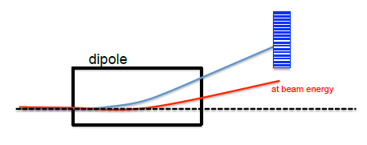
Auxiliary Detectors and the IR
measure via single photons
cartoon schematic
hadrons electrons
-45 m
-35 m
-15 m
0 m
18 m
Electron Polarimetry
  Measure via Compton Scattering
  Shine laser on electron beam, flip helicity state and measure asymmetry in cross section
  Focus here on measuring longitudinal component of spin, i.e. measure photon energy
  Working on extracting the full polarization vector angle and magnitude by a 2D fit in angle and energy of photon
measure via electrons

Slide 18
Summary
Construction of an EIC is deemed a top priority in major facility construction in the US by the NSAC
Major detector R&D programs underway for detector technologies and the planning of the detector to meet the physics goals of the facility
A new detector is being developed to carry out the next generation DIS measurements (BeAST)
The design of detector components, configuration, and technologies guided by physics requirements
  Main DIS detector
  Auxiliary support through down stream close to beam line detectors, luminosity monitors and polarimeters

Slide 19
Backups

Slide 20
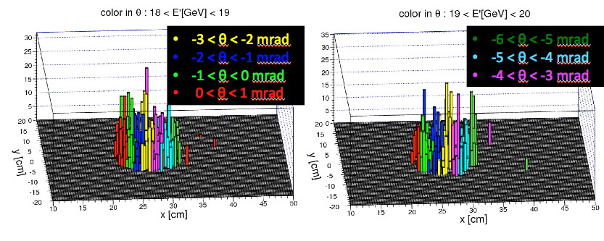
Physics with a low Q²-tagger
acceptance of electrons from events down to Q² ~ 10⁻⁵ GeV²
allows for further study of photoproduction physics
  represents large portion of total cross section
  probing the quark structure of photons
    direct vs resolved photon
  look for change in event properties associated with transition of real to virtual photon
pythia events
with electron reconstructed in the tagger
Notes:
----- Meeting Notes (8/27/15 10:34) -----
mention that 2D plot is accepted electrons → done!, put Q2 scale as log scale → done!

Slide 21
Auxiliary Detectors and the IR
hadrons electrons
-45 m
-35 m
-15 m
0 m
18 m

Slide 22
Scattered Lepton Kinematics
Cuts: Q²>1 GeV², 0.01<y<0.95, z>0.1
Q² > 1.0 GeV²: rapidity coverage -4 < η < 1 is sufficient
Q² < 0.1 GeV²: a dedicated low-Q² tagger is required anyway
Also notice: as lepton beam energy goes up scattered lepton is boosted to negative η

Slide 23
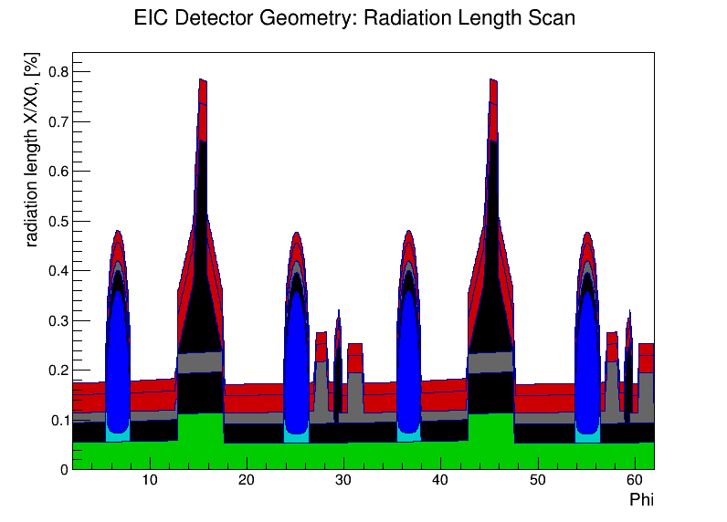
Silicon Vertex Tracker
ALICE ITS design
Two innermost layers
2x2 barrel layers with high resolution MAPS
assume discrete 20x20 μm² pixels and ~0.3% X₀ per layer
~180 mm
The prototype (ALICE ITS TDR page)
Radiation length scan (single layer)

Slide 24
Forward & backward Silicon Trackers
2x7 disks with 30 .. 180 mm radius
for now assume the same building blocks (complete staves) as in the vertex tracker
Final configuration can be a combination of ALICE ITS and MFT upgrades
~360 mm
Design of this subsystem will likely become a topic for a separate R&D effort soon

Slide 25
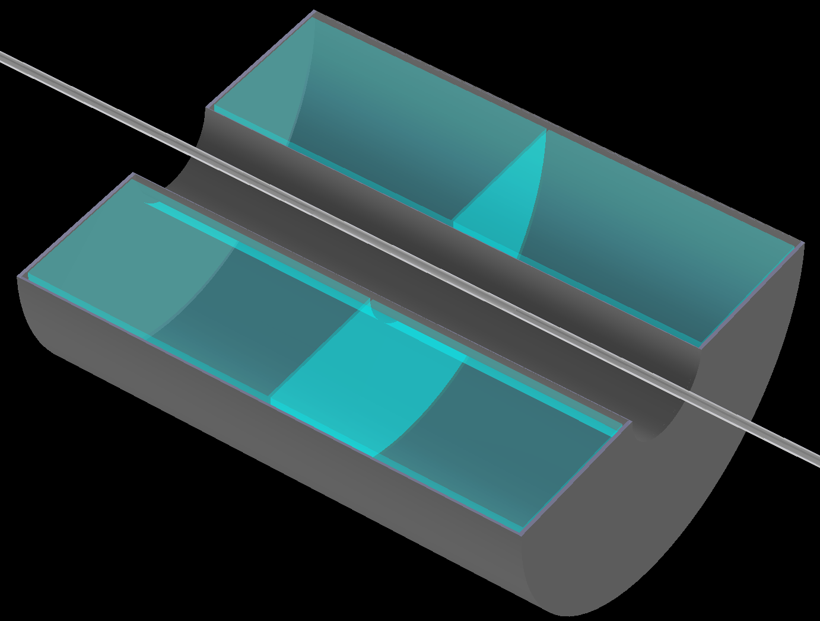
TPC
~2m long; gas volume radius [225..775] mm
1.2% X/X₀ IFC, 4.0% X/X₀ OFC; 15.0% X/X₀ end-caps
assume 5 mm long GEM pads and ~250 μm single point {rφ} resolution for the max. drift distance of ~1m
A gas mixture like T2K at ~250 V/cm (very small transverse dispersion in 3T field) will do the job
Ongoing EIC R&D project
~2.0 m
~1.6 m
A medium size and medium resolution TPC, having in mind current status of the ILD R&D work

Slide 26
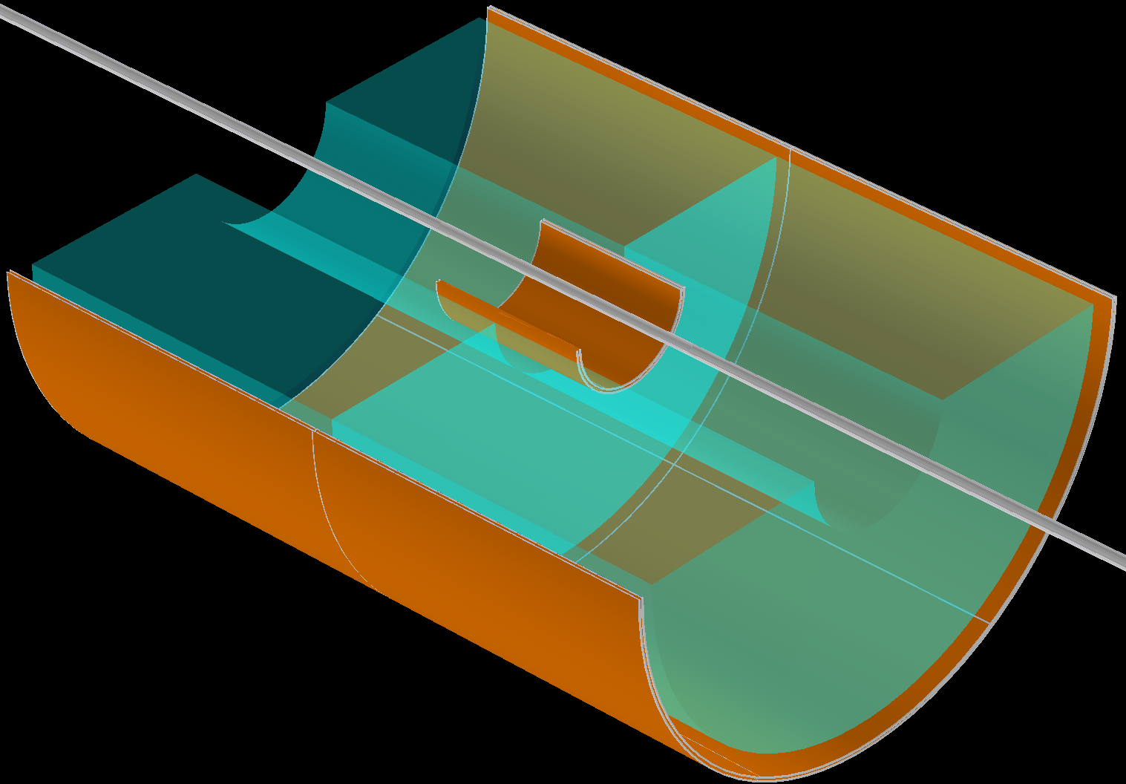
Micromegas barrel tracker
4 layers; technologically driven azimuthal and longitudinal segmentation
2D readout; assume ~100 μm spatial resolution
CLAS12 upgrade project
~2.0 m
Internal structure modeled according to the real-life prototypes
~0.5% X/X₀ per layer
Real life module (Saclay)

Slide 27
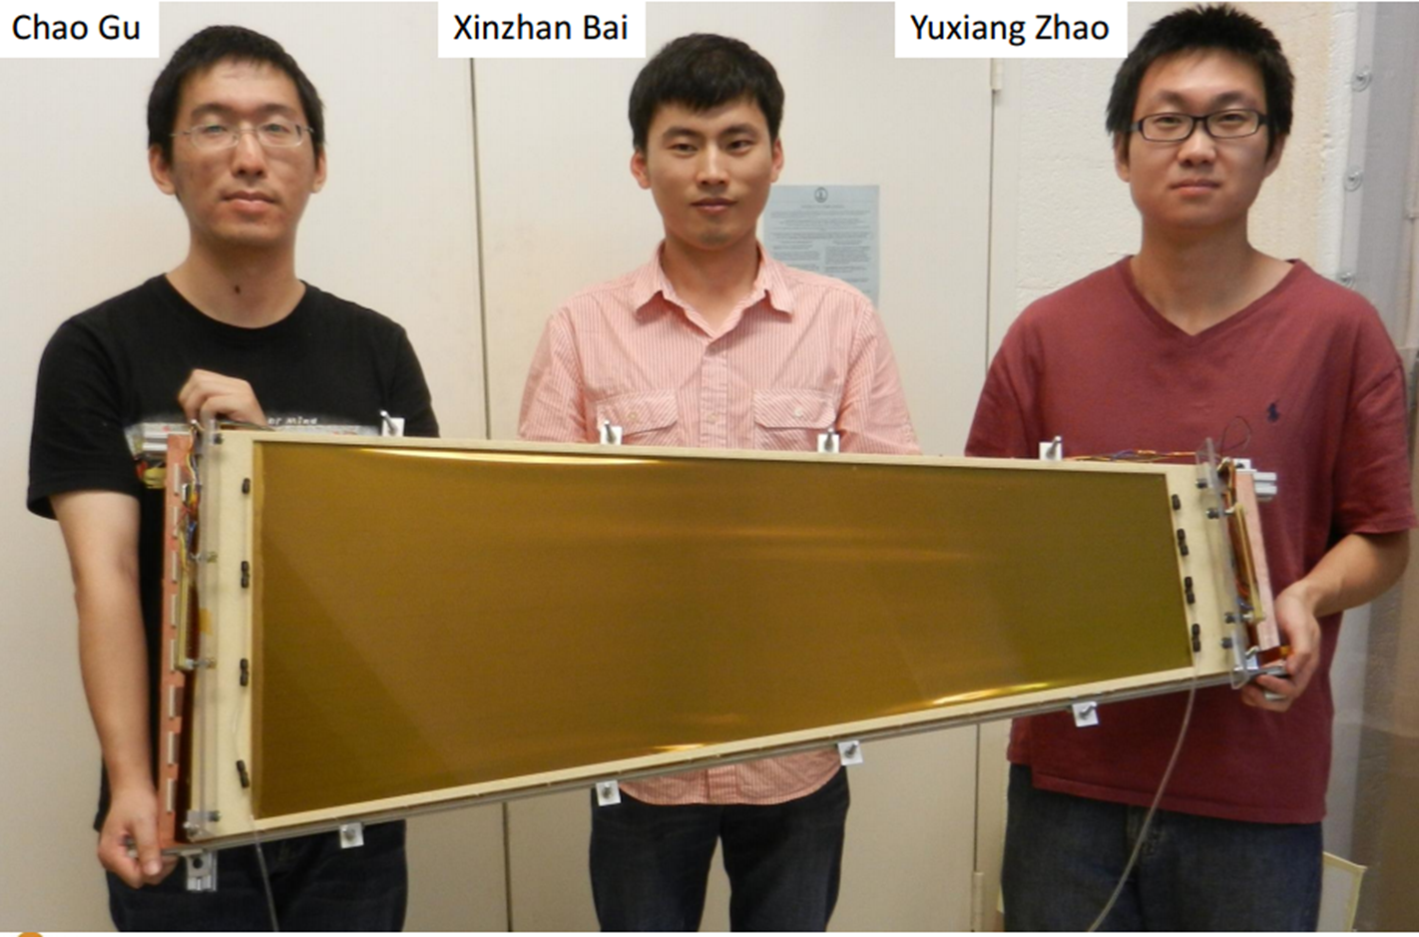
GEM endcap trackers
Ongoing EIC R&D project
3 disks behind the TPC end-caps; SBS internal design for now
assume 50 μm {rφ} spatial resolution can be achieved
~75 cm
Well advanced R&D program
A couple of groups have their own large area GEM designs

Slide 28
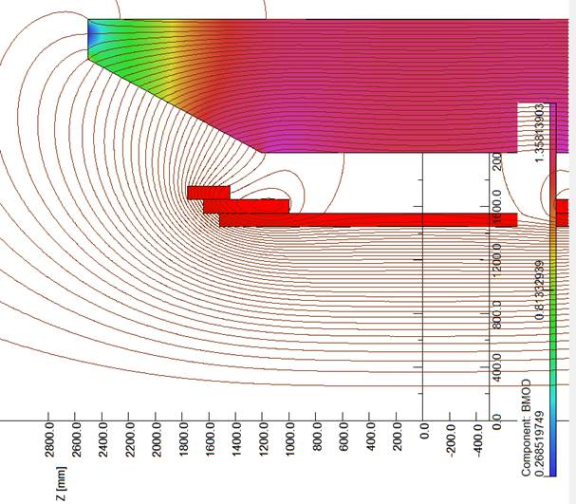
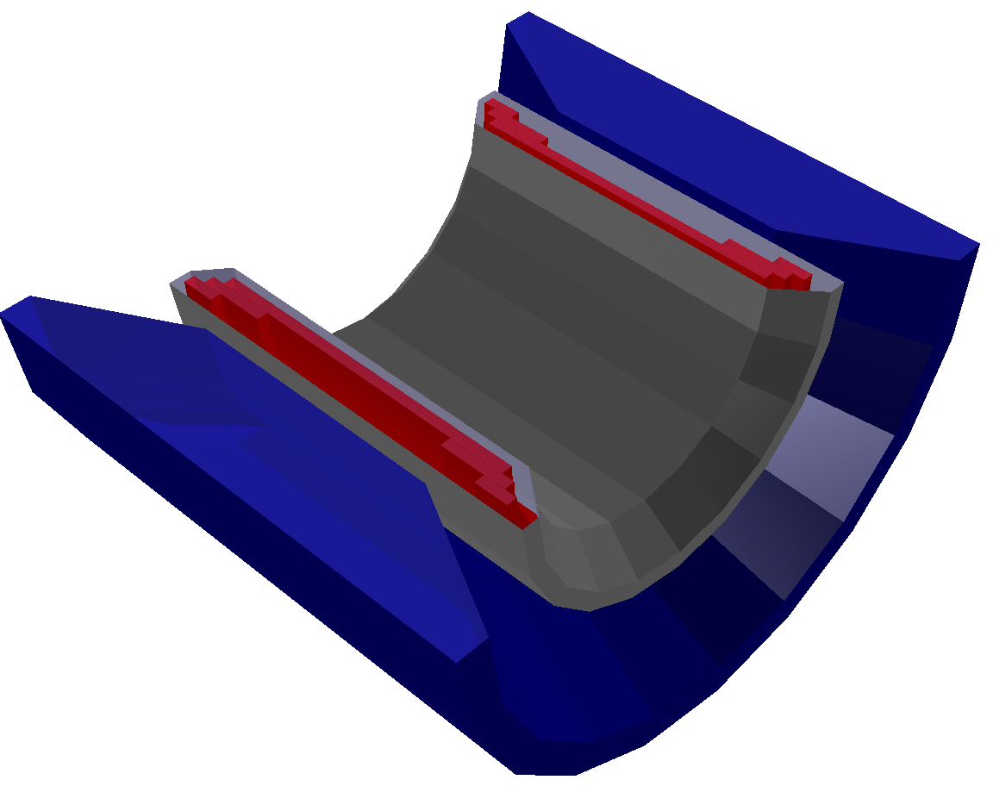
Superconducting solenoid
Goal:
Implement in the same compact design:
homogeneous ~3T field in the TPC
hadron-track-aligned field in the RICH
Keep it simple (no dual solenoid configuration; no reversed current coils; no flux return through HCal; no warm coils between RICH and EmCal)
η = 1.0
η = 1.5
RICH
location
TPC volume
η = 3.5
Field variation in TPC volume
Central field | 3T
Current density | 23 A/mm²
Full current | 4.6 kA
Main coil radius | 1500 mm
Coil pack length | 3520 mm
Cryostat inner radius | 1350 mm
+/- 4% or so

Slide 29
Electromagnetic calorimeters
Very backward pseudo-rapidities (η < -2):
PWO crystals with ~2%/√E (or better) energy resolution
Pseudo-rapidity range -2 < η < 3.5:
Tungsten powder scintillating fiber technology with ~7-10%/√E energy resolution
Ongoing EIC R&D projects
e⁻ and γ energy measurement;
e/p electron ID
H1 : (7..12)%/√E+1%
ZEUS : 18%/√E+1%
May’2016 test run in FNAL
Present status (May’2016 test run)
Several configurations tested since 2012
Reach energy resolution level of ~{7%/√E + 1%} with the PMTs
See clear path towards getting similar level of performance with a compact readout

Slide 30

Hadronic calorimeter(s) in the end-cap(s)
Electron identification in electron-going direction;
jet physics in hadron-going direction
EIC R&D project
MC: 12 GeV pions: Hcal vs EmCal
Slope ~1.20 perfectly
matches measured data
Lead absorber scintillating plate sandwich technology
~50%/√E energy resolution looks fine
Adequate Monte-Carlo model exists in GEANT
Cost optimization and further R&D may be required (use steel plates instead of lead?)

Slide 31
SIDIS: kinematic coverage for pions (and kaons, protons)
Increasing lepton beam energy boosts hadrons
more to negative rapidity
Increasing hadron beam energy influences max. hadron energy at fixed η
except for the highest η values (1.5 < η < 3.5 range)
π/K/p separation below ~5 GeV/c or so is sufficient

Slide 32
SIDIS: kinematic coverage for pions (and kaons, protons)
Cuts: Q²>1 GeV², 0.01<y<0.95, p>1GeV
(no difference between π±, K±, p±)
-3.5 < η < 3.5 covers entire kinematic region in p_{t} & z important for physics

Slide 33
DVCS photon kinematics
Cuts: Q²>1 GeV, 0.01<y<0.85
EmCal pseudo-rapidity coverage -4 < η < 1 is sufficient
Also notice: increasing hadron beam energy influences max. photon energy at fixed η – photons are boosted to negative rapidities (lepton direction)

Slide 34
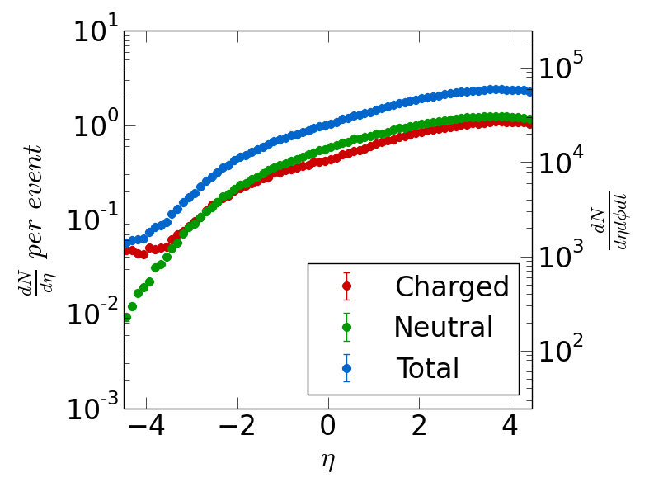
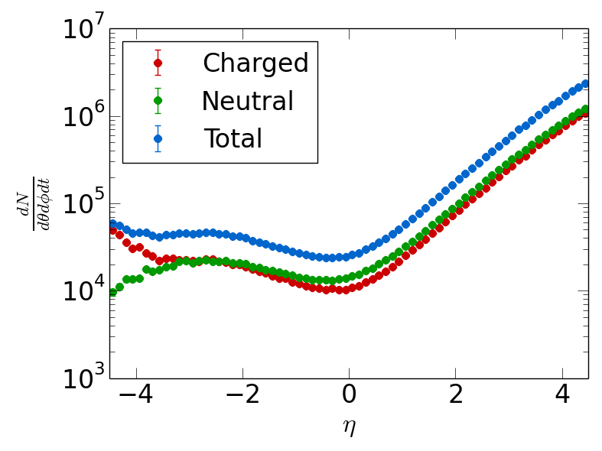
Interaction rate & absolute yields
PYTHIA 20x250 GeV configuration; absolute particle yields for L=10³³ cm⁻² s⁻¹
Per unit of {η,φ}
Per unit of {θ,φ}
Interaction rate ~50kHz (so 1:200 at ~10MHz bunch crossing frequency)
At most few particles per unit of η per event
Correspondingly low particle fluxes per unit of time
Not even close to LHC-HL upgrade (to say the least)

Slide 35
Electron ID
15x250 GeV configuration; particle yields versus momentum in the -4 < η < 4 range:
γ suppression:
the same η coverage for
tracking & Ecal
h⁻ suppression through E/p
-3.5<η<-1: 10:1 to 10³:1
−1<η <1: 10⁴:1
Pseudo-rapidity range [-1.0 .. -3.5] is also covered by the hadronic calorimeter

Slide 36
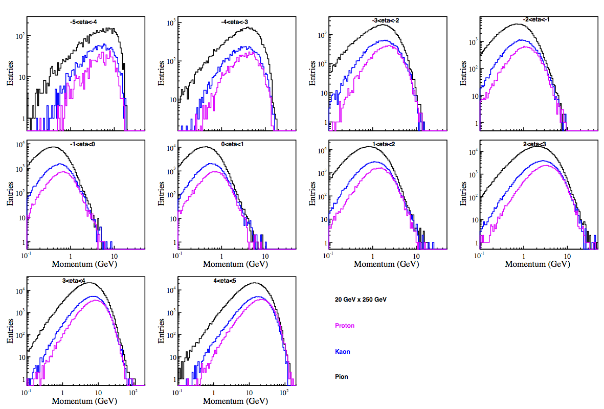
Relative pion/kaon/proton yields
20x250 GeV configuration; yields versus momentum in the 4 < η < 4 range:
π/K/p distributions at the same η look similar
π/K ratio is about 3:1 -> depending on the desired efficiency and contamination this defines the required suppression factors

Slide 37
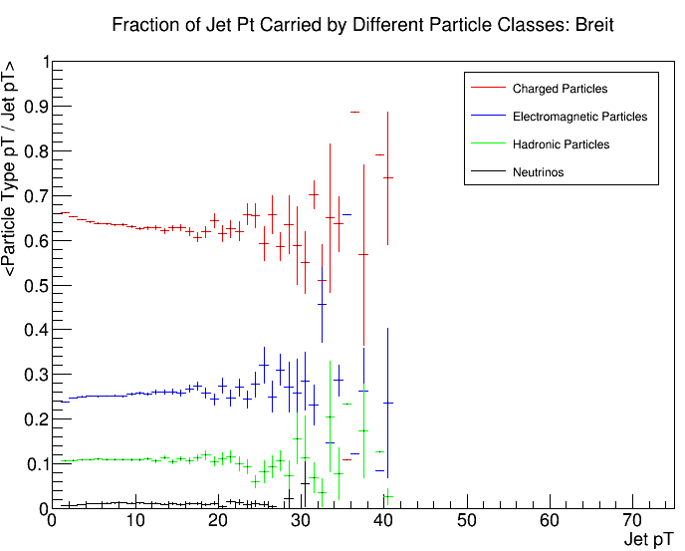
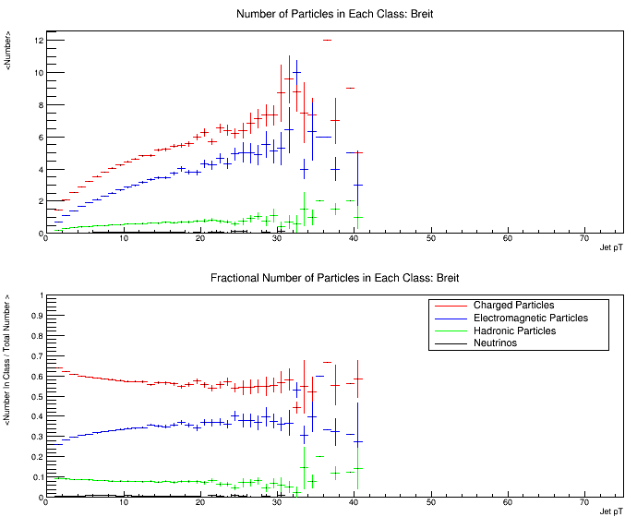
Jets at mid-rapidities
20x250 GeV; Q² [10 .. 100] GeV² ; -1 < η < 1
Fraction of jet P_{t} carried by different particles classes
EIC jets at |η|<1 are “jetlets”
Absolute number of particles in each class
Fractional number of particles in each class
Fraction of P_{t} carried by neutral hadrons is small
No way ~50%/√E hadronic calorimeter energy resolution at <40 GeV/c can beat tracker momentum resolution

Slide 38
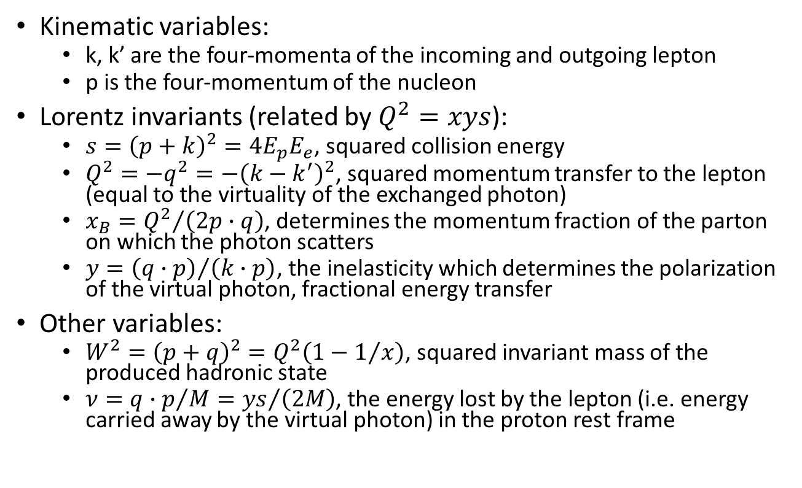
Kinematic variable definitions: reminder
Kinematic variables:
  k, k’ are the four-momenta of the incoming and outgoing lepton
  p is the four-momentum of the nucleon
Lorentz invariants (related by $Q^{2}=xys$):
  $s={\left(p+k\right)}^{2}=4E_{p}E_{e}$, squared collision energy
  $Q^{2}=−q^{2}=−{\left(k−k^{′}\right)}^{2}$, squared momentum transfer to the lepton (equal to the virtuality of the exchanged photon)
  $x_{B}={Q^{2}}/{\left(2p∙q\right)}$, determines the momentum fraction of the parton on which the photon scatters
  $y={\left(q∙p\right)}/{\left(k∙p\right)}$, the inelasticity which determines the polarization of the virtual photon, fractional energy transfer
Other variables:
  $W^{2}={\left(p+q\right)}^{2}=Q^{2}\left(1−1/x\right)$, squared invariant mass of the produced hadronic state
  $ν={q∙p}/M={ys}/{\left(2M\right)}$, the energy lost by the lepton (i.e. energy carried away by the virtual photon) in the proton rest frame

Slide 39
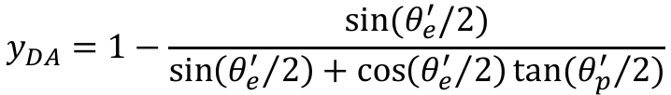
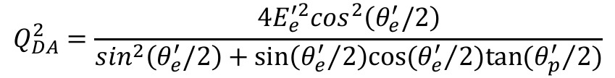
Kinematic Variable Reconstruction
Lepton method
  Use only the scattered lepton to determine event kinematics
  Resolution goes as:
Double angle method
  Use a combination of information from the scattered lepton and hadronic state
$$Q_{DA}^{2}=\frac{4E_{e}^{′2}\cos^{2}\left(θ_{e}^{′}/2\right)}{\sin^{2}\left(θ_{e}^{′}/2\right)+sin⁡\left({θ_{e}^{′}}/2\right)cos⁡({θ_{e}^{′}}/2)tan⁡({θ_{p}^{′}}/{2)}}$$
$$y_{DA}=1−\frac{sin⁡(θ_{e}^{′}/2)}{\sin\left({θ_{e}^{′}}/2\right)+\cos\left({θ_{e}^{′}}/2\right)tan⁡({θ_{p}^{′}}/2)}$$

