Slide 1
E1039 @ FNAL:
Measuring the and Sivers Asymmetry
Andi Klein
Los Alamos National Laboratory

Slide 2
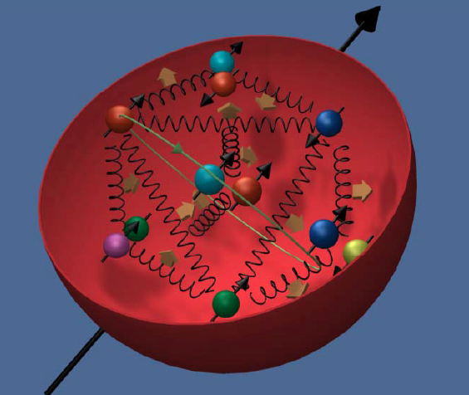
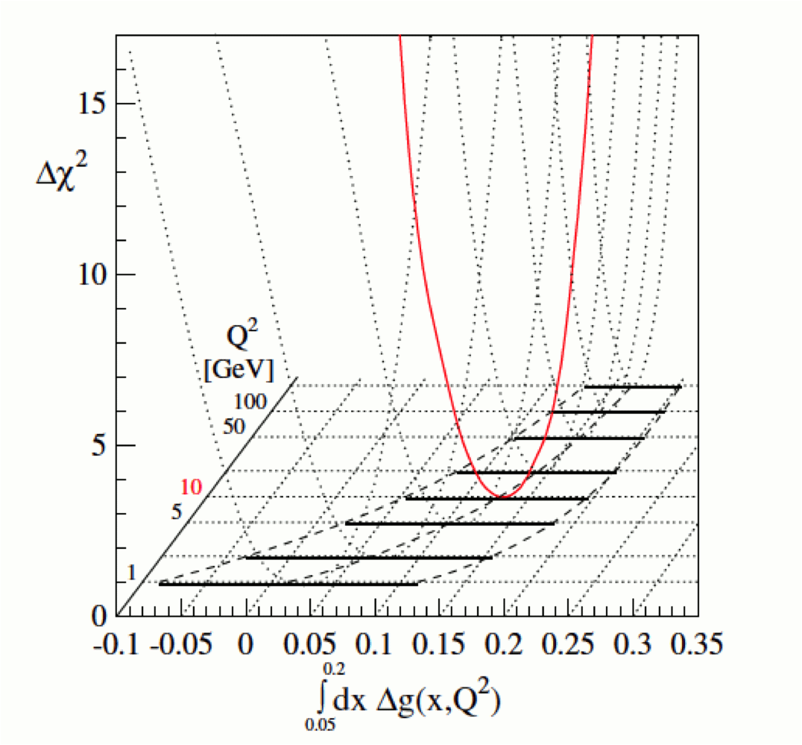

Where are we today
½ = ½ ΔΣ + ΔG +L_{q} + L_{g}
Quark contribution
Gluon contribution
Angular Momentum of q,g
RHIC
Quark Polarization from all flavors
Notes:
Today lots of experiment to determine the quark polarization, getting more info on the gluon
Looks like we are 50% short.
Not very satisfactory picture

Slide 3
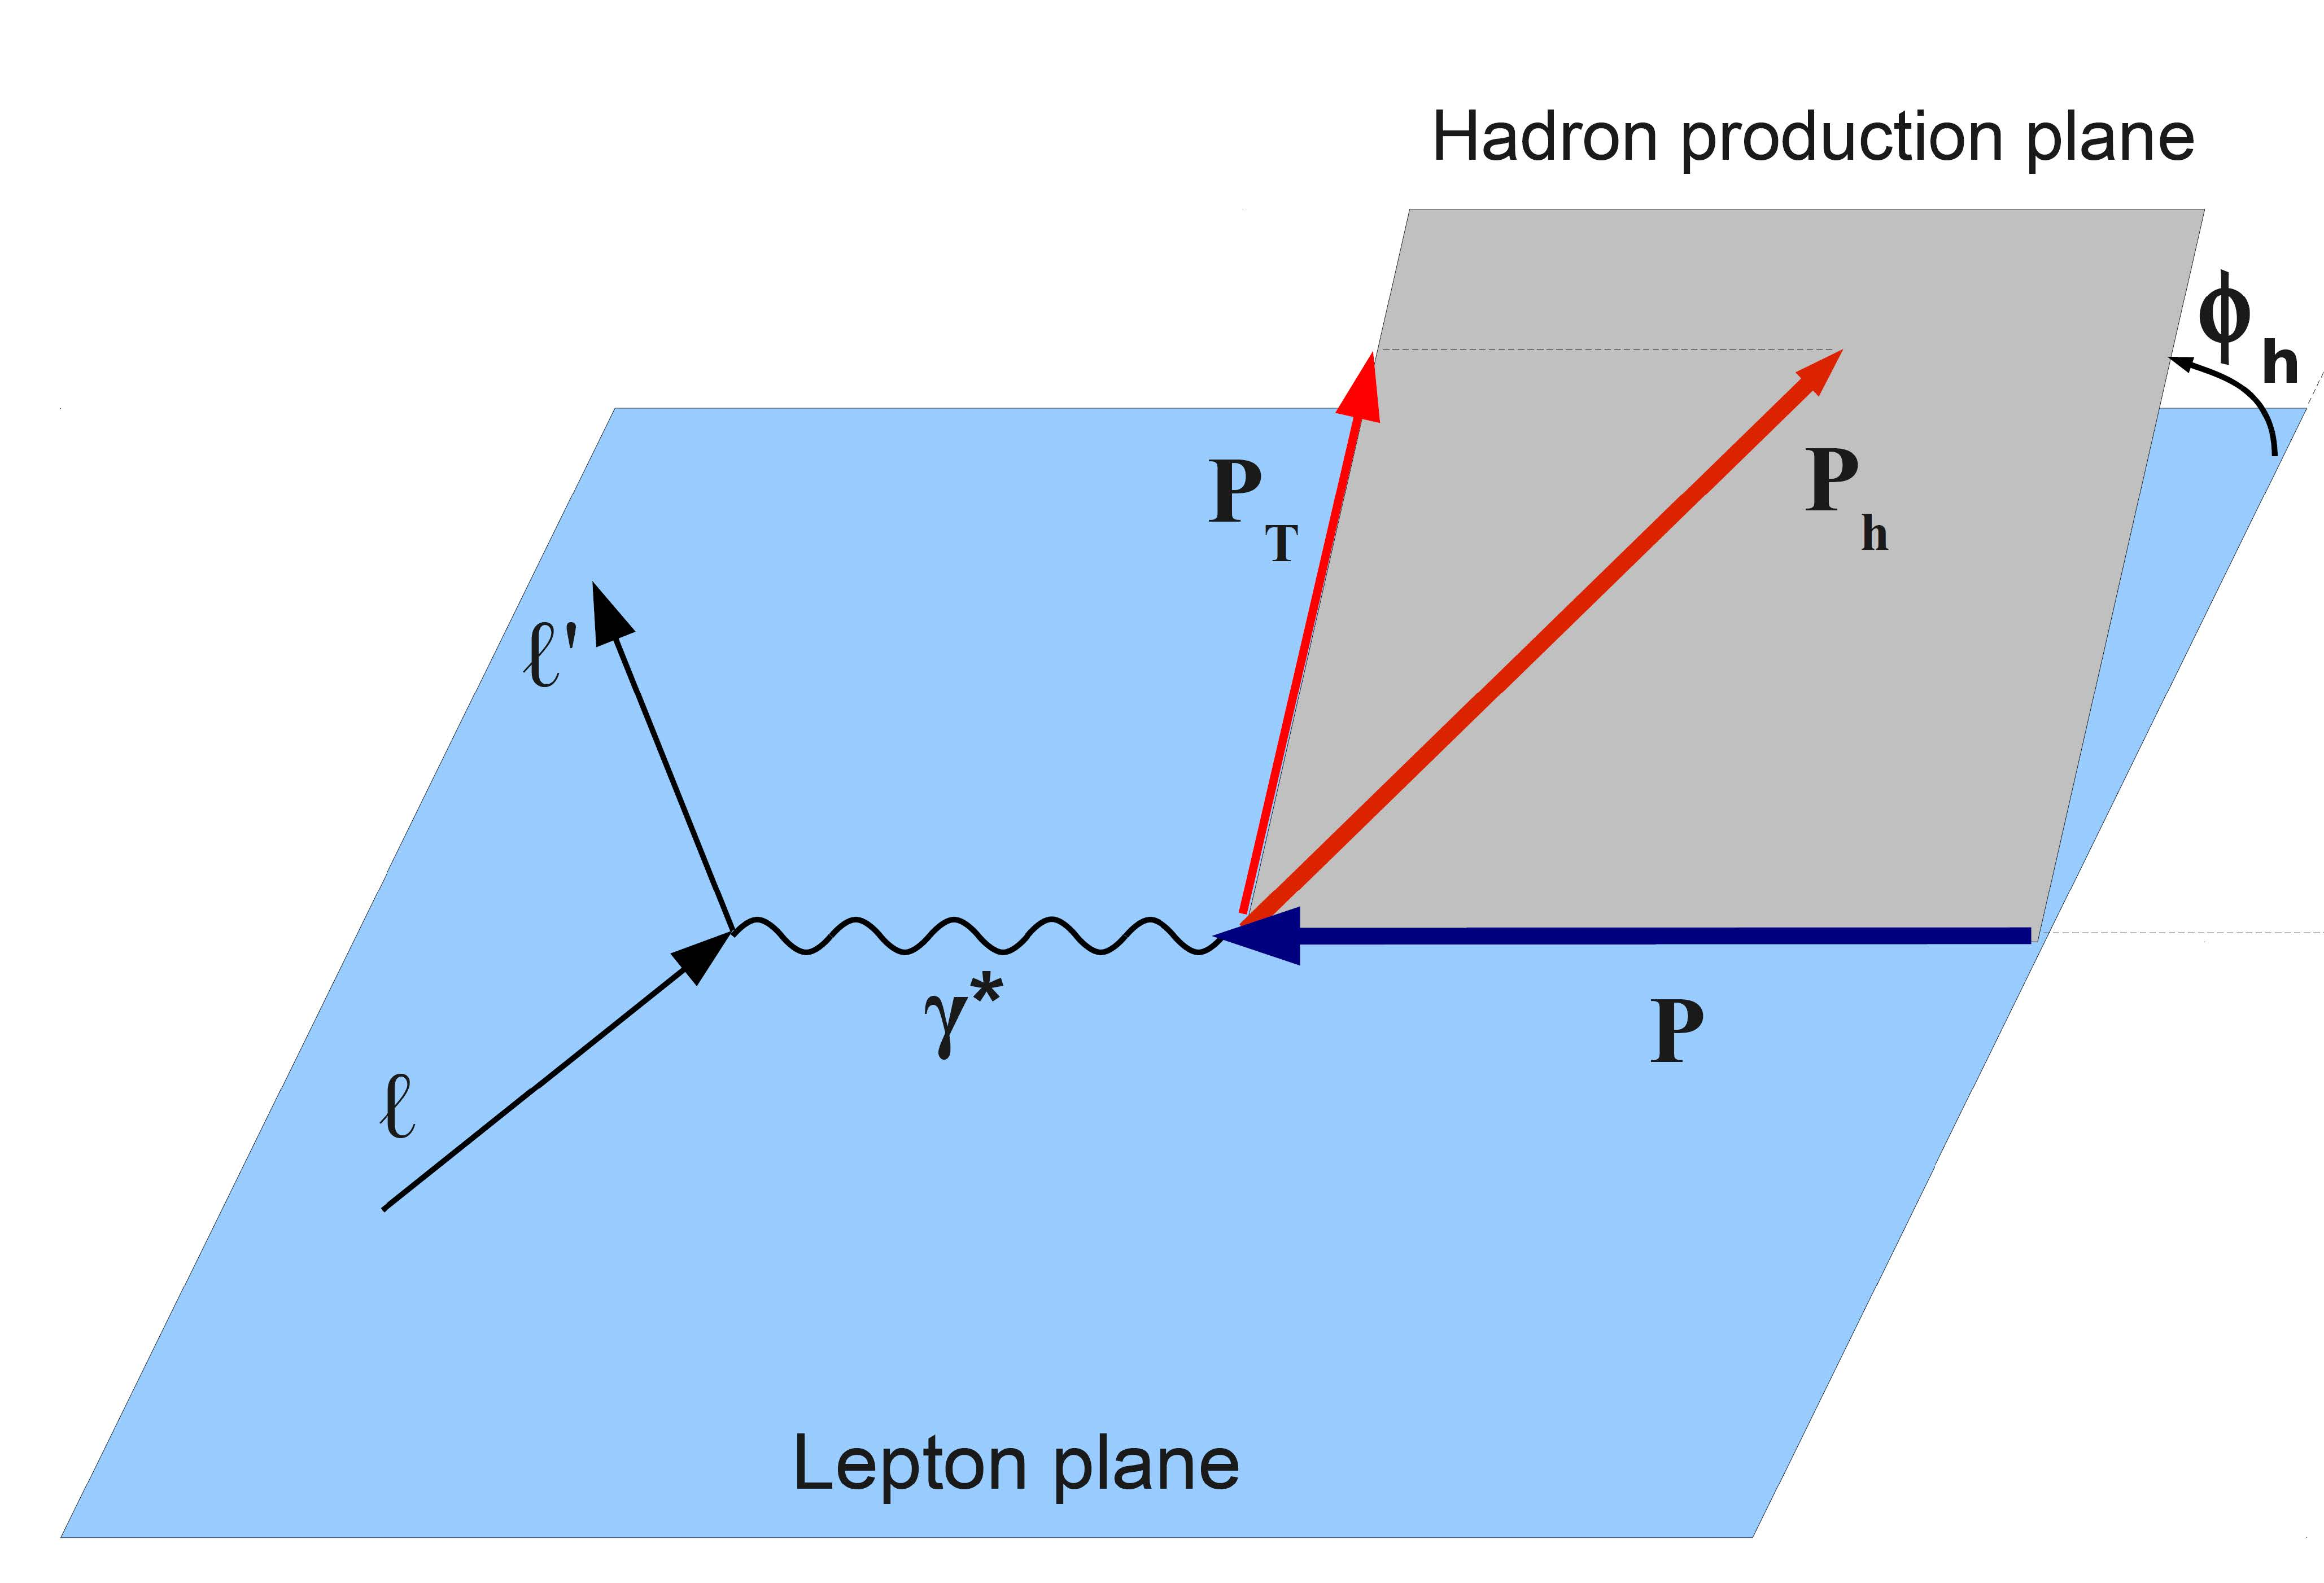
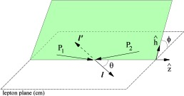

Path Forward
Leave one dimensional world of PDF and Helicity distributions which are collinear configurations.
  Heisenberg uncertainty =>
  SIDIS, DY not collinear
Drell-Yan
SIDIS
Simultaneous: longitudinal and transverse D.o.F of partons
Enter the world of Transverse Momentum Distributions

Slide 4


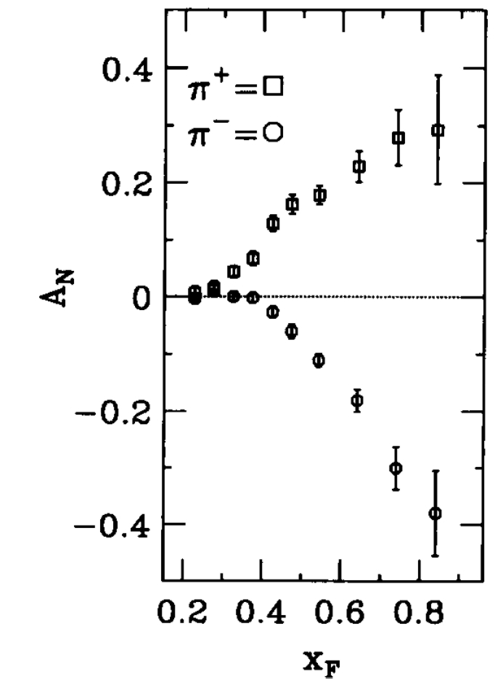
The Sivers Function
Distribution of unpolarized quarks in a transversely polarized nucleon
S: nucleon spin
p_{T:} Transverse momentum
Sivers function
Proposed to explain single spin asymmetries in hadron production
T-odd =>
also T-odd
Sivers effect: quark’s transverse motion generates a left-right bias.
up-quarks favor the left, down-quarks favor the right (L_{u} ≈ - L_{d})
E704 √s =20 GeV. PLB 264 (1991) 462.
Sivers function = 0 ⬅➔ L_{q}=0
Notes:
Measure analyzing power was An=Pol_beam*(p_beam x p_pion)whih is Odd under naïve Time reversal. To produce such an observable (T even) need interference of Teven amplitudes which have different helicity structures, one spin flip one non spin-flip, interference of Lz,Lz+1 states
Also, since Sivers relates to spin of nucleon, in order to build scalar, parity invariant quantity, S must couple to the only other avilable psedo vetcor, which is L (of g or q)

Slide 5
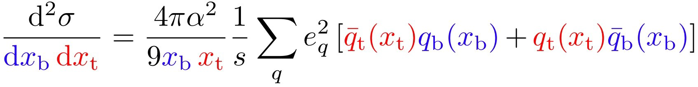
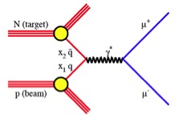
How to Access Sea Quark Sivers Distribution with Drell-Yan
target sea quark
beam valence quark
small
x_{F} = 0
E1039 Acceptance
Through kinematics choose quark from beam and antiquark from target
Does Drell-Yan yield depend on target’s spin direction?
if
Notes:
Accepted event distribution

Slide 6
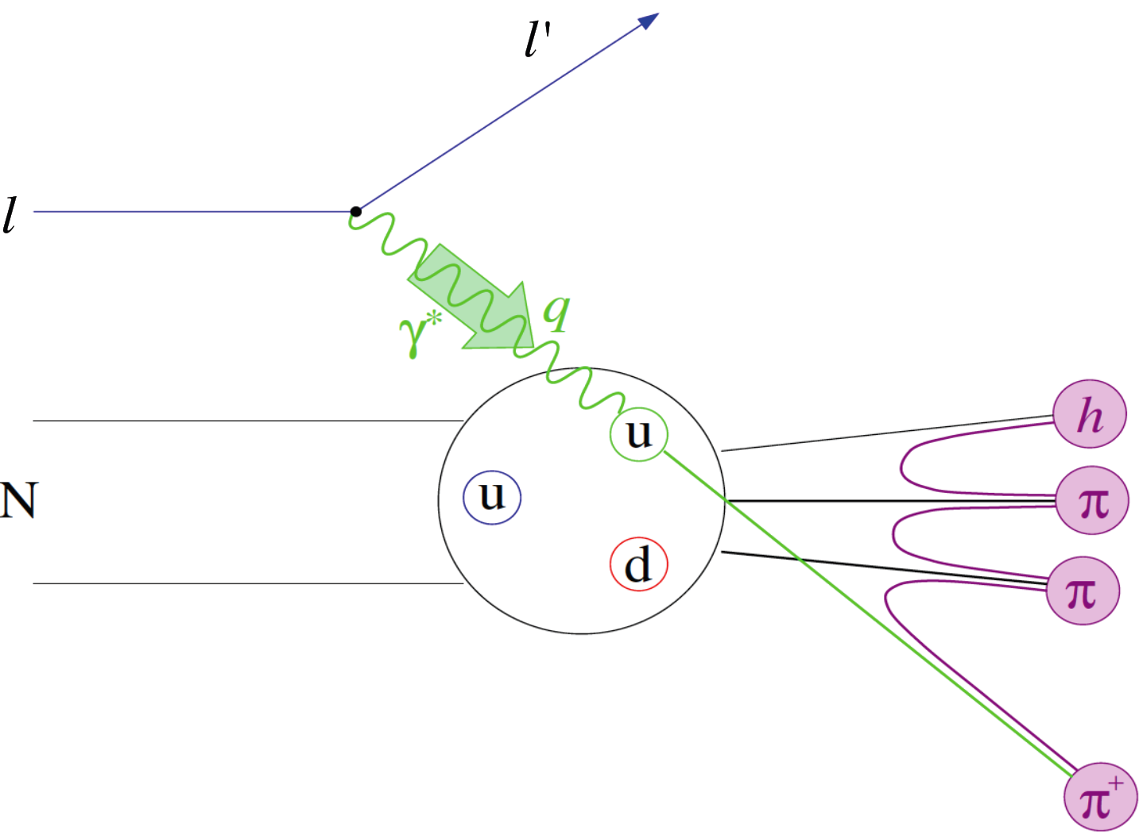
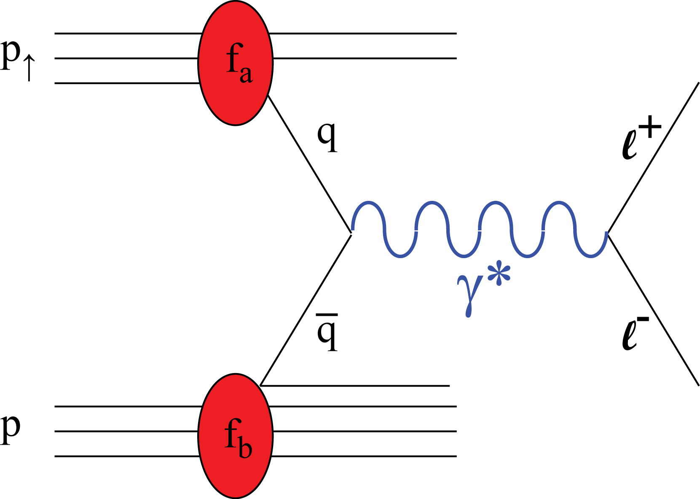
Asymmetry in Semi-Inclusive DIS
Asymmetry in Drell-Yan
Never
done
Involves quark to hadron frag. function.
Valence and sea quarks are mixed.
No quark frag. func. involved.
Valence and sea quarks can be isolated
  Pol. Beam➔valence quark (E-1027)
  Pol. Target➔sea quark (E-1039)
Result of repulsive initial state (DY) vs attractive final state (SIDIS) interaction

Slide 7
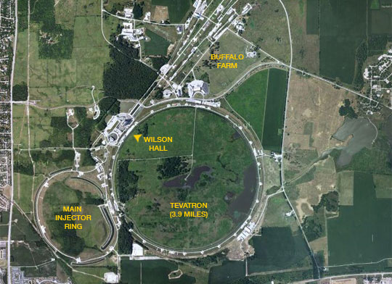
E1039
Polarized Drell-Yan with Seaquest
Measure Sivers asymmetry for :

Slide 8
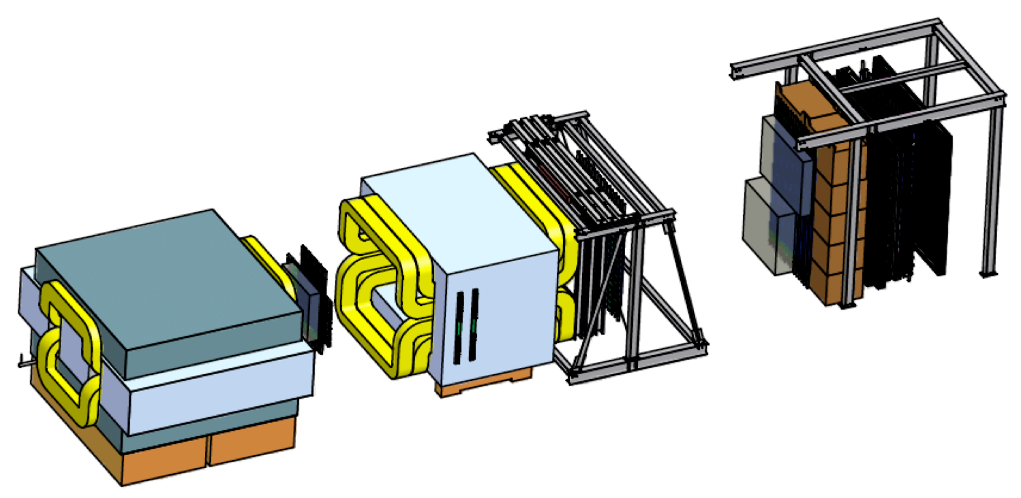
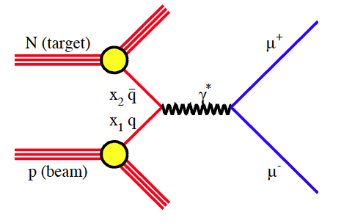
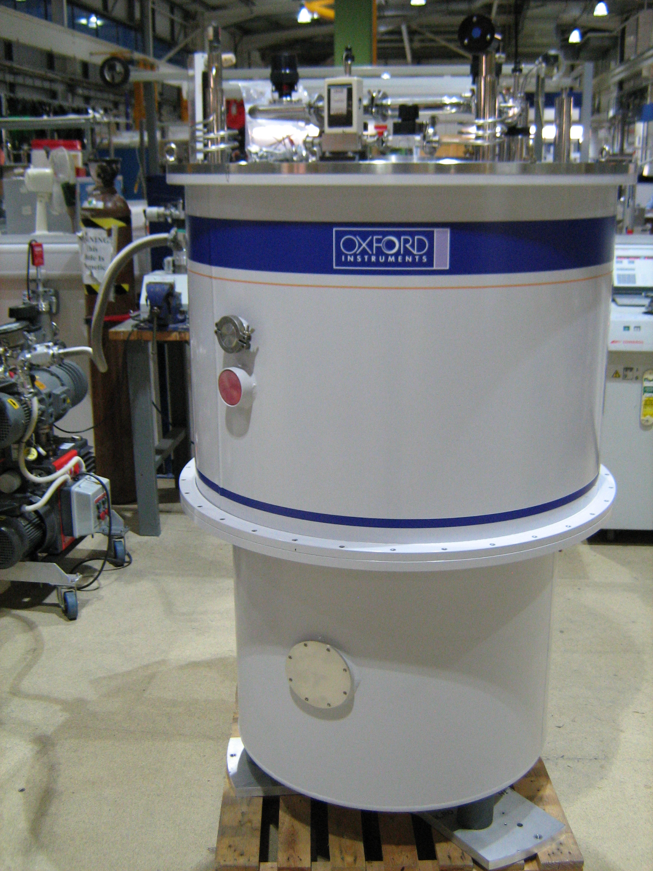
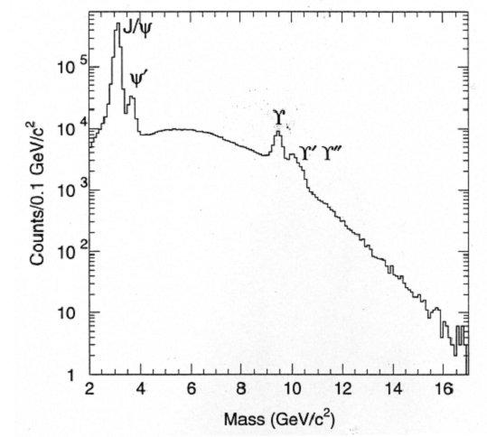
How do we measure the Asymmetry
ST4
ST3
ST2
x: Bendplane
ST1
KMAG
B-Field
FMAG
x
μ⁺
μ⁻
E906 Spectrometer
p beam 120 GeV
2.7*10¹² p/spill, one 4s spill/minute
Kinematic Range 4 < M <9 GeV
Luminosity: 3*10³⁵ /cm^2/sec (NH₃)
120 GeV protons
KTev beam line
√s = 15 GeV
E866
L = 1.82 *10⁴²/cm² NH₃ , 2.11 *10⁴²/cm² ND₃ for 2 years

Slide 9
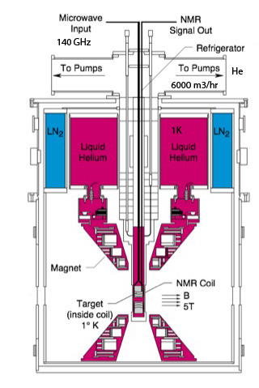
Polarization in a Nut Shell
Polarization P for paramagnetic materials:
Thermal Equilibrium TE: T=1K, H=5T
P_{e} = .998
P_{p} =.005 since μ_{N} / μ_{B} ~ 10⁻³
NMR
TE
Polarization Measurement P~92 %
NMR
NMR
ν_{e =} 140GHz
protons
B
Keith et al. NIM A 501 (2003), 327 JLAB
Well established technology: SLAC, JLAB, PSI …
electrons
ν_{e}+ν_{p}
ν_{e}-ν_{p}
Hydrogen
micro wave
Notes:
Create paramagnetic centers through irradiation since NH₃ is not paramagnetic
Use dipole-dipole interaction=> Hyperfine Splitting
Pump on electrons with 140 GHz
τ_{e} << τ_{p} => Large Polarization (τ Relaxation times)

Slide 10
To summarize:
Low Temperature : 1K
High Magnetic Field : 5T
RF transitions: 140 GHz
Paramagnetic Material: Irradiation of NH₃ and ND₃
How do we get there?

Slide 11
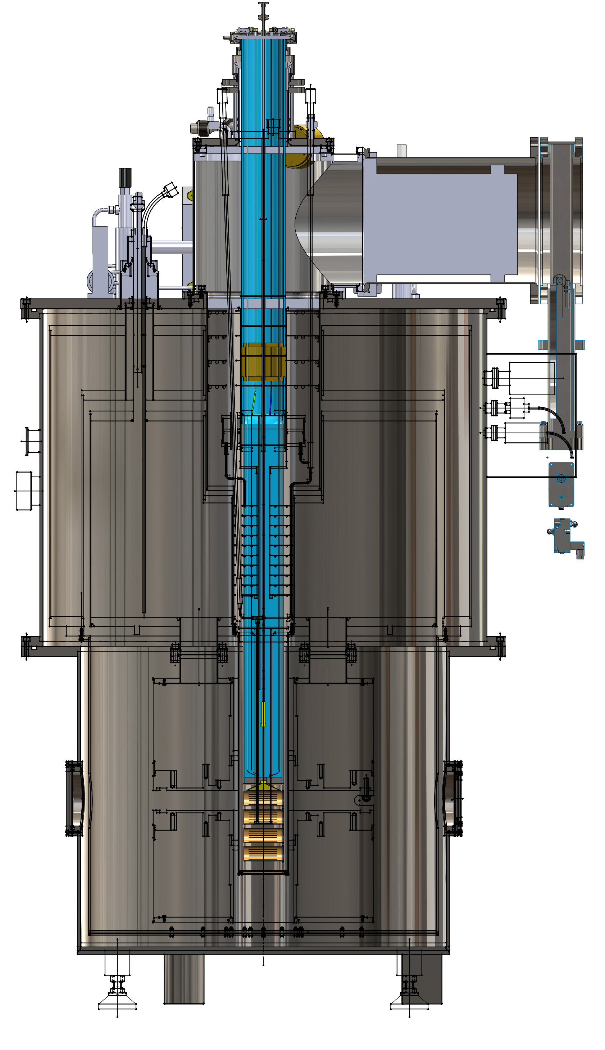
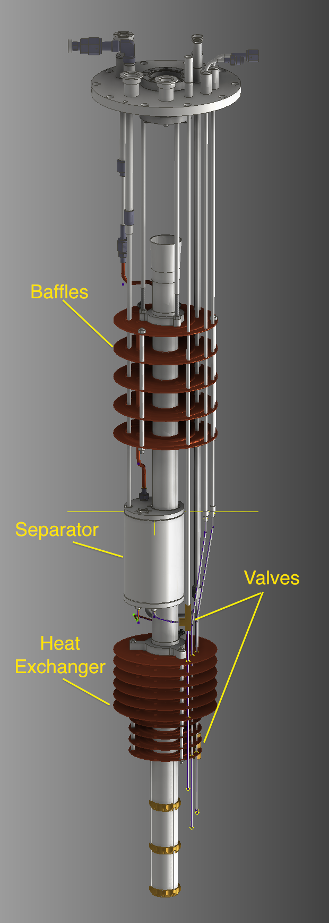
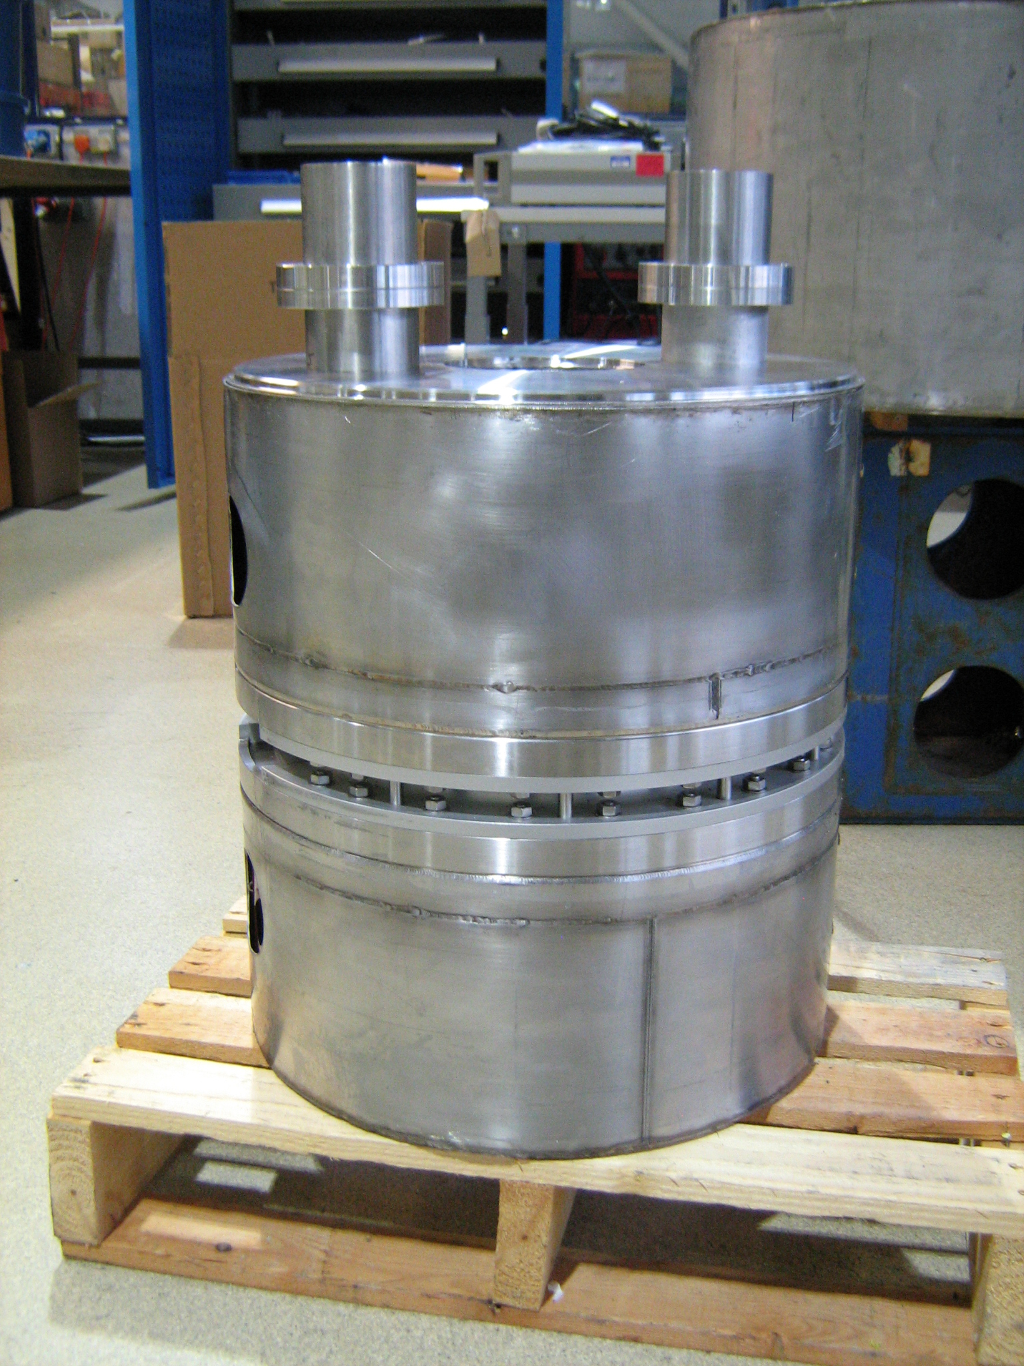
The Polarized Target System
Microwave: Induces electron spin flips
Measure polarization NMR)
Roots pump system used to pump on ⁴He vapor to reach 1K
Refrigerator:
Superconducting Coils for Magnet: 5T
Coils
Target material: frozen NH₃
Irradiation @ NIST

Slide 12
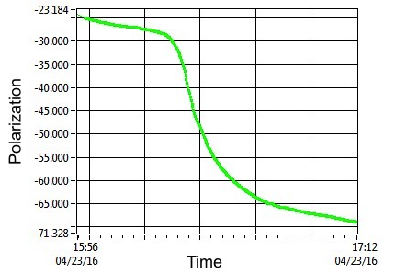
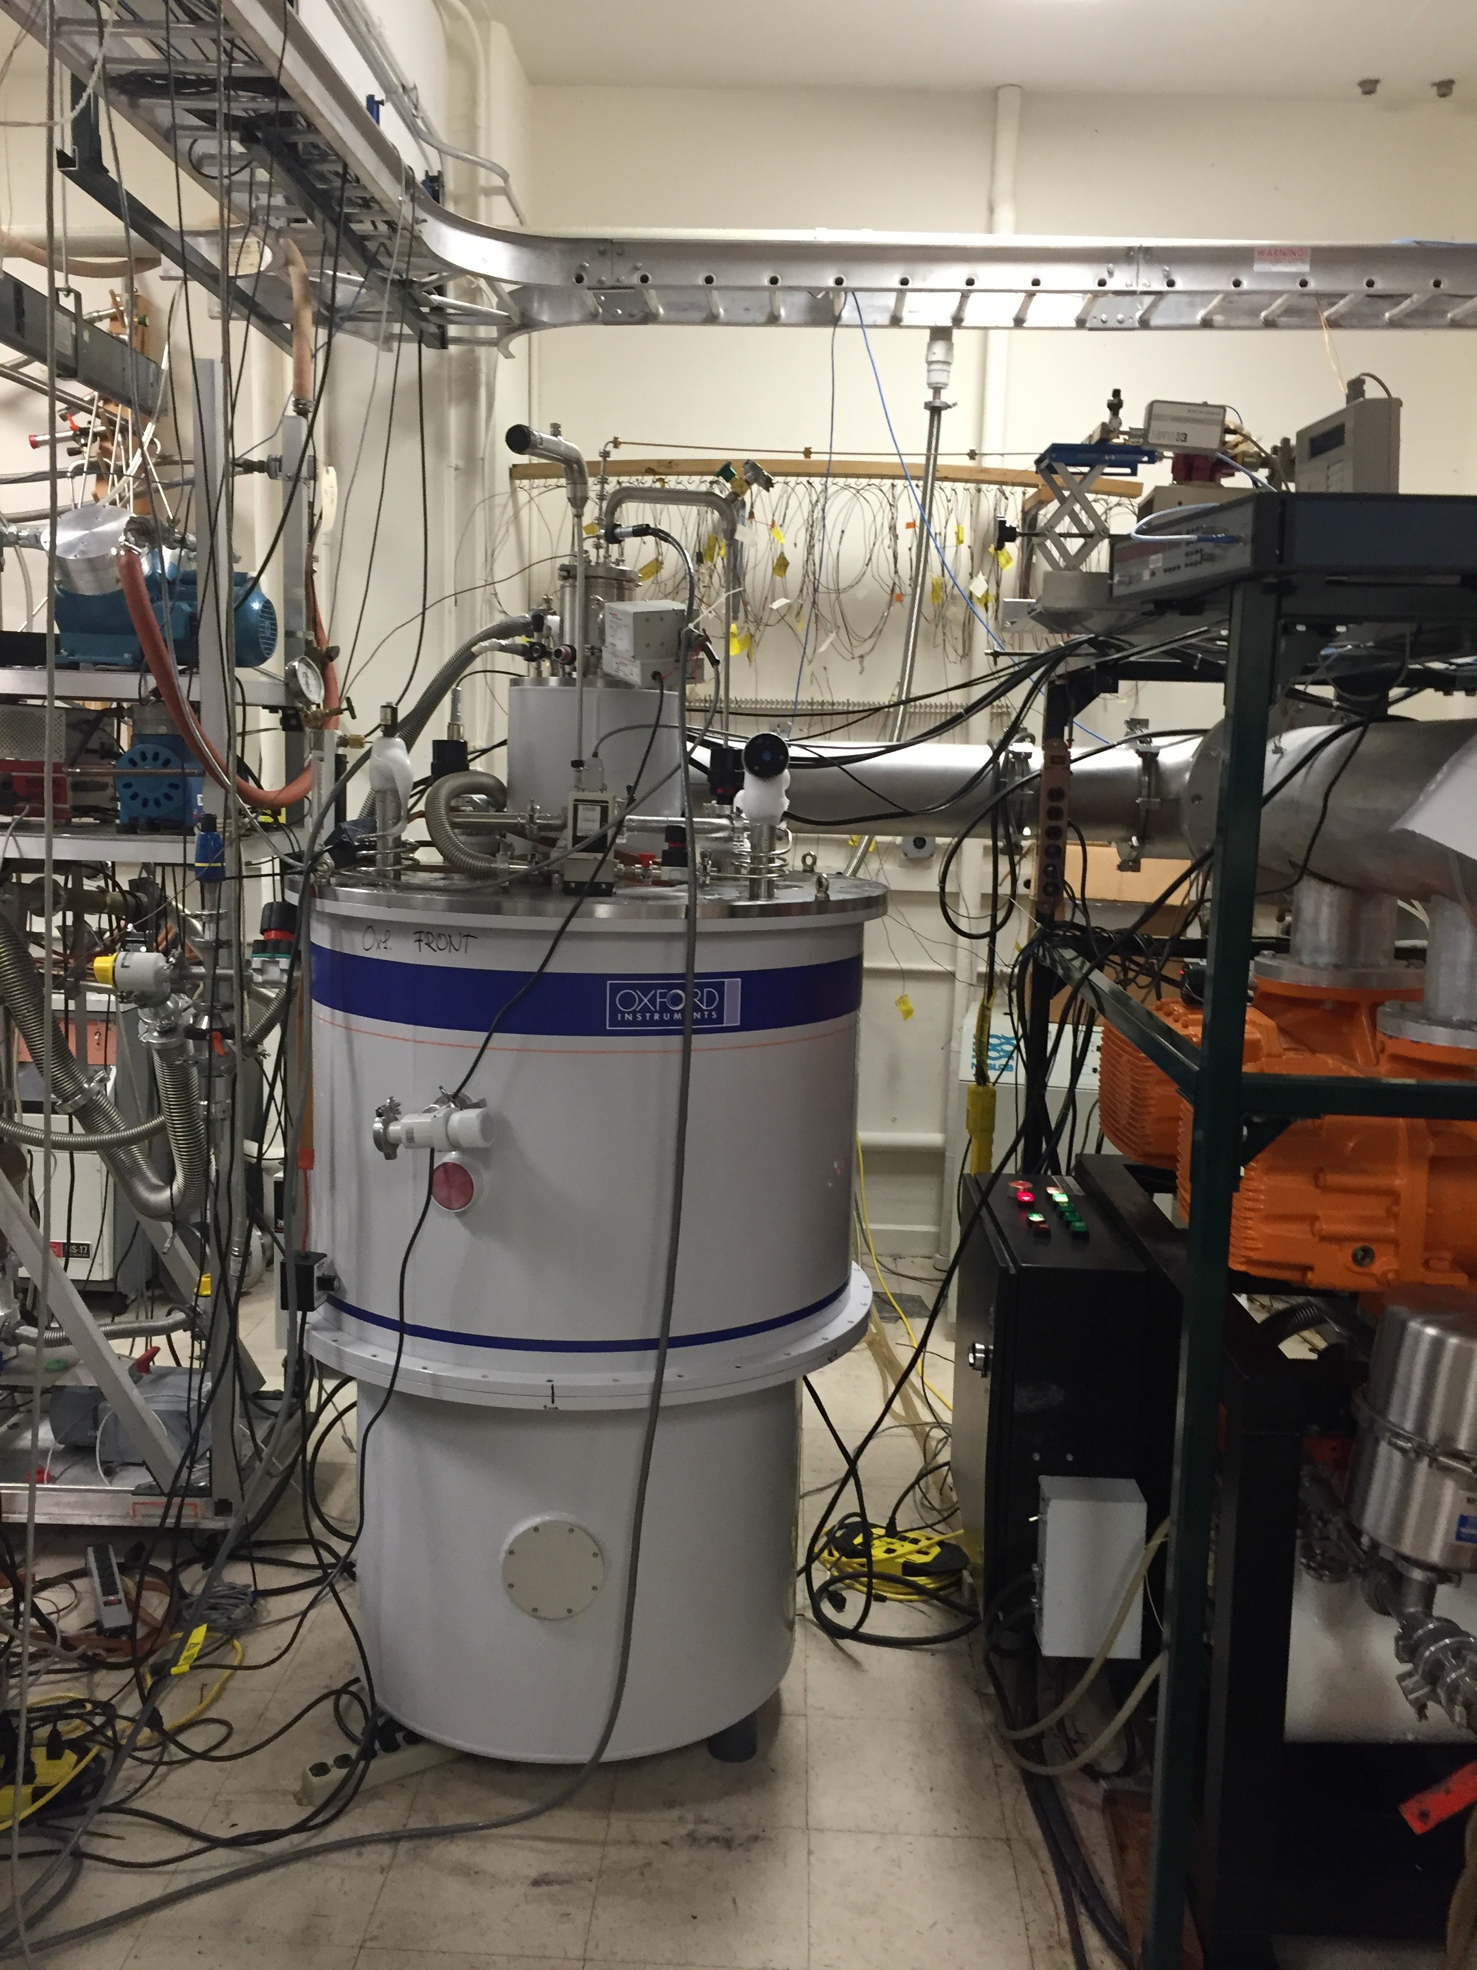
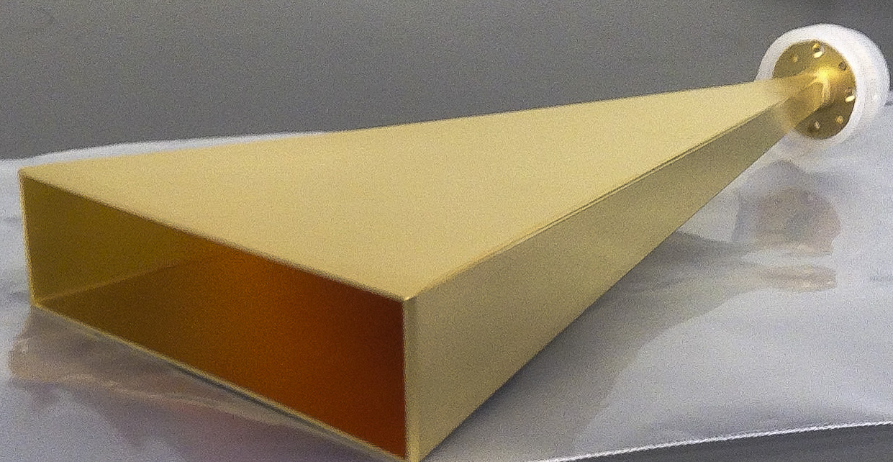
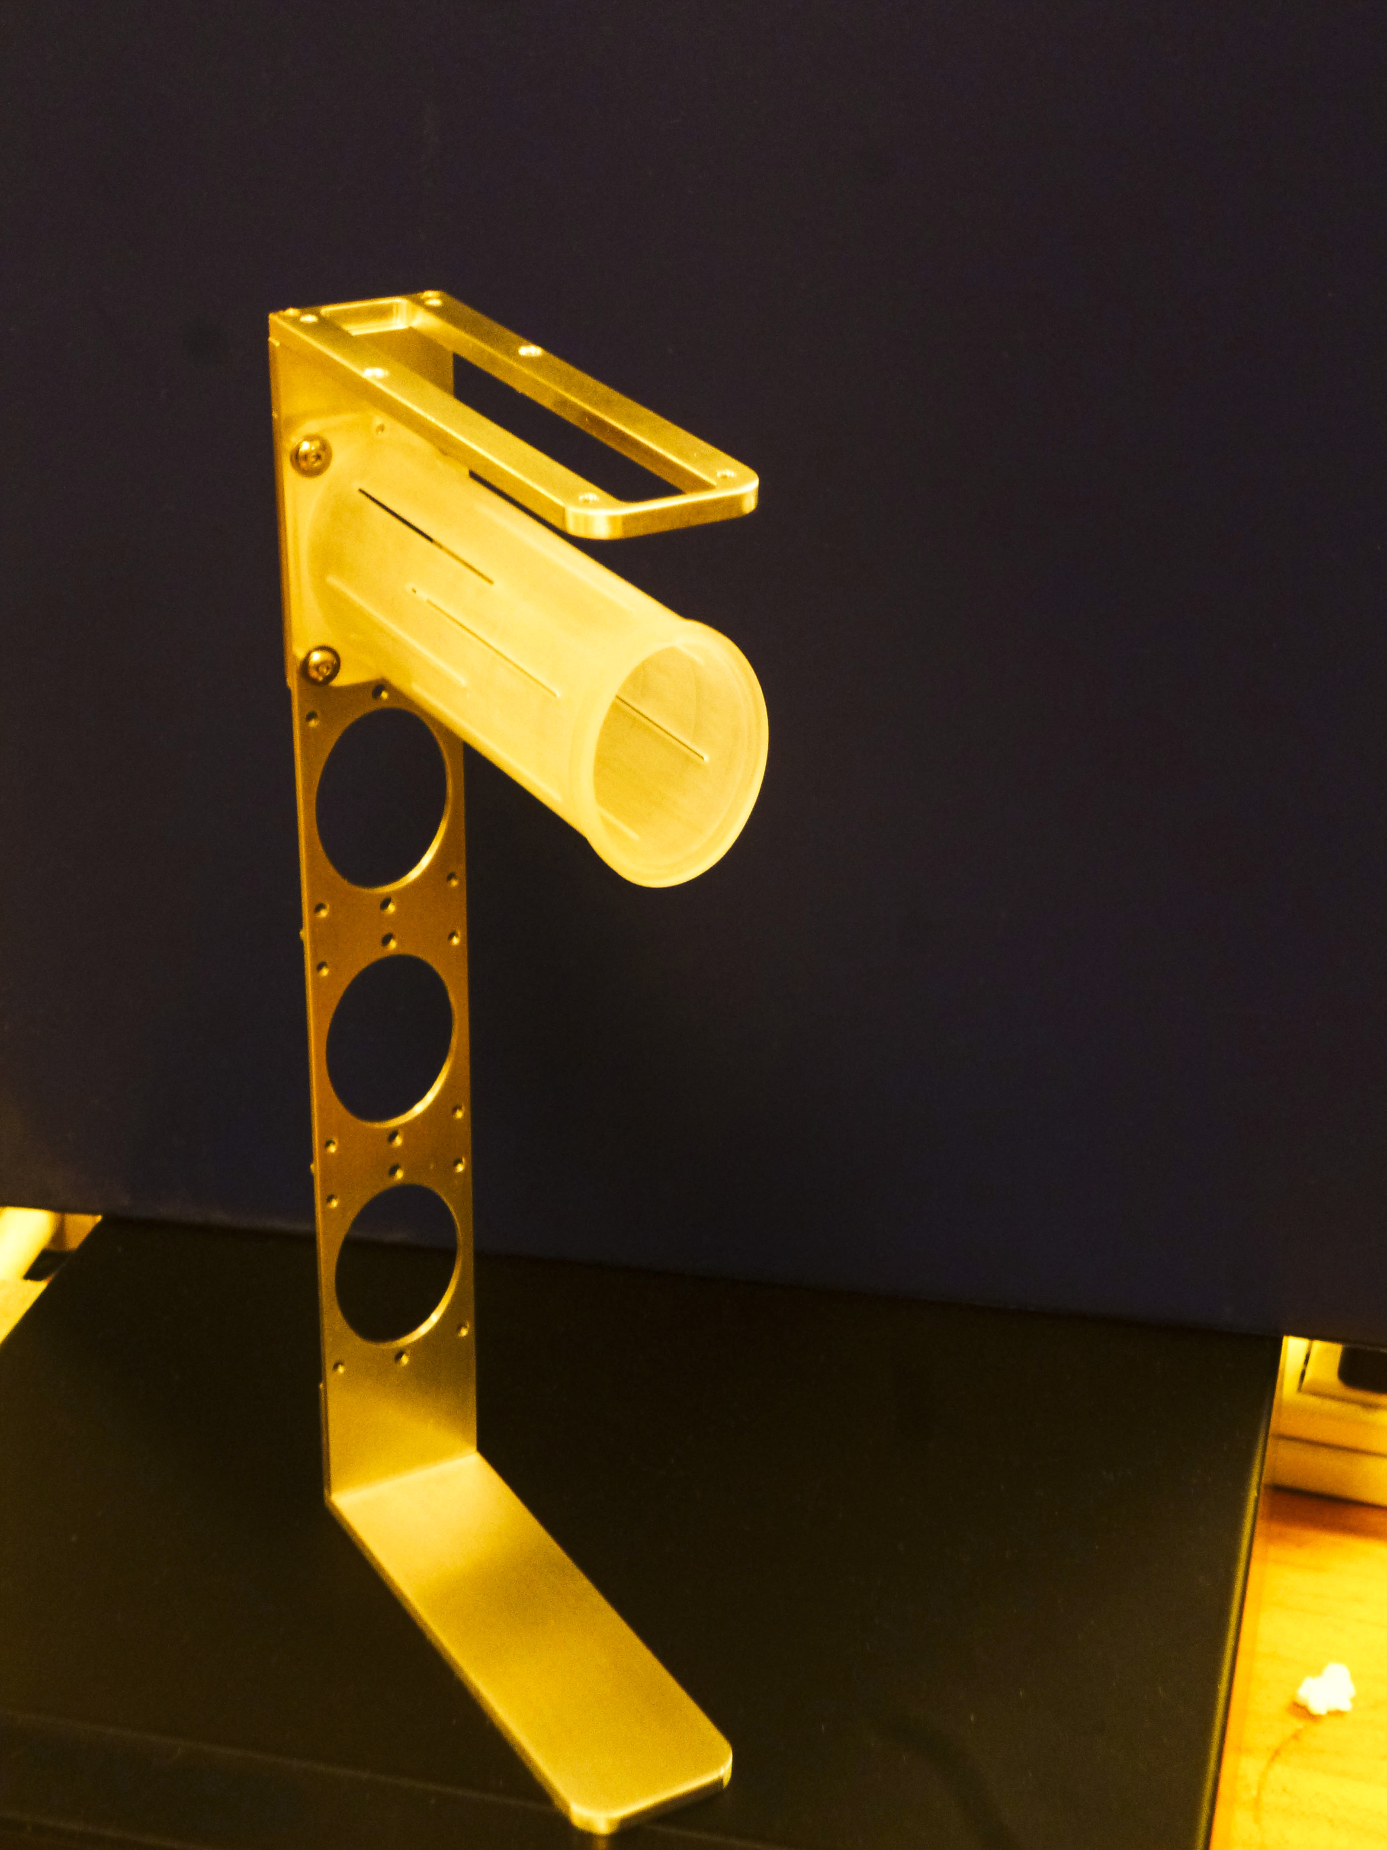
The E1039 Target
Field: 5T @ 1K
Elliptical: 1.9 cm x 2.1 cm (x,y), l:7.9cm (z)
ρ= .87 g/cm³ NH_{3 ,} 1 g/cm³ ND₃
Packing Fraction = .6
Dilution Factor ~ .176 , .3
Polarization <80%>, <32%>
IL: 8.6% , 9.5%
3 active cells, 1 empty
Helium consumption 100 l/day

Slide 13
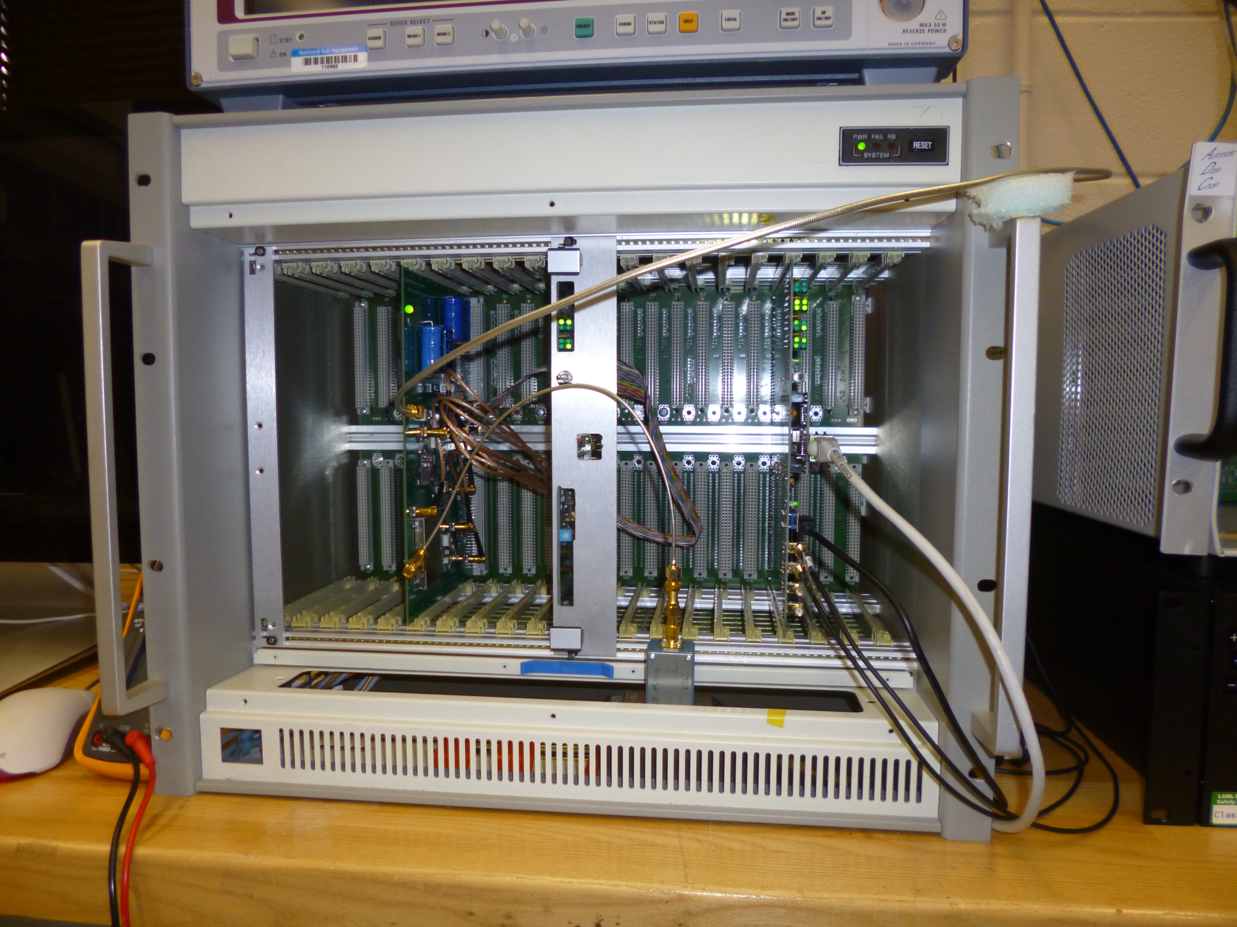
Developed new NMR system
TE
Pol: ~70%
VME based system
9 coils; 3 per cell
Fully digital
Liverpool Q-meter ~1993

Slide 14
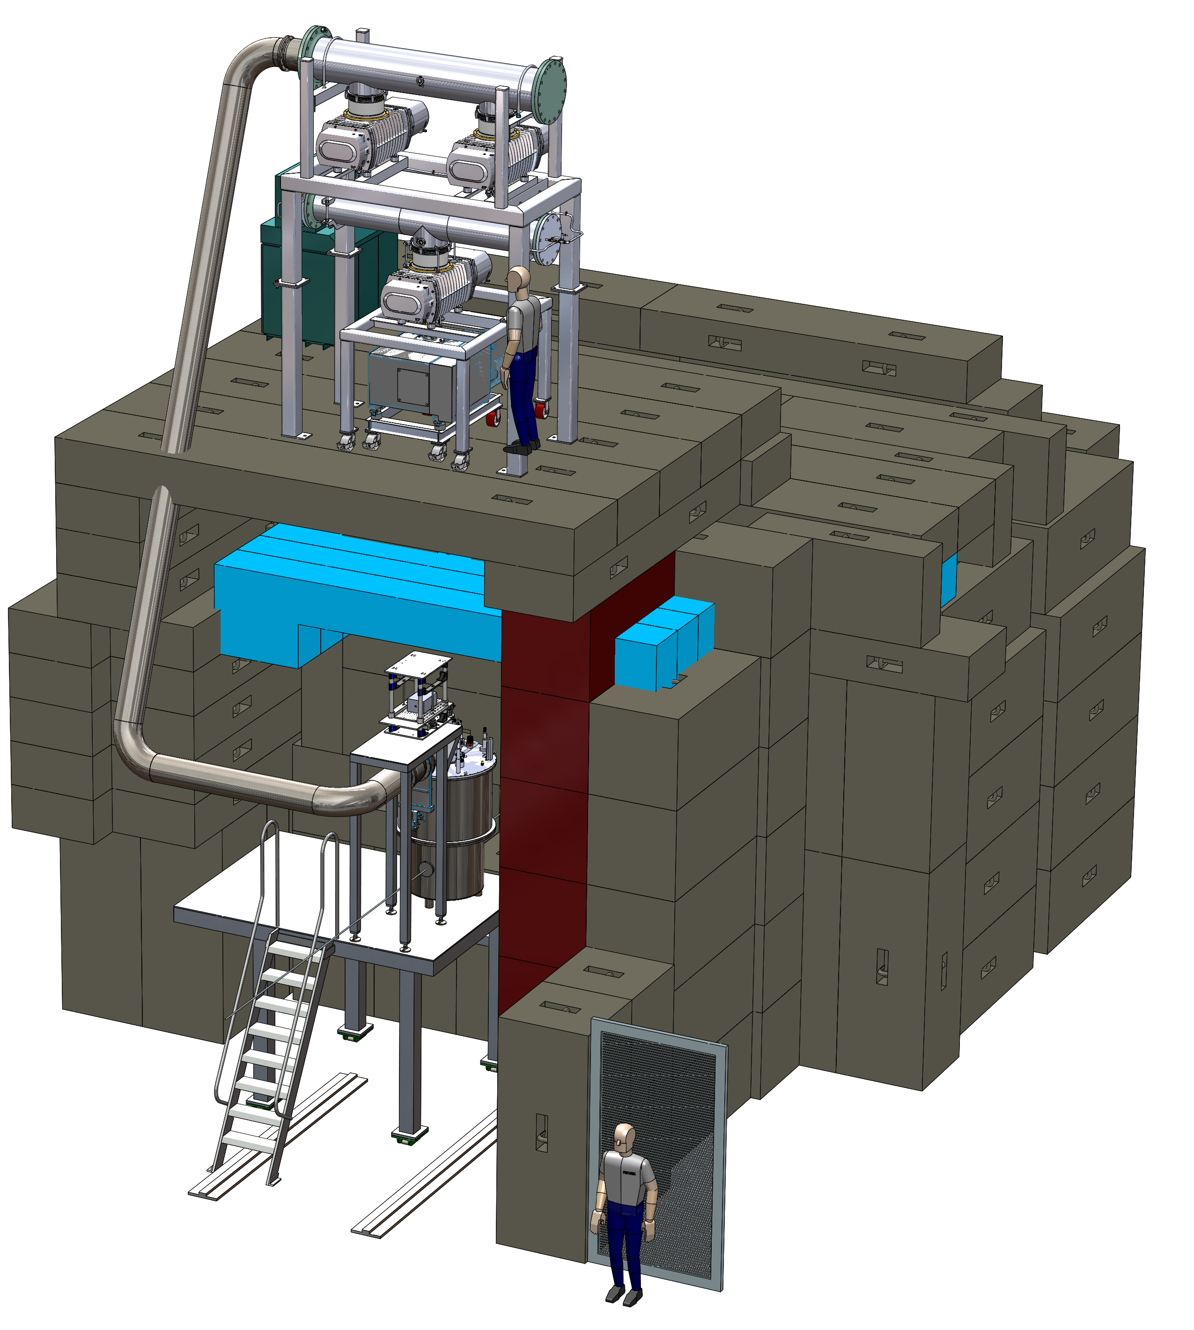
E1039 Target and FMAG
Changes needed :
Collimators upstream
Closed Loop He system
90 degree monitors L/R, T/B
Beam
σ_{x}=17mm, σ_{y}=19mm
Target upstream by ~200cm
lower x₂Acceptance
Better Target – Dump separation

Slide 15
Yield and Asymmetry estimates
Range x₂ | Mean x₂ | N events p | ΔA % p | N events n | ΔA % n
0.1-0.16 | .139 | 5.0 x 10⁴ | 3.2 | 5.8 x 10⁴ | 5.4
0.16-0.19 | 0.175 | 4.5 x 10⁴ | 3.3 | 5.2 x 10⁴ | 5.7
0.19-0.24 | 0.213 | 5.7 x 10⁴ | 2.0 | 6.6 x 10⁴ | 5.0
0.24-0.6 | 0.295 | 5.5x 10⁴ | 3.0 | 6.4 x 10⁴ | 5.1
Target/Accelerator Effi: 50%
Spectrometer: 80%
Acceptance 2.2%
Trigger 90%
Reconstruction 60%
Beam: 2.67 x 10 ¹² p/spill
Total integrated Luminosity: 1.82 x 10⁴² & 2.11 x 10⁴² cm⁻²
f = .176 , .3
P = .8 , .32
Notes:
Red box

Slide 16
Projected Statistical Precision with a Polarized Target at SeaQuest
First Sea Quark Sivers Asymmetry Measurement
Determine sign and value of ubar ,dbar Sivers distribution
x_{T}
Statistics shown for two calendar years of running :
L = 1.82 *10⁴² /cm² and
Running will be two calendar years of beam time
Notes:
Reduce text

Slide 17
Summary
First Measurement of Sivers asymmetry in Drell Yan for sea quarks
Flavor dependence of the Sivers asymmetry for and
Sign and magnitude of sea quark Sivers Distribution
If A_{N}≠0, major discovery: “Smoking Gun” evidence for L_{sea}≠0
If A_{N}=0: L_{sea}=0, spin puzzle more dramatic ?
Beginning of a spin program at FNAL
  tensor structure function b₁
  transversity with polarized beam
Approved experiment E1039 (stage 1)
2 calendar years of beam time

Slide 18
Thank You

Slide 19
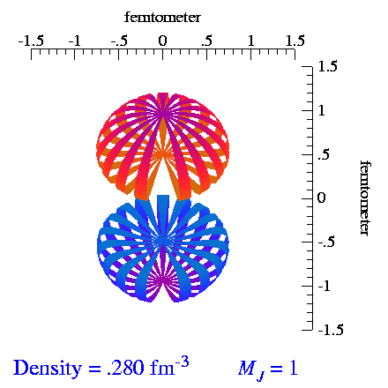
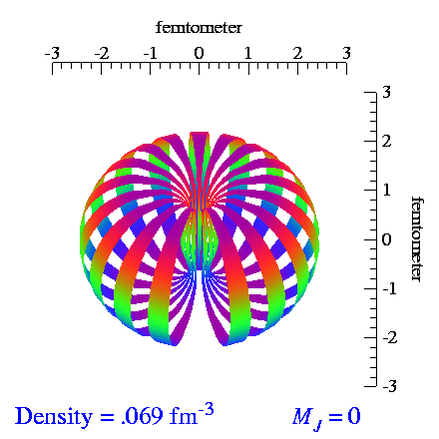
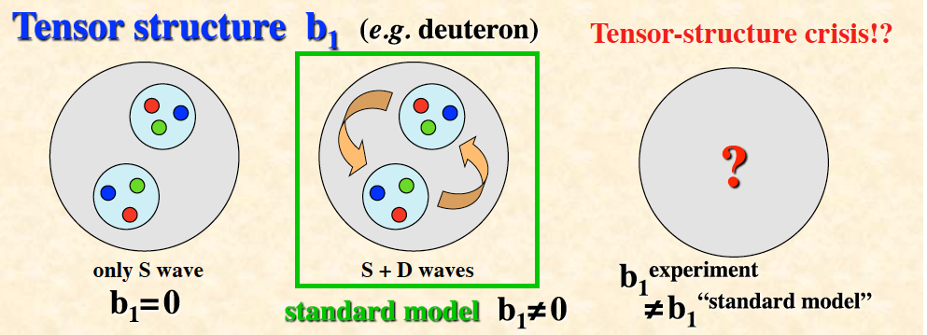
Tensor Polarization of Deuteron
d is spin 1 particle, opens up new physics
Spin-1 system in a B-field leads to
3 sublevels
via Zeeman interaction
Vector polarization: (n+ - n-); -1 < Pz < +1
Tensor polarization: (n+ - n0) – (n0 - n-); - 2 < Pzz < +1 Normalization: (n+ + n- +n0) = 1
From S. Kumano, arxiv.org/1606.03149
Notes:
Very interesting since it means that b1 not only dependent on the parton distributions but also on the
relative alignment of the two nucleons. Bridge between nuclear and particle physics.

Slide 20
(Un)Polarized Drell-Yan Experiments
Experiment | Particles | Energy (GeV) | x_{b} or x_{t} | Luminosity (cm⁻² s⁻¹) |  | P_{b} or P_{t} (f) | rFOM# | Timeline
COMPASS (CERN) | π⁻ + p↑ | 160 GeV √s = 17 | x_{t} = 0.1 – 0.3 | 2 x 10³³ | 0.14 | P_{t} = 90% f = 0.22 | 1.1 x 10⁻³ | 2015-2016, 2018
PANDA (GSI) | p + p↑ | 15 GeV √s = 5.5 | x_{t} = 0.2 – 0.4 | 2 x 10³² | 0.07 | P_{t} = 90% f = 0.22 | 1.1 x 10⁻⁴ | >2018
PAX (GSI) | p↑ + p | collider √s = 14 | x_{b} = 0.1 – 0.9 | 2 x 10³⁰ | 0.06 | P_{b} = 90% | 2.3 x 10⁻⁵ | >2020?
NICA (JINR) | p↑ + p | collider √s = 26 | x_{b} = 0.1 – 0.8 | 1 x 10³¹ | 0.04 | P_{b} = 70% | 6.8 x 10⁻⁵ | >2020?
J-PARC (high-p beam line) | π⁻ + p | 10-20 GeV √s = 4.4-6.2 | x_{b} = 0.2 – 0.97 x_{t} = 0.06 – 0.6 | 2 x 10³¹ | --- | --- | --- | >2019? under discussion
fsPHENIX (RHIC) | p↑ + p↑ | √s = 200 √s = 510 | x_{b} = 0.1 – 0.5 x_{b} = 0.05 – 0.6 | 8 x 10³¹ 6 x 10³² | 0.08 | P_{b} = 60% P_{b} = 50% | 4.0 x 10⁻⁴ 2.1 x 10⁻³ | >2021
SeaQuest (FNAL: E-906) | p + p | 120 GeV √s = 15 | x_{b} = 0.35 – 0.9 x_{t} = 0.1 – 0.45 | 3.4 x 10³⁵ | --- | --- | --- | 2012 - 2017
Pol tgt DY‡ (FNAL: E-1039) | p + p↑ | 120 GeV √s = 15 | x_{t} = 0.1 – 0.45 | 4.4 x 10³⁵ | 0 – 0.2* | P_{t} = 85% f = 0.176 | 0.15 | >2018
Pol beam DY§ (FNAL: E-1027) | p↑ + p | 120 GeV √s = 15 | x_{b} = 0.35 – 0.9 | 2 x 10³⁵ | 0.04 | P_{b} = 60% | 1 | >2020
‡ 8 cm NH₃ target / § L= 1 x 10³⁶ cm⁻² s⁻¹ (LH₂ tgt limited) / L= 2 x 10³⁵ cm⁻² s⁻¹ (10% of MI beam limited) *not constrained by SIDIS data / # rFOM = relative lumi * P² * f² wrt E-1027 (f=1 for pol p beams, f=0.22 for π⁻ beam on NH₃)
W. Lorenzon (U-Michigan) 7/2016
Notes:
COMPASS scheduled to run in 2018 not confirmed yet

Slide 21
Hints of Non-Vanishing Sea Quark Sivers Distribution ?
Sea quark generates left-right bias ?
Left-right bias generated through fragmentation process ?

Slide 22
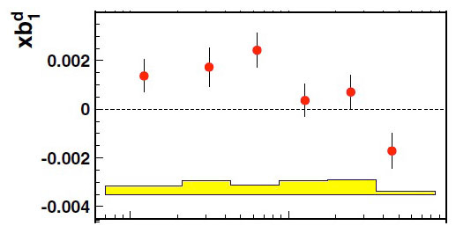
HERMES , Phys. Rev. Lett. 95, 242001
10⁻²
10⁻¹
x
S. Kumano, arxiv.org/1606.03149

