Slide 1
Record-level quantum efficiency from a high polarization strained GaAs/GaAsP superlattice photocathode with Distributed Bragg Reflector
Wei Liu^{1,2,3}
Shukui Zhang, Matt Poelker, Marcy Stutzman
Jefferson Lab
Yiqiao Chen, Wentao Lu, Aaron Moy
SVT Associates

Slide 2
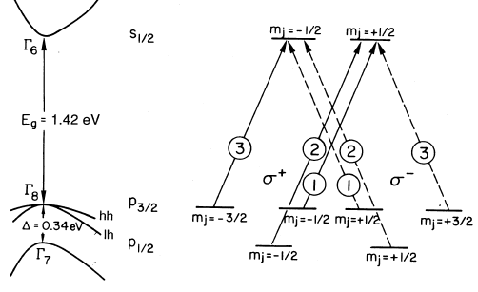
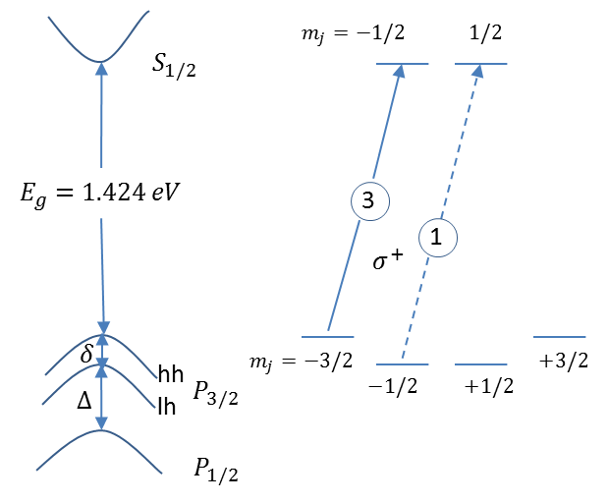
Existing polarized photocathodes
Structure | P (%) | QE (%)
Bulk GaAs | 35 | 10
GaAs/GaAsP (strained well) | 92 | 1.2
GaAs/GaAsP (strained compensated) | 92 | 1.6
InGaAs/AlGaAs | 77 | 0.7
AlInGaAs/GaAs | 91 | 0.5
AlInGaAs/AlGaAs (with DBR) | 92 | 0.85
AlInGaAs/GaAsP (with DBR) | 92 | 0.6
These QE values support sustained beam delivery at ~ uA levels
Unstrained GaAs
Strained GaAs

Slide 3
High Current Electron Accelerators
Accelerator | P | Current
eRHIC | 75% | 10 to 50 mA
Polarized positrons at CEBAF | 90% | 1 mA+
* See talk by Joe Grames
Polarized electron beams at mA current will enable new physics experiments and new capabilities
Most of the incident drive laser light simply heats the photocathode – photocathode cooling required, this is complicated at high voltage
High polarization photocathodes with QE ~ 10% desired: simplify gun design, reduce requirements on drive laser, prolong operating lifetime
Bulk GaAs has very high QE but low polarization
Solution: High polarization photocathode with Distributed Bragg Reflector

Slide 4
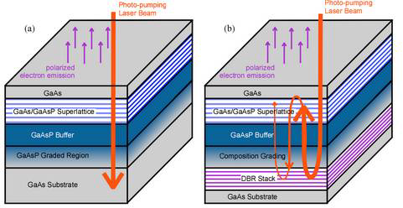
Benefits of DBR
non-DBR Photocathode : absorption in the GaAs/GaAsP superlattice < 5%
Most light passes into the substrate and leads to unwanted heat
DBR photocathode : absorption in the GaAs/GaAsP superlattice >20%
Less light is required to make required beam, less light means less heat
Non-DBR photocathode
DBR photocathode

Slide 5
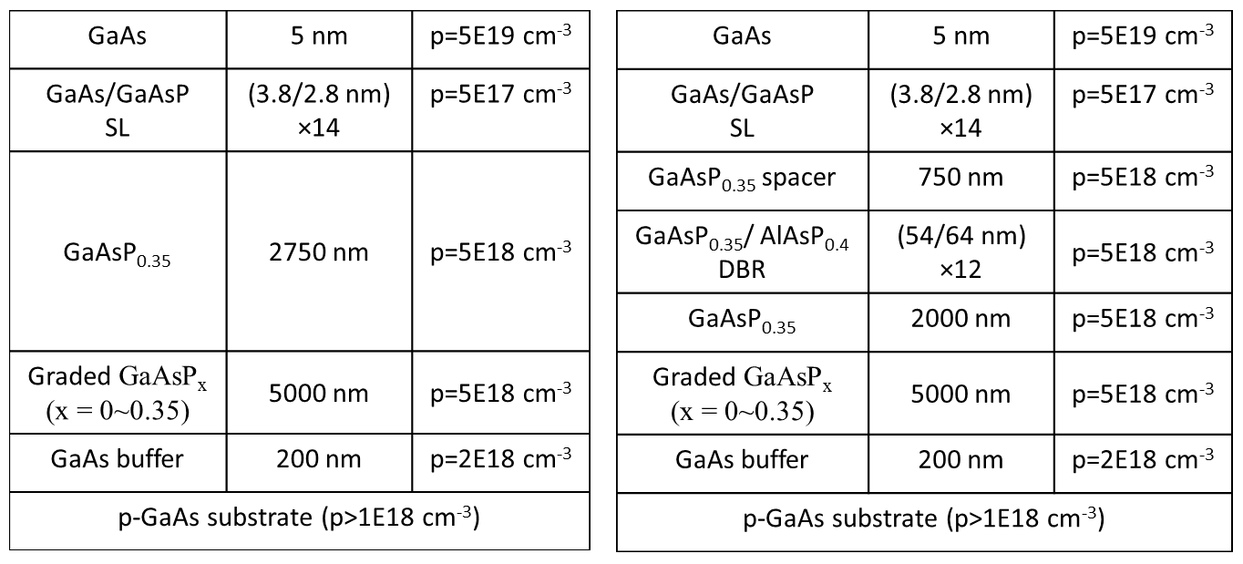
Schematic structure of photocathodes
Non-DBR Photocathode
DBR photocathode
Phosphorus content influences the refractive index of each layer, and therefore the optical path length which is the key design consideration for this type of photocathode

Slide 6
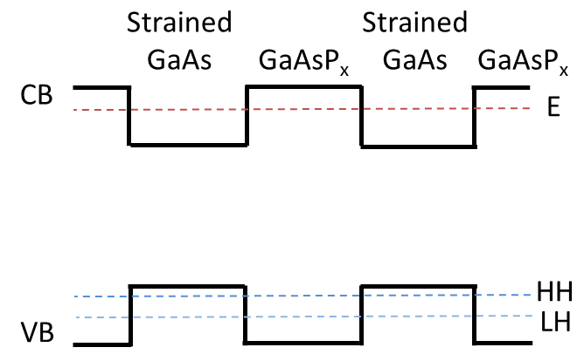
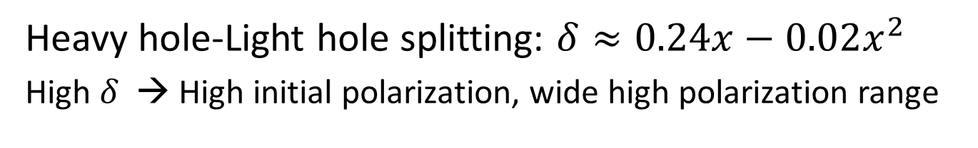


Energy level of strained GaAs/GaAsP superlattice
Heavy hole-Light hole splitting: $δ≈0.24x−0.02x^{2}$
High $δ$ → High initial polarization, wide high polarization range
$$x=0.35, δ=81.6 meV$$
$$δ$$
This part of the photocathode design was set in 2004, reported at PESP2004 (part of SPIN2004)

Slide 7


Design of the DBR photocathode
To get high reflectivity for DBR:
$$n_{H}\left(λ_{DBR}\right)d_{H}=\frac{λ_{DBR}}{4}=n_{L}(λ_{DBR})d_{L}$$
To get high absorption for photocathode:
$$2\sum_{i}{n_{i}d_{i}}=mλ_{R} (m:integer)$$
Precise control the optical path length of each layer!!!

Slide 8
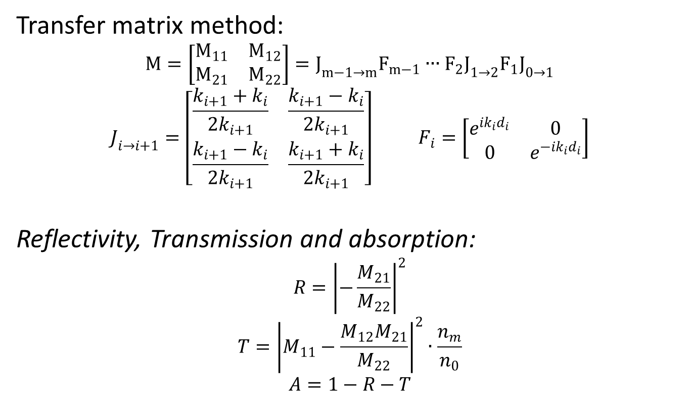
Calculation for absorption of photocathode
Transfer matrix method:
$$M=\left[\begin{matrix}M_{11} & M_{12} \\ M_{21} & M_{22}\end{matrix}\right]=J_{m−1→m}F_{m−1}∙∙∙F_{2}J_{1→2}F_{1}J_{0→1}$$
$$J_{i→i+1}=\left[\begin{matrix}\frac{k_{i+1}+k_{i}}{2k_{i+1}} & \frac{k_{i+1}−k_{i}}{2k_{i+1}} \\ \frac{k_{i+1}−k_{i}}{2k_{i+1}} & \frac{k_{i+1}+k_{i}}{2k_{i+1}}\end{matrix}\right] F_{i}=\left[\begin{matrix}e^{ik_{i}d_{i}} & 0 \\ 0 & e^{−ik_{i}d_{i}}\end{matrix}\right]$$
Reflectivity, Transmission and absorption:
$$R{=\left|−\frac{M_{21}}{M_{22}}\right|}^{2}$$
$$T={\left|M_{11}−\frac{M_{12}M_{21}}{M_{22}}\right|}^{2}∙\frac{n_{m}}{n_{0}}$$
$$A=1−R−T$$

Slide 9
Surface reflection of GaAsP/AlAsP DBR
More pair layers, higher reflection.
For 12 pair layers: highest reflection is 93.2%
Surface reflection of DBR at different numbers of pair layers(n)

Slide 10
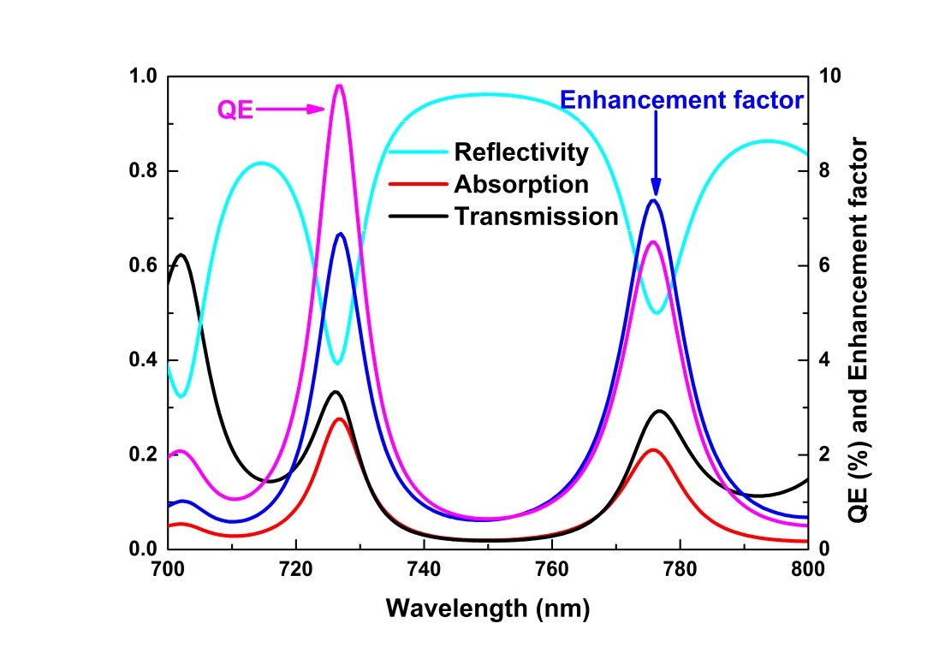
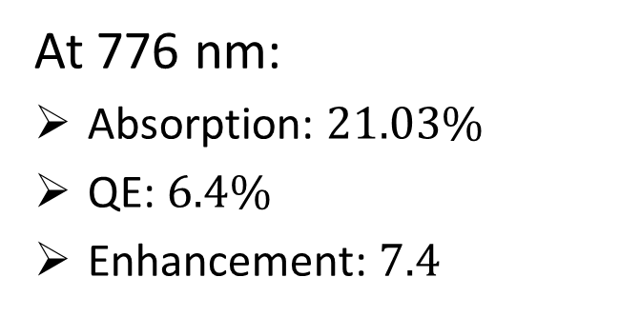
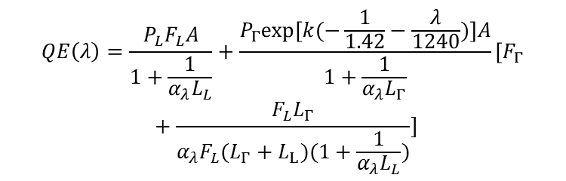
Calculation results for DBR photocathode
At 776 nm:
Absorption: $21.03\%$
QE: $6.4\%$
Enhancement: $7.4$
$$QE\left(λ\right)=\frac{P_{L}F_{L}A}{1+\frac{1}{α_{λ}L_{L}}}+\frac{P_{Γ}exp[k(−\frac{1}{1.42}−\frac{λ}{1240})]A}{1+\frac{1}{α_{λ}L_{Γ}}}[F_{Γ}+\frac{F_{L}L_{Γ}}{α_{λ}F_{L}(L_{Γ}+L_{L})(1+\frac{1}{α_{λ}L_{L}})}]$$
Calculated absorption, reflectivity and transmittance of the DBR photocathode, QE for the DBR photocathode, the absorption and QE enhancement factors compared to the photocathode without the DBR.
Notes:
Are the quoted values consistent with plots? And consistent with what we said in paper?
Change legend in bottom plot, QE for DBR should be red, or graph should be black….

Slide 11
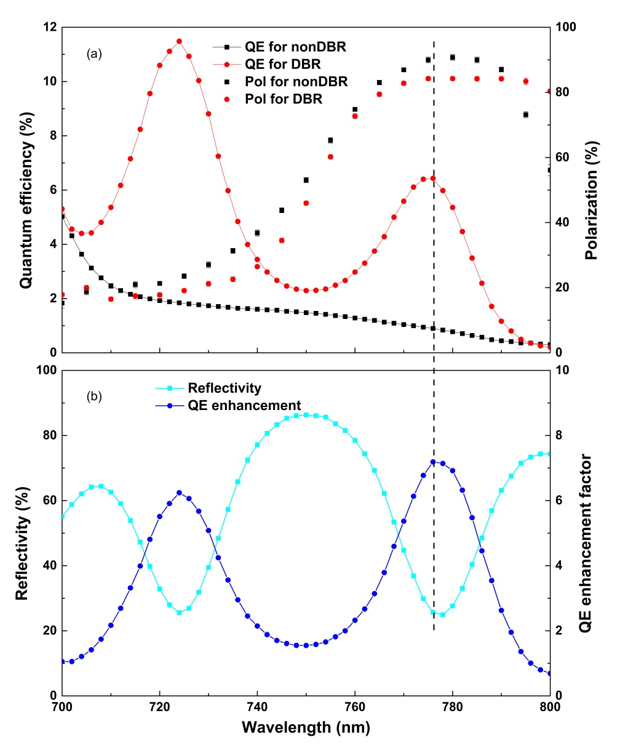
Experiment results
At 776 nm:
For non-DBR: QE - 0.89% and Polarization - 92%
For DBR: QE - 6.4% and Polarization - 84%
QE Enhancement: 7.2, very close to predicted
(a) The QE and polarization for the strained GaAs/GaAsP superlattice photocathodes with and without DBR as a function of the wavelength; (b) Reflectivity and QE enhancement factor of photocathode with DBR as a function of the wavelength.

Slide 12
Figure of merit of polarized electron sources
Cathode | Ref. | P(%) | QE (%) | Figures of Merit (P²QE)
GaAs/GaAsP_{0.36} (no DBR) | SLAC/SVT | 86 | 1.2 | 0.89
GaAs/GaAsP_{0.38} (no DBR) | Nagoya | 92 | 1.6 | 1.35
Al_{0.19}In_{0.2}GaAs/Al_{0.4}GaAs (with DBR) | St. Peterburg | 92 | 0.85 | 0.72
GaAs/GaAsP_{0.35} (with DBR) | JLab/SVT | 84 | 6.4 | 4.52
The good result comes from precise control of many layers - the biggest challenge!
Accurate modeling is necessary and very helpful.

Slide 13
Conclusions
Strained GaAs/GaAsP superlattice photocathodes with DBR show dramatic QE enhancement of 7x, polarization over 84%.
Further work to tune the wavelength and increase the value of QE peak is going on. Expect higher values at SPIN2018!
DBR photocathodes will be used to produce high current polarized electron beams soon in CEBAF

Slide 14
Thanks for your attention

Slide 15
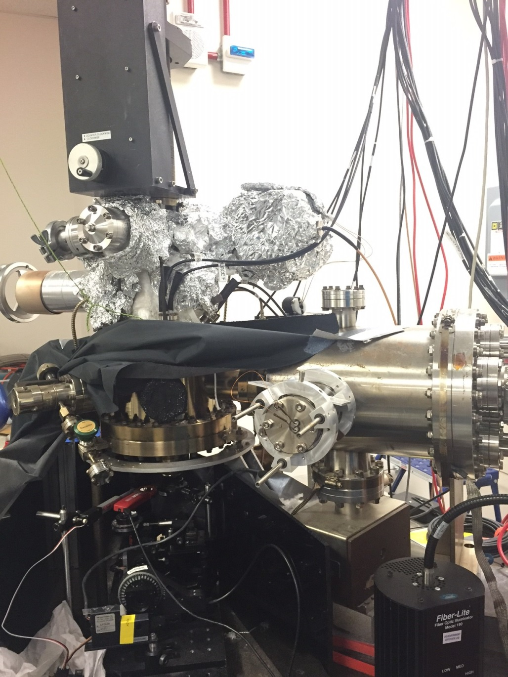
apparatus

Slide 16
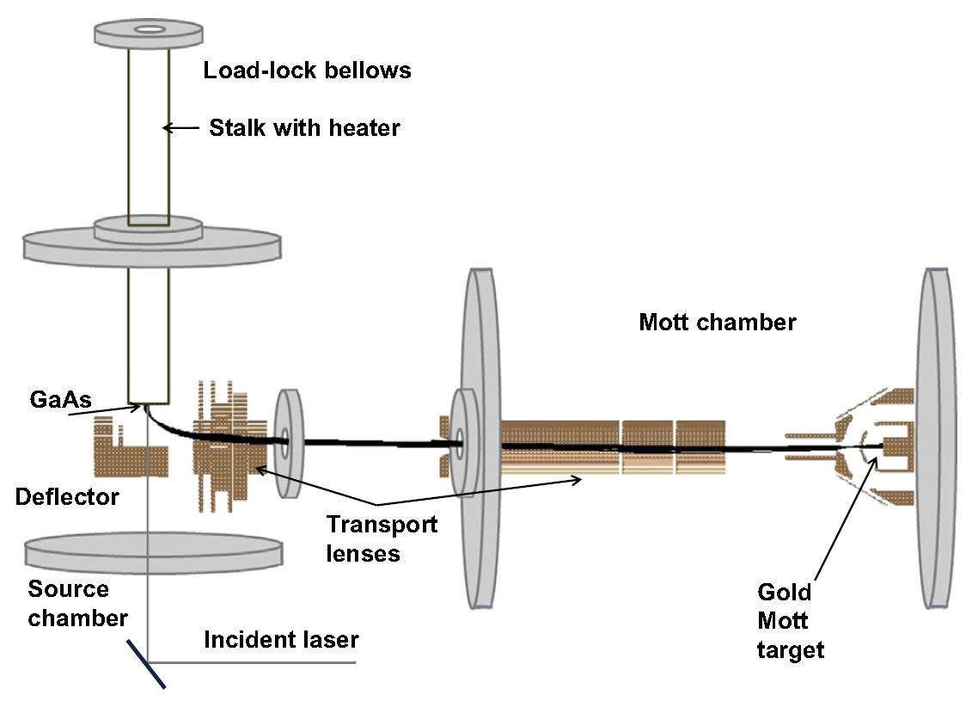
Schematic of the experiment apparatus

Slide 17
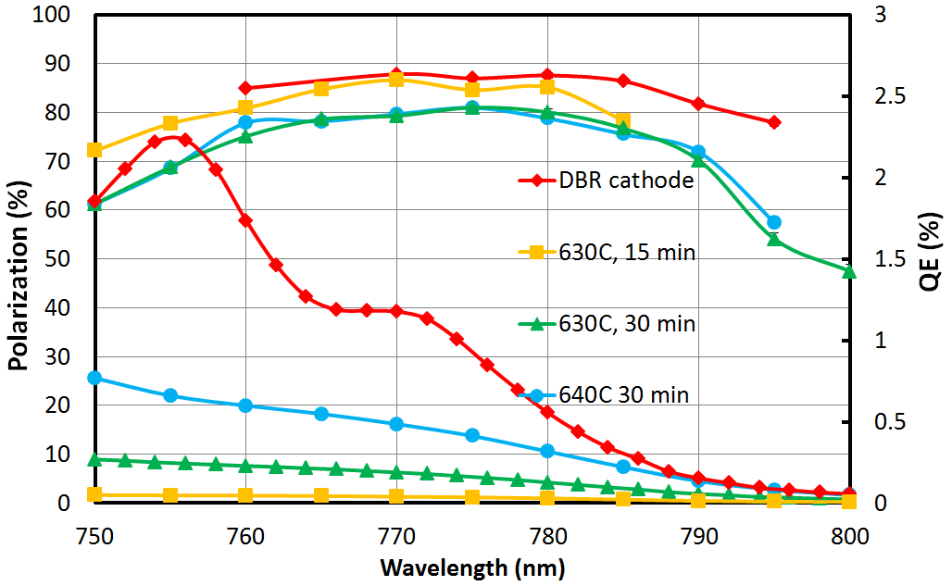
Results shown in IPAC 2015

