Slide 1
Various structures of the neutron-rich nucleus ³¹Mg investigated by β−γ spectroscopy of spin-polarized ³¹Na
Hiroki Nishibata
Nuclear Spectroscopy Laboratory, RIKEN
PhD work
at Osaka Univ.
Applications of spin polarization to nuclear structure study.
Unique method to assign spin-parity of excited levels based on β−γ spectroscopy of spin-polarized Na isotopes.
Investigation of nuclear structure of their daughters, i.e., Mg isotopes.

Slide 2
Physics motivation

Slide 3
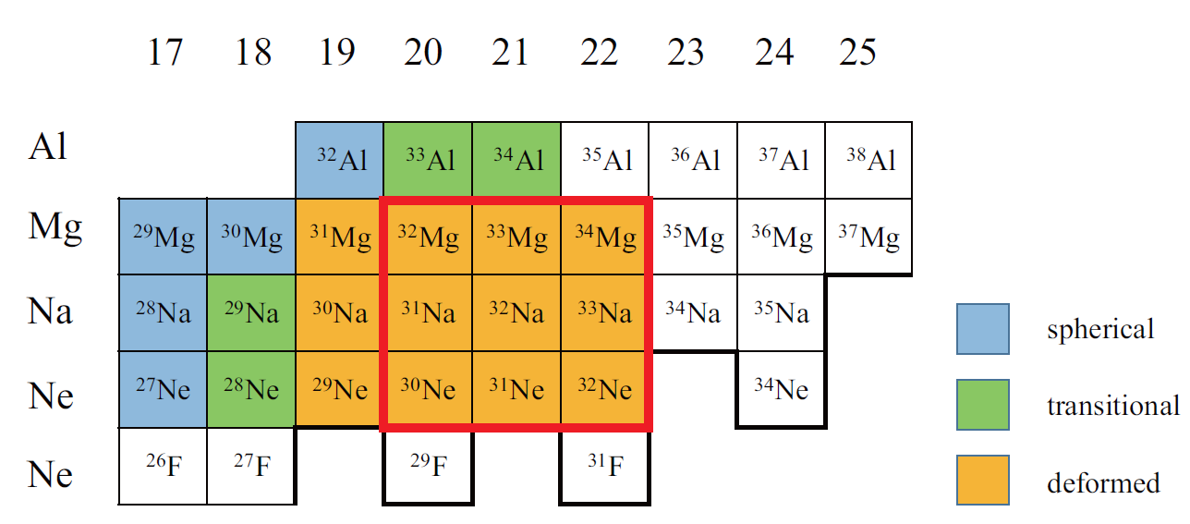
Deformed ground states of neutron rich nuclei with N~20
N=
B (E2)
T. Motobayashi et al.,
Phys. Rev. Lett. 346 (1994) 9
H. Iwasaki et al.,
Phys. Lett. B 522 (2001) 227
island of inversion
OSAKA
F
magnetic moment and spin
G. Huber et al.
Phys. Rev. C 18 (1978) 2342
magnetic moment and spin
D. Yordanov et al.
Phys. Rev. Lett. 99 (2007) 212501
magic
number
pf-shell
shell gap
magnetic moment and spin
G. Neyens et al.,
Phys. Rev. Lett. 94 (2005) 022501
sd-shell
Many experimental and theoretical investigations have been performed since 1970’s.
2-particle-2-hole
(2p2h)

Slide 4
Large-scale Shell Model calculations
Caurier et al., Phys.Rev. C 90 (2014) 014302
SDPF-U-MIX interaction
model space n: sd-pf, p: sd
across the N=20 “shell gap”
Nuclear correlations pull down the (2p-2h) level energies, and in some cases they become lower than the normal (0p-0h) level energies.
N=20
The existence of islands of inversion or deformation are explained as the result of the competition between
(1) the spherical mean field
and
(2) nuclear correlations which favor
the deformed configurations.

Slide 5
Shape coexistence
competition between spherical mean field and nuclear correlation which drives deformation
investigation of shape coexistence in the low excitation energy region
comparison of the experimental and theoretical levels on the level-by-level basis
Today’s talk : ³¹Mg (N=19)

Slide 6
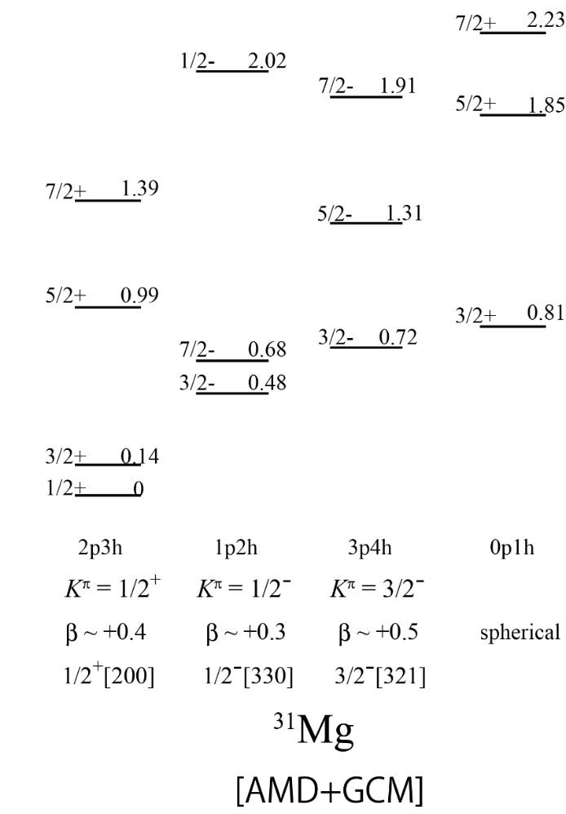
Various structures in ³¹Mg
predicted by anti-symmetrized molecular dynamics
plus generator coordinate method (AMD+GCM)
With assuming neither deformation nor mean field, this theory predicts both collective structures and single-particle structures in low excitation energy region.
The 1/2+ ground state is successfully predicted.
single-particle nature
rotational bands
shape coexistence in ³¹Mg
M. Kimura,
Phys. Rev. C 75(2007)041303(R)

Slide 7
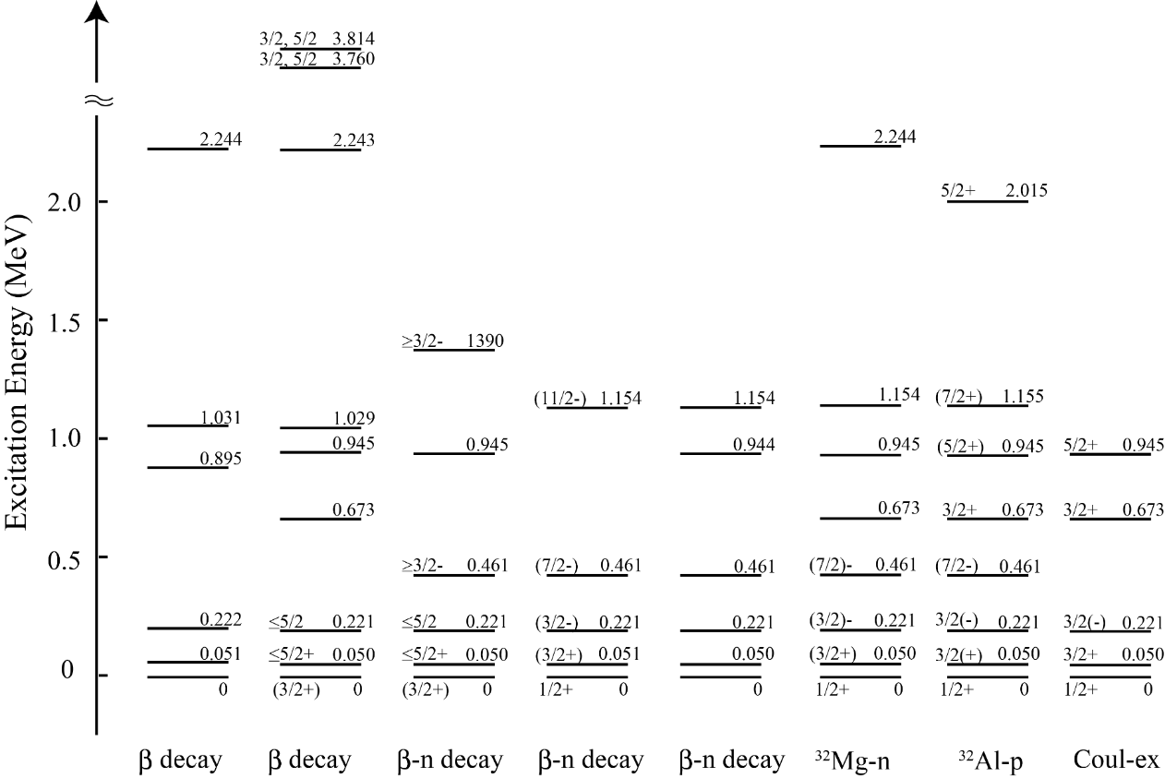
Discovery history of ³¹Mg levels
β-delayed γ spectroscopy
³¹Na
β
γ
³¹Mg
no spin-parity assignments
D. Guillemaud-Mueller et al., Nucl. Phys. A426 (1984) 37
G. Klotz et al., Phys. Rev. C 47 (1993) 2502
³¹Na
³¹Na
(year)
(1984)
(1993)

Slide 8
Discovery history of ³¹Mg levels
β-delayed n-γ spectroscopy
β
³²Na
n
γ
G. Klotz et al., Phys. Rev. C 47 (1993) 2502
H. Mach et al., Eur. Phys. J. A 25 (2005) 105
³¹Mg
C. Mattoon et al., Phys. Rev. C 75 (2007) 017302
³²Mg
Unexpected spin-parity 1/2+ was determined in 2005 by combined measurements of hyperfine-structure and β –NMR.
G. Neyens et al,
Phys. Rev. Lett. 94 (2005) 022501
³¹Na
³¹Na
³²Na
³²Na
³²Na
(year)
(1984)
(1993)
(1993)
(2005)
(2007)

Slide 9
Discovery history of ³¹Mg levels
one-neutron-removal reaction from ³²Al
one-proton-removal reaction from ³²Mg
Coulomb excitation of ³¹Mg
J. Terry et al., Phys. Rev. C 77 (2008) 014316
D. Miller et al., Phys. Rev. C 79 (2009) 054306
Seidlitz et al., Phys. Lett. B 700 (2011) 181
³¹Na
³¹Na
³²Na
³²Na
³²Na
(year)
(1984)
(1993)
(1993)
(2005)
(2007)
(2008)
(2009)
(2011)

Slide 10
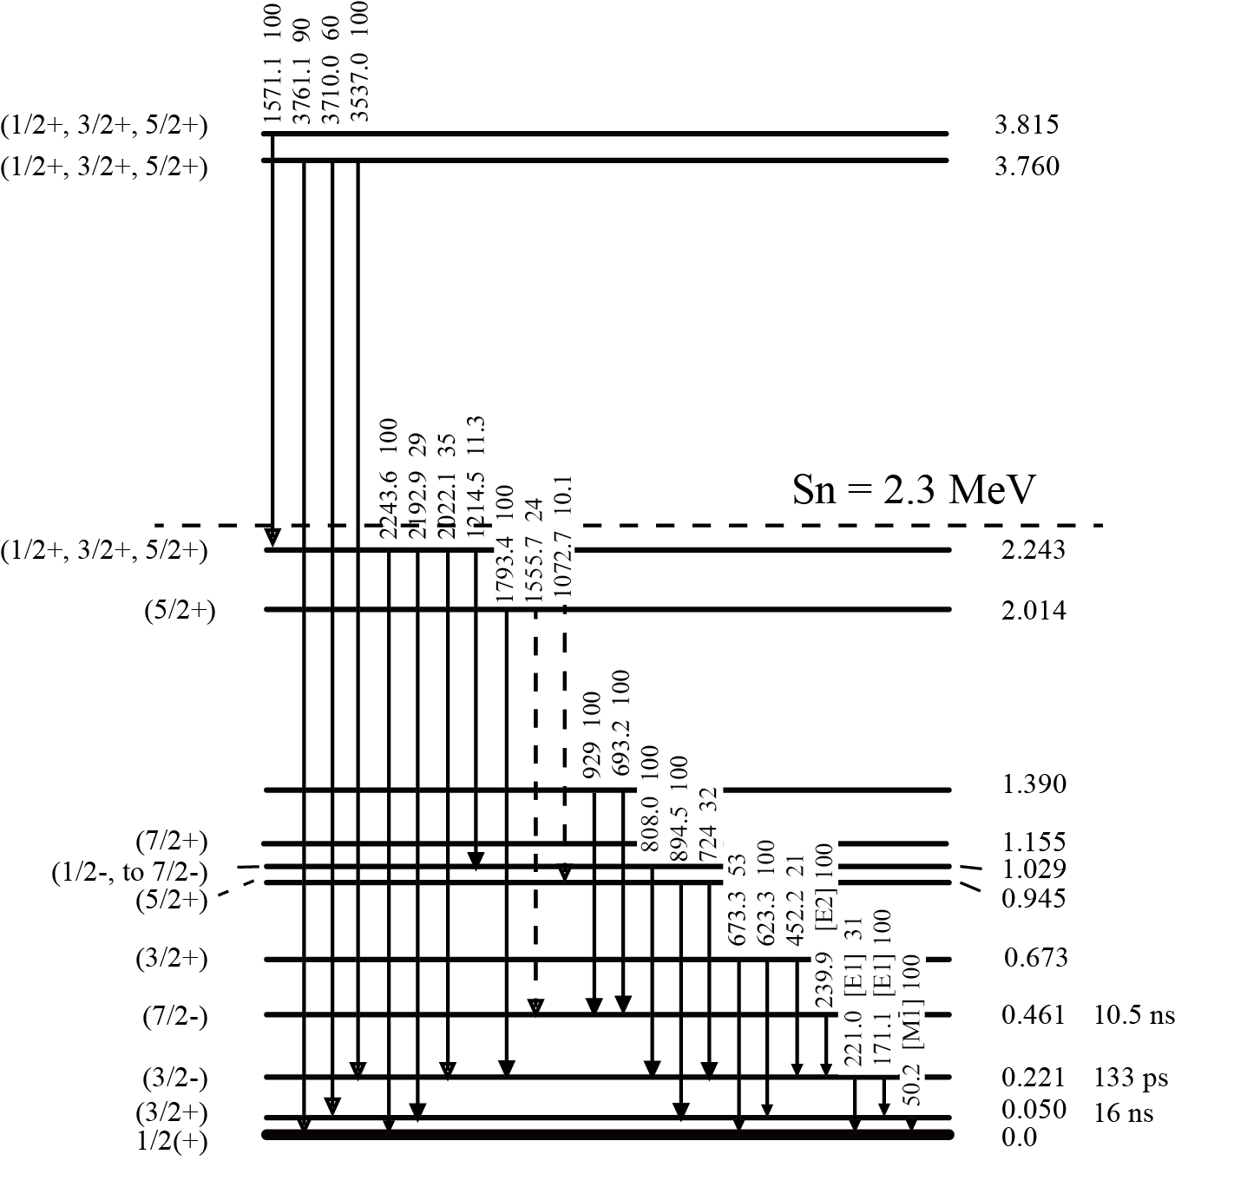
Adopted levels in ³¹Mg by NNDC (updated in 2013)
Most of the spins and parities are unassigned, except for the 1/2+ ground state.

Slide 11
Firm spin-parity assignments are essential to understand the structure of ³¹Mg.
Our method uses spin-polarized ³¹Na to unambiguously assign the spins and parities of the levels in ³¹Mg.

Slide 12
Principle of the measurement and
Experiment

Slide 13
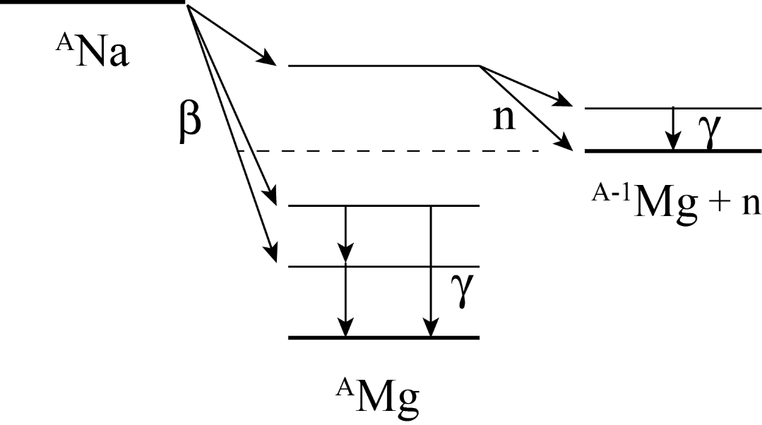
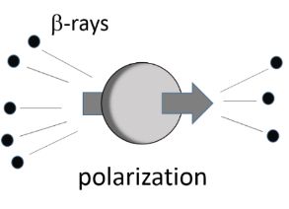
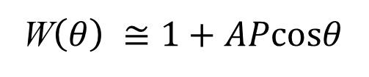
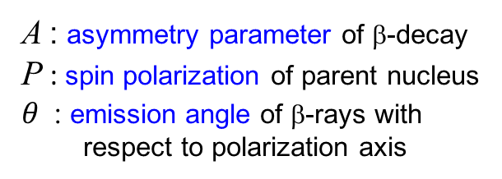
How to assign spin-parity of ³¹Mg states
angular distribution of β-rays from polarized nucleus
polarized
allowed transition
³¹Na
I^{π}₁
W$\left(θ\right) ≅1+APcosθ$
A : asymmetry parameter of β-decay
P : spin polarization of parent nucleus
$θ$: emission angle of β-rays with
respect to polarization axis
I^{π}₂
³⁰Mg
I^{π}₃
I^{π}₄
³¹Mg
in the case
A=-1, P=0.5 W(180°) / W(0°) = 3

Slide 14
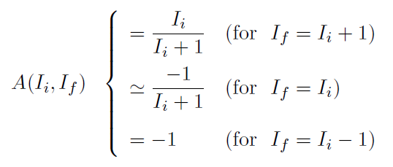
Asymmetry parameter A
The asymmetry parameter A is a constant depending on the daughter state spin value.
allowed transition
very discrete values
I_{i}^{π}
I_{f}^{π}
(³¹Na)
(³¹Mg)
A
5/2+
+0.6
3/2+
3/2+
-0.4
I_{i}: the parent spin
I_{f}: the daughter state spin
1/2+
-1.0
experimental A
spin of ³¹Mg state
parity = + for allowed transitions

Slide 15
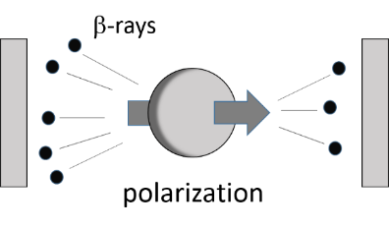
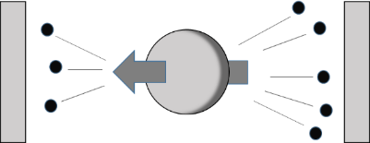
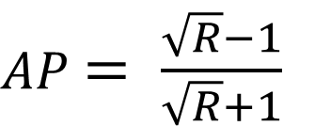
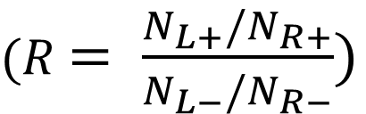
How to measure asymmetry parameter A
θ = 180°
θ = 0°
θ = 0°
θ = 180°
L
R
spin flip
L
R
every 100sec
ε ： efficiency N ： Total β decay counts
AP-values are measured freely from instrumental asymmetry.
$AP$ $= \frac{\sqrt{R}−1}{\sqrt{R}+1}$
$(R$ $= \frac{N_{L+}/N_{R+}}{N_{L−}/N_{R−}})$
P is common for all β-transitions
and can be determined by comparing two transitions.

Slide 16
Polarized ³¹Na beam at TRIUMF in Canada
Target fragmentation:
500 MeV 10 μA proton beam
with UCx target
³¹Na+ ion beam intensity:
~ 800 pps (extracted), 28keV
~ 200 pps (after polarizer)

Slide 17
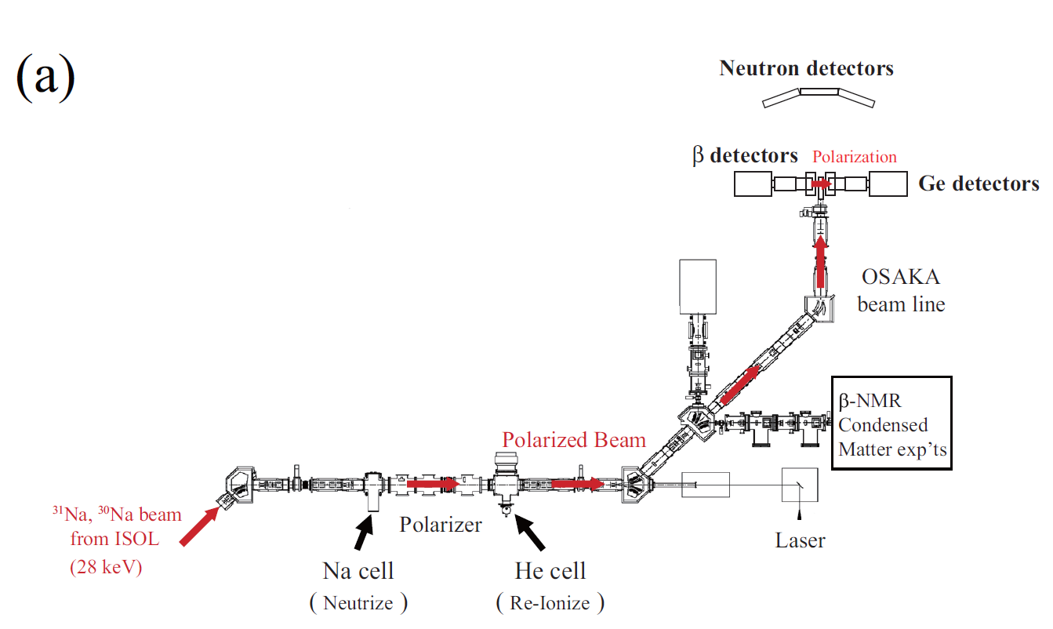
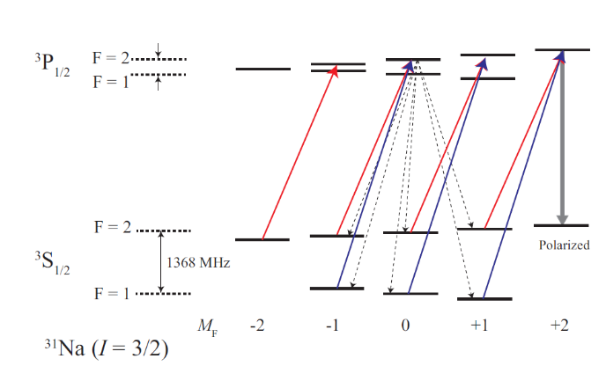
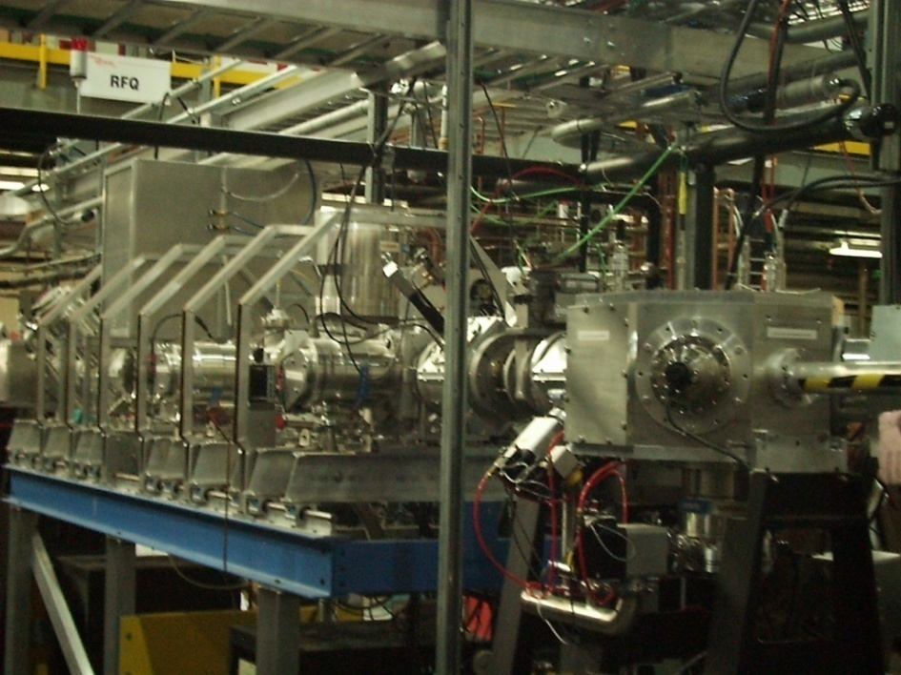
Polarizer at ISAC TRIUMF
The polarized beam stops in Pt foil.
optical pumping with two laser beams
spin polarization:
collinear laser optical pumping
P ~30%
B = 0.5 T
³P_{1/2}
Osaka
beam line
³S_{1/2}
B₀ = 10 Gauss
Na⁺
Na⁰
Na⁺
590 nm
70 mW
achieved
effective pol.
P ~ 32%

Slide 18
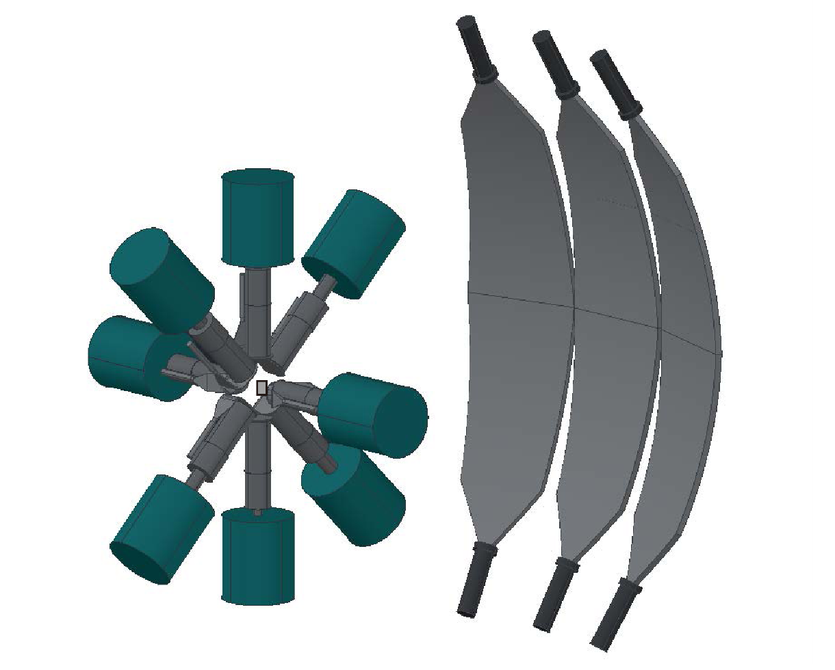
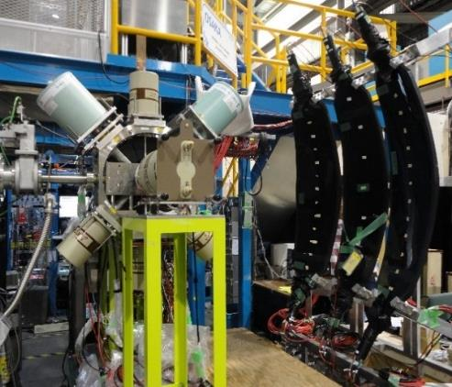
Detector Setup
β-asymmetry: β−γ, β−γ−γ, β−n
coincidence: γ−γ, n−γ
8 x (HPGe +2 plastic)
3 neutron TOF counters
Pt foil stopper
β-detection efficiency: 15%
γ-detection efficiency: 2.9% @1333keV
n-detection efficiency: 0.2%@2MeV
L : β−asymmetry
R : β−asymmetry
B～530mT
polarization
³¹Na beam
neutron TOF counter
28 keV
P~32%
³¹Na beam
β, γ identification and β-ray energy measurement
β- and γ-rays
Ge
plastic scintillators (1.5 mm)

Slide 19
Experimental Results
β−γ measurement: ³¹Na→ ³¹Mg

Slide 20
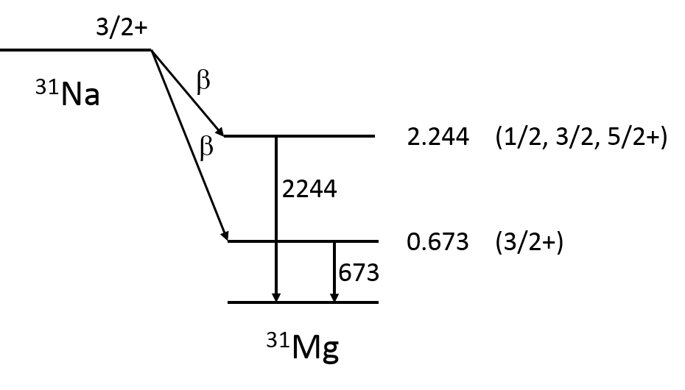
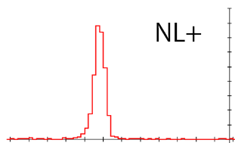
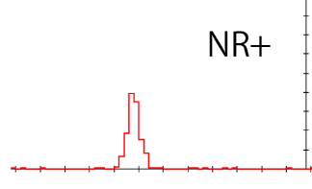
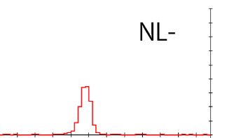
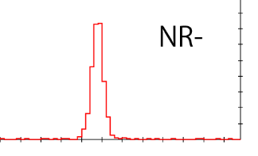
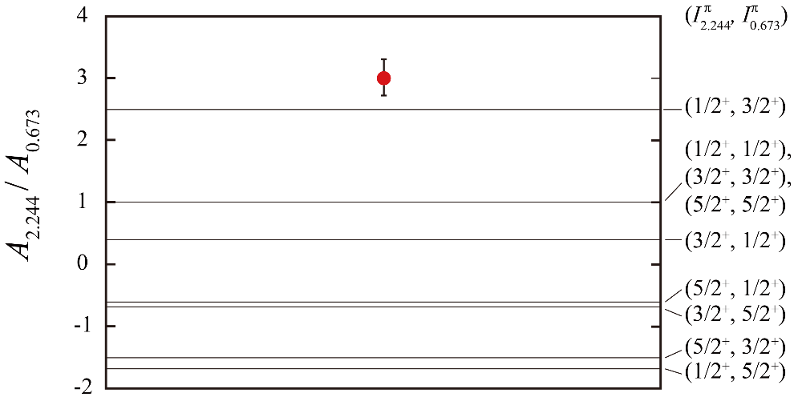
Determination of polarization P
1/2+
673keV γ-ray peak coincident with β-rays
A_{0.673}P = -0.11(1)
3/2+
in the same manner
0.0
A_{2.244}P = -0.33(1)
ratio of two AP values to cancel out P
(A_{2.244}P)/ (A_{0.673}P) = A_{2.244}/ A_{0.673} = 3.0(3)
I^{π}_{0.673} = 3/2+
A_{0.673} = -0.4
I^{π}_{2.244} = 1/2+
A_{2.244} = -1.0
A_{2.244}/ A_{0.673}
9 possible cases
A_{0.673}P = -0.11(1)
P = 28(3) %
A_{2.244}P = -0.33(1)
P = 33(1) %
P = 32(1)%

Slide 21
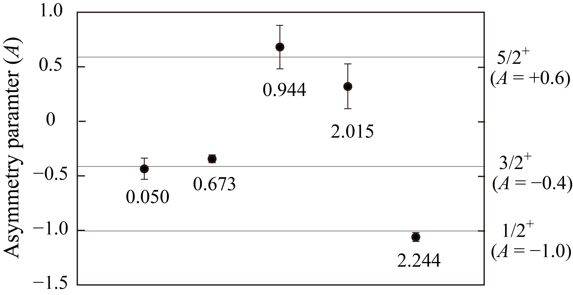
Spin-parity assignments of ³¹Mg levels
experimental AP values and polarization
P ＝ 32(1)%
A
5/2+
3/2+
Ex=
1/2+
5 levels are firmly assigned!
The 50 keV level was assigned as 3/2+ for the first time.

Slide 22
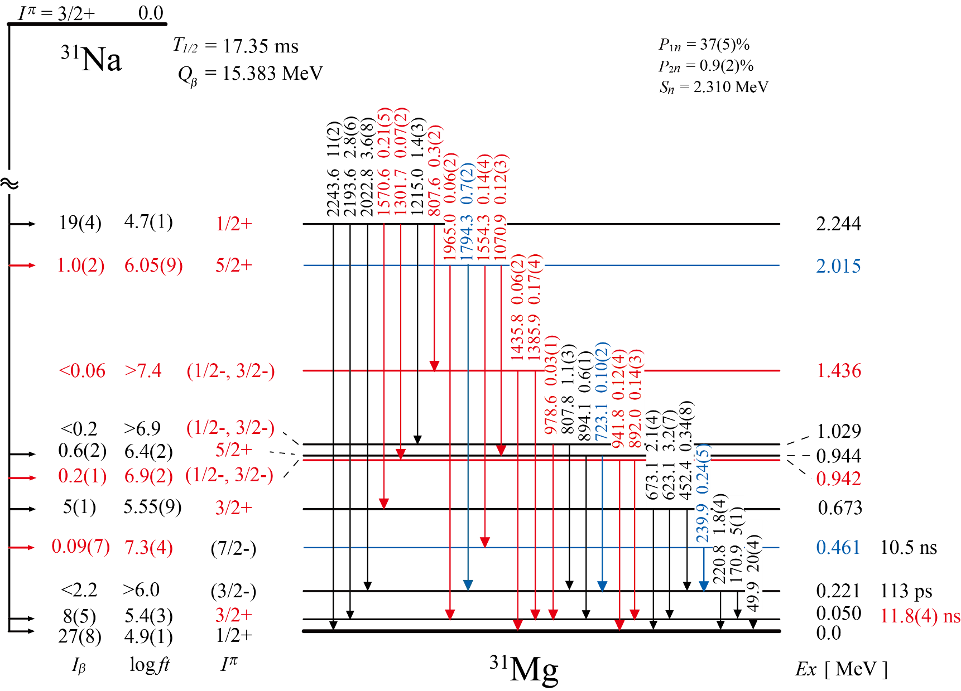
Decay scheme of ³¹Na → ³¹Mg
newly found or assigned
newly observed in β-decay
All spins of the
positive-parity
levels are assigned.
From the detailed
β and γ transition
probabilities, spins
of negative parity-
levels are proposed.
S_{n} = 2.3 MeV

Slide 23
Comparison with predictions
by Antisymmetrized Molecular Dynamics
(AMD+GCM) theory

Slide 24
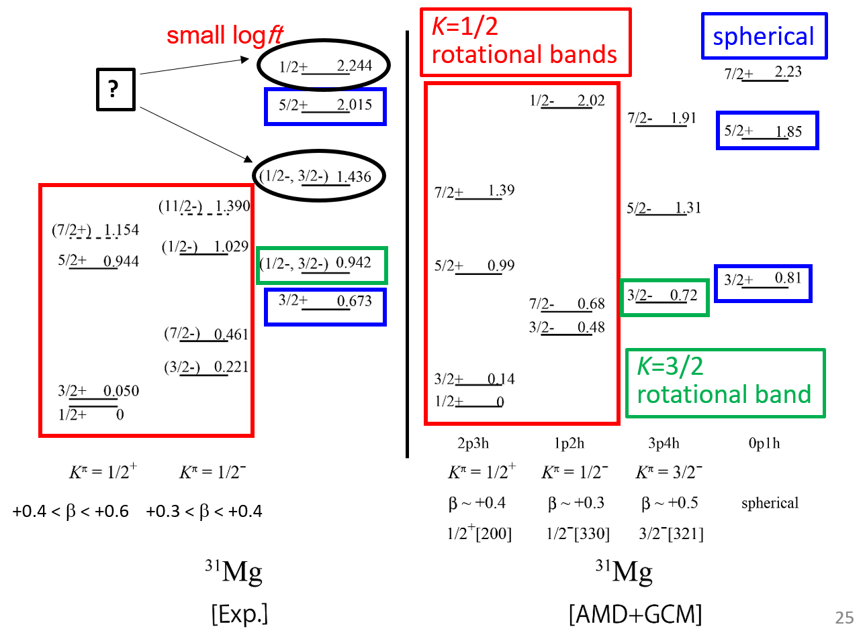
Comparison of energy levels

Slide 25
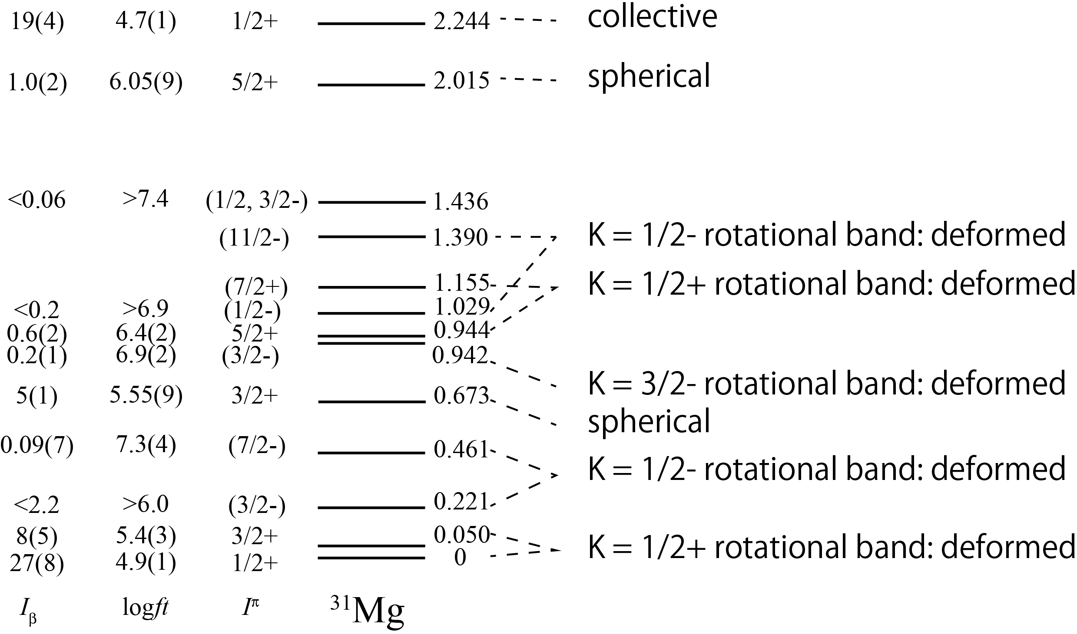
Summary
We confirmed three types of rotational bands and spherical states.
This is the experimental evidence of the coexistence of various structures.
Coexistence of
various structures !
collective？
？

Slide 26
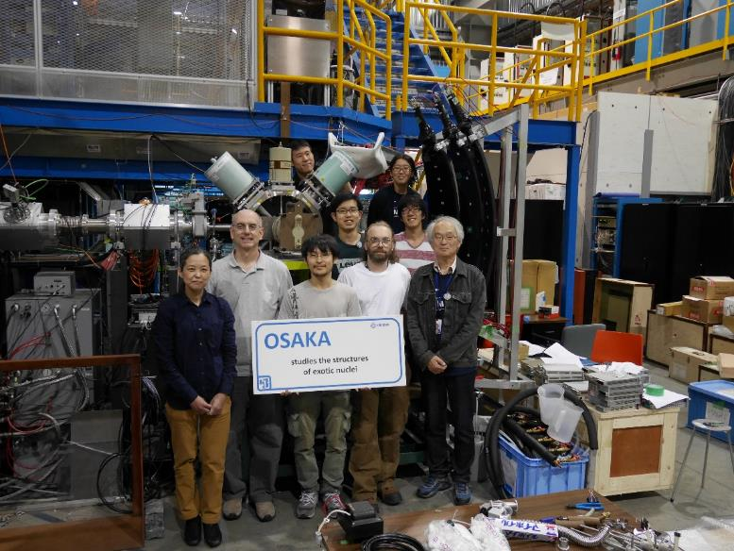
Thank you for your attention.
Collaborators of TRIUMF experiment S1391 (Aug. 2014)
Osaka University, Japan
H. Nishibata, T. Shimoda, A. Odahara, S. Morimoto, S. Kanaya, Y. Yagi,
H. Kanaoka
TRIUMF, Canada
M. Pearson, C. D. P. Levy

Slide 27
End of presentation

Slide 28
Optical Pumping
alkali atom
with hyperfine int.
without hyperfine int.
³P_{1/2}
circularly-polarized
laser light
σ+
³S_{1/2}
atomic polarization
3/2
1/2
atomic and
nuclear polarization
1368 MHz
To achieve high polarization we need two laser beams.
ν
laser freq.
Notes:
Now let me explain the optical pumping to polarize the nuclear spin.
This figure shows the atomic levels of the alkali atom, when we do not take into account the hyperfine interactions. If we inject a circularly polarize laser beam, which has angular momentum plus one, this atomic sub-level absorbs the photon and this excited state is populated. It decays shortly to both of the ground sub-levels. However, this ground state sublevel can not absorb the photon because there is no excited state here. Then, the population of the +1/2 sub-level becomes larger that that of the -1/2 sub-level. If we repeat this process many times, we can polarize the atomic state. This is the principle of optical pumping.
However, in reality, we have to consider the hyperfine interactions. In the case of 31Na we have F=1 and 2 levels for the ground state and we have 3 and 5 sub-levels as shown here. If we pump the 31Na atom with this laser light with red color, these 4 sub-levels are pumped up. However, if the de-excitation goes to the lower sub-levels, we can not do anything for these states. Then the polarization becomes lower. Therefore, It is essential to have two laser beams to pump up the sub-levels in the lower state. Then, all of the atomic sub-levels come to this level. Here the atomic spin and nuclear spin are in the same direction. Therefore the nuclear spin is also polarized.

Slide 29
How to assign spin-parity of ³¹Mg states
High polarization is essential for radioactive nuclear beams.
0.6
10,000 pps
P = 1 %
5/2+
50 pps
P = 30 %
A
-0.4
3/2+
-1.0
1/2+
β-branch: 1%, γ-detection efficiency 1%, 24 hrs accumulation time
Notes:
Let me just remind you that the high polarization is essential for radioactive nuclear beams.
This figure shows the Monte-Carlo simulation of the asymmetry parameter measurement. In the case of small polarization, say 1%, even we accumulate the data with very high intensity beam, the statistics is not good enough to determine the spin. However, If we have high polarization, say 30%, even with such low beam intensity of only 50 pps, the error bar is much smaller. Actually the 31Na beam intensity was only 50 pps. Therefore we need such high polarization.

Slide 30
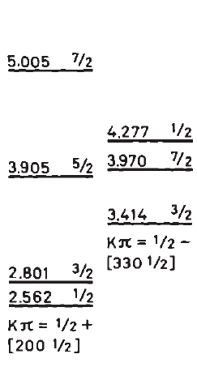
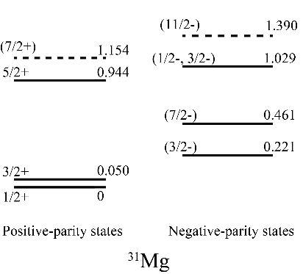
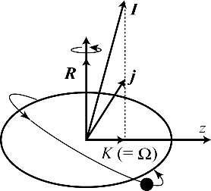
K=1/2 rotational bands in ³¹Mg
Litherland et al., Can J. Phys. 36 (1958) 378
²⁵Mg
a = -0.8
a = -4.4
a = -0.8
a = -3.5
K=1/2+
K=1/2-
K=1/2+
K=1/2-
a: decoupling parameter
³¹Mg K=1/2 rotational bands
Positive 1/2+[200]
Negative 1/2- [330]
A=odd
+0.4 < β < +0.6
+0.3 < β < +0.4

Slide 31
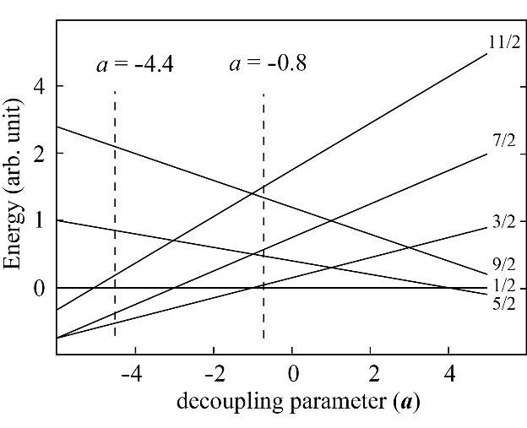
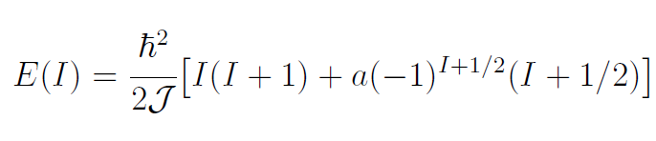
K=1/2 rotational bands in ³¹Mg
z
11/2
7/2
5/2
1/2
3/2
7/2
1/2
3/2
a = -0.8
a = -4.4
a: decoupling parameter
from the ordering of spins
and energy difference between states
Decoupling parameter a
depends on the orbit occupied
by the unpaired nucleon.
rotational motion in odd-A nuclei
z : symmetry axis
j : particle angular momentum
R : rotational angular momentum
K : projection of the total angular
momentum on the symmetry axis
I : total angular momentum
Configuration could be estimated
from the K=1/2 rotational band
observed in ²⁵Mg.
Notes:
Let me pick up some experimental levels and display according to their parity. The level sequence is very characteristic of the K=1/2 rotational bands of odd-A nuclei. 【CLICK】
The rotational band is called a decoupling band and the energies are expressed in this equation with the decoupling parameter a. Here the energy levels are plotted as a function of the decoupling parameter a. By comparing the experimental level sequence and energy difference, we determine the decoupling parameters 【CLICK】 as shown here. 【CLICK】
The decoupling parameter a depends on the orbit occupied by the unpaired nucleon. The determined decoupling parameters are similar to those observed in 25Mg many years ago.

Slide 32
Litherland et al., Can J. Phys. 36 (1958) 378
K=1/2 rotational bands in ³¹Mg
²⁵Mg
a = -0.8
a = -4.4
a = -0.8
a = -3.5
K=1/2+
K=1/2-
K=1/2+
K=1/2-
Values of decoupling parameter a
Is in good agreement with each other.
K^{π}: projection of the total angular
momentum on the symmetry axis
N: principal quantum number
n_{z}: number of nodes in the wave
function in the z direction
Λ: projection of the orbital angular
momentum on the symmetry axis
³¹Mg K=1/2 rotational band
Positive 1/2+[200]
Negative 1/2- [330]
K^{π}[Nn_{z}Λ]
Notes:
In the right panel of this slide, the levels of 25Mg in the high excitation energy region are plotted. These levels are understood as the members of the K=1/2 rotational bands with the Nilsson orbits associated with the asymptotic quantum numbers shown here. It is noticed that the decoupling parameters are similar in both nuclei. Thus we speculate the same Nilllson orbits for 31Mg. Then, we can estimate the deformation parameters of these rotational bands by comparing with the Nillson diagrams, as shown in the next slide.

Slide 33
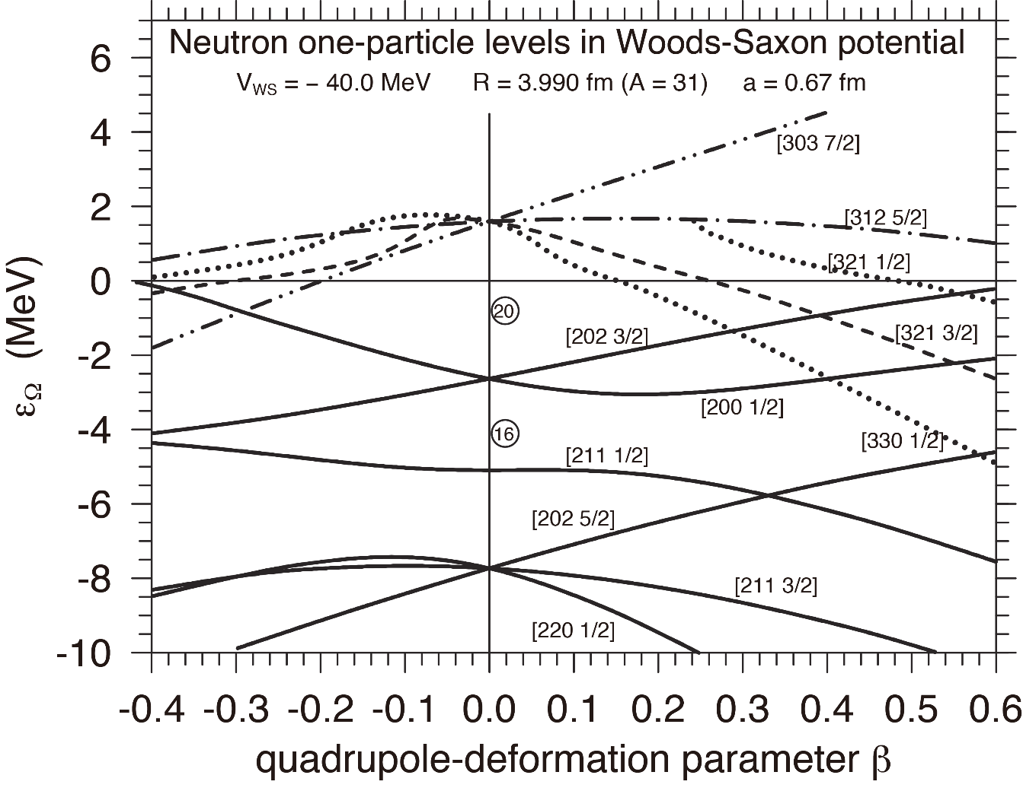
Nilsson diagrams for ³¹Mg
Ikuko Hamamoto, Phys. Rev. C76 (2007) 054319
neutron one-particle levels in ³¹Mg
1f_{7/2}
N=19
1d_{3/2}
K = 1/2-
K =3 /2-
K = 1/2+
2s_{1/2}
1/2+ ground state is largely deformed.
last neutron’s orbit
1d_{5/2}
prolate
Notes:
This figure with the result of magnetic moment measurement. shows the Nillson diagram for 31Mg, calculated by Hamamoto. The potentials are optimized for 31Mg. The last neutron in 31Mg is in the d3/2 orbit in the spherical limit. If we deform the potential along the z axis, the degeneracy is resolved and this orbit goes up in energy. The orbits in higher shell come down and intersect with this [202] orbit. If we increase the deformation more the last neutron comes into the [300] orbit. Now the parity is changed. This is nothing but the rotational band state with K^pi=1/2-[330] structure. If we deform the nucleus more another intersection comes and the last neutron jumps into the [200]. This is the ground state rotational band with K^pi = 1/2+ [200] structure. By comparing with the experimental results it is understood that the ground state rotational band with positive parity is largely deformed with beta~0.4-0.6 and the negative parity rotational band is deformed with slightly smaller beta. The large deformation of the ground state is consistent

Slide 34
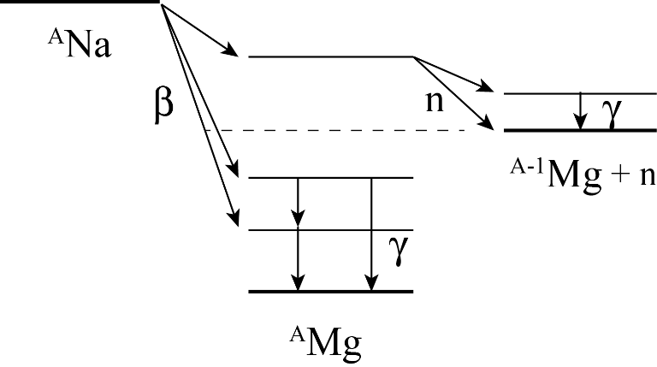
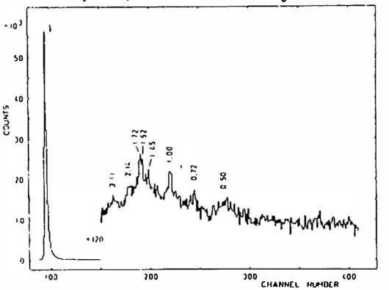
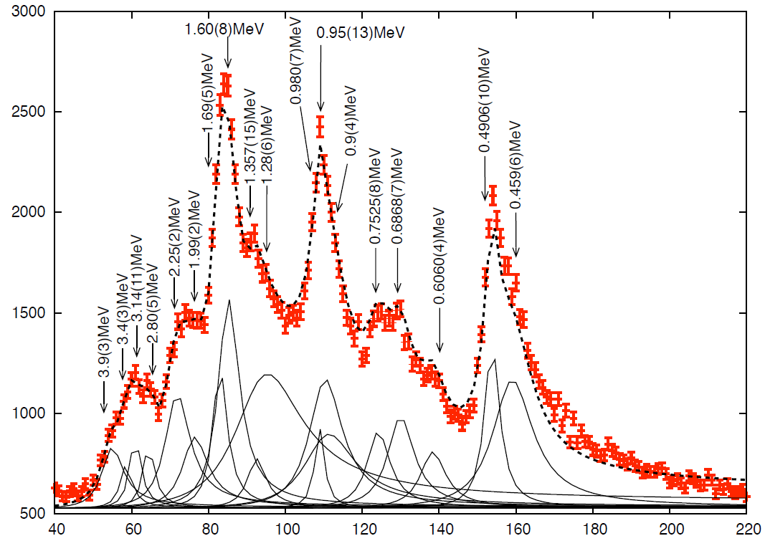
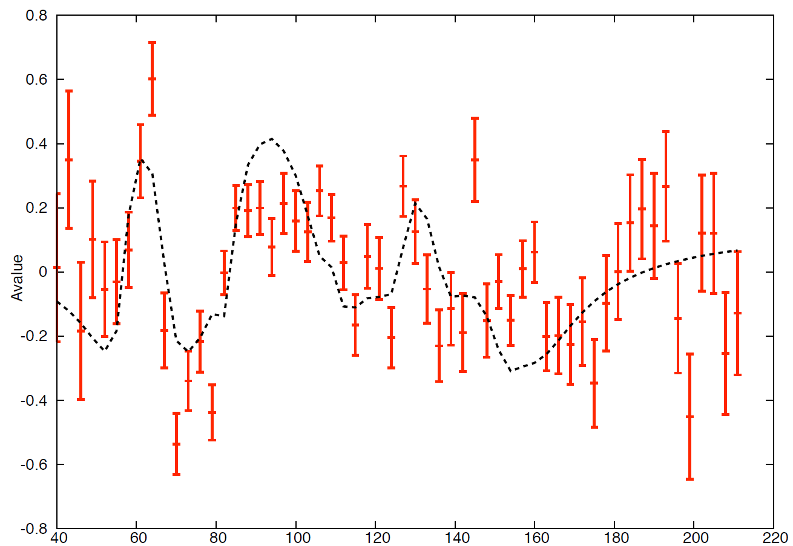
β-delayed neutrons
³¹Na
P. Baumann et al.,
AIP Conf. Proc.:5th Int. Conf. on Nuclei
Far from Stability, Rosseau Lake,Canada (1987)
³⁰Mg
³¹Mg
18 peaks
Counts
A
TOF (ns)
TOF (ns)

Slide 35
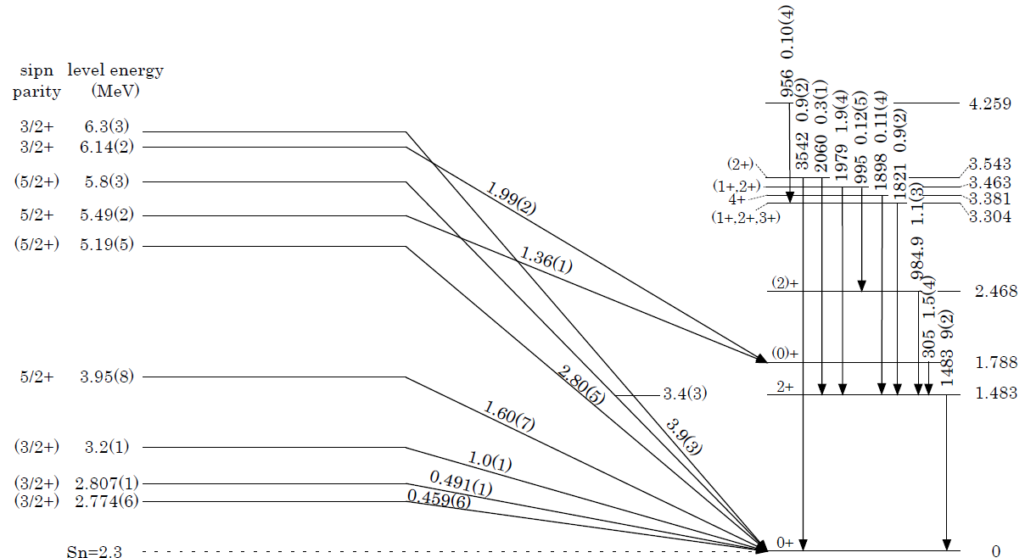
levels above S_{n}
³⁰Mg
tentatively proposed
g.s.
Analysis in progress
³¹Mg

Slide 36
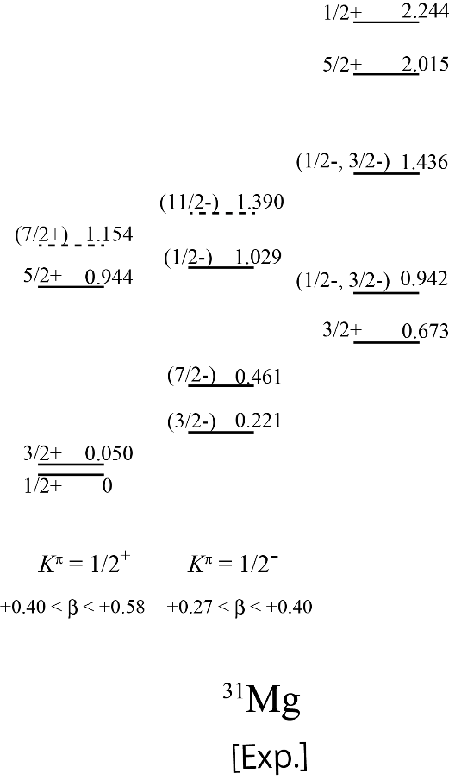
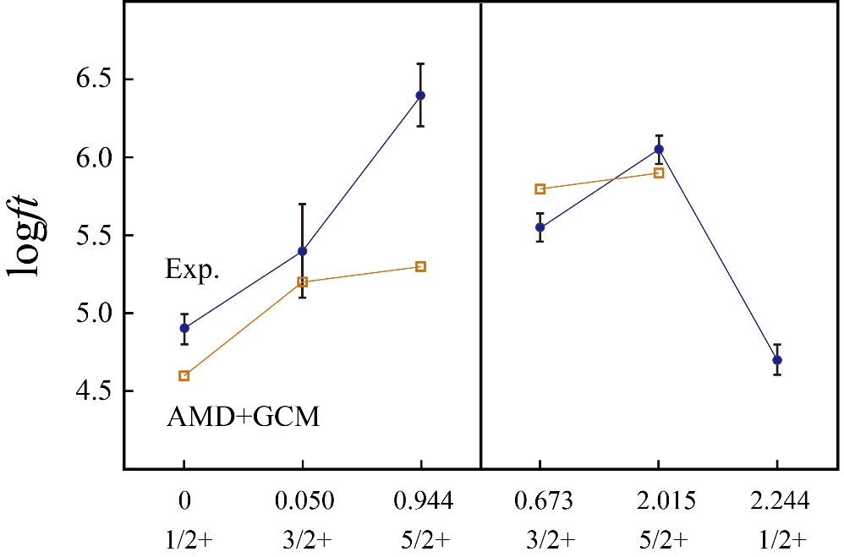
Comparison of logft values
between experimental results and AMD+GCM calculation
?
³¹Na
I_{β}
change of
nuclear structure
of core?
logft
spherical
³¹Mg
no prediction
by AMD+GCM
Ex [MeV]
I^{π}
K=1/2
rotational
band
K=1/2
rotational band
spherical
?

Slide 37

How is the level scheme of 31Mg revised?
Present work
(TRIUMF experiment S1391 in 2014)
NNDC in 2013

Slide 38
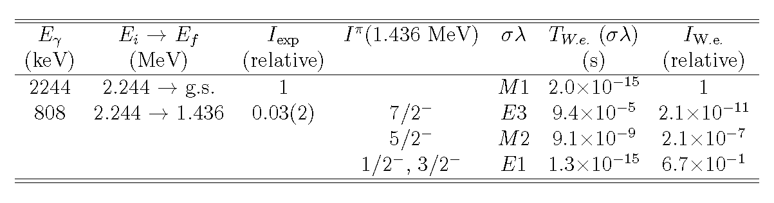
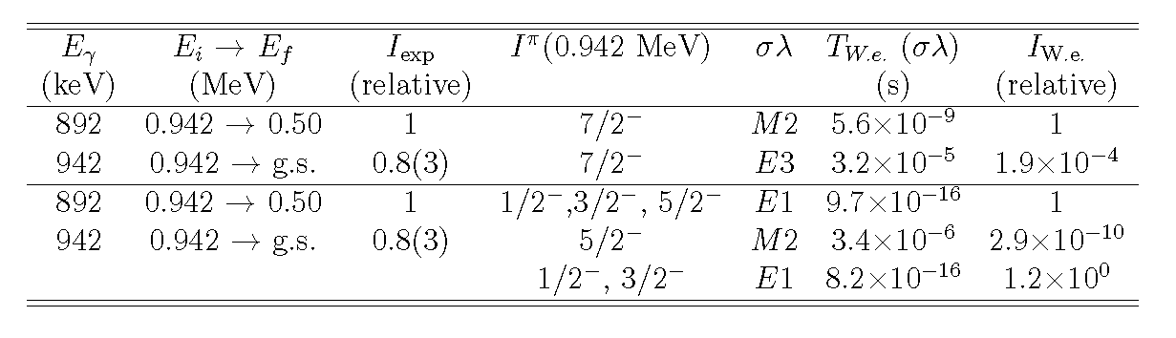
spin-parity assignment of the levels at 1.436 and 0.942 MeV
1/2+
2.244
(1) 1.436-MeV level
808
2244
[0.03]
[1]
1.436
1/2+
0
hindrance factor of E1 : ~10⁻² from 2.244 ---> 0.221 MeV
(1/2+) (3/2-)
(2) 0.942-MeV level
1/2+
0.942
942
892
[1]
[0.8]
0.50
1/2+
0
3/2+

Slide 39
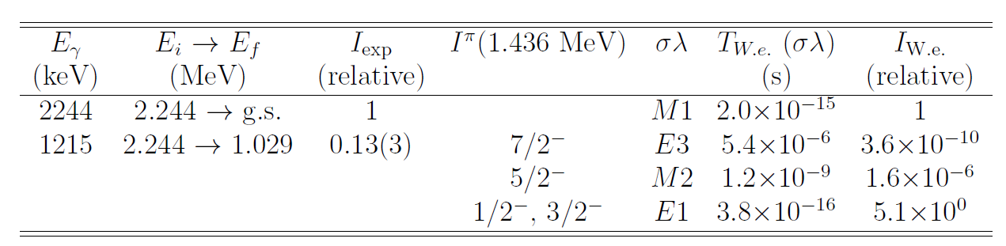
spin-parity assignment of the level at 1.029 MeV
1/2+
2.244
1215
2244
[0.13]
[1]
1.029
1/2+
0
hindrance factor of E1 : ~10⁻² from 2.244 ---> 0.221 MeV
(1/2+) (3/2-)

Slide 40
(1/2-,3/2-)
1.436
(1/2-,3/2-)
相対強度
1
M1/E1
1/1
2.8
M1/E1
1.1/1.1
相対強度
1.029
0.942
1
E1
1
36.7
M1
1.5
相対W.u.
1
M1/E1
1/1
1.2
M1/E1
0.89/0.85
相対W.u.
(3/2-)
3/2+
3/2+
0.221
3/2+
1/2+
0.050
1/2+
0.050
0.050
0
0

Slide 41
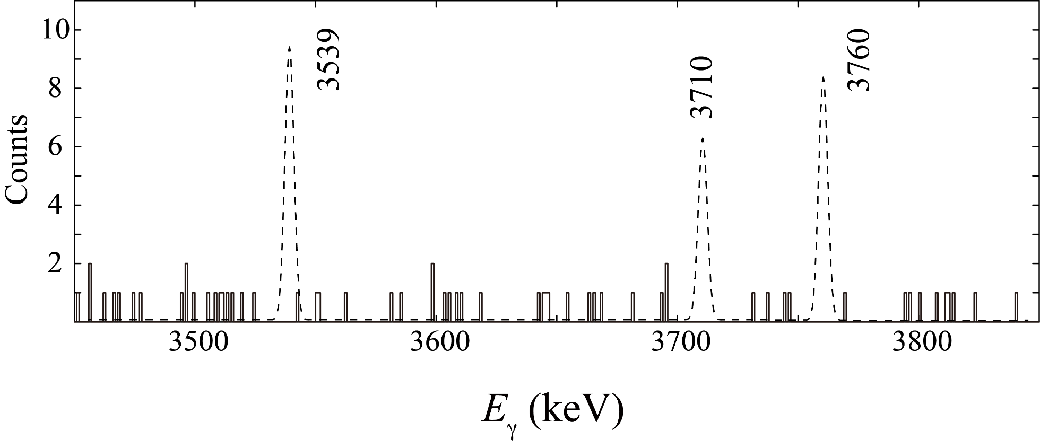
No such high-energy γ-rays were observed.
Detection efficiency with β-gate is taken into account.

Slide 42


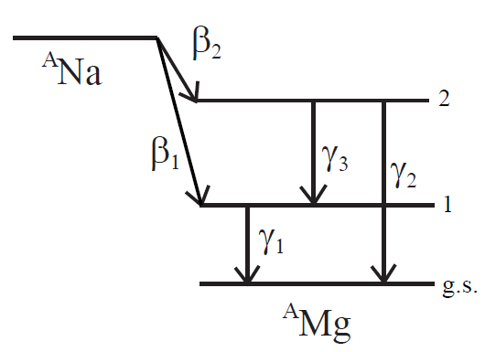


In the case of cascade feeding
Deduced A from β-γ coincidence is affected by the feeding from upper levels.
measured from β-γ₁ coincidence
known
unknown

Slide 43
Achieved polarization
Phil Levy @TRIUMF
⁸Li: 80%, ⁹Li: 56%, ¹¹LI: 55%,
²⁰Na: 57%, ²¹Na: 56%, ²⁶Na: 55%,
²⁷Na: 51%, ²⁸Na: 45%,
²⁸Na: 28%, ²⁹Na: 36%,
³⁰Na: 31%, ³¹Na: 32%
Corrected for spin-relaxation
K. Minamisonno et al.,
Nucl. Phys. A746(2004)673c
Uncorrected for spin-relaxation,
attenuation due to solid angle

Slide 44
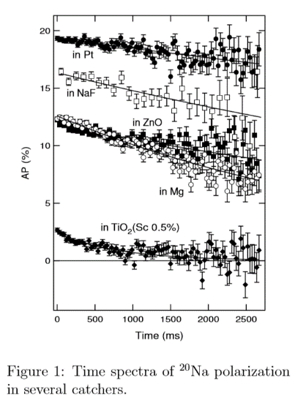
Spin Relaxation
Pt B₀ = 0.5 T
²⁰Na 22.0(19) s
²⁶Na 0.78(8) s
Korringa’s relation
T₁×T ∝ (Ih/μ)²
³⁰Na 600 ms
³¹Na 400 ms
48 ms
17 ms
K. Minamizono et al.
Hyperﬁne Interactions 159, 261 (2004)

Slide 45
³¹Na β-decay
17.0ms
or
17.35ms
[ 98.3%
or
93.8% ]
[ >98.4% ]
236ms
644ms
157.36m
stable
β−
β−
β−
β−
³¹Na
³¹Mg
³¹Al
³¹Si
³¹P
[ 61.8% ]
[ 1.7%
or 6.2%]
[ <1.6% ]
β⁻n
β⁻n
β⁻n
335ms
3.62s
stable
β−
β−
[ 37.3% ]
³⁰Mg
³⁰Al
³⁰Si
β⁻2n
[ 0.87% ]
1.30s
6.56m
stable
β−
β−
²⁹Mg
²⁹Al
²⁹Si

Slide 46
TRIUMF Mass separator
TRIUMF Mass separator
ΔM/M ～ 1/10000
³¹Na-³¹Mg
ΔM/M ～ 1/1825
³¹Na-³¹Al
ΔM/M ～ 1/1050

Slide 47
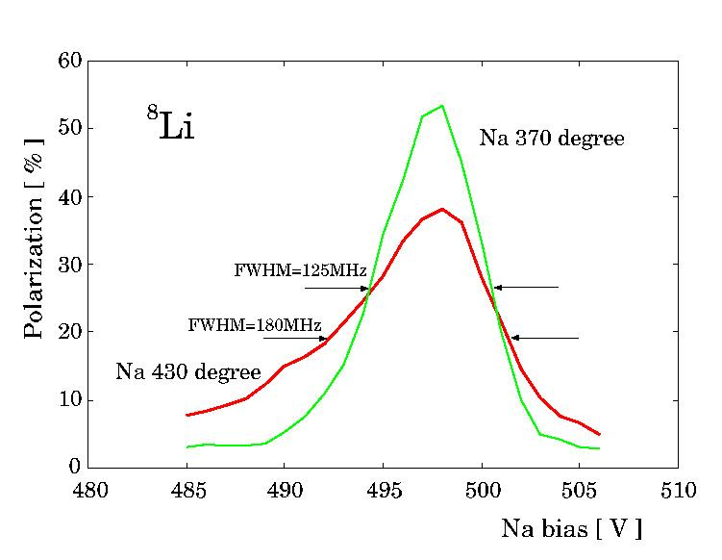
energy (Doppler) broadening of the neutralized beam
>> laser line width
～ 1 MHz
6.3 eV
multiple collisions with Na atoms in the neutralizer

Slide 48
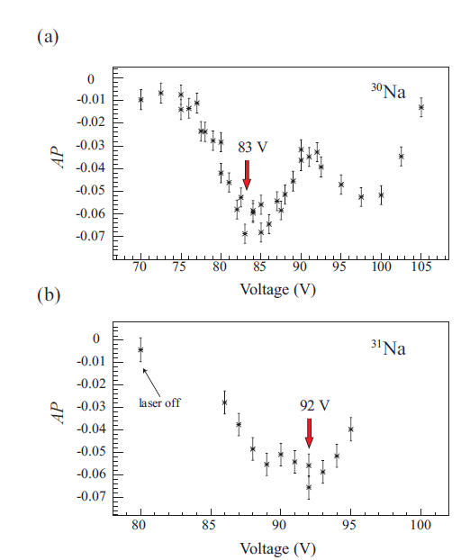
Beam tuning
共鳴点のサーチ
Na cellのvoltage
をかえる

Slide 49


beta-decay asymmetry
Doppler-shift tuning
¹¹Li
deceleration bias (Na vapor cell)
tuning to adjust ion beam velocity
so as to meet the Doppler shift
absorption line
scanning velocity
ν
fixed
ν

Slide 50




Slide 51

Comparison with shell model calculation
G. Neyens et al., Phys. Rev. Lett. 94, 022501(2005)
M. Kimura, Phys. Rev. C75, 041302(R) (2007)
Notes:
51

Slide 52

spin-parity of the ground state in ³¹Mg : understanding from the shell model
[USD interaction]
Magnetic moment
[MCSM]
sd-p_{3.2}f_{7/2}
[ANTOINE]
full sd-pf
μ= -0.88355(15) μ_{N}
lowering of
Ex for the 1/2⁺
level
pf-shell
sd-shell
³¹Mg
sdpf-shell
sd-shell
2-particle-2-hole
(2p2h)
G. Neyens et al., Phys. Rev. Lett. 94, 022501 (2005)

Slide 53

Negative-parity states in ³¹Mg
Lifetime measurement in ³¹Na β decay
H. Mach et al., Eur. Phys. J. A 25 s01, 105 (2005).

Slide 54



anti-symmetrized molecular dynamics
plus generator coordinate method (AMD+GCM)
AMD
Antisymmetrized Molecular Dynamics
Reasonably describes cluster states such as ¹²Be
Y. Kanada-En’yo et al.,
Phys. Rev. C 68, 014319 (2003)
GCM
Generator Coordinate Method
treats collective motion

Slide 55

Theoretical Framework of AMD+GCM

Slide 56

Excited States in even-mass Mg isotopes
Examples: 0+ states with different shapes
spherical
²⁶Mg
²⁸Mg
t (³⁰Mg,³²Mg)p
K. Wimmer et al.,
Phys. Rev. Lett. 105, 252501 (2010)
³⁰Mg
Excitation Energy (MeV)
³²Mg
B (E2)
T. Motobayashi et al.,
Phys. Rev. Lett. 346 (1994) 9,
and many others
?

Slide 57

Revised Decay Scheme of ^{28,29}Na and New Levels in ^{28,29}Mg
13 γ rays & 9 energy levels
Spins & parities of 4 levels
3 γ rays & 1 energy levels
Spins & parities of 7 levels

Slide 58


Enlargement of the magnetic field by magnet
Return yoke
(B～200 Gauss)
Permanent
magnet
B (z=0)
816 Gauss
828 Gauss
測定位置 [ mm ]
ＴＯＳＣＡ simulation
Exp.
Notes:
シミュレーションにはTOSCAを用いた
リターンヨークの形状を決定し、200Gaussの永久磁石の磁場は、816Gaussとなり、4倍もの値になった
実際に製作したマグネットとリターンヨーク
実測すると828Gaussになり、シミュレーション通りの結果が得られ、磁場の強化が実現できた。

Slide 59
static magnet to preserve polarization
Return yoke
Plastic Scintilator
Plastic Scintilator
Permanent magnet
Pt stopper
Notes:
200Gaussの永久磁石がある
リターンヨークを付けて強化しようとした
どのような形状にするかは、ビームラインで制限されていた
・マグネットは中空にし、偏極軸に対して平行に設置したGeでβ線を取れるようにする
・ビームライン上にかぶる形にするため、穴が開いた形状
・多数のGeが上の配置図のようになる
のをクリアするため、最終的にこの形状にした。

