Slide 1
GeantV – Structure and interfaces
Andrei Gheata and Alberto Ribon (CERN) for the GeantV development team

Slide 2
Overview
CORE
RUN MANAGER
CONFIGURATION
USER APPLICATION
PHYSICS
EVENT SERVER
BASKETIZER
SCHEDULER
PROPAGATOR
EVENT GENERATOR
GEOMETRY NAVIGATION
CONCURRENCY SERVICES
VecCore
BACKENDS
CONCURRENT I/O
Notes:
Main components of the system in the form of an overview. Several bits and pieces of the initial prototype that grew-up in different phases of the project and now are making up a more coherent framework.

Slide 3
Starting a GeantV application
Create a configuration object
  Configure GeantV: #events, event buffer size, vector size, geometry, physics, ...
  Configure concurrency: max. threads, #propagators, use threads/tasks
Create the user application and primary generator
  Derived from base classes having curently a minimal interface
Create a run manager and initiate event loop
  After connecting configuration, user application and generator
Examples provided as executables or root macros
Notes:
We have mainly focused in the R&D phase on demonstrating performance, so the interfaces in GeantV are in the “infancy” stage, providing only the minimum required by the prototype.

Slide 4
Main concept
Increase the instruction/data locality by “holding” more tracks to be processed by the same instruction sequence
  E.g. particles in the same geometry volume will use the same geometry algorithm for exiting, electrons will undertake the same physics processes
  Will profit cache coherence and vectorization
Increasing the effectiveness of gathering large “baskets” of similar tracks can be done at the expense of keeping many tracks in flight
  Mix tracks from different events
  Do the basketizing concurrently, otherwise we would need <ncores> more events in memory to achieve the same efficiency per thread AND using all resources
  Dealing with more tracks require memory management mechanisms
    Explained in detail in the “Parallelism, transport structure and overall performance” talk

Slide 5
Workflow
Scheduler
geometry baskets
Workload manager
Basketizer
Flow
Controller
Event
Server
concurrent
queues
Primary generator
Filters
Geom
Transport
manager
(Fast)
Phys
Physics SOA
Geometry SOA
in development
Physics
(propose step)
Geometry
Interfaces
physics baskets
Field
Propagator
User application
Concurrent
I/O
Hits
MC truth
User
actions
Physics actions
(along step, post step, at rest)
Notes:
The core of GeantV is the track propagator. This is composed by a workload manager, taking as input a basket of tracks in the same logical volume and calling the geometry and physics methods required to perform a “multi-particle” step, plus a scheduler, doing the filtering and basketizing of tracks coming from transport into vectors of tracks grouped by geometry or physics locality criteria. The work is balanced by a concurrent queue shared by many workers.

Slide 6
Fast simulation hooks & flow
R&D
Fast simulation filters foreseen in the track data stream
  Generating shortcuts exiting to other streams
GeantV scheduler
Data stream<Track>
SimulationFilters
<Track>
FastGeom filters
<Track>
FastSim filters
<Track>
particle, region, energy, …
Parameterized
det. response
The framework may construct the parameter database learning from full sim + response from user module
Full simulation
Geometry/mat. parameterizations
Frozen showers/ fast tracking
Tracks exiting tracker
User application
Hits
fast sim shortcuts
Data stream<hits>
Trackers
<reco_event>
Digitizers
<hits>
Digits
Data stream<digits>
Reco tracks
Notes:
GeantV fast sim approach can be looked as specialized filters inserted in the MCtruth tracks data stream, using parameterized geometry and/or tracking and/or detector response to generate shortcuts to other data streams (e.g. reconstruction). Having access to both MCtruth and response functions from the user application (reco/analysis) the framework may also be used to construct parameterizations for some common use cases.

Slide 7
CORE

Slide 8
Core functionality
Provide data structures and concurrent services
  Track AOS/SOA, data factories, pools, queues, basketizers
Dispatch and control the concurrent workflow
  Specialized concurrency services minimizing contention
  Monitor workflow and take actions according the conditions
    Work balancing, flushing pending baskets, switch between vector/scalar modes, prioritizing transport of certain events, …
Enforce work coherence by packing particles in vectors
  Grouped by criteria maximizing code locality (geometry, physics)
Provide vectorization tools for geometry and physics algorithms
  Including back-ends adapted to the machine architecture

Slide 9
The run manager
Entry point for steering the GeantV run
  The run configuration, event server, physics and I/O (MC truth) managers are connected to it
No static access, the run manager is percolated in GeantV and user code via interfaces
  Member of GeantTaskData, holding GeantV state information
Coordinates:
  initialization (geometry, physics)
  event loop control (internal or external)
  list of propagators (see next)
  work stealing control
  run termination

Slide 10
Propagators
GeantPropagator – class controlling the GeantV transport core
  Work queue + WorkloadManager + Scheduler
  Steering a fixed number of co-operating working threads
  Re-designed to handle a part of the machine’s hardware
    A cluster of threads on the same processor
    NUMA-aware, using knowledge of the HW threads pinning/ memory partitioning – under development
GeantV can fill a machine with one or more propagators
  The objective is to increase data/processing locality and cut down contention
Propagators handle their own basket queues and generally work standalone
  When propagators are detected to become idle, their work queue is fed by the run manager from the “wealthy” ones

Slide 11
Data structures: AOS versus SOA
GeantTrack
GeantTrack_v
Contiguous, aligned buffer
00
40
80
C0
00
fEvent
fNode
fParticle
fPDG
…
fXpos
fYpos
fZpos
fXdir
fYdir
fZdir
…
Edep
Pstep
Snext
Safety
*fPath
*fNextpath
*fEventV
*fNodeV
*fParticleV
*fPDGV
…
*fXposV
*fYposV
*fZposV
*fXdirV
*fYdirV
*fZdirV
…
*fEdepV
*fPstepV
*fSnextV
*fSafetyV
**fPathV
**fNextpath
vector 1
fEventV
fNodeV
fParticleV
…
AOSOA considered also (more cache friendly):
{(xxxx)(yyyy)(zzzz)},
{(xxxx)(yyyy)(zzzz)},
…
fXPosV
fYPosV
fZPosV
…
SOA of fNtracks
fSnextV
fSafetyV
192 bytes + 2*sizeof(VolumePath_t)
fPathV
fNextpathV
vector 2
fEventV
fNodeV
32 tracks ~ 7kBytes
AOS
(xyz)(xyz)(xyz)(xyz)…
SOA (needed for vectorization)
(xxx…)(yyy…)(zzz…)
Ready to use, SIMD-ized, serializable
Overheads for basketizing, data copy, reshuffle operations, larger memory footprint
  Morphing AOS->SOA needed during transport

Slide 12
Synchronization objects
Used in GeantV for concurrent services: data gather/scatter, workload balancing, I/O, data services
  Generally lock-free, minimizing ‘Amdahl’ in low contention regime
Concurrent queues
  Multi-producer/multi-consumer (MPMC) – basket distribution to workers
  Multi-producer/single consumer (MPSC) – concurrent I/O
Basketizers
  Chopping data coming from multiple producers into groups
Data factories – pre-allocated, reusable
  Templated on user data (factories) or specialized pools (e.g. tracks)
  Allocating blocks of multiple objects with lock-free “Get/ReleaseObject”-like interface
Notes:
For the primitives implementation, we have tried using existing libraries such as Boost and TBB. Chosen own implementation for most structure, due to their specialization (hard to find an efficient concurrent ‘basketizer’ around). We used C++11 features for dealing with lock-free progrmming, rather than existing libraries.

Slide 13
Example: Basketizers
Assembling concurrently groups of tracks
  AddTrack() interface
  Filling in lock-free manner a GeantTrack_v container up to a threshold
  Deploying the container in the client propagator work queue
Current scheme using GeantTrack_v SOA to rebasketize
  Highly optimized, lock-free
  Involves important data copying, reducing the basketizing effective throughput
    Generates sizeable Amdahl for high basketizing rates
AddTrack
Basketizer
Recycle

Slide 14
New: AOS basketizer
N_{copy}=7
AddTrack(Track *tr, std::vector<Track*> &extract)
Idea: Work with AOS for basketizing, copy to SOA only when deploying to geometry/physics
  Lightweight basketizing: regrouping pointers rather than complete tracks
Now integrated in GeantV
  Circular buffer, fixed size baskets
  No memory barriers
  Better scalability
Push & extract in the same method
  Fills std::vector<Track*>
N_{copy}=3
ibasket = ibuf & basket_mask
ibuf = icrt & buffer_mask
phys. cores
max speed-up SOA basketizer
Notes:
The SOA basketizer getting a max speed-up of ~20. AOS->SOA coversion done only when needing to dispatch data to geometry/physics, and ONLY for the required fields. We consider using HW to help this operation in future.

Slide 15
Concurrent I/O
Not re-inventing the wheel: using ROOT as I/O technology
  Writing standard root tree for hits/MC truth kinematics
2 models tested:
  Many producers of data, one thread responsible for writing to file
    Amdahl problems since writing includes serializing/zipping
  Many producer of memory resident files, one thread responsible of merging them + writing the output
    Much higher throughput achieved since serialization/zipping done per worker
See talk on “Output and utilities for details

Slide 16
GeantV MC truth
Handling of particle history is problematic per se and multithreading adds complexity
  tracking of daughter particles can completed before mother particle ‘end of life’
GeantV focuses on providing light and flexible interface to particle history
  Framework provides the ‘handles’ to store concurrently event trees
  User has to implement implements his concrete MC ‘selection algorithm’ and conversion to his event record
Concrete example provided, see talk on “Output & utilities”

Slide 17
USER APPLICATION

Slide 18
User application
Mandatory user class connected to the run manager
  Used to notify the user code about run/event/stepping actions
Interface define by base class GeantVapplication
  Currently minimal functionality
    Initialize(), StepManager(), FinishRun() – sufficient for performing benchmarks
  To be extended to provide a full suite of user actions similar to G4 one
Interface extended to interact with task-based user framework
  Steering event loop from user application
  Optionally controlled via TBB tasks:
    SpawnEventLoopTask(), SpawnUserEndRunTask()
Notes:
As mentioned, the current version of interfaces is in embryonic form, to be extended. StepManager() is equivalent to SteppingAction() in Geant4 language. TBB task mode interacting with user application was recently introduced, will be presented in detail in the concurrency presentation.

Slide 19
Current implementation
fApplication
GeantVApplication
Init() = 0
StepManager() = 0
FinishRun() = 0
GeantRunManager
optional
fPrimaryGenerator
TBBApplication
SpawnProcessEventsTask() provided
SpawnUserEndEventTask() = 0
SpawnUserEndRunTask() = 0
PrimaryGenerator
UserApplication
UserPrimaryGenerator

Slide 20
User application: interfaces
GeantV stepping propagates a basket of tracks
  To their individual geometry/physics limited steps
The user application interfaces using vectors rather than scalar objects for the stepping action:
    StepManager(std::vector<GeantTrack*> tracks, GeantTaskData *td)
A task data object is percolated into user code
  Containing GeantV state interesting for the user (e.g. unique task id)
  “Whiteboard” allowing the user code to post state data, managed by GeantV in a single thread access mode
    no need to manage thread safety for user task data
    user code MUST be thread safe and re-entrant
Notes:
TaskData is a fundamental concurrency concept minimizing the state to be handled concurrently, by just percolating it via interfaces. Task data is unique per thread in the static thread approach of GeantV, or percolated hierarchically in its task-based approach

Slide 21
(User) Data factories
User code needs to allocate/use data objects during simulation
  Issues: thread safety, re-usability, efficiency
  Hits, “summable” digits, tracks
GeantV provides a mechanism to allocate large blocks of user data (per event) using templated factories
  GeantFactory<MyData> *MyDataFactory = GeantFactoryStore::Instance()
  ->GetFactory<MyData>(nevt, nwrk)
  MyData *obj = MyDataFactory->NextFree(ievent, taskId)

Slide 22
Event generators and event server
Events can be injected in GeantV using the PrimaryGenerator interface
  userGenerator->InitPrimaryGenerator();
  GeantEventInfo &info = userGenerator->NextEvent();
  for (int itr=0; itr<info.ntracks; ++itr) {
  GeantTrack &track = trk_mgr.GetTrack();
  userGenerator->GetTrack(itr, track);
  }
Simple functionality available for now:
  Eta, phi, momentum cuts
  Vertex per event
Primary events injected into concurrent GeantV event server at beginning of run
  Or at the beginning of each event loop if steered by user code
UserPrimaryGenerator
AddEvent()
GeantEventServer
track buffer
concurrent clients

Slide 23
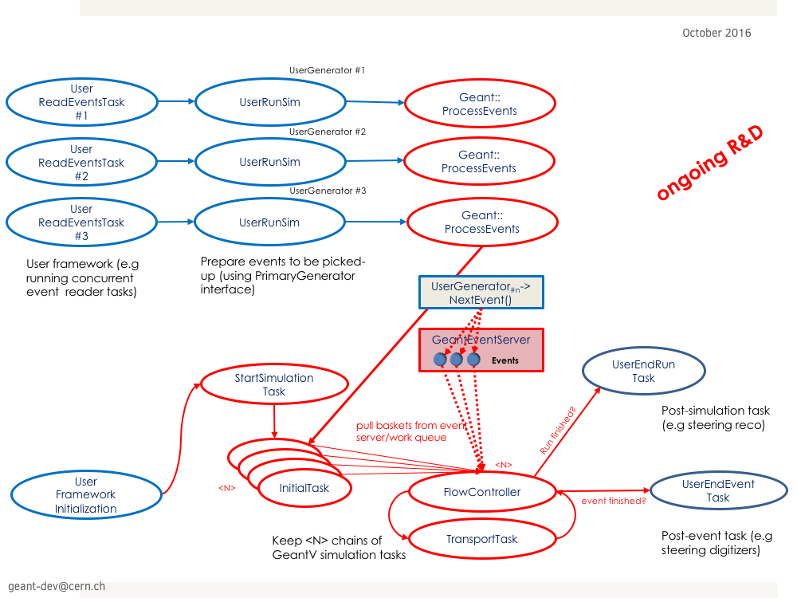
User application: TBB interface
New TBB approach recently developed
  Working on interaction with user task-based framework
  Presented in detail in the parallelism talk

Slide 24
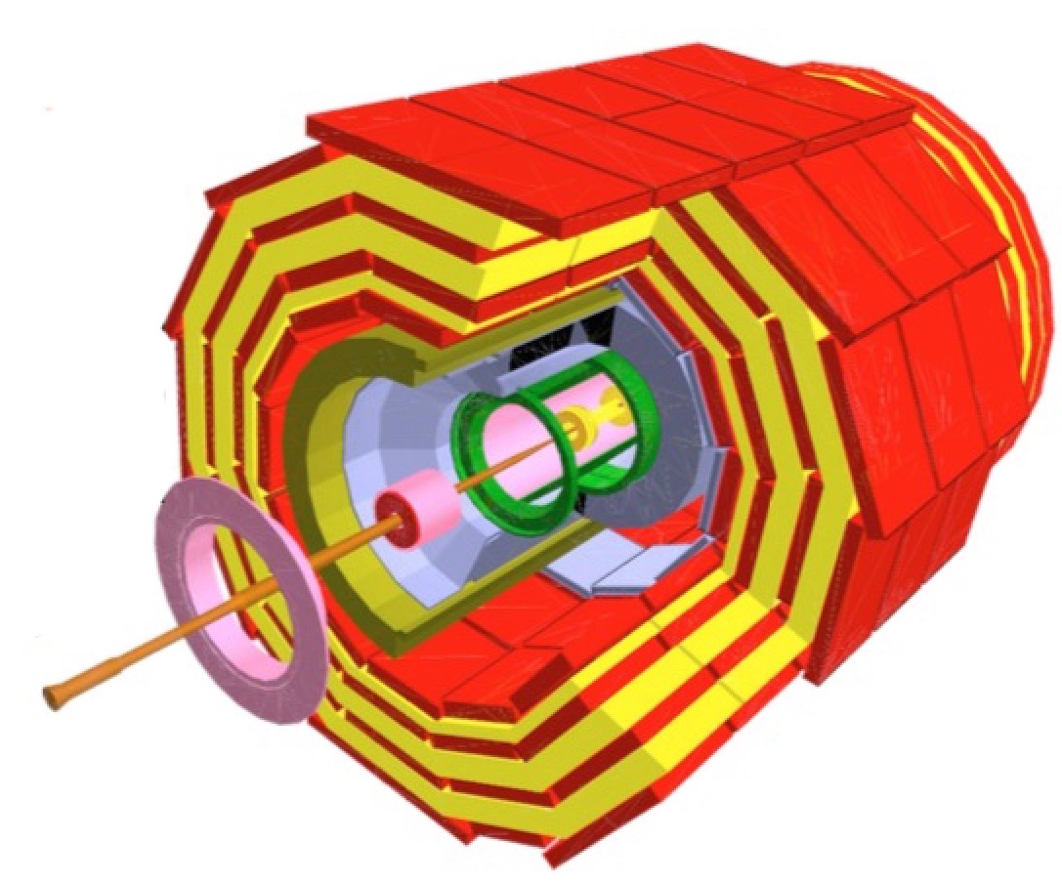
GEOMETRY

Slide 25

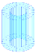

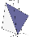



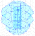

VecGeom – GeantV geometry package
Geometry algorithms are expensive in the simulation budget
  Optimizing them for the GeantV vector use case was required
Get maximum profit from “multi-particle” requests
Not just another geometry package
  VecGeom emerged from an existing Geant4 + ROOT geometry unification effort, taking it to the next level
  Final goal is to integrate VecGeom with Geant4 and ROOT
See geometry presentations
Safety
DistanceToIn
DistanceToOut
Normal

Slide 26
Geometry interfaces
GeantV maintains a generic interface to geometry
  Supporting multi-particle interfaces, having both vector and scalar (loop based) implementations
Possible to run GeantV with VecGeom, but also with any other geometry modeller
  TGeo interface supported, mainly to have a stable reference

Slide 27
PHYSICS

Slide 28
Tabulated physics
First, very rough “physics” developed for GeantV
  In order to have (in a short time, with a crude interface) something “reasonable” to play with
    for scheduling, basketizing, vectorizing, etc.
  Tabulated cross sections and final states, as extracted from Geant4
    for fixed (energy) production cuts and no multiple scattering
    for all particles and elements, for a grid of energies
  Several, obvious limitations on the physics
    limited final-state possibilities
    energy-momentum conservation only statistically
  Only a temporary solution for developers, until the real physics simulation is implemented

Slide 29
GeantV Plan for Physics Development
Design of the Physics Interface
Review of the main electromagnetic physics processes
  ionization, bremsstrahlung, multiple scattering
  photoelectric, Compton, pair production
=> needed for simulating electromagnetic showers
Review of the main hadronic physics models
  String model (QGS), intranuclear cascade model (BERT-like), precompound/de-excitation
=> needed for simulating hadronic showers
Start with high-energy applications, but with low-energy extensions in mind
  e.g. low-energy neutrons already considered...

Slide 30
Goals of the Physics Interface
Create the basic infrastructure to fit the whole physics of GeantV
Decay
Electromagnetic physics
Hadronic physics
Fast simulation
Biasing
etc.

Slide 31
Strategy
Keep a small coupling between kernel and physics
  Keep transportation in the kernel, outside physics
Leverage as much as possible on the experience in design and development of Geant4 physics
  Trying to streamlining it, e.g. reducing the inheritance depth and the number of classes
  Boosting its CPU performance by replacing, whenever possible, e.g. virtual function polymorphism with static template polymorphism
  Offering thin interfaces for direct calls to cross sections and final-state models
  Two complementary strategies:
  1. Reviewing the physics and writing code from scratch
  2. Exporting code from Geant4 and adapting it into GeantV, to quickly investigate track vectorization opportunities

Slide 32
Main ideas
As in G4, any physics process can have 3 “components”:
  Along-step, i.e. continuous part of the in-flight process
  Post-step, i.e. discrete part of the in-flight process
  At-rest, i.e. interaction when the particle stops
Discrete and at-rest processes compete, whereas continuous processes collaborate
As in G4, each continuous process can propose a step limitation; but for discrete processes, the proposed step length takes into account the cross sections of all discrete processes of the particle
  Equivalent to G4, and with the same number of random calls
  More adapted for simplicity, locality and track vectorization
  Individual cross sections of the discrete processes are then used to sample the process
  Similar approach also for the lifetime of at-rest processes

Slide 33
KERNEL
PhysicsInterface
PhysicsProcessHandler
Outline
Inherits
Calls at initialization
Uses
PhysicsListManager
PhysicsManagerPerParticle
Creates objects at initialization
Contains a list of physics lists
Contains the list of physics
processes of one particle
PhysicsList
PhysicsProcess
Creates objects at initialization
Inherits
Inherits
PhysicsListA
PhysicsListN
ProcessA
ProcessK

Slide 34
PhysicsProcessHandler
Similar to the Geant4 G4SteppingManager concept, this class handles the physics simulation in one step
  It exists only one instance (object) of this class
At initialization, it creates all the physics related objects (managers, handlers, physics tables)
At run time, it decides and calls the appropriate methods to simulate the physics of any given particle happening in one step

Slide 35
PhysicsListManager
Singleton class that handles the physics-list
(per region)
  In nearly all practical cases, only one physics list exists for all regions
  But in special cases, a more sophisticated EM model is needed in one region, e.g. in Geant4:
    Use PAI in ALICE TRD
    Use EM Opt1 (_EMV) everywhere, except in the sampling calorimeter where standard EM Opt0 is used (e.g. ALICE ECAL, CMS HCAL)
Its main work is at initialization
  Creates all the particles and the PhysicsManagerPerParticle objects and all the rest

Slide 36
Physics list
Abstract base class from which any physics list derives from
Its main work is at initialization
  Creates all the physics processes for all particles and assigns to them
Note:
  we assume that all the GeantV particles are always present in any simulation, but by default they have no physics processes associated to them (i.e. they will be transported without interactions, like “geantinos”)

Slide 37
PhysicsManagerPerParticle
Similarly to the Geant4 G4ProcessManager concept, this class keeps the list of physics processes associated to one type of particle
For each physics list, there is one object of this class per particle type (e⁻,e⁺, γ, π⁻, π⁺, p, n, etc.)
Keeps the (total and per-process) lambda tables
  Macroscopic cross sections per material or material-cut
  Built at initialization
  Used at run-time to sample the physics step length and the discrete process

Slide 38
PhysicsProcess
Similarly to the Geant4 G4VProcess concept, this is the (abstract) base class for any physics process associated to one particle type
Main methods
  ComputeMacroscopicXSection
  AlongStepLimitationLength
  AlongStepDoIt
  PostStepDoIt
  AtRestDoIt

Slide 39
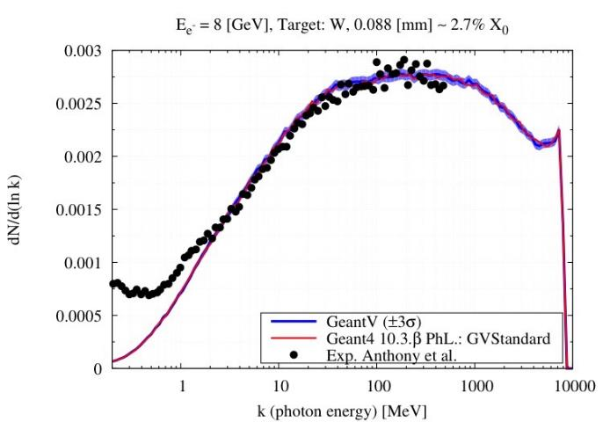
First Physics Result with the
New Physics Framework
See dedicated presentation “New electron physics modelling”
M. Novak

Slide 40
Vector Physics
In parallel to the review and development from scratch of electromagnetic physics processes, on-going work on how to vectorize final-state physics models and evaluating how much we can gain from it
Considered some electromagnetic models (e.g. Compton, photoelectric, etc.), taken from Geant4 and adapted to GeantV, and investigated the replacement of the rejection sampling with alternative sampling techniques
See dedicated presentation “Vectorization of existing physics models”

Slide 41
Conclusions
GeantV started as a prototype focusing on the proof of principle
  Developing bits and pieces needed by concurrency, vectorization of geometry/physics, data structure and management, new model development
    To demonstrate modelling, algorithmic and HPC improvements
  In most cases functionality not available in other libraries/frameworks, or needing adaptations
Current state: consolidation of the core framework/services and interfaces
  New physics interface ready and successfully used for producing the first electromagnetic physics results.
  High performance vector-aware geometry package interfaced in multi-particle mode with GeantV
  Many products/services developed in this phase could be re-stated as community effort
    Integrated in existing frameworks (e.g. ROOT) or becoming stand-alone products
  The acquired knowledge can be useful to many HEP areas
    Concurrency, data management, vectorization, …
Bottom-up and top-down approaches converging to a coherent framework

