Slide 1
D2 Status
P.Fabbricatore
INFN Genova
The contract for the construction of the short model
The present D2 design as starting point of the industrial activities
Some results of the revised mechanical analysis
Conductor insulation, Quench Heaters and Coil wedges

Slide 2
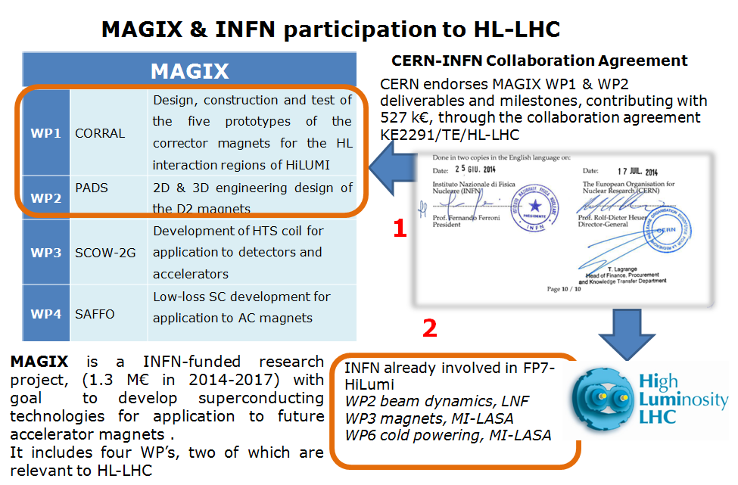

Slide 3
New agreements (under signature) CERN-INFN for magnet constructions
For D2 the agreement is finalised to the construction (in industry) of a short model (1.6 m) and a prototype (8 m).
The short model shall be delivered to CERN at the end of 2017 and tested at CERN in a vertical cryostat.
The prototype shall be delivered at end of 2019, assembled in a cold mass with the correctors, and tested in a horizontal cryostat.
The involved INFN section is the Genova section.
On the basis of this agreement and subsequently to an international tender, INFN has awarded to ASG Superconductors the construction of the short model

Slide 4
Tender and contract to ASG Superconductors
In the framework of the new agreement CERN-INFN the first step is the procurement of a short model. The main aim of the model (1.6 m long) is to verify the magnetic feld cross talk compensation with asymmetric specular coils.
On 2016 May 31th the request for an offer were asked to the 4 companies qualified by CERN. The tender was of the type «Best Quality/Price ratio»
Two offers were received on 2016 July 15th
The selecting board (3 persons) met on July 25th for technical evaluation and on July 26th for opening the envelopes with economical offers. A company was selected.
On Sept. 14th the INFN managment approved the tender. ASG Superconductors to be awarded with the contract, which due to formal technicalities (ex. 35 days waiting time) can formally start within November. The expected delivery is 15 months from contract start. However on Oct. 21st we hold the kick-off meeting.

Slide 5
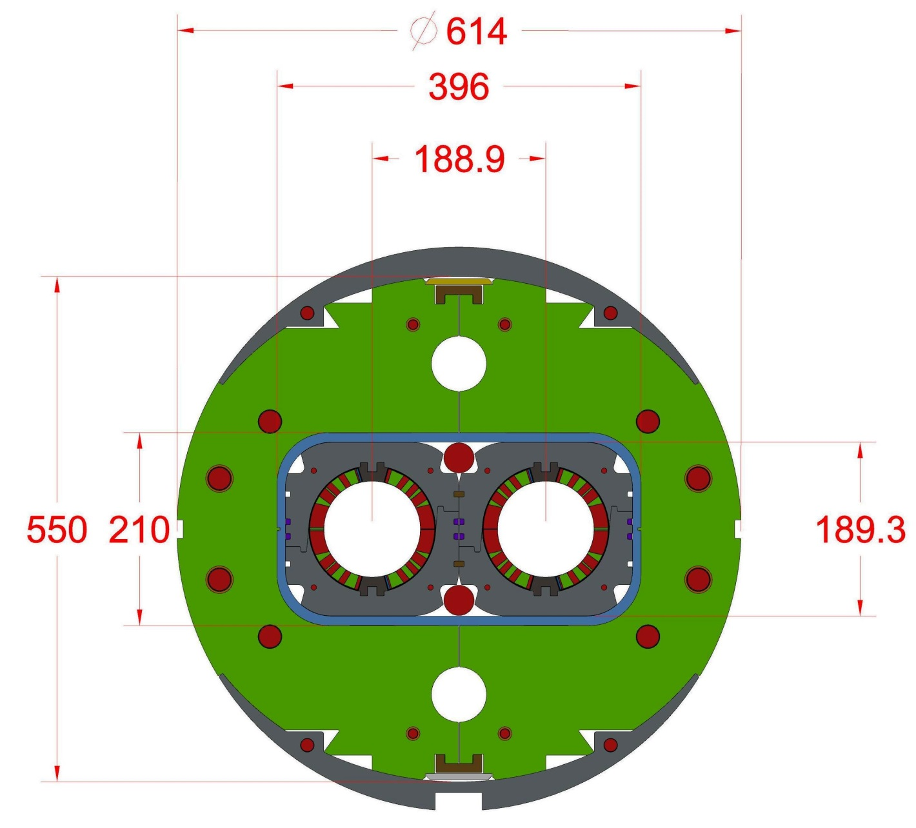
Present cross section of the D2
Aluminum alloy sleeve 6061-T6 or 7075-T6 made of short elements 50-100 mm. At room temperature the gap with collared coils is 0.2 mm
Collars made of austenitic steel. The nose allows future coil modifications without changing the main collar structure
Iron yoke
Asymmetric specular coils
Longitudinal tie rods
Clamps and welded stiffening bars

Slide 6
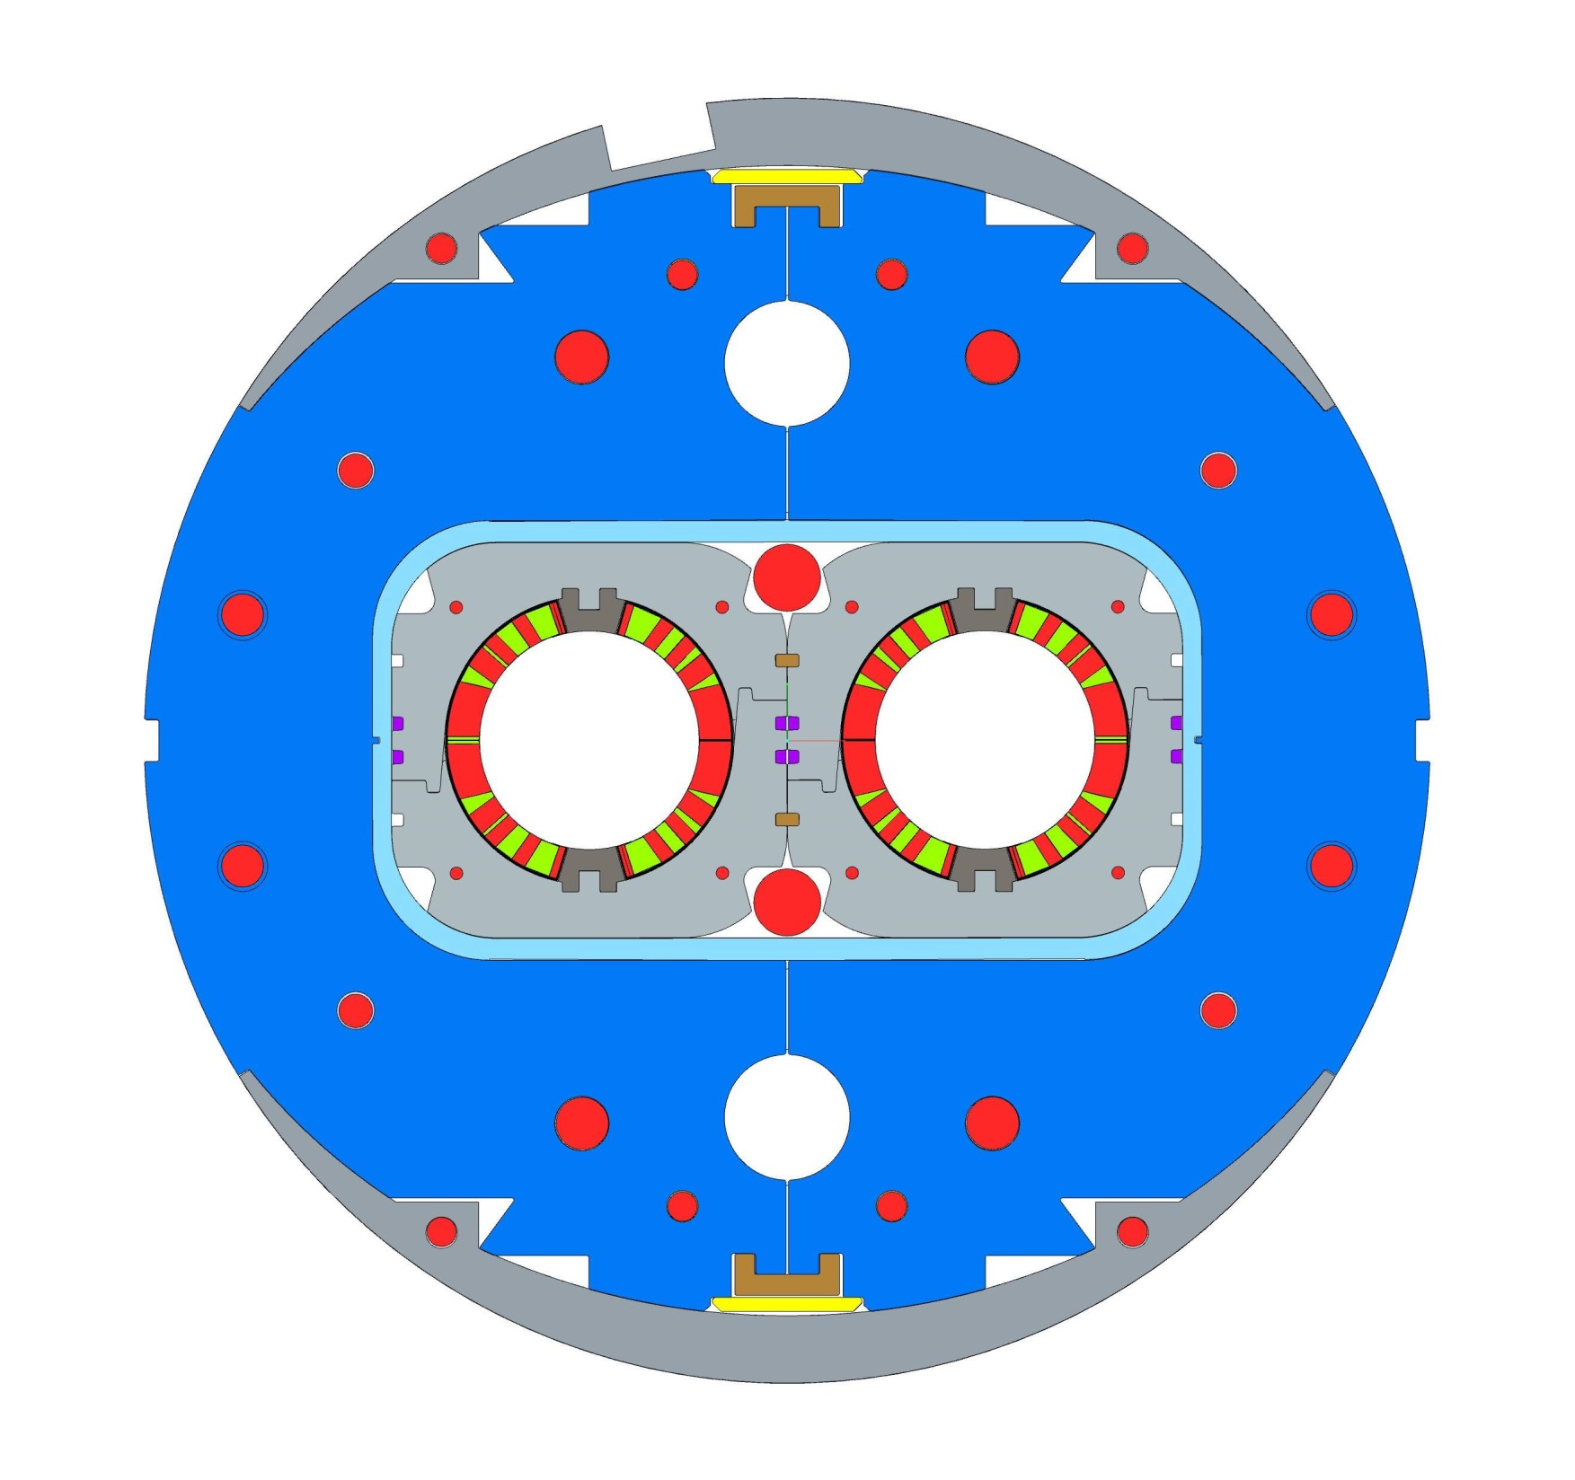
Detail of the collared coil cross section.
The role of the Al sleeves

Slide 7
Field quality and construction phases
Magnetic measurements at room temperature. The measurement of the room temperature multipoles in three stages:
collared coil,
collared coils in the Al sleeve, and
final assembly in the iron yoke.
They will be jointly analysed by INFN and by the contractor to validate the final assembly. These measurements need a stainless steel tube to be temporary installed in both apertures.

Slide 8
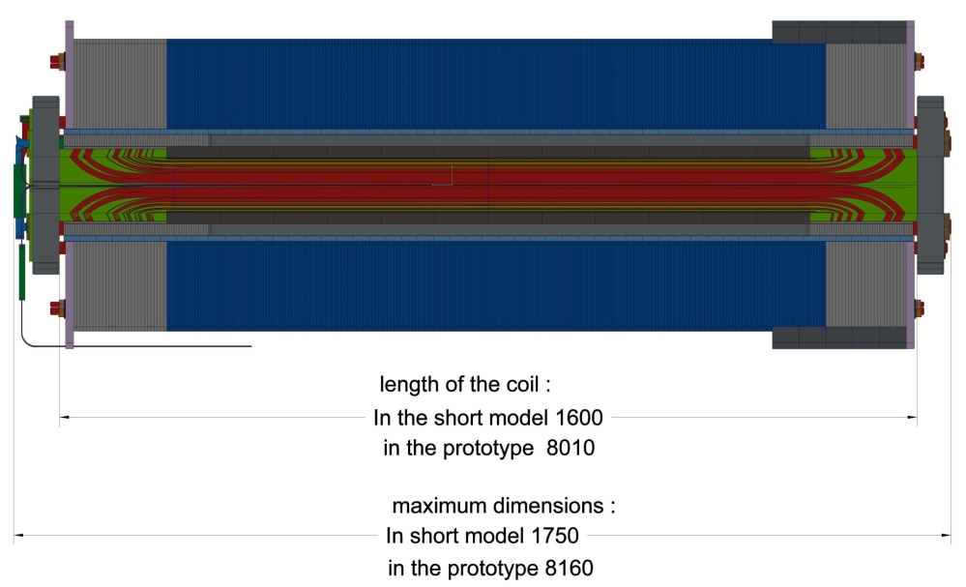
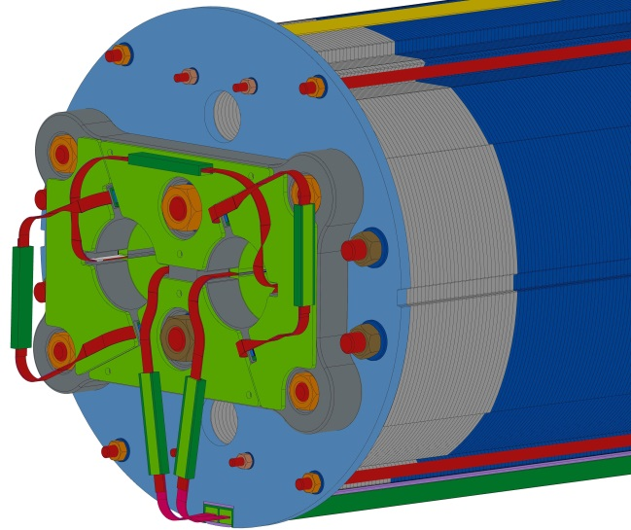
Main Characteristics of the short model
Parameter | Unit | Value
Bore field | T | 4.5
Peak field | T | 5.25
Current | kA | 12.250
Temperature | K | 1.9
Load line margin | (%) | 35
Overall current density | A/mm² | 443
Stored energy | MJ | 2.18
Differential inductance per meter | mH | 27.3
Superconductor |  | Nb-Ti
Strand diameter | mm | 0.825
Cu/No Cu |  | 1.95
RRR |  | >150
Superconductor current density at 10 T, 1.9 K | A/mm² | 2100
Number of strands per cable |  | 36
Cable bare width | mm | 15.1
Cable bare mid thickness | mm | 1.480
Keystone angle | degrees | 0.90
Insulation thickness per side radial | mm | 0.160
Insulation thickness per side azimuthal | mm | 0.145

Slide 9
Scope of the Supply of the ASG Superconductor contracts
The contracts aims at constructing a short (1.6 m) model of D2 magnet. The supply is composed of the following five deliverables:
Engineering design of the short model dipole. The engineering design documentation shall consist in a set of executive drawings and engineering reports covering the whole cold mass design issues: geometrical and electrical lay-out, winding procedures, collaring and implementation of the iron yoke. The activity shall be performed on the basis of this specification and the attached documents. As the contract will be awarded, INFN will provide a set of final drawings developed on the basis of the INFN conceptual design. The firm is obliged to follow the INFN magnetic design.
Engineering design of general equipment for the construction. In this category winding machine, curing press, collaring press, Young modulus measurement tools and other minor equipment are included
Extracted from technical specifications

Slide 10
Scope of the SupplY (cont)
Engineering design of specific equipment for the winding, the thermal curing of the coils and the integration into the iron yoke. In this category winding mandrel, polymerization moulds and yoke integration tool are included.
Construction of the cold mass. This includes activities and part of the materials for 4.1) Winding of the two coils composing the dipole with an insulated cable provided by INFN; 4.2) Curing; 4.3) Collaring; 4.4) Collared coil integration; 4.5) Iron yoke integration, 4.6) Electrical exits preparation and instrumentations, 4.7) Quality control. Some materials will be provided by CERN through INFN as described later.
A complete set of documents at the conclusion of this contract including a complete set of "as built" assembly and detail drawings of all the components associated with this contract, both in hard copies and as electronic files according a format to be agreed
Extracted from technical specifications

Slide 11
Items and Services provided by INFN/CERN
INFN will provide the following items and services:
4.1 Nb-Ti insulated superconducting cables;
4.2 Stainless steel collar raw material;
4.3 Iron yoke raw material;
4.4 Quench heaters.
4.5 An engineering design including:
• Electromagnetic design of the cross-section;
• Coil end design;
• Mechanical structure based on separate collars;
• Iron yoke design;
• Lifting interface features;
CERN
INFN

Slide 13
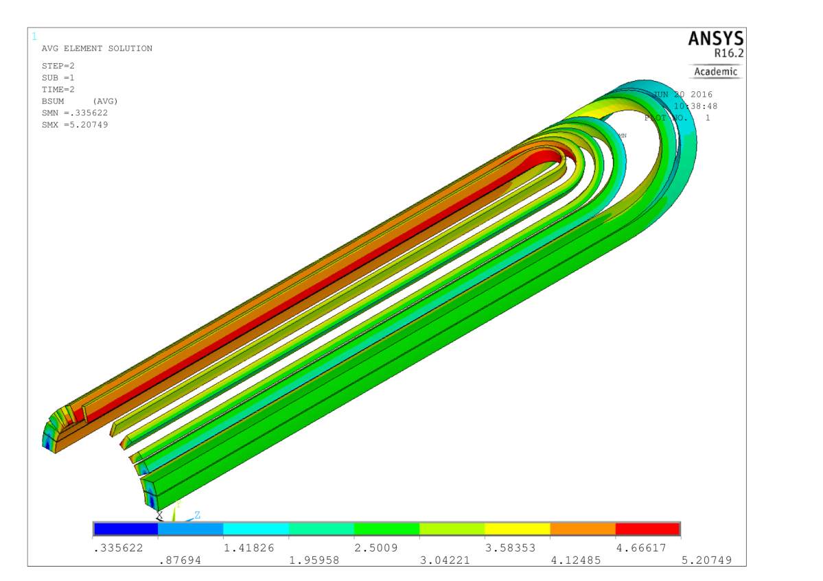
The mechanical analysis was completely revised due to a modification of the longitudinal pre-stressing system
The total axial magnetic force sums-up to 264 kN (calculated with both ANSYS and Roxie).
This force is held by the prestressed magnet (coils +collars) and by longitudinal tie-rods. Recently the tie rods diameter was increased and we have now six ss tie rods (two 30 mm diameter and four 25 mm). Collars were modified.
The total longitudinal displacement due to magnetic force for the 8 m long magnet is about 0.15 mm (each side). The revised 3D mechanical analysis is still under way

Slide 14
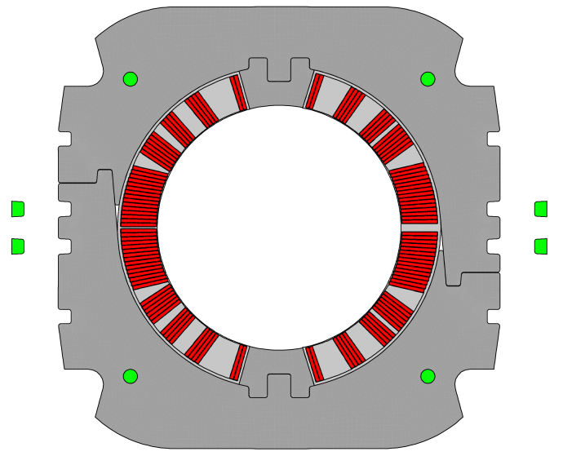
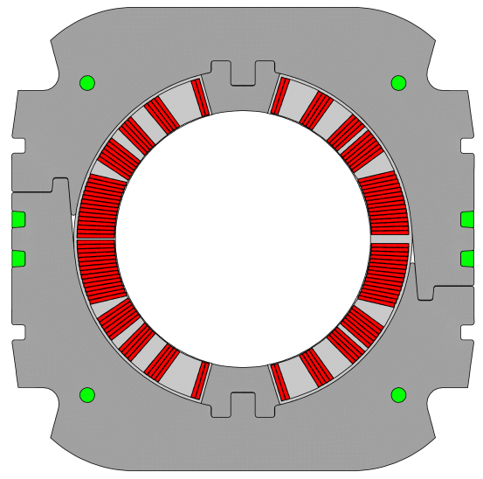
COLLARING
a pressure is applied to align the holes, the keys are inserted, the pressure is released
Δy=+0.12 mm
Δx=-0.11 mm
F=397 ton/m
Δy
Δx
Δy
average stress in the winding:
87 MPa
average stress in the winding:
76 MPa

Slide 15
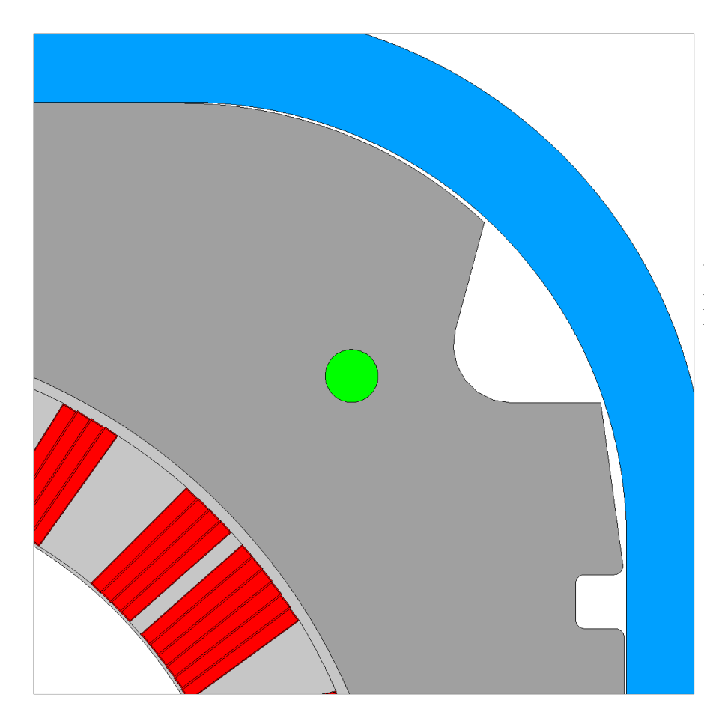
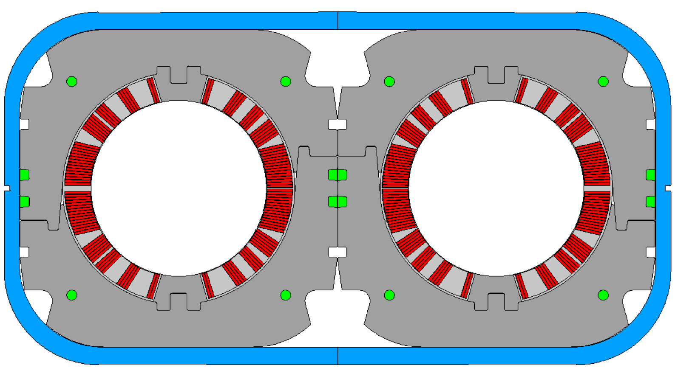
Al alloy sleeve insertion
no stress results from this operation because of the continuous 0. 3 mm gap between collars and sleeves
rc=50 mm
0.3 mm geom. gap
0.18 mm residual gap
rc=49.5 mm
0.3 mm geom. gap
0.37 mm residual gap

Slide 16
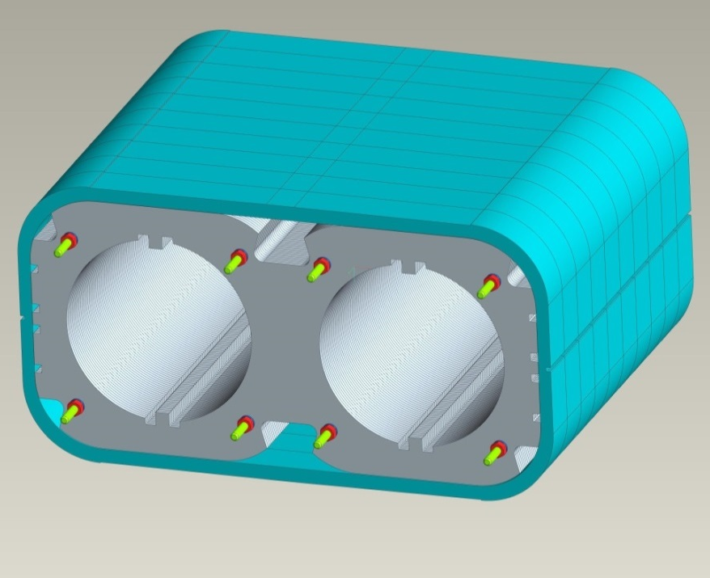
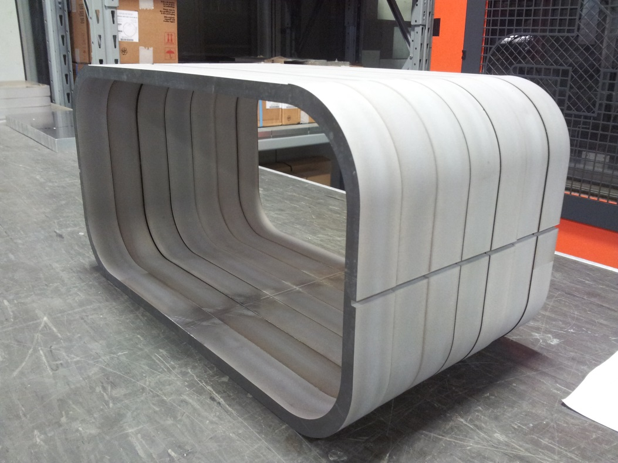
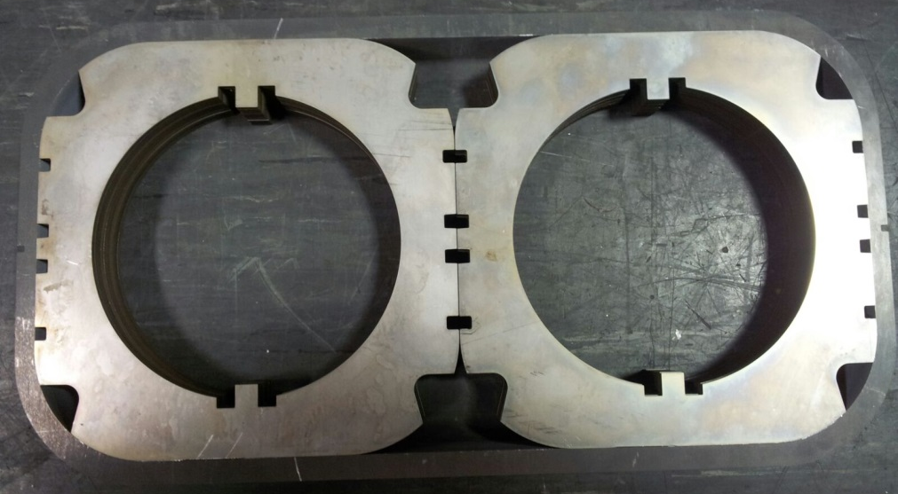
Mock-up
The moke-up construction was finalised to better understand the integration of collared coils into the Al sleeves with 0.2 mm gap any side, is finished.

Slide 17
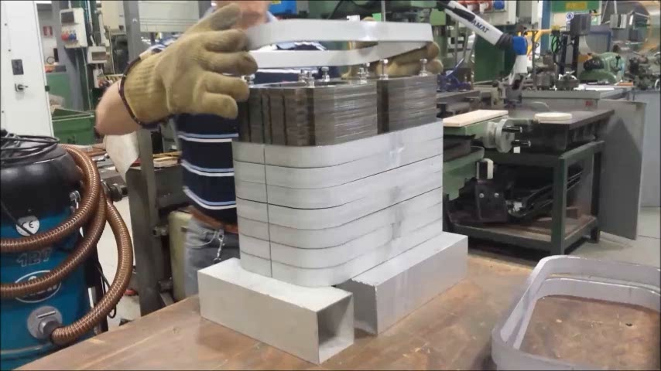
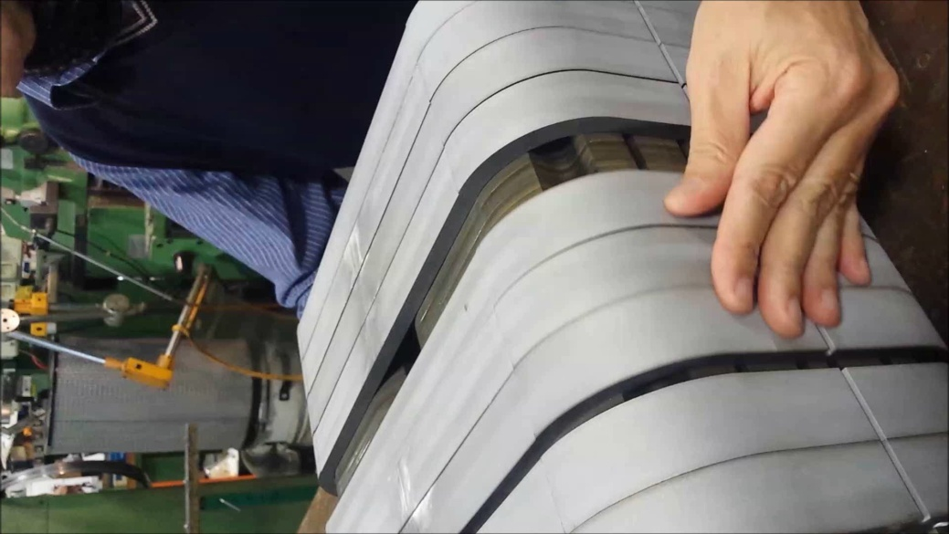
Integration of collars into the sleeves (0.2 mm any side)
Vertical - Al sleeves warmed up 120 C Horizontal- Sleeves at room temperature

Slide 18
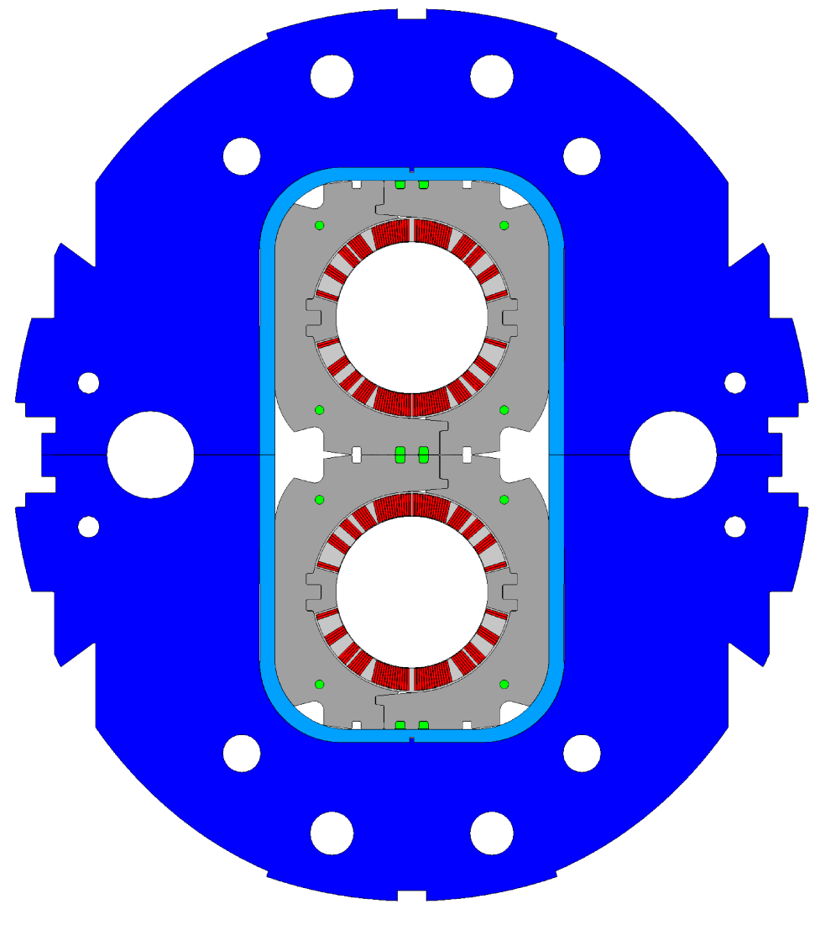
Iron yoke assembly
0.6 mm per side for a total of 1.2 mm gap between the two halves of the yoke
the assembly is done under pressure with no effect on the collared coil
F=271 ton/m

Slide 19
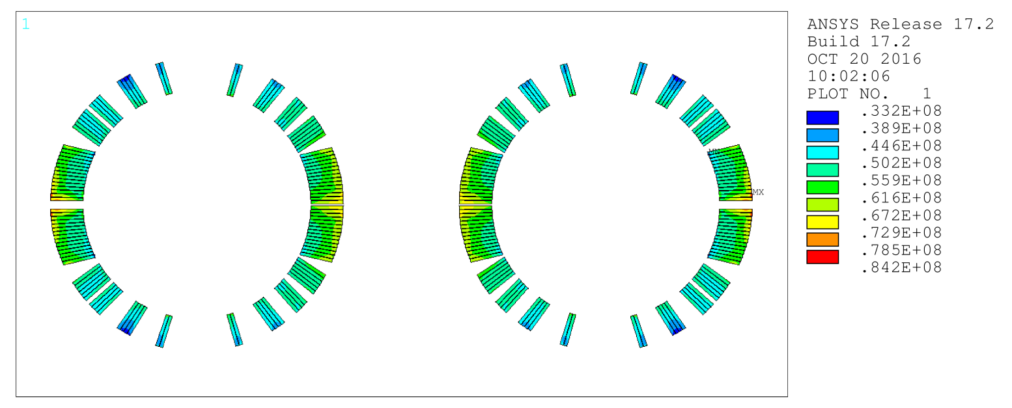
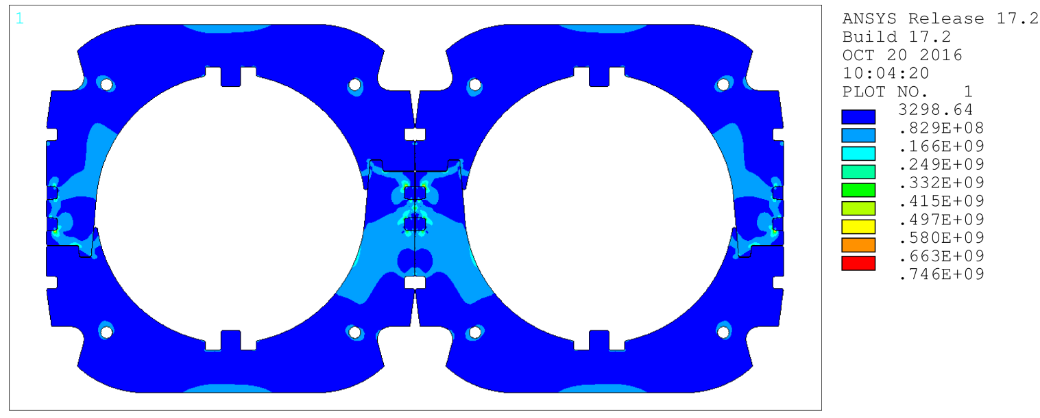
Stress in winding and collars after cool-down
<σ_{VM}>=54 MPa

Slide 20
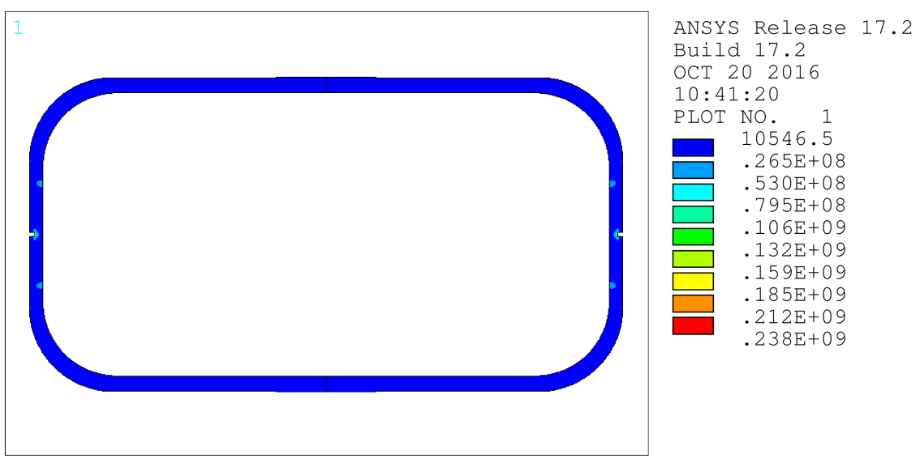
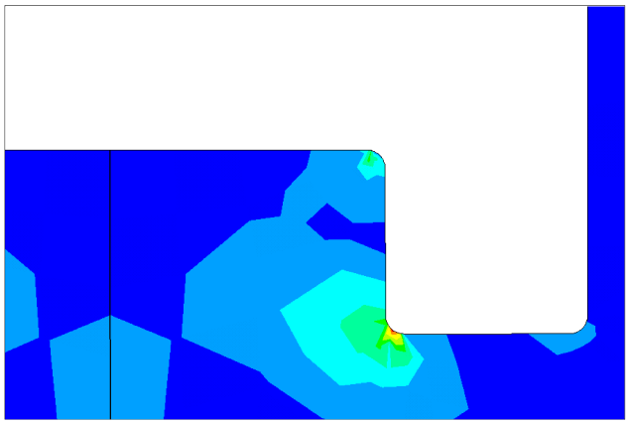
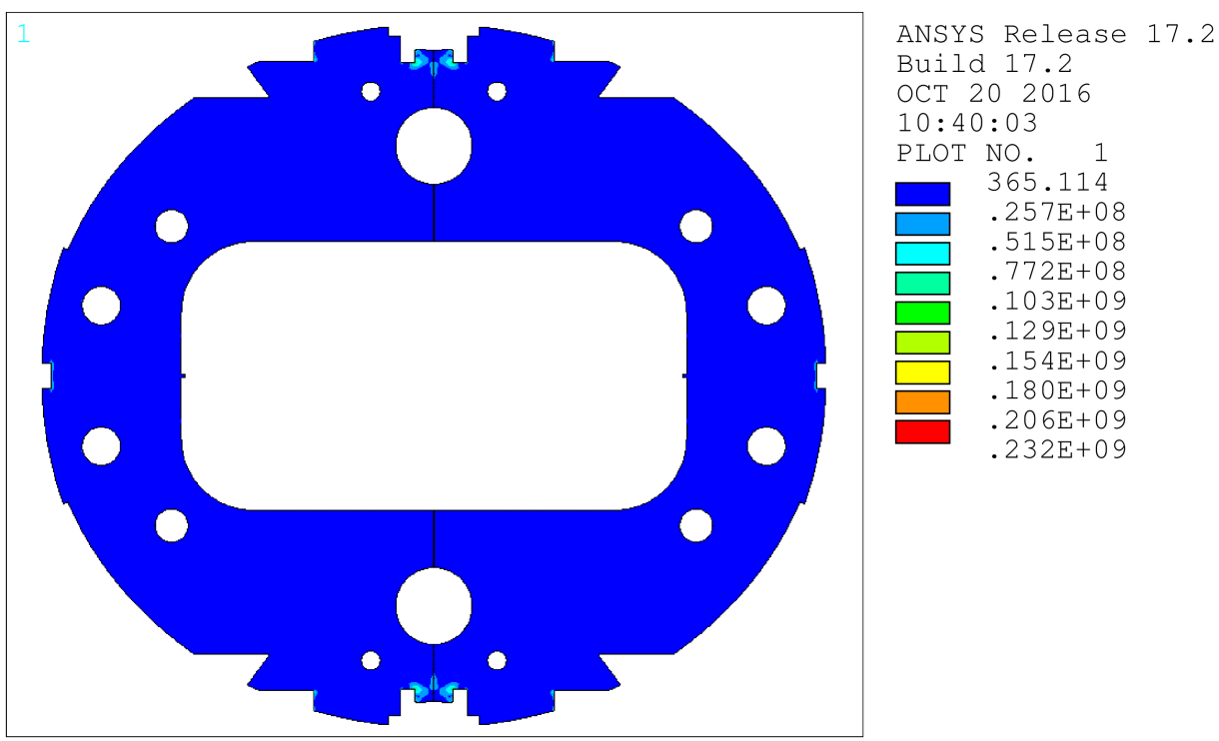
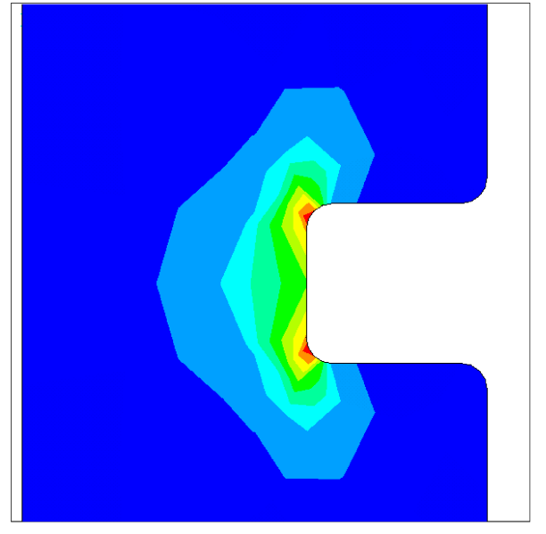
Stress in iron yoke and Al alloy sleeve after cool-down
<σ_{VM}>=4.4 MPa
<σ_{VM}>=5.5 MPa

Slide 21
Lorentz forces at 4.5 T
F_{x}=196 kN/m and corresponds to the unbalance between the left and right part of each coil
(F_{xA}=+1351 kN/m and F_{xB}=-1155 kN/m)
Fy=-845 kN/m (F_{xA}=-433 kN/m and F_{xB}=-412 kN/m)
F_{y}
B
F_{y}
A
F_{x}
F_{x}

Slide 22
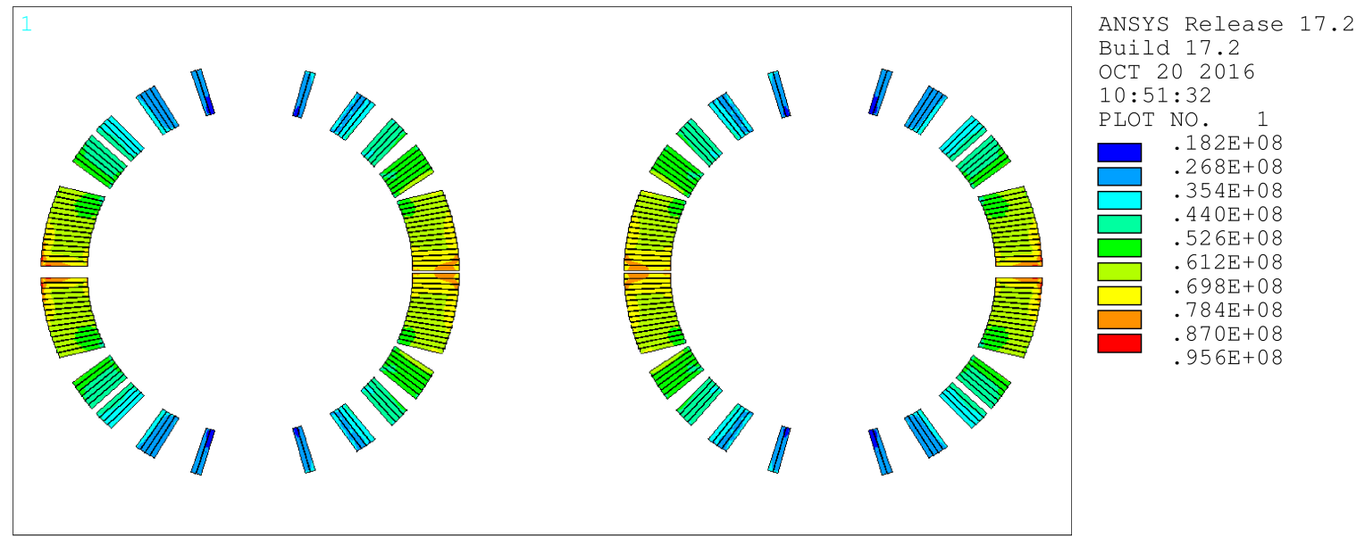
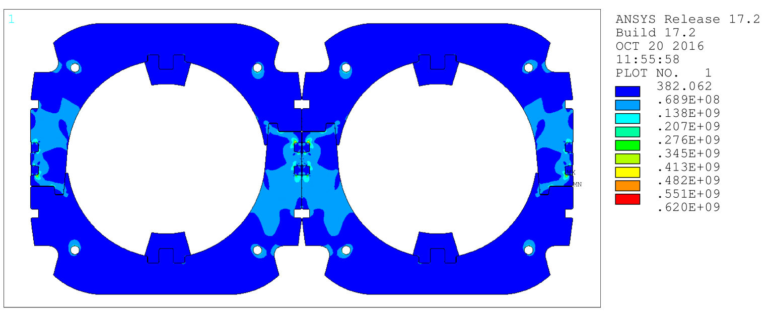
Stress in winding and collars after energization at 4.5 T
<σ_{VM}>=56 MPa

Slide 23
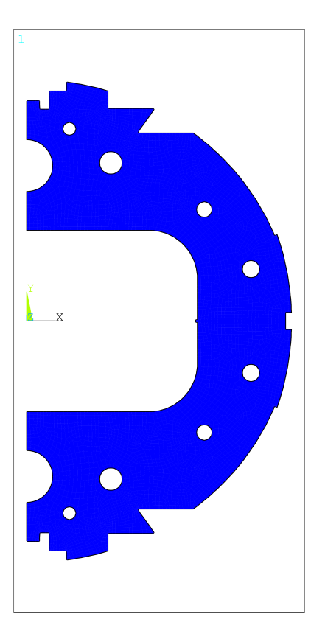
Gap between the iron yoke halves
The effect of the outer shell not evaluated yet (the short model has no shell)

Slide 24
The present D2 insulation scheme based on SIS300 experience was questioned
The resulting thickness after curing is:
98 µm azimuthal – 125 µm radial
Rised issues :
The 25 µm tape is critical;
The overlapping 2/3 is critical
Actions and results :
Check the use of 25 µm tape in other LHC magnets (and in accelerator magnets ≠ SIS300).
Result: Many LHC magnets involves 25 µm tape but never 2/3 overlapped .
2) Possible solutions
  2.1) Replacing the 25 µm tape with a 37.5 µm tape and involving 2 layers half overlapped we have the same result of 3 layers of 25 µm tape 2/3 overlapped. The 68 µm layer with adhesive being unchanged. – No need to re-design the magnet
  2.2) Involving the insulation of LHC MQ (one layer with 37.5 µm tape ; one layer with 50 µm layer and a layer cross wrapped 65 µm thick with adhesive) for a total azimuthal thickness after curing of 110 µm . Preliminary result: The coil lay-out can remain the same, spacers are modified; acceptable field quality but a disturbing -3.4 unit of b11.→ Modified coil design.
  2.3) Involving the insulation of LHC MD (The insulation azimuthal thickness is 130 µm). The coil lay out will change (four configurations under study) . Preliminary result: Far to be satisfactory yet.

Slide 25
QUENCH HEATERS AND COIL WEDGES
  Quench Heaters. The quench simulation with Roxie were done considering the QH involved in LHC. Nevertheless this QH is not optimized for the present D2 coil lay-out. INFN and ASG Superconductors will design a new QH.
Coil wedges. The design has been performed considering the coil wedges made of insulated copper. Nevertheless the use of a composite (type G11) seems adequate as well with the advantage to have already in hand a deep knowledge of the coil mechanical properties based on SIS300 experience. CERN/INFN should check possible issues related to the use of G11. If not INFN will perform again the mechanical analysis with this material (same geometry)

Slide 26
CONCLUSIONS
The contract for short model construction is very close to start at ASG Superconductors
Kick-off meeting already held. Next meeting before Christmas. ASG Superconductors is supposed to present a detailed schedule
INFN has ready the reference drawings supported by FEA analysis
Some doubts to be solved soon about coil insulation, quench heaters and coilwedges

