Slide 1
LBDS Failure Scenarios
C. Wiesner, W. Bartmann, C. Bracco, M. Fraser, A. Lechner, N. Magnin

Slide 2
Outline
LBDS components and possible failure scenarios
MKD erratics
MKB failures
Discussion: failure scenarios for HL-LHC

Slide 3
Main LBDS Components
15 MKD – Q4 – 15 MSD – 4 MKBH – 6 MKBV
TSU / RTS / CIBDS
BEMS / BETS
Protection Devices: TCDQ, TCDS, TDE, …
HL-LHC: → ~twice N_{tot} → required upgrades?
T. Kramer et al, PAC’09, TU6RFP031

Slide 4
(Some) LBDS Failure Scenarios
Dump request fails
Wrong beam energy (BEMS)
→ mismatched extraction
Less than 15(14) MKDs fire upon request
→ mismatched extraction
Wrong synchronization with abort gap (TSU)
→ asynch. dump
Erratic trigger of n MKDs → asynch. dump; Observed with n = 1, n = 3
Erratic firing of CIBDS → asynch. dump?
Erratic trigger of n MKBs → synch. dump
Less than 4+6 MKBs fire upon request
→ higher power density on TDE
MSD trip
Q4 quench
In order of severity
(to be discussed).
Red: observed during operation (to be checked)
See also R. Filippini, J. Uythoven, CERN ATS Note 2013-042; N. Magnin et al., LHC BEAM DUMPING SYSTEM STATUS AND READINESS FOR LHC RUN II, Evian (2014)

Slide 5
MKD Erratics
Number of Erratics during Operation
Erratic Type I (nominal waveform), Type II (faster), Type III, …
“Normal” asynch. dump: acceptable? Change of waveform (faster rise time…): critical?
C. Bracco et al., LHC Performance Workshop, Chamonix (2016)
“Triple erratic” on 26/02/2016 00:46:15
Erratic Type 1 and 2
C. Bracco et al., LHC Performance Workshop, Chamonix (2016)
W. Bartmann et al., MPP Meeting, 8-April-2016

Slide 6
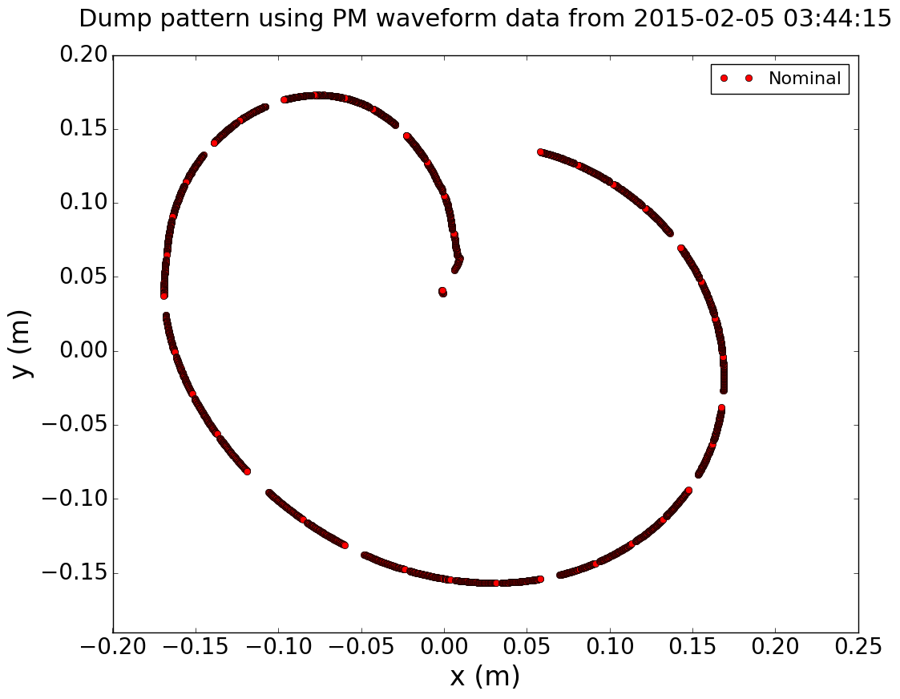
TDE Pattern – Nominal
Simulated position of bunch centers at TDE.
TDE: FLUKA studies performed for
nominal case
2 MKBH missing
→ significant temp. rise for HL-LHC parameters
Using filling_scheme_standard_25ns_2748b_2736_2452_2524_288bpi12inj_beam2.txt for HL-LHC
and PM waveform data from 2015-02-05 03:44:15

Slide 7
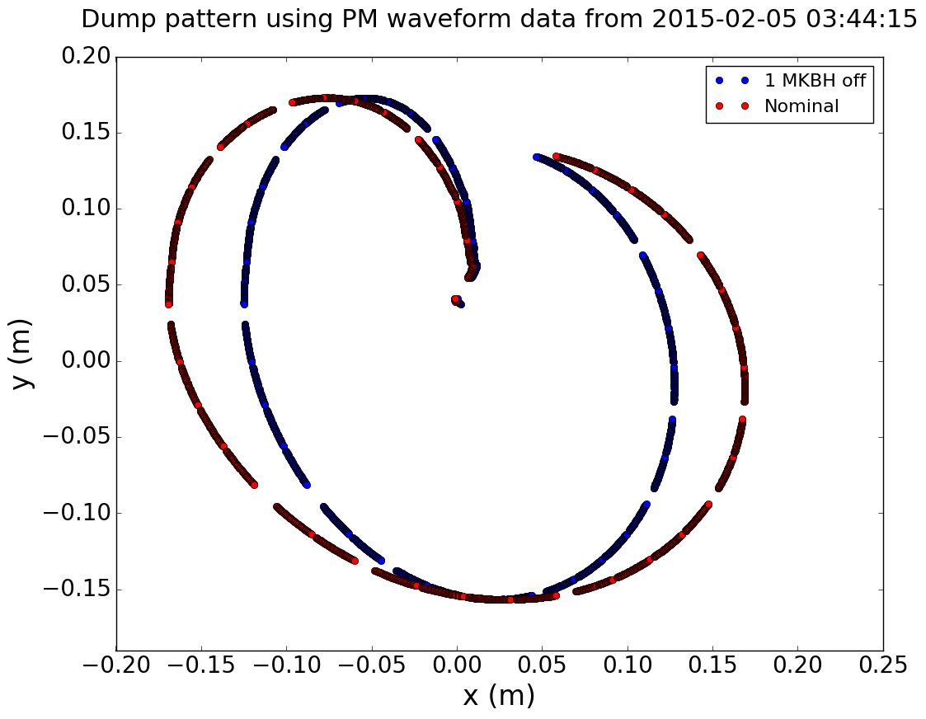
TDE Pattern – 1 MKBH off
Simulated failure of MKBH.A
TDE: FLUKA studies performed for
nominal case
2 MKBH missing
→ significant temp. rise for HL-LHC parameters
Using filling_scheme_standard_25ns_2748b_2736_2452_2524_288bpi12inj_beam2.txt for HL-LHC
and PM waveform data from 2015-02-05 03:44:15

Slide 8
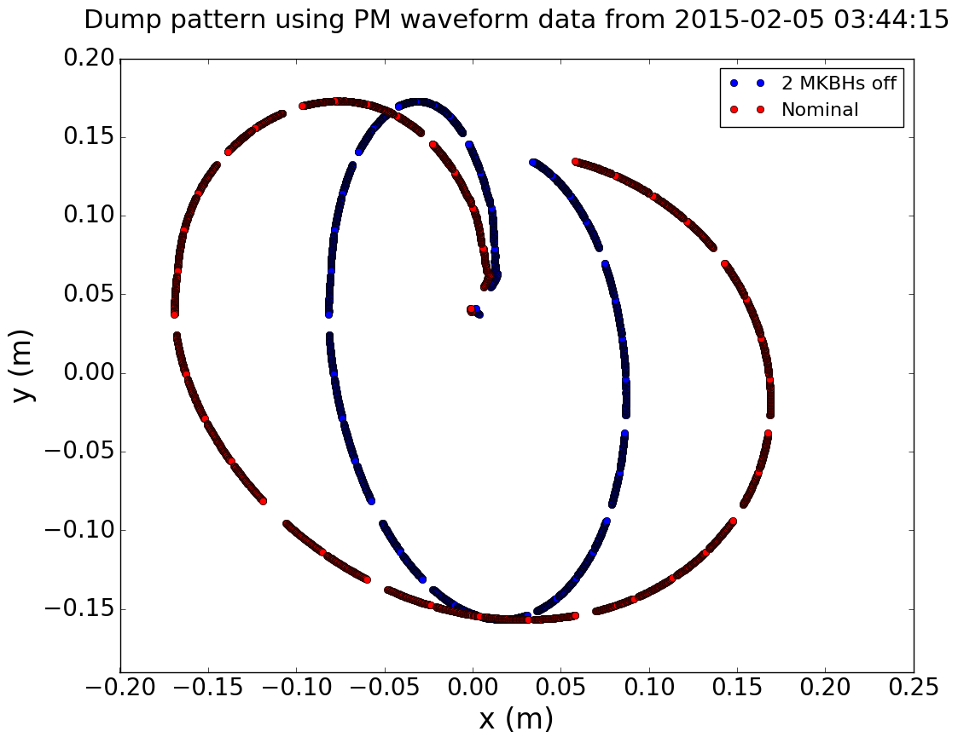
TDE Pattern – 2 MKBHs off
Simulated failure of MKBH.A and MKBH.B
TDE: FLUKA studies performed for
nominal case
2 MKBH missing
→ significant temp. rise for HL-LHC parameters
MKB erratic → Risk of 2 MKBs out of phase? Mitigation?
Using filling_scheme_standard_25ns_2748b_2736_2452_2524_288bpi12inj_beam2.txt for HL-LHC
and PM waveform data from 2015-02-05 03:44:15

Slide 9
Questions and Discussion
Are these scenarios realistic? Are we too conservative? What is the likelihood of such failures?
Did we neglect anything?
Can we prevent some failures to occur? E.g. prevent simultaneous failing of 2 MKBs?
For the TDE: is there any level of damage that we can accept for operation?
Double failures? Dependencies?
  E.g. MKD triple erratic, 2 MKBs out of phase, …
Classify LBDS faults?
  Consequences (e.g. synch./asynch. dump)
  Component (e.g. MKD)
  Fault type (e.g. generator erratic)

Slide 10
Thank you for your attention!

