Slide 1
Proposed Far Site CAD Integration Process
FS CF & Cryo Integration Meeting
CERN
6 Dec 2016
E McCluskey

Slide 2
Overall integration goals
The goal of integrating separate CAD models and designs is to have latest versions of cad models available to everyone in a common format useable to everyone so that
  clashes and interferences can found and resolved
  Designs can be coordinated and installation/construction sequences can be planned.
Issues with getting to this goal include
  Access for everyone
  Format
  Frequency
  Configuration control
  Ability to find the latest easily

Slide 3
Proposed CAD Integration Process
LBNF/DUNE Engineering Support team, sited at Fermilab, proposes to
  integrate the 3D solid models of the far site conventional facilities, cryostats, cryogenics systems and detector modules into a common format on a consensus periodic basis
  make it available to the entire LBNF/DUNE enterprise.
  also make available lighter integrated “views” that contain only “envelope” information of the far site campus that can be generated for certain specific locations if needed, to aid in quick studies of interfaces, clash detection, etc.
In process of developing a “FS CAD Integration Plan” to describe the process

Slide 4
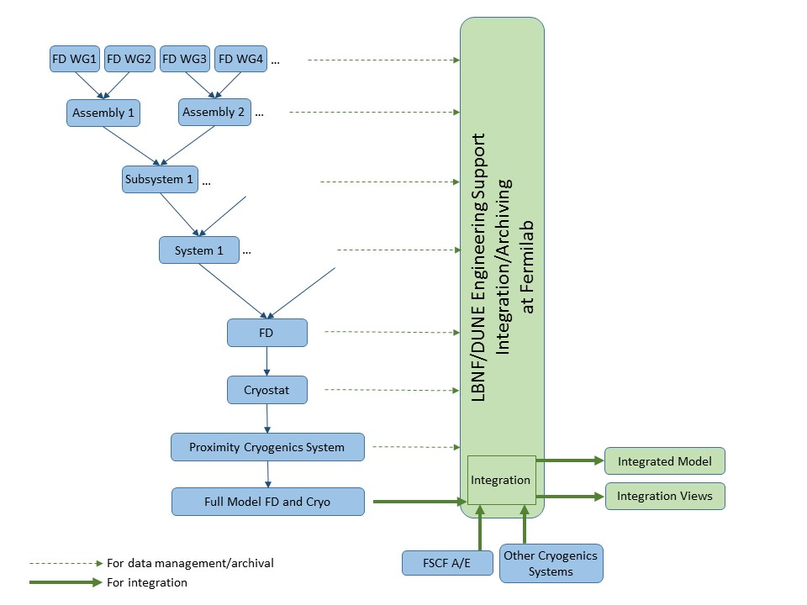
CERN already doing this

Slide 5
Details
Far Site sub-projects and working groups shall provide 3D solid models and any associated 2D drawings to the Fermilab Engineering Support Team for integration purposes and for data archiving/ configuration control at specific points in time.
  The input files shall be in the following formats:
    3D Solid Models – STEP file format
    2D Drawings – Original file format and PDF
  Propose that starting in early 2017, LBNF/DUNE Engineering Support Team provide far site “Integrated Views” and “Integrated models” to the LBNF/DUNE enterprise available from a consensus location at the following frequency, with the exact timing to be discussed.
  Integrated Model – Quarterly
  Integrated Views – Monthly
Process would provide for
  Ability to everyone to find latest information easily
  Configuration control

